Slide 1
Understanding logistics – behind the scenes of the supply chain
Teaching material

Slide 2
Have you ever wondered…?
… how many packages an Austrian household receives per year?
On average, a household in Austria receives 65 packages per year, which is more than one package per week. In Vienna, it is even over 110 packages per household!
Notes:
Source:
Wirtschaftskammer Wien (2024): KEP Branchenreport Wien 2024: https://www.wko.at/wien/verkehr-betriebsstandort/kep-branchenreport-2024.pdf; p. 9; accessed 01.12.2025

Slide 3
How to best work with this teaching material
Power Point: The following PowerPoint presentation provides an introduction to the topic “Logistics”. Each slide includes speaker notes with explanations and source references. Activity slides are highlighted in yellow and contain practical examples, exercises, videos, and other interactive elements specifically prepared for classroom use.
Videos and supplementary exercises: Videos and exercises on the topic can be found in the presentation on the color-coded activity slides as well as at: https://www.rewway.at/en/teaching-materials
All teaching materials offer a compact overview to support lesson planning: learning objectives, target groups, level of difficulty, methods, and links to the curriculum.
References: The sources used in the presentation are available both in the notes section of each slide and at the end of the PowerPoint.

Slide 4
Learning objectives and target groups
Learning objectives:
Learners can define the term “logistics” and understand the core tasks of logistics.
Learners are able to analyze different logistics processes (e.g., TUL processes).
Learners understand the term “supply chain” and can identify the structure and challenges of global supply chains.
Learners can assess the impacts of globalisation on the logistics sector.
Learners can explain what sustainability means and which dimensions (ecological, economic, social) it includes.
Learners recognize the impacts of the logistics sector—especially transport—on the environment and discuss measures to reduce emissions.
Learners can identify important trends and innovations in the logistics sector and explain their advantages and disadvantages (e.g., autonomous vehicles, alternative drive systems, digitalisation).
Target groups:
Upper secondary school students (AHS) and vocational schools (BHS)
Vocational students/apprentices
Students as an introduction to the field of logistics
Career changers and professionals from other industries

Slide 5
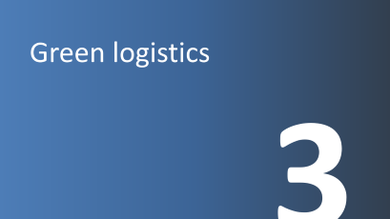
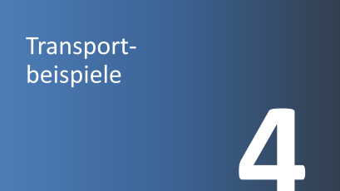
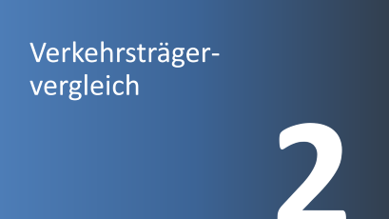
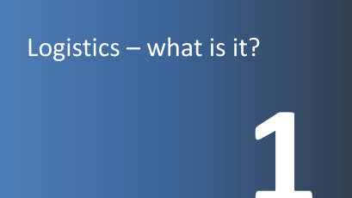
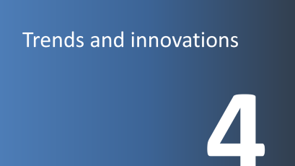
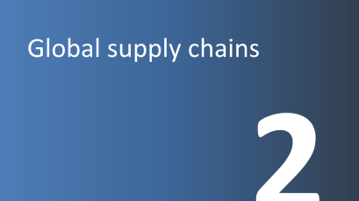
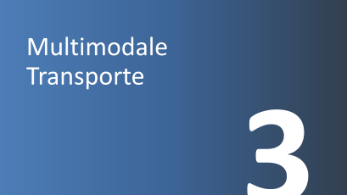

INLAND SHIPPING AS PART OF THE TRANSPORT CHAIN

Slide 6
Logistics – what is it?
1

Slide 7
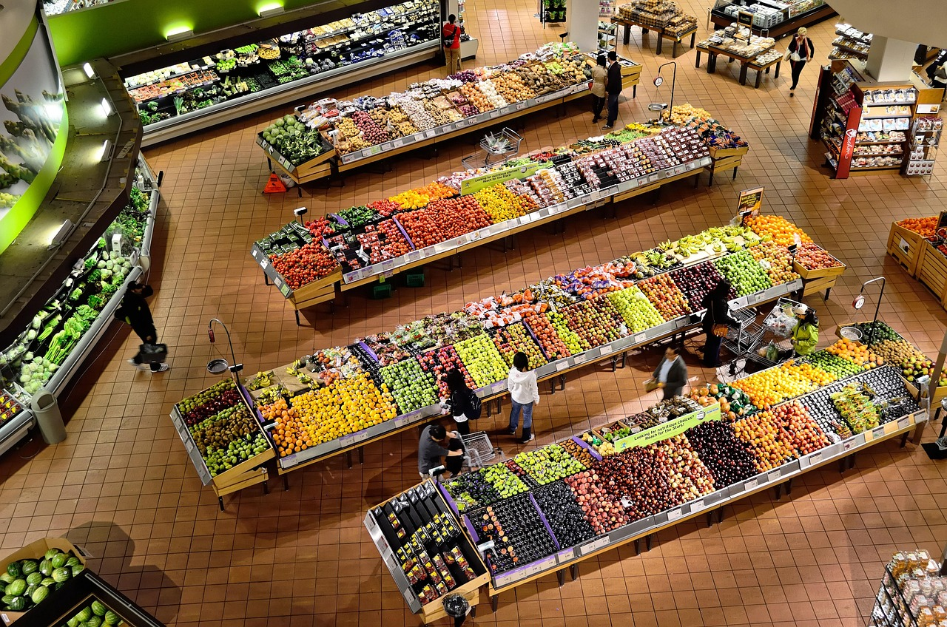
What role does logistics play in this picture?
Picture: Pixabay
Notes:
As an introduction to the topic of “logistics,” a discussion can be useful.
Logistics ensures that consumers in the food retail sector have a variety of different food products available and that these are provided in sufficient quantities. In doing so, various challenges must be managed, such as ensuring a continuous cold chain for dairy products.
Possible discussion questions (5–10 minute discussion):
What other challenges are there in food retail in connection with logistics?
Input – possible discussion points:
Expiry dates must be observed
Product quality must be ensured
How do promotions (e.g., buy 2 get 1 free) affect logistics?
Input – possible discussion points:
Additional quantities must be transported and available on time
Sufficient shelf space must be available in supermarkets
Warm-up discussion to introduce the topic
Input – possible discussion points:
Global supply chains for food
What challenges are there in supplying supermarkets?
Supermarkets in city centers are difficult to access for large trucks
A continuous cold chain must be ensured
Picture source:
Pixabay (2025): https://pixabay.com/photos/supermarket-stalls-coolers-market-949913/; accessed 04.02.2025

Slide 8
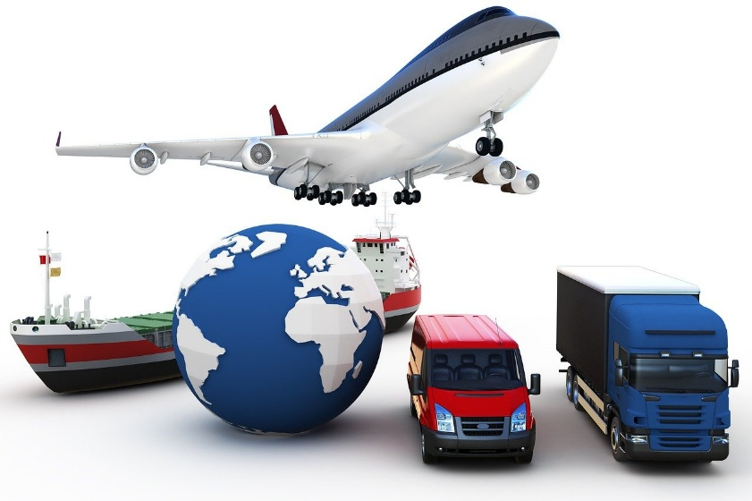
Logistics – what is it?
Planning, coordination, execution, and monitoring of material flows as well as the related goods-specific information
Linguistic roots:
Greek: “lego” (to think, thinkable)
French: “logement” (accommodation)
Origin in the military
the third military discipline alongside tactics and strategy
After World War II: transfer into the business sector
40
Image: Pixabay
Notes:
Logistics refers to the planning, coordination, execution, and monitoring of the flow of goods as well as the associated goods-related information from production to the end consumer.
Wirtschaftslexikon Gabler (2025): https://wirtschaftslexikon.gabler.de/definition/logistik-40330, accessed 07.01.2025
The term logistics has two linguistic roots: the Greek “lego” (to think, thinkable) and the French “logement” (accommodation). The origin of logistics lies in the military sector and includes all activities (e.g., transport of troops and supply) that support the army and fall under the responsibility of logistics. Logistics in the military gained increasing importance over time and, after the Second World War, was also transferred to the business sector in the United States.
In Europe, logistics only gained importance in business in the 1970s. At that time, its development was mainly in the hands of engineers, who focused primarily on material flow technologies (transport and storage technologies). Only later, towards the end of the 1970s, were new economic and process-organizational aspects addressed, leading to concepts such as zero-inventory production, batch size one, just-in-time, and Kanban (order-based production). After automotive companies, as pioneers, introduced initial logistics concepts into industry, other sectors followed this example and increasingly engaged with the discipline of logistics.
Kummer, Sebastian / Grün, Oskar / Jammernegg, Werner (4th edition, 2019): Grundzüge der Beschaffung, Produktion und Logistik; p. 334f
Image source:
Pixabay (2025): https://pixabay.com/illustrations/transportation-logistics-business-4506971/; accessed 07.01.2025

Slide 9
Perspectives of logistics
Material and goods flow-related service function
Transport, storage, handling
Coordination function
Coordination of material and information flows within and across companies
Flow orientation
Management function is becoming increasingly important
Supply Chain Management
Consideration of the entire value chain
Notes:
While the scope of logistics has evolved over the years, the way logistics is perceived within companies has also changed due to increasing know-how. Kummer distinguishes four perspectives: logistics as a material and goods flow-related service function, as a coordination function, as a flow-oriented management approach, and as supply chain management.
(Kummer, Sebastian / Grün, Oskar / Jammernegg, Werner (4th edition 2019): Grundzüge der Beschaffung, Produktion und Logistik; pp. 343–349)
Material and goods flow-related service function
This perspective on logistics includes all transport, handling, and storage processes within and between companies. In this view, the management of logistics services is central. Other important services that may be included are order picking (e.g., assembling an order consisting of different products), palletizing, labeling, or packaging.
Coordination function
When logistics is viewed as a coordination function, the focus is no longer on the efficiency of individual operational processes within a company, but on the effectiveness of company-wide and cross-company process chains. Logistics therefore includes more than just transport and storage.
A very good practical example is just-in-time production, which connects procurement and production. Just-in-time refers to the delivery of goods exactly at the time they are needed in production. One advantage of this concept is minimal or no inventory, which reduces storage costs. However, a disadvantage is that delayed deliveries can bring production to a halt.
Flow orientation
The next stage in development is logistics as a flow-oriented management function within the company. After analyzing and improving individual operational functions and process chains, the focus shifts to management and organizational design. This change is driven by increasing competition and the growing importance of material and goods flow-related expertise.
As competition intensifies, companies must differentiate themselves from competitors. This can be achieved, for example, by organizing and planning production processes or capacity planning within different production departments themselves. Such changes help achieve the goal of flow-oriented logistics: improving responsiveness and reaction speed to changes in the business environment.
Supply Chain Management
Consideration of the entire value chain: Supply Chain Management (SCM) aims to efficiently meet customer demand through the coordination and integration of suppliers, producers, and trade. It focuses not only on optimizing internal processes but also on cross-company collaboration across the entire value chain.
SCM includes not only logistics but also product development and customer relationship management (CRM).
Source:
Kummer, Sebastian / Grün, Oskar / Jammernegg, Werner (4th edition, 2019): Grundzüge der Beschaffung, Produktion und Logistik; pp. 343–349

Slide 10
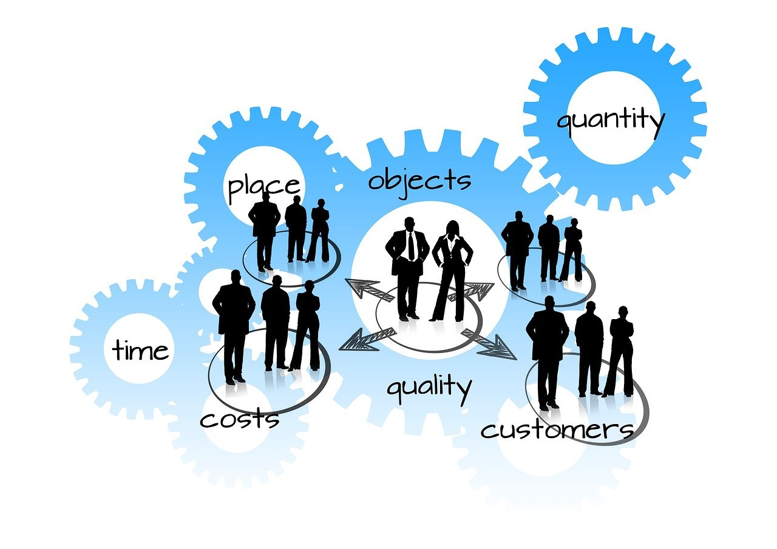
Tasks of logistics
The right products….
in the right quantity
in the right quality
without damage
at the right time
in the right place
at the right prices
….making them available for customers
Image: Pixabay
Notes:
In today’s world, logistics is one of the most important aspects of the economy. In the literature, different definitions can be found, as logistics has a different meaning in every industry and company. However, the main task of logistics can be seen as ensuring that the products desired by customers are available in the quantity and quality they want, at the right time, in the right place, and at the right price. This definition is frequently found in the literature.
For example, logistics ensures that the food desired by consumers is available in supermarkets at the right time, in the right quality, and at a reasonable price.
Source:
Ten Hompel, Michael / Schmidt, Thorsten (2003): Warehouse Management: Automatisierung und Organisation von Lager- und Kommissioniersystemen; p. 10
Image source:
Pixabay (2025): https://pixabay.com/illustrations/logistics-people-group-gears-877568/; accessed 07.01.2025

Slide 11
Raw egg – Transport task
Group work (4–5 people per team)
The goal of the task is to protect a raw egg so that it survives a fall from a great height (out of a window) without damage!
Conditions & rules:
The egg: Draw a face on the egg. The face must remain visible during the entire transport (even through the packaging).
Prohibition: The egg must not be placed inside the balloon.
Tools: Laptops, mobile phones, or other items not listed are strictly forbidden.
Pen: The pen may only be used to draw the face.
Working time: You have a total of 45 minutes for planning and building..
Materials (per group):
1 raw egg; 25 drinking straws; 1 balloon; 5 matches; 2 m masking tape; 1 pair of scissors; 1 tissue; 1 A4 sheet
Notes:
The goal of the task is to protect a raw egg using creative constructions made from limited materials so that it survives a fall from a great height (usually 2–10 meters) without damage. As a team activity, it promotes creativity, planning, and an understanding of physics. In a relaxed atmosphere, students are encouraged to experiment creatively. Using simple materials provided to each group in a box, they are expected to develop a functional transport solution.
Learning objectives:
Students learn to use a limited amount of material efficiently to achieve a goal.
They engage practically with physical concepts and learn how to build a stable protective structure from unstable materials through clever arrangement.
Students learn to organize a task independently, distribute responsibilities within a group, and make decisions together.
Students learn to first visualize and theorize ideas before implementing them.
Students learn to find creative solutions under time pressure and think beyond standard solutions.
1. The mission
Plan and build a construction that protects a raw egg when dropped from a window. The goal is achieved if the egg survives the impact undamaged.
2. Conditions & rules
The egg: A face must be drawn on the egg. This face must remain visible throughout the entire transport (even through the packaging).
Prohibition: The egg must not be placed inside the balloon.
Tools: Laptops, mobile phones, or other items not listed are strictly prohibited.
Pen: The provided pen may only be used to label the egg.
3. Materials (per group)
The following materials are available (not all must be used):
1 raw egg
25 drinking straws
1 balloon
5 matches
2 m masking tape
1 pair of scissors
1 tissue
1 A4 sheet
4. Procedure
Group size: 4–5 people per team
Working time: A total of 45 minutes is available for planning and building
Additionally, create a sketch of your solution on a flipchart
Presentation: Each group presents its solution
Testing: Afterwards, a practical test is carried out by dropping it from a window

Slide 12
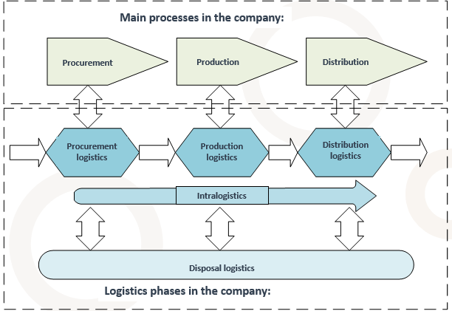
Orientation along the material flow
Graphic: own illustration
Notes:
The different phases of logistics are fundamentally divided into procurement logistics, production logistics, distribution logistics, and disposal logistics.
Procurement logistics refers to the acquisition of all types of goods that a company needs for its operations (e.g., raw materials, semi-finished parts, finished parts—trade goods, operating resources, etc.). Activities in procurement logistics begin with supplier contact and extend to the provision of goods for production or sale. In an industrial company, goods can be delivered to a procurement warehouse near the production site. There is also the possibility of using a supplier warehouse, where many small suppliers deliver their goods, which are then bundled and transported further.
Production logistics takes place in manufacturing or processing companies and directly follows procurement logistics. It mainly handles the internal transport of the required goods to the necessary production stages. If production occurs at multiple locations, production logistics also includes external transport between different company sites. The provision of goods may include raw materials as well as semi-finished and finished products; sometimes it is also necessary to store semi-finished products temporarily until they can be completed. Production logistics concludes with the final transfer of finished products to the distribution warehouse.
Distribution logistics refers to the distribution of finished products (as well as spare parts) and/or trade goods from the distribution warehouse to the desired destination. Products can be distributed from the distribution warehouse to so-called regional delivery warehouses, which serve different regional markets, or delivered more cost-effectively from a central warehouse to the destination. Through a network of various transport channels (such as road, rail, inland waterways), warehouse locations, and transshipment points, goods are delivered to the customer. Distribution logistics acts as the link between production and the sales market, as well as the connection to the customer’s procurement logistics within a logistics chain.
Intralogistics refers to the material and goods flows within a company site that are necessary for logistics. In manufacturing or processing companies, intralogistics is either essential or largely identical to production logistics. As part of procurement and distribution logistics, intralogistics in a trading company can be described as the operation of its own warehouse.
Source:
Muchna, Claus / Brandenburg, Hans / Fottner, Johannes / Gutermuth, Jens (2nd edition, 2021): Grundlagen der Logistik. Begriffe, Strukturen und Prozesse; pp. 31–33
Image:
own illustration

Slide 13
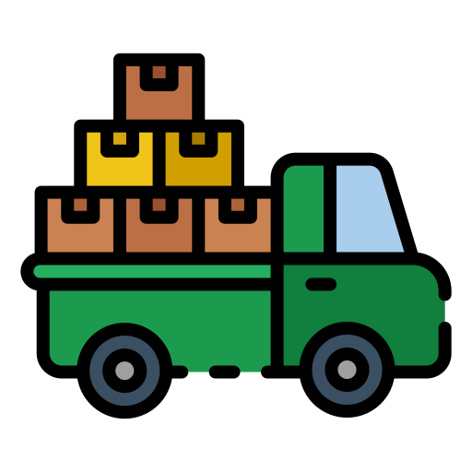


Procurement logistics
Transport of goods from central production sites or from decentralized warehouse locations
Structures the processes within the company in such a way that timely and high-quality material supply is ensured
Link between the suppliers’ distribution logistics and the production logistics of the manufacturing company
Images: Flaticon
Notes:
Procurement logistics serves as the link between the suppliers’ distribution logistics and the company’s production logistics. It involves the transport of goods from the production site through the manufacturer’s or retailer’s storage stages to the points of sale in retail. From the manufacturer’s perspective, it is part of distribution logistics, whereas for the retailer it is considered procurement logistics.
Procurement logistics is responsible for structuring processes within the company in such a way that timely and high-quality material supply is ensured. The required goods—such as raw materials, parts, and components—are sourced either directly from suppliers’ central production sites or, if necessary, from decentralized warehouse locations in order to support the production process.
Source:
Muchna, C. / Brandenburg, H. / Fottner, J. / Gutermuth, J. (2018, 2nd edition 2021): Grundlagen der Logistik. Begriffe, Strukturen und Prozesse; pp. 31 and 143
Image sources:
Flaticon (2024): https://www.flaticon.com/free-icons/timeline; Timeline created by Freepik – Flaticon, accessed 29.04.2024
Flaticon (2024): https://www.flaticon.com/free-icons/checklist; Checklist created by Freepik – Flaticon, accessed 29.04.2024
Flaticon (2024): https://www.flaticon.com/de/kostenlose-icons/lkw-laden; Truck loading icons created by Good Ware – Flaticon, accessed 03.05.2024

Slide 14
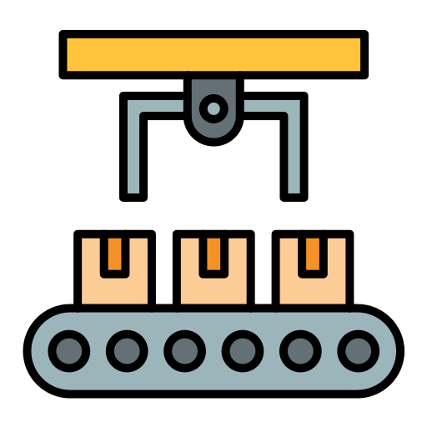
Production logistics
Transport of required parts from procurement logistics to the production line
Transport of finished products to distribution logistics
Provision of the required raw materials, semi-finished and finished products to the production line and handover to distribution logistics
Link between procurement logistics and production, as well as between production and distribution logistics
Images: Flaticon
Notes:
Production logistics is found in manufacturing or processing companies and directly follows procurement logistics. It mainly handles the internal transport of the required goods to the necessary production stages. If production takes place at multiple locations, production logistics also includes external transport between the different company sites. The provision of goods may include raw materials as well as semi-finished and finished products; sometimes it is also necessary to temporarily store semi-finished products until they can be completed. Production logistics concludes its activities with the final handover of finished products to the distribution warehouse.
Source:
Muchna, C. / Brandenburg, H. / Fottner, J. / Gutermuth, J. (2018, 2nd edition 2021): Grundlagen der Logistik. Begriffe, Strukturen und Prozesse; pp. 31–33
Image sources:
Flaticon (2024): https://www.flaticon.com/free-icons/timeline; Timeline created by Freepik – Flaticon, accessed 29.04.2024
Flaticon (2024): https://www.flaticon.com/free-icons/checklist; Checklist created by Freepik – Flaticon, accessed 29.04.2024
Flaticon (2024): https://www.flaticon.com/free-icons/conveyer; Conveyor created by Vectoricons – Flaticon, accessed 29.04.2024

Slide 15
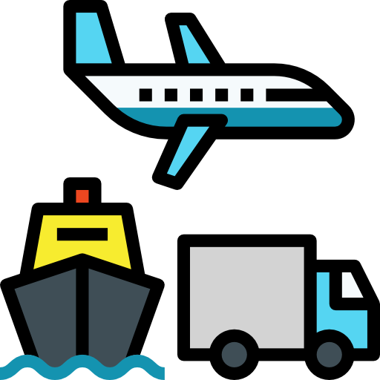
Distribution logistics
Provision of goods to customers via various transport channels, warehouse locations, and transshipment points
Distribution of finished products/trade goods from production/warehouse to the destination
Link between production and the customer’s procurement logistics within a supply chain
Images: Flaticon
Notes:
Distribution logistics refers to the distribution of finished products (as well as spare parts) and/or trade goods from the distribution warehouse to the desired destination. Products can either be distributed from the distribution warehouse to so-called regional delivery warehouses, which serve different regional markets, or delivered more cost-effectively from a central warehouse to the destination. Through a network of various transport channels (such as road, rail, inland waterways), warehouse locations, and transshipment points, goods are delivered to the customer. Distribution logistics acts as the link between production and the sales market, as well as the connection to the customer’s procurement logistics within a logistics chain.
Source:
Muchna, C. / Brandenburg, H. / Fottner, J. / Gutermuth, J. (2018, 2nd edition 2021): Grundlagen der Logistik. Begriffe, Strukturen und Prozesse; p. 33
Image sources:
Flaticon (2024): https://www.flaticon.com/free-icons/timeline; Timeline created by Freepik – Flaticon, accessed 29.04.2024
Flaticon (2024): https://www.flaticon.com/free-icons/checklist; Checklist created by Freepik – Flaticon, accessed 29.04.2024
Flaticon (2024): https://www.flaticon.com/de/kostenlose-icons/transport; Transport icons created by geotatah – Flaticon, accessed 03.05.2024

Slide 16
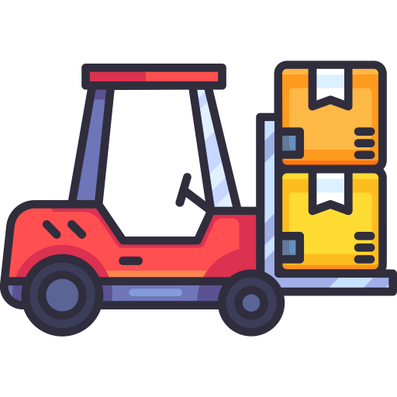
Intralogistics
All necessary transport from the receipt of goods to the dispatch of goods within a company
All logistics processes within a company
Production companies: essential component of production logistics
Production companies: identical to production logistics
Trading companies: part of procurement and distribution logistics
Images: Flaticon
Notes:
Intralogistics refers to the material and goods flows within a company site that are necessary for logistics. In manufacturing or processing companies, intralogistics is either essential or largely identical to production logistics. As part of procurement and distribution logistics, intralogistics in a trading company can be described as the operation of its own warehouse.
Source:
Muchna, C. / Brandenburg, H. / Fottner, J. / Gutermuth, J. (2018, 2nd edition 2021): Grundlagen der Logistik. Begriffe, Strukturen und Prozesse; p. 33
Image sources:
Flaticon (2024): https://www.flaticon.com/free-icons/timeline; Timeline created by Freepik – Flaticon, accessed 29.04.2024
Flaticon (2024): https://www.flaticon.com/free-icons/checklist; Checklist created by Freepik – Flaticon, accessed 29.04.2024
Flaticon (2024): https://www.flaticon.com/de/kostenlose-icons/stapler; Forklift icons created by kerismaker – Flaticon, accessed 03.05.2024

Slide 17

Disposal logistics
Transport of goods from the customer for disposal or reprocessing / reintegration
Transport of waste and recyclable materials for disposal or recycling
Return of goods, empties, load carriers, and packaging
Responsibility from the sales market to the procurement and disposal market
Images: Flaticon
Notes:
It involves transporting waste and recyclable materials for disposal or recycling, returning unsold goods directly from customers or retailers, and returning empties, load carriers, and packaging. The field of disposal logistics begins at the sales market and ends at the procurement and disposal market.
Disposal logistics enables goods to be reintegrated into different stages of the supply chain, for example through quality inspections or by reintegrating returns into distribution warehouses. Reverse logistics plays a crucial role in transferring the flow of goods from the sales market back to the procurement and disposal market. It is not only about disposing of damaged or unsellable goods, but also about returning them for repair or reprocessing. Therefore, the term “disposal logistics” may be too narrow and should be replaced by the more appropriate term “reverse logistics.”
Source:
Muchna, C. / Brandenburg, H. / Fottner, J. / Gutermuth, J. (2018, 2nd edition 2021): Grundlagen der Logistik. Begriffe, Strukturen und Prozesse; p. 34
Image sources:
Flaticon (2024): https://www.flaticon.com/free-icons/timeline; Timeline created by Freepik – Flaticon, accessed 29.04.2024
Flaticon (2024): https://www.flaticon.com/free-icons/checklist; Checklist created by Freepik – Flaticon, accessed 29.04.2024
Flaticon (2024): https://www.flaticon.com/de/kostenlose-icons/kreislaufwirtschaft; Circular economy icons created by Freepik – Flaticon, accessed 03.05.2024

Slide 18
Industry logistics
Adaptation of logistics processes to the specific characteristics of individual industries
Examples:
Construction: just-in-time delivery to construction sites
Retail: store delivery, returns management
Healthcare: cold chains, emergency supply
Event logistics: temporary infrastructure, tight time windows
Disaster logistics: rapid response, unpredictable conditions
Notes:
Every industry has its own requirements, challenges, and specific characteristics. In construction, for example, materials often have to be delivered exactly when they are needed—too early is just as problematic as too late. In healthcare, the focus is on sensitive goods such as medicines or blood supplies, which must be transported under specific conditions. Event logistics is particularly exciting—here, an entire infrastructure is set up for a few days and then dismantled again. And in disaster logistics, every minute counts—aid supplies must be delivered quickly and flexibly to where they are needed.
This diversity makes industry logistics so fascinating—and shows how important it is to adapt logistics processes to the respective context.

Slide 19
From the stage to the emergency room – logistics in special application areas
Work in groups to develop logistics concepts for the following sectors:
Group 1: Festival logistics – planning a music festival
Group 2: Disaster logistics – flooding in Austria
Group 3: Healthcare logistics – supply in a hospital
Notes:
From the stage to the emergency room – logistics in special application areas
Students work in groups to create a short report or presentation on a sector, focusing on its specific logistics characteristics.
Task:
In groups, you will examine different specialized areas of logistics and consider how logistics processes must be planned and implemented differently depending on the industry. What specific real-world challenges exist in the sector? How can they be solved?
Group 1: Festival logistics – planning a music festival
Plan the logistics for a fictional open-air music festival with around 10,000 visitors.
To consider:
Delivery of stages, lighting and sound equipment, catering, sanitary facilities
Schedule for setup and dismantling
Storage and temporary storage of materials
Personnel planning (e.g., security, technical staff, cleaning)
Handling unforeseen events (e.g., weather changes, delivery delays)
Group 2: Disaster logistics – flooding in Austria
Analyze the logistical challenges during a flood in Austria (e.g., 2013 or 2024). It is also possible to limit the area to a specific federal state.
To investigate:
What logistical challenges arise during a flood in Austria?
How was the response managed (e.g., fire brigade, military)?
What role did transport, storage, and communication play?
What could have been improved?
Group 3: Healthcare logistics – supply in a hospital
Examine the logistics processes in a hospital.
To analyze:
How does the supply of medicines, blood units, and surgical materials work?
What role does maintaining cold chains play?
How are emergencies or supply shortages handled?
What logistics processes operate in the background to keep the hospital running?
Guidelines for completion:
Use internet research, textbooks, or interviews (e.g., with parents or acquaintances working in the sector)
Ensure a clear structure and understandable presentation
Each group presents its results in about 5–7 minutes
Learning objectives:
Students understand that logistics processes strongly depend on the requirements and conditions of each industry
They analyze industry-specific logistics challenges and develop their own solutions
Students reflect on the role logistics plays in socially relevant areas such as disaster response, healthcare, and large events
Students improve their ability to conduct structured research and critically evaluate sources
Students practice teamwork, time management, and collaborative work
Duration: 2 teaching units

Slide 20
TUL processes
Transport: change of location
Transshipment: loading and unloading of goods or change of means of transport
Storage: bridging time
Order picking: assembling goods according to customer requirements
Packaging
Notes:
Transport, transshipment, and storage processes are closely interconnected with procurement, production, and distribution processes. TUL processes are considered the physical core services of logistics and are supported by order picking and packaging. (Muchna et al.: p. 86)
The transport function includes the movement and relocation of goods. Transshipment refers to the loading or unloading of goods onto/from a means of transport, as well as the transfer (reloading) between different means of transport.
The following types of storage are distinguished: procurement storage (inbound storage), intermediate storage (production storage), and dispatch/sales/distribution storage.
Order picking refers to the assembly of goods according to orders and customer requirements, regardless of whether the customers are internal or external.
As a rule, goods are packaged when they pass through the logistics process. Packaging fulfills various functions: protection function, usage function, rationalization function (unit formation), identification function (labeling), as well as storage and transport function.
Source:
Muchna, C. / Brandenburg, H. / Fottner, J. / Gutermuth, J. (2018, 2nd edition 2021): Grundlagen der Logistik. Begriffe, Strukturen und Prozesse; pp. 86–105

Slide 21
Logistics controlling
Information function as a core task
Enables planning, management, and control
Operational task: specify goals and make them measurable
Strategic task: logistics strategies
Logistics cost accounting, logistics budget, key performance indicators
Notes:
Logistics controlling includes the information function as a central task, encompassing planning, management, and control.
The collection and analysis of data, as well as the measurement of performance using key performance indicators, facilitate the planning and monitoring of efficiency and effectiveness—for example, demand forecasting and inventory optimization.
By making logistics measurable as a service through cost accounting, budgeting, and key performance indicators, operational goals can be specified and measured, and costs and performance can be presented transparently. At the strategic level, logistics controlling provides the basis for business decisions.
Sources:
Koch, Susanne (2012): Logistik. Eine Einführung in Ökonomie und Nachhaltigkeit; p. 215 ff.
Wirtschaftslexikon Gabler (2025): https://wirtschaftslexikon.gabler.de/definition/logistik-controlling-38772; accessed 10.04.2025

Slide 22
Transport law
Legal regulations governing the transport of goods/persons:
Private law regulations: forwarding law, freight law, insurance law, …
Public law regulations: trade law, GGBG, StVO, KFG, …
National & international regulations
Mode-specific regulations
Notes:
When it comes to the transport of goods or people, there are numerous legal regulations that must be observed.
Private law regulations govern the relationship between companies and their customers or partners. These include, for example, forwarding law, freight law, or insurance law—covering everything related to contracts, liability, and insurance in the transport sector.
On the other hand, there are public law regulations. These primarily concern the protection of general interests, such as road safety or environmental regulations. Examples include trade law, the Dangerous Goods Transport Act (GGBG), the Road Traffic Regulations (StVO), or the Motor Vehicle Act (KFG).
In addition, a distinction is made between national and international regulations. National provisions include, for example, the Austrian Civil Code (ABGB) and the Commercial Code (UGB), while at the international level, frameworks such as Incoterms play an important role—especially in cross-border delivery and trade contracts.
Finally, there are also specific regulations that apply to particular modes of transport—meaning separate rules for road, rail, air, sea, or inland waterway transport.

Slide 23
Transport law: Incoterms
Incoterms since 1936: “International rules for the interpretation of commonly used trade terms” (International Commercial Terms)
Publisher: International Chamber of Commerce (ICC), Paris
Current version: Incoterms® 2020
Globally recognized, standardized contract and delivery terms
Goal: standardized, simplified handling of a commercial transaction between contracting parties
Notes:
Incoterms are globally recognized and standardized contract and delivery terms that enable uniform handling of commercial transactions in both international and national trade. They define the allocation of costs, risks, and responsibilities between the contracting parties.
The importance of Incoterms lies in the clarity they provide regarding mutual obligations, helping to prevent misunderstandings and costly disputes, and reducing the risk of legal complications for both parties. However, they do not regulate legal issues such as the conclusion of contracts, transfer of ownership, payment processing, or the legal consequences of contract breaches, which depend on the contractual terms or applicable law.
Sources:
Schindler, Darius Oliver / Zimmermann, Yves Clément (2021): Internationales Handels- und Logistikrecht; pp. 63–69
IHK Niederrheinische Industrie und Handelskammer: Incoterms 2020; https://www.ihk.de/niederrhein/hauptnavigation/international/import-export/lieferbedingungen-incoterms-3925010#:~:text=Die%20Bedeutung%20der%20Incoterms,-Die%20Internationale%20Handelskammer&text=Januar%202020%20in%20Kraft.,aber%20auch%20nationalen%2C%20Handelsgesch%C3%A4ft%20erm%C3%B6glichen; accessed 29.04.2025

Slide 24
Global supply chains
2

Slide 25
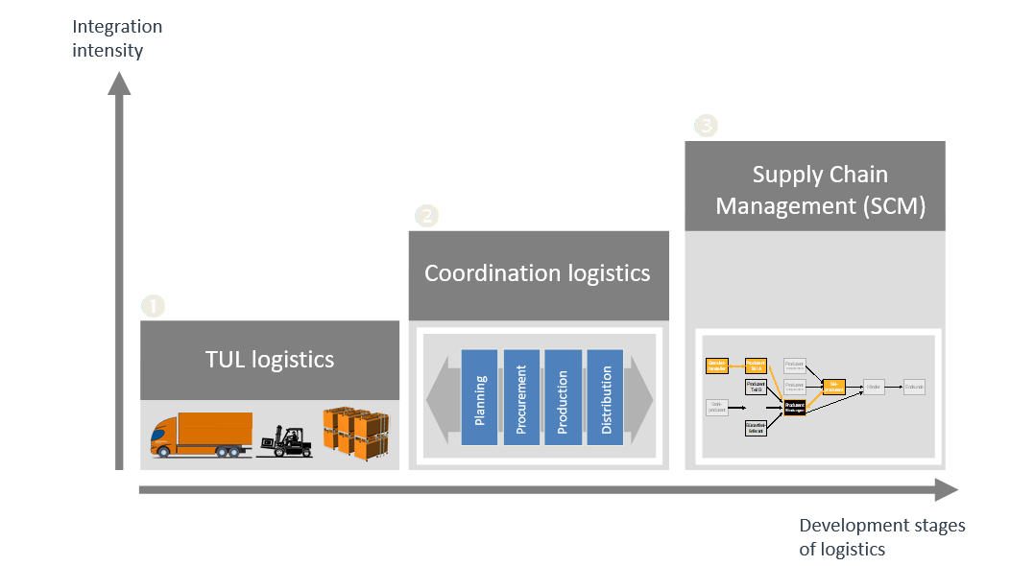
Stages of logistics development
Graphic: own illustration, adapted from Schönwetter
Notes:
The foundation of all logistics is what we refer to as TUL logistics: transporting, transshipping, and storing (see previous chapter).
The next stage, logistics management (sometimes referred to as coordination logistics), builds on the first stage and ensures within companies that goods—and especially information—can flow.
The final stage of development is Supply Chain Management (SCM), which considers the entire supply chain.
Source:
Schönwetter, Gerald (2023): Grundlagen des Logistikmanagements. Die Logistik als Kernfunktion der Realwirtschaft; p. 2 ff
Image source:
Own illustration based on and with kind permission of Schönwetter, Gerald (2023): Grundlagen des Logistikmanagements. Die Logistik als Kernfunktion der Realwirtschaft; p. 4

Slide 26
Supply Chain Management
Supply Chain = Lieferkette
usually not a linear chain, but a complex network
Supply Chain Management:
Managing and optimizing flows of goods, information, and finances across the entire value creation process (from raw materials to the end customer)
Notes:
There are numerous definitions and descriptions of Supply Chain Management. The term dates back to 1982 and was coined by the British economist Keith Oliver.
Kummer et al. define SCM as follows:
“Supply Chain Management (SCM) is a process-oriented management approach that encompasses all flows of goods (raw materials, components, semi-finished and finished products), information, financial resources, as well as the contractual and social relationships along the supply chain—from the raw material supplier to the end customer—and aims at integrating value creation processes and ultimately improving the competitive position of all parties involved in the supply chain.” (Kummer et al., 2019: p. 84)
Fawcett refers to the seamless integration of all companies within a supply chain. This definition additionally emphasizes the importance of people and technology, as well as the goal of satisfying the end customer:
“Supply Chain Management is the collaborative effort of multiple channel members to design, implement, and manage seamless value-added processes to meet the real needs of the end customer. The development and integration of people and technological resources as well as the coordinated management of materials, information, and financial flows underlie successful supply chain integration.” (Fawcett / Magnan, 2001: p. 427)
Sources:
Kummer, Sebastian / Grün, Oskar / Jammernegg, Werner (4th edition, 2019): Grundzüge der Beschaffung, Produktion und Logistik, p. 82 ff
Fawcett, Stanley E. / Magnan, Greg (2001): What is Supply Chain Management? Separating the Rhetoric from the Reality, available at ResearchGate; accessed 30.04.2025

Slide 27
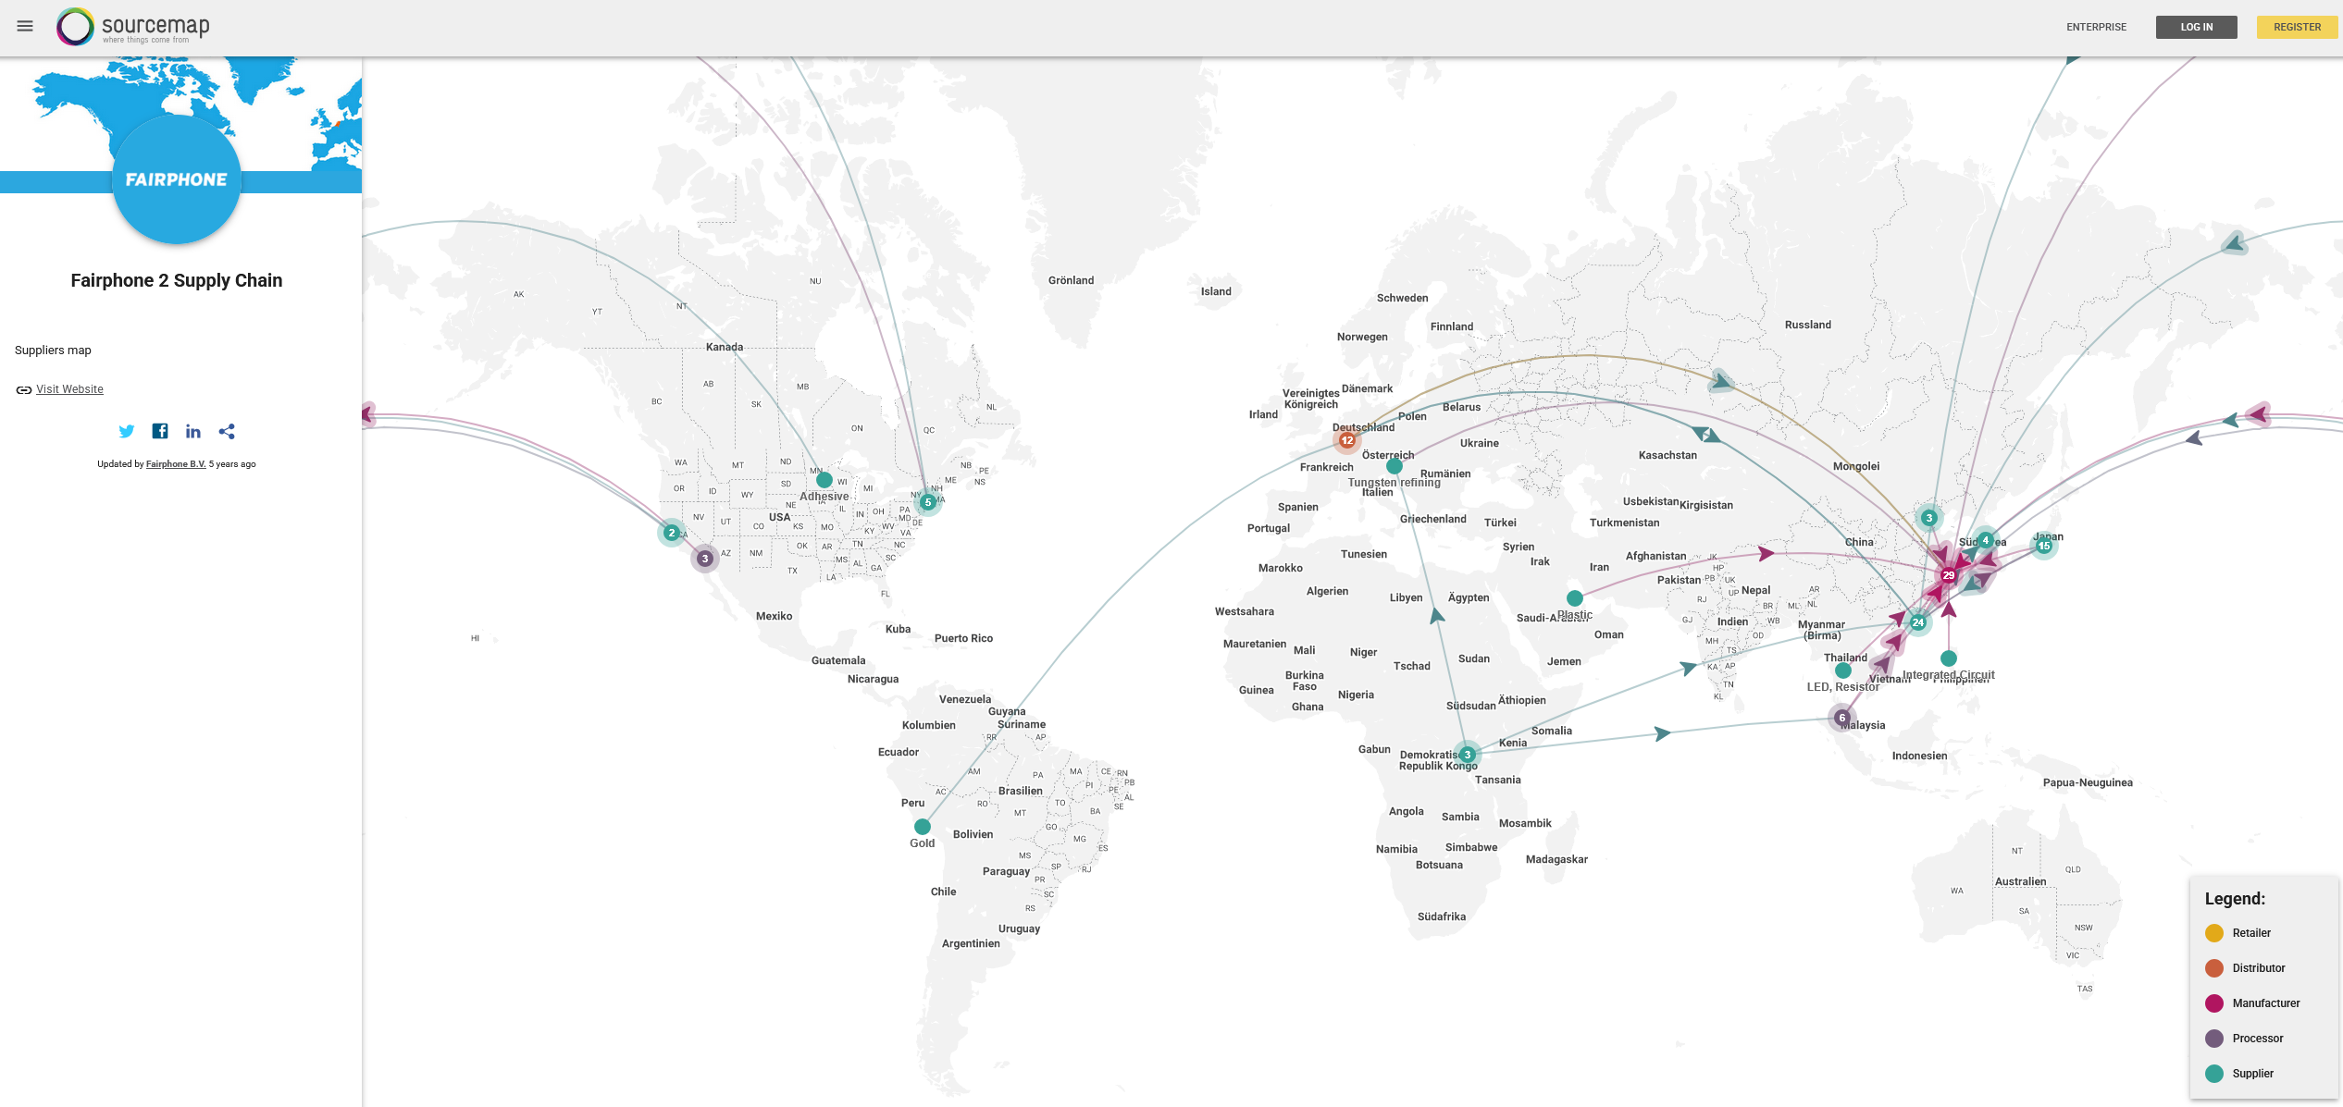
Global supply chains
Image: Open Sourcemap
Notes:
This graphic illustrates global supply chains and the origins of a smartphone. It clearly shows that the raw materials for production are sourced almost worldwide—with a strong focus on countries in the Global South. The subsequent processing, i.e., the manufacturing and assembly of electronic components, largely takes place in the Far East. Only then are the finished devices delivered to consumers worldwide. The coordination and management of these complex international processes is a central task of Supply Chain Management.
Explore global supply chains and information about the individual players at: https://open.sourcemap.com/
Source:
Open Sourcemap (2025): https://open.sourcemap.com/maps/57bd640851c05c0a5b5a8be1; accessed 30.04.2025

Slide 28
The journey of a smartphone
Imagine you are working in the field of Supply Chain Management at a large electronics company.
Your task is to trace the journey of a smartphone—from raw material extraction to sale—and mark and describe the key stages on a world map.
Work based on the guiding questions and prepare a results presentation.
Notes:
Imagine you are working in the field of Supply Chain Management at a large electronics company that manufactures smartphones. Your task is to trace the journey of a smartphone—from raw material extraction to sale—and mark and describe the key stages on a world map.
1. Research and assign the following elements to the correct country of origin:
(Note: Multiple countries per stage are possible)
Raw materials:
Which raw materials are contained in a smartphone and where are they sourced?
e.g. lithium (for batteries), copper, gold (for circuit boards)
Production and assembly:
Electronics manufacturing (e.g. microprocessors, displays)
Final assembly of the device
Sales & use:
Target markets: Where are most smartphones sold?
2. Discuss in your group and answer the following questions:
What social or environmental challenges exist in the different stages of the supply chain?
Why is organizing this chain so complex?
What responsibility do companies have when sourcing raw materials?
What role does Supply Chain Management play in this context?
What could your company do to make its supply chain more sustainable?
3. Presentation of your results:
Prepare a short presentation (approx. 3–5 minutes) in which you present your findings to the class.
Alternatively: Submit your work as a report or summarize your results in several PowerPoint slides.
Learning objectives:
Students develop a basic understanding of global economic interconnections and their impacts.
They gain practical insight into the field of Supply Chain Management and learn about its key tasks and challenges.
Students engage with the social, environmental, and economic aspects of global supply chains.
They become more aware of how their own consumption behavior affects people and the environment.
Additionally, they develop important methodological skills, especially in research, presentation techniques, and teamwork.
Duration:
1–2 lessons, depending on the type of presentation
Tip:
Helpful information can be found here:
https://www.teacheconomy.de/media/unterrichtsmaterial/iphone-produktionsprozess/interaktiv/index.html
Video (Galileo): The journey of a smartphone
https://www.youtube.com/watch?v=N9vPQf_L7-k
https://www.faz.net/aktuell/wirtschaft/infografik-wo-unsere-smartphones-herkommen-15940155.html

Slide 29

What is globalisation?
Interconnection of economy, communication, environment, politics, culture, and language
3 phases of development:
Colonialism: considered the beginning; emergence of new trade routes and sea routes
Industrialization: acceleration phase; growth of global trade
Hyperglobalisation: current stage; communication innovations and trade agreements
40
Picture: Pixabay
Notes:
Globalisation can be understood as the interconnectedness of different areas. To name a few examples: the interconnection of the economy is reflected in international trade; communication is interconnected through telephone and the internet, and social media allows people all over the world to be contacted at any time; politics operates through cooperation between various organizations such as the EU and the UN.
The five dimensions of globalisation are described as economy, environment, politics, language, and culture.
Globalisation is divided into three phases of development:
Colonialism: the beginning in the 15th century; European conquests opened up new trade routes and developed new sea routes.
Industrialization: industrialization and related inventions such as steam engines and railways, and later cars and airplanes, led to a significant acceleration of globalisation. Transportation became cheaper and faster, and trade relations between countries were established.
Hyperglobalisation: this phase began at the end of the last century. Key drivers were the introduction of the internet and inventions such as computers and smartphones, enabling fast and global communication. Countries entered into trade agreements and reduced trade barriers such as tariffs.
Tip: Eurostat Globalisation Dashboard:
https://ec.europa.eu/eurostat/cache/dashboard/globalisation/
Sources:
Studyflix (2025): https://studyflix.de/wirtschaft/globalisierung-7814; accessed 05.05.2025
Studyflix (2025): https://studyflix.de/wirtschaft/globalisierung-vor-und-nachteile-1909; accessed 05.05.2025
Image source:
Pixabay (2025): https://pixabay.com/photos/worldwide-global-globe-earth-world-6064090/; accessed 05.05.2025

Slide 30
Globalisation: Advantages & Disadvantages
Advantages
Promotion of international trade
Global cooperation
Creation of new jobs
Greater variety of goods
Mobility of goods and people
Communication opportunities
Disadvantages
Environmental impacts
Exploitation of labor
Unequal distribution of wealth
Intense competition
Relocation of companies
International problems and crises
Notes:
There are many advantages and disadvantages of globalisation; some of them are presented and described below.
Advantages:
Promotion of international trade:
International trade increases as a result of globalisation. This means that countries can provide each other with goods and services. Through joint trade agreements and the removal of trade barriers, faster exchange of goods is also enabled.
Global cooperation:
The interconnection of countries allows them to jointly address global problems such as climate change, poverty, and terrorism. States cooperate in international organizations such as the UN or the EU to tackle these challenges.
Creation of new jobs:
globalisation leads to the creation of new jobs as companies expand globally and enter new markets. This creates additional employment opportunities in many countries.
Greater variety of goods:
Through globalisation, consumers can purchase goods that are not produced in their home country, such as electronic devices or exotic fruits. This also increases competition between companies and leads to lower prices for consumers.
Mobility of goods and people:
globalisation has made it easier and faster to transport people and goods. Faster transportation supports trade and enables people to work and live worldwide.
Communication opportunities:
Through networked communication via the internet, people around the world can communicate in real time and stay connected more easily, supporting the exchange of ideas and information across long distances.
Disadvantages:
Environmental impacts:
Increased trade relations and the associated rise in transport of goods contribute to significant environmental pollution, climate change, and the excessive exploitation of natural resources.
Exploitation of labor:
globalisation can lead to the exploitation of workers in low-wage countries to gain competitive advantages. For workers, this often means poor working conditions and inadequate pay.
Unequal distribution of wealth:
globalisation has led to significant inequality between rich and poor. To reduce costs, industrialized countries increasingly relocate production abroad. Often, profits benefit large companies and wealthy countries, while workers in developing countries are exploited and live in poverty.
Intense competition:
globalisation leads to strong competition between companies from different countries, as they all compete for the same markets and customers. This often results in smaller companies being pushed out by larger ones that can reduce costs more effectively.
Relocation of companies:
Companies move production abroad to reduce costs and produce more cheaply, which can lead to job losses in their home countries.
International problems and crises:
Due to globalisation, problems and crises can quickly become international, as countries are closely interconnected. Economic or political issues in one country can therefore have impacts on many others.
Studyflix (2025): https://studyflix.de/wirtschaft/globalisierung-vor-und-nachteile-1909; accessed 05.05.2025

Slide 31
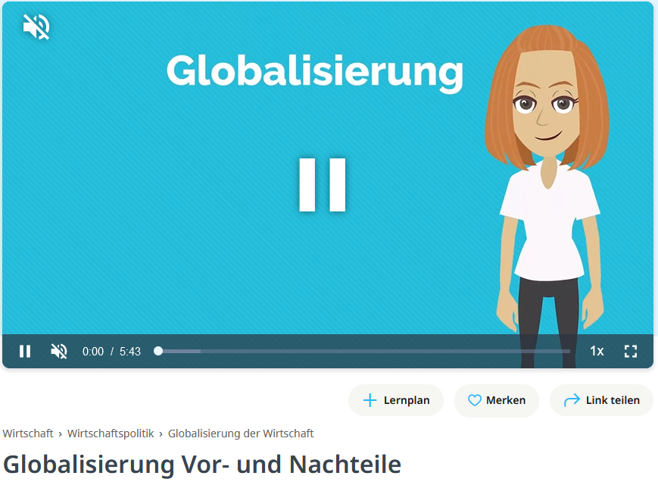
Globalisation Video
Questions about the video:
How is the hyperglobalisation phase used by companies?
Which economic developments of globalisation can be perceived as advantages and disadvantages?
What negative impacts does globalisation have on countries?
What effects does globalisation have on the environment?
Consider what impact globalisation has on your home country.
https://studyflix.de/wirtschaft/globalisierung-vor-und-nachteile-1909
Notes:
Source:
Studyflix (2025): https://studyflix.de/wirtschaft/globalisierung-vor-und-nachteile-1909; accessed 05.05.2025
Questions including answers:
How is the hyperglobalisation phase used by companies?
Relocation of production facilities to low-wage countries to reduce costs
Which economic developments of globalisation can be perceived as advantages and disadvantages?
Unequal distribution of wealth:
Disadvantage – exploitation of poor working conditions due to weak enforcement of human rights
Advantage – lower prices for end consumers and job creation in economically disadvantaged regions
What negative impacts does globalisation have on countries?
Due to interdependence, crises elsewhere have stronger effects on one’s own country; increasing competition to attract companies for location decisions
What effects does globalisation have on the environment?
Increased life expectancy and living standards lead to higher consumption → greater demand for natural resources and massive greenhouse gas emissions
Consider what impact globalisation has on your home country:
e.g., loss of traditional dialects, reduced cultural diversity (due to streaming, etc.), arrival of large companies and job creation, etc.

Slide 32
The largest exporters of goods
Graphic: own illustration based on WTO
Notes:
The diagram shows the 10 largest goods exporters in the world. In 2024, China remains the largest exporting country in the world. In 2024, China’s goods exports amounted to around 3.58 trillion US dollars. This puts China far ahead of the USA (2.07 trillion US dollars) and Germany (1.68 trillion US dollars).
Source:
WTO (2025): Die 20 größten Exportländer weltweit im Jahr 2024. In: Statista: https://de-statista-com.fhooe.idm.oclc.org/statistik/daten/studie/37013/umfrage/ranking-der-top-20-exportlaender-weltweit/; accessed 05.05.2025

Slide 33
Example: Supply chains of lithium-ion batteries
Highly concentrated supply chains in battery production:
Lithium mining: Only eight companies from the USA, Chile, China, and Australia control over 95% of the global lithium market.
Battery production: Ten manufacturers from China, South Korea, and Japan produce over 93% of all battery cells and packs worldwide.
High dependency in Europe.
These supply chains are vulnerable to political conflicts, trade restrictions, and natural disasters.
Notes:
Global battery production – especially for electric vehicles – is highly concentrated in a few countries and companies:
Lithium mining: Only eight companies from the USA, Chile, China, and Australia control over 95% of the global lithium market.
Battery production: Ten manufacturers from China, South Korea, and Japan produce over 93% of all battery cells and packs worldwide.
This concentration makes supply chains vulnerable to political conflicts, trade restrictions, or natural disasters. Countries such as Austria or Germany are highly dependent on imports.
Source:
Gerschberger, Markus et al. (2025): Potential Future Pathways in the Battery Supply Chain – An Upper Austrian Perspective. ASCII Policy Brief. In: https://ascii.ac.at/wp-content/uploads/2025_Automotive-Policy-Brief_final_0612.pdf; accessed 01.07.2025

Slide 34
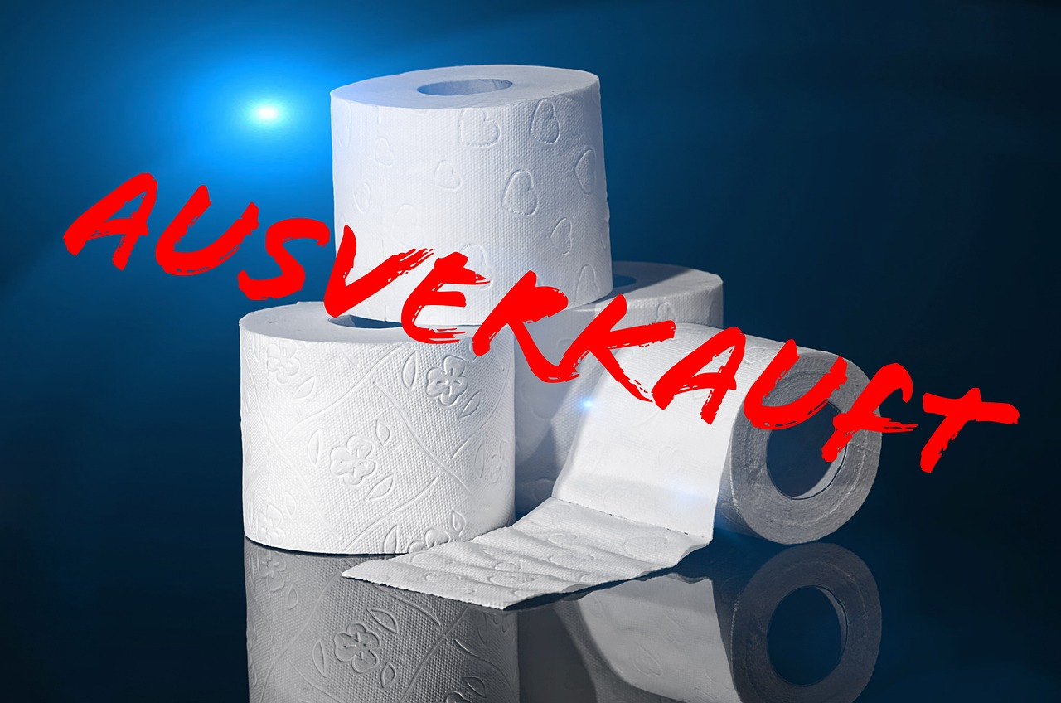
The bullwhip effect
Phenomenon in multi-stage supply chains (supply chains)
Amplification of demand fluctuations along the supply chain
Everyone orders “just in case” → demand is overestimated
Consequences: high inventory levels & costs
Risk: spoiled or obsolete products
Example: toilet paper during the COVID-19 pandemic
Sold out
Image: Pixabay
Notes:
The so-called bullwhip effect, also known as the whiplash effect, describes the phenomenon in which fluctuations in customer demand become increasingly amplified along a multi-stage supply chain. The original demand signal from the end customer is often delayed or misinterpreted as it moves through the chain.
Retailers frequently respond by ordering larger quantities than actually needed—including safety stock—from wholesalers. These wholesalers, in turn, place inflated orders with manufacturers to avoid potential shortages. Due to these safety margins and time delays, a chain reaction occurs in which actual demand is exceeded, leading to excessive inventory levels.
Thus, the effect builds up from stage to stage, as each party reacts to uncertain or delayed information with overestimated orders. The consequences include overloaded production, rising inventory costs, and the risk of products spoiling or becoming obsolete.
A clear example of the bullwhip effect occurred at the beginning of the COVID-19 pandemic: the sudden surge in demand for toilet paper quickly led to stockouts in many supermarkets. In response, manufacturers significantly increased production. A few weeks later, however, retailers’ and producers’ warehouses were overstocked with toilet paper—while actual demand had already been satisfied, as consumers had stocked up earlier.
Source:
Studyflix (2025): https://studyflix.de/wirtschaft/bullwhip-effekt-1523; accessed 05.05.2025
Image source:
Pixabay (2025): https://pixabay.com/photos/toilet-paper-sold-out-4942764/; accessed 05.05.2025

Slide 35
Green logistics
3

Slide 36
Sustainability and green logistics
Sustainability:
Long-term development that meets the needs of the present generation without compromising the ability of future generations to meet their own needs.
Green Logistics:
A holistic transformation of the logistics sector to create environmentally friendly and resource-efficient logistics processes, balancing economic and ecological efficiency.
40
Notes:
The concept of sustainability was first developed in forestry in the 18th century to prevent deforestation, although it had already been practiced regionally in the 15th century. Since the 1970s, there has been growing concern about how the economy—particularly logistics—affects the environment and exploits and pollutes natural resources.
The term “sustainability” was coined to describe long-term development that meets the needs of the present generation without compromising the ability of future generations to meet their own needs. According to the Brundtland Commission, the needs of the current generation should not be satisfied at the expense of future generations. Natural resources should only be used to the extent that they can regenerate.
Environmental problems require not only reactive protective measures but also active climate protection through a shift in thinking within industrial society. In the logistics and transport sector, the term “Green Logistics” is commonly used. It refers to the holistic transformation of logistics strategies, structures, processes, and systems to create environmentally friendly and resource-efficient logistics processes. The goal of green logistics is to achieve a balance between economic and ecological efficiency and to create sustainable corporate value.
Source:
Koch, Susanne (2012): Logistik. Eine Einführung in Ökonomie und Nachhaltigkeit, p. 292 ff.

Slide 37
The 3 pillars of sustainability in logistics
Green Logistics
Economic
Ecological
Social
“…environmentally friendly and socially responsible, but also financially viable”
Notes:
The concept of “green logistics” aims to balance economic, ecological, and social objectives in the field of logistics, which also affects the transport sector. This creates tensions between these three areas, as not all goals can be pursued simultaneously. The following objectives can be assigned to each area:
Social objectives: Raising awareness for sustainable transport and ensuring a good quality of life.
Ecological objectives: Reducing emissions and overall resource consumption.
Economic objectives: From a financial perspective, avoiding additional costs or achieving cost reductions, and minimizing inefficiencies (periods in which something or someone is not productive).
Of course, additional objectives can be assigned to these areas, making it even more challenging to achieve a balanced approach across all dimensions.
Sources:
Pazirandeh, Ali / Jafari, Hamid (2013): Making sense of green logistics; International Journal of Productivity and Performance Management, p. 889 ff.
Saroha, Rituraj (2014): Green logistics & its significance in modern day systems; International Review of Applied Engineering Research, p. 90

Slide 38
Sustainability: Economy, Ecology, Social aspects in tension
Critically examine the three pillars of sustainability in three groups. What often does not work in our world?
Discuss the following guiding questions for each pillar.
Group 1: Economy – Sustainability vs. Profit
Group 2: Ecology – Saving the environment, but how?
Group 3: Social – Sustainability for everyone?
Notes:
Sustainability in Balance – Economy, Ecology, Social Aspects in Tension
Duration: 1 lesson (1 EH)
Group Discussion
Each group is assigned one pillar of sustainability and discusses the following questions:
Group 1: Economy – Sustainability vs. Profit
Where do economic interests conflict with ecological or social goals?
Examples of companies or industries that are not sustainable
Are there positive examples of sustainable business practices?
Group 2: Ecology – Saving the Environment, but How?
Why are environmental goals often not achieved?
What challenges exist (e.g. climate change, resource consumption, pollution, biodiversity loss)?
Who is responsible – governments, companies, or consumers?
Group 3: Social – Sustainability for Everyone?
Where does our economic system create social inequality?
Which people or countries are most affected by unsustainable practices?
Why is a sustainable lifestyle difficult for many people to achieve?
Class Reflection (after group work)
How can sustainability be better implemented in all areas?
What can individuals and society do?
Which pillar is the hardest to implement?
Possible Solutions / Teacher Input
Economy – Sustainability vs. Profit
Promote sustainable business models (e.g. circular economy, eco-certifications)
Introduce true cost pricing (include environmental & social costs)
Laws & incentives for companies (tax benefits, stricter regulations)
Change consumer behavior (less fast fashion, more regional products)
Ensure fair supply chains (mandatory sustainability reporting)
Ecology – Saving the Environment
Promote environmental awareness (education in schools & companies)
Reduce CO₂ emissions (renewables, taxes, stricter regulations)
Strengthen circular economy (recycling, repairability, less waste)
Support green innovation (subsidies for sustainable technologies)
Increase global cooperation (international agreements)
Social – Sustainability for All
Fair wages & working conditions worldwide
Make sustainable products affordable
Improve access to education & healthcare
Sustainable urban planning (public transport, affordable housing)
Raise awareness (campaigns for fair consumption)
Additional Discussion Questions
What can individuals do vs. what requires policy & business action?
Is a “green economy” realistic or are radical changes needed?
Should companies be liable for environmental/social damage?
Why is sustainability often seen as expensive or inconvenient?
Which countries or industries are leaders in sustainability?
Learning Objectives
Students will:
Understand the three pillars of sustainability and their interdependencies
Critically evaluate business strategies and policies
Reflect on their role as consumers
Develop teamwork, critical thinking, and argumentation skills

Slide 39
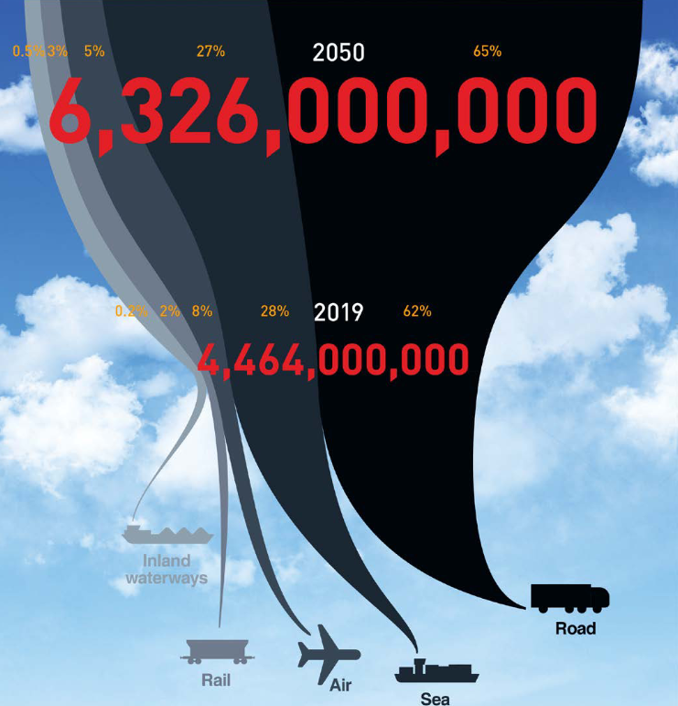
Impacts of the transport sector
Transport emissions are rising sharply
Forecasts assume an almost doubling of freight transport by 2050 (compared to 2019)
In particular, truck transport is increasing
40
Image: Smart Freight Centre
Notes:
The continuous increase in freight transport, especially road freight (trucks), has significant impacts on the environment and climate.
Forecasts predict an almost doubling of freight transport by 2050 (compared to 2019). (ITF 2023: p. 67)
Image source:
Smart Freight Centre (2024): GLEC Framework v3.1 edition, revised and updated. In: https://https://www.smartfreightcentre.org/en/our-programs/emissions-accounting/global-logistics-emissions-council/calculate-report-glec-framework/, p. 8
Based on: ITF (2023): ITF Transport Outlook 2023, OECD Publishing, Paris; on https://doi.org/10.1787/b6cc9ad5-en ; accessed 25.09.2024
Source:
ITF (2023): ITF Transport Outlook 2023, OECD Publishing, Paris; on https://doi.org/10.1787/b6cc9ad5-en ; accessed 06.03.2025

Slide 40
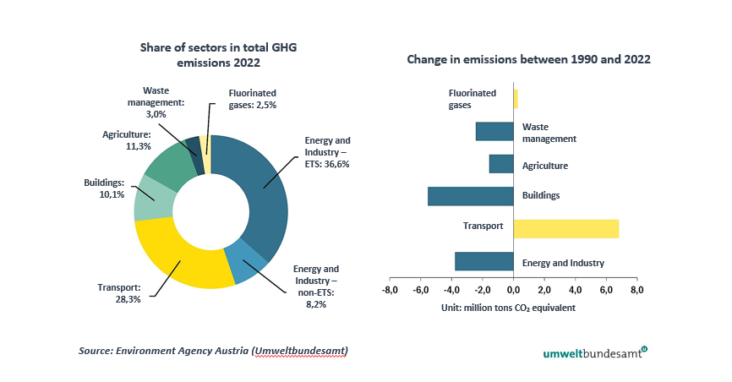
Emissions by sector in Austria
Notes:
The transport sector, at around 28%, is the second-largest contributor to greenhouse gas emissions after the energy and industry sector. It is the only sector that has significantly increased its emissions since 1990.
“Since 1990, the transport sector (including domestic aviation) has recorded the highest increase in emissions of all sectors in the period 1990–2022, with a rise of 49.6%, mainly caused by the increase in road traffic activity.” (Umweltbundesamt 2024: p. 138)
Road transport is responsible for around 99% of emissions in the transport sector.
Source:
Umweltbundesamt (2024): Klimaschutzbericht 2024. Available at: https://www.umweltbundesamt.at/fileadmin/site/publikationen/rep0913.pdf; accessed 14.01.2025

Slide 41
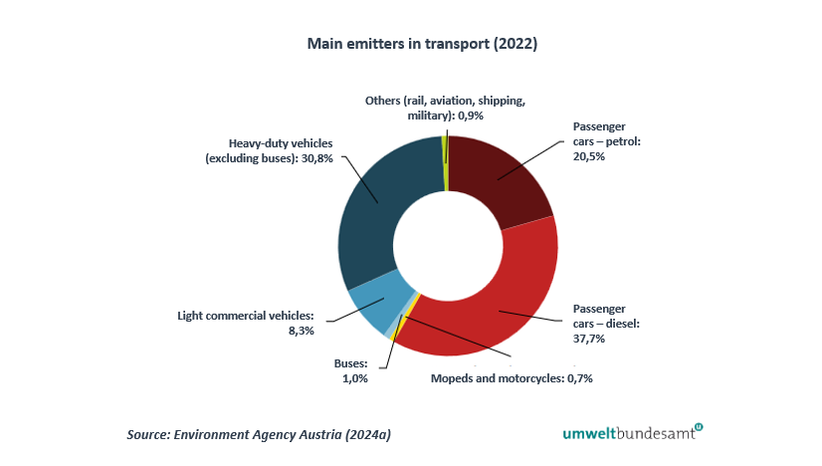
Road transport as the main contributor
Notes:
Road transport is responsible for around 99% of emissions in the transport sector. (Umweltbundesamt 2024: p. 138)
Source:
Umweltbundesamt (2024): Klimaschutzbericht 2024. Available at: https://www.umweltbundesamt.at/fileadmin/site/publikationen/rep0913.pdf; accessed 14.01.2025

Slide 42

Sustainable freight transport – why and how?
Increasing transport volumes increases the need for action
Sustainable transport through:
Avoidance of transport
Shift to sustainable modes of transport such as rail and inland waterways
Alternative fuels
Innovative technologies, digitalisation
Adjusted pricing
Holistic consideration of the value chain and suppliers
40
Image: Flaticon
Notes:
Freight transport is identified as an environmentally harmful area of logistics, as it causes significant environmental and sustainability problems in Europe due to greenhouse gas emissions and traffic congestion. In view of the increasing volume of transport, the need for action and the relevance of sustainability in freight transport are becoming ever greater.
To counter these problems, various measures are being implemented. These include adjusted pricing, the use of alternative fuels, promoting a shift to sustainable modes of transport such as rail and inland waterways, and increased use of innovative technologies.
Source:
European Commission (2011): White Paper – Roadmap to a Single European Transport Area – Towards a competitive and resource-efficient transport system, p. 10 ff.
Image source:
Flaticon (2024): https://www.flaticon.com/de/kostenlose-icons/erde; Earth icons created by Freepik – Flaticon, accessed 08.07.2024

Slide 43
Trends and innovations
4

Slide 44
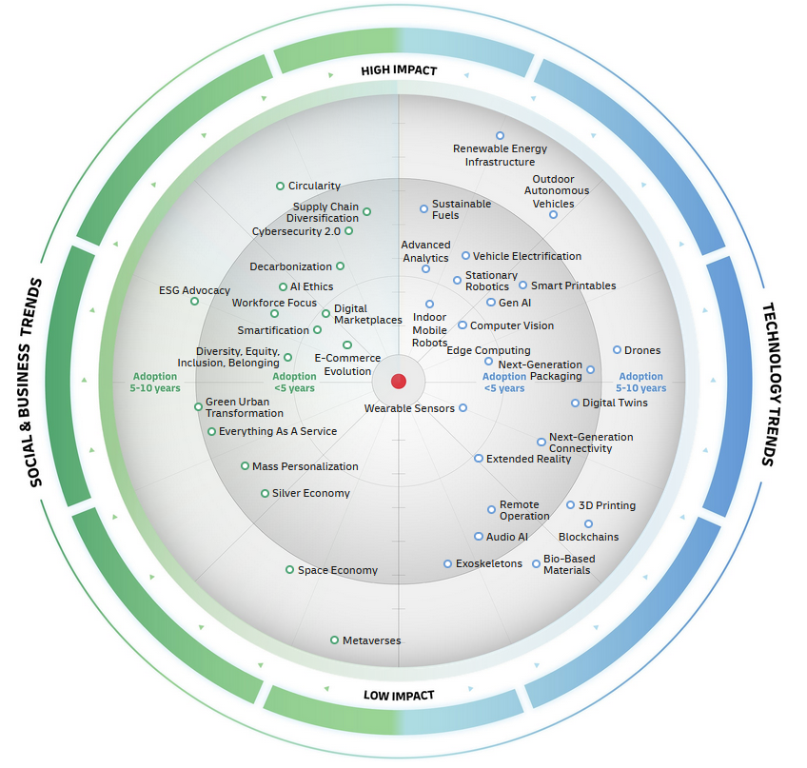
DHL trend radar
Sustainability, digitalisation, and automation as key drivers
Also societal development
Image: DHL Group
Notes:
The DHL Logistics Trend Radar is a visual overview of current and future trends that influence the logistics industry.
An interactive version is available at: https://www.dhl.com/de-en/home/innovation-in-logistics/logistics-trend-radar.html
The radar is structured into two main areas:
Technology trends (blue) on the right side
Social & economic trends (green) on the left side
…and two axes:
Horizontal axis: time until widespread adoption of the trend (from “now” to “in 10 years”)
Vertical axis: assessment of impact – from low to high
Examples of high-impact trends:
Further development of e-commerce (new delivery models, increasing customer expectations, e.g. same-day delivery)
Artificial intelligence & advanced data analytics (automated decisions, forecasting, process optimization)
Infrastructure for renewable energy (power supply for warehouses, vehicles, and facilities using green energy)
Mobile and stationary robotics (automation in warehouses, e.g. autonomous vehicles, picking robots, digital twins)
Electrification of vehicles (electric trucks and emission-free urban delivery)
Cybersecurity 2.0 (new security standards against more complex cyberattacks)
Conclusion:
Sustainability, digitalisation, and automation are the key drivers.
Trends such as artificial intelligence, electric vehicles, and robotics are fundamentally transforming the industry.
Logistics companies must evolve both technologically and socially to remain future-proof and ensure an attractive working environment.
Source:
Dörrmann, Klaus et al. (2024): Logistics Trend Radar 7.0. DHL Group. Available at: https://www.dhl.com/de-en/home/innovation-in-logistics/logistics-trend-radar.html; accessed 06.05.2025

Slide 45
Sustainability in logistics
Sustainability along the entire supply chain
EU target for freight transport over 300 km: shift 30% to alternative modes of transport such as rail or inland waterways by 2030; over 50% by 2050
Innovative technologies
Image: Flaticon
Notes:
The European Union has set the goal of shifting 30% of freight transport over distances greater than 300 km to alternative modes of transport such as rail or inland waterways by 2030. By 2050, this share is expected to increase to over 50% in order to achieve a long-term reduction in CO₂ emissions in freight transport.
Source:
European Commission (2011): White Paper – Roadmap to a Single European Transport Area – Towards a competitive and resource-efficient transport system, p. 10 ff.
Image source:
Flaticon (2024): https://www.flaticon.com/de/kostenlose-icons/erde; Earth icons created by Freepik – Flaticon, accessed 08.07.2024

Slide 46
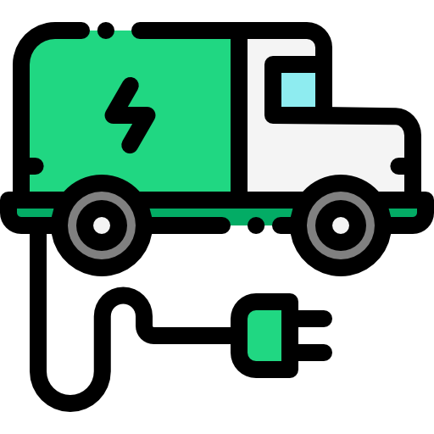
Alternative drives
Electromobility:
Reduction of CO₂ emissions and noise
Use in urban areas
Challenges: limited range, charging times and infrastructure, higher acquisition costs
Potential through digitalisation, autonomous driving and alternative energy sources
Image: Flaticon
Notes:
Electromobility is increasingly gaining importance as an alternative drive technology in the logistics sector. It enables a reduction of emissions and noise pollution. Especially in urban logistics, the use of electric vehicles is suitable, as trip distances are shorter and loading and unloading points can be well planned.
However, limited range, charging times, and charging infrastructure pose challenges, particularly in non-urban areas, as do the higher acquisition costs of electric vehicles compared to combustion-engine vehicles. Through digitalisation, autonomous driving, and alternative energy sources, further potential is expected in the future.
Source:
Fraunhofer IML (2025): https://www.iml.fraunhofer.de/de/abteilungen/b3/verkehrslogistik/alternative_antriebe.html ; accessed 06.05.2025
Image source:
Flaticon (2024): https://www.flaticon.com/free-icons/ecology-and-environment ; Ecology and environment icons created by Freepik – Flaticon; accessed 13.06.2024

Slide 47

Digitalisation
Logistics 4.0 or “Digital Logistics”:
Networking of all actors and processes within the supply chain
Focus on efficiency and effectiveness
Expansion of value chains into value networks
Integration across all logistics functions: warehousing, transport, procurement, production, distribution & information
Image: Flaticon
Notes:
With the advancement of Industry 4.0 and the increasing digitalisation of society, supply chains—especially logistics—are also being transformed by digitalisation. This development is referred to as Logistics 4.0 or “Digital Logistics,” which involves the integration of modern and intelligent systems within the logistics process chain to connect all actors and processes across the supply chain.
The focus of Logistics 4.0 is on improving efficiency and effectiveness, including greater transparency, higher levels of automation, and increased flexibility.
Through digitalisation, traditional value chains can evolve into value networks. This requires trust among partners, as data must be shared across the entire network.
The implementation of Logistics 4.0 spans all areas of the value chain in logistics, including procurement and warehousing, distribution and transport, as well as production logistics. Information logistics is becoming increasingly important within the value chain due to digitalisation.
Source:
Gabler Wirtschaftslexikon (2025): https://wirtschaftslexikon.gabler.de/definition/logistik-40-54203 ; accessed 06.05.2025
Image source:
Flaticon (2024): https://www.flaticon.com/free-icons/networking; Networking icons created by Freepik ; accessed 10.09.2024

Slide 48
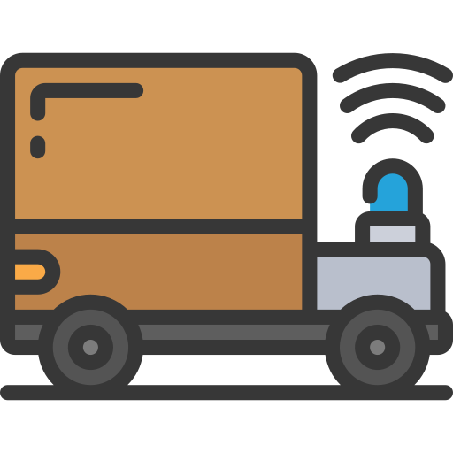
Autonomous driving: Trucks
Opportunities:
Mitigation of skilled labor shortages
Reduction of environmental impact through platooning and fuel savings
Avoidance of rear-end collisions
Limits and Risks:
Weather conditions
Human road users
Vulnerability to hacking
Image: Flaticon
Notes:
The implementation of autonomous trucks offers a range of advantages:
Cost savings for companies and mitigation of skilled labor shortages
Reduction of environmental impact through optimized traffic flow via vehicle-to-vehicle communication, leading to more efficient driving
Increased safety
Risks and limitations:
Complex situations and a high number of road users—especially in urban traffic—pose challenges
Weather conditions (e.g., poor visibility for cameras)
Risk of cyberattacks
Video tip on the trend:
Youtube (2024): Testphase: MAN erprobt autonom fahrende LKW | BR24 - https://www.youtube.com/watch?v=MOXl8SvKzKY; accessed 30.09.2024
Sources:
Jobmatch (2024): https://jobmatch.me/blog/arbeitnehmer/logistik/autonomes-fahren-eine-gefahr-fuer-die-lkw-fahrer/; accessed 03.07.2024
Neubauer, Matthias / Hutter, Bernadette (2022): Research Report "Für LKW-Fahrer und LKW-Fahrerinnen wird es noch lange Arbeit geben": Matthias Neubauer, Professor at the University of Applied Sciences Upper Austria, on automated driving and its impact on the world of work in transport and logistics, interview. In: https://hdl.handle.net/10419/269898 ; accessed 06.05.2025
Image source:
Flaticon (2024): https://www.flaticon.com/free-icons/autonomous-car; Autonomous-car icons created by juicy_fish – Flaticon; accessed 02.07.2024

Slide 49

Autonomous navigation: Inland shipping
Belgian company SEAFAR as a pioneer in (semi-) autonomous shipping
Remote control centers
Remotely operated vessels with full crew and also reduced crew in operation
Remote-controlled navigation of unmanned and highly automated push barges
Technology to enhance safety in human-centered operations
Picture: Seafar
Notes:
The Belgian company SEAFAR was founded in 2018 in Antwerp and specializes in the development and operational integration of technologies for remotely controlled shipping. Ships are operated from three modern control centers located in Antwerp, Charleroi, and Duisburg. The automation of vessels is implemented step by step and in coordination with local regulatory authorities. Both remotely controlled ships with full crew and ships with reduced crew are currently in operation. While operations are managed remotely, navigation is still carried out by the crew on board. Through technologies such as object detection and data collection, onboard crews can be supported and safety can be enhanced. On two routes in Belgium, remotely controlled ships without any crew on board are also being tested.
Source:
SEAFAR Company Presentation (2024)
https://seafar.eu/de/
Picture source:
Seafar (2024)

Slide 50
Thank you for your attention!

Slide 51
Additional information for teachers
This teaching material package is available under the so-called Creative Commons Attribution 4.0 International License.
You are therefore free to integrate these materials into your teaching, adapt them to your needs, and share them with your students or other individuals.
We kindly ask that you leave the logos on the slides unchanged.
Image sources are indicated in the notes section; use in other contexts is not permitted.
Statement on the use of generative AI and AI-supported technologies:
During the development of this project, the authors used ChatGPT and Microsoft Copilot to support concept development and idea generation—especially for interactive exercises. The use of these AI tools was carried out with careful consideration. All content was subsequently thoroughly reviewed and, if necessary, revised by the authors to ensure compliance with academic standards. The authors bear full responsibility for the final content of the publication.
40

Slide 52
Additional information for teachers
For questions and feedback, feel free to contact us via email at:
rewway@fh-steyr.at
Further slide sets and practical exercises can be found at:
http://www.rewway.at/en/teaching-materials/
Are you interested in a Transport School Lab, an excursion, or a guest lecture?
http://www.rewway.at/en/pages/workshops
40

Slide 53
List of references I
Dorhmann, Klaus et al. (2024): Logistics Trend Radar 7.0. DHL Group. In: https://www.dhl.com/de-en/home/innovation-in-logistics/logistics-trend-radar.html ; accessed 06.05.2025
European Commission (2011): White Paper – Roadmap to a Single European Transport Area – Towards a competitive and resource-efficient transport system
Fawcett, Stanley E. / Magnan, Greg (2001): What is Supply Chain Management? Separating the Rhetoric from the Reality , In: https://www.researchgate.net/profile/Stanley-Fawcett/publication/268287410_WHAT_IS_SUPPLY_CHAIN_MANAGEMENT_SEPARATING_THE_RHETORIC_FROM_THE_REALITY/links/54d4139a0cf25013d028f8de/WHAT-IS-SUPPLY-CHAIN-MANAGEMENT-SEPARATING-THE-RHETORIC-FROM-THE-REALITY.pdf; accessed 30.04.2025
Fraunhofer IML (2025): https://www.iml.fraunhofer.de/de/abteilungen/b3/verkehrslogistik/alternative_antriebe.html ; accessed 06.05.2025
Gabler Wirtschaftslexikon (2025): https://wirtschaftslexikon.gabler.de/definition/logistik-40-54203 ; accessed 06.05.2025
Gerschberger, Markus et al. (2025): Potential Future Pathways in the Battery Supply Chain – An Upper Austrian Perspective. ASCII Policy Brief. In: https://ascii.ac.at/wp-content/uploads/2025_Automotive-Policy-Brief_final_0612.pdf ; accessed 01.07.2025
IHK Niederrheinische Industrie und Handelskammer: Incoterms 2020; https://www.ihk.de/niederrhein/hauptnavigation/international/import-export/lieferbedingungen-incoterms-3925010#:~:text=Die%20Bedeutung%20der%20Incoterms,-Die%20Internationale%20Handelskammer&text=Januar%202020%20in%20Kraft.,aber%20auch%20nationalen%2C%20Handelsgesch%C3%A4ft%20erm%C3%B6glichen; accessed 29.04.2025
ITF (2023): ITF Transport Outlook 2023, OECD Publishing, Paris; on https://doi.org/10.1787/b6cc9ad5-en ; accessed 06.03.2025
Jobmatch (2024): https://jobmatch.me/blog/arbeitnehmer/logistik/autonomes-fahren-eine-gefahr-fuer-die-lkw-fahrer/ ; accessed 03.07.2024
Koch, Susanne (2012): Logistik. Eine Einführung in Ökonomie und Nachhaltigkeit
Kummer, Sebastian / Grün, Oskar / Jammernegg, Werner (4th edition, 2019): Grundzüge der Beschaffung, Produktion und Logistik
Muchna, Claus / Brandenburg, Hans / Fottner, Johannes / Gutermuth, Jens (2nd edition, 2021): Grundlagen der Logistik. Begriffe, Strukturen und Prozesse
40

Slide 54
List of references II
Neubauer, Matthias / Hutter, Bernadette (2022): Research Report "Für LKW-Fahrer und LKW-Fahrerinnen wird es noch lange Arbeit geben": Matthias Neubauer, Professor at the University of Applied Sciences Upper Austria, on automated driving and its impact on the world of work in transport and logistics, interview. In: https://hdl.handle.net/10419/269898 ; accessed 06.05.2025
Pazirandeh, Ali / Jafari, Hamid (2013): Making sense of green logistics. In: International Journal of Productivity and Performance Management
Saroha, Rituraj (2014): Green logistics & its significance in modern-day systems. In: International Review of Applied Engineering Research
Schindler, Darius Oliver / Zimmermann, Yves Clément (2021): Internationales Handels- und Logistikrecht
Schönwetter, Gerald (2023): Grundlagen des Logistikmanagements. Die Logistik als Kernfunktion der Realwirtschaft
SEAFAR Company Presentation (2024)
Studyflix (2025): https://studyflix.de/wirtschaft/bullwhip-effekt-1523 ; accessed 05.05.2025
Studyflix (2025): https://studyflix.de/wirtschaft/globalisierung-7814 ; accessed 05.05.2025
Studyflix (2025): https://studyflix.de/wirtschaft/globalisierung-vor-und-nachteile-1909 ; accessed 05.05.2025
Ten Hompel, Michael / Schmidt, Thorsten (2003): Warehouse Management: Automatisierung und Organisation von Lager- und Kommissioniersystemen
Umweltbundesamt (2024): Klimaschutzbericht 2024. In: https://www.umweltbundesamt.at/fileadmin/site/publikationen/rep0913.pdf ; accessed 14.01.2025
Wirtschaftslexikon Gabler (2025): https://wirtschaftslexikon.gabler.de/definition/logistik-40330 ; accessed 07.01.2025
Wirtschaftslexikon Gabler (2025): https://wirtschaftslexikon.gabler.de/definition/logistik-controlling-38772 ; accessed 10.04.2025
WTO (2025): Die 20 größten Exportländer weltweit im Jahr 2024. In: Statista: https://de-statista-com.fhooe.idm.oclc.org/statistik/daten/studie/37013/umfrage/ranking-der-top-20-exportlaender-weltweit/ ; accessed 05.05.2025

