Slide 1
Transport and logistics – fundamentals and multimodal approaches
Teaching materials

Slide 2
How to work most effectively with this teaching material
PowerPoint: The following PowerPoint presentation provides an introduction to the topic “Transport and logistics – fundamentals and multimodal approaches”. Each slide includes speaker notes with explanations and references. Activity slides are highlighted in yellow and contain practical examples, exercises, videos and other interactive elements that have been specifically prepared for classroom use.
Videos and supplementary exercises: Videos and exercises on the topic can be found within this presentation on the colour-highlighted activity slides as well as at: https://www.rewway.at/de/lehrmittel/ . All teaching materials include a concise overview to support lesson planning: learning objectives, target groups, level of difficulty, methods and links to the curriculum.
References: The sources used for the presentation are available both in the notes section of the individual slides and at the end of the PowerPoint presentation.

Slide 3
Learning objectives and target groups
Learning objectives:
Learners are able to explain the advantages and disadvantages of the modes of transport road freight, rail and inland waterways.
Learners are familiar with the criteria that play a role in the selection of transport modes.
Learners are able to explain what multimodal transport means and how the combination of different modes of transport leads to more efficient and sustainable logistics.
Learners are able to explain the importance of inland navigation for freight transport.
Target groups:
Upper secondary school pupils (AHS and BHS)
Vocational school students
Students receiving an introduction to the fields of transport logistics, inland navigation and multimodal transport
Career changers and professionals from other sectors

Slide 4
Have you ever asked yourself…?
…why the majority of freight transport still takes place by road rather than by rail or inland waterways?
…how the intelligent combination of different modes of transport can create more efficient, cost-effective and environmentally friendly transport chains?
…what potential inland navigation offers for more sustainable logistics, and why it has so far been used comparatively little?
Notes:
Warm-up and learning objectives
The questions are suitable as a warm-up: brainstorming and discussion in a classroom setting (approx. 10 minutes).
Objective: activation of prior knowledge, promotion of critical thinking, introduction to the topic through everyday relevance.
Learning objectives:
Pupils critically reflect on the role and importance of different modes of transport in freight transport.
Pupils discuss the challenges and potential of multimodal and sustainable logistics solutions.
Pupils develop an initial awareness of the ecological relevance of transport chains and their design.

Slide 5
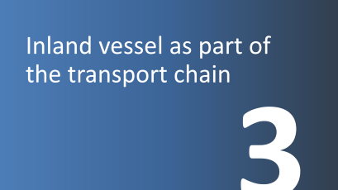

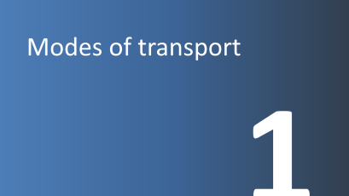
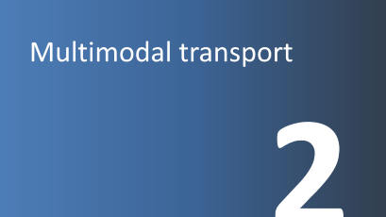



Slide 6
Modes of transport
1

Slide 7
Comparison of transport modes
Mode of transport (infrastructure)
Means of transport (vehicles)
Means of transport:
Vehicle used for transporting people and goods
Land
Road
Pipeline
Rail
Pipeline
Train
Truck
Mode of transport:
Infrastructure used for the operation of transport vehicles
Water
Inland Waterways
Sea/Ocean
Inland Ship
Ocean-going Ship
Air
Air Transport
Airplane
Freight transport
Transport chain:
Pre-carriage, main carriage, on-carriage
Multimodal transport:
Transport of goods using at least two different means of transport
Graphic: adapted from viadonau and Eurostat
Notes:
There are different types of modes of transport and means of transport. A mode of transport provides the infrastructure required for the use of a specific means of transport. Roads, railways, and waterways are examples of modes of transport.
Means of transport refer to vehicles and equipment used to transport people and goods, such as inland vessels, trucks, or trains.
Multimodal transport means transporting goods using two or more different modes of transport.
The pre-carriage represents the first leg of a transport chain, i.e., the transport of goods to a transshipment hub (e.g., a port). In many cases, the pre-carriage is carried out by truck.
The on-carriage refers to the transport of goods from the transshipment hub to the recipient's location; this is also usually carried out by truck.
The main leg connects the pre-carriage and the on-carriage. In multimodal transport, this typically refers to the longest distance traveled by rail or inland waterway.
Sources:
Viadonau (2019): Handbuch der Donauschifffahrt, pp. 185–187
Eurostat (2025): Transport Mode Glossary – Eurostat. Accessed at 27.02.2025

Slide 8
Mode of transport quiz
Assign each statement to a mode of transport (Road, Waterway, Rail):
This mode of transport enables fast delivery right to your doorstep.
This mode of transport can carry large amounts of goods at once but is slower than other options.
There are often traffic jams on this mode of transport, especially in large cities.
This mode of transport is particularly suitable for transporting goods over long distances within a country.
This mode of transport uses natural infrastructure and is especially environmentally friendly.
This mode of transport causes the most harmful air pollutants.
These two modes of transport are particularly safe, with very few accidents occurring.
Notes:
The quiz questions are suitable as an introduction or to lighten the mood and are either discussed as a class or worked on in pairs.
Duration: approx. 10 minutes
Answers:
This mode of transport enables fast delivery right to your doorstep. (Road/Truck)
This mode of transport can carry large quantities of goods at once but is slower than other options. (Waterway/Inland Ship)
There are often traffic jams on this mode of transport, especially in large cities. (Road)
This mode of transport is particularly suitable for transporting goods over long distances within a country. (Rail/Train)
This mode of transport uses natural infrastructure and is especially environmentally friendly. (Waterway/Inland Ship)
This mode of transport causes the most harmful air pollutants. (Road/Truck)
These two modes of transport are particularly safe, as hardly any accidents occur. (Rail/Train and Waterway/Inland Ship)
Learning objectives:
Students recognize the fundamental differences between road, rail, and waterways.
Students reflect on initial connections between transport, the environment, and everyday life.
Students exchange experiences about freight transport and supply chains.

Slide 9
Mode of transport: Road
Transport speed
Network density & area coverage
Flexibility
Technological progress
Low usage costs
Door-to-door transport without transshipment
Vehicle tracking and communication with personnel
High external costs (environment, CO₂ emissions, noise, accidents, etc.)
Unfavorable ratio between payload and vehicle weight
Limited loading capacity
Time restrictions: driving bans
Relatively high accident risk
Dependency on road conditions and traffic situations
Notes:
The high transport speed compared to the modes of transport rail and inland waterway can be seen as an advantage of road transport. The widespread infrastructure coverage—and therefore the ability to form a network (door-to-door)—is also one of the strengths of road transport. Due to the wide range of available vehicles, this mode offers great flexibility. In addition, many IT solutions (e.g., tracing and tracking) are already widely used. Furthermore, the use of infrastructure is associated with relatively low costs (costs for road damage are only partially covered).
However, since costs related to traffic congestion or noise pollution (so-called external costs) are gaining increasing attention, road transport is facing growing cost pressure. Time restrictions in the form of driving bans also affect this mode of transport. In terms of environmental aspects such as noise pollution and accidents, road transport performs poorly compared to other modes.
Source:
Kille, Christian/ Schmidt , Norbert (2008): Wirtschaftliche Rahmenbedingungen des Güterverkehrs. Studie zum Vergleich der Verkehrsträger im Rahmen des Logistikprozesses in Deutschland, p. 53; Online: http://www.scs.fraunhofer.de/content/dam/scs/de/dokumente/studien/Wirtschaftliche_Rahmenbedingungen_des_Gueterverkehrs.pdf. Accessed at 04.02.2025

Slide 10
Mode of transport: Rail
High capacity for bulk transport
Predictability
Low accident risk
Largely weather-independent
Low transport costs over long distances
Low environmental impact
Limited cross-border operations
Limited flexibility
Low network density
Difficult shipment tracking
Low punctuality rate (ÖBB rail freight approx. 70%)
Notes:
Especially with block or direct trains, rail can score points with fast transport speeds. In addition, this mode of transport has high bulk transport capacity, and shipments are predictable. Due to established standards, the safety level is very high. Unlike road transport, transport prices are not influenced by toll charges and can therefore be relatively inexpensive depending on the quantity transported. The lower CO₂ consumption compared to road transport is also an advantage.
However, due to infrastructural differences, cross-border transport by rail remains challenging. Dependence on timetables limits the flexibility of rail transport. Shipment tracking is also much more difficult compared to road transport. Furthermore, unlike air transport, rail does not benefit from any tax advantages.
Sources:
Kille, Christian/ Schmidt , Norbert (2008): Wirtschaftliche Rahmenbedingungen des Güterverkehrs. Studie zum Vergleich der Verkehrsträger im Rahmen des Logistikprozesses in Deutschland, p. 54; Online: http://www.scs.fraunhofer.de/content/dam/scs/de/dokumente/studien/Wirtschaftliche_Rahmenbedingungen_des_Gueterverkehrs.pdf; Retrieved 04.02.2025
ÖBB (2025): https://infrastruktur.oebb.at/de/unternehmen/kundinnen-im-mittelpunkt/schwerpunkt-puenktlichkeit; Retrieved 06.03.2025

Slide 11
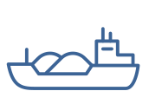
Mode of transport: Inland Waterway
High capacity for bulk transport
Very low transport costs
Low environmental impact
Safety
Frequent transport availability (operational 24/7)
Low infrastructure costs
Freely available infrastructure capacity (e.g., Danube)
Low transport speed
Low network density
Dependence on navigable waterway conditions
Berthing/discharge fees at ports
Almost always requires additional land transport for pre- and onward carriage
Notes:
Above all, rail can score highly in the case of full or direct trains due to its high transport speed. In addition, this mode of transport has a high capacity for bulk goods, and transport operations are predictable. Thanks to standardisation, the level of safety is very high. Unlike road transport, transport costs are not influenced by toll charges and can therefore be relatively low depending on the volume transported. A further advantage is lower CO₂ consumption compared to road transport.
Due to differences in infrastructure, cross-border transport by rail is still difficult. Dependence on timetables reduces the flexibility of transport operations. Shipment tracking is also much more difficult compared to road transport. In addition, unlike air transport, rail transport does not offer any tax advantages.
Sources:
Kille, Christian/ Schmidt , Norbert (2008): Wirtschaftliche Rahmenbedingungen des Güterverkehrs. Studie zum Vergleich der Verkehrsträger im Rahmen des Logistikprozesses in Deutschland, p. 56; Online: http://www.scs.fraunhofer.de/content/dam/scs/de/dokumente/studien/Wirtschaftliche_Rahmenbedingungen_des_Gueterverkehrs.pdf; Retrieved 04.02.2025
Viadonau (2019): Handbuch der Donauschifffahrt, p. 17
Viadonau (2024): Jahresbericht der viadonau 2023

Slide 12
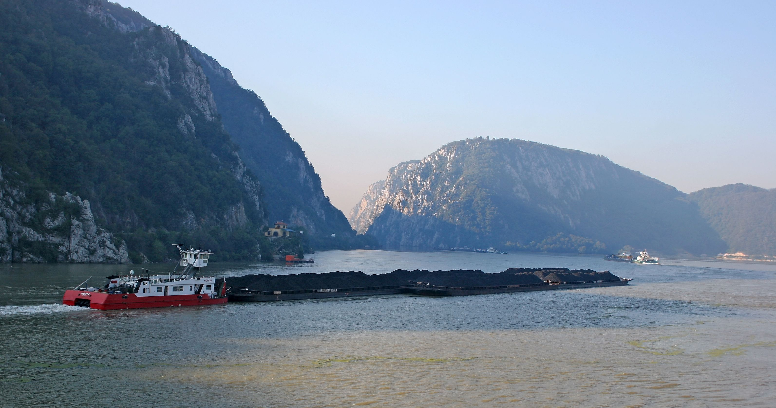
This is what an inland vessel looks like:
Picture: Leitner@TTS, Austria
Notes:
Here you can see a push convoy on the Danube in Serbia/Romania:
It consists of a pusher vessel (a motor ship designed for pushing) and eight coupled barges carrying bulk cargo.
On the Danube in Austria, a vessel can push up to four barges. On the lower Danube in Romania, where the river is very wide, up to twelve barges are possible.
Picture: Leitner@TTS, Austria

Slide 13
Freight transport in Austria and Europe (Modal Split)
Own illustration based on Statistik Austria and Eurostat.
Notes:
Modal split describes the share of transport performance by mode of transport.
Sources:
Statistik Austria (2024): Verkehrsstatistik 2023, In: https://www.statistik.at/fileadmin/publications/Verkehr2023barr.pdf, Retrieved 05.02.2025
Eurostat (2024): Modal split of inland freight transport: https://ec.europa.eu/eurostat/databrowser/view/tran_hv_frmod/default/table?lang=en&category=tran.tran_hv_ms; Retrieved 06.02.2025

Slide 14
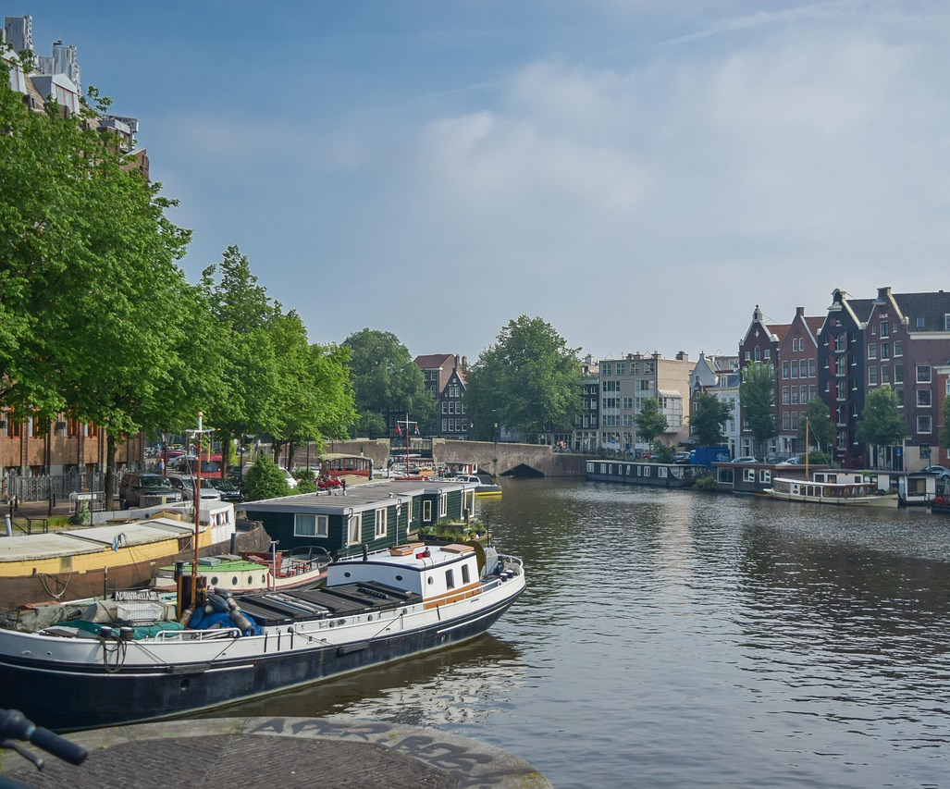
Best practice inland waterway: Netherlands
Own illustration based on Eurostat
  Picture: Pixabay
Notes:
The share of freight tonne-kilometers transported via inland waterways varies greatly among EU countries.
For example:
Netherlands: major seaports and a dense inland waterway network → highest inland shipping share at 41% (2022)
Malta & Cyprus: have no inland waterways, so the share is 0%
Source:
Eurostat (2024): Modal split of inland freight transport: https://ec.europa.eu/eurostat/databrowser/view/tran_hv_frmod/default/table?lang=en&category=tran.tran_hv_ms; Retrieved 06.02.2025
Picture source:
Pixabay (2025): https://pixabay.com/de/photos/amsterdam-kanal-stadt-boot-6619660/; Retrieved 26.02.2025

Slide 15
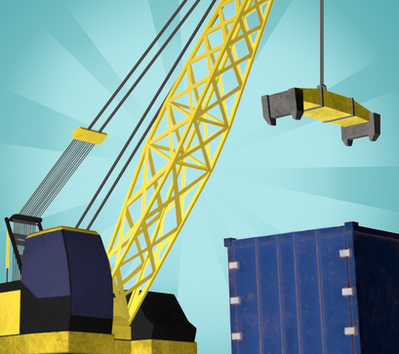
Transport planning with the Logistify App
Game 1 – Means of Transport
Your transport planning talent is needed – we need your help!
We want to transport various goods from A to B in the best possible way. In doing so, we place particular emphasis on choosing the right means of transport (truck, train, or inland ship).
The transport should be planned to be as ecological and economically efficient as possible.
Download the app at:
Logistify: Understanding the World of Logistics
Explanation video: https://www.youtube.com/watch?v=kZhL5SPtn6A
Image: FH OÖ
Notes:
Download App unter: https://logistify.app/
Erklärvideo: https://www.youtube.com/watch?v=kZhL5SPtn6A
More information at: https://rewway.at/en/teaching-materials/transport-planning-with-the-logistify-app
The learning app "Logistify" focuses on various means of transport, their sustainable and efficient use of resources, and logistics-related careers. In the games, students are challenged to use their transport planning skills. The task is to transport various goods efficiently from A to B, to plan multimodal transport chains from raw materials to end customers, and to explore careers in the logistics sector.
Duration: Game 1 takes approximately 15 minutes.
Learning objectives:
Students recognize the importance of different modes of transport in freight logistics.
Students reflect on how resources can be used sustainably and efficiently in transportation.
Students analyze logistical challenges and make well-reasoned decisions in transport planning.
Students playfully engage with digital learning formats to understand logistics concepts.

Slide 16
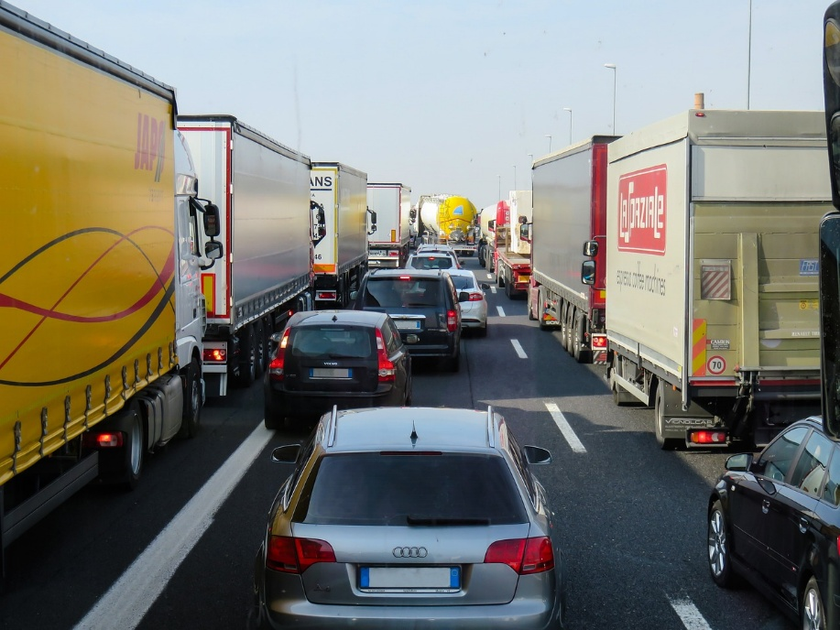
External costs of transport
Costs that are not paid by the polluters – the costs are borne by society, i.e., by all of us!
Pollutant emissions
Noise
Accident costs
Land consumption
Impact on flora and fauna
Congestion costs
40
Picture: Pixabay
Notes:
Costs that arise from mobility but are not borne by those who use transport are referred to as external costs of transport. These costs are passed on to third parties, such as taxpayers and future generations. The negative external effects of transport include, in particular: pollutant emissions, CO₂ emissions, noise emissions, accident-related costs, land use, and impacts on flora and fauna.
External costs have significant effects on society and health (e.g., quality of life, noise pollution, stress, illnesses) as well as on the environment (climate change, biodiversity).
Source:
Koch, Susanne (2012): Logistik – Eine Einführung in Ökonomie und Nachhaltigkeit, pp. 294f
Picture source:
Pixabay (2025): https://pixabay.com/de/photos/verkehr-transport-stau-autobahn-2251530; Retrieved 27.02.2025

Slide 17
External costs of transport – comparison
Traffic Congestion
Climate Costs
Emissions
Noise
Accidents
Cents per tonne - kilometer
Road
Rail (Diesel)
Rail (Electrified)
Inland Waterway
Graphic: Own illustration based on Christidis/Brons
Notes:
Inland waterway vessels and electrified rail cause by far the lowest external costs compared to trucks.
In 2023, approximately 75 percent of all railway infrastructure in Austria was electrified. (cf. Schienen-Control)
In the EU-27, the electrification rate of railway networks in 2023 was 57.4%. (cf. Eurostat 2025)
Sources:
Own illustration based on:
Christidis, P., & Brons, M. (2016): External costs of freight transport in European Union Member States (Joint Research Centre (JRC)). Harvard Dataverse.
https://dataverse.harvard.edu/dataset.xhtml?persistentId=doi:10.7910/DVN/YA3VCY
https://doi.org/10.7910/DVN/YA3VCY; Retrieved 28.01.2025
Eurostat (2025): https://ec.europa.eu/eurostat/statistics-explained/index.php?title=Characteristics_of_the_railway_network_in_Europe; Retrieved 06.03.2025
Schienen-Control (2025): https://www.schienencontrol.gv.at/de/wettbewerbsregulierung/eisenbahnnetz-oesterreich.html; Retrieved 28.01.2025

Slide 18
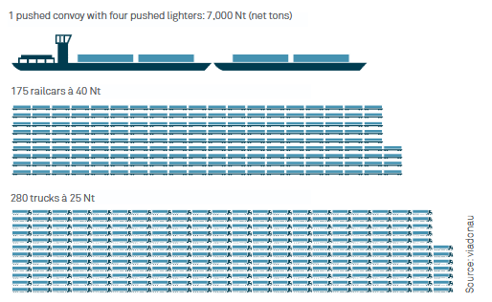
Transport capacity – Comparison of modes of transport
Largest transport capacity of the inland vessel:
Pushed convoy with 4 barges
= 175 rail wagons
= 280 trucks
Graphic: viadonau
Notes:
The inland vessel offers numerous advantages over other modes of transport:
Compared to other land transport modes, inland shipping provides significantly higher transport capacity per transport unit and can (or could) make an important contribution to relieving road and rail traffic.
To illustrate the mass transport capability of inland shipping:
An inland vessel with 4 barges (7,000 net tons) can transport as much as 175 rail wagons or 280 trucks.
This corresponds to a convoy of trucks stretching about 20 km on the highway.
What is a barge?
A floating cargo container without its own propulsion. It is connected to the front of an inland vessel and pushed.
Source: Viadonau (2019): Handbuch der Donauschifffahrt, pp. 18, 19, 112
Picture source: Viadonau (2019): Manual on Danube Navigation, p19

Slide 19
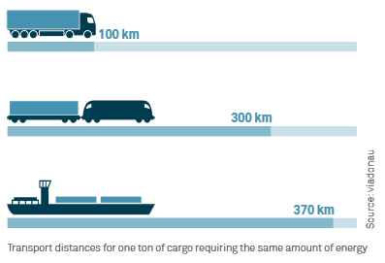
Specific energy consumption – Comparison of modes of transport
An inland vessel can transport one ton of cargo nearly four times farther than a truck using the same amount of energy.
Notes:
In terms of specific energy consumption, inland waterway transport can be considered the most efficient and therefore the most environmentally friendly mode of transport. An inland vessel can transport one ton of cargo nearly four times farther than a truck using the same amount of energy.
Source: Viadonau (2019): Handbuch der Donauschifffahrt , p. 18
Image source: Viadonau (2019): Manual of Danube Navigation, p. 18

Slide 20
Multimodal transport
2

Slide 21


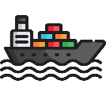





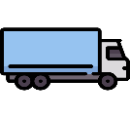
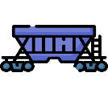
Transport chains
Transport using one mode of transport = unimodal transport
e.g. Road
Multiple modes of transport = multimodal transport
e.g. Transshipment from a truck to an inland vessel
Sender
Receiver
Pre-carriage
Main carriage
On-carriage
Transshipment point
Images: Flaticon
Notes:
A direct or single-stage transport refers to direct delivery from the sender to the receiver.
The term “transport chain” or “multi-stage transport” refers to transport from sender to receiver using different means of transport.
In unimodal transport, the mode of transport does not change.
Examples include truck transport by road or rail transport between two locations with direct rail access. The goods may be reloaded, but only one mode of transport is used.
In multimodal transport, the transport is carried out using more than one mode of transport.
Source:
Muchna, Claus / Brandenburg, Hans / Fottner, Johannes / Gutermuth, Jens (2nd edition 2021): Grundlagen der Logistik. Begriffe, Strukturen und Prozesse, pp. 152–161
Images sources:
Flaticon (2024): https://www.flaticon.com/de/kostenlose-icons/lkw; Truck icons by Freepik – Flaticon, accessed 20.05.2024
Flaticon (2024): https://www.flaticon.com/de/kostenlose-icons/fabrik; Factory icons by Freepik – Flaticon, accessed 03.05.2024
Flaticon (2024): https://www.flaticon.com/de/kostenlose-icons/boxen; Box icons by monkik – Flaticon, accessed 20.05.2024
Flaticon (2024): https://www.flaticon.com/de/kostenlose-icons/guterzug; Freight train icons by Freepik – Flaticon, accessed 20.05.2024
Flaticon (2024): https://www.flaticon.com/de/kostenlose-icons/schiff; Ship icons by Freepik – Flaticon, accessed 29.04.2024

Slide 22
Multimodal transport
Transhipped transport
Transport using at least two modes of transport
The goods themselves are transhipped
Transhipped bulk transport
Traditional general cargo transport
Intermodal transport
Transport using at least two modes of transport
Only the loading unit is transhipped, not the goods themselves
Special form: combined transport
Notes:
Transhipped transport refers to the transport of goods using two or more modes of transport, whereby the goods themselves are transferred.
This represents the key difference from intermodal transport, in which not the goods themselves but only the loading units (including the goods) are transferred. This means that when changing from one mode of transport to another, only the loading unit or the vehicle is reloaded—the goods always remain in the same container (for example, in a container). In this way, costs and time can be saved and the risk of damage minimised.
Combined transport is a special form of intermodal transport in which the main part of the journey is carried out by inland vessel or rail, while the initial and final legs by road are kept as short as possible. Since the main leg of the transport is carried out by rail or inland vessel, combined transport is a very environmentally friendly alternative.
Within transhipped transport, a further distinction is made between transhipped bulk transport and traditional general cargo transport.
In transhipped bulk transport, goods such as piecey, granular, dusty, liquid or gaseous materials are transported in unpackaged form. As bulk goods cannot be handled individually, they are measured in units such as tonnes or litres. Examples include liquid cargoes such as oil, dry bulk such as coal or ore, and suction cargoes such as grain.
In traditional general cargo transport, goods are transported that are individualised and distinguishable. The goods can be handled separately, with quantities expressed as the number of items. Examples include machinery, pallets or heavy goods.
Source:
viadonau (2019): Handbuch der Donauschifffahrt, pp. 187–188

Slide 23


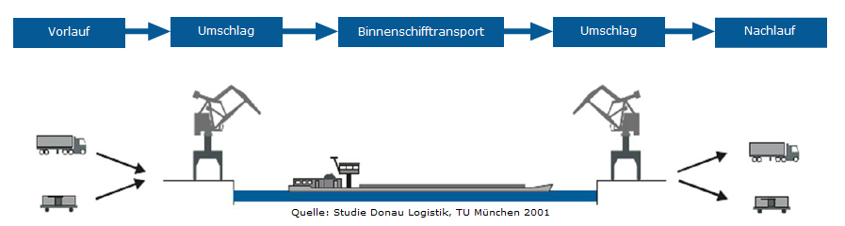


Elements of multimodal transport
Loading of the loading unit
Pre-carriage (first leg of the transport from the sender to the transhipment point; usually by lorry)
Transhipment (transfer of the loading unit/cargo between modes of transport)
Terminals or transhipment facilities are required for this purpose
Main leg
On-carriage (from the receiving transhipment point to the recipient, the so-called “last mile”; usually by lorry)
Unloading of the loading unit
Notes:
In principle, the multimodal transport chain consists of the elements pre-carriage, transhipment, main leg and on-carriage. In some cases, stuffing and stripping – the loading and unloading of the loading unit (e.g. container) – can also be counted among the elements of the multimodal transport chain.
In the pre-carriage, main leg and on-carriage stages, a specific transport route is covered.
The pre-carriage is the first segment of the transport and takes place from the sender to the first (or receiving) transhipment point (hub). Consolidated transport operations can also serve as pre-carriage if multiple consignments from different senders are collected at one transhipment point (hub). The goods are then transported onwards in the main leg – from the sending transhipment point (hub) to the receiving transhipment point (hub). From the receiving transhipment point (hub), the goods are then transported to the recipient. The on-carriage is also often referred to as the “last mile” and is of particular importance in transport operations.
Pre-carriage and on-carriage are predominantly organised by lorry, as access to terminals – and thus to rail and inland waterways – is limited.
To enable a change of mode of transport (modal shift), transhipment of the loading unit (e.g. container) is required. In most cases, terminals or transhipment facilities are needed to carry out this process.
Source:
Posset et al. (2014): Intermodaler Verkehr Europa, pp. 51–55

Slide 24
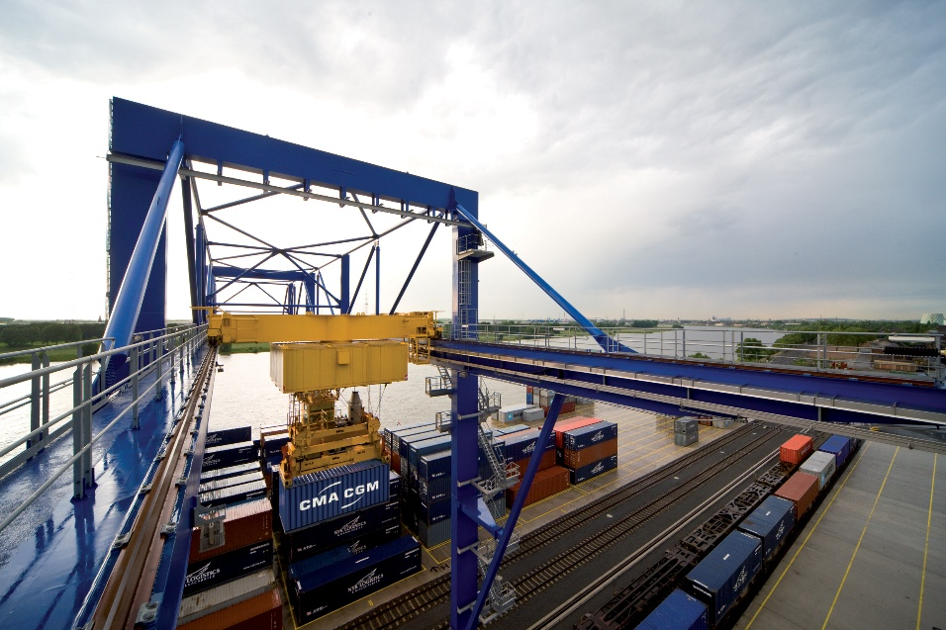
Terminals
= Transshipment facilities
Loading of cargo units (e.g., containers) between different modes of transport
Prerequisite for multimodal transport
Also serve as storage facilities
14 publicly accessible transshipment facilities in Austria
Picture: duisport
Notes:
A terminal is a spatially defined facility for handling, storage, and logistics of a specific type of cargo (e.g., container or heavy cargo terminal).” (viadonau 2019)The loading and unloading of cargo units (e.g., containers) enables the use of different modes of transport. Terminals are a key prerequisite for multimodal transport and also serve as storage facilities. In Austria, there are 14 publicly accessible transshipment terminals.
Sources:
Bundesministerium für Innovation, Mobilität und Infrastruktur (2025): https://www.bmimi.gv.at/themen/mobilitaet/transport/gueterverkehr/kombiverkehr/terminals-rola/oesterreich.html; accessed 14.07.2025
SGKV – Studiengesellschaft für den Kombinierten Verkehr (2025): https://www.intermodal-info.com/terminals-im-kv/; accessed 18.03.2025
Viadonau (2019): Handbuch der Donauschifffahrt
Image source:
Duisport / Frank Reinhold: Container handling – logport II Gateway West, Duisburg

Slide 25
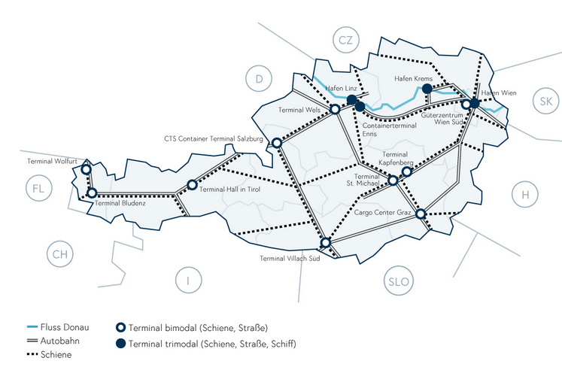
Terminals in Austria
Danube River
Bimodal terminal (rail, road)
Motorway
Trimodal terminal (rail, road, inland waterway)
Rail
Image: BMIMI
Notes:
Image source:
Bundesministerium für Innovation, Mobilität und Infrastruktur (2025): https://www.bmimi.gv.at/themen/mobilitaet/transport/gueterverkehr/kombiverkehr/terminals-rola/oesterreich.html; Accessed on 14.07.2025

Slide 26
Actors in multimodal transport
Sender – person who hands over the goods into the custody of others
Recipient – person authorised to take delivery of the goods
Freight forwarder – organises the transport of goods as an intermediary
Carrier – responsible for transport; physically provides the means of transport
Terminal (operator) – acts as the central transhipment point
Shipping companies – shipping enterprises that commercially organise and carry out transport operations
40
Notes:
In multimodal transport, numerous people and actors may be involved; the following actors are among the key components of a multimodal transport chain, although depending on the specific transport, additional actors may also be involved in the process.
The sender, also referred to as the consignor or shipper, is the person who hands over the goods to be transported to the other actors, for example the manufacturer of the goods, so that they can be delivered to the recipient. The sender may also carry out the transport using their own means of transport.
The recipient is the person who is authorised to take delivery of the goods at the destination.
A freight forwarder organises the transport of goods on behalf of the sender and/or provides related services.
The carrier is responsible for the transport of the goods and either carries it out itself or has it carried out by others. Unlike the freight forwarder, who only organises the transport and engages a carrier to carry it out, the carrier physically provides the means of transport.
At the terminal, suitable facilities are ideally available for the most efficient possible transhipment of goods; these are operated by the terminal operator. (Further information on the various transhipment facilities can be found in the slide set “Ports”.)
Shipping companies are maritime transport enterprises that are commercially organised and professionally arrange and carry out transport operations. Both owned and chartered vessels are used; a characteristic feature of shipping companies is that they prepare and monitor transport operations on land.
Source:
Gronalt, M. / Höfler, L. / Humpl, D. / Käfer, A. / Pehersdorfer, H. / Posset, M. / Prifti, H. / Starkl, F. (2010): Handbuch Intermodaler Verkehr, p. 36ff.

Slide 27
Transport planning with the Logistify App
Game 2 – Transport Chains
Plan the appropriate transport based on the means of transport, production facilities, and plants shown on the cards.
To ensure the transport runs as smoothly as possible, you must choose the suitable means of transport, especially those that offer advantages over long distances.
Download the app at: Logistify: Understanding the World of Logistics
Explanation video: https://www.youtube.com/watch?v=kZhL5SPtn6A
Image: FH OÖ
Notes:
Download App unter: https://logistify.app/
Erklärvideo: https://www.youtube.com/watch?v=kZhL5SPtn6A
More information at: https://rewway.at/en/teaching-materials/transport-planning-with-the-logistify-app
The educational app "Logistify" focuses on different means of transport, their careful and efficient use of resources, and career profiles in the logistics sector. In the games, students are challenged to apply their transport planning skills.
Tasks include efficiently transporting various goods from A to B, planning multimodal transport chains from raw material to end customer, and exploring logistics professions.
For Game 2, printed cards with transport modes, production facilities, and transshipment points are required!
Duration: Game 2 takes up to 30 minutes, depending on the number of transport examples.
Learning objectives:
Students plan simple multimodal transport chains considering efficiency and sustainability.
Students develop a basic understanding of the complexity of modern supply chains.
Students use digital learning tools in a playful way to grasp logistical relationships.

Slide 28
Advantages of multimodal transport
Make use of the specific advantages of individual modes of transport
Minimise the disadvantages of the modes of transport
Environmental aspects and energy efficiency
Cost-effective when…
  transhipment is organised efficiently
  pre-carriage and on-carriage are cost-effective
  consolidation in the main leg is possible
Mode of transport | Strengths | Weaknesses
Road | High network density Fast over short transport distances | Low transport volumes High external costs
Rail | Low environmental impact (CO₂, pollutants, noise) Cost-effective and fast over medium transport distances | Lower network density than road
Inland waterways | Low environmental impact (CO₂, pollutants, noise) Low transport costs and minimal negative effects at high volumes | Longer transport times Low network density
Notes:
By combining different modes of transport, the specific advantages of each can be utilised while their disadvantages are minimised.
Due to the high network density and speed over short transport distances, road transport is particularly suitable for the pre-carriage and on-carriage stages of multimodal transport. Owing to their low environmental impact and comparatively low transport costs over medium to long distances and for high volumes, rail and inland waterways are well suited for the main leg in multimodal transport. By consolidating shipments, the required transport volumes can be achieved, making transport by these modes economically viable.
Multimodal transport can be more advantageous than unimodal transport for a variety of reasons. For example, many transport operations cannot be carried out unimodally for geographical reasons, or there may be insufficient lorry capacity available. In practice, however, the most important factor in choosing a specific transport option is usually economic considerations—namely, which transport alternative is the most cost-effective. Organising a multimodal transport operation is more complex due to the many actors involved and the necessary transhipment processes, and it therefore requires a higher level of planning effort. Ensuring economic efficiency compared to a lorry transport is often challenging and is typically only achieved for longer transport distances. Over short distances, multimodal transport is therefore usually not competitive.
For an economically viable organisation of multimodal transport, the following factors are essential:
efficient organisation of transhipment processes
cost reduction in pre-carriage and on-carriage
consolidation in the main leg to offset additional costs
Source:
Posset et al. (2014): Intermodaler Verkehr Europa, p. 48

Slide 29
Modal shift in freight transport
EU target by 2050: Reduction of greenhouse gas emissions in the transport sector by 90%
EU target for freight transport:
Increase in inland waterway and short-sea shipping by 25% by 2030, and by 50% by 2050
Increase in rail freight transport by 50% by 2030, and doubling by 2050
Advantages of inland waterway transport:
Sustainable mode of transport
Waterways offer sufficient free capacity
Notes:
The European Union has set itself the goal of becoming the first climate-neutral continent by 2050 and reducing greenhouse gas emissions in the transport sector by 90%.
To achieve this, the European Commission’s Strategy for Sustainable and Smart Mobility outlines, among other measures, a modal shift toward more sustainable modes of transport.
The target for shipping includes a 25% increase in inland waterway and short-sea shipping by 2030, and a 50% increase by 2050.
Rail freight transport is to increase by 50% by 2030 and double by 2050.
Source:
European Commission (2025): https://commission.europa.eu/strategy-and-policy/priorities-2019-2024/european-green-deal_de; accessed 05.02.2025
European Commission (2023): Sustainable & Smart Mobility Strategy, at: https://transport.ec.europa.eu/transport-themes/mobility-strategy_en; accessed 05.02.2025; p.10

Slide 30
Promotion of multimodal transport
Further development of Europe’s transport network
Liberalisation of rail freight transport
Increase capacity and avoid bottlenecks (rail and inland waterways)
Technical improvements and standards for loading units
EU directive on the liberalisation of pre-carriage and on-carriage
Increased attractiveness of multimodal transport through:
facilitation of cross-border transport
tax advantages (e.g. reduced vehicle tax)
financial support measures
other advantages: exemption from weekend and public holiday driving bans, etc.…
40
Notes:
Through further development of the transport network in Europe—particularly of environmentally friendly modes such as rail and inland waterways—a shift of transport towards these modes is to be encouraged. In addition, increasing liberalisation of rail freight transport enables more competitive pricing in rail transport. To promote greater use of rail and inland waterways, capacities must be increased in order to make consolidation more attractive and to avoid congestion.
Technical improvements that support optimal transport planning and enhance the performance of transport modes can also encourage the use of multimodal transport. Appropriate standards must be established for loading units so that they can be transported across the diverse modes of transport and transhipment can be carried out efficiently.
The use of combined transport is supported by transport policy through numerous measures. These aim to ensure a shift towards environmentally friendly modes of transport, such as from lorry to ship or rail. In addition to various financial support schemes available at both national and international level, these measures also include fiscal and regulatory policies, such as exemptions from night-time driving bans or weekend and public holiday restrictions.
A further important step towards increasing the use of combined transport has been taken by the European Union through the adoption of a directive establishing common rules for certain types of transport in combined goods transport between Member States. The aim of this directive is to liberalise pre-carriage and on-carriage in combined transport and thereby increase its attractiveness. Key aspects include facilitating cross-border transport. In addition, tax relief measures are also предусмотрed.
Sources:
viadonau (2019): Handbuch der Donauschifffahrt, pp. 188–191
Institute for Transport Studies, University of Leeds, United Kingdom (2010): The future of sustainability in freight transport and logistics, pp. 22–23; online: https://www.europarl.europa.eu/RegData/etudes/IDAN/2010/431578/IPOL-TRAN_NT(2010)431578_DE.pdf; accessed 28 April 2026

Slide 31
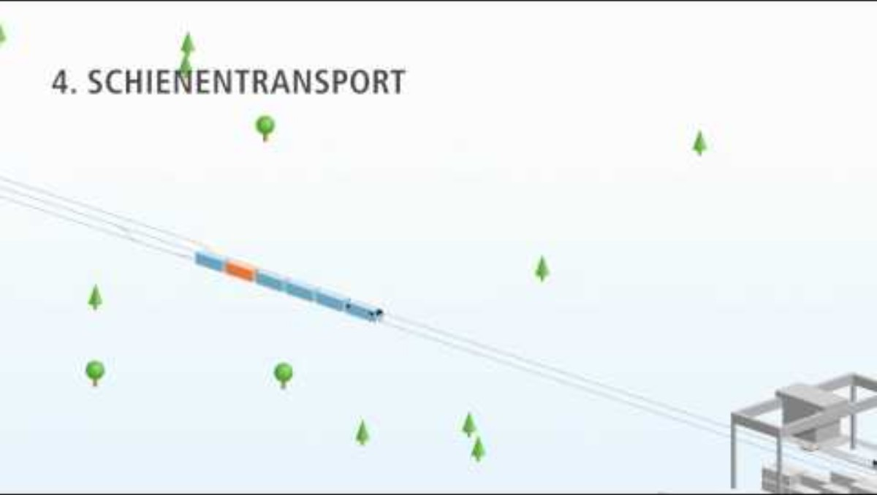
Video “Intermodal transport chain”
Discussion questions on the video:
What is meant by “intermodal transport”?
The video divides an example intermodal transport chain into seven steps. What are these steps called and what tasks do they include?
What are the main reasons for the economic efficiency and environmental sustainability of an intermodal transport chain?
https://youtu.be/aUJGdZbdn3k?si=iSCS81U93fgemFx4
Notes:
Here you will find a brief outline of answers for discussion with learners:
What is meant by “intermodal transport”?
In intermodal transport, multiple modes of transport (e.g. road, rail, inland waterways, deep-sea shipping) are combined. This can be due to economic reasons (lower transport costs), environmental considerations (main leg on an environmentally friendly mode of transport), as well as safety-related reasons (use of a safe mode of transport such as rail). During the entire transport process, the goods remain in the same loading unit without being reloaded.
The video divides an example intermodal transport chain into seven steps. What are these steps called and what tasks do they include?
1. Transport order
2. Road pre-carriage
3. Dispatch handling at the terminal
4. Rail transport
5. Arrival handling at the terminal
6. Road on-carriage
7. Delivery
At the beginning of each transport chain there is a transport order. This is often received by a freight forwarder, who selects the transport route and the modes of transport used in coordination with the client (e.g. industrial or trading company), also referred to as the consignor. Road pre-carriage begins with the collection of goods from the sender. Using a semi-trailer, swap body or container, the goods are transported to a rail freight terminal, where the loading unit is transhipped onto rail. Several consignments are then consolidated and transported efficiently by rail. The main leg of the transport chain ends with arrival handling at the terminal. The loading unit transported by rail is transferred onto a lorry for collection. Road on-carriage refers to the transport of the consignment by road directly to the recipient. With the delivery of the goods to the recipient, the transport order is completed, which in continental intermodal transport is carried out by rail and road.
What are the main reasons for the economic efficiency and environmental sustainability of an intermodal transport chain?
The economic efficiency and environmental sustainability of an intermodal transport chain primarily result from the high level of consolidation over long distances (main leg), for example by rail or by inland or deep-sea vessel.

Slide 32
Inland vessel as part of the transport chain
3

Slide 33
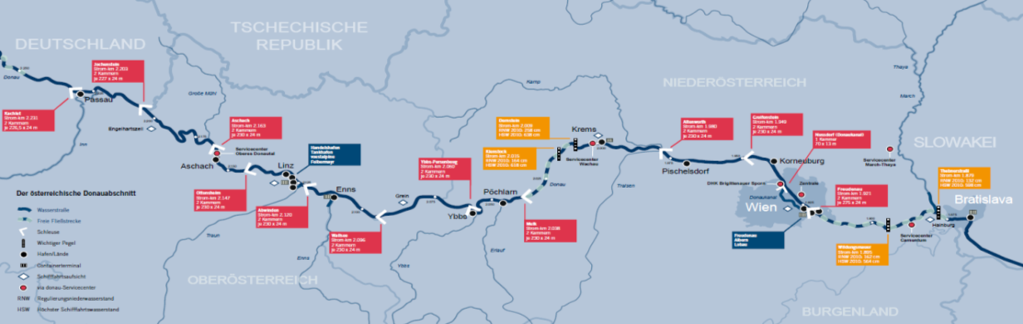
Importance of Danube navigation in Austria
In the Danube corridor: 12% share of the Austrian modal split
Transport of 2.177 million tonnes of goods per year on the Austrian section of the Danube
The Danube is the second-longest river in Europe, with a length of 2,845 km
It connects 10 countries and serves as an important waterway for freight transport
Austrian section of the Danube: approx. 351 km
Austrian section of the Danube
Source: viadonau
Notes:
In Austria, 2.177 million tonnes of goods are transported annually. Extrapolated, the share of the Danube waterway in the modal split within the Austrian Danube corridor is therefore around 12%. The Danube plays a particularly important role in upstream transport, especially in imports across the eastern border and in transit; in these areas, the Danube performs roughly on a par with rail. Across Austria as a whole, the Danube accounts for a modal split share of around 3.5%.
The Danube is 2,845 km long and the second-longest river in Europe. It connects a total of ten countries and serves as an important waterway for freight transport by inland vessels. The Austrian section of the Danube is approximately 351 km long and lies at the centre of the Rhine–Main–Danube waterway axis, which connects the North Sea and the Black Sea. In Austria, apart from the Danube, there are no other relevant waterways for goods transport.
Sources:
Dalziel, A. (2013): Whitepaper Logistik im Jahr 2020. Bad Homburg: Kewill
viadonau (2019): Handbuch der Donauschifffahrt, pp. 22, 41

Slide 34




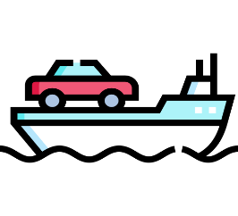
Freight transport on inland waterways
Bulk Goods
Ores, coal, steel, agricultural products
Main type of goods transported on the Danube
Hazardous Goods
e.g. flammable liquid goods such as gasoline, heating oil, chemicals, liquefied gases
Containers
Growing market segment
Heavy Goods
Heavy or bulky cargo
RoRo Ships
(eng. Roll on/Roll off)
Images: Flaticon
Notes:
Inland waterway transport is primarily dominated by bulk goods. These include, for example, agricultural products, ores, coal, and steel. Inland shipping is particularly important for the steel industry in Austria (voestalpine, headquartered in Linz on the Danube).
A key function of inland waterway transport is the transportation of hazardous goods, which includes flammable liquid goods such as gasoline and heating oil, basic chemicals like methanol, finished products such as acids, and liquefied gases like ammonia. It also includes dry hazardous goods transported in bulk. Safety norms and standards are essential for this type of transport.
The transport of containers by inland vessels has more than doubled in recent years. A large portion of container and hinterland transport is handled on the Rhine and via the ZARA ports (Zeebrugge, Antwerp, Rotterdam, Amsterdam).
Due to their dimensions, inland vessels are particularly well suited for transporting heavy or bulky cargo. These ships can withstand point loads of over 40 tons per square meter or individual item weights of up to 1,000 tons. Transporting heavy goods by water offers clear advantages: infrastructure is not damaged, and obstacles like streetlights or trees do not need to be removed in advance, as would be the case with truck transport. Increasingly, turbines or rotor blades for wind turbines are transported via waterways. The rising number of heavy cargo shipments on inland vessels in recent years confirms this trend.
RoRo ships are specialized vessels designed to transport movable goods, where the cargo is driven onto the ship (roll-on/roll-off). This typically involves a combination of vehicles such as cars or trucks, or trains that can drive onboard themselves, as well as cargo units that are rolled on using tractors. RoRo ships have drivable decks and usually adjustable deck heights to make more flexible use of cargo space. RoRo ships are especially important for the automotive industry.
Sources:
BDB (2025): https://www.binnenschiff.de/system-wasserstrasse/gueterschifffahrt/ (Accessed 18.03.2025)
Viadonau (2019): Handbuch der Donauschifffahrt, pp. 161 ff.
Images sources:
https://www.flaticon.com/de/kostenlose-icons/mehl; Flour icons by Freepik – Flaticon; accessed 07.02.2025
https://www.flaticon.com/de/kostenlose-icons/gefahrgut; Hazardous goods icons by surang – Flaticon; accessed 19.04.2024
https://www.flaticon.com/de/kostenlose-icons/container; Container icons by Freepik – Flaticon; accessed 07.02.2025
https://www.flaticon.com/de/kostenlose-icons/metall; Metal icons by surang – Flaticon; accessed 07.02.2025
https://www.flaticon.com/free-icons/ferry-boat; Ferry boat icons by Freepik – Flaticon; accessed 19.04.2024

Slide 35
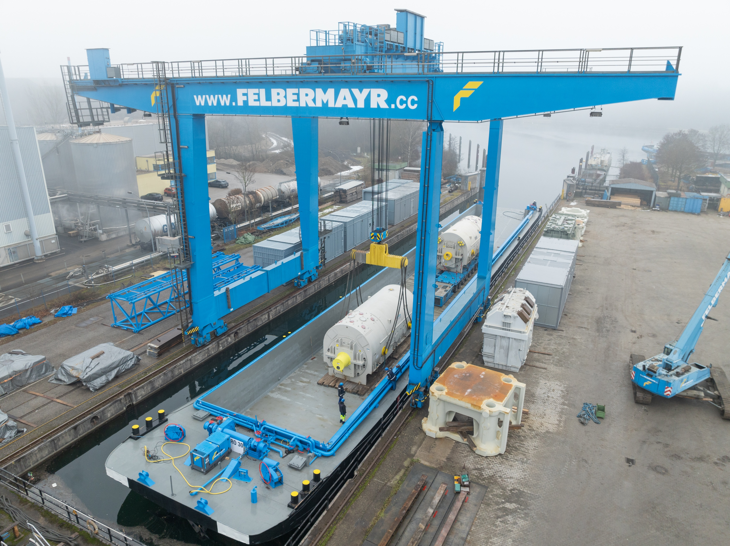
High & Heavy transport on inland waterways
enormous loading capacity
operational 24/7
no infrastructure costs
no permits, escorts, or road closures required
environmentally friendly
40
Picture: Felbermayr
Notes:
When it comes to transporting especially large and heavy goods—so-called High & Heavy transports—inland shipping offers a number of advantages that other modes of transport can hardly match.
Enormous loading capacity: Ideal for machines, components, or industrial plants that are too large for trucks or trains.
Operational 24/7: Unlike road transport, which is often restricted by driving bans or rest periods, a ship can operate around the clock—without breaks, without traffic jams.
No infrastructure costs: Roads don’t need reinforcement, and bridges don’t need adjustment. Waterways already exist and can be used without additional construction costs.
No permits or escort vehicles required: While heavy road transports often require lengthy approval processes and police escorts, a ship can usually carry such goods as regular cargo—without permits or road closures.
Environmentally friendly: Transport by ship generates significantly less CO₂ than trucks or airplanes. Especially over long distances and with heavy loads, this is a major sustainability advantage.
Source:
Viadonau (2025): https://www.viadonau.org/wirtschaft/donaulogistik/high-heavy-transporte; Retrieved 10.07.2025
Picture: Felbermayr

Slide 36
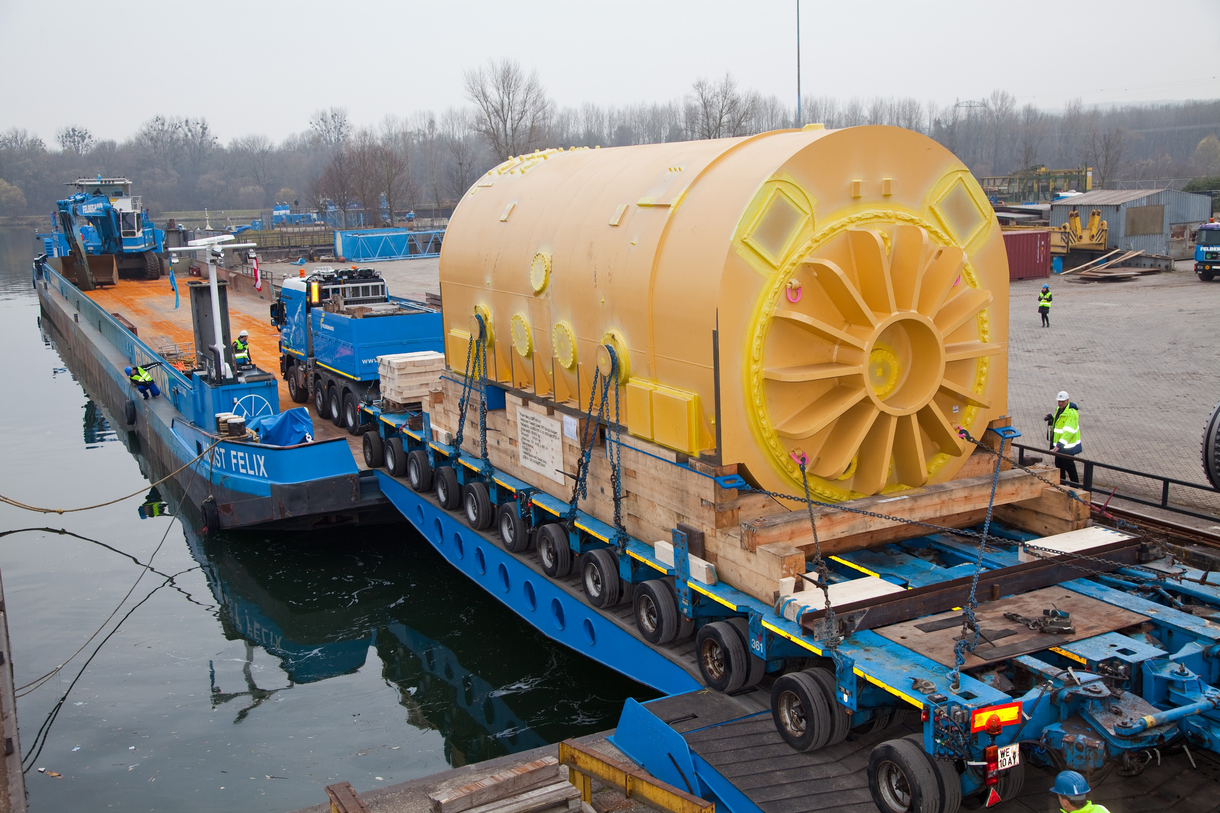
High & Heavy transport
Picture: Felbermayr
Notes:
Picture: Felbermayr

Slide 37
Think-Pair-Share: Inland waterway transport – an underrated climate protector?
First, think on your own (think – 5 min): What are the advantages of multimodal transport when linking trucks and inland waterway vessels? What measures could be taken to create more incentives for this? What are the concrete economic benefits for freight carriers or trucking companies?
Share your thoughts (pair – 5 min) with your seatmates.
Prepare your answer for a presentation to the class (share – 3 min).
Notes:
Think-Pair-Share: Individually (Think), in pairs or small groups (Pair), then present discussion results to the class (Share)
Duration: approx. 15–20 minutes
Social structure: Individual work → partner or small group work → class discussion
Possible arguments (to support or inspire):
Low primary energy demand: Inland waterway vessels consume significantly less energy per ton transported compared to trucks or trains.
Lowest external costs: Less air pollution, noise, CO₂ emissions, and infrastructure wear.
Few accidents: Very high safety compared to road and rail transport.
Large transport volumes possible: One ship can replace many trucks.
Use of existing natural infrastructure: Rivers and canals already exist.
Cost-effective in the long term: Especially for bulk goods and long distances.
Learning objectives:
Students analyze the ecological and economic advantages of inland waterway transport compared to other transport modes.
Students argue factually and with reasoning for or against greater use of waterways for freight transport.
Students reflect on the political and societal conditions that influence the use of inland navigation.
Students present their results clearly and structured to the class and engage with other perspectives.

Slide 38
Ecological challenges in inland navigation
High water and low water levels:
Increase in extreme water levels due to climate change
Low water levels lead to restrictions and reduced transport volumes in freight transport
Possible solutions: vessels with a lower draught to enable transport even at low water levels

Slide 39
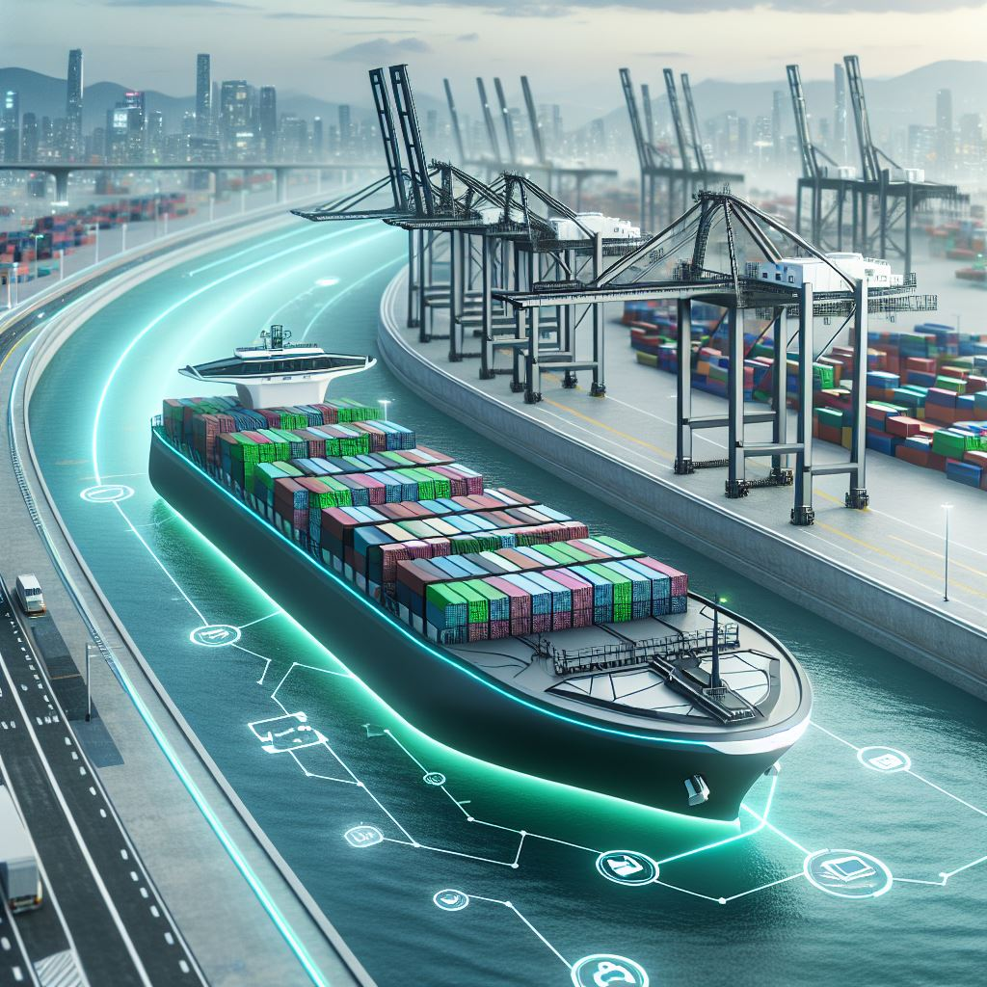
Development trends in inland waterway shipping
Modernization of ships and ports ("retrofitting")
Digitalisation
Automation
Use of sustainable resources
Low-water vessels
Waterway interconnectivity
Opening up new markets
40
Image: AI generated (MS Copilot)
Notes:
Measures to Further Promote the Sustainability and Usability of Inland Waterway Shipping:
Retrofitting refers to the process of equipping existing ships with modern technology to maintain their competitiveness, save fuel, and become more environmentally friendly. One example is the conversion of the “MSC Flaminia” by the shipping company NSB after a fire. By installing a new bulbous bow and propeller, fuel consumption was reduced by up to twelve percent. Retrofitting also demonstrates that older vessels can compete with new ones in terms of design and efficiency.
Digitalisation: By using modern technologies such as automated systems, telematics, and data analysis, efficiency gains and emission reductions can be achieved. The digital networking of ships and ports allows for optimized route planning, improved cargo tracking, and more efficient use of resources like fuel. Digitalisation contributes to increased efficiency, cost reduction, and environmental relief in inland shipping.
Waterway interconnectivity supports the increased usability of inland navigation by improving waterway infrastructure and creating efficient connections between various bodies of water. The goal is to facilitate the transport of goods by inland vessels while minimizing environmental impact. This is achieved through optimizing waterways, expanding locks, and eliminating bottlenecks, resulting in shorter transport times, reduced energy consumption, and lower CO₂ emissions.
The use of eco-friendly fuels and the switch to alternative propulsion systems such as electric mobility or hydrogen propulsion also contribute to sustainable inland shipping.
Opening up new markets and market segments (e.g., container transport) can increase the share of inland waterway transport in the overall traffic volume.
Sources:
Bundesanstalt für Wasserbau (2017): Kolloquium Wasserbauliche Herausforderungen an den Binnenschifffahrtsstraßen, https://izw.baw.de/publikationen/kolloquien/0/02_Kempmann-Kriedel_Rusche-Pauli-Georges_Herausforderungen....pdf; retrieved 18.03.2025
Verband deutscher Reeder (2016): https://www.reederverband.de/sites/default/files/publikationen/deutsche_seeschifffahrt/deutsche_seeschifffahrt_2016_-_umweltspecial.pdf; retrieved 18.03.2025
Heinzelmann, Christoph / Bödefeld, Jörg / Duric, Zorana (2020): Digitalisierung im Verkehrswasserbau. Bautechnik, 97; In: https://doi.org/10.1002/bate.202000029 ; pp. 441-444
Image source:
Generated using AI (Microsoft Copilot) on 12.06.2025, Prompt: "Create an image of a futuristic cargo ship (loaded with containers) that reflects visions and development trends in inland waterway shipping – with a focus on modern technologies, sustainability, and autonomous navigation. Urban port environment along a river."

Slide 40
Expert group discussion on the Danube
Research one of the topics in a group using the internet and present your findings to the class:
What role does freight transport on waterways play in the global economy?
What advantages does freight transport on waterways offer compared to other modes of transport?
What well-known European waterways exist besides the Danube, and how are they connected?
What current problems does Danube shipping face?
The future of the Danube: How could the waterway be made more sustainable?
Notes:
Expert Group Discussion on the Danube – Focus on Waterways
Duration: 30–40 minutes (10 min research phase, 10–15 min group presentations, 10–15 min concluding class discussion)
Students work in groups. Each group is assigned a topic:
What role does freight transport on waterways play in the global economy?
What advantages does freight transport on waterways offer compared to other modes of transport?
What well-known European waterways exist besides the Danube, and how are they connected?
What current challenges does Danube shipping face?
The future of the Danube: How could the waterway be made more sustainable?
Procedure:
Each group researches their topic for 10 minutes online; consulting AI tools (e.g., ChatGPT) is allowed.
Then, each group presents their topic in 2–3 sentences.
Final step: A joint discussion on the importance of waterways and the Danube.
Learning Objectives:
Students discuss the significance of waterways in the context of sustainable mobility and the global economy.
Students reflect on how infrastructure, the environment, and trade are interconnected.
Students strengthen their teamwork, media literacy, and argumentation skills.

Slide 41
Thank you for your attention!

Slide 42
Additional information for teachers
This teaching material package is available under a so-called Creative Commons Attribution 4.0 International License.
You may therefore freely integrate these teaching materials into your lessons, adapt them to your needs, and share them with your students or other individuals.
We only ask that you leave the logos on the slides.
The image rights are specified in the notes fields; usage in other settings is not permitted.
Explanation of the Use of Generative AI and AI-Supported Technologies:
During the development of this project, the authors used ChatGPT and Microsoft CoPilot to support concept creation and idea generation—especially for interactive exercises. The use of these AI tools was done with careful consideration. Afterwards, the content was thoroughly reviewed and, if necessary, revised by the authors to ensure compliance with academic standards.The authors bear full responsibility for the final published content.

Slide 43
Additional information for teachers
For questions and feedback, feel free to contact us via email at:
rewway@fh-steyr.at.
You can find additional slide sets and practical exercises at:
http://www.rewway.at/en/teaching-materials/
Are you perhaps interested in a Transport School Lab, an excursion, or a guest lecture?
http://www.rewway.at/en/pages/workshops

Slide 44
References I
BDB (2025): https://www.binnenschiff.de/system-wasserstrasse/gueterschifffahrt/; Accessed on: 18.03.2025
Bundesanstalt für Wasserbau (2017): Kolloquium Wasserbauliche Herausforderungen an den Binnenschifffahrtsstraßen, https://izw.baw.de/publikationen/kolloquien/0/02_Kempmann-Kriedel_Rusche-Pauli-Georges_Herausforderungen....pdf; Accessed on: 18.03.2025
Bundesministerium für Innovation, Mobilität und Infrastruktur (2025): https://www.bmimi.gv.at/themen/mobilitaet/transport/gueterverkehr/kombiverkehr/terminals-rola/oesterreich.html; Accessed on: 14.07.2025
Christidis, P., & Brons, M. (2016): External costs of freight transport in European Union Member States (Joint Research Centre (JRC)). Harvard Dataverse. https://dataverse.harvard.edu/dataset.xhtml?persistentId=doi:10.7910/DVN/YA3VCY https://doi.org/10.7910/DVN/YA3VCY; Accessed on: 28.01.2025
Dalziel, A. (2013). Whitepaper Logistik im Jahr 2020. Bod Homburg: Kewill.
European Commission (2025): https://commission.europa.eu/strategy-and-policy/priorities-2019-2024/european-green-deal_de; Accessed on: 05.02.2025
European Commission (2023): Sustainable & Smart Mobility Strategy, In: https://transport.ec.europa.eu/transport-themes/mobility-strategy_en; Accessed on: 05.02.2025; p.10
Eurostat (2024): Modal split of inland freight transport: https://ec.europa.eu/eurostat/databrowser/view/tran_hv_frmod/default/table?lang=en&category=tran.tran_hv_ms; Accessed on: 28.04.2026
40

Slide 45
References II
Eurostat (2025): https://ec.europa.eu/eurostat/statistics-explained/index.php?title=Glossary:Transport_mode/de; Accessed on: 27.02.2025
Eurostat (2025): https://ec.europa.eu/eurostat/statistics-explained/index.php?title=Characteristics_of_the_railway_network_in_Europe; Accessed on: 06.03.2025
Gronalt, M. / Höfler, L. / Humpl, D. / Käfer, A. / Pehersdorfer, H. / Posset, M. / Pfripfl, H. / Starkl, F. (2010): Handbuch Intermodaler Verkehr
Heinzelmann, Christoph / Bödefeld, Jörg / Duric, Zorana (2020): Digitalisierung im Verkehrswasserbau. Bautechnik, 97; In: https://doi.org/10.1002/bate.202000029; pp. 441-444
Institute for Transport Studies, Universität Leeds, Vereinigtes Königreich (2010): Die Zukunft der Nachhaltigkeit in Güterverkehr und Logistik; pp. 22-23; Online: https://www.europarl.europa.eu/RegData/etudes/IDAN/2010/431578/IPOL-TRAN_NT(2010)431578_DE.pdf; Accessed on: 28.04.2026
Kille, Christian/ Schmidt, Norbert (2008): Wirtschaftliche Rahmenbedingungen des Güterverkehrs. Studie zum Vergleich der Verkehrsträger im Rahmen des Logistikprozesses in Deutschland, p.53; Online: http://www.scs.fraunhofer.de/content/dam/scs/de/dokumente/studien/Wirtschaftliche_Rahmenbedingungen_des_Gueterverkehrs.pdf; Accessed on: 04.02.2025
Koch, Susanne (2012): Logistik – Eine Einführung in Ökonomie und Nachhaltigkeit
Muchna, Claus / Brandenburg, Hans/ Fottner, Johannes/ Gutermuth, Jens (2nd edition 2021): Grundlagen der Logistik. Begriffe, Strukturen und Prozesse
ÖBB (2026): https://infrastruktur.oebb.at/de/unternehmen/kundinnen-im-mittelpunkt/schwerpunkt-puenktlichkeit; Accessed on: 30.04.2026
40

Slide 46
References III
Posset et al. (2014): Intermodaler Verkehr Europa
Schienen-Control (2025): https://www.schienencontrol.gv.at/de/wettbewerbsregulierung/eisenbahnnetz-oesterreich.html, Accessed on: 28.01.2025
SGKV – Studiengesellschaft für den Kombinierten Verkehr (2025): https://www.intermodal-info.com/terminals-im-kv/; Accessed on: 18.03.2025
Verband deutscher Reeder (2016): https://www.reederverband.de/sites/default/files/publikationen/deutsche_seeschifffahrt/deutsche_seeschifffahrt_2016_-_umweltspecial.pdf; Accessed on: 18.03.2025
Viadonau (2019): Handbuch der Donauschifffahrt
Viadonau (2024): Jahresbericht der viadonau 2023
Viadonau (2025): https://www.viadonau.org/wirtschaft/donaulogistik/high-heavy-transporte; Accessed on: 10.07.2025
40

