Slide 1
Logistics – digitalisation, technologies and trends
Teaching materials

Slide 2
How to get the best out of this teaching material
PowerPoint: The following PowerPoint provides an introduction to trend and digitalization in the logistics sector. For each slide, you will find speaking notes, explanations and source references in the notes section. Activity slides are highlighted in yellow and include practical examples, exercises, videos and other interactive elements that have been specifically prepared for use in teaching.
Videos and supplementary exercises: Videos and exercises on the topic can be found both within the presentation on the colour-highlighted activity slides and at: https://www.rewway.at/de/lehrmittel/. All teaching materials include a compact overview to support lesson planning: learning objectives, target groups, level of difficulty, methods and links to the curriculum.
List of sources: The sources used for the presentation are available both in the notes section of the individual slides and at the end of the PowerPoint.

Slide 3
Learning objectives and target groups
Learning objectives:
Students can explain the role of digitalisation, IoT and artificial intelligence in logistics processes, analyse specific application examples and evaluate their benefits.
Learners can identify both the opportunities and the challenges and risks of artificial intelligence in the field of logistics.
Learners are familiar with different types of autonomous means of transport (e.g. lorries, drones, ships) and how they function.
Learners recognise the importance of sustainable technologies for the future of logistics.
Learners can describe and compare different alternative drive systems (e.g. e-mobility, hydrogen).
Target groups:
Upper secondary students (AHS) and (BHS)
Vocational school students

Slide 4
Imagine ordering a pair of trainers today – and having them delivered to your door early tomorrow morning.
Or a parcel is no longer delivered by a person, but by a drone.
Sounds like the future?
In logistics, this is already part of everyday life.

Slide 5
Brainstorming: trends in logistics
Which important trends in logistics are you familiar with?
What role do modern technologies such as drones and self-driving vehicles play in the logistics industry, and how could they influence the supply chains of the future?
Do you think that sustainability can play an important role in automated logistics solutions – and if so, how exactly?
Notes:
Brainstorming in a classroom setting as an interactive introduction to the topic. Specific trends and innovations in the logistics sector are presented in the following slides.

Slide 6
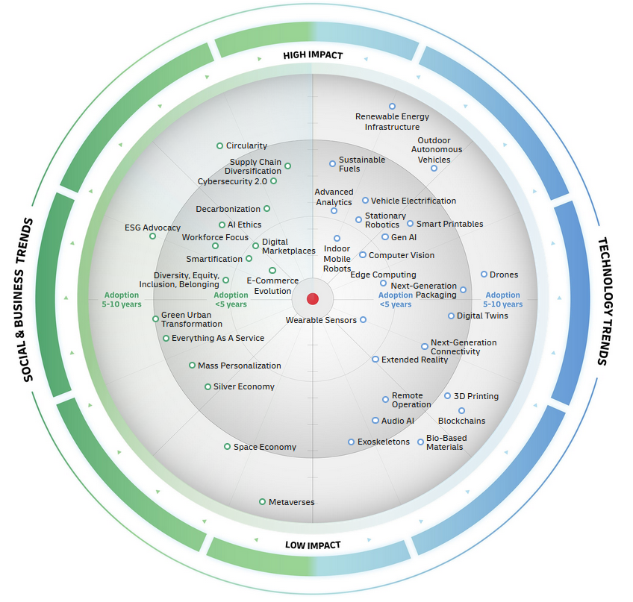
DHL trend radar
Sustainability, digitalisation and automation as key drivers
also societal development
Image: DHL Group
Notes:
DHL logistics trend radar is a visual overview of current and future trends that influence the logistics sector.
An interactive version is available at: https://www.dhl.com/de-en/home/innovation-in-logistics/logistics-trend-radar.html
The radar is divided into two main areas:
Technology trends (blue) on the right-hand side
Social and business trends (green) on the left-hand side
…as well as two axes:
Horizontal axis: time until widespread adoption of the trend (from ‘now’ to ‘in 10 years’)
Vertical axis: assessment of impact – from low to high
Examples of trends with high impact:
Development of e-commerce (new delivery models, increasing customer expectations, e.g. same-day delivery)
Artificial intelligence and advanced data analytics (automated decisions, forecasts, process optimisation)
Renewable energy infrastructure (power supply for warehouses, vehicles and facilities through green energy)
Mobile and stationary robotics (automation in warehouses, e.g. autonomous vehicles, picking robots, digital twins)
Vehicle electrification (electric vehicles and emission-free delivery in cities)
Cybersecurity 2.0 (new security standards against more complex cyberattacks)
Conclusion:
Sustainability, digitalisation and automation are the central drivers.
Trends such as artificial intelligence, electric vehicles and robotics are fundamentally transforming the sector.
Logistics companies must continue to evolve both technologically and socially in order to remain viable in the future and to ensure an attractive working environment.
Source:
Dorhmann, Klaus et. al. (2024): Logistics Trend Radar 7.0. DHL Group. In: https://www.dhl.com/de-en/home/innovation-in-logistics/logistics-trend-radar.html; Accessed on: 06.05.2025

Slide 7


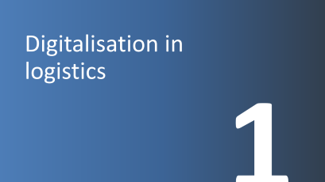

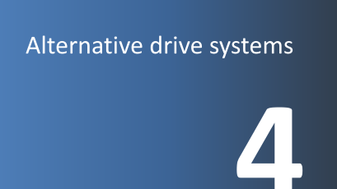
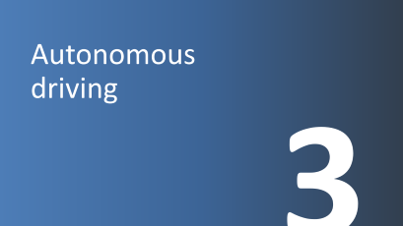




Slide 8
Digitalisation in logistics
1

Slide 9

Digitalisation
Logistics 4.0 or “digital logistics”:
Networking of all actors and processes within the supply chain
Focus on efficiency and effectiveness
Expansion of value chains into value networks
Integration across all logistics departments: warehousing, transport, procurement, production, distribution and information
Image: Flaticon
Notes:
Through the expansion of Industry 4.0 and the general spread of digitalisation in society, supply chains—particularly logistics—are increasingly confronted with digital transformation. The term Logistics 4.0 is based on “Industry 4.0”, which refers to the fourth industrial revolution: digitalisation. The implementation of digitalisation in the logistics sector is referred to as Logistics 4.0 or “digital logistics”. This involves the integration of modern and intelligent systems within process chains in logistics in order to network actors within a supply chain and their processes.
The focus of Logistics 4.0 is on improving efficiency and effectiveness. It also describes the increase in transparency, the level of automation, and flexibility. Through the influence of digitalisation, traditional value chains can be expanded into value networks; however, this requires the necessary trust in order to share data within the entire network.
The integration of Logistics 4.0 takes place across all value creation areas of logistics, starting with procurement and warehousing logistics, continuing through distribution and transport logistics, and extending to production logistics. Information logistics is also becoming increasingly important within value creation as a result of digitalisation.
Sources:
Gabler Wirtschaftslexikon (2025): https://wirtschaftslexikon.gabler.de/definition/logistik-40-54203; Accessed on: 06.05.2025
Hausladen, Iris (4th edition 2020): IT-gestützte Logistik. Systeme – Prozesse – Anwendungen, p. 14
Image source:
Flaticon (2024): https://www.flaticon.com/free-icons/networking; Networking icons created by Freepik ; Accessed on: 10.09.2024

Slide 10
Data as a basis
Data in itself is of no value; only through preparation and structuring does it provide information
Products are increasingly being equipped with sensors and a variety of data collection options
Forecasts: more reliable when well-founded data is available (e.g. sales data, expected market changes)
Digitalisation is successful when it helps to analyse data and support processes
Enables faster responses and more informed decision-making
Notes:
Data in itself is worthless; only when it is processed and structured does it become valuable information that enables targeted use. Digitalisation is therefore successful when it helps to analyse data and support processes.
In logistics, raw data can be collected from various sources such as GPS trackers, warehouse management systems and supply chain management software. This data must be structured and analysed in order to generate valuable insights. For example, analysing GPS data can help identify the most efficient routes for delivery vehicles.
This enables faster responses and more informed decision-making. In Hamburg, for instance, the platform smartPORT logistics is used to optimise fleet management.
Products are increasingly equipped with sensors and a wide range of data collection options. In cold chain logistics, for example, temperature sensors are used to ensure that perishable goods such as food and medicines are transported under optimal conditions.
Forecasts are data-driven and become more reliable when well-founded data is available, such as sales data or expected market developments.
By analysing historical sales data and market trends, companies can make accurate predictions about future orders. This enables better planning of inventory levels.
Source:
DHL Freight Connections (2025): https://dhl-freight-connections.com/de/trends/big-data-in-der-logistik-wie-wertvoll-sind-daten-wirklich/; Accessed on: 08.05.2025

Slide 11
Big data in logistics: Use case predictive shipping
Prediction of which products customers are likely to purchase soon
Products are moved to regional warehouses or even into the shipping process before a specific order is placed → “predictive shipping”
Example Amazon: Same-day delivery based on purchase forecasts through analysis of:
previous purchasing behaviour
search queries
wish lists
local trends
seasonal factors (e.g. start of the school year, Christmas)
Notes:
Companies such as Amazon now rely on so‑called anticipatory shipping models, also known as predictive shipping. The aim is to predict which products customers are likely to purchase even before a specific order is placed.
These items are then moved in advance to regional warehouses – or even fed directly into the shipping process. The goal is to shorten delivery times and improve availability. Amazon uses a wide range of data for this purpose.
This includes previous purchasing behaviour, search queries and wish lists, as well as local trends and seasonal events such as Christmas or the start of the school year. In this way, products can, for example, be delivered on the same day (same-day delivery).
Sources:
Bundesvereinigung Logistik (2014): logistic2go. 3/2024. Logistik mit Gedanken lesen: Anticipatory Shipping im Onlinehandel
Inbound Logistics (2025): https://www.inboundlogistics.com/articles/the-future-of-predictive-shipping-and-the-amazon-advantage/?utm_source=chatgpt.com; Accessed on: 08.07.2025

Slide 12
Predictive shipping – opportunity or risk?
Amazon analyses our online behaviour in order to predict what we are likely to order soon – and dispatches it before we even click.
Discuss the following questions:
What advantages does this system offer for customers and companies?
What risks or concerns arise as a result – for example, in terms of data protection, consumer behaviour, or resource consumption?
Do you feel better served by such predictions, or rather manipulated?
Notes:
Discussion in a class group or small groups:
Predictive shipping – opportunity or risk / practical or problematic?
Discussion questions:
What advantages does this system offer for customers and companies?
What risks or concerns arise as a result – e.g. in terms of data protection, consumer behaviour, or resource consumption?
Do you feel better served by such predictions, or rather manipulated?
Conclusion: Each group or the teacher summarises how they assess predictive shipping.
Support and possible viewpoints:
Advantages for customers: shorter delivery times (e.g. same-day delivery), availability of high-demand products, convenience: less waiting time
Advantages for companies: more efficient inventory planning and utilisation, improved forecasting of order volumes, competitive advantage through faster service, fewer returns due to more accurate offers
Risks:
Data protection: intensive monitoring of user behaviour, personal data is extensively analysed and stored
Consumer behaviour: risk of manipulation (“I buy because it is already nearby/is delivered faster”), reinforcement of impulse purchases, psychological pressure through personalised offers
Environment / resources: higher transport effort due to incorrect forecasts, energy consumption for data processing and pre-transport, enables more efficient warehouse logistics (avoiding overstock), fewer returns if the right products arrive on time, demand-driven production can be optimised
Duration: depending on the time available (15 minutes for a short plenary discussion up to one lesson for group discussion with presentation and conclusion)
Learning objectives:
Students describe the concept of “predictive shipping” (anticipatory/predictive shipping) and explain how it works using examples (e.g. Amazon).
Students analyse the opportunities and risks of data-driven logistics with regard to sustainability, data protection and consumer behaviour.
Students critically discuss to what extent such systems contribute to increased efficiency – or may promote problematic developments such as surveillance or overconsumption.
Students develop their own viewpoints and present them in the group.

Slide 13
Internet of things
Internet of Things (IoT)
Networking of everyday objects via the internet
Connected product systems such as “smart toys”, “smart home”, “smart city”
Data collected provides insights into processes in the physical world
Example applications in logistics:
Parcels “report” if they have been damaged (e.g. through shock sensors)
Warehouse shelves automatically report when goods are missing
Notes:
The “Internet of Things” (IoT) describes the increasing networking of everyday objects via the internet. Physical objects – from household appliances and toys to entire cities – are equipped with sensors, software and other technologies in order to collect, exchange and process data intelligently.
A well-known example is so‑called “smart toys”, i.e. connected toys that can respond to voice input or analyse learning progress. In the “smart home” sector, intelligent thermostats, lamps or refrigerators enable convenient and energy-efficient control of one’s home. This concept is taken even further in the “smart city”: here, traffic flows, energy consumption and waste disposal are digitally monitored and optimised in order to make urban life more sustainable and efficient.
The IoT represents the merging of the physical and digital worlds. Objects that previously functioned purely mechanically or in an analogue way are now becoming part of a global network. This leads to interconnected product systems that can communicate and cooperate with one another. For example, a connected refrigerator can independently detect when a product is running low, update a shopping list or even initiate an order.
The data collected in this way provides valuable insights into processes in the physical world. Companies can monitor production processes in real time, identify maintenance needs at an early stage, or better understand consumer behaviour. At the same time, this development raises questions regarding data protection, security and the ethical use of the information collected.
Sources:
Bundesamt für Sicherheit in der Informationstechnik (2025): Internet der Dinge. In: https://www.bsi.bund.de/DE/Themen/Verbraucherinnen-und-Verbraucher/Informationen-und-Empfehlungen/Internet-der-Dinge-Smart-leben/internet-der-dinge-smart-leben_node.html; Accessed on: 08.05.2025
Wortmann, Felix et.al. (2021): Der lange Weg im IoT – Von der Vernetzung zur Profitabilität. In: Meinhardt, Stefan / Wortmann, Felix (Hrsg.): IoT – Best Practices. Internet der Dinge, Geschäftsmodellinnovationen, IoT-Plattformen, IoT in Fertigung und Logistik, p. 4

Slide 14
How connected is our everyday life?
4 groups & topic areas:
Smart home (e.g. refrigerators that automatically trigger reorders)
Smart mobility (e.g. connected transport systems)
Smart health (e.g. digital health monitoring)
Smart city (e.g. waste management, street lighting)
Describe 2–3 concrete examples of IoT applications in your topic area in relation to logistics.
What advantages arise for everyday life?
What potential does this create for environmental protection / reducing emissions?
What risks or challenges do you see (e.g. data protection, dependency)?
Create a short poster or a digital presentation slide.
Notes:
Exercise: how connected is our everyday life?
Introduction:
Short prompt question for the class: “Which everyday objects in your lives are already connected to the internet?”
Group work (20 minutes):
The class is divided into 4 groups. Each group is assigned one topic area:
Group 1: Smart home (e.g. intelligent parcel boxes that automatically receive deliveries, refrigerators that trigger reorders independently)
Group 2: Smart mobility (e.g. connected transport systems, delivery robots, smart traffic control: traffic lights recognise, for example, public buses and give them priority)
Group 3: Smart health (e.g. temperature-monitored medicine deliveries, delivery of emergency medication by drone in remote regions)
Group 4: Smart city (e.g. sensor-based waste disposal, smart street lighting)
Task for each group:
Describe 2–3 concrete examples of IoT applications in your topic area in relation to logistics. How does this change the last mile of logistics?
What advantages arise for everyday life?
What potential does this create for environmental protection / reducing emissions?
What risks or challenges do you see (e.g. data protection, dependency)?
Create a short poster or a digital presentation slide.
Presentation & discussion (10 minutes):
Each group presents its results in a maximum of 3 minutes.
This is followed by a joint discussion focusing on:
Which applications do you find particularly useful?
Where do you see risks?
How should society deal with this technology?
Extension idea:
Design your own IoT device for everyday life in the future. What should it be able to do? How does it work? What data is collected – and how do you protect users’ privacy?
Learning objectives:
Students are able to explain the concept of the “Internet of Things” and illustrate it using everyday examples.
Students analyse opportunities and risks of IoT applications critically, particularly with regard to data protection, security, sustainability and societal change.
Students work collaboratively in groups to research, structure information and present their findings.
Students reflect on the role of digital technologies in their own everyday lives and develop an awareness of responsible use of connected devices.
Duration: 1 lesson

Slide 15
Artificial intelligence (AI)
AI system – definition according to the EU AI Act:
“…a machine-based system that is designed to operate with varying degrees of autonomy and that demonstrates adaptability after deployment, and that, for explicit or implicit objectives, infers from the inputs it receives how to generate outputs such as predictions, content, recommendations or decisions that can influence physical or virtual environments. “
Notes:
The Artificial Intelligence Act of the EU defines an AI system as follows:
“An AI system” is a machine-based system that is designed to operate with varying degrees of autonomy and that demonstrates adaptability after deployment, and which, for explicit or implicit objectives, infers from the inputs it receives how to generate outputs such as predictions, content, recommendations or decisions that can influence physical or virtual environments” (EU Regulation 2024/168: Article 3.1).
It is therefore a machine-based system that can continue to develop and learn after its initial deployment and generate decisions and recommendations.
Regulation (EU) 2024/1689 of the European Parliament and of the Council of 13 June 2024 on laying down harmonised rules for artificial intelligence. Available at: https://eur-lex.europa.eu/legal-content/DE/TXT/PDF/?uri=OJ:L_202401689; Accessed on: 03.06.2025

Slide 16
AI in logistics
Particularly important in planning:
- demand forecasting
- transport and route planning (real-time tracking)
- production planning
Warehouse management: more efficient use of space and resources, inventory control
Automation of processes, order picking, goods dispatch, transport: helping to address the shortage of skilled workers
Notes:
The use of artificial intelligence in logistics is becoming increasingly important, particularly in planning. One central application area is demand forecasting: with the help of intelligent algorithms, it is possible to predict which products will be in demand within a certain period – for example, in the coming month. This involves not only historical sales data but also external influencing factors such as seasonal fluctuations or current trends. Modern AI systems can even detect spontaneous demand and analyse data from social networks, enabling sudden increases in demand to be identified early and integrated into planning.
AI is also used in transport and route planning. By processing real-time data, optimal routes can be calculated, traffic flows taken into account and delivery times precisely planned. This leads to more efficient use of resources and a reduction in emissions.
In production planning, artificial intelligence plays a key role in the automation and optimisation of processes. AI systems help to organise production sequences efficiently by analysing and weighing factors such as material availability, machine capacities and delivery deadlines in real time.
Another important application area is warehouse management. Here, AI enables more efficient use of storage space, more accurate inventory control and optimised placement and movement of goods within the warehouse.
By automating logistical processes, the shortage of skilled workers can also be addressed.
Sources:
Fraunhofer-Institut für Materialfluss und Logistik IML (2021): Whitepaper. Künstliche Intelligenz in der Logistik. In: https://www.iml.fraunhofer.de/content/dam/iml/de/documents/101/19_Whitepaper_KI_Logistik.pdf; Accessed on: 03.06.2025
Flechsig, Christian et.al. (2021): Langsam, aber sicher: Mithilfe von digitalen Technologien auf dem Weg zur Beschaffung 4.0. In: Fritzsche, Roy / Winter, Stefan / Lohmer, Jakob (Hrsg.): Logistik in Wissenschaft und Praxis. Von der Datenanalyse zur Gestaltung komplexer Logistikprozesse, p. 342

Slide 17
Ask an AI about the logistics of the future
Choose a topic area in logistics (e.g. demand forecasting, warehouse management, transport planning, training of skilled workers)
Formulate 3 prompts and ask an AI (e.g. ChatGPT, Copilot):e.g. How does AI-supported demand forecasting work?
Make notes and critically analyse the responses:
What advantages are mentioned?
What risks or ethical questions arise?
How credible and clear are the responses?
Create a short PowerPoint presentation on this topic
Notes:
Ask an AI about the logistics of the future
Individual work (also suitable as homework)
Choose a topic area from logistics, e.g.:
demand forecasting
route planning
warehouse management
automation in order picking
AI to address the shortage of skilled workers
Formulate 3 specific questions (prompts) that you ask an AI (e.g. ChatGPT, Microsoft Copilot).
Examples:
“How can AI help to use warehouse space more efficiently?”
“What risks are associated with the use of AI in transport planning?”
“How does AI-supported demand forecasting work?”
Analyse the answers critically:
What advantages are mentioned?
What risks or ethical questions arise?
How credible and understandable are the responses?
Create a short presentation (e.g. PowerPoint) including the following content:
your chosen topic and the three questions
summary of the AI responses
your own assessment: opportunities and challenges
Duration: approx. 30 minutes, with presentation: 1 lesson
Learning objectives:
Students identify specific fields of application for AI in logistics, e.g. in planning, warehouse management and automation.
Students formulate targeted questions for an AI and critically evaluate the answers.
Students reflect on the opportunities and risks of using AI (e.g. efficiency vs. data protection).

Slide 18
Challenges of AI
Data protection and data security/legal uncertainties
Lack of international standards
Ensuring the traceability of algorithms
Integration of new technologies into existing systems
Qualification of employees and change management
High energy consumption
Notes:
Modern technologies bring a range of challenges and risks:
A key issue is data protection and data security. Who has access to the data, and how well are they protected? Many technologies are developing faster than legislation, which leads to grey areas and legal uncertainties.
The lack of international standards is often a problem, particularly in logistics. Without uniform rules, cross-border cooperation becomes more difficult.
Traceability of algorithms is essential: when AI makes decisions, it must be possible to understand how these decisions are reached, especially in sensitive areas such as medicine, justice or finance.
Another challenge is the integration of new technologies into existing systems. Legacy IT infrastructures are often not compatible with modern solutions.
The qualification of employees also plays a major role. New technologies require new skills. Without targeted change management, there may be resistance or overload within organisations.
The high energy consumption should not be underestimated, particularly in blockchain applications or when training large AI models.
Flechsig, Christian et.al. (2021): Langsam, aber sicher: Mithilfe von digitalen Technologien auf dem Weg zur Beschaffung 4.0. In: Fritzsche, Roy / Winter, Stefan / Lohmer, Jakob (Hrsg.): Logistik in Wissenschaft und Praxis. Von der Datenanalyse zur Gestaltung komplexer Logistikprozesse, p. 347

Slide 19

Blockchain
Public online database
Data sets relating to an object (“block”) are linked together (“chain”)
Decentralised = the data are not stored on a single server, but on many computers (network)
Immutable = once stored, data can no longer be altered secretly
Secure = through encryption and control by the network
Image: Flaticon
Notes:
Public online database: the blockchain is visible to everyone and stores data permanently. Anyone can trace what happened and when – without central control.
Linked data sets (“blocks”): each new piece of information is stored in a so‑called block. These blocks are connected chronologically, like links in a chain (“chain”). This creates seamless documentation.
Decentralised storage: the data are not held on a single server, but distributed across many computers worldwide. All participants in the network have a copy – making manipulation extremely difficult.
Immutability: once stored, data cannot be secretly altered or deleted. Any change would be immediately noticeable, as it would be compared with all other copies in the network.
Security through encryption: transactions are secured by mathematical processes (hashes). A new block is only added if all participants in the network agree.
These characteristics make blockchain particularly interesting for areas such as finance, supply chains, logistics, or digital contracts (e.g. consignment notes).
Source:
Barenkamp, Marco (2021): IoT Security Best Practices. In: Meinhardt, Stefan / Wortmann, Felix (Hrsg.): IoT – Best Practices. Internet der Dinge, Geschäftsmodellinnovationen, IoT-Plattformen, IoT in Fertigung und Logistik, p. 401
Image source:
Flaticon (2024): https://www.flaticon.com/free-icons/blockchain; Blockchain icons created by Freepik - Flaticon; Accessed on: 11.09.2024

Slide 20
Use case: blockchain in parcel delivery
Every step (packaging, dispatch, arrival) is stored on the blockchain. Every participant can track the location of the parcel at any time.
Advantages: transparent, tamper-proof, efficient, automated (e.g. payments can be triggered automatically when a parcel has arrived)
Who is involved?
Sender (e.g. an online shop)
Logistics service providers (e.g. Austrian Post, freight forwarders)
Warehousing and transhipment centres
Drivers or delivery personnel
Recipient (e.g. private individual or company)
Customs authorities (for international shipments)

Slide 21
Practical example: digital twin
Virtual representation of a real environment or process
Complex processes – such as supply chains, inventory levels or machines – are digitally visualised in real time
Enables analysis, forecasting and optimisation
Use in logistics:
Warehouse management
Route planning
Maintenance of machines/vehicles
Notes:
The digital twin is a virtual representation of a real environment or process. It digitally maps, for example, supply chains, inventory levels or machines – and does so in real time. As a result, complex processes can not only be monitored but also analysed, predicted and optimised in a targeted manner.
Its use is particularly diverse in logistics:
In warehouse management, the digital twin helps to maintain an overview of stock levels and to utilise storage space efficiently.
In route planning, it enables better coordination of delivery routes – depending on traffic conditions, weather or capacity.
In the maintenance of machines or vehicles, it identifies wear at an early stage and prevents failures through timely repairs.
Sources:
Spengler, Thomas et. al (2021): Methoden und Werkzeuge für die synergetische Konzeption und Bewertung von Industrie 4.0-Lösungen, In: Fritzsche, Roy / Winter, Stefan / Lohmer, Jakob (Hrsg.): Logistik in Wissenschaft und Praxis. Von der Datenanalyse zur Gestaltung komplexer Logistikprozesse, p. 194
Kocaoglu, Batuhan (2024): Logistics Information Systems. Digital Transformation and Supply Chain Applications in the 4.0 Era, p. 164

Slide 22
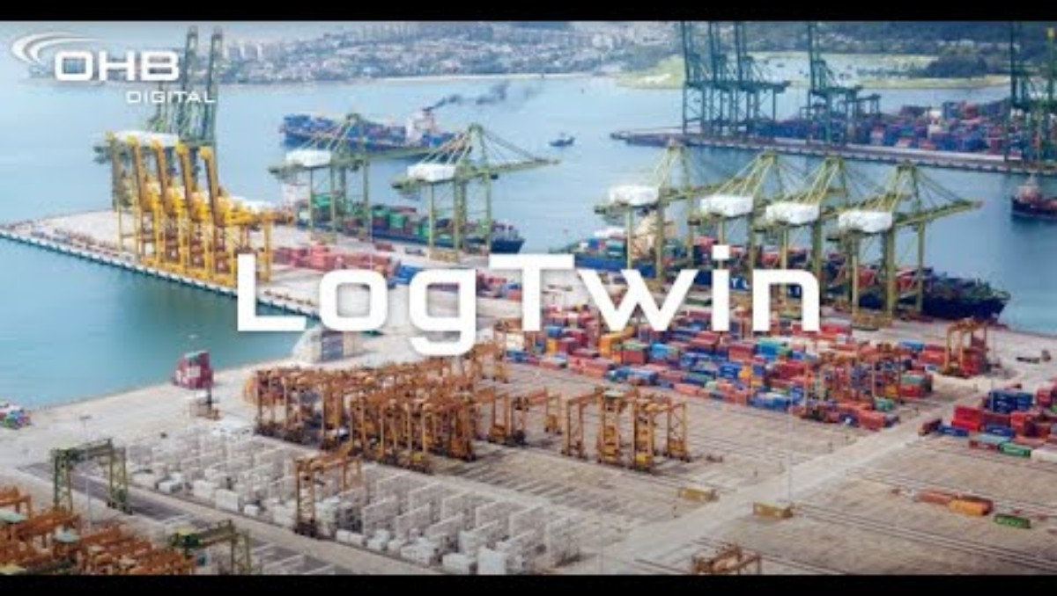
Video “digital twin”
Questions about the video:
What is meant by a “digital twin”?
For which types of goods can the system be used?
Which information is digitally recorded in real time?
https://www.youtube.com/watch?v=K1AGi68ZB_0
Notes:
https://www.youtube.com/watch?v=K1AGi68ZB_0
What is meant by a “digital twin”?
A digital, three-dimensional representation of reality; in this case, of a logistics facility, including the stored goods, material flows, processes and transport operations.
For which types of goods can the system be used?
For all types: bulk goods, general cargo, consolidated shipments, and project cargo.
Which information is digitally recorded in real time?
Goods-related information (including across multiple locations), vehicle information, as well as weather and traffic data.

Slide 23
Application example: smart ports
Example: Port of Hamburg
Increased efficiency through sensor technology, analysis, forecasting and information systems
Networking of traffic flows, infrastructure and goods flows
Examples of applications:
  Equipping the vehicle fleet with sensors for shorter routes and better utilization
  Handling all documentation in digital form
  Real-time management of navigation and parking allocation
Notes:
With the implementation of the smart port concept at the Port of Hamburg, efficiency gains can be achieved on a new level. Through sensor technology, as well as analysis, forecasting and information systems, all possibilities for increasing efficiency are utilised in real time. This enables optimal networking of traffic flows, infrastructure and goods flows.
Major advantages already evident today:
By equipping the vehicle fleet with sensor technology, the location can be determined at any time, efficient transport routes can be planned and designed, and this leads to better utilisation of the fleet
Documentation for maintenance is carried out in digital form and can therefore be accessed and updated at any time
Real-time management of navigation across the port area, as well as the necessary allocation of parking spaces for lorries, speeds up handling processes
Sustainability also plays a key role in the implementation of smart ports, which is why there is increasing focus on electromobility, including the necessary infrastructure. Renewable energy is essential both for shipping as a means of propulsion and in the context of shore power usage. The corresponding infrastructure is being created and expanded
Source:
Hamburg Port Authority (2023): https://www.hamburg-port-authority.de/de/hpa-360/smartport; Accessed on: 04.10.2024

Slide 24
Sustainable technologies
2

Slide 25
Sustainable technologies in logistics
Digitalisation and intelligent control
Sustainable packaging
Sustainable warehousing and transhipment centres
Circular economy
Sustainable supply chains
CO₂ monitoring and compensation
Decarbonisation of transport
Notes:
Sustainability in logistics encompasses a wide range of measures:
Digitalisation and efficient control (see previous chapter)
An example is sustainable and reusable packaging. Recyclable or biodegradable packaging, reusable transport packaging (e.g. foldable boxes, pallets), and packaging optimisation to reduce volume
Sustainable warehousing and transhipment centres: energy-efficient facilities with solar systems, heat pumps, green roofs, use of daylight, LED lighting
Circular economy: reducing and recycling products and packaging lowers costs, saves resources and transport routes. Examples include the return of old devices or empty containers
Sustainable supply chains: selection of environmentally certified and regional suppliers, transparent CO₂ balances along the supply chain, consideration of social standards (fair, safe, humane)
CO₂ monitoring and compensation: recording emissions per transport or shipment, offsetting emissions through investments in climate protection projects, partly required within the framework of ESG reporting
Decarbonisation of transport through alternative drive systems: see following slides

Slide 26
Circular economy
Objective: keep materials and products in circulation for as long as possible
Reduce – reuse – recycle
Extending product life cycles
Repair, reuse and recycling instead of disposal
Resource conservation and CO₂ reduction
Examples:
Reusable shipping packaging
Fairphone: smartphone with a modular design for easy repair and recycling
Notes:
The circular economy aims to keep materials and products in use within the economic system for as long as possible. Instead of consuming resources in a linear way—by extracting, using and then disposing of them—this model is based on closed material cycles.
At its core are the principles: reduce – reuse – recycle. This means reducing resource consumption, using products multiple times, and recycling materials at the end of their life cycle.
By extending product life cycles, enabling repair and promoting reuse, raw materials can be conserved and CO₂ emissions significantly reduced.
Examples of such approaches include:
ReZip – a system for reusable shipping packaging used in e-commerce.
Fairphone – a modular smartphone that is easy to repair and recycle.
Source:
Bretzke, Wolf-Rüdiger / Barkawi, Karim (2021): Nachhaltige Logistik. Antworten auf eine globale Herausforderung, p. 153

Slide 27
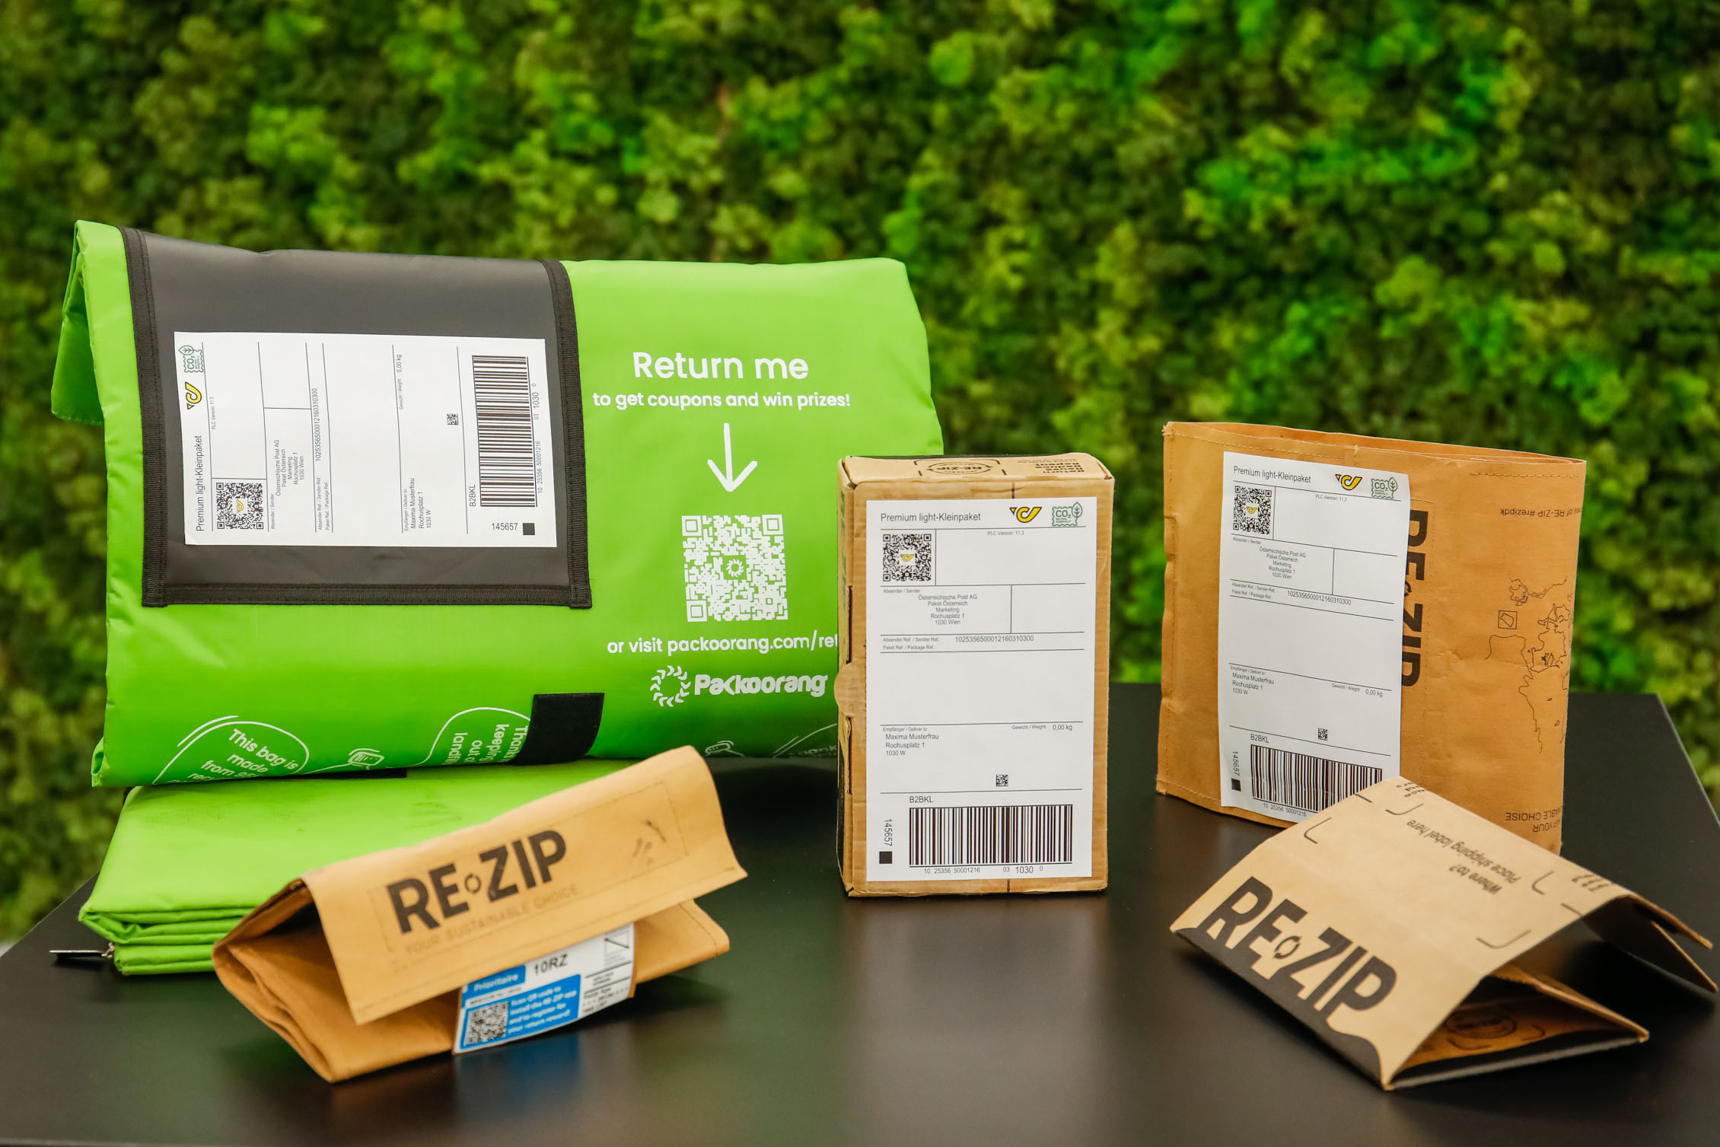
Green packaging “post loop”
Reusable shipping bags and parcels
Successful market launch following a pilot project by the University of Applied Sciences Upper Austria and Austrian Post with several companies
Shipping of online orders in loop packaging
Return of the packaging by customers
Depending on the type of packaging, reusable between 10 and 100 times
Picture: Österreichische Post
Notes:
Since 2023, Austrian Post has been offering a loop service for reusable packaging, Post Loop, as a regular service. Retailers can rent the packaging and offer it to their customers at online checkout. Depending on the online shop, the return of the packaging works in different ways—some providers use deposit systems, others reward returns with vouchers or offer simple return options via letterboxes and post office branches.
This was preceded by a research project and a pilot project conducted by the University of Applied Sciences Upper Austria and Austrian Post, together with companies such as Interspar, Intersport, Tchibo, Thalia and dm.
Key points of the project:
Packaging made from wood fibre or recycled PET. The packaging has different life cycles, which in the photo range between 10 and 100 cycles.
Returns are made easily via letterboxes, post office branches or self-service zones.
A carbon footprint analysis showed ecological advantages, particularly for wood fibre packaging.
Customer acceptance was high—many were willing to pay a deposit.
The project demonstrates that a circular economy can work in mail order business—with benefits for the environment, companies and consumers.

Slide 28
Sustainable supply chains
Considers environmental, social and economic aspects throughout the entire product life cycle:
Transparency regarding origin and production conditions
Avoidance of overproduction
Fair working conditions and social standards
Resource conservation and CO₂ reduction in transport and production
Compliance with environmental and social standards (e.g. supply chain legislation)
Example:
VAUDE – German outdoor equipment manufacturer: fair and sustainable supply chain in the textile industry
Notes:
Sustainable supply chains take environmental, social and economic aspects into account throughout the entire product life cycle—from raw material extraction, production and transport through to disposal or recycling.
A key objective is to create transparency regarding the origin of materials and production conditions. Only in this way can it be traced under which circumstances a product was manufactured. Another important aspect is the avoidance of overproduction. Sustainable supply chains also emphasise fair working conditions and compliance with social standards—particularly in countries with low wages or weaker regulation. Environmental goals also play a central role. These include conserving resources and reducing CO₂ emissions, for example through efficient transport routes or the use of renewable energy. The topic is also becoming increasingly important from a legal perspective—keyword: supply chain legislation.
An example of a sustainable supply chain is the company VAUDE, a German outdoor equipment manufacturer. VAUDE focuses on fair working conditions, environmentally friendly materials and transparent production processes.
Sources:
Fraunhofer Gesellschaft (2025): https://www.fraunhofer.de/de/ueber-fraunhofer/nachhaltigkeit/verantwortungsvolle-unternehmensgestaltung/nachhaltige-lieferkette.html; Accessed on: 11.07.2025
Vaude (2025): https://www.vaude.com/ch/de/blog/post/deutscher-nachhaltigkeitspreis-2024.html?srsltid=AfmBOopqfSPfonZkMPD_UrqkVO3ZtUWxnHodHQRce5o5zLLcuLWrSQp3; Accessed on: 11.07.2025

Slide 29
Autonomous driving
3

Slide 30
Levels of automation
Level 0 | No automation | The human as driver
Level 1 | Driver assistance | Assistance systems (e.g. cruise control), the driver has control of the vehicle
Level 2 | Partial automation | The vehicle can, for example, steer and brake at the same time, but the human monitors
Level 3 | Conditional automation | The vehicle drives independently; the human must be able to intervene if necessary
Level 4 | High automation | The vehicle operates completely independently in defined areas (e.g. motorway, logistics centre)
Level 5 | Full automation | No driver required. The vehicle can drive independently everywhere and at any time
Notes:
Autonomous driving means that a vehicle can move independently—without a human actively having to intervene. This is made possible by sensors, cameras, artificial intelligence and digital maps. The development towards fully autonomous vehicles is gradual. The international SAE levels define a total of six stages—from level 0 to level 5—which describe the degree of automation.
Level 0 – No automation:
The human drives entirely independently. There are assistance systems such as warning signals, but the vehicle does not take over any control functions.
Level 1 – Driver assistance:
A first assistance system is introduced—for example cruise control or a lane-keeping assistant. However, the human remains fully in control.
Level 2 – Partial automation:
The vehicle can now steer and brake simultaneously—for example during automated parking or in traffic jams. Nevertheless, the human must always be ready to intervene.
Level 3 – Conditional automation:
The vehicle can drive independently in certain situations—for example on the motorway. However, the human must be able to intervene quickly if the system requires support.
Level 4 – High automation:
Here, the vehicle operates completely independently—but only in clearly defined areas, such as within a logistics centre or on specific routes.
Level 5 – Full automation:
This is the highest level: the vehicle no longer requires a driver and can operate independently everywhere—whether in the city, on rural roads or on motorways.
Source:
Kraftfahrbundesamt (2025): https://www.kba.de/DE/Themen/Marktueberwachung/Produktpruefungen/Pruefinhalte/AutomatisiertesAutonomesFahren/Automatisierungsstufen/Automatisierungsstufen_node.html; Accessed on: 09.07.2025

Slide 31
Autonomous lorry
at least 10% lower fuel consumption compared to manually operated lorries
Opportunities:
Mitigating the shortage of skilled workers
Avoiding rear-end collisions
Reducing environmental impact through fuel savings
Limitations and risks:
Weather conditions
Humans as road users
Manipulation by hackers, data protection
Ethical considerations: responsibility in the event of accidents
Notes:
The implementation of autonomous lorries offers a wide range of benefits:
Cost savings for companies and mitigation of the shortage of skilled workers
Increased safety
Reduction of environmental impact: optimisation of traffic flow through vehicle-to-vehicle communication, leading to more efficient driving
Studies assume that fuel savings of at least 10% compared to manually operated lorries are possible. At lower speeds and in complex traffic situations (urban traffic), efficiency gains are even higher.
Limitations and risks:
Complex situations and the large number of road users—particularly in urban traffic—pose a challenge
Weather conditions as a difficulty (e.g. reduced visibility for cameras)
Risk of hacker attacks
Video tip on the trend:
Youtube (2024): Test phase: MAN trials autonomous lorries | BR24 - https://www.youtube.com/watch?v=MOXl8SvKzKY; Accessed on: 30.09.2024
Sources:
Jobmatch (2024): https://jobmatch.me/blog/arbeitnehmer/logistik/autonomes-fahren-eine-gefahr-fuer-die-lkw-fahrer/; Accessed on: 03.07.2024
Neubauer, Matthias / Hutter, Bernadette (2022): Research Report "Für LKW-Fahrer und LKW-Fahrerinnen wird es noch lange Arbeit geben": Matthias Neubauer, Professor at the University of Applied Sciences Upper Austria, on automated driving and its impacts on the world of work in transport and logistics; interview. In: https://hdl.handle.net/10419/269898; Accessed on: 06.05.2025
Fortune Business Insights (2025): https://www.fortunebusinessinsights.com/de/autonomer-lkw-markt-103590; Accessed on: 10.07.2025

Slide 32

Autonomous ships
Belgian company SEAFAR as a pioneer in (partially) autonomous shipping
Remote control centres
Remotely controlled ships operating with full crews as well as with reduced crews
Remote-controlled navigation of unmanned and highly automated push barges
Technology to increase the safety of human-centred processes
Video: https://www.youtube.com/watch?v=N9ma8_XfgQQ
Picture: SEAFAR
Notes:
The Belgian company SEAFAR was founded in Antwerp in 2018 and specialises in the development and operational integration of technologies for the remote-controlled operation of vessels in shipping. Ships are controlled from three modern control centres in Antwerp, Charleroi and Duisburg. The automation of vessels is implemented gradually and in coordination with the local regulatory authorities. Both remotely controlled ships with full crews and vessels with reduced crews are in operation. The remote-controlled navigation relieves the crew on board. Technologies such as object recognition and data acquisition support the crew on board and increase safety. Currently, remotely controlled ships without any crew on board are also being tested on certain routes in Belgium.
Video tip: https://www.youtube.com/watch?v=N9ma8_XfgQQ
Source:
SEAFAR company presentation (2024)
https://seafar.eu/de/
Picture source:
Seafar (2024)

Slide 33
Robots in warehouses
What do warehouse robots do?
Transport goods from one location to another (e.g. driverless transport systems)
Automatically sort parcels and products
Picking (compiling orders)
Scanning and inventorying warehouse stock
Maintenance tasks
Notes:
Modern warehouse robots now perform central functions in intralogistics and make a significant contribution to increasing efficiency, process reliability and the scalability of logistics operations. They are used in various forms — ranging from autonomous mobile robots (AMRs) and driverless transport systems (DTS) to collaborative robots (cobots).
Their main tasks include:
Internal goods transport: Robots move goods automatically between warehouse zones, picking stations and dispatch areas.
Automated sorting processes: They recognise, classify and sort parcels or products based on barcode or RFID data.
Picking: Warehouse robots support or take over the assembly of customer orders. They operate either autonomously or in collaboration with human employees within hybrid systems.
Inventory management: Using integrated sensor and scanning technology, they record stock levels, carry out inventories and automatically report discrepancies to the warehouse management system.
Maintenance and system monitoring: Some systems are able to independently detect faults, carry out simple maintenance tasks or initiate preventive measures.
Source:
AutoStore (2025): https://www.autostoresystem.com/de/insights/warehouse-robotics-guide; Accessed on: 07.07.2025

Slide 34
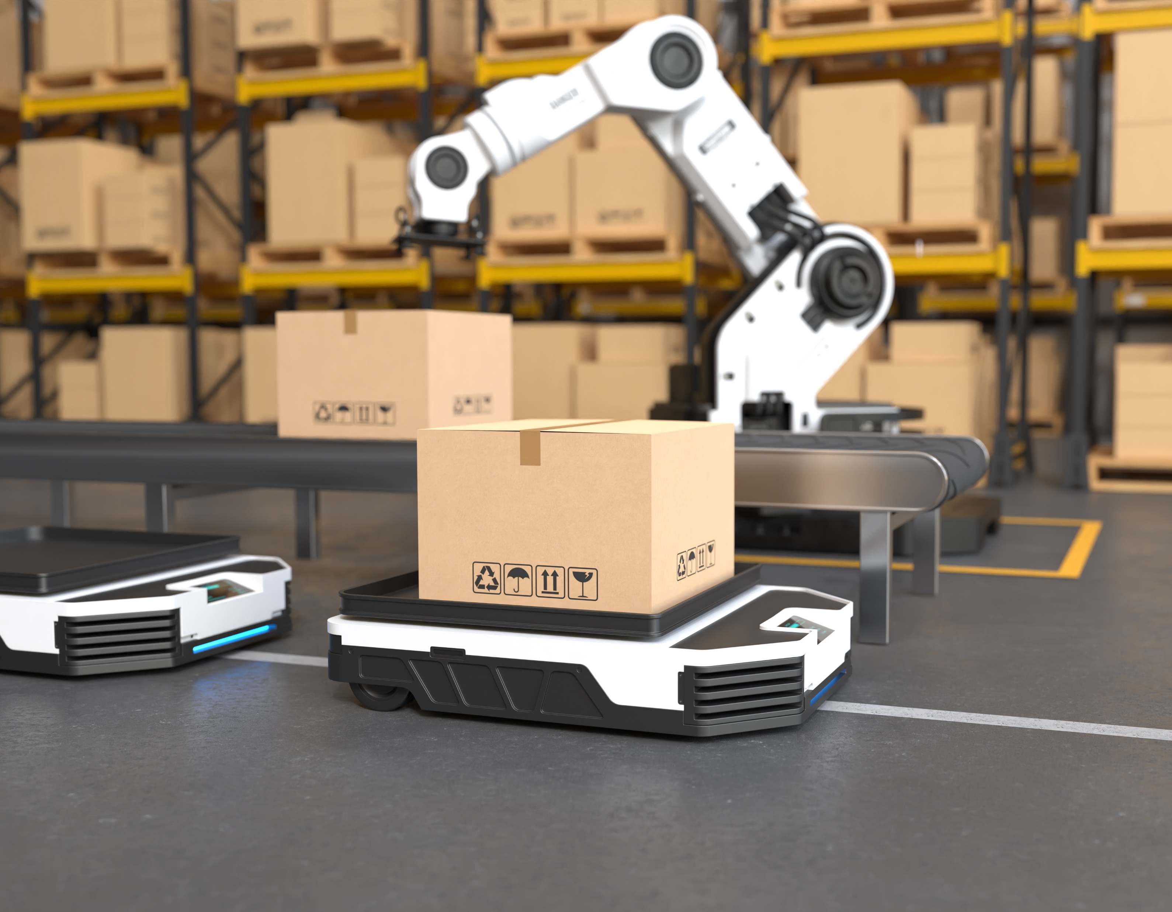
Dark warehouse
Fully automated warehouse → therefore no lighting required
High investment costs
However, high efficiency (operates around the clock)
Lower personnel and energy costs
Application examples:
Amazon
SSI Schäfer & Fraunhofer IML: Net Zero Warehouse
Picture: Freepik
Notes:
A dark warehouse (German: “dark warehouse”) is a fully automated warehouse that can operate with little or no human involvement — and therefore does not require lighting. Amazon already uses largely automated processes in many of its logistics centres. SSI Schäfer and Fraunhofer IML are working together on concepts for sustainable, automated warehouses. One example is the project to develop a Net Zero Warehouse, which is intended not only to be automated but also climate-neutral in operation.
Sources:
Forbes (2025): https://www.forbes.com/councils/forbesbusinesscouncil/2023/01/31/will-the-dark-warehouse-ever-become-reality-perhaps-not-in-our-lifetime/; Accessed on: 16.06.2025
Logistik heute (2025): https://logistik-heute.de/fachmagazin/fachartikel/prozesse-nachhaltigkeit-der-weg-zum-net-zero-warehouse-214157.html; Accessed on: 16.06.2025
Address Advisors (2025): https://addressadvisors.com/blog/what-are-dark-warehouses-definition-and-explanation; Accessed on: 16.06.2025
Picture source:
Designed by Freepik

Slide 35
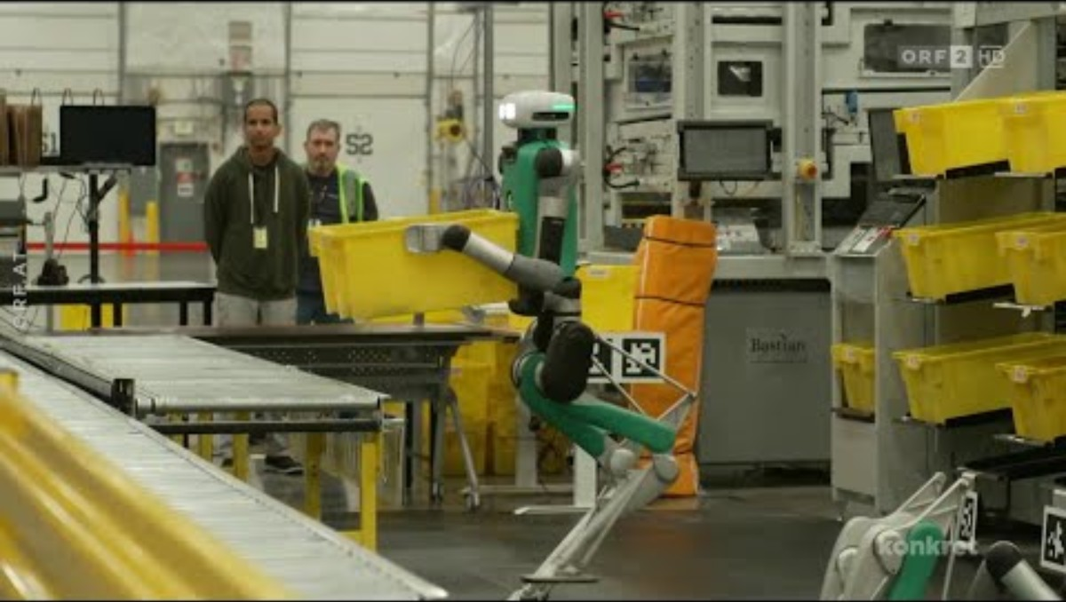
Video "AI and robots at Amazon"
Answer the following questions afterwards:
What tasks do the robots perform in the warehouse?
What is one advantage of the robot-supported warehouse system?
What is being tested for delivering parcels in California and Texas?
https://www.youtube.com/watch?v=rgtOdMCUKWc
Notes:
https://www.youtube.com/watch?v=rgtOdMCUKWc
Please make sure that the English subtitles are turned on.
What tasks do the robots perform in the warehouse?
The 200 robots move crates containing products, transport them to interim storage, or retrieve them for customer orders.
What is an advantage of the robot-supported warehouse system?
It enables fast and efficient processing of orders as well as optimal use of warehouse space. Robots can operate in small, confined areas. They also analyse which routes lead to damage and can make adjustments accordingly. This allows people to focus on more important tasks.
What is being tested for delivering parcels in California and Texas?
Drones

Slide 36
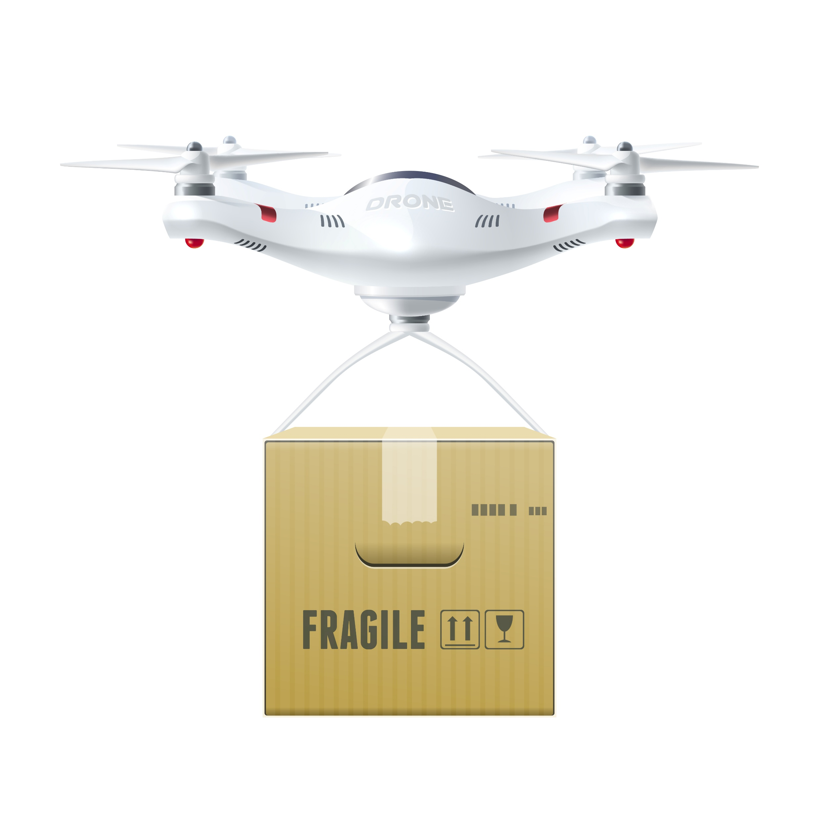
Drones
Autonomous use for:
Inspection (e.g. vehicle inspections)
Warehouse inventory (barcode scanners)
Delivery of parcels (last mile)
Image: freepik
Notes:
Drones perform a wide range of tasks in logistics. One example is the inspection of vehicles: drones can be equipped with cameras and automatically check lorries or containers for damage. Another area of application is warehouse inventory: drones fly through large warehouse halls and use integrated barcode scanners to scan storage locations. In some regions, drones are already being tested to deliver parcels on the so-called “last mile” — that is, directly from the distribution centre to the customer’s doorstep.
Sources:
Kocaoglu, Batuhan (2024): Logistics Information Systems. Digital Transformation and Supply Chain Applications in the 4.0 Era; p. 25
Eyesee (2025): https://www.eyesee-drone.com/de/inventur-mit-drohnen/; Accessed on: 01.07.2025
Image source:
Designed by macrovector / Freepik

Slide 37
Logistics centre 2050
Group work: Design an innovative warehouse in which various robots and autonomous machines work together and sustainability is a key priority:
What goods are stored?
Which technologies are used?
How are processes automated?
How is your logistics centre operated in a climate-friendly and resource-efficient way?
What special features distinguish your warehouse?
Visualise your logistics centre using an AI image generator.
Present your idea.
Notes:
Further information for teachers, handouts and lesson plans can be found here: https://www.rewway.at/en/teaching-materials/logistics-hub-2050

Slide 38
Alternative drive systems
4

Slide 39
Alternative drive systems
Electric drive
Hydrogen
Hybrid systems
Biofuels
E-fuels (synthetic fuels)
Methanol and ammonia
Multimodal transport solutions
Notes:
Alternative drive systems aim to decarbonise transport — that is, to reduce or avoid CO₂ emissions and other greenhouse gases. More detailed information on electric mobility and hydrogen propulsion can be found on the following two slides.
Hybrid systems: Combination of internal combustion engine and electric motor; can cover short distances in electric mode (especially plug-in models). Transitional technology, as dependence on fossil fuels remains.
Biofuels: Produced from plants, organic waste or manure. Sustainability depends heavily on the origin of the raw materials. Biofuels such as HVO (Hydrotreated Vegetable Oil) and LBM (Liquid Bio-Methane) are considered short-term solutions, as they can be used in existing engines. Risk of land-use conflicts and competition with food production due to the use of crops.
E-fuels (synthetic fuels): Artificially produced fuels made from hydrogen and CO₂. Can be used in conventional combustion engines. Potentially climate-neutral, but very energy-intensive to produce, not yet widely available on the market, and expensive.
Methanol and ammonia: Used particularly as fuels in shipping. Both can be used in modified combustion engines or fuel cells. However, handling toxic (methanol) and explosive (ammonia) substances is challenging. Low energy density, therefore large tanks are required.
Multimodal transport solutions: Great potential for reducing emissions in transport by shifting traffic from road and air to more sustainable modes such as rail and inland waterways.
Note: Gas fuels such as LPG (liquefied petroleum gas) or CNG (compressed natural gas) are not included in this list, as they are not climate-neutral as long as they are derived from fossil sources. Their long-term contribution to decarbonisation is therefore limited.
Sources:
Auto Motor Sport (2025): https://www.auto-motor-und-sport.de/news/alternative-antriebe-konzept-ueberblick/; Accessed on: 07.07.2025
Klimaschutz Kommune (2025): https://www.klimaschutz-kommune.de/buergerinfo/alternative-antriebsarten/; Accessed on: 07.07.2025
Van der Linden, Erwin (2024): Study on alternative propulsion on the Danube. In: https://www.viadonau.org/fileadmin/content/20241128_Aristoi_Study_Viadonau_final.pdf; Accessed on: 07.07.2025; p. 17
TU Graz (2025): https://www.tugraz.at/news/artikel/mit-neuen-kraftstoffen-zu-klimaneutraler-schifffahrt; Accessed on: 07.07.2025

Slide 40
Alternative fuels in inland shipping
Challenges:
Infrastructure, particularly the widespread provision for ports
Costs for converting ships
Space requirements on board and on land
Safety aspects
Performance balance of alternative propulsion systems
Biofuels
Methanol
Electric drive
Hybrid systems
Hydrogen
Ammonia
Notes:
Source: Van der Linden, Erwin (2024): Study on alternative propulsion on the Danube. In: https://www.viadonau.org/fileadmin/content/20241128_Aristoi_Study_Viadonau_final.pdf; Accessed on: 07.07.2025
Further links: https://www.wko.at/oe/transport-verkehr/schifffahrt/alternative-kraftstoffe-und-antriebstechnologien.pdf

Slide 41
Electromobility
Electromobility:
Reduction of CO₂ emissions and noise
Challenges: limited range, charging times and charging infrastructure, higher purchase costs
Potential through digitalisation, autonomous driving and alternative energy sources
Notes:
Electromobility is becoming increasingly important as an alternative form of propulsion in the logistics sector. It enables a reduction in emissions and noise pollution. The use of electric vehicles is particularly suitable in urban logistics, as journey distances are shorter and loading and unloading points can be planned effectively. However, limited range, charging times and the availability of charging infrastructure still represent challenges, especially outside urban areas. Higher purchase costs compared with vehicles with internal combustion engines also play a role. Nevertheless, digitalisation, autonomous driving and alternative energy sources offer further potential for the future.
Source:
Fraunhofer IML (2025): https://www.iml.fraunhofer.de/de/abteilungen/b3/verkehrslogistik/alternative_antriebe.html; Accessed on: 06.05.2025

Slide 42
Hydrogen
Advantages:
No CO₂ or nitrogen emissions during operation
No particulate matter pollution
Can be produced entirely from renewable electricity (green hydrogen)
Disadvantages:
Large storage volume required
High safety requirements (highly flammable)
Efficiency in production: very energy-intensive
Infrastructure: high costs for refuelling stations and safety facilities
Need for further research in fuel cell technology
Notes:
Hydrogen propulsion is considered a climate-friendly alternative to diesel and petrol — especially in heavy-duty transport, for buses or ships (i.e. where battery-powered systems reach their limits). Its major advantage is that no CO₂ or nitrogen oxide emissions and no particulate matter are produced during operation. If hydrogen is produced using electricity from renewable energy sources — known as green hydrogen — the entire propulsion system is almost emission-free.
However, there are several challenges: storing hydrogen requires large tanks or high pressure, which makes the technology complex and expensive. The efficiency of production is also limited — a significant proportion of the energy used is lost during electrolysis. In addition, there are safety considerations: hydrogen is highly flammable and requires special measures for handling and storage. Furthermore, the necessary infrastructure, such as refuelling stations, is still lacking and requires investment. Fuel cells are not yet fully developed for widespread use in many areas — further research and development are needed.
Sources:
Fraunhofer-Gesellschaft zur Förderung der angewandten Forschung (2025): https://www.fraunhofer.de/de/forschung/aktuelles-aus-der-forschung/wasserstoff-so-bleiben-wir-mobil.html; Accessed on: 07.07.2025
Van der Linden, Erwin (2024): Study on alternative propulsion on the Danube. In: https://www.viadonau.org/fileadmin/content/20241128_Aristoi_Study_Viadonau_final.pdf; Accessed on: 07.07.2025; p. 17

Slide 43
Biofuels
Biofuels such as HVO (Hydrotreated Vegetable Oil) and LBM (liquid biomethane) are considered a short-term realistic solution for reducing emissions in inland shipping
Sustainability depends heavily on the origin of the raw materials
Pilot project: The grain vessel Nedertarwe operates using HVO100 from Utrecht to Rotterdam
Significantly lower CO₂ emissions than diesel
Can be used in existing engines
Lower investment compared with hydrogen or batteries
No new infrastructure required
EU approvals for blends up to 37%, in some cases up to 100% for new engines
Currently cheaper and quicker to implement than hydrogen or ammonia
Higher operating costs than diesel
Quality varies depending on the raw material
Use of food crops as raw materials can cause social conflicts
Notes:
Van der Linden, Erwin (2024): Study on alternative propulsion on the Danube. In: https://www.viadonau.org/fileadmin/content/20241128_Aristoi_Study_Viadonau_final.pdf; Accessed on: 07.07.2025

Slide 44








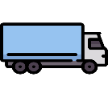

Multimodal transport
EU target by 2050: reduction of greenhouse gas emissions in the transport sector by 90%
Several modes of transport → multimodal transport
e.g. transhipment of goods from a lorry to an inland vessel
Transport on a single mode of transport, e.g. road
→ unimodal transport
Sender
Recipient
Pre-carriage
Main carriage
On-carriage
Transhipment point
Notes:
The European Union has set the goal of becoming the first climate-neutral continent by 2050 and reducing greenhouse gas emissions in the transport sector by 90%. The European Commission’s strategy for sustainable and intelligent mobility includes, among other measures, a shift towards more sustainable modes of transport. Targets for shipping include increasing inland waterway transport’s share of short-distance transport from 25% in 2030 to 50% by 2050. Rail freight transport is also set to increase by 50% by 2030 and double by 2050.
Unimodal or direct transport refers to transport from the sender directly to the recipient.The term “transport chain” or “multistage transport” refers to transport from the sender to the recipient using different modes of transport. In unimodal transport, the mode of transport does not change. For example, lorry transport by road or rail transport between two locations with a direct rail connection. Goods may be reloaded, but only one mode of transport is used.
In multimodal transport, transport is carried out using more than one mode of transport.These transport chains are not only relevant for freight transport but also for passenger transport: for example, travelling individually to the station by car or bicycle and then transferring to public transport.
Sources:
European Commission (2025): https://commission.europa.eu/strategy-and-policy/priorities-2019-2024/european-green-deal_de; Accessed on: 05.02.2025
European Commission (2023): Sustainable & Smart Mobility Strategy, In: https://transport.ec.europa.eu/transport-themes/mobility-strategy_en; Accessed on: 05.02.2025; p.10
Muchna, Claus / Brandenburg, Hans/ Fottner, Johannes/ Gutermuth, Jens (2nd edition 2021): Grundlagen der Logistik. Begriffe, Strukturen und Prozesse; pp. 152 – 161
Images sources:
Flaticon (2024): https://www.flaticon.com/free-icons/lkw; lorry icons created by Freepik – Flaticon; Accessed on: 20.05.2024
Flaticon (2024): https://www.flaticon.com/free-icons/fabrik; factory icons created by Freepik – Flaticon; Accessed on: 03.05.2024
Flaticon (2024): https://www.flaticon.com/free-icons/boxen; box icons created by monkik – Flaticon; Accessed on: 20.05.2024
Flaticon (2024): https://www.flaticon.com/free-icons/güterzug; freight train icons created by Freepik – Flaticon; Accessed on: 20.05.2024
Flaticon (2024): https://www.flaticon.com/free-icons/schiff; ship icons created by Freepik – Flaticon; Accessed on: 29.04.2024

Slide 45
Our consumption behaviour
Decarbonising transport requires much more than just alternative propulsion systems.
Our consumption behaviour has an impact on freight transport:
Every online order creates traffic
Fast delivery = more emissions
Returns place a burden on the environment
Products from overseas = long transport distances
Regional products = shorter distances
Consume less, but more consciously
Our own mobility behaviour also plays an important role in reducing emissions!
Notes:
Decarbonising (i.e. reducing CO₂) in the transport sector is a key challenge in tackling climate change.
However, it is not sufficient to rely solely on alternative propulsion technologies such as electric vehicles. A more fundamental change in society’s consumption behaviour is equally important:
Every online order generates traffic: parcels travel long distances before reaching the customer — by lorry, aeroplane or delivery van.
Fast delivery = more emissions: express shipping often results in less efficient transport with more empty runs and higher energy consumption.
Products from overseas = long transport distances: clothing, electronics or food from Asia or South America lead to high CO₂ emissions from shipping and air transport.
Returns put a strain on the environment: every return doubles the transport effort — and many returned products are not resold.
Regional products = shorter distances: buying locally reduces freight transport and at the same time strengthens the regional economy.
Consume less, but more consciously: more sustainable consumption also means fewer transport operations, less packaging and lower emissions.
Our own mobility behaviour also plays an important role:
Cover more distances on foot or by bicycle — especially in local areas, many everyday journeys can be made emission-free.
Increased use of public transport — buses, trains and trams generate significantly lower emissions per passenger kilometre compared with private motorised transport.
Form car-sharing groups — sharing journeys increases vehicle utilisation and reduces CO₂ emissions per person.
Avoid unnecessary travel — not every journey is necessary; digital alternatives such as home office or video conferences can help reduce mobility needs.
Rethink travel habits — especially in leisure and holiday travel, conscious decisions, for example in favour of rail travel, can make a significant difference.

Slide 46
How do you shop sustainably?
Group work:
Create an online survey (e.g. using Mentimeter) on consumption behaviour
Consider which question format you would like to use (e.g. multiple choice, ranking, scale, open formats)
Create 4–5 questions that you would like to ask your classmates about consumption behaviour
Exchange surveys with the other groups and answer the questions from the other teams
Compare and discuss the results
Notes:
Introductory discussion on the topic: see previous slide.
Group work (small groups) with the following task: Create a short online survey (4–5 questions) on consumption behaviour. Suitable tools include Mentimeter, Google Forms or Kahoot. Create 4–5 questions that you would like to ask your classmates about their shopping behaviour.
Which aspects of shopping behaviour are relevant? Consider which question format you would like to use (e.g. multiple choice, ranking, scale). How can your survey be used to find out something about the relationship between consumption and transport?
Examples of question formats:
Multiple choice (“Where do you most often buy clothing?”)
Ranking (“Arrange the following consumption decisions according to how strongly, in your opinion, they influence freight transport.”)
Scale (from “does not apply at all” to “fully applies”: “How likely is it that you would return an order?”)
Open-ended format: word cloud, collection of personal opinions
Guidance and possible questions:
How often do you shop online and which products are most frequently ordered online?
How likely are you to buy regional products more often in the future? How important is environmental protection to you when shopping?
How much attention do you pay to the origin or dispatch location of products when shopping online?
Are you aware of sustainable online shops or delivery services? Do you use them?
What would need to change for you to buy regional products more often?
How could your own consumption behaviour influence freight transport?
What would be a realistic first step towards more sustainable shopping behaviour for you?
Procedure:
Groups exchange surveys (rotation or QR codes)
Each group scans the QR code or opens the link for another group’s survey
They answer the questions and view the results (e.g. as a word cloud or chart)
Final short class discussion: What stands out? What is surprising?
Duration: 1 lesson
Learning objectives:
Students should develop their own questions in order to capture and critically reflect on everyday consumption behaviour.
Students learn about different digital survey formats (e.g. multiple choice, scale, ranking) as well as digital tools for creating surveys and apply them appropriately.
Students develop an awareness of sustainable consumption and mobility, compare and reflect on both their own behaviour and that of others.
Students work collaboratively in a team.
Image: Flaticon (2025): https://www.flaticon.com/free-icons/networking; Networking icons created by Becris - Flaticon, Accessed on: 26.03.2025

Slide 47
Thank you for your attention!

Slide 48
Additional information for teachers
This set of teaching materials is available under the so-called Creative Commons Attribution 4.0 International Licence.
You may therefore freely integrate these materials into your teaching, adapt them to your needs and share them with your students or other individuals.
We kindly ask you to leave the logos on the slides unchanged.
Image rights are indicated in the notes sections; use in other contexts is not permitted.
Explanation of the use of generative AI and AI-supported technologies:
During the development of this project, the authors used ChatGPT and Microsoft Copilot to support conceptual design and idea generation — particularly with regard to interactive exercises. The use of these AI tools was carried out with careful consideration. The content was subsequently thoroughly reviewed by the authors and revised where necessary to ensure compliance with academic standards. The authors take full responsibility for the final content of the publication.
40

Slide 49
Additional information for teachers
For questions and feedback, please contact us by email at:
rewway@fh-steyr.at.
Further slide sets and practical exercises can be found at:
https://www.rewway.at/en/teaching-materials/
Are you interested in a Transport School Lab, an excursion or a guest lecture?
https://www.rewway.at/en/pages/workshops
40

Slide 50
List of sources I
Address Advisors (2025): https://addressadvisors.com/blog/what-are-dark-warehouses-definition-and-explanation; Accessed on: 16.06.2025
Auto Motor Sport (2025): https://www.auto-motor-und-sport.de/news/alternative-antriebe-konzept-ueberblick/; Accessed on: 07.07.2025
AutoStore (2025): https://www.autostoresystem.com/de/insights/warehouse-robotics-guide; Accessed on: 07.07.2025
Barenkamp, Marco (2021): IoT Security Best Practices. In: Meinhardt, Stefan / Wortmann, Felix (Hrsg.): IoT – Best Practices. Internet der Dinge, Geschäftsmodellinnovationen, IoT-Plattformen, IoT in Fertigung und Logistik; p. 401
Bretzke, Wolf-Rüdiger / Barkawi, Karim (2021): Nachhaltige Logistik. Antworten auf eine globale Herausforderung, p. 153
Bundesamt für Sicherheit in der Informationstechnik (2025): Internet der Dinge. In: https://www.bsi.bund.de/DE/Themen/Verbraucherinnen-und-Verbraucher/Informationen-und-Empfehlungen/Internet-der-Dinge-Smart-leben/internet-der-dinge-smart-leben_node.html; Accessed on: 08.05.2025
Bundesvereinigung Logistik (2014): logistic2go. 3/2024. Logistik mit Gedanken lesen: Anticipatory Shipping im Onlinehandel
DHL Freight Connections (2025): https://dhl-freight-connections.com/de/trends/big-data-in-der-logistik-wie-wertvoll-sind-daten-wirklich/; Accessed on: 08.05.2025
Dorhmann, Klaus et. al. (2024): Logistics Trend Radar 7.0. DHL Group. In: https://www.dhl.com/de-en/home/innovation-in-logistics/logistics-trend-radar.html; Accessed on: 06.05.2025
European Commission (2025): https://commission.europa.eu/strategy-and-policy/priorities-2019-2024/european-green-deal_de; Accessed on: 05.02.2025
European Commission (2023): Sustainable & Smart Mobility Strategy, In: https://transport.ec.europa.eu/transport-themes/mobility-strategy_en; Accessed on: 05.02.2025; p.10
Eyesee (2025): https://www.eyesee-drone.com/de/inventur-mit-drohnen/; Accessed on: 01.07.2025
Flechsig, Christian et.al. (2021): Langsam, aber sicher: Mithilfe von digitalen Technologien auf dem Weg zur Beschaffung 4.0. In: Fritzsche, Roy / Winter, Stefan / Lohmer, Jakob (Hrsg.): Logistik in Wissenschaft und Praxis. Von der Datenanalyse zur Gestaltung komplexer Logistikprozesse.
40

Slide 51
List of sources II
Forbes (2025): https://www.forbes.com/councils/forbesbusinesscouncil/2023/01/31/will-the-dark-warehouse-ever-become-reality-perhaps-not-in-our-lifetime/; Accessed on: 16.06.2025
Fortune Business Insights (2025): https://www.fortunebusinessinsights.com/de/autonomer-lkw-markt-103590; Accessed on: 10.07.2025
Fraunhofer Gesellschaft (2025): https://www.fraunhofer.de/de/ueber-fraunhofer/nachhaltigkeit/verantwortungsvolle-unternehmensgestaltung/nachhaltige-lieferkette.html; Accessed on: 11.07.2025
Fraunhofer IML (2025): https://www.iml.fraunhofer.de/de/abteilungen/b3/verkehrslogistik/alternative_antriebe.html; Accessed on: 06.05.2025
Fraunhofer-Gesellschaft zur Förderung der angewandten Forschung (2025): https://www.fraunhofer.de/de/forschung/aktuelles-aus-der-forschung/wasserstoff-so-bleiben-wir-mobil.html; Accessed on: 07.07.2025
Fraunhofer-Institut für Materialfluss und Logistik IML (2021): Whitepaper. Künstliche Intelligenz in der Logistik. In: https://www.iml.fraunhofer.de/content/dam/iml/de/documents/101/19_Whitepaper_KI_Logistik.pdf; Accessed on: 03.06.2025
Hamburg Port Authority (2023): https://www.hamburg-port-authority.de/de/hpa-360/smartport; Accessed on: 04.10.2024
Inbound Logistics (2025): https://www.inboundlogistics.com/articles/the-future-of-predictive-shipping-and-the-amazon-advantage/?utm_source=chatgpt.com; Accessed on: 08.07.2025
Jobmatch (2024): https://jobmatch.me/blog/arbeitnehmer/logistik/autonomes-fahren-eine-gefahr-fuer-die-lkw-fahrer/; Accessed on: 03.07.2024
Klimaschutz Kommune (2025): https://www.klimaschutz-kommune.de/buergerinfo/alternative-antriebsarten/; Accessed on: 07.07.2025
Kocaoglu, Batuhan (2024): Logistics Information Systems. Digital Transformation and Supply Chain Applications in the 4.0 Era
Kraftfahrbundesamt (2025): https://www.kba.de/DE/Themen/Marktueberwachung/Produktpruefungen/Pruefinhalte/AutomatisiertesAutonomesFahren/Automatisierungsstufen/Automatisierungsstufen_node.html; Accessed on: 09.07.2025
Logistik heute (2025): https://logistik-heute.de/fachmagazin/fachartikel/prozesse-nachhaltigkeit-der-weg-zum-net-zero-warehouse-214157.html; Accessed on: 16.06.2025
40

Slide 52
List of sources III
Muchna, Claus / Brandenburg, Hans/ Fottner, Johannes/ Gutermuth, Jens (2nd edition 2021): Grundlagen der Logistik. Begriffe, Strukturen und Prozesse; pp. 152 – 161
Neubauer, Matthias / Hutter, Bernadette (2022): Research Report "Für LKW-Fahrer und LKW-Fahrerinnen wird es noch lange Arbeit geben": Matthias Neubauer, Professor at the University of Applied Sciences Upper Austria, on automated driving and its impact on the world of work in transport and logistics, in conversation. In: https://hdl.handle.net/10419/269898; Accessed on: 06.05.2025
SEAFAR company presentation (2024)
Spengler, Thomas et. al (2021): Methoden und Werkzeuge für die synergetische Konzeption und Bewertung von Industrie 4.0-Lösungen, In: Fritzsche, Roy / Winter, Stefan / Lohmer, Jakob (Hrsg.): Logistik in Wissenschaft und Praxis. Von der Datenanalyse zur Gestaltung komplexer Logistikprozesse; p. 194
TU Graz (2025): https://www.tugraz.at/news/artikel/mit-neuen-kraftstoffen-zu-klimaneutraler-schifffahrt; Accessed on: 07.07.2025
Van der Linden, Erwin (2024): Study on alternative propulsion on the Danube. In: https://www.viadonau.org/fileadmin/content/20241128_Aristoi_Study_Viadonau_final.pdf; Accessed on: 07.07.2025
Vaude (2025): https://www.vaude.com/ch/de/blog/post/deutscher-nachhaltigkeitspreis-2024.html?srsltid=AfmBOopqfSPfonZkMPD_UrqkVO3ZtUWxnHodHQRce5o5zLLcuLWrSQp3; Accessed on: 11.07.2025
Regulation (EU) 2024/1689 of the European Parliament and of the Council of 13 June 2024 laying down harmonised rules for artificial intelligence. In: https://eur-lex.europa.eu/legal-content/DE/TXT/PDF/?uri=OJ:L_202401689; Accessed on: 03.06.2025
Wortmann, Felix et.al. (2021): Der lange Weg im IoT – Von der Vernetzung zur Profitabilität. In: Meinhardt, Stefan / Wortmann, Felix (Hrsg.): IoT – Best Practices. Internet der Dinge, Geschäftsmodellinnovationen, IoT-Plattformen, IoT in Fertigung und Logistik, p. 4
40

