Slide 1
The Danube – ecosystem and lifeline
Teaching materials

Slide 2
How to work best with this teaching material
PowerPoint: The following PowerPoint presentation introduces the topic “The Danube – ecosystem and lifeline”. Each slide includes speaker notes with explanations and references. Activity slides are highlighted in orange and contain practical examples, exercises, videos and other interactive elements that have been specifically prepared for classroom use.
Information sheet: The information sheet provides a concise overview to support lesson planning: learning objectives, target groups, level of difficulty, methods and links to the curriculum.
Videos and supplementary exercises: Videos and exercises on the topic can be found both within the presentation on the colour-coded activity slides and here: https://www.rewway.at/en/teaching-materials/
Kahoot!: For a playful review of learning progress, a ready-made, freely accessible Kahoot! can be used in class. The QR code or direct link to the quiz can be found at the end of the PowerPoint.
List of sources: The sources used in the presentation are available in the notes section of the individual slides as well as at the end of the PowerPoint.

Slide 3
Learning objectives and target groups
Learning objectives:
Participants should:
gain a basic understanding of river systems and their ecological functions
recognise the importance of ecosystem services provided by rivers
understand the methods of ecological river engineering and restoration measures
reflect on future challenges and solutions for managing rivers.
Target group:
Upper secondary school pupils (AHS) and vocational colleges (BHS)
Vocational school students
University students as an introduction to the topics of river ecosystems and the sustainability of flowing waters
Career changers and professionals from other sectors

Slide 4
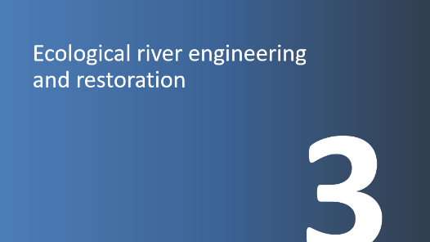
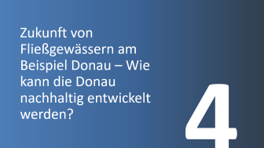
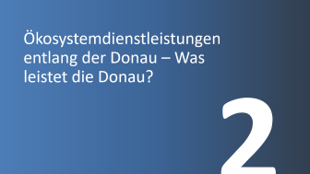
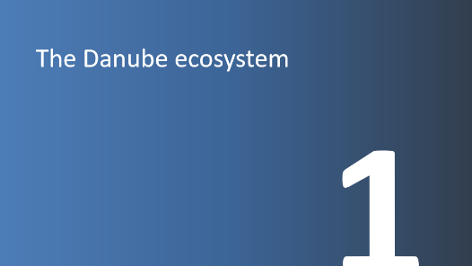
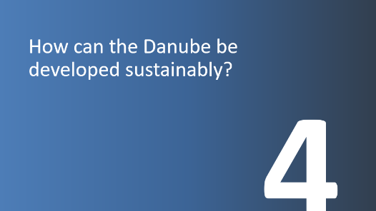
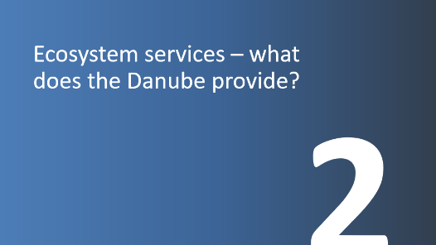
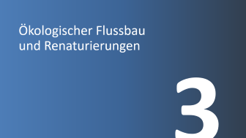
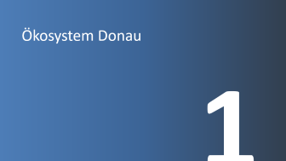
The Danube – ecosystem and lifeline

Slide 5
The Danube ecosystem
1

Slide 6
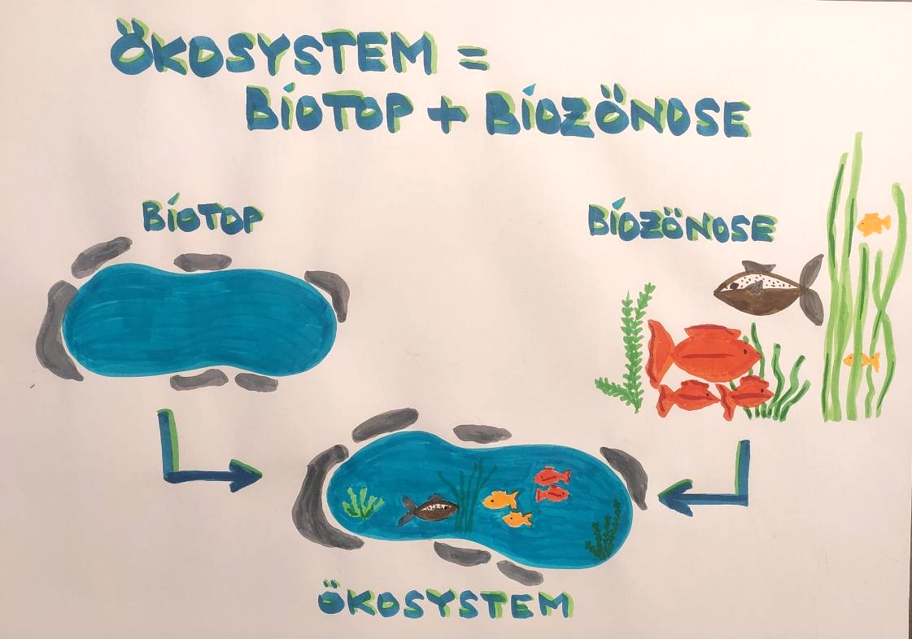
Ecosystem
An ecosystem is a unit consisting of living organisms (biocoenosis) and their non-living environment (biotope)
Biocoenosis and biotope are in constant interdependence and interaction with one another
The size of an ecosystem can vary greatly, from a small pond to a large forest
Image: own illustration
Notes:
Source: sofatutor GmbH (2025): https://www.sofatutor.at/biologie/videos/das-oekosystem#oekosystem-definition (Accessed on: 21.10.2025)

Slide 7
Freshwater ecology
Investigates water bodies as ecosystems and habitats
Two main areas of focus
Biological perspective: Examination of aquatic plants, fish, zooplankton, etc. | Physico-chemical perspective: Investigation of factors such as temperature, oxygen content and flow velocity
Objective: Understanding the structure, function and dynamics of freshwater ecosystems in order to be able to assess them
Notes:
Source: BMLUK (2025a): https://www.generationblue.at/wasserwissen/wasserqualitat/was-ist-gewaesseroekologie.html (Accessed on: 21.10.2025)

Slide 8
Freshwater ecology – flora and fauna
Water bodies are inhabited by a wide variety of different living organisms. These have different requirements for their habitat. Which animals and plants are found in a water body therefore always depends on the specific characteristics of that habitat.
If the habitat of a water body is altered by human interventions, certain species may no longer be able to exist there. They disappear or are replaced by other species.
These changes in animal and plant communities are measured in terms of ecological status and assessed according to a grading system – from very good to poor. The greater the deviation from the natural state, the worse the status.
A small deviation – a good ecological status – is still acceptable. However, if the deviation from the natural state increases, important functions, such as the natural self-purification capacity, can no longer be maintained.
The Danube is essential for Europe’s flora and fauna.
Side arms, groundwater, floodplains and alluvial forests form a complex ecosystem for numerous plants and animals.
Notes:
Source: BMLUK (2025b): https://info.bml.gv.at/themen/wasser/gewaesserbewirtschaftung/umsetzungsprojekte/gewaesseroekologie.html (Accessed on: 21.10.2025)
Our water bodies are inhabited by a wide variety of living organisms, such as fish, insects, mussels, crustaceans, algae and aquatic plants. These have different requirements for their habitat; for example, some need cold, fast-flowing waters, while others prefer warmer, slow-flowing conditions. Which animals and plants are found in a water body therefore always depends on the specific characteristics of that habitat.
If water bodies are altered by human interventions, such as straightening, construction or impoundment, the habitat changes. As a result, certain species may no longer be able to exist there. They disappear or are replaced by other species.
These changes in animal and plant communities are measured in terms of ecological status and assessed according to a grading system – from very good to poor. The greater the deviation from the natural state, the worse the status.
A small deviation – a good ecological status – is still acceptable. However, if the deviation from the natural state increases, important functions, such as the natural self-purification capacity, can no longer be maintained.
The Danube is essential for Europe’s flora and fauna.
Side arms, groundwater, floodplains and alluvial forests form a complex ecosystem for numerous plants and animals.

Slide 9
External influences on freshwater ecology
Human activity | Impact on water bodies
Nutrient inputs from agriculture and fertilisers | Algal blooms and oxygen depletion
Wastewater discharges | Pollutant inputs (heavy metals, hormone-like substances), pollution, changes in water quality
Construction and river regulation | Alteration of natural flow patterns and habitats, barriers to fish migration, changes in sediment transport
Climate change | Rising temperatures, increased evaporation, altered precipitation patterns affecting the water balance
Water abstraction for industry, agriculture and drinking water | Lowering of water levels, changes in flow conditions
Shipping and recreational use | Wave formation, noise, resuspension of bed sediments, bank erosion
Introduced animal and plant species | Displacement of native species and alteration of the ecosystem
Fisheries management | Selective fishing, disproportionate stocking of commercially valuable species, introduction of non-native species, introduction of parasites
Notes:
Sources: Bayrisches Landesamt für Umwelt (2025): https://www.lfu.bayern.de/wasser/klimawandel_wasserhaushalt/auswirkung_auf_wasserhaushalt/gewaesseroekologie/index.htm
(Accessed on: 21.10.2025)
Bund für Umwelt und Naturschutz Deutschland e.V. (BUND) (2025): https://www.bund.net/fluesse-gewaesser/auswirkungen-des-klimawandels-auf-den-wasserhaushalt/ (Accessed on: 21.10.2025)
Jungwirth et. Al (2003): https://boku.ac.at/fileadmin/data/H03000/H81000/H81200/_TEMP_/lehre/Angewandte_Fisch%C3%B6kologie_an_Flie%C3%9Fgew%C3%A4ssern.pdf (Accessed on: 21.10.2025)

Slide 10
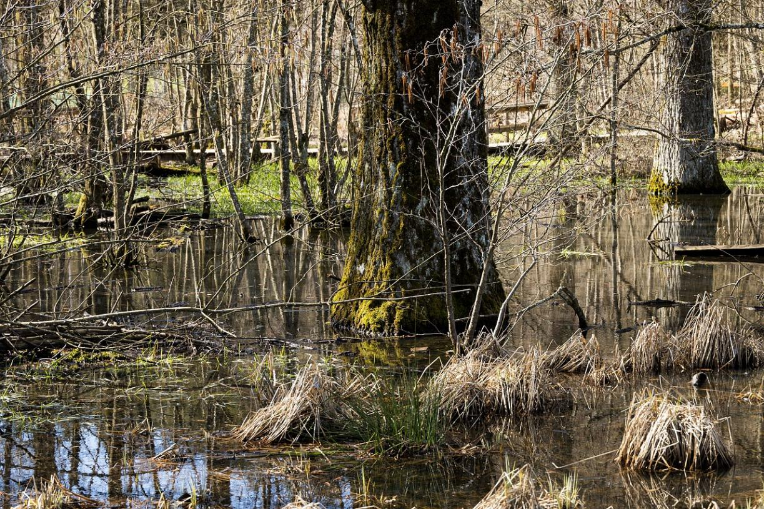
Nature conservation
Objective: Protection and preservation of animals and plants in their natural habitats
Many species are threatened with extinction and are protected by conservation laws; this means they may not be hunted or captured
For species protection, habitats such as rivers, forests, mountains and meadows must also be preserved
Responsibility in nature conservation:
  National responsibility: Each country protects nature within its own territory
  International cooperation: Governments must coordinate in order to jointly protect large areas such as rainforests. Organisations such as the EU and the UN implement cross-border conservation regulations.
Picture: Pixabay
Notes:
Sources: Umweltverband WWF Österreich (2025): https://www.wwf.at/artikel/naturschutz-was-heisst-das-genau/ (Accessed on: 21.10.2025)
Picture source: Pixabay (2025): https://pixabay.com/de/photos/wasser-sumpf-teich-holz-t%C3%BCmpel-4937798/ (Accessed on: 21.10.2025)

Slide 11
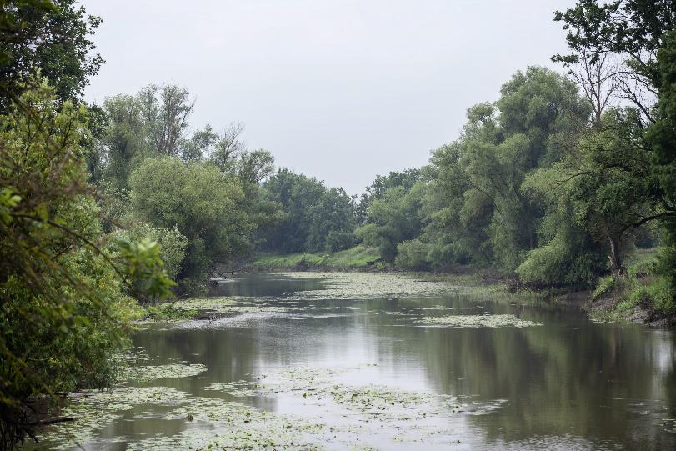
International protected area categories I
are monitored by the IUCN (International Union for Conservation of Nature)
it classifies protected areas and distinguishes six categories:
  strict nature reserve / wilderness area
  national park
  natural monument
  habitat/species management area
  protected landscape / marine area
  protected area with sustainable use of natural resources / cultural landscape
Picture: viadonau/Zinner
Notes:
Sources: Nationalparks Austria (2025): https://www.nationalparksaustria.at/de/news-detail-aktuelles/naturschutz-im-nationalpark.html (Accessed on: 21.10.2025)
Naturfreunde Österreich (2025): https://www.naturfreunde.at/berichte/reportagen/umweltthemen/unsere-naturschaetze-schutzgebiete-in-oesterreich/ (Accessed on: 21.10.2025)
Picture source: viadonau/Zinner
Monitored by the IUCN (International Union for Conservation of Nature), the World Conservation Union. It classifies protected areas and distinguishes six categories:
strict nature reserve / wilderness area
national park
natural monument
habitat/species management area
protected landscape / marine area
protected area with sustainable use of natural resources / cultural landscape.
The IUCN category Ia is the strictest protection category. An area in this category must remain free from human intervention of any kind and may only be entered for research purposes.
Areas in IUCN category Ib are large protected areas, mostly uninhabited regions, that should remain largely free from human impacts. They may be entered, but due to strict regulations, they are not suitable as tourist recreation areas.
In Austria, there is only one area in this protection category: the Rothwald primeval forest in Lower Austria in the Dürrenstein wilderness area (protected area category Ib).
A national park is a large protected area with particularly valuable natural landscapes that are only minimally influenced by humans. Abstaining from any economic use on at least 75% of the area is a prerequisite for recognition as a protected area according to IUCN category II. In contrast to protection category I, recreation and environmental education are a priority here. There are six national parks in Austria.

Slide 12
International protected area categories II
Strict nature reserve / wilderness area
IUCN category Ia is the strictest protection category. An area in this category must remain free from any human intervention and may only be entered for research purposes.
Areas in IUCN category Ib are large protected areas, mostly surrounding Ia areas, which should remain largely free from human intervention. They may be entered, but due to strict regulations they are not suitable as tourist recreation areas.
In Austria, there is only one area in this protection category: the Rothwald primeval forest in Lower Austria in the Dürrenstein wilderness area (protected area category Ib)..
National park
  A national park is a large protected area with particularly valuable natural landscapes that are only minimally influenced by humans. Abstaining from any economic use on at least 75% of the area is a prerequisite for recognition as a protected area according to IUCN category II. In contrast to protection category I, recreation and environmental education are the main focus here. In Austria, there are six national parks.
Notes:
Sources: Nationalparks Austria (2025): https://www.nationalparksaustria.at/de/news-detail-aktuelles/naturschutz-im-nationalpark.html (Accessed on: 21.10.2025)
Naturfreunde Österreich (2025): https://www.naturfreunde.at/berichte/reportagen/umweltthemen/unsere-naturschaetze-schutzgebiete-in-oesterreich/ (Accessed on: 21.10.2025)

Slide 13
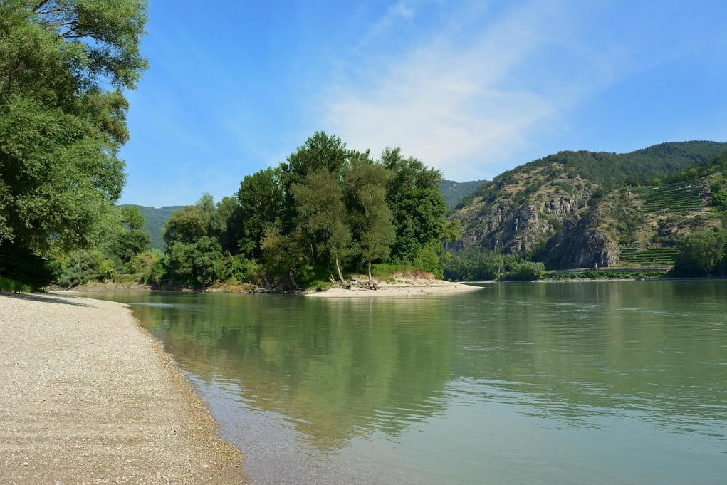
National park Danube floodplains
Founded in 1996
Area of 9,600 hectares
Last large riverine floodplain landscape in Central Europe
The freely flowing Danube over a stretch of around 36 km forms the lifeline of the national park
A hotspot of biodiversity for fish (74% of all species found in Austria) and amphibians (67%)
Habitat for the white-tailed eagle and the European pond turtle
Picture: Pixabay
Notes:
Source: Nationalpark Donau-Auen GmbH (2025): https://www.donauauen.at/wissen/zahlen-daten-fakten (Accessed on: 21.10.2025)
Picture source: Pixabay (2025): https://pixabay.com/de/photos/donau-auen-natur-auen-wald-sommer-4466714/ (Accessed on: 21.10.2025)
The path to the national park
Until the 19th century, the Danube was an untamed river. Extensive regulation and straightening by humans then drastically altered the natural balance of this river landscape in order to ensure flood protection and improve conditions for navigation. Many side arms were cut off and have since only been supplied with water by the Danube during floods. The Marchfeld flood protection dam separated large parts of the floodplains from the influence of the Danube.
Further major interventions followed through intensive forestry use across large areas of the floodplain forests. In the 1950s, construction began on an almost continuous chain of hydropower plants along the Austrian section of the Danube. This had an impact on the ecology of the entire river system. Apart from the Wachau, the last remaining free-flowing section of the Danube was located east of Vienna.
Initial protection considerations and measures
From 1973: first plans for a Danube–March–Thaya floodplain national park
1978: designation of the Lobau as a nature reserve (from 1977, the Lower Lobau was also a UNESCO biosphere reserve, although this status is no longer valid)
1982: designation of the Danube–March–Thaya floodplains in Lower Austria as a protected landscape area
1983: classification of the Danube–March–Thaya floodplains and the Lower Lobau as a wetland of international importance (under the Ramsar Convention)
In 1984, the planned construction of the Hainburg hydropower plant threatened to destroy this last longer free-flowing section of the Danube and its floodplain forests. Appeals by nature and environmental organisations led to nationwide protests. When construction was about to begin, thousands of people from all age groups and professions peacefully occupied the floodplain forests near Stopfenreuth (“Hainburg floodplain occupation”). After several unsuccessful attempts by police units to clear the area in December 1984, the federal government ordered a pause for reconsideration.
Extensive scientific studies were carried out, leading to surprising discoveries. For example, far more fish species were identified in the Danube than had been known at the time the hydropower plant was planned. The key outcome of these studies was that the Danube floodplains in and east of Vienna were worthy of national park status. It was also established that a hydropower plant would not be compatible with a national park.
In 1989/90, a 411-hectare area of the Regelsbrunn floodplain was secured through the WWF initiative “Buying back nature”. In 1990, an agreement was concluded between the Republic of Austria and the federal states of Lower Austria and Vienna to prepare for the establishment of a national park. From 1991 to 1995, planning for the national park was carried out by the Marchfeld Canal operating company.
On 27 October 1996, a state treaty was signed between the Republic of Austria and the federal states of Vienna and Lower Austria to establish and maintain the Donau-Auen National Park in accordance with Article 15a of the Federal Constitutional Law. The agreement was signed by Environment Minister Martin Bartenstein, Mayor Michael Häupl and Governor Erwin Pröll. The Donau-Auen National Park was thus officially established.
Developments since establishment
Forestry activities have largely been discontinued. The structural diversity and species composition of the floodplain forest, as well as the proportion of deadwood, show a trend back towards natural conditions. This benefits numerous rare species, including beetles, woodpeckers, owls and bats that inhabit ageing trees, as well as over 1,000 species of fungi.
Some floodplain meadows, which enhance the landscape and biodiversity of the national park, continue to be managed carefully. The “Heißländen” – unique dry grassland habitats – are actively maintained to preserve them.
Quiet zones have been established, providing habitats for sensitive species such as the white-tailed eagle, which had not bred in Austria for a long time. Today, the national park is a hotspot for this species, with up to six breeding pairs. Other rare and characteristic species of river landscapes are also specifically supported, such as the European pond turtle, which maintains Austria’s last reproducing native population here. The Danube floodplains east of Vienna are also home to many notable plant species, including black poplar, water soldier and wild grapevine.
Ecological river engineering and restoration
Significant progress has been made in ecological river engineering in cooperation with viadonau. Former side arms that had been cut off by regulation have been reconnected to the Danube, and heavily reinforced banks have been redesigned in a more natural way. This not only preserves but also improves the dynamic character of the floodplain landscape.
Floodwaters are now able to enter the area more frequently and shape it continuously. This creates habitats that benefit many endangered species, such as extensive unvegetated gravel banks and steep eroding riverbanks.
Following an initial water connectivity project in Haslau–Regelsbrunn, further projects were implemented in Orth an der Donau and Schönau. Near Hainburg, riverbank structures were removed along a stretch of almost 3 km. Shortly afterwards, the Danube reclaimed these areas, forming structurally diverse, natural banks. These innovative projects quickly attracted attention across Europe.
Subsequently, additional bank sections within the national park were restored, and the Hainburg Johler arm was reconnected to the river. Another project enabled the renaturalisation of the Spittelau branch in the Stopfenreuth floodplain, which now carries water for much of the year. Further projects are already in planning.
International cooperation
International cooperation and exchange of experience with partner protected areas is a key focus of national park work. The DANUBEPARKS network, founded at the initiative of Donau-Auen National Park, brings together protected areas from Bavaria to the Danube Delta and continuously implements joint projects in nature conservation, species protection and eco-tourism.
The Alpine–Carpathian River Corridor, a successful project in the CENTROPE Vienna–Bratislava region, has enabled ecological improvements along several Danube tributaries such as the Fischa and Schwechat, as well as rivers in neighbouring Slovakia, with strong involvement of local communities.

Slide 14
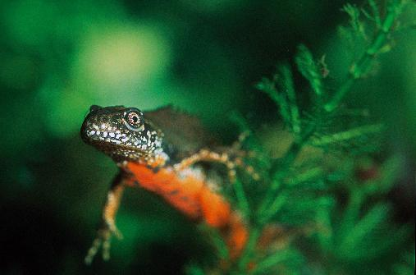
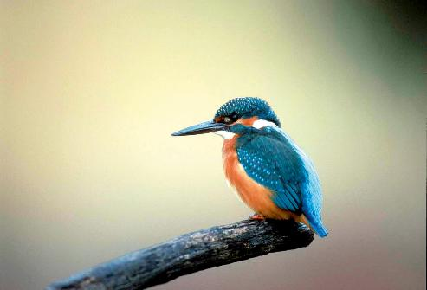
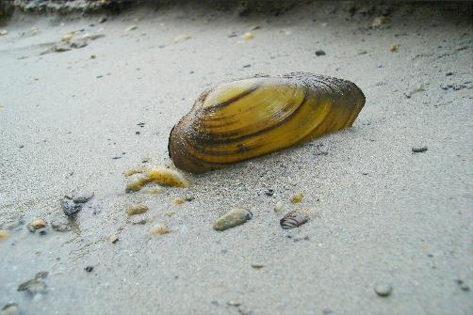
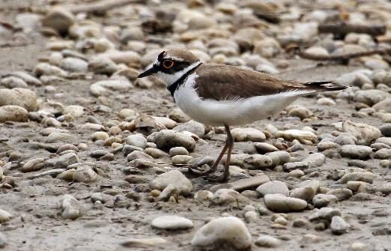
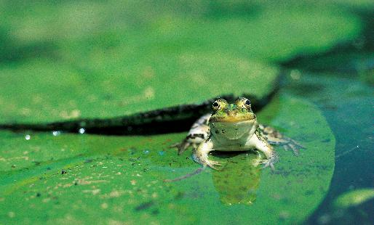
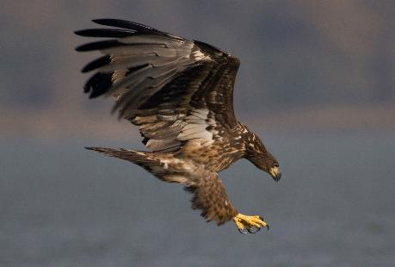
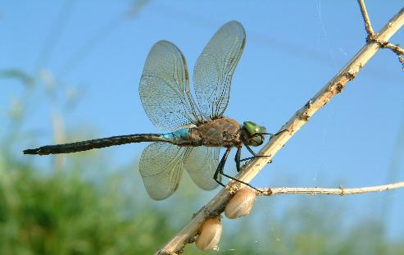
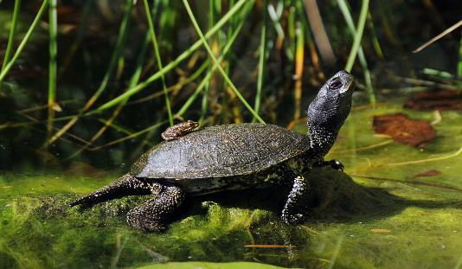
National park Danube floodplains: fauna
Danube crested newt
Picture source: Grotensohn
Kingfisher
Picture source: Kracher
Freshwater mussel
Picture source: Kern
Little ringed plover
Picture source: Kern
Pond frog
Picture source: Golebiowski-Navara
White-tailed eagle
Picture source: Hoyer
Dragonfly
Picture source: Geerts
European pond turtle
Picture source: Kern
Notes:
Pictures source: Nationalpark Donau-Auen https://www.donauauen.at/aktuelles/downloads/foto-service (Accessed on: 22.10.2025)

Slide 15
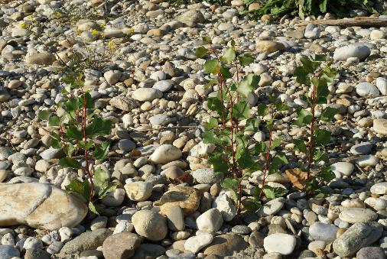
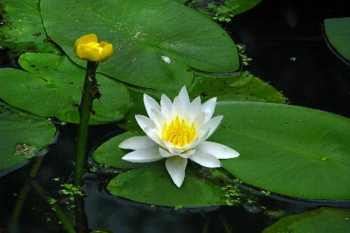
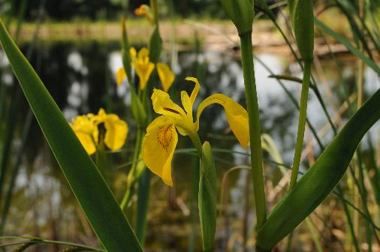
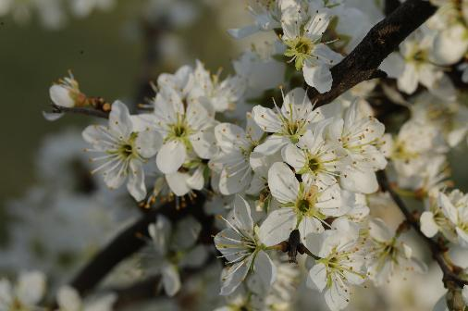
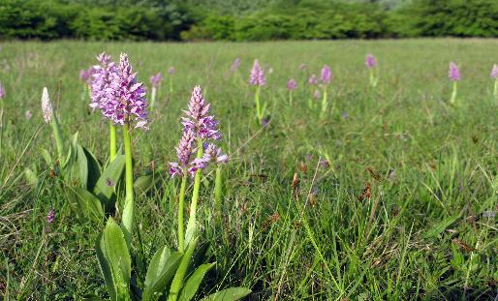
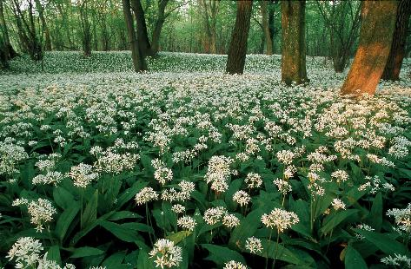
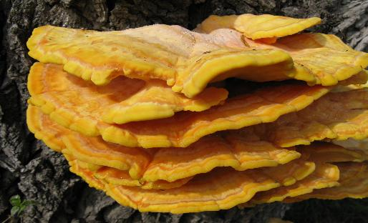
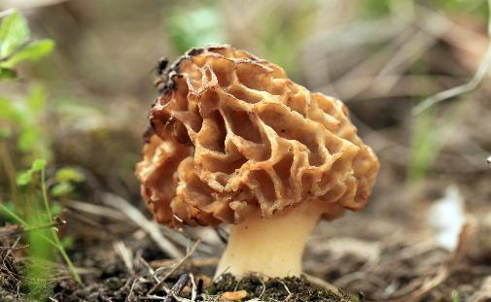
National park Danube floodplains: flora
Black poplar
Picture source: Baumgartner
Pond lily and water lily
Picture source: Kern
Yellow iris
Picture source: Dolecek
Blackthorn
Picture source: Baumgartner
Orchids
Picture source: Baumgartner
Wild garlic
Picture source: Krovacs
Sulphur polypore
Picture source: Baumgartner
Morel
Picture source: Baumgartner
Notes:
Pictures source: Nationalpark Donau-Auen https://www.donauauen.at/aktuelles/downloads/foto-service (Accessed on: 22.10.2025)

Slide 16
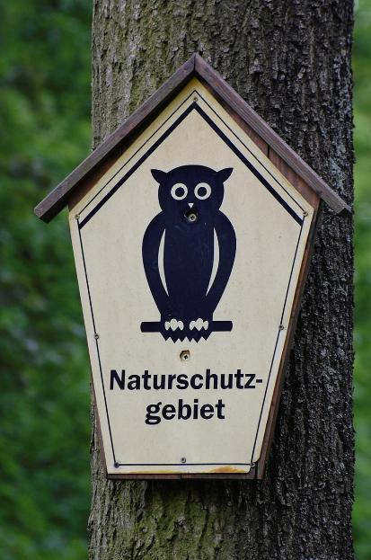
Quiz
What percentage of Austria’s area is under strict nature conservation (IUCN categories Ia, Ib and II)?
Picture: Pixabay
Notes:
Picture source: Pixabay (2025): https://pixabay.com/de/photos/naturschutzgebiet-schild-eule-1139610/ (Accessed on: 21.10.2025)

Slide 17
Quiz
What percentage of Austria’s area is under strict nature conservation (IUCN categories Ia, Ib and II)?
According to a 2023 study, only 2.5% of Austria is under strict nature conservation (IUCN categories Ia, Ib and II).
Picture: Pixabay
Notes:
Source: Gatti et.al (2023): https://link.springer.com/article/10.1007/s10531-023-02644-5#Fig1 (Accessed on: 21.10.2025)
Picture source: Pixabay (2025): https://pixabay.com/de/photos/naturschutzgebiet-schild-eule-1139610/ (Accessed on: 21.10.2025)

Slide 18
Additional (European and national) protected area categories
Strict nature reserve / wilderness area | National parks
Natura 2000 To safeguard Europe’s natural diversity, the EU has adopted two directives: Birds Directive Habitats Directive Both directives provide for the establishment of protected areas in which endangered species and habitats are to be preserved for the future, known as Natura 2000 sites. Natura 2000 covers around 19% of the European mainland (as of January 2024). In Austria, there are 353 such sites, covering around 15% of the national territory (as of January 2024). | Nature conservation area A nature conservation area is a largely natural or near-natural area with valuable habitats and/or rare or endangered animal and plant species worthy of protection. The protection of these natural assets is the primary objective. Interventions that are incompatible with conservation goals are to be prevented. This type of protected area is one of the most important categories of area-based conservation in Austria. Although, in principle, any intervention in nature is prohibited in nature conservation areas, agricultural and forestry use is generally permitted “to the same extent as before”.
Other protected areas include: areas awarded the European Diploma, biosphere reserves, landscape protection areas, nature parks, etc.
Notes:
Sources: Naturfreunde Österreich (2025): https://www.naturfreunde.at/berichte/reportagen/umweltthemen/unsere-naturschaetze-schutzgebiete-in-oesterreich/ (Accessed on: 21.10.2025)
Umweltverband WWF Österreich (2025): https://www.wwf.at/artikel/natura-2000/?gad_source=1&gclid=Cj0KCQiAkJO8BhCGARIsAMkswyh71nae9HUR7LEu9G1OLZZhZyNbGKgZRszYVLRGgbYh9TOaoR9klTUaApUpEALw_wcB (Accessed on: 21.10.2025)
A nature conservation area is a largely natural or near-natural area characterised by the presence of valuable habitats and/or the occurrence of rare or endangered animal and plant species. The protection of these natural assets is the primary objective, and interventions that are incompatible with conservation goals are to be prevented. The first nature conservation area in Austria was designated in 1927 in the Marchfeld region: the Weikendorfer Remise near Oberweiden.
This category of protected area is one of the most important forms of area-based conservation in Austria. In general, however, agricultural and forestry uses are permitted “to the same extent as before”, even though, in principle, any intervention in nature is prohibited. In certain cases, this can lead to conflicts of interest. Management plans, which have been developed for nature conservation areas in some federal states, define the necessary measures for habitat conservation and regulate land use in line with conservation objectives.

Slide 19
Solving a crossword puzzle
Test your knowledge of the ecology of the Danube with our crossword puzzle!
Download here:
www.rewway.at/en/teaching-materials/danube-ecology-crossword

Slide 20
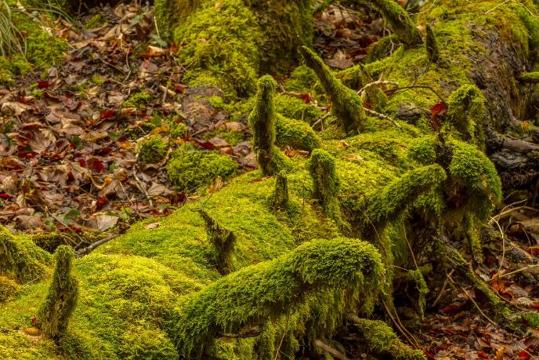
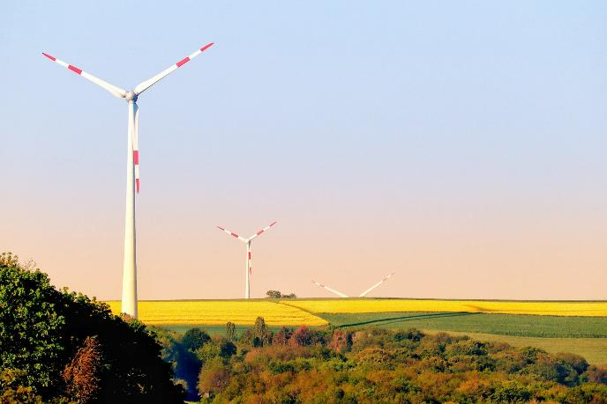
Nature conservation vs. climate protection
Nature conservation aims to preserve and protect biodiversity and ecosystems, as well as natural habitats
Climate protection seeks to combat human-induced climate change in order to minimise its impacts
Pictures: Pixabay
Notes:
Source: Heinrich-Böll-Stiftung Schleswig-Holstein e.V. (2025) https://bewirk.sh/2023/klimaschutz-vs-naturschutz/ (Accessed on: 21.10.2025)
Pictures sources: Pixabay (2025): https://pixabay.com/de/photos/moos-natur-holz-baum-totholz-3068171/ (Accessed on: 21.10.2025)
Pixabay (2025): https://pixabay.com/de/photos/windm%C3%BChle-windenergie-windpark-8003051/ (Accessed on: 22.10.2025)

Slide 21
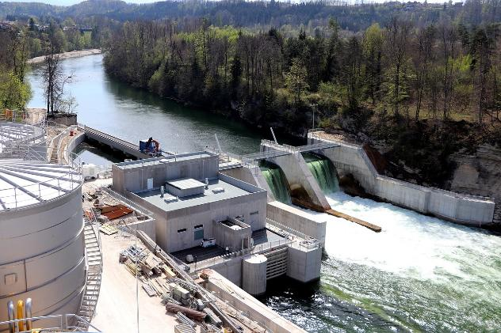
Nature conservation vs. climate protection – hydropower
In Austria, there are over 5,200 hydropower plants; every 900 metres, a transverse structure interrupts our rivers and streams.
Problems:
  Extensive river engineering is the main reason why 60% of native fish species are endangered or threatened with extinction
  Unrestricted expansion instead of refurbishing and improving the efficiency of existing plants
  Many hydropower projects are planned in protected areas
  The minimal contribution of small hydropower plants to the energy transition is often disproportionate to the environmental damage they cause
  What solutions could look like to ensure that climate protection and nature conservation go hand in hand?
Picture: Pixabay
Notes:
Source: WWF Österreich (2025): https://www.wwf.at/das-schuetzen-wir/fluesse/wasserkraft-in-oesterreich/ (Accessed on: 21.10.2025)
Picture source: Pixabay (2025): https://pixabay.com/photos/hydropower-plant-electricity-energy-4560237/ (Accessed on: 21.10.2025)
Since time immemorial, humans have made use of the power of water: to drive mills, to transport goods and, in the last century, also to generate electricity. Electricity produced from hydropower is often marketed as ecological and sustainable. But is this really the case?
Each power plant is a major intervention
The fact is that hydropower plants interfere massively with the natural habitat of a river. They block it, dam it, divert water or flood entire valleys behind a dam wall. As a result, hydropower contributes to species loss and reduces the vitality of healthy rivers. This is particularly alarming, as freshwater ecosystems such as rivers are already among those most affected by biodiversity loss. Hydropower therefore cannot truly be described as ecological and sustainable.
Hydropower in Austria
In Austria, hydropower accounts for a large share of electricity generation. Austria’s rivers are therefore under pressure: the expansion of hydropower continues to be strongly promoted, even though rivers are already heavily modified. There are already more than 5,200 hydropower plants in Austria. So-called hydrological alteration – for example, the destruction of natural river landscapes – is the main cause of species loss in Austria.
The WWF therefore works together with partner organisations and local communities to promote careful and respectful interaction with nature and to oppose further development of ecologically valuable river stretches.
Facts and figures
More than 5,200 hydropower plants place pressure on Austria’s rivers – 80% of them do not meet minimum ecological standards
60% of our rivers need to be restored
Only 15% of our rivers are in a good ecological condition
Every 900 metres, a transverse structure interrupts rivers and streams
Wildlife
60% of all native fish species are endangered or threatened with extinction
Endangered animal species such as grayling, common sandpiper, gravel bank grasshopper or dipper depend on natural and dynamic river landscapes
Threats
How hydropower threatens rivers in Austria
Threat 1: Uncontrolled expansion
Austria’s rivers have been heavily developed and regulated for flood protection, land use and hydropower. No other country in Europe has as many hydropower plants relative to its area as Austria. The majority of these installations are outdated and do not meet minimum ecological standards.
Too much water is often extracted from rivers, and fish are obstructed in their essential migration routes. The extensive modification of rivers is the main reason why 60% of native fish species are endangered or threatened with extinction. Many other animal and plant species, such as the common sandpiper or German tamarisk, are also losing their habitats.
However, instead of refurbishing old plants and improving their efficiency, Austria continues to build new ones. Hundreds of hydropower projects are being pursued without coordination and subsidised with tens of millions of euros. Construction is often planned in the most ecologically valuable and last remaining near-natural stretches, including protected areas: every third hydropower project is planned within a protected area.
Humans are also affected by the loss of natural river landscapes, as recreational areas are lost and the safeguarding of water resources is compromised.
Threat 2: An overly positive image
Electricity from hydropower has a positive public image. However, this is misleading: while water itself is renewable, destroyed habitats are not. Hydropower expansion must therefore be ecologically and socially compatible. In practice, however, consideration for nature is often seriously neglected.
Under the argument of public interest, power plants are approved even in ecologically sensitive river sections. This puts Austria at odds with European legislation, which requires that the condition of water bodies must not deteriorate. Through political directives, even projects that would not normally be approved – such as the Lesachbach hydropower plant (upper section) in East Tyrol – are allowed to proceed.
The minimal contribution these small hydropower plants make to the energy transition is disproportionate to the environmental damage they cause. There is a lack of an overall strategy defining where and under what conditions hydropower is still acceptable, and where valuable river ecosystems must be preserved for future generations.
80% of Austrian hydropower plants do not meet minimum ecological standards
Threat 3: Subsidies create the wrong incentives
The expansion of renewable energy sources is funded by electricity consumers. While this is generally positive, in the case of hydropower it creates the wrong incentives by driving expansion in ecologically sensitive areas.
Subsidies are distributed without differentiating sufficiently according to the ecological impacts of a plant. Even very small hydropower plants, which make no significant contribution to the energy transition but cause disproportionately high environmental damage, receive comparatively high levels of funding. This subsidy policy effectively makes environmental degradation profitable – and that is highly problematic.
Solutions
How we can protect the last living rivers
Solution 1: A rescue plan for our rivers
As only very few parts of our rivers remain in a very good ecological condition, it is essential both to protect the remaining natural and near-natural river stretches from development and to restore degraded water bodies.
The last intact river sections can be protected by imposing construction bans or by designating them as protected areas. At the same time, 60% of our rivers must be restored so that they can return to a good ecological condition.
The modernisation of outdated hydropower plants plays an important role in making rivers passable again and restoring ecological functions. The removal of unprofitable plants is also an important measure for restoring the natural vitality of rivers.
Long-term and effective protection could preserve wild river landscapes such as the Lech or Isel as habitats for animals and plants, as well as recreational areas for future generations.
Solution 2: Climate protection and nature conservation hand in hand
Forecasts indicate that electricity demand will continue to rise in the coming years. However, even if the last small streams were developed, this would still not be sufficient to meet increasing demand. The complete expansion of hydropower is therefore not a solution to the energy problem.
Instead, it is necessary to reduce energy consumption. There is significant potential in areas such as mobility and building insulation. By modernising and improving the efficiency of existing power plants, more electricity can be generated without causing additional damage to nature.
When expanding renewable energy sources, a balanced energy mix is required, along with clear and effective environmental compatibility criteria. The WWF study “Energy transition and water protection” shows how a nature-compatible energy transition can be achieved without sacrificing Austria’s natural assets.
Solution 3: Environmental criteria for renewable electricity subsidies
To avoid creating incentives for environmentally harmful hydropower projects in unsuitable locations, it is essential to link subsidies to strict nature conservation criteria. The Renewable Energy Expansion Act adopted in 2021 defines funding rules. For the first time, it includes protection criteria for ecologically high-quality river sections, ensuring that the most harmful new projects are excluded from subsidies.
However, loopholes still exist, particularly for developments in protected areas and for small hydropower plants that generate relatively little electricity but cause significant environmental damage. Here, the funding system continues to create misguided incentives for the development of intact rivers.
Only 14% of water bodies are still in a very good ecological condition, while 60% require restoration. Subsidised projects must not worsen the condition of rivers or harm protected species. In the future, even controversial projects in protected areas must not be supported by subsidies.
The modernisation of outdated installations must take priority over the construction of new hydropower plants. An intact natural environment is our strongest ally against the climate crisis. Therefore, habitats of threatened species must be better protected when expanding renewable energy.
Source: https://www.wwf.at/das-schuetzen-wir/fluesse/wasserkraft-in-oesterreich/

Slide 22
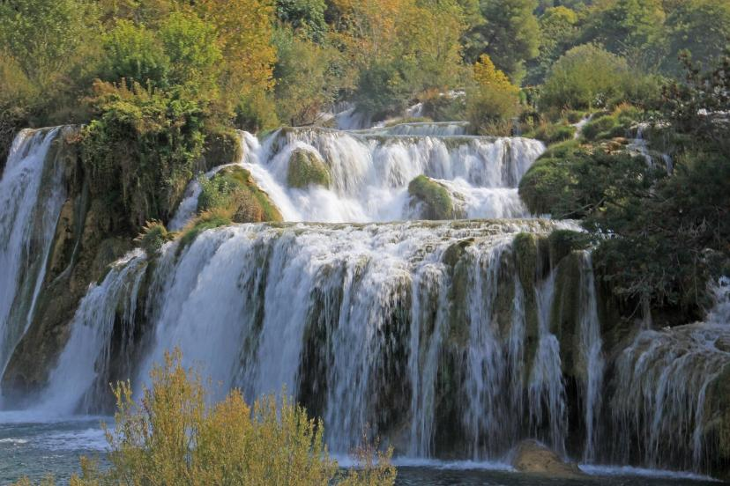
Nature conservation vs. climate protection – hydropower
Solutions:
  Modernisation and efficiency improvements of outdated hydropower plants?
  When expanding renewable energy sources, ensure a balanced mix of energy sources as well as clear and effective environmental compatibility criteria?
  Link funding to nature conservation criteria?
Picture: Pixabay
Notes:
Source: WWF Österreich (2025): https://www.wwf.at/das-schuetzen-wir/fluesse/wasserkraft-in-oesterreich/ (Accessed on: 21.10.2025)
Picture source: Pixabay (2025): https://pixabay.com/photos/waterfall-water-flow-nature-4530180/ (Accessed on: 21.10.2025)
Since time immemorial, humans have used the power of water: to drive mills, to transport goods and, in the last century, also to generate electricity. Electricity produced from hydropower is often marketed as ecological and sustainable. But is this really the case?
Each power plant is a major intervention
The fact is that hydropower plants intervene massively in the natural habitat of a river. They block it, dam it, divert water or flood entire valleys behind a dam wall. As a result, hydropower contributes to species loss and reduces the vitality of healthy rivers. This is particularly alarming, as freshwater ecosystems such as rivers are already among the most affected by biodiversity loss. Hydropower therefore cannot truly be described as ecological and sustainable.
Hydropower in Austria
In Austria, hydropower accounts for a large share of electricity generation. Austria’s rivers are therefore under pressure: the expansion of hydropower continues to be strongly promoted, even though rivers are already heavily modified. There are already more than 5,200 hydropower plants in Austria. So‑called hydrological alteration – for example, the destruction of natural river landscapes – is the main cause of species loss in Austria.
The WWF therefore works together with partner organisations and local communities to promote careful and respectful interaction with nature and to oppose further development of ecologically particularly valuable river stretches.
Facts and figures
More than 5,200 hydropower plants place pressure on Austria’s rivers – 80% of them do not meet minimum ecological standards
60% of our rivers need to be restored
Only 15% of our rivers are in a good ecological condition
Every 900 metres, a transverse structure interrupts our rivers and streams
Wildlife
60% of all native fish species are endangered or threatened with extinction
Endangered animal species such as grayling, common sandpiper, gravel bank grasshopper or dipper depend on natural and dynamic river landscapes
Threats
How hydropower threatens rivers in Austria
Threat 1: Uncontrolled expansion
Austria’s rivers have been heavily developed and regulated for flood protection, land use and hydropower. No other country in Europe has as many hydropower plants relative to its area as Austria. Most of these installations are outdated and do not meet minimum ecological standards.
Too much water is often extracted from rivers, and fish are obstructed in their essential migration routes. The extensive modification of rivers is the main reason why 60% of native fish species are endangered or threatened with extinction. Many other animal and plant species, such as the common sandpiper or German tamarisk, also lose their habitats.
However, instead of modernising old plants and improving their efficiency, Austria continues to build new ones. Hundreds of hydropower projects are being pursued in an uncoordinated manner and subsidised with tens of millions of euros. Construction is often planned in the most ecologically valuable and last remaining near-natural stretches, including protected areas: every third hydropower project is planned within a protected area.
Humans are also affected by the loss of natural river landscapes, as recreational areas are disappearing and the safeguarding of water resources is being compromised.
Threat 2: An overly positive image
Electricity from hydropower has a positive public image. However, this is misleading: while water itself is renewable, destroyed habitats are not. Hydropower expansion must therefore be ecologically and socially compatible. In practice, however, consideration for nature is often largely neglected.
Under the argument of public interest, power plants are approved even in ecologically sensitive river sections. This puts Austria at odds with European legislation, which requires that the condition of water bodies must not deteriorate. Through political directives, even projects that would not normally be eligible for approval – such as the Lesachbach hydropower plant (upper section) in East Tyrol – are allowed to proceed.
The minimal contribution that such small hydropower plants make to the energy transition is disproportionate to the environmental damage they cause. There is a lack of an overall strategy that defines where and under what conditions hydropower is still possible, and where valuable river ecosystems should be preserved for future generations.
80% of Austrian hydropower plants do not meet minimum ecological standards
Threat 3: Subsidies create the wrong incentives
The expansion of renewable energy sources is financed through electricity consumers. While this is generally welcome, in the case of hydropower it creates the wrong incentives by encouraging expansion in ecologically sensitive areas.
Subsidies are often distributed without sufficiently considering the ecological impacts of a plant. Even very small hydropower plants, which make no significant contribution to the energy transition but cause disproportionately high environmental damage, receive comparatively high levels of funding. This subsidy policy effectively makes environmental damage profitable – which is highly problematic.
Solutions
How we can protect the last living rivers
Solution 1: A rescue plan for our rivers
As only very few parts of our rivers remain in a very good ecological condition, it is essential both to protect the remaining natural and near-natural river stretches from development and to restore degraded water bodies.
The last intact river sections can be protected by imposing construction bans or by designating them as protected areas. In addition, 60% of our rivers must be restored so that they can return to a good ecological condition.
Modernising outdated hydropower plants plays an important role in restoring river continuity and ecological functions. The removal of unprofitable plants is also an important measure to restore the natural vitality of rivers.
Long-term and effective protection could preserve wild river landscapes such as the Lech or Isel as habitats for animals and plants, as well as recreational areas for future generations.
Solution 2: Climate protection and nature conservation hand in hand
Forecasts indicate that electricity demand will continue to rise in the coming years. However, even if the last small streams were developed, this would not be sufficient to meet increasing demand. The complete expansion of hydropower is therefore not a solution to the energy problem.
Instead, it is necessary to reduce energy consumption. There is considerable potential in areas such as mobility and building insulation. By modernising and improving the efficiency of existing power plants, more electricity can be generated without causing additional damage to nature.
When expanding renewable energy sources, attention must be paid to a balanced mix of energy sources as well as to clear and effective environmental compatibility criteria. The WWF study “Energy transition and water protection” shows how a nature-compatible energy transition can be achieved without sacrificing Austria’s natural assets.
Solution 3: Environmental criteria for renewable electricity subsidies
To avoid creating incentives for particularly environmentally harmful hydropower plants in unsuitable locations, it is essential to link subsidies to strict nature conservation criteria. The Renewable Energy Expansion Act adopted in 2021 defines the funding framework. For the first time, protection criteria for ecologically high-quality river stretches have been included, meaning that at least the most harmful new projects are excluded from subsidies.
However, the continued existence of loopholes for developments in protected areas and for small hydropower plants — which generate relatively little electricity but cause significant environmental damage — is highly problematic. Here, the funding system still creates misguided incentives for the development of intact rivers.
Only 14% of water bodies are still in a very good ecological condition, while 60% require restoration. Subsidised projects must not worsen the condition of rivers or harm protected species. In future, even controversial projects in protected areas must no longer be supported by subsidies.
The modernisation of outdated installations must take priority over the construction of new hydropower plants. An intact natural environment is our greatest ally in tackling the climate crisis. Therefore, the habitats of endangered species must also be better protected during the expansion of renewable energy.
Source: https://www.wwf.at/das-schuetzen-wir/fluesse/wasserkraft-in-oesterreich/

Slide 23
Ecosystem services – what does the Danube provide?
2

Slide 24
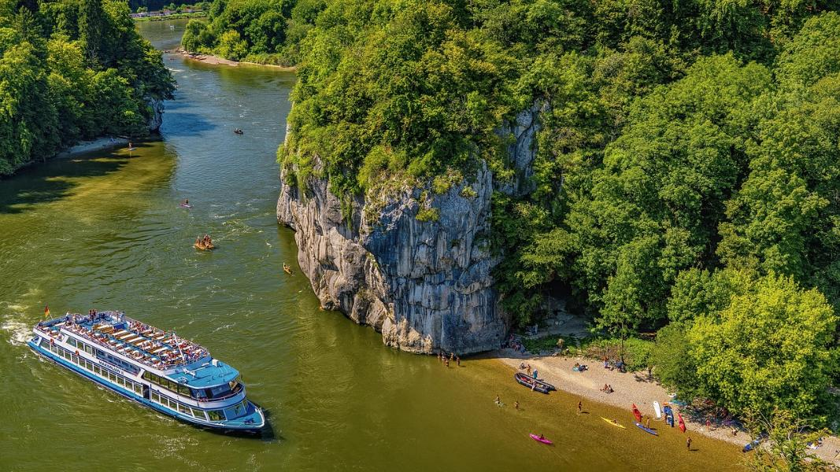
Ecosystem services
Ecosystem services are services that provide direct or indirect benefits to humans, for example economic, material, health-related or psychological benefits.
Which ecosystem services do rivers provide?
Picture: Pixabay
Notes:
Source: Umweltbundesamt (2021): https://www.umweltbundesamt.de/leistungen-nutzen-renaturierter-fluesse#okosystemleistungen-von-fliessgewassern (Accessed on: 21.10.2025)
Picture source: Pixabay (2025): https://pixabay.com/de/photos/donau-bayern-stadt-flu%C3%9F-wasser-2646145/ (Accessed on: 21.10.2025)

Slide 25
Ecosystem services of rivers
Water supply (drinking water, industry, agriculture)
Habitat for numerous plant and animal species
Flood protection
Tourism and recreation
Climate regulation
Energy generation
Transport route
Picture: Pixabay
Notes:
Source: Umweltbundesamt (2021): https://www.umweltbundesamt.de/leistungen-nutzen-renaturierter-fluesse#okosystemleistungen-von-fliessgewassern (Accessed on: 21.10.2025)

Slide 26
Water management and drinking water supply
Task
Read the two newspaper articles and discuss the advantages and disadvantages of water management.
Donauwasser gegen die Dürre: Lösung für den Osten Österreichs?
WWF: Donau-Wasser im Neusiedler See wäre folgenschwerster Eingriff seit 100 Jahren - WWF Österreich
Notes:
1. Newspaper article in Kurier by Michael Pekovics (2 September 2024): Danube water against drought: a solution for eastern Austria?
In view of increasing water scarcity in eastern Austria, an important step towards securing water resources was taken on the very first working day after the “political summer break”. Federal Minister Norbert Totschnig (ÖVP), the Governor of Lower Austria Johanna Mikl-Leitner (ÖVP) and the Governor of Burgenland Hans Peter Doskozil (SPÖ) signed a memorandum of understanding. A key measure is the transfer of Danube water to the dry regions in the east. For Burgenland, this cooperation is of great importance, particularly for protecting Lake Neusiedl and the soda lakes in the Seewinkel region.
Doskozil emphasised: “In Burgenland, we can already draw on detailed and well-founded studies regarding the transfer and compatibility of Danube water. We should therefore move quickly to take the necessary planning steps and coordination measures. We will not find an effective ‘stop button’ for climate change any time soon.”
“We need to develop long-term and robust solutions for regions with low precipitation,” Minister Totschnig agreed. The focus is on sustainable drinking water supply as well as safeguarding domestic food production. “For me, drinking water supply has top priority.”
There is also an urgent need for action in Lower Austria: “Together with Burgenland, we agree on the necessity of supra-regional water supply systems. We want to plan interregional pipelines to channel Danube water into the low-rainfall regions north and south of the Danube, so that future water demands can be met sustainably,” explained Mikl-Leitner.
The plan includes a thorough assessment of both social and environmental impacts. In the coming months, concrete implementation concepts and financing models are to be developed in order to advance this water strategy. Both agricultural adaptation and the protection of regional ecosystems will be taken into account.
All technical, ecological and financial aspects of the Danube water transfer are to be clarified in a feasibility study. This will examine not only the transfer of water but also how it can be used efficiently to ensure both drinking water supply and agricultural production.
In the long term, cooperation between the federal government and the provinces is intended to create interregional supply systems that ensure a stable and sustainable water supply for the entire eastern part of Austria.
Burgenland already has experience with water scarcity. For years, the impacts of climate change and the necessary countermeasures have been discussed. Intensive exchanges at expert level have taken place in recent months with Lower Austria and the Ministry of Agriculture. Agriculture, alongside drinking water supply, is one of the sectors most affected by drought.
“Our agriculture must adopt new farming methods and crop types that require less water,” adds Heinrich Dorner, Burgenland’s provincial councillor for infrastructure. Careful use of the valuable resource water is essential. “The priorities set out in the memorandum align with our plans to adapt agriculture to changing climatic conditions.”
Particular attention is being paid to sensitive wetland habitats such as Lake Neusiedl, which are important not only for the environment but also for tourism. Lake Neusiedl, a UNESCO World Heritage Site, and the soda lakes of the Seewinkel are especially affected. These unique ecosystems depend heavily on the water balance and react sensitively to changes.
“We all agree on the national and international importance of unique habitats such as Lake Neusiedl and the soda lakes of the Seewinkel. That is why we share the goal of implementing measures to secure water resources in eastern Austria in the face of climate change, and thereby safeguarding these habitats,” said Doskozil.
2. WWF press release by Valentin Ladstätter (3 October 2023): WWF: Danube water in Lake Neusiedl would be the most serious intervention in 100 years
At present, the UNESCO World Heritage Secretariat and the Ramsar Secretariat are conducting a joint advisory mission at Lake Neusiedl. Their aim is to gain an on-site impression of the controversial plans to supply water to the lake. On this occasion, the conservation organisation WWF Austria urgently warns of the irreparable damage that would result from artificially introducing Danube water into Lake Neusiedl.
“A transfer of foreign water would gradually dilute the saline lake and ultimately lead to the complete loss of its salt content,” warns WWF conservation expert Bernhard Kohler. “The dilution process began with the construction of the Einser Canal 100 years ago and has already progressed dangerously far. With every discharge via the canal, the lake has lost large amounts of salt. The introduction of calcareous Danube water would accelerate this process and deal the final blow to the lake.”
Today, the salt content of the lake is only 1–2 grams per litre. Before the construction of the Einser Canal, levels of up to 16 grams were recorded — roughly half the salinity of the Atlantic Ocean.
“Almost all animal and plant species that make Lake Neusiedl unique in Europe depend on a certain salt content,” explains Kohler. “In addition, the lake would lose its self-purification capacity if water were added, leading to massive algal growth and accelerated siltation and silting up.”
Instead of transferring Danube water, WWF argues for a different approach to water management in the region: floodwaters should no longer be diverted to the same extent. Formerly connected floodplains should be reconnected to the lake, allowing them to store water during high-water periods and release it during dry phases.
“This is particularly important in light of the climate crisis, which leads not only to longer periods of drought but also to more intense flooding events,” explains Kohler. Water management must adapt to these changes by storing water during wet periods in order to prepare for dry periods.
To retain more water in the lake, existing bathing facilities must also be made flood-proof. “The Einser Canal has deprived the lake of both floodwaters and salt. It is time to restore natural flooding processes and stop salt loss by largely avoiding water diversion,” says Kohler.
“The solution to the water problem lies in greater naturalness, not in increased artificial intervention.”
Background
The Ramsar Convention is an international agreement for the protection of wetlands, which Austria joined exactly 40 years ago. Lake Neusiedl was the first wetland nominated by Austria under this convention, committing both the Republic of Austria and the Province of Burgenland to its conservation and sustainable use.
Under the concept of “wise use”, the Ramsar Convention promotes the careful use of wetlands while preserving their ecological integrity. If the ecological integrity of a designated wetland appears to be at risk, an international advisory mission by Ramsar experts can be initiated. This mission may issue recommendations for improved protection or even advise against projects that could endanger the site.
At Lake Neusiedl, a joint mission by the Ramsar Secretariat and the UNESCO World Heritage Secretariat took place from 2 to 5 October 2023, as both designations are considered to be at risk due to ongoing and planned developments.

Slide 27
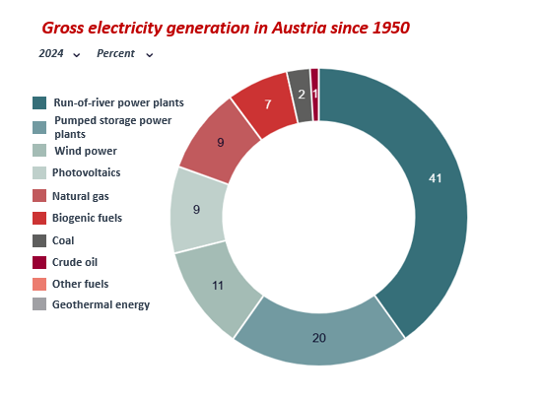
Energy generation
In 2023, 85% of the electricity generated in Austria came from renewable sources — primarily hydropower, with a share of 60.8%.
Image: E-Control
Notes:
Source: Österreichs E-Wirtschaft (2025): https://oesterreichsenergie.at/fakten/stromstatistik (Accessed on: 27.10.2025).
Image source: E-Control (2025): https://oesterreichsenergie.at/fakten/stromstatistik (Accessed on: 27.10.2025).

Slide 28
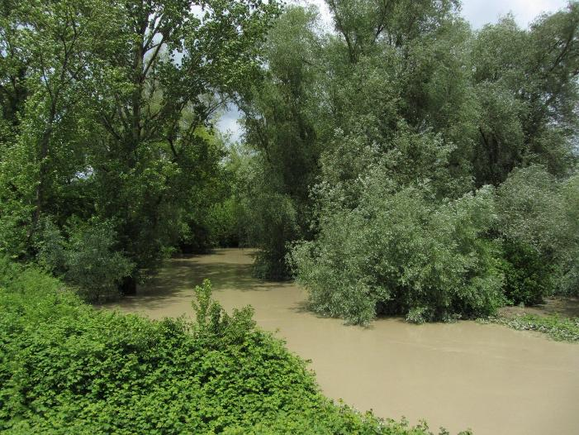
Flood protection
Flood protection is one of the central functions of a natural river ecosystem.
For example, the extensive Danube floodplains east of Vienna serve as natural retention areas. They can absorb large quantities of water, release it again with a delay and thereby significantly reduce the impacts of flooding. In contrast, such wide floodplain areas are largely absent west of Vienna today.
In order for rivers to have sufficient space to expand during floods, undeveloped floodplain areas and retention spaces are of crucial importance. At the same time, these flooding events are vital for the floodplain ecosystem itself, as they maintain its natural dynamics and biodiversity.
Picture: Pixabay
Notes:
Sources: BMLUK (2025): https://www.generationblue.at/wasserwissen/wasserqualitat/was-ist-gewaesseroekologie.html (Accessed on: 27.10.2025).
Nationalpark Donau-Auen GmbH (2025): https://www.donauauen.at/wissen/natur-wissenschaft/die-donau/die-au-nach-dem-hochwasser (Accessed on: 27.10.2025).
Picture source: Pixabay (2025): https://pixabay.com/de/photos/hochwasser-fluss-baum-landschaft-180495/ (Accessed on: 27.10.2025).

Slide 29
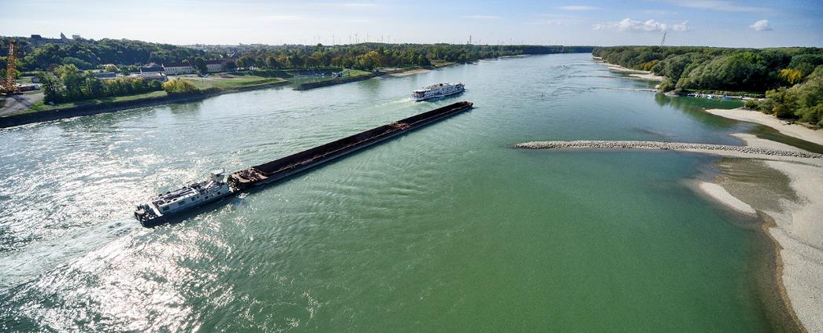
The Danube as transport and transport infrastructure
2,415 km navigable
Connects 10 riparian countries (from the Black Forest to the Black Sea)
Important for the transport of steel, paper, mineral oil, agricultural products, chemical products, cars and mechanical engineering goods
Transport volume 2024: 6.6 million tonnes
Lock passages of vessels at Austrian Danube locks 2024:
  Freight transport: 33,433 vessels
  Passenger transport: 42,634 vessels
Picture: via donau/Zinner
Notes:
Source: via donau (2025): https://www.viadonau.org/fileadmin/user_upload/Jahresbericht_Donauschifffahrt_2024.pdf (Accessed on: 27.10.2025)
Picture source: via donau/Zinner
Further information can be found in the Danube navigation handbook: https://www.viadonau.org/fileadmin/user_upload/Handbuch_der_Donauschifffahrt.pdf

Slide 30
The Danube – between environment, tourism and transport
Challenge: balancing ecology and economy
In recent decades, the Danube and its tributaries have been significantly modified to enable shipping, hydropower and flood protection. Today, less than 19% of the original floodplain areas remain.
A study involving the Leibniz Institute of Freshwater Ecology and Inland Fisheries (IGB) shows that shipping has significantly accelerated the loss of river-typical species – such as fish, mussels and small crustaceans. At the same time, invasive species have spread, leading to increasing homogenisation of animal communities.
The numerous interventions have greatly altered the so-called sediment regime – the transport and deposition of sediment – in the 20th century. Due to the narrowing of the riverbed and increased gradient, flow velocity and thus sediment transport capacity have risen. In addition, there is a sediment deficit caused by retention in dams. As a result, the Danube is cutting deeper into its riverbed – with serious ecological consequences:
lowering of the groundwater level
disconnection of side arms
loss of natural river structures and habitats
Notes:
Sources: Strnadl, Susanne (2022): https://www.derstandard.at/story/2000134131010/die-donau-ein-oekosystem-zwischen-umwelt-tourismus-und-verkehr (Accessed on: 27.10.2025).
Krachler, Harald (2018): https://veus-shipping.com/2018/06/die-donau-nicht-nur-schiffartsweg-sondern-auch-lebensader-fuer-mensch-und-natur/
(Accessed on: 27.10.2025).
Neumann, Nadja (2024): https://www.igb-berlin.de/news/schifffahrt-schadet-der-biodiversitaet-europas-fluessen (Accessed on: 27.10.2025).
Hennig, Rainer (2024): https://www.dvz.de/unternehmen/detail/news/die-donau-in-oesterreich-spagat-zwischen-oekologie-und-oekonomie.html (Accessed on: 27.10.2025).
Additional information:
Source: Newspaper article in Der Standard, 20 March 2022, by Susanne Strnadl
The Danube – an ecosystem between environment, tourism and transport
At around 2,800 kilometres in length, the Danube is not only Europe’s second-longest river, but also one of its oldest trade routes. This was already the case in Roman times and remains true today: more than eight million tonnes of goods pass through the 350‑kilometre Austrian section each year. At the same time, ten run-of-river power plants generate electricity. In addition, the river provides space for recreation, sport and tourism. All these benefits for humans are summarised under the term “ecosystem services”.
For ecosystems to deliver these services, however, they require an intact network of diverse organisms. Only if the needs of all these organisms are taken into account can a habitat function sustainably over the long term. For decades, the Danube has been exposed to major human interventions. In particular, extensive river regulation and impoundments for energy generation have significantly altered its natural dynamics and, with them, the living conditions of plant and animal species. Taking these ecological requirements into account is challenging, especially given the economic pressure on Austria’s most important waterway.
Dynamics in rivers
To reconcile these competing demands, viadonau, Verbund and the Austrian Federal Forests, together with the University of Natural Resources and Life Sciences, Vienna (BOKU), have established a Christian Doppler Laboratory entitled “Meta-Ecosystems Dynamics in Riverine Landscapes” (MERI). These laboratories are collaborations between research institutions and industry, funded equally by public authorities and companies, and run for seven years.
The concept of “meta-ecosystems” extends the traditional understanding of habitats by also considering their spatial connections and all influencing factors. For example, if a gravel bank is created as a spawning ground for fish, it must also be ensured that the fish can reach it at the appropriate time. In aquatic environments in particular, habitats for different life stages are often located far apart.
Researchers will therefore analyse the development of the Danube over the past 200 years in relation to fish populations. The aim is to understand how river regulation and dam construction have affected the ecosystem. Particular attention is given to species such as nase, barbel and Danube salmon (huchen), whose populations have declined significantly despite conservation efforts.
Barriers to movement
In order to identify effective conservation measures, researchers are studying fish behaviour in detail — from feeding patterns to migration routes. Species such as nase and barbel migrate into tributaries to spawn, but their routes are often blocked by hydropower infrastructure.
Although these barriers cannot always be removed entirely, targeted measures can be implemented at critical points. Fish require continuous stretches of flowing water and accessible tributaries. The project aims to determine how long these river sections need to be, both in the Danube and its tributaries, in order to positively influence biodiversity.
Tracking fish
To monitor fish migration, individuals have been fitted with transmitters for several years, allowing their movements to be tracked and recorded. The number of tagged fish is now to be significantly increased. In addition, molecular biological methods and isotope analyses will be used to investigate food webs within the ecosystem.
All stakeholders share the goal of improving biodiversity in the Danube. However, both spatial and financial resources are limited. The task of the new research laboratory is therefore to determine how these resources can be allocated as effectively as possible.

Slide 31
Ecological river engineering and restoration
3

Slide 32
Ecological river engineering
Changes driven by the EU Water Framework Directive and the National River Basin Management Plan (NGP): in addition to flood protection, the focus today is also on achieving and maintaining a good ecological status of water bodies.
Objectives of ecological river engineering at viadonau:
Preservation and improvement of habitats for animals and plants along the Danube, March and Thaya rivers
Implementation under the principle that flood safety and other uses must not be impaired
Depending on the river and the objectives, various measures are applied, including:
  Riverbank restoration
  Reconnection of water bodies
  Optimisation of groynes
  Gravel structures
  Free migration routes
  Sediment management
  Ecological bank reinforcement
Notes:
Sources: BMLUK (2025): https://info.bml.gv.at/dam/jcr:2444b658-06d2-47d5-8844-0e28be5f8daa/Flussbau_Oekologie_A4_web_1_360.pdf
(Accessed on: 28.10.2025)
via donau (2025): https://www.viadonau.org/umwelt/oekologischer-wasserbau (Accessed on: 28.10.2025)

Slide 33
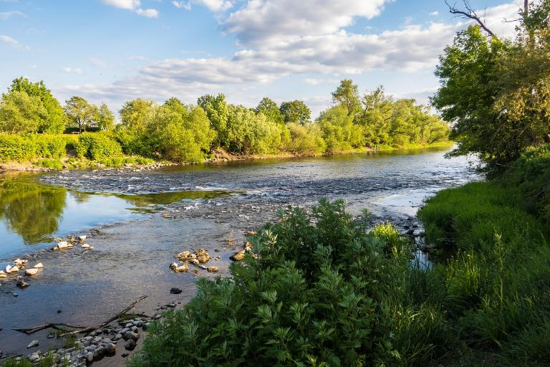
Restoration
The term refers to restoring natural ecosystems to a near-natural state after they have been damaged or destroyed.
The aim of river restoration is to make rivers and streams more natural again and to improve their ecological status.
Both ecological river engineering and restoration promote ecological quality. However, restoration focuses more strongly on achieving conditions that are as close to natural as possible, whereas ecological river engineering also takes economic and technical requirements into account.
Picture: Pixabay
Notes:
Sources: WWF Österreich (2025): https://www.wwf.at/artikel/moore-waelder-fluesse-so-funktioniert-renaturierung/#:~:text=Renaturierung%20bedeutet%2C%20dass%20%C3%96kosysteme%20wieder,(Nature%20Restoration%20Law)%20beschlossen
(Accessed on: 28.10.2025)
https://pixabay.com/de/photos/fluss-stromschnellen-flie%C3%9Fen-ufer-5178950/

Slide 34
Best practice – revitalisation of the Spittelau branch
Project: Dynamic LIFE Lines Danube (DLLD) – EU funded
Objectives and implementation:
Reconnection of the side arm systems to the main channel of the Danube
Completion of the connection of the Spittelau branch: 2021
Measures:
Deepening of the inflow opening → year-round water supply
Removal of lengthwise and mouth transverse structures → free flow of water and sediment
Removal of bank reinforcements along a length of 710 m
Results:
Creation of a 4.34 km long side water body, with an almost year-round flow
Development into a dynamic lifeline of the Danube floodplains
Post-monitoring until 2026
Notes:
Source: via donau (2024): https://www.viadonau.org/unternehmen/projektdatenbank/dynamic-life-lines-danube/uebersicht-zu-zielen-und-massnahmen/gewaesservernetzung-spittelauer-arm (Accessed on: 28.10.2025)
Additional information:
As part of the EU-funded project Dynamic LIFE Lines Danube (DLLD), the two side arm systems Spittelau branch and Haslau–Regelsbrunn were revitalised and reconnected to the main channel of the Danube. The connection of the Spittelau branch was completed in 2021.
Implemented measures:
The existing inflow opening was lowered so that water can flow into the side arm almost throughout the year
The longitudinal transverse structures and the mouth transverse structure were removed so that water and transported sediments can flow back into the Danube
Existing bank reinforcements were removed along a total length of 710 m
As a result of the reconnection, a 4.34 km long side water body was created, which is almost continuously flowing
The former side arm has already developed into a dynamic lifeline for the Danube floodplains.
Post-monitoring will continue until 2026
https://www.viadonau.org/unternehmen/projektdatenbank/dynamic-life-lines-danube/uebersicht-zu-zielen-und-massnahmen/gewaesservernetzung-spittelauer-arm

Slide 35
Best practice – bank restoration in the Danube floodplains national park
Project:
As part of the EU-funded MERLIN project, rivers, streams, wetlands and peatlands in 17 areas from Finland to Israel are being restored to a near-natural state.In Austria, hard bank reinforcements are being removed along one river section in the Danube floodplains national park, and the effects of restoration are being examined.
Implementation and special features:
Integrated planning → no impairment of the Danube waterway
Japanese knotweed (a particularly persistent invasive species) is professionally treated using thermal methods
After excavation works: natural bank development through the Danube’s own dynamics
Accompanying research:
The bank restoration is evaluated by BOKU through monitoring activities before and after implementation
Findings from the MERLIN project are combined with insights from other projects
In this way, valuable knowledge can be gained for future restoration projects across Europe
Notes:
Sources: via donau (2023): https://www.viadonau.org/newsroom/news/detail/merlin-spatenstich-fuer-uferrueckbau-in-der-hainburger-au#:~:text=Mit%20dem%20Horizon%2D2020%2DProjekt,von%20S%C3%BC%C3%9Fwasser%2D%C3%96kosystemen%20offiziell%20gestartet. (Accessed on: 28.10.2025)
via donau (2025): https://www.viadonau.org/unternehmen/projektdatenbank/merlin (Accessed on: 28.10.2025)

Slide 36
How can the Danube be developed sustainably?
4

Slide 37
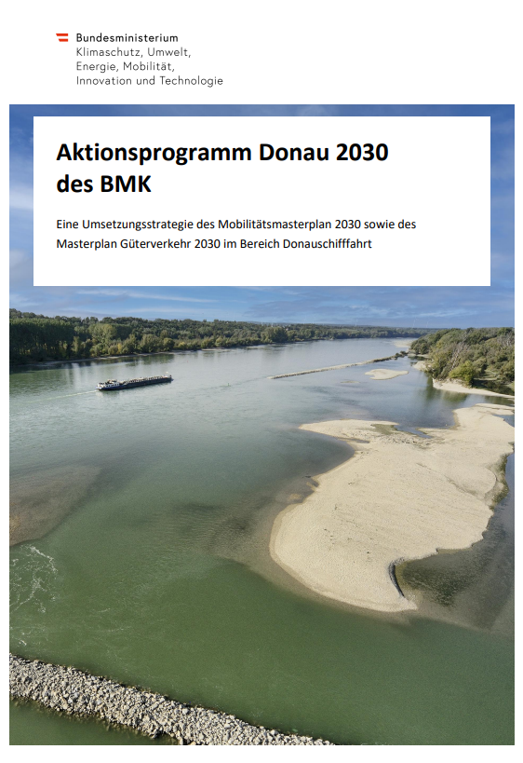
Strategies and measures for sustainable river development: Danube 2030 action programme
Defines the development framework up to 2030 (in line with the United Nations Agenda 2030, the European Green Deal and the Austrian government programme)
Objectives: Protection of the Danube and use of its potential as a recreational and economic space
Key priorities: Promotion of climate and environmental protection, resilient waterways and environmentally friendly inland navigation
Measures: Ten work packages for balanced development as a natural environment and transport route
Image: BMK/viadonau
Notes:
Source: Simoner et. Al (2023): https://www.viadonau.org/fileadmin/content/viadonau/06Unternehmen/Dokumente/2025/Aktionsprogramm_Donau_2030_BMK_viadonau.pdf (Accessed on: 08.07.2025)
Image source: Screenshot BMK und via donau (2023): https://www.viadonau.org/fileadmin/content/viadonau/06Unternehmen/Dokumente/2025/Aktionsprogramm_Donau_2030_BMK_viadonau.pdf (Accessed on: 08.07.2025)

Slide 38
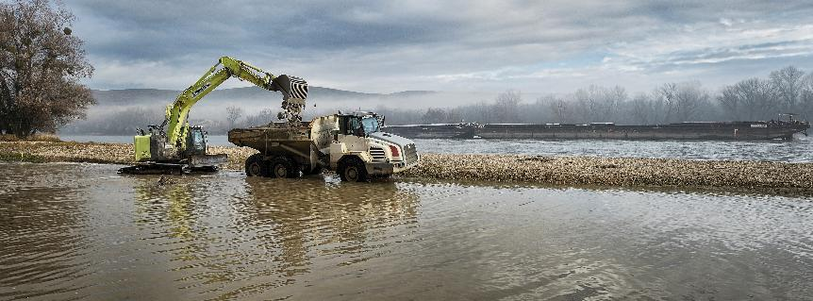
Work package 10: implementing restoration, species and habitat conservation projects to achieve good ecological status along the Danube/March/Thaya
Planned activities
Removal of bank reinforcements, creation of sandy and gravelly banks, near-natural design of riverbanks and confluence areas
Implementation of species and nature conservation projects to preserve biodiversity
Control of invasive species and promotion of native, climate-resilient plants
Introduction of near-natural management approaches for embankments and riverbanks
Expansion of the knowledge base on the effects of river regulation and climate change
Strengthening cooperation in the development of measures and in data management and monitoring
Picture: viadonau/Zinner
Notes:
Source: Simoner et. Al (2023): https://www.viadonau.org/fileadmin/content/viadonau/06Unternehmen/Dokumente/2025/Aktionsprogramm_Donau_2030_BMK_viadonau.pdf (Accessed on: 08.07.2025)
Picture source: via donau/Zinner
Additional information: Implementation of restoration, species and habitat conservation projects aimed at achieving a good ecological status/potential and a favourable conservation status along the Danube/March/Thaya
Initial situation and challenges
Various human uses have led and continue to lead to interventions in the natural hydromorphological processes of rivers and their adjacent biotopes (e.g. transverse structures, riverbank straightening, drainage of former side arms). These interventions disrupt the river and its associated ecosystems and carry significant potential for damage.
At the same time, some of these anthropogenic structures also have a high potential to serve as substitute habitats. For example, extensive dry grasslands have developed on flood protection embankments.
In recent years, numerous restoration and species conservation measures have already been implemented along the Austrian sections of the Danube, March and Thaya. These have significantly improved the ecological functioning of river habitats. The reconnection of side arms, river widening, restoration of riverbanks, the creation of small-scale biotopes and environmentally compatible maintenance methods for riverbanks and flood protection structures have positively influenced ecological corridors and strengthened ecosystem resilience, also with regard to climate change.
The task for the coming years is to continue these efforts, further implement restoration and species conservation measures, and continuously improve their effectiveness through scientific support, research and the development of innovative methods, with particular focus on climate change impacts and biodiversity enhancement.
Planned activities
Initiatives to improve hydromorphological processes in the river system through bank restoration, enabling the formation of sandbanks and gravel banks, as well as the preservation and creation of habitats and deep pools
Initiatives to improve hydromorphological connectivity and river dynamics (longitudinal and lateral connectivity) through watercourse reconnections, bank restoration and near-natural design of riverbanks and confluence areas
Implementation of nature and species conservation projects to preserve biodiversity – for example by expanding the range of target species and preserving or creating suitable habitats, or by establishing wave-protected areas
Measures to curb the spread of invasive species (neobiota) along the waterway (e.g. control of neophytes) and to promote native, site-appropriate and climate-resilient species
Implementation of near-natural maintenance concepts for embankments and riverbanks
Strengthening the knowledge base on the effects of river regulation and climate change on natural habitats and species diversity of the Danube/March/Thaya (including knowledge exchange with ASFINAG, ÖBB and other Danube countries)
Strengthening cooperation with relevant stakeholders and research institutions in the development of measures and in data management and monitoring
Implementation of projects for the preservation and improvement of floodplains, for example by improving hydromorphological connectivity, enhancing habitats and maintaining flood conveyance capacity
Lead organisation and partners
Lead organisation: viadonau
Cooperation partners: public authorities, neighbouring countries, Environment Agency Austria, environmental organisations, fisheries associations, water associations, Verbund, research institutions
Impact indicators
Length of newly created dynamic, near-natural riverbanks along the Danube, March and Thaya and their side arms (annual target until 2030: at least 5,000 m per year on a five-year average)
Area of meadows managed according to strict ecological criteria within viadonau’s management (approx. 650 ha) (target by 2030: at least 60%)
Area of newly created and preserved natural forest at all stages of development within viadonau’s management (approx. 700 ha) (target by 2030: at least 80%)

Slide 39

Kahoot!
Testing your knowledge with our transport quiz!
https://create.kahoot.it/share/the-danube-ecosystem-and-lifeline/d2790d18-b18e-492c-8051-11890f4e1dc8
https://kahoot.com/de/
Notes:
How it works:
Log in to Kahoot! or register for free: https://kahoot.com/en/
Open the following link to the quiz: https://create.kahoot.it/share/the-danube-ecosystem-and-lifeline/d2790d18-b18e-492c-8051-11890f4e1dc8
Start the quiz in class – either in individual mode or as a group game.

Slide 40
Thank you for your attention!

Slide 41
Additional information for teachers
This set of teaching materials is available under a Creative Commons Attribution 4.0 International licence.
You may therefore freely integrate these materials into your lessons, adapt them to your needs and share them with your pupils/students or other individuals.
We kindly ask you to leave the logos on the slides unchanged.
The image rights are indicated in the notes sections; use in other contexts is not permitted.
Statement on the use of generative AI and AI-supported technologies:
During the development of this project, the authors used ChatGPT and Microsoft Copilot to support concept development and the generation of ideas — particularly with regard to interactive exercises. The use of these AI tools was carried out with due consideration.
The content was subsequently carefully reviewed and, where necessary, revised by the authors to ensure compliance with academic standards. The authors assume full responsibility for the final content of the publication.

Slide 42
Additional information for teachers
For questions and feedback, please contact us by email at:
rewway@fh-steyr.at.
You can find more slide sets and practical exercises at:
http://www.rewway.at/en/teaching-materials/
Are you interested in a Transport School Lab, an excursion, or a specialist lecture?
http://www.rewway.at/en/pages/workshops

Slide 43
List of sources
Bayrisches Landesamt für Umwelt (2025): https://www.lfu.bayern.de/wasser/klimawandel_wasserhaushalt/auswirkung_auf_wasserhaushalt/gewaesseroekologie/index.htm (Accessed 21.10.2025)
BMLUK (2025): https://info.bml.gv.at/dam/jcr:2444b658-06d2-47d5-8844-0e28be5f8daa/Flussbau_Oekologie_A4_web_1_360.pdf (Accessed: 28.10.2025)
BMLUK (2025): https://www.generationblue.at/wasserwissen/wasserqualitat/was-ist-gewaesseroekologie.html (Accessed: 27.10.2025).
Bund für Umwelt und Naturschutz Deutschland e.V. (BUND) (2025): https://www.bund.net/fluesse-gewaesser/auswirkungen-des-klimawandels-auf-den-wasserhaushalt/ (Accessed 21.10.2025)
Gatti et.al (2023): https://link.springer.com/article/10.1007/s10531-023-02644-5#Fig1 (Accessed: 21.10.2025)
Heinrich-Böll-Stiftung Schleswig-Holstein e.V. (2025) https://bewirk.sh/2023/klimaschutz-vs-naturschutz/ (Accessed: 21.10.2025)
Hennig, Rainer (2024): https://www.dvz.de/unternehmen/detail/news/die-donau-in-oesterreich-spagat-zwischen-oekologie-und-oekonomie.html (Accessed: 27.10.2025).
Jungwirth et. Al (2003): https://boku.ac.at/fileadmin/data/H03000/H81000/H81200/_TEMP_/lehre/Angewandte_Fisch%C3%B6kologie_an_Flie%C3%9Fgew%C3%A4ssern.pdf (Accessed 21.10.2025)
Krachler, Harald (2018): https://veus-shipping.com/2018/06/die-donau-nicht-nur-schiffartsweg-sondern-auch-lebensader-fuer-mensch-und-natur/ (Accessed: 27.10.2025).
Nationalpark Donau-Auen GmbH (2025): https://www.donauauen.at/wissen/natur-wissenschaft/die-donau/die-au-nach-dem-hochwasser (Accessed: 27.10.2025).
Nationalpark Donau-Auen GmbH (2025): https://www.donauauen.at/wissen/zahlen-daten-fakten (Accessed: 21.10.2025)
Nationalparks Austria (2025): https://www.nationalparksaustria.at/de/news-detail-aktuelles/naturschutz-im-nationalpark.html (Accessed: 21.10.2025)
Naturfreunde Österreich (2025): https://www.naturfreunde.at/berichte/reportagen/umweltthemen/unsere-naturschaetze-schutzgebiete-in-oesterreich/ (Accessed: 21.10.2025)

Slide 44
List of sources
Neumann, Nadja (2024): https://www.igb-berlin.de/news/schifffahrt-schadet-der-biodiversitaet-europas-fluessen (Accessed: 27.10.2025).
Österreichs E-Wirtschaft (2025): https://oesterreichsenergie.at/fakten/stromstatistik (Accessed: 27.10.2025).
Simoner et. Al (2023): https://www.viadonau.org/fileadmin/content/viadonau/06Unternehmen/Dokumente/2025/Aktionsprogramm_Donau_2030_BMK_viadonau.pdf (Accessed: 08.07.2025)
sofatutor GmbH (2025): https://www.sofatutor.at/biologie/videos/das-oekosystem#oekosystem-definition (Accessed: 21.10.2025)
Strnadl, Susanne (2022): https://www.derstandard.at/story/2000134131010/die-donau-ein-oekosystem-zwischen-umwelt-tourismus-und-verkehr (Accessed: 27.10.2025).
Umweltbundesamt (2021): https://www.umweltbundesamt.de/leistungen-nutzen-renaturierter-fluesse#okosystemleistungen-von-fliessgewassern (Accessed: 21.10.2025)
Umweltverband WWF Österreich (2025): https://www.wwf.at/artikel/naturschutz-was-heisst-das-genau/ (Accessed: 21.10.2025)
via donau (2023): https://www.viadonau.org/newsroom/news/detail/merlin-spatenstich-fuer-uferrueckbau-in-der-hainburger-au#:~:text=Mit%20dem%20Horizon%2D2020%2DProjekt,von%20S%C3%BC%C3%9Fwasser%2D%C3%96kosystemen%20offiziell%20gestartet. (Accessed: 28.10.2025)
via donau (2024): https://www.viadonau.org/unternehmen/projektdatenbank/dynamic-life-lines-danube/uebersicht-zu-zielen-und-massnahmen/gewaesservernetzung-spittelauer-arm (Accessed: 28.10.2025)
via donau (2025): https://www.viadonau.org/umwelt/oekologischer-wasserbau (Accessed: 28.10.2025)
via donau (2025): https://www.viadonau.org/unternehmen/projektdatenbank/merlin (Accessed: 28.10.2025)
Viadonau (2019): Handbuch der Donauschifffahrt: https://www.viadonau.org/fileadmin/user_upload/Handbuch_der_Donauschifffahrt.pdf
WWF Österreich (2025): https://www.wwf.at/artikel/moore-waelder-fluesse-so-funktioniert-renaturierung/#:~:text=Renaturierung%20bedeutet%2C%20dass%20%C3%96kosysteme%20wieder,(Nature%20Restoration%20Law)%20beschlossen (Accessed: 28.10.2025)
WWF Österreich (2025): https://www.wwf.at/artikel/natura-2000/?gad_source=1&gclid=Cj0KCQiAkJO8BhCGARIsAMkswyh71nae9HUR7LEu9G1OLZZhZyNbGKgZRszYVLRGgbYh9TOaoR9klTUaApUpEALw_wcB (Accessed: 21.10.2025)
WWF Österreich (2025): https://www.wwf.at/das-schuetzen-wir/fluesse/wasserkraft-in-oesterreich/ (Accessed: 21.10.2025)

