Slide 1
European Waterways: Structures, Significance and the Role of the Danube
Teaching materials

Slide 2
How to best work with this educational material
Power Point: The following PowerPoint presents an introduction to the topic "European Waterways". For each slide, you will find spoken texts, explanations and references in the notes field. Activity slides are highlighted in yellow and contain practical examples, exercises, videos and other interactive elements that have been specially prepared for use in the classroom.
Videos and supplementary exercises: Videos and exercises on the topic can be found here in the presentation on the colour-coded activity slides as well as: https://rewway.at/en/teaching-materials/
All teaching materials contain a compact overview that makes lesson planning easier: learning objectives, target groups, level of difficulty, methods and points of contact with the curriculum.
References: The sources used for the presentation are available in the respective note field of the individual slides as well as at the end of the PowerPoint.

Slide 3
Learning objectives and target groups
Learning objectives:
The learners know the most important inland waterways in Europe and can name the Rhine and Danube in particular and explain their central importance for transport and the economy.
The learners understand the basic structures of waterways and their infrastructure as well as central maintenance measures and external influencing factors.
The learners have an overview of freight transport by inland waterway vessel as well as of key types of goods and transport volumes and understand the function of ports as important transshipment points.
The learners are able to describe the Danube as an important European inland waterway as well as explain essential transport volumes and types of goods and classify their economic importance.
Target groups:
Secondary school pupils
vocational school pupils
Students for an introduction to the topics of transport logistics, inland waterway transport and multimodal transport
Career changers and skilled workers from other industries

Slide 4
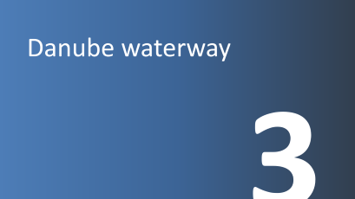

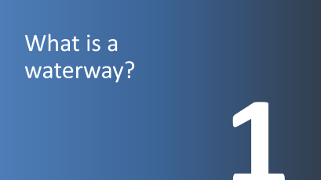
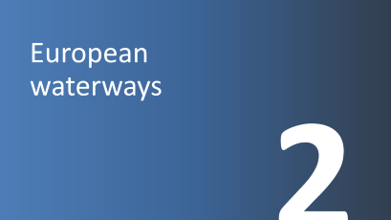



Slide 5
What is a waterway?
1

Slide 6
Ecosystem Flowing Waters
Ecosystem = biotope (habitat) + biocenosis (animals, plants)
Flowing waters = water biotope in which various animals, plants and fungi live
Types: Trickle, Stream, River, Stream, Canal
In Austria: Danube (total length 2,845 km = second longest river in Europe)
Notes:
The biocenosis and the biotope form an ecosystem. The biotope refers to the habitat in which organisms exist, while the biocenosis represents the entire community of animals, plants and microorganisms that live in this habitat. The ecosystem is therefore composed of inanimate (abiotic) and animate (biotic) factors.
Flowing waters are watercourses that are formed due to a certain gradient. Without a corresponding gradient, the water would not move and could not flow from one place to another. As a rule, flowing waters are very steep at the beginning and become shallower and shallower as they progress. This is because the water flows faster on steeper ground, and thus has more energy to erode the surrounding material and deepen the riverbed.
The formation of natural flowing waters is closely linked to precipitation. The water flows towards the lowest point when rain or snow falls to the ground, transporting material that is deposited at the bottom of the river. This helps the river to become wider and deeper over time. As a result, a variety of habitats for plants and animals are formed, which are adapted to the special ecosystem of the rivers.
However, flowing waters can also be artificially created by human intervention. This can be done to improve the irrigation of fields or to generate hydropower. In such cases, the terrain is deliberately altered to create an artificial river. Even under these circumstances, a separate ecosystem develops over time, adapting to the special circumstances of the artificial river.
Overall, flowing waters are of great importance for our environment. They not only act as a habitat for numerous animal and plant species, but also play an important role in the water balance and the material cycle of the earth.
The Danube rises in the Black Forest, Germany, and crosses ten riparian states before flowing into the Black Sea in Romania and Ukraine. With a total length of 2,845 km and a navigable distance of about 2,415 km, the Danube has been an important trade route since the early history of Europe. It also serves as an important source of energy and drinking water and offers a unique living and recreational space.
Sources:
Studysmarter (2026): https://www.studysmarter.de/schule/geographie/hydrographie/fliessgewaesser/; Retrieved 15.05.2026
Viadonau (2019):https://www.viadonau.org/fileadmin/user_upload/Manual_on_Danube_Navigation.pdf; p. 14, accessed 27.05.2026

Slide 7
River & Canal
River:
natural, flowing water
rises from a spring and flows into the lake, river or sea
Rivers all flow downhill from a higher point to another body of water
Canal:
Artificially created and navigable watercourse
no spring and no mouth
for example, connects several lakes or rivers
Notes:
Rivers are watercourses that originate from a source and are created by a certain gradient. Without a corresponding gradient, the water would not move and could not flow from one place to another. As a rule, flowing waters are very steep at the beginning and become shallower and shallower as they progress. This is because the water flows faster on steeper ground, and thus has more energy to erode the surrounding material and deepen the riverbed.
The formation of natural flowing waters is closely linked to precipitation. The water flows towards the lowest point when rain or snow falls to the ground, transporting material that is deposited at the bottom of the river. This helps the river to become wider and deeper over time. Rivers flow into a lake, river or sea.
A canal is an artificially created waterway that is usually used to transport ships from one place to another. Unlike rivers, canals do not have a natural source or estuary, and the water in them usually does not flow. Instead, they are built in such a way that they are as level as possible. Occasionally, locks are required to compensate for the difference in height between different canals or rivers. Canals can also connect different bodies of water, such as lakes, rivers, or even seas. However, there are also natural straits such as the English Channel or artificial waterways such as most canals in Venice, which are incorrectly referred to as canals.
Sources:
Klexikon (2024): https://klexikon.zum.de/wiki/Kanal; Retrieved 15.05.2026
Studysmarter (2026): https://www.studysmarter.de/schule/geographie/hydrographie/fliessgewaesser/; Retrieved 15.05.2025

Slide 8
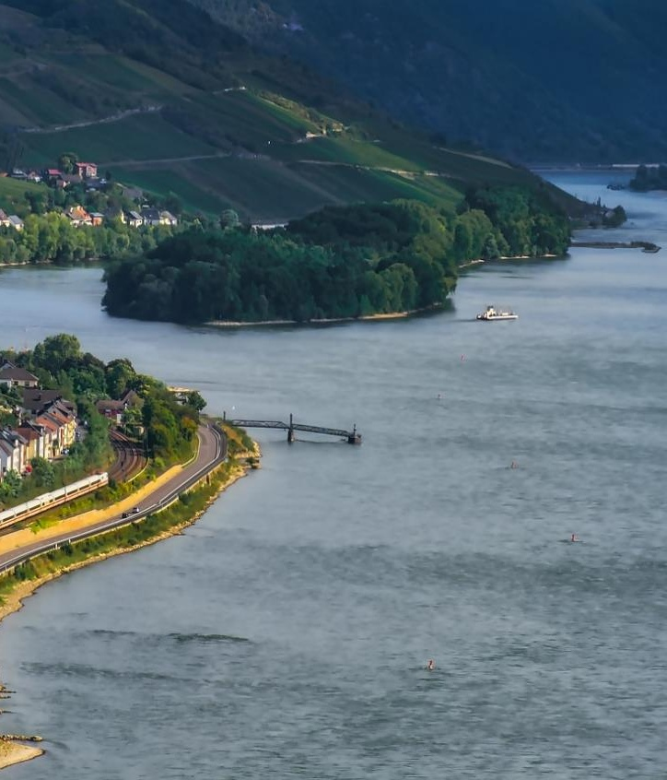
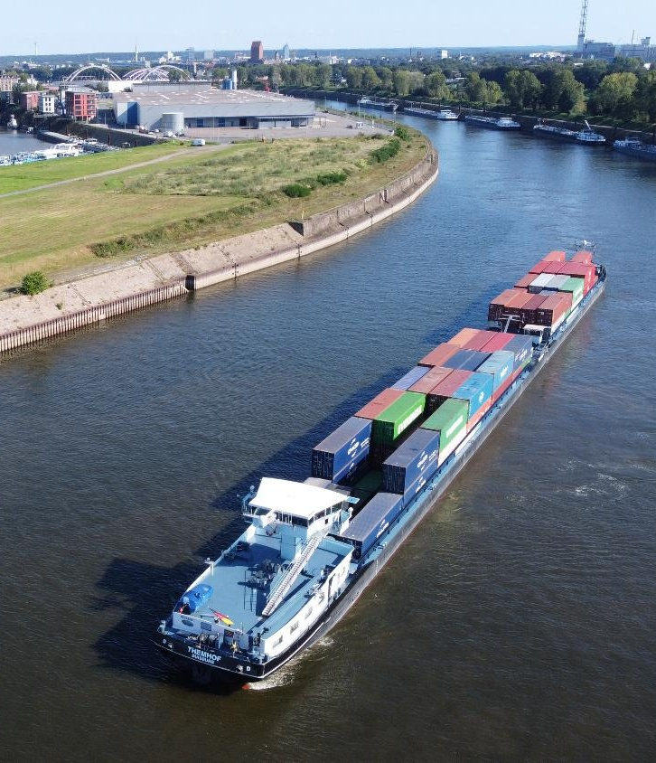
River & Canal
Image: pixabay
Image: Haeger & Schmidt Logistics GmbH
Notes:
Image sources:
Pixabay (2025): https://pixabay.com/de/photos/rheintal-fluss-deutschland-6665508/; Retrieved 15.05.2025
Image on the right courtesy of Haeger & Schmidt Logistics GmbH

Slide 9
Rivers as economic areas
Rivers and canals are not only a living space, but also an economic area:
Waterway as a transport route
Drinking water supply
Water for industry and agriculture
Runoff of precipitation and drainage, flood protection
Energy generation through hydroelectric power plants
Recreation area, tourism
Notes:
In addition to their function as transport routes, rivers and canals perform a variety of other important tasks. They are essential for drainage and runoff of precipitation and play an important role in water supply and conservation. In addition, they contribute to flood and ice hazard prevention and can supply cost-effective and environmentally friendly energy in dammed-controlled sections. They are also used for leisure activities. Rivers are the main natural arteries for water runoff and are often used to extract large quantities of water for industrial, agricultural and drinking water purposes.
The use of hydropower is an extremely environmentally friendly method of generating energy. In Germany, run-of-river power plants are often built for shipping as part of river regulation.
Source:
BDB (2026): https://www.binnenschiff.de/system-wasserstrasse/wasserstrasse/; Retrieved 15.05.2026

Slide 10
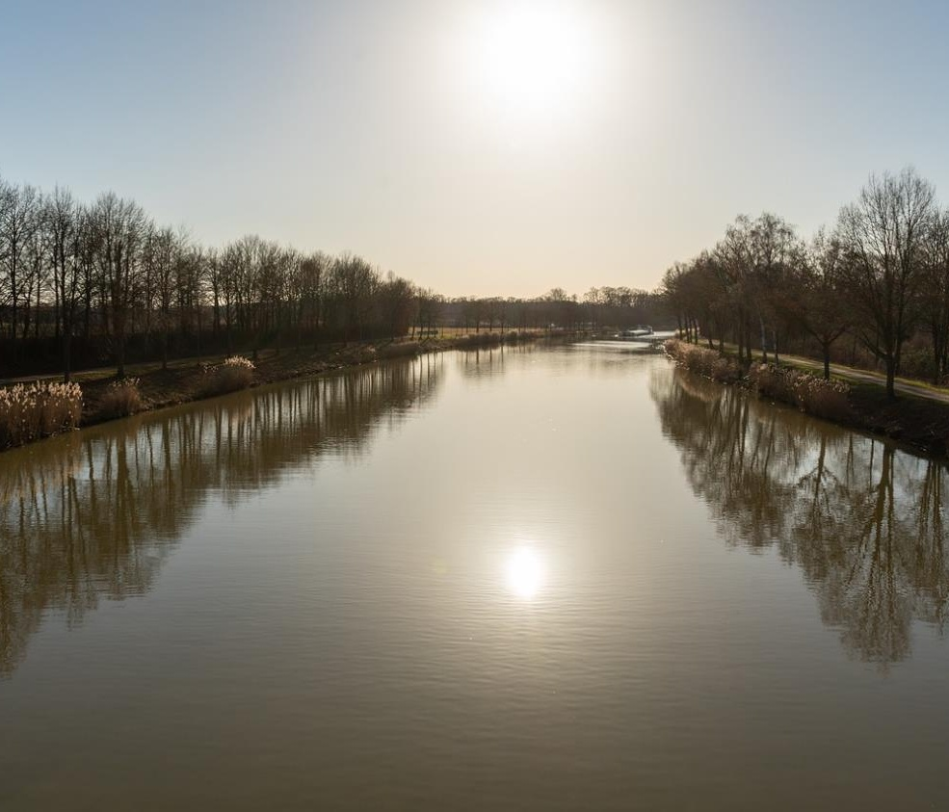
Waterways as a traffic and transport route
Inland vs. sea waterways
the first important settlements were built
on rivers
Rivers as the first "roads"
Construction of canals in industrialization
from the 19th century onwards
Image: pixabay
Notes:
Waterways are above-ground bodies of water that serve as traffic routes for ships. If they are located within a country, they are referred to as inland waterways – at the sea, by sea waterways. Rivers are natural waterways, while canals are artificially created.
Rivers can be described as the first roads ever, people traveled on them by boats and rafts before the first vehicles with wheels existed. The first significant settlements in history were built on rivers.
During industrialization in the 19th century, the history of canals in Europe began. England, the increasing demand for coal for the factories was a problem that was to be solved by the expansion of the waterways. In the Netherlands, canals were built to divert water from the low-lying parts of the country. With industrialization in the 19th century, the importance of artificial waterways increased sharply. In Austria, for example, the Vienna Danube Canal was expanded. Due to its close proximity to the then city of Vienna, it developed into a central link for passenger and freight shipping – a role that it still fulfils in parts today.
Sources:
WSV: https://www.schifffahrtsschule.wsv.de/Webs/Schifffahrtsschule/SharedDocs/Downloads/Rheinstromgebiet/Wasserstrassen.pdf?__blob=publicationFile&v=1; Retrieved 27.05.2026
Planet wissen WDR (2026): https://www.planet-wissen.de/technik/schifffahrt/kanaele_kuenstliche_wasserwege/pwieeuropaeischekanalgeschichte100.html; Retrieved 27.05.2026
Image Source:
Pixabay (2024): https://pixabay.com/de/photos/wasserkanal-schiff-himmel-6093822/; Retrieved 23.04.2024

Slide 11
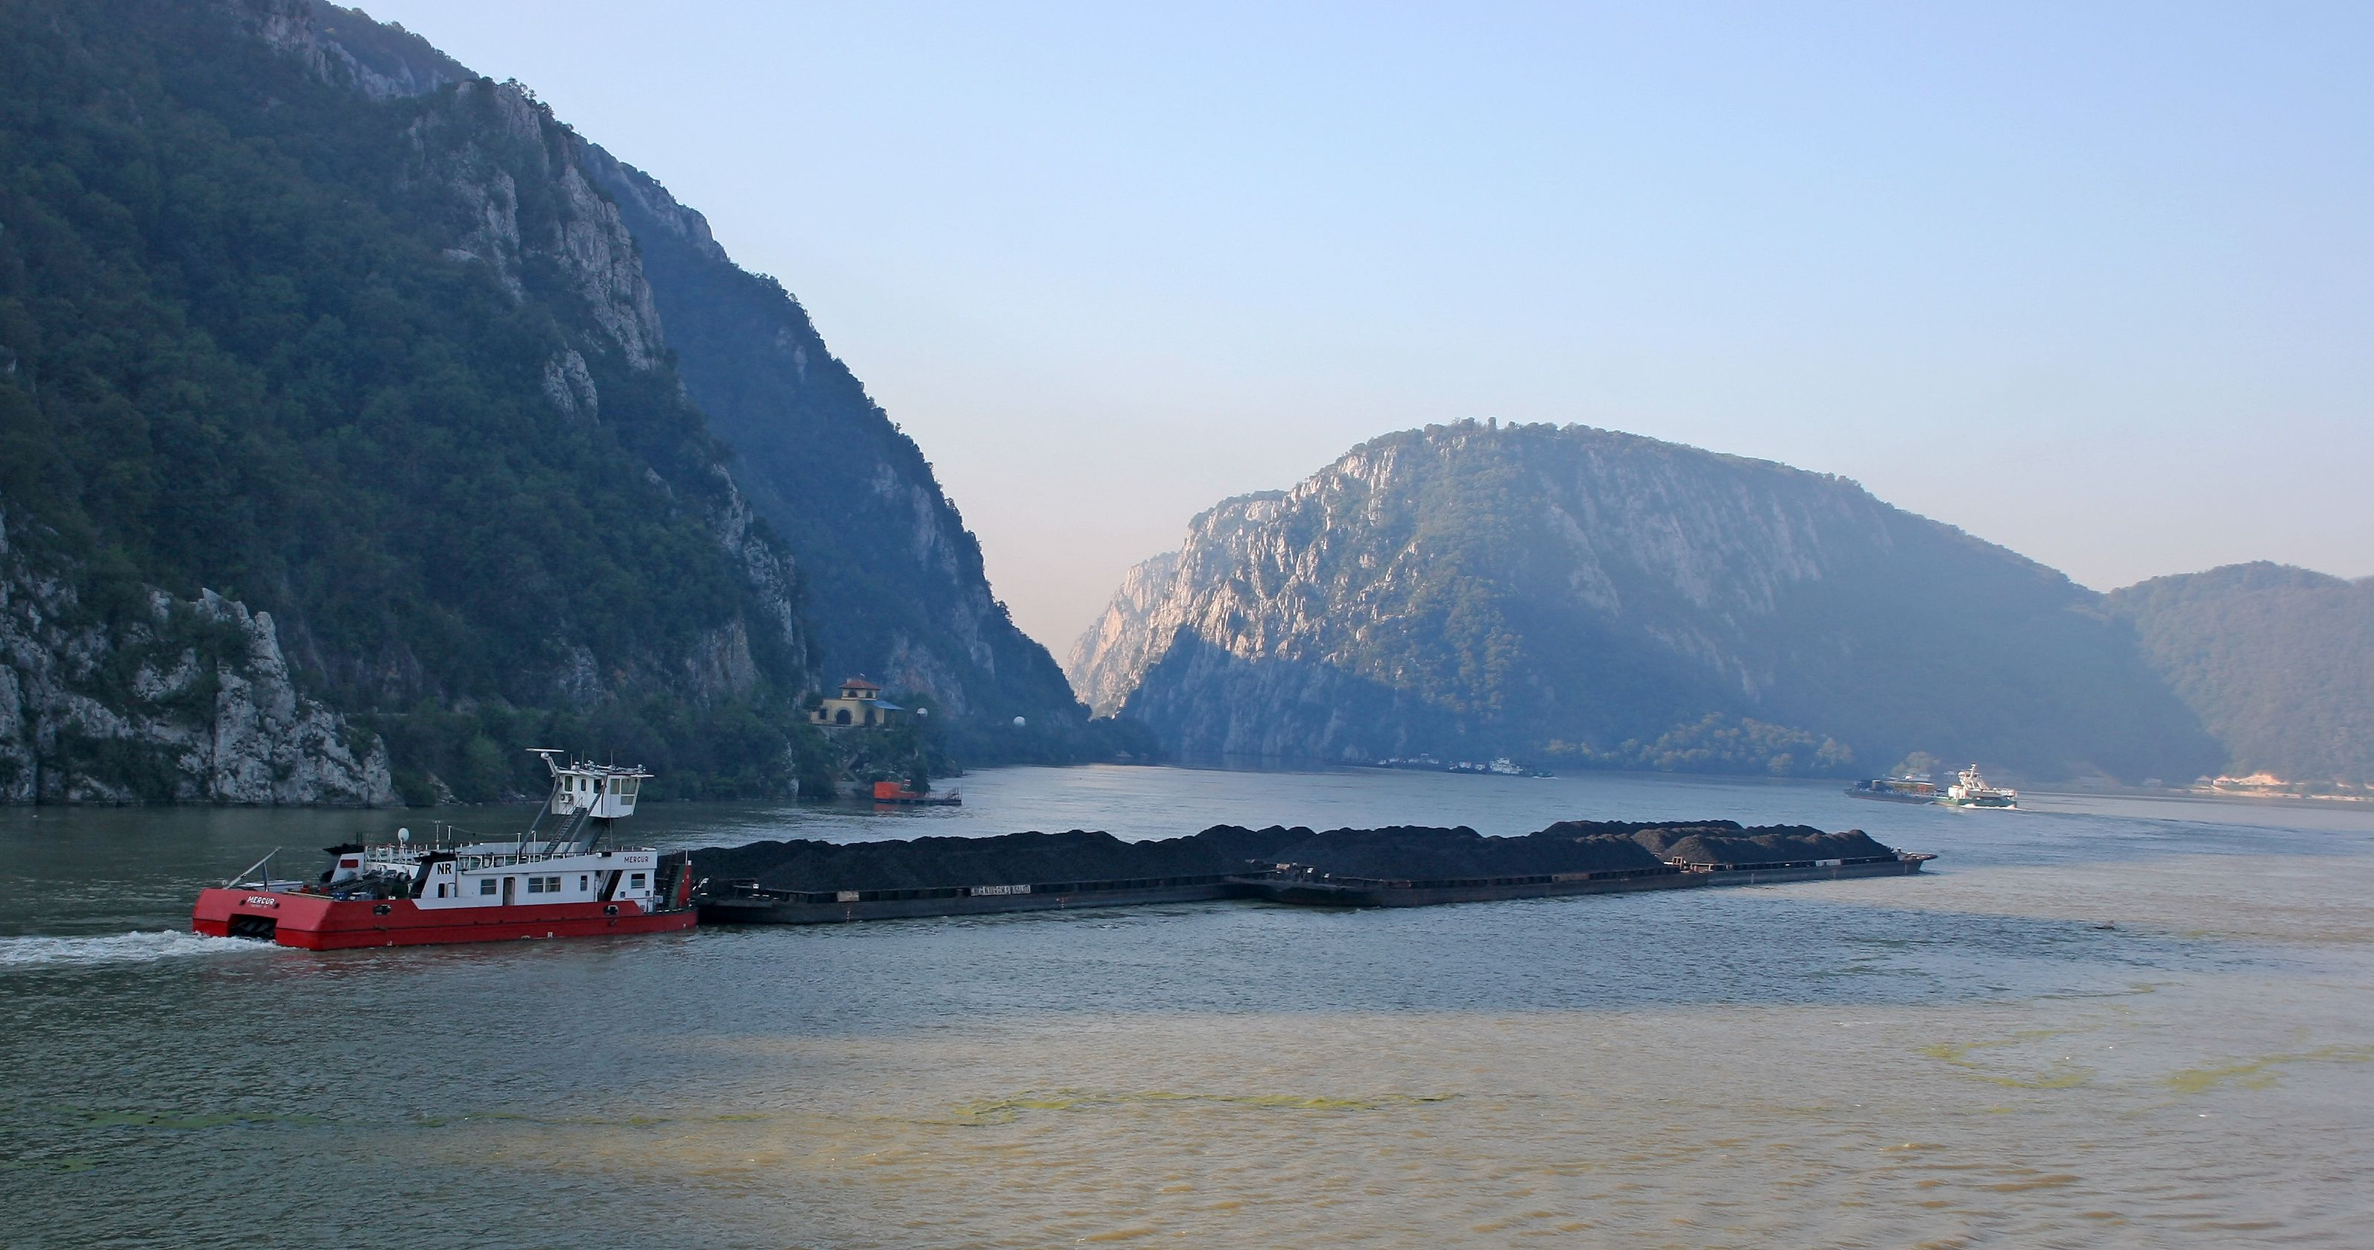
Inland waterway vessels
Inland waterway vessels: motor cargo vessels & convoys
Motor cargo ship: motorized, with cargo hold
Dry cargo, tanker, container and RoRo ships
Pusher convoy: motor vessel + push barge/barges
lighter = undriven, floating cargo container
Tugboat: Pulling of unpowered ship units
Image: Leitner@TTS, Austria
Notes:
There are two types of inland waterway cargo vessels: motor cargo vessels (self-propelled) and ship formations, consisting of a motor cargo vessel or push vessel and unpowered units.
On the Rhine, the individual motor cargo ships are dominant, while on the Middle and Lower Danube, the main preference is given to the ship convoys. In contrast, on the Upper Danube, the ratio between individual drivers and convoys of ships is balanced.
Motor cargo ships, also known as "self-propelled", have one or two engines and cargo holds. There are different types of motor cargo vessels, such as dry cargo, tanker, container and RoRo vessels. RoRo = Roll-on-Roll-off: transports vehicles
Push convoys consist of a push vessel (a motor vessel used for pushing) and one or more push barges or barges. These powerless units are tightly connected to the pushing vessel unit and at least one unit is mounted in front of the pushing vessel.
A motor cargo ship can also be used for propulsion, these ship convoys are called coupling or push-coupling convoys. In this case, one or two barges or barges are coupled to the motor cargo vessel on the sides, while in a push-coupling convoy, several barges or barges are also preceded.
Tugboats pull unpowered ship units, so-called barges. Barges are vessels for transporting goods with a rudder position for steering. Since tugboats are less economically profitable than push boats, tugboats are hardly ever found on the Rhine and Danube today.
Here you can see a pusher convoy on the Danube at the Iron Gate on the border of Serbia and Romania: consisting of a push boat (a motor ship used for pushing) and eight coupled push barges with bulk cargo. Here on the Danube in Austria, a ship can sail with up to 4 push barges, on the lower Danube in Romania, where the river is very wide, up to 12 push barges are possible.
Image: Leitner@TTS, Austria
Source:
Viadonau (2019): Handbook of Danube Navigation; p. 16 & p. 112 ff.

Slide 12
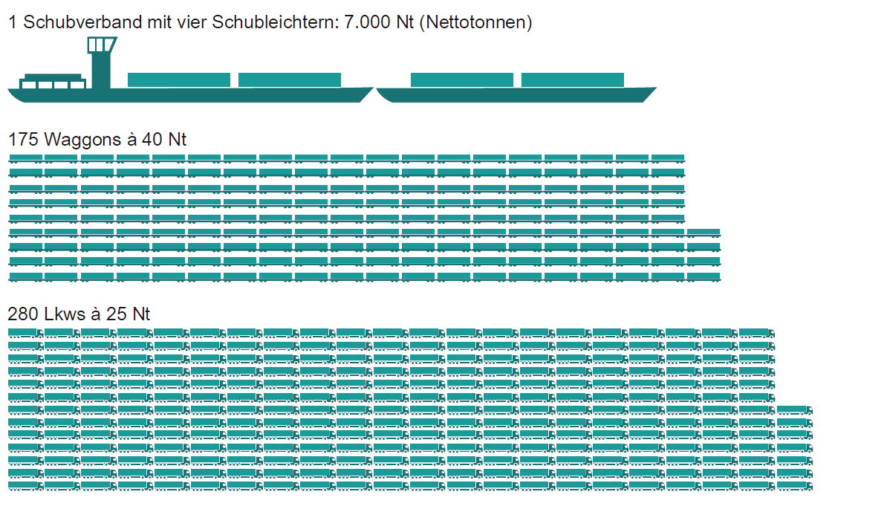
Freight transport on waterways - Danube navigation
Advantage:
Large transport capacity of inland waterway vessel:
Push convoy with 4 push barges
= 175 train cars
= 280 trucks
Graphic: viadonau
Notes:
Inland waterway vessels have numerous advantages over other means of transport:
Compared to the other modes of land transport, inland waterway vessels offer a significantly larger transport capacity per transport unit and can or could thus make an important contribution to relieving road and rail congestion.
To illustrate the mass capacity of inland navigation:
A typical barge on the Danube with 4 barges (7,000 net tons) can transport as much as 175 railway wagons or 280 trucks.
This corresponds to a convoy of trucks of about 20 km on the motorway.
What is a push barge?
A floating cargo container without propulsion. It is connected to an inland vessel at the front and pushed.
Source: Viadonau (2019): Manual on Danube Navigation pp. 18, 19, 112
Image source: Viadonau (2019): Manual on Danube Navigation p. 19

Slide 13
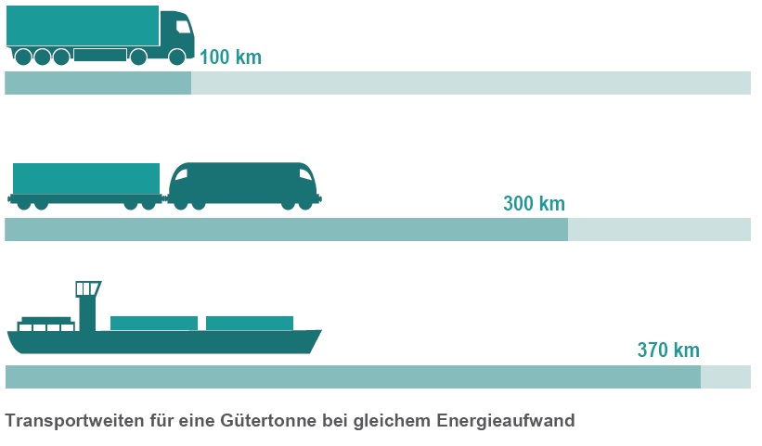
Danube navigation: specific energy consumption
An inland waterway vessel can transport a tonne of cargo almost four times as far as a truck with the same energy consumption.
Graphic: viadonau
Notes:
In terms of specific energy consumption, inland waterway transport can be described as the most effective and therefore the most environmentally friendly mode of transport. A typical inland vessel on the Danube can transport a ton of cargo almost four times as far as the truck with the same energy consumption.
Source: Viadonau (2019): Manual on Danube Navigation p. 18
Image source: Viadonau (2019): Manual on Danube Navigation p. 18

Slide 14
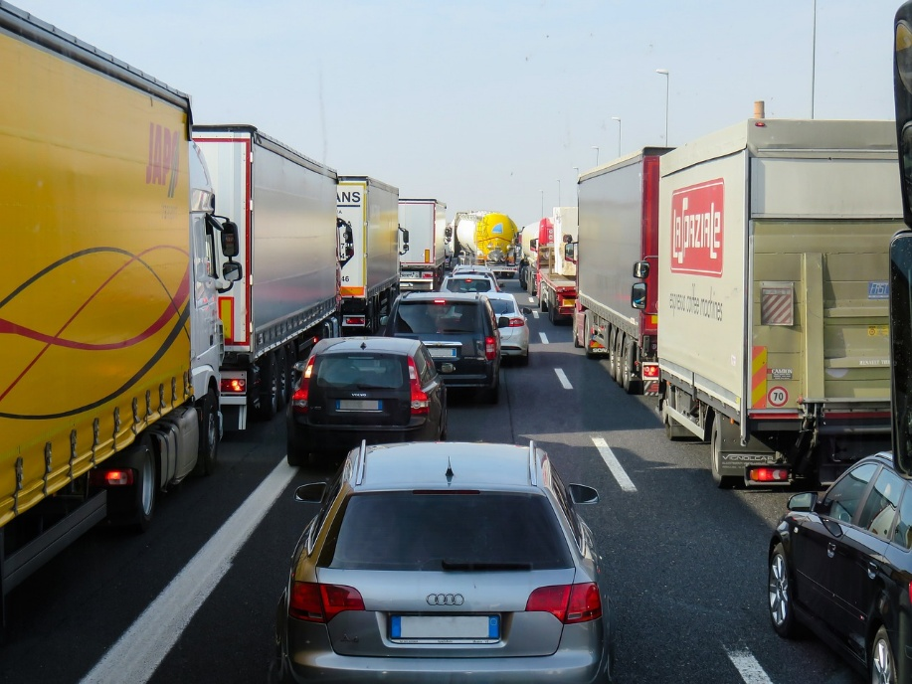
External costs of transport
Costs that are not borne by the perpetrators –
the costs are borne by society, i.e. all of us!
Pollutant emissions
Noise
Accident costs
Land consumption
Effects on flora and fauna
Congestion costs
40
Image: Pixabay
Notes:
Costs that arise from mobility but are not borne by those who use transport are referred to as external costs of transport. These costs are passed on to third parties, such as taxpayers and future generations. The negative externalities of transport include, in particular, pollutant emissions, CO2 emissions, noise emissions, consequential accident costs, land use and effects on flora and fauna. The external costs have considerable social and health effects (e.g. quality of life, noise pollution, stress, diseases) as well as on the environment (climate change, biodiversity).
Source:
Koch, Susanne (2012): ): Logistik – Eine Einführung in Ökonomie und Nachhaltigkeit, p. 294f
Image source:
Pixabay (2025): https://pixabay.com/de/photos/verkehr-transport-stau-autobahn-2251530; Retrieved 27.02.2025

Slide 15
External costs of transport – comparison of modes of transport
Cents per Tonnenkilometer
Graphic: own illustration based on Christidis/Brons
Notes:
Inland waterway and rail (electrified) cause by far the lowest external costs compared to trucks.
In 2023, the share of electrified lines of all infrastructure operators in Austria was around 75 percent. (cf. Rail Control)
In the EU-27, the electrification rate of rail networks was 57.4 % in 2023. (cf. Eurostat 2025)
Sources:
Own illustration based on:
Christidis, P., & Brons, M. (2016): External costs of freight transport in European Union Member States (Joint Research Centre (JRC)). Harvard Dataverse. https://dataverse.harvard.edu/dataset.xhtml?persistentId=doi:10.7910/DVN/YA3VCY https://doi.org/10.7910/DVN/YA3VCY; Abruf 28.01.2025
Eurostat (2025): https://ec.europa.eu/eurostat/statistics-explained/index.php?title=Characteristics_of_the_railway_network_in_Europe; Retrieved 06.03.2025
Schienen-Control (2025): https://www.schienencontrol.gv.at/de/wettbewerbsregulierung/eisenbahnnetz-oesterreich.html, accessed 28.01.2025

Slide 16
Think-Pair-Share:
Inland waterway vessel – underestimated climate protector?
First think on your own (think – 5min) about the advantages of multimodal transport in linking trucks and inland waterway vessels and what measures could be taken to create more incentives for this. What are the specific business benefits for the carrier/truck operator?
Share your thoughts (pair – 5min) with your seatmates.
Prepare your answer for a plenary presentation (share – 3min)
Notes:
Think-Pair-Share: Alone, in twos or threes (Pair), then present the results of the discussion in plenary (Share)
Duration: approx. 15–20 minutes
Social form: Individual work → partner or small group work → plenary discussion
Possible arguments (for support or as an impulse)
Low primary energy requirement: Inland waterway vessels consume significantly less energy per tonne transported compared to trucks or trains.
Lowest external costs: Less air pollution, noise, CO₂ emissions and infrastructure wear.
Hardly any accidents: Very high safety compared to road and rail.
Large transport volumes possible: One ship replaces many trucks.
Use of existing natural infrastructure: Rivers and canals are already in place.
Cost-effective in the long term: Especially for bulk goods and long distances.
Learning objectives:
The pupils analyse the ecological and economic advantages of inland navigation compared to other modes of transport.
The students argue objectively and justifiably for or against greater use of the waterway in freight transport.
The students reflect on the political and social framework conditions that influence the use of inland navigation.
The students present their results in a structured and understandable way in the plenary session and deal with other perspectives.

Slide 17
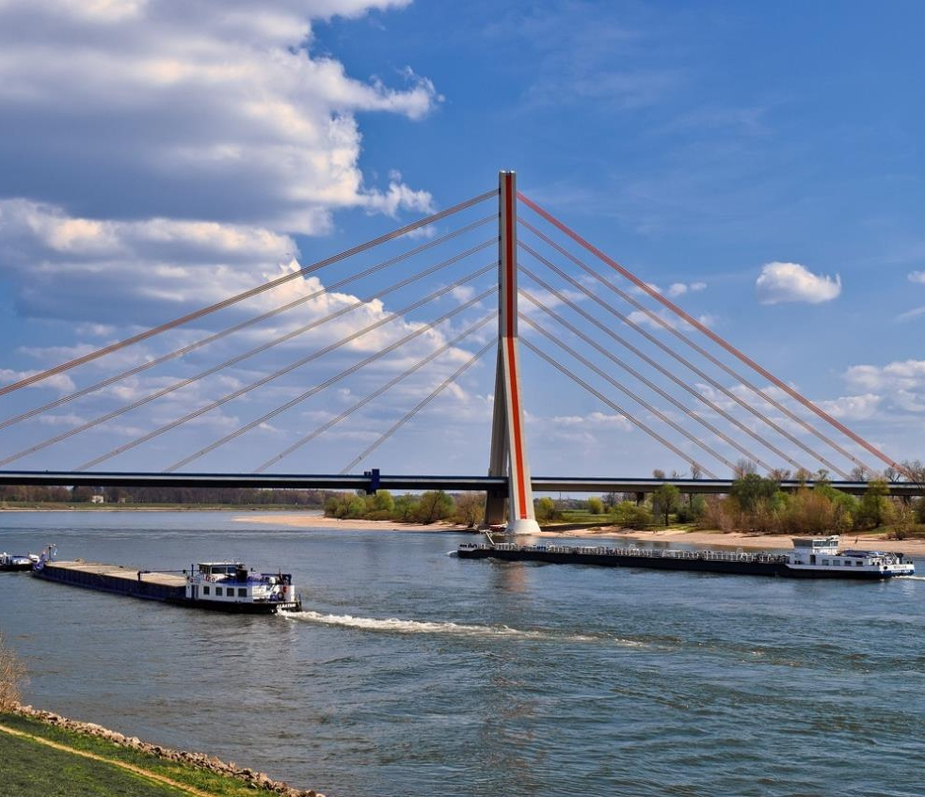
Waterway infrastructure
Fairway and fairway
Locks
Bridges and spans
Continuous maintenance of waterways
Image: Pixabay
Notes:
Which inland vessels and convoys of vessels can sail on an inland waterway is mainly determined by the infrastructure of the waterway:
Depth, width and radius of curvature of the fairway and the fairway
Size of lock chambers
Openings (clear height and width) under bridges and overhead lines
In Austria, viadonau is responsible for the preservation, maintenance and further development of waterways.
Source:
Viadonau (2019): Manual on Danube Navigation, p. 47 ff.
Image source:
Pixabay (2024): https://pixabay.com/de/photos/rhein-flu%C3%9F-wasser-landschaft-4129208/; Retrieved 23.04.2024

Slide 18
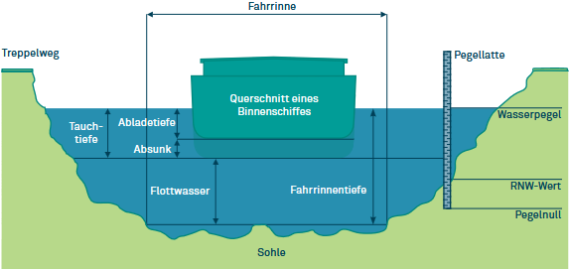
Fairway
Part of an inland waterway intended for shipping
critical factor for transport by water
Ensuring certain minimum depth and width even at unfavourable water levels (low water)
Graphic: viadonau
Notes:
The fairway refers to the area of a river or canal that is intended for navigation. In this area, the Waterways Administration ensures that a certain minimum depth and width is maintained so that ships can sail safely. The fairway is a part of the entire fairway, i.e. the navigable area of a body of water. The determination of the fairway is based on a minimum cross-section. This is based on the most critical points of a river section – i.e. where the water is shallowest or narrowest, especially at low tide. On the Danube, the required depth of the fairway is measured at the so-called regulatory low water level, or RNW for short.
The depth of the fairway in the fairway determines how far a cargo ship can be "unloaded"; the more goods a ship has loaded, the greater its unloading depth, i.e. the draught of the ship at rest corresponding to a certain loading condition. The unloading depths that can be used by shipping have a decisive influence on the profitability of inland waterway transport.
Source:
Viadonau (2019): Manual on Danube Navigation p. 49f.
Graphics:
Viadonau (2019): Manual on Danube Navigation p. 50

Slide 19
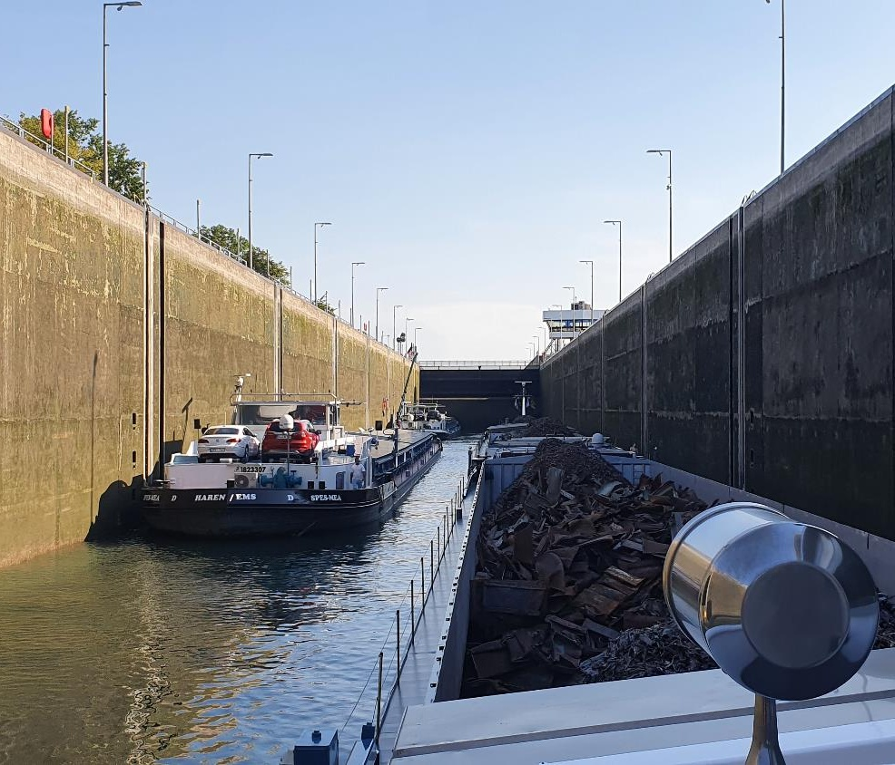
Locks
Overcoming height differences
Filling or emptying the lock chamber
Raising and lowering of ships up to 25 meters
Image: Björn Bosch
Notes:
Locks make it possible to overcome height differences along a waterway (usually created by barrages at run-of-river power plants). In a chamber lock, when the lock gates are closed, the lock chamber is filled or emptied and thus raised or lowered to the level of the upstream or downstream. This allows ships to be lifted or lowered and a height difference of up to 25 meters can be overcome.
Source:
Klexikon (2026): https://klexikon.zum.de/wiki/Schleuse; Retrieved 26.05.2026
Viadonau (2019): Manual on Danube Navigation, p. 53 f.
Image source:
Björn Bosch

Slide 20
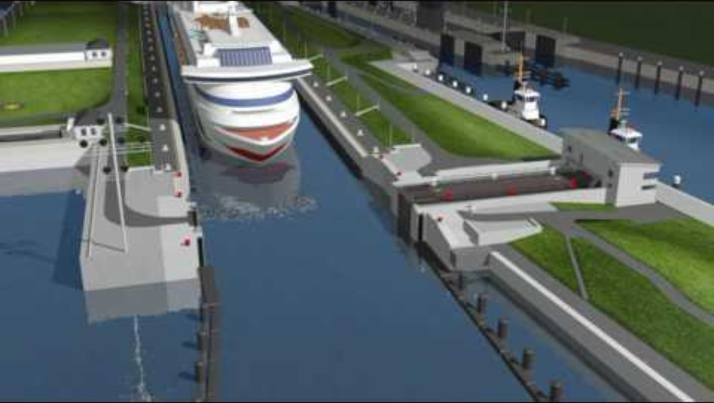
Video "Lock Process Overview"
Watch the video and try to explain the following terms:
Lock chamber
Upper Gate and Lower Gate
https://www.youtube.com/watch?v=RRIhiR-13Ok
Notes:
https://www.youtube.com/watch?v=RRIhiR-13Ok
Watch the video and try to explain the following terms:
Lock chamber
Upper Gate and Lower Gate
The lock chamber is the part of the lock where the ship is located during the lock process.
The two gates at the end of the lock chamber are the Upper Gate and the Lower Gate. The upper gate is the gate for the barrier of the higher water level, while the lower gate is the gate for the barrier of the lower water level. By changing the water level, it is possible to raise or lower the ships.

Slide 21
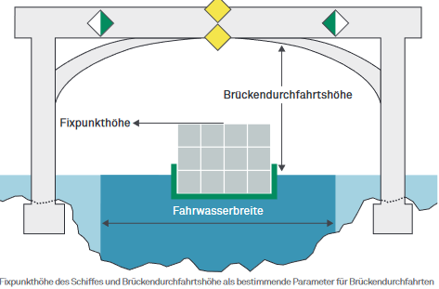
Bending down
usually two passage openings for ship traffic: ascent and descent
varying water levels on rivers
Clearance height of the bridge and fixed point height of the ship
Graphic: viadonau
Notes:
Bridges can lead over waterways, harbour entrances or run-of-river power plants. Depending on the distance between the bridge piers, there are one or more passage openings. The majority of the bridges have 2 openings for shipping traffic (ascent and descent). Shipping signs on the bridge indicate whether passage is allowed or prohibited. On undammed sections of the river, water levels can vary, which can affect the passage under bridges during high water levels.
Whether a ship can pass under a bridge depends primarily on two factors: the clearance height of the bridge above the water level and the fixed point height of the ship.
"The fixed point height refers to the vertical distance between the waterline and the highest immovable point of a ship after moving parts such as masts, radar or wheelhouse have been folded down or lowered." (Viadonau 2019: Manual on Danube Navigation , p.55-56)
If the anchor point height of a ship is too large, it can be reduced by loading ballast water into special tanks or by loading solid ballast.
In addition to the height of a bridge passage and the fixed point height of a ship, the profile of the bridge can also influence the possibility of passage. Especially in the case of arch-shaped bridges, a sufficient safety distance must be guaranteed.
Source:
Viadonau (2019): Manual on Danube Navigation , p. 55 ff.
Image source:
Viadonau (2019): Manual on Danube Navigation , p. 56

Slide 22
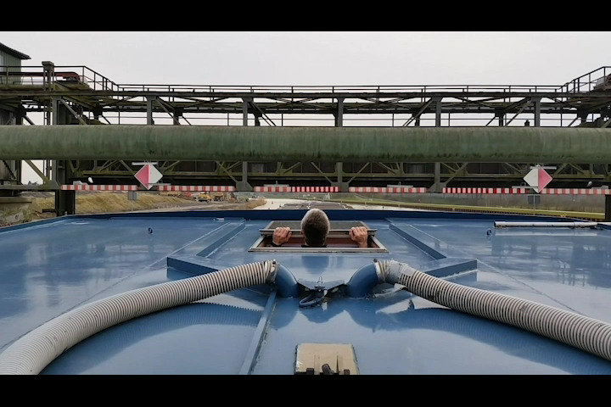
Video bridge passage
Video: Björn Bosch
Notes:
Source:
Private / Björn Bosch

Slide 23
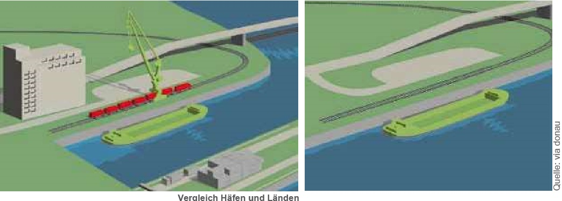
Handling options
Ports
Facilities for the handling of goods
at least one harbour basin
Protective function during floods, ice formation or other extreme weather events
According to national laws, certain goods may only be handled in port basins
Länden
Transshipment points without port basins
Notes:
Ports are facilities for the handling of goods that have at least one port basin. Transshipment points without a port basin are referred to as transshipment landings (in Austria) or as river ports (in Germany).
A port has several advantages over a landing: On the one hand, there are longer quay walls and thus more handling possibilities or logistics areas. According to national laws, certain goods may only be handled in a port basin. In addition, a port fulfils an important protective function: during floods, ice formation or other extreme weather events, ships can remain safely in a port.
Ports link the modes of transport road, rail and waterway with each other and are important service providers in the areas of handling, storage and logistics. In addition to the basic functions of a port such as handling and storage, a whole range of logistical value-added services are often provided to customers, such as packaging, stuffing and stripping of containers, sanitary inspection and quality control.offered. In this way, ports become logistics platforms and driving forces for business settlements and economic development. As multimodal logistical nodes, they act as hubs between the various modes of transport. An important indication of the performance of a port is the handling volumes between the modes of transport. In a port, transshipment takes place not only between waterways, road and rail, but also between non-water-based modes of transport such as rail-rail or road-rail.
Source: viadonau (2019): Manual on Danube Navigation , p. 86
Image source: viadonau (2019): Manual on Danube Navigation, p. 86

Slide 24
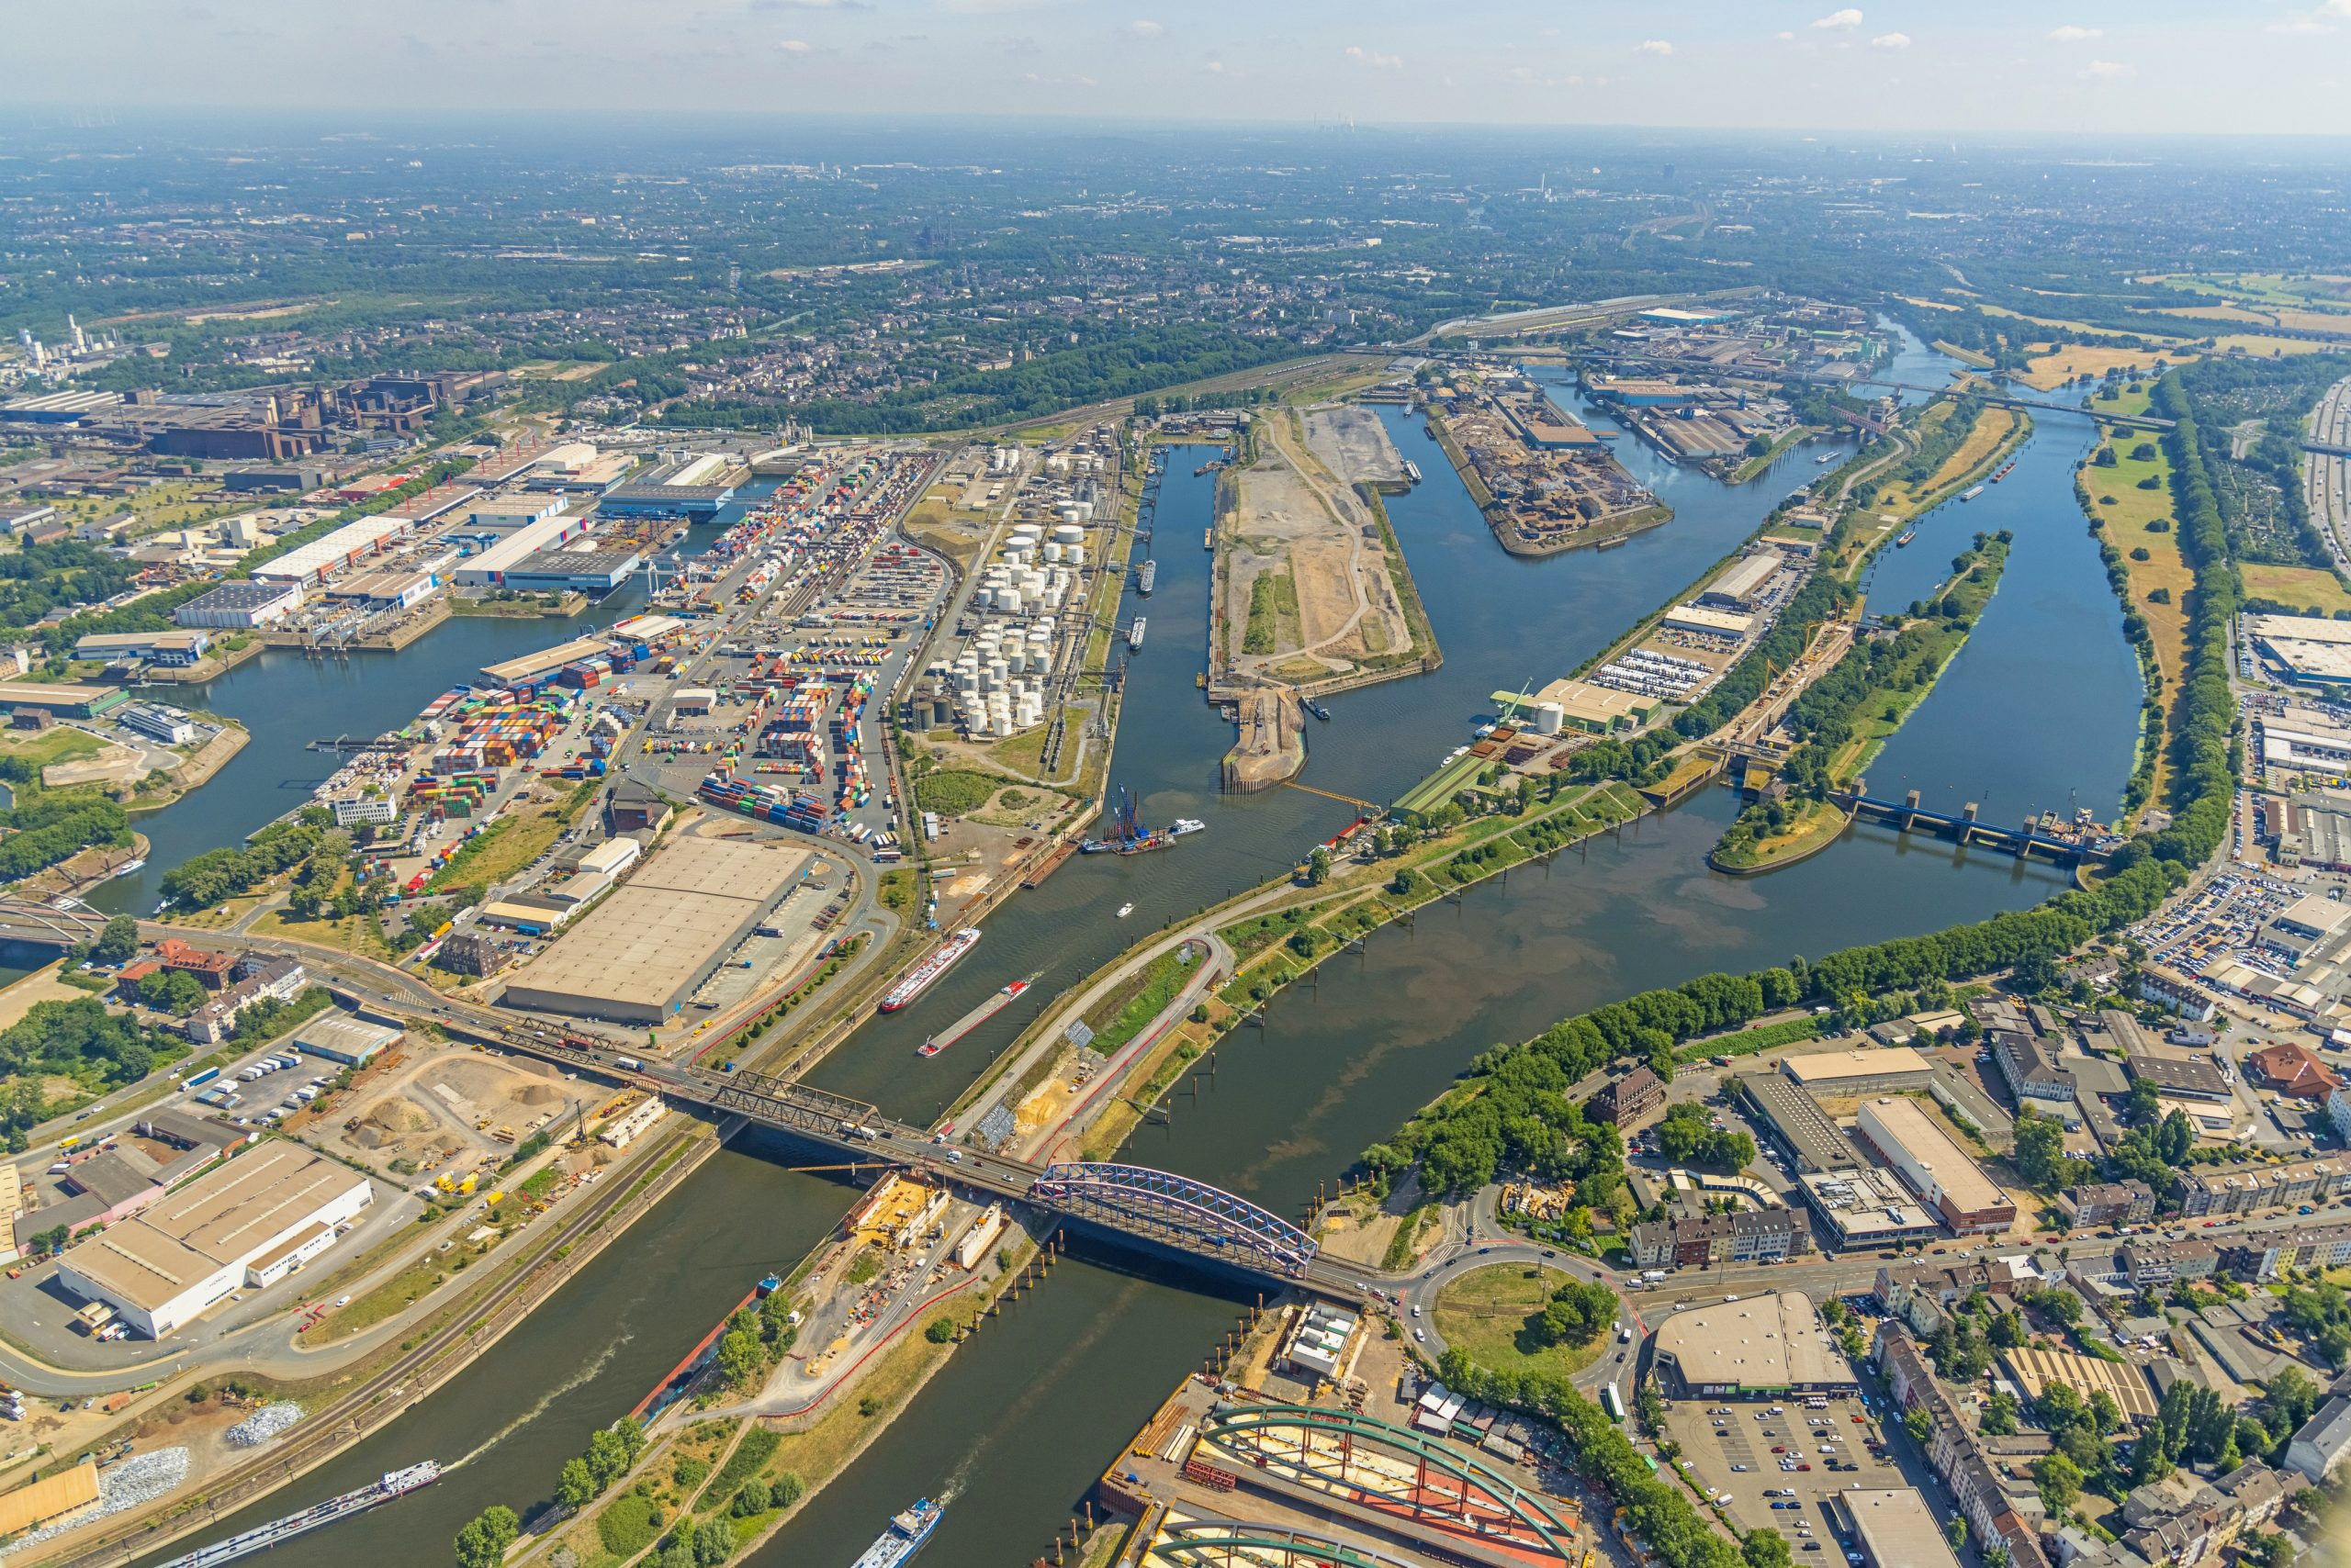
Hinterland (transport)
Three-part basic structure of a port: water side, port area, hinterland
Hinterland = catchment area of a port:
region directly adjacent to a seaport, which is connected by the various modes of transport
not clearly defined, depending on economic distance
Hinterland traffic: Term for landside inbound and outbound traffic from seaports
Image: duisport_Hans Blossey
Notes:
Each port has a three-part basic structure:
Waterside
Harbour area
Hinterland
In a port, traffic flows from the hinterland, i.e. the catchment area of a port, are bundled and unbundled. The size of this catchment area depends on the economic distance, which is defined not only by the geographical distance in kilometres, but also by the transport duration and transport costs.
Source: viadonau (2019): Manual on Danube Navigation, pp. 87-88

Slide 25
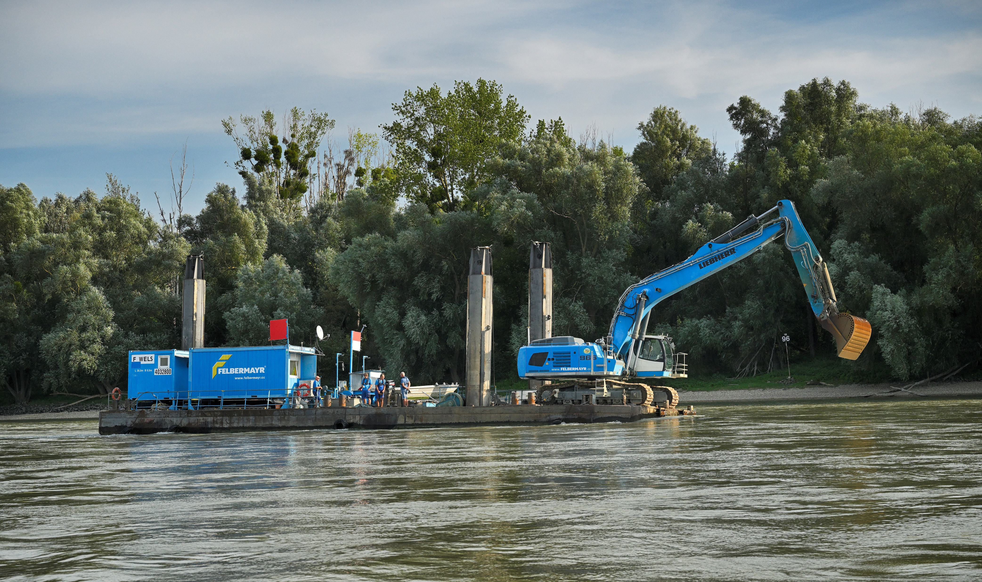
Waterway maintenance
important for the competitiveness of the waterway
Waterways are living systems and are influenced by continuous change: in particular free-flowing stretches (= river sections that have not been altered by dams, diversions, locks or similar water infrastructure)
Regular bottom measurements to ensure the fairway
Periodic dredging work and regulation structures required
Image: viadonau, Zinner
Notes:
If the minimum fairway parameters cannot be met, the competent national waterway administration must take appropriate measures to restore them. This is usually achieved by dredging at shallow areas (fords) within the fairway. During dredging work, soil sediments (sand and gravel) are removed and reintroduced at another point in the river, taking ecological aspects into account. Dredging requires forward-looking planning on the basis of the results of regular bottom surveys and a final review (success control) of the work by the responsible waterway management body. Since the fairway maintenance measures are recurring and interdependent, this can be referred to as a fairway maintenance cycle. The most important measures include:
Regular survey of the river bed to identify problem areas in the fairway (reduced depths and widths)
Planning or prioritization of the necessary measures (dredging, change of the course of the fairway, traffic regulation) based on the analysis of current river bed surveys
Implementation of maintenance measures (especially dredging including success control)
Ongoing and target group-oriented information about the current condition of the fairway to the users of the waterway
Source: viadonau (2019): Manual on Danube Navigation, pp. 57-63

Slide 26
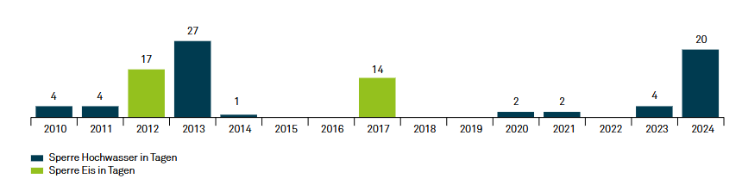
Availability – using the example of the Danube
long-term availability of the Danube at 98.3% (in Austria) = 359 days per year
Reasons for official blocks:
Extreme situations: ice formation, flooding
Traffic accidents
Lock failure, construction work
Water pollution
Events
weather-related closures:
Ice formation: Winter months, mainly January and February
Floods: Spring, summer months
Graphic: viadonau
Notes:
On average for the years 2010 to 2024, 98.3% of the Austrian section of the Danube was navigable as a waterway, or on about 359 days per year. During this period, there were two ice closures with an average duration of around 15 days. In addition, the waterway had to be closed for an average of about eight days in eight years due to flooding.
Weather-related closures of the Danube can be ordered by the authorities in Austria, for example due to ice or flooding. Ice barriers usually occur in winter (January/February), floods tend to occur in spring or summer. In addition, there may also be closures due to accidents, technical malfunctions, dirt, construction work or events. In 2024, these added up to a total of just over 16 hours.
Viadonau (2025): Annual Report Danube Navigation in Austria 2024, p. 24 f
Graphic: Viadonau (2025): Annual Report Danube Navigation in Austria 2024, p. 24

Slide 27
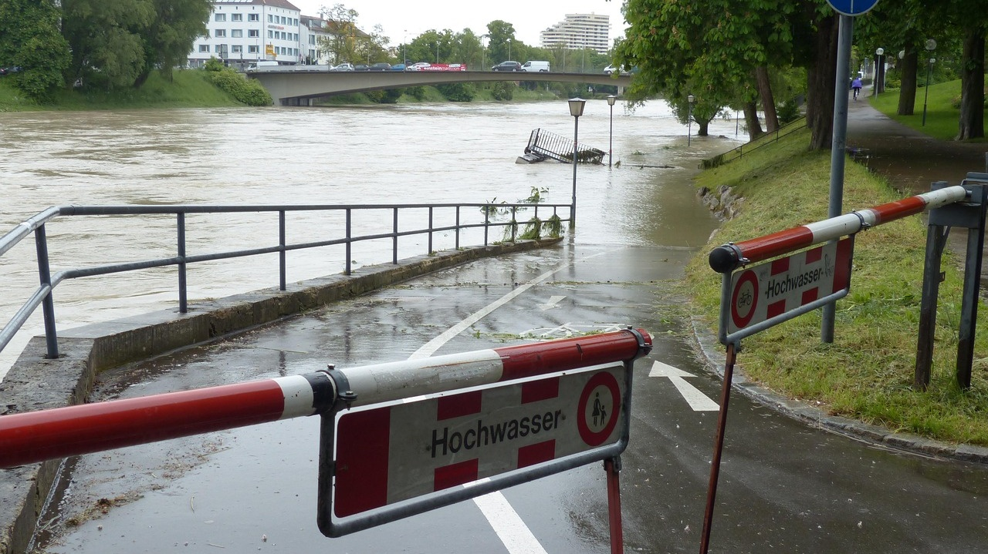
Flooding
caused by precipitation, snowmelt
Increase in extreme weather events due to climate change
Consequences for inland navigation:
Failure of navigability
Delays
Damage to infrastructure (e.g. ships, ports, locks)
Changes in inland waterways and riverbed morphology
Flooding of areas
Increases risk of collisions with navigation signs
Higher flow velocity
Debris, debris, flotsam
Image: Pixabay
Notes:
Flooding can be caused by high rainfall over a long period of time or by snowmelt after winter. A high water level mainly affects the water level of the waterway and thus the inland waterway traffic and infrastructure. High water levels can lead to disruption of shipping, delays, damage to infrastructure such as ships, ports and locks due to driftwood. Possible consequences include the flooding of the surrounding inland waters, the change in the inland waterways themselves and the morphology of the banks. Floods thus have a major impact on inland waterway transport, as they have a negative impact on waterway infrastructure, which is crucial for efficient transport by inland waterway vessels.
Depending on the geographical location, droughts or floods can last longer and therefore also have a significant impact on the economic viability of inland navigation. In this way, high and low water can be identified as weather phenomena with a high impact on inland navigation.
Sources:
Juha Schweighofer, “The impact of extreme weather and climate change on inland waterway transport” in Natural Hazards, May 2014, Volume 72, Issue 1, p 23-40, p. 25-27
Strobl, T., Zunic, F. (2006): Wasserbau. Aktuelle Grundlagen – Neue Entwicklungen. Springer-Verlag, Berlin Heidelberg. p 383-447.
Pixabay (2025): https://pixabay.com/de/photos/hochwasser-stra%C3%9Fe-gesperrt-schaden-123218/; Retrieved 12.02.2025

Slide 28
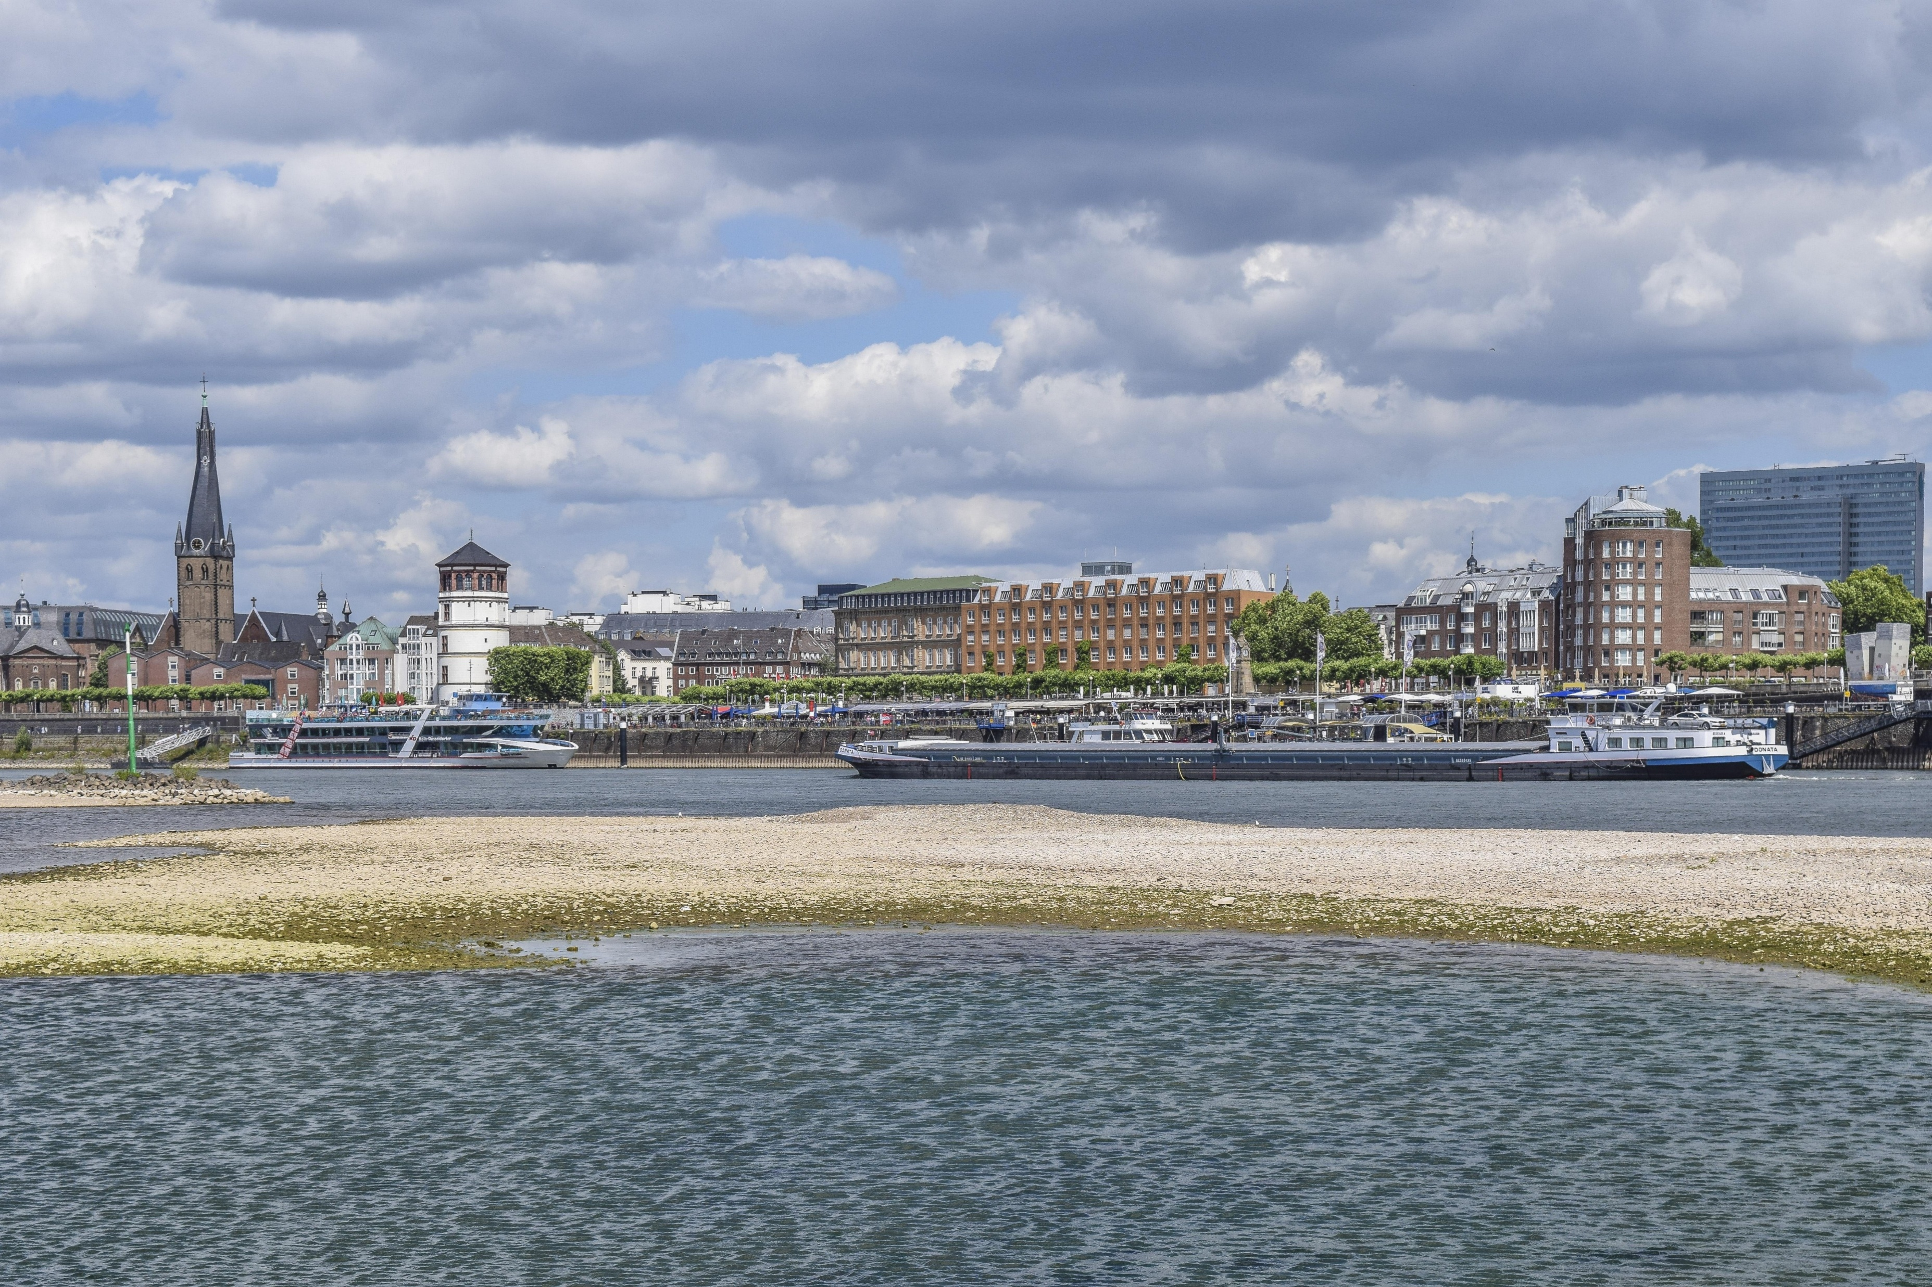
Low water
caused by low rainfall and/or high temperatures
Increase due to climate change
Consequences for inland navigation:
lower flow velocity
Reduced fairway depth
Lower freight capacity due to unloading depth (draught)
longer duration of transport
Fuel consumption increases
Low flotation water increases the probability of running aground
can last for a longer period of time
Image: Pixabay
Notes:
Drought can be caused by low rainfall and high temperatures. As a result, inland waterways face low water levels during periods of drought. The effects on inland navigation are therefore different from those of floods. On the one hand, the freight capacity of inland vessels is decreasing due to low water. On the other hand, the transport time increases, which also leads to higher fuel consumption of inland vessels.
Depending on the geographical location, droughts or floods can last longer and therefore also have a significant impact on the economic viability of inland navigation. In this way, high and low water can be identified as weather phenomena with a high impact on inland navigation.
The fairway depth present in the fairway determines how far a cargo ship can be "unloaded"; the more goods a ship has loaded, the greater its unloading depth, i.e. the draught of the ship at rest corresponding to a certain loading condition. The unloading depths that can be used by shipping have a decisive influence on the profitability of inland waterway transport.
Quelle: Juha Schweighofer, “The impact of extreme weather and climate change on inland waterway transport” in Natural Hazards, May 2014, Volume 72, Issue 1, p 23-40, p. 25-27.
Image source: pixabay, https://pixabay.com/photos/skyline-architecture-city-building-5362429/; Retrieved 20.05.2026

Slide 29
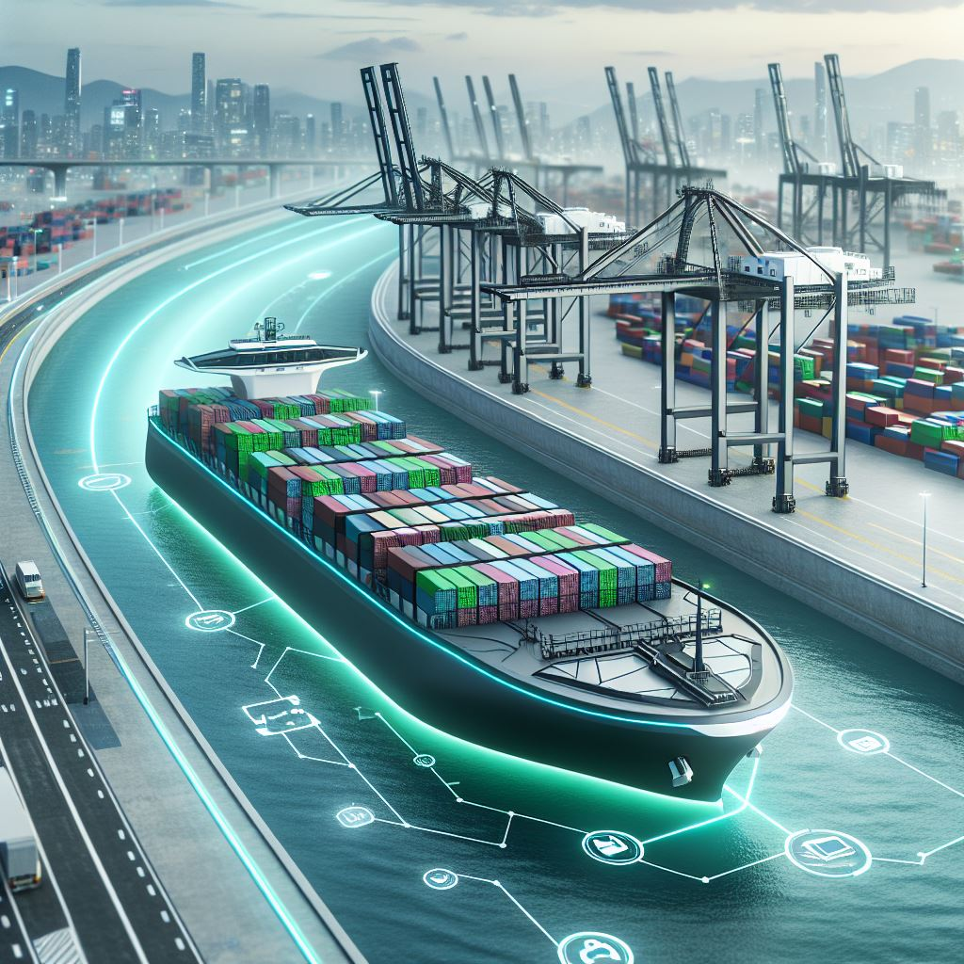
Development trends in inland navigation
Modernization of ships and ports ("retrofitting")
Digitization
Automation
Use of sustainable resources
Low-water vessels
Water Networks
Opening up new markets
40
Image: AI-generated (MS Copilot)
Notes:
Measures to further promote the sustainability and usability of inland navigation:
Retrofitting refers to the process of equipping existing ships with modern technology to maintain their competitiveness, save fuel and become more environmentally friendly. One example of this is the conversion of the "MSC Flaminia" by the shipping company NSB after a fire. By installing a new bow bulge and propeller, fuel consumption could be reduced by up to twelve percent. The retrofitting also serves as a demonstration that older vessels with modern design and efficiency can compete with new vessels.
Digitalization: The use of modern technologies such as automated systems, telematics and data analysis can achieve efficiency gains and emission reductions. The digital networking of ships and ports, for example, enables optimized route planning, improved cargo tracking and more efficient use of resources such as fuel. Digitalisation contributes to increasing efficiency, reducing costs and reducing the burden on the environment in inland navigation.
Water networks support increased usability of inland navigation, with the aim of improving waterway infrastructure and creating efficient connections between different bodies of water. The aim is to facilitate the transport of goods on inland waterway vessels while minimising the environmental impact. This is achieved by optimising waterways, expanding locks and reducing bottlenecks, resulting in shorter transport times, lower energy consumption and lower CO2 emissions.
The use of environmentally friendly fuels and the switch to alternative propulsion systems such as electromobility or hydrogen propulsion contribute to sustainable inland navigation.
The development of new markets and market segments (e.g. container transport) can increase the share of inland waterway transport in total transport.
Source:
Bundesanstalt für Wasserbau (2017): Kolloquium Wasserbauliche Herausforderungen an den Binnenschifffahrtsstraßen, https://izw.baw.de/publikationen/kolloquien/0/02_Kempmann-Kriedel_Rusche-Pauli-Georges_Herausforderungen....pdf; retrieved: 27.05.2026
Verband deutscher Reeder (2016): https://www.reederverband.de/sites/default/files/publikationen/deutsche_seeschifffahrt/deutsche_seeschifffahrt_2016_-_umweltspecial.pdf; retrieved 18.03.2025
Heinzelmann, Christoph / Bödefeld, Jörg / Duric, Zorana (2020): Digitalisierung im Verkehrswasserbau. Bautechnik, 97; In: https://doi.org/10.1002/bate.202000029; p 441-444
Image source:
generated with AI (Microsoft Copilot) on 12.06.2025, Prompt: "Create an image of a futuristic cargo ship (loaded containers) that shows visions and development trends in inland shipping – with a focus on modern technologies, sustainability and autonomous navigation. Urban harbour environment along the river."

Slide 30
European waterways
2

Slide 31
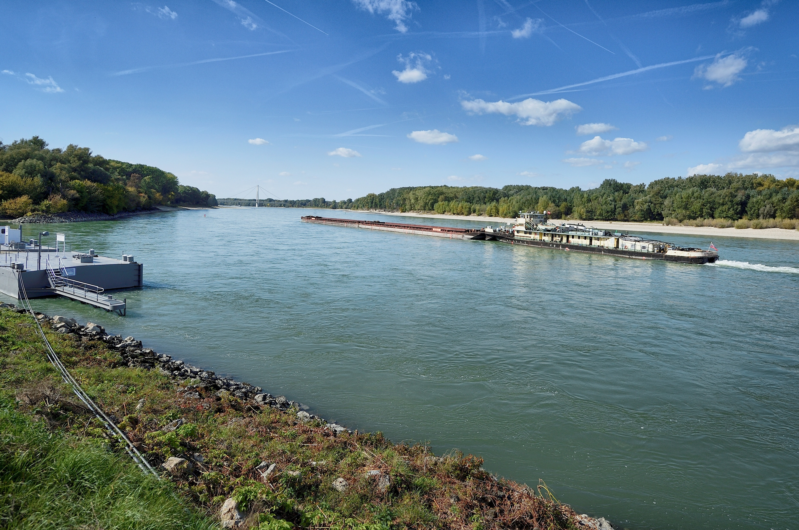
Waterways network in Europe
40,000 km of waterways in Europe
Most frequented waterway: Rhine
Navigable waterway in Austria: Danube
Rhine-Main-Danube Corridor connects the North Sea with the Black Sea
Image: viadonau, Zinner
Notes:
Source:
“Facts & Figures- Inland Navigation in Europe”, slide 2, URL: http://de.slideshare.net/carolinevandeleur/platina-ff-general-14427068; Abruf 21.05.2026
BDB (2026): https://www.binnenschiff.de/system-wasserstrasse/wasserstrasse/; Retrieved 18.05.2026
Image: viadonau, Zinner

Slide 32
Waterways network in Europe
Available waterways: 40,000 km
of which 20,000 km are navigable for ≥ 1,000 t. ships
19 out of 28 EU Member States have access to navigable waterways
Available waterways | Share of inland waterways in the modal split (% of total tkm)
France (8,501 km*) Finland (8,000 km*) Germany (7,467 km*) Austria (358 km *) | Netherlands: 40% Romania: 23% Bulgaria: 22% Austria: 2%
  * Total length of navigable rivers, canals and other bodies of water
Graphic: own presentation based on Indexmundi and Eurostat
Notes:
Europe has 40,000 km of waterways, half of which are navigable for ships with a capacity of 1,000 tonnes. Currently, 18 out of 27 EU Member States have access to navigable waterways.
Within Europe, France has the most available waterways (including rivers, canals, and other bodies of water that are navigable), followed by Finland. Germany is in third place. In contrast, Austria has only 358 km of navigable waterways.
Although there are many inland waterways available, inland waterway transport is generally the least used mode of transport in Europe. Nevertheless, there are different values at the national level: In the Netherlands, inland waterway transport has the highest share of the modal split of inland freight transport with 43.2% in 2018 (% of total tonne-kilometres), and Romania and Bulgaria also have a relatively high share compared to other countries in Europe. In contrast, inland waterway transport in other countries (e.g. Austria, Latvia or Lithuania) has a very small or no share of the modal split. These differences can be explained by various limiting factors such as accessibility, transport distance and transport volume.
“Facts & Figures- Inland Navigation in Europe”, slide 2, URL: http://de.slideshare.net/carolinevandeleur/platina-ff-general-14427068; Abruf 21.05.2026
Indexmundi: http://www.indexmundi.com/map/?t=10&v=116&r=eu&l=en; Retrieved 21.05.2026
Eurostat (2024): Modal split of inland freight transport: https://ec.europa.eu/eurostat/databrowser/view/tran_hv_frmod/default/table?lang=en&category=tran.tran_hv_ms; Abruf 28.04.2026

Slide 33
Freight transport in Austria and Europe (modal split)
Own presentation based on Statistics Austria and Eurostat
Notes:
Modal split describes the proportionate transport performance according to modes of transport.
Sources:
Eurostat (2024): Modal split of inland freight transport: https://ec.europa.eu/eurostat/databrowser/view/tran_hv_frmod/default/table?lang=en&category=tran.tran_hv_ms; Abruf 28.04.2026

Slide 34
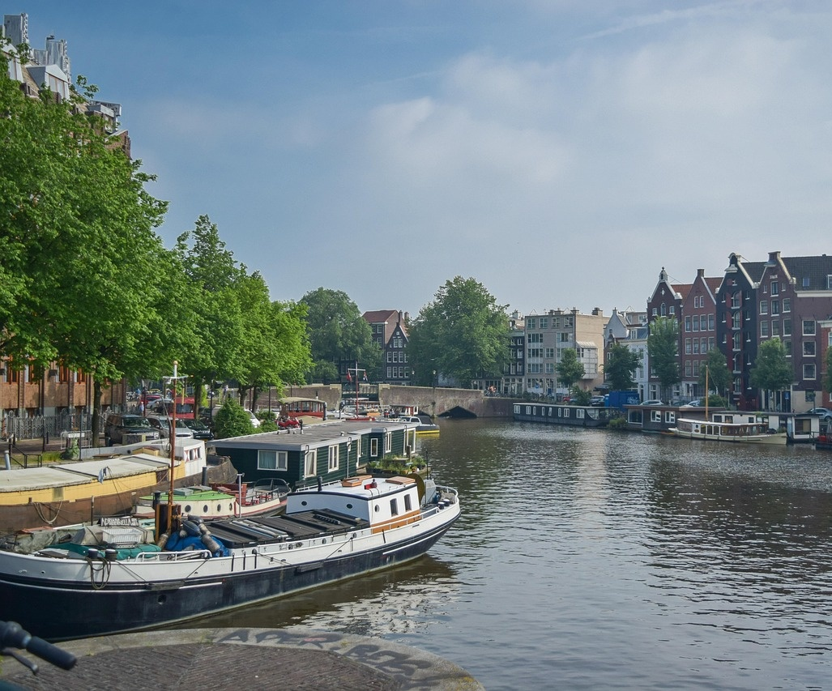
Best Practice Waterway: Netherlands
Own illustration based on Eurostat
Image: Pixabay
Notes:
The proportion of tonne-kilometres of goods travelled on waterways varies greatly between EU countries.
The frontrunners in terms of waterways are the Netherlands, with a share of inland waterway transport of around 40% (2022). This is due, among other things, to its important seaports and an extensive network of waterways.
Source:
Eurostat (2024): Modal split of inland freight transport: https://ec.europa.eu/eurostat/databrowser/view/tran_hv_frmod/default/table?lang=en&category=tran.tran_hv_ms; Abruf 28.04.2026
Image source:
Pixabay (2025): https://pixabay.com/de/photos/amsterdam-kanal-stadt-boot-6619660/; Retrieved 26.02.2025

Slide 35
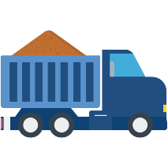

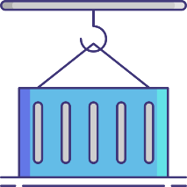

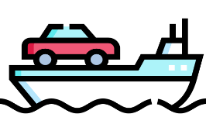
Freight transport by inland waterway vessel
Bulk Goods
e.g. building materials, ores, coal, steel, agricultural products
70% of the total amount
in inland waterway transport
Dangerous goods
e.g. flammable liquid goods such as gasoline, heating oil, chemical substances, liquefied gases
Container
of great importance, especially on the Rhine
High & Heavy
Heavy or bulky loads
RoRo Ships
(Roll on Roll off)
Images: Flaticon
Notes:
Inland waterway transport is mainly dominated by bulk cargo, which accounts for about 70% of the total. These include, for example, building materials, ores, coal and steel, but also agricultural products. With a share of around 42%, the voestalpine plant port in Linz has the highest throughput volume in Austria (compared to the other Danube ports).
An important branch of inland navigation is the transport of dangerous goods, which includes flammable liquid goods such as petrol and heating oil, basic chemical materials such as methanol, end products such as acids and liquefied gases such as ammonia, but also dry, dangerous goods that are transported in bulk. Safety norms and standards are essential for this transport.
The transport of containers by inland waterway vessel is increasing. A large part of container and hinterland traffic is handled via the ZARA ports (Zeebrugge, Antwerp, Rotterdam, Amsterdam), where inland shipping has a high share of the modal split.
Due to their dimensions, inland vessels are particularly suitable for transporting heavy or bulky cargoes. These vessels can withstand point loads of over 40 tonnes per square metre or unit weights of up to 1,000 tonnes. Transporting heavy cargo by water offers clear advantages: the infrastructure is not damaged and there is no need to remove obstacles such as lanterns or trees in advance, as would be the case with truck traffic. For example, turbines or rotor blades for wind turbines are increasingly being transported on waterways. The increasing number of heavy lift transports on inland waterway vessels in recent years is proof of this trend.
RoRo ships are special ships that transport movable goods in which the cargo is driven onto the ship (roll-on-roll-off). These are usually a combination of vehicles such as cars or trucks or trains that can drive on board the ships themselves, but also loading units that are rolled on board with tractors. RoRo ships have navigable decks and usually variable deck heights in order to use the cargo space more flexibly. RoRo ships are particularly important for the automotive industry.
Source:
BDB (2024): https://www.binnenschiff.de/system-wasserstrasse/gueterschifffahrt/; Retrieved 19.04.2024
Viadonau (2025): Annual Report Danube Navigation in Austria 2024
Image source:
https://www.flaticon.com/de/kostenlose-icons/massengut-lkw; Bulk truck icons created by Arslan Haider – Flaticon; Retrieved 19.04.2024
https://www.flaticon.com/de/kostenlose-icons/gefahrgut; Dangerous Goods Icons created by surang – Flaticon; Retrieved 19.04.2024
https://www.flaticon.com/de/kostenlose-icons/containerkran; Container Crane Icons created by Flat Icons – Flaticon; Retrieved 19.04.2024
https://www.flaticon.com/de/kostenlose-icons/container; Container Icons created by smashingstocks – Flaticon; Retrieved 19.04.2024
https://www.flaticon.com/free-icons/ferry-boat; Ferry boat icons created by Freepik – Flaticon; Abruf 19.04.2024

Slide 36
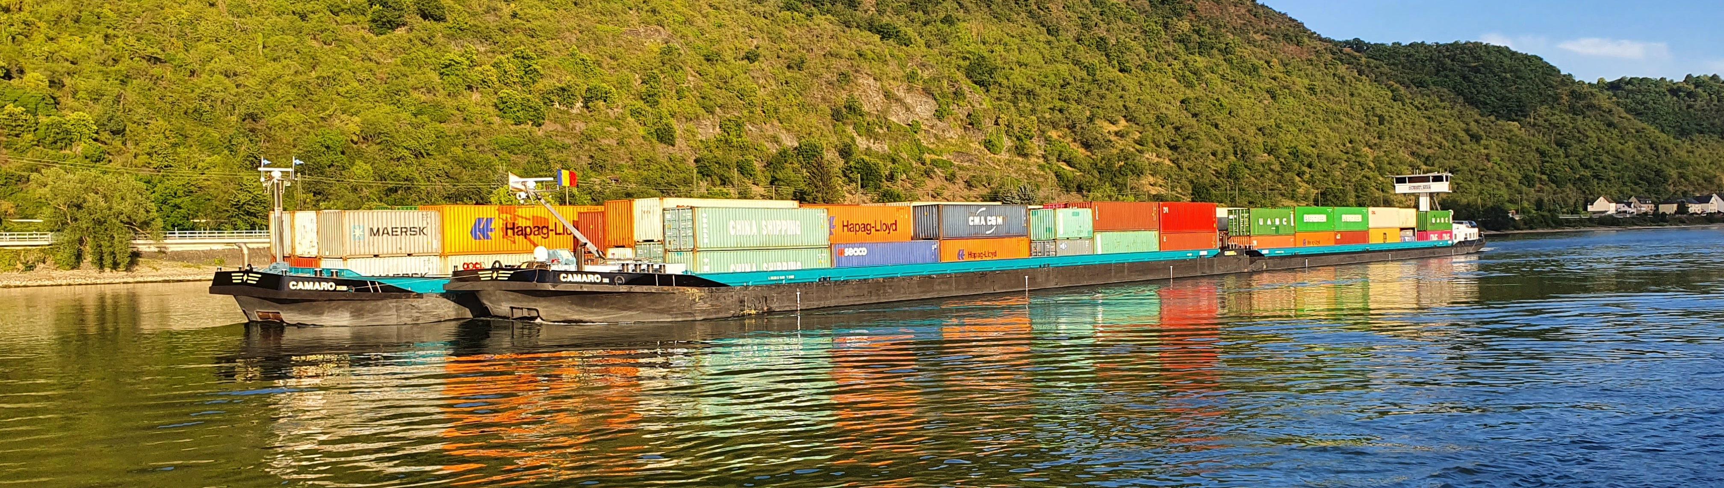
Infrastructure as a decisive factor
129 bridges along the Danube waterway
42 on the Austrian Danube line
on the Upper Danube: maximum 2-3 layer container transports possible,
therefore almost no container traffic on the Upper Danube (hardly profitable)
mainly container transports on the Rhine
Image: Björn Bosch
Notes:
From Kelheim to Sulina, a total of 129 bridges span the international Danube waterway. Among the 129 Danube bridges, there are 21 lock and weir bridges. With 89 Danube bridges, there is by far the highest density of bridges on the Upper Danube: 41 bridges span the German, 42 the Austrian and six the Slovakian Danube route. There are a total of 34 bridges on the Middle Danube; on the Lower Danube there are only seven.
On the Upper Danube, a maximum of 2-3 layer container transport is possible, which means that the transport is not very profitable. In comparison, many container transports are carried out on the Rhine due to other infrastructural requirements.
In general, bridges have a major impact on the profitability of inland navigation, as they affect the transport volume of inland waterway vessels.
Source: Viadonau (2019): Manual on Danube Navigation, pp. 55-56
Image Credit: Björn Bosch (private)

Slide 37
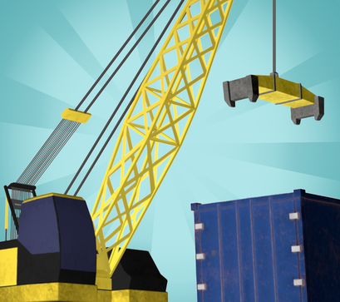
Transport planning with the Logistify app
Game 1 - Means of transport
Your transport planning talent is in demand – we need your help!
We want to transport various goods from A to B in the best possible way. We attach particular importance to the choice of the appropriate means of transport (truck, train or inland waterway vessel).
The transport should be planned as ecologically and economically efficient as possible.
Download App unter: Logistify: Understanding the World of Logistics
Explanatory video: https://www.youtube.com/watch?v=kZhL5SPtn6A
Image: FH OÖ
Notes:
Download app at: https://logistify.app/
Explanatory video: https://www.youtube.com/watch?v=kZhL5SPtn6A
Information and instructions for the game at: https://rewway.at/en/teaching-materials/transport-planning-with-the-logistify-app
The learning app "Logistify" deals with the different means of transport, their careful and efficient use of resources and job profiles in the logistics sector. The games require the students' transport planning talent. The task is to efficiently transport various goods from A to B, to plan multimodal transport chains from the raw product to the end customer and to discover job profiles in the logistics industry.
Duration: for game 1 about 15 minutes are needed
Learning objectives:
The students recognize the importance of different modes of transport in freight transport.
The students reflect on how resources in the transport sector can be used sparingly and efficiently.
The students analyze logistical challenges and make well-founded decisions on transport planning.
The students use digital learning formats in a playful way to grasp logistical relationships.

Slide 38
Classification of waterways
European Waterway Classification System
Objective: To promote a single inland waterway network
is based on spatial dimensions of ship types, with length and width being the most important parameters
The class of a waterway depends on the size of the ships that can sail on it.
Rhine-Main-Danube corridor as the most important European waterway axis
Notes:
The European classification of inland waterways aims to promote a unified network of inland waterways. This classification is based on the spatial dimensions of vessels and pusher convoys, with length and width being the most important parameters.
The waterway classes are designated with Roman numerals from I to VII and have different economic significance for freight transport. Waterways of Class IV and above are of international importance, while Classes I to III are more regionally or nationally relevant. The class of a waterway depends on the size of the ships that can sail on it. The width and length of the inland vessels are decisive. For international waterways, a minimum draught (2.50 m) and the minimum clearance height under bridges (5.25 m at maximum water) apply.
Sources:
WSV (2024): https://www.gdws.wsv.bund.de/DE/wasserstrassen/01_bundeswasserstrassen/Klassifizierung/Klassifizierung_node.html; Retrieved 29.05.2026
Viadonau (2019): https://www.viadonau.org/fileadmin/user_upload/Manual_on_Danube_Navigation.pdf , pp. 42-44; Retrieved 19.04.2024

Slide 39
TEN-T corricdors (I)
Trans-European Transport Network (TEN-T): Building an effective, EU-wide and multimodal transport network
includes railways, inland waterways, short maritime routes and roads connected to cities, ports, airports and terminals
Goal: sustainable and efficient transport routes throughout the EU without bottlenecks or missing connections
Milestones of this Trans-European Network (TEN-T) are:
  2030: Completion of the core network
  2040: Completion of extended core network
  2050: Completion of the entire network
Notes:
The EU has put in place a Trans-European Transport Network (TEN-T) policy to build an effective, multimodal transport network across the EU. This network includes railway lines, inland waterways, short maritime transport routes and roads that connect to major transport hubs. The TEN-T policy identifies the transport infrastructure in the Member States that has a high added value at European level and should be part of the TEN-T network. The infrastructure must meet certain requirements, such as safety, quality and environmental objectives.
This policy is of great importance for the development of coherent and high-quality transport infrastructure in the EU. Its aim is to support sustainable and efficient transport routes, simplify access to jobs and services, and promote trade and economic growth. The TEN-T policy also strengthens cohesion in the EU by promoting seamless interconnection of transport systems across borders and removing bottlenecks.
Milestones for this trans-European transport network are: by 2030, the core network will be completed (completion of the main transport routes), by 2040 the extended core network (requirements for speed and quality) and by 2050 the entire network (full functionality). The core network and the extended core network form the European transport corridors, which are the most strategic part of the network with the highest EU added value.
Source:
European Commission (2021): https://ec.europa.eu/commission/presscorner/detail/de/qanda_21_6725; Retrieved 29.05.2026

Slide 40
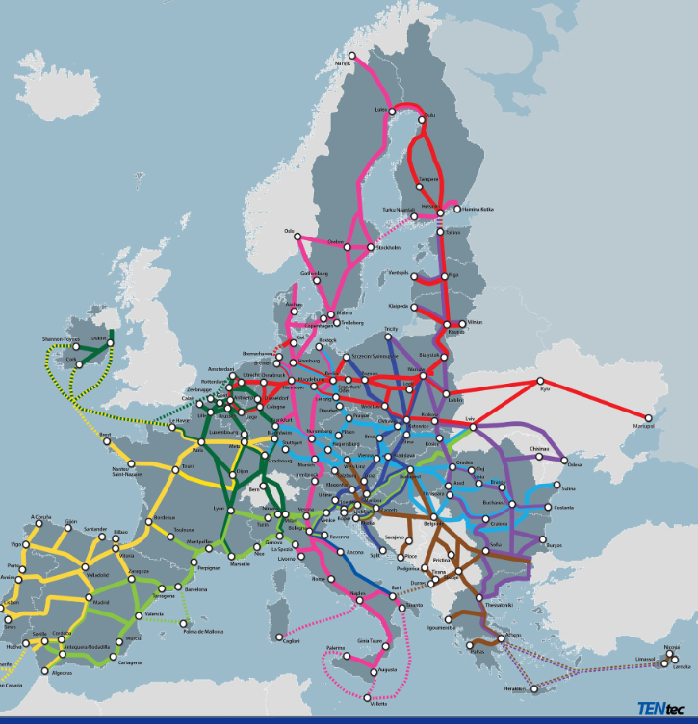
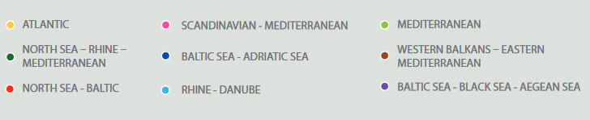
TEN-T corridors (II)
Image: European Commission (2024): TEN-T maps. Licensed under CC BY 4.0
Notes:
The Trans-European Transport Network defines 9 core corridors:
Scandinavia-Mediterranean Corridor
Kiel Corridor
Atlantic Corridor
Rhine-Danube Corridor
Mediterranean Corridor
Baltic-Adriatic Corridor
Western Balkans-Eastern Mediterranean Corridor
North Sea-Rhine-Mediterranean Corridor
Baltic-Black Sea-Aegean Corridor
Image source:
European Commission (2024): TEN-T maps. Licensed under CC BY 4.0. In: https://transport.ec.europa.eu/transport-themes/infrastructure-and-investment/trans-european-transport-network-ten-t/tentec-information-system-and-ten-t-map-library/ten-t-maps-european-transport-corridors_en; retrieved 29.05.2026

Slide 41
Comparison Danube & Rhine
Danube
2,415 km
Rhine
885 km
55.2 million tons of transport volume (2023)
284.5 million tons of transport volume
(2024)
64 billion tonne-kilometre transport capacity
23 billion tonne-kilometre transport capacity
Danube is 2.7 times longer
5x more goods are transported
on the Rhine
Danube transports are characterized by longer distances.
Notes:
Sources:
CCNR (2025): Market observation - Annual Report 2025; https://www.ccr-zkr.org/files/documents/om/om25_II_en.pdf, pp. 25, 30f; Retrieved 29.05.2026
Viadonau (2025): Annual Report Danube Navigation in Austria 2024, p. 45

Slide 42
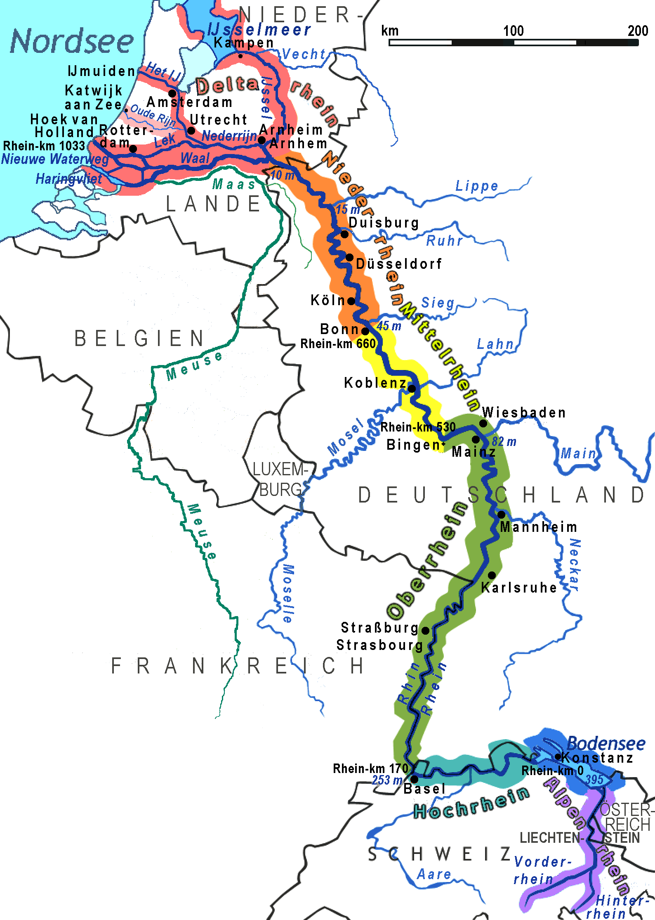
The Rhine
Rhine = most important and busiest inland waterway in Europe
80% of European inland waterway freight transport
almost 200,000 ships per year (550 ships per day)
from Basel (Switzerland) to Rotterdam (Netherlands)
Length of 1,233 km, of which 885 km are navigable
Image: Ulamm, CC BY-SA 3.0 via Wikimedia Commons
Notes:
Europe's most important and most frequently used inland waterway is the Rhine. This international waterway connects the western seaports with the inland . Approximately 80% of European inland waterway freight transport can be attributed to this international waterway. In the vicinity of the seaport of Rotterdam, inland waterway vessels account for over 40% of freight traffic, and in Antwerp more than 30%. Every year, almost 200,000 ships sail the Lower Rhine, which corresponds to an average of about 550 ships per day.
The Rhine Route stretches from Rotterdam (Netherlands) to Basel (Switzerland) and is 1,233 km long.
Because of the different gradients, the navigable Rhine is divided into Upper (Rheinfelden/Switzerland to Mannheim/Germany), Middle (Mannheim to Cologne) and Lower Rhine (Cologne to the German-Dutch border).
About 70% of all German waterway transports take place on the Lower Rhine between the Rhine estuary ports and the German inland ports. (cf. WSV 2024)
Sources:
BDB (2026): https://www.binnenschiff.de/system-wasserstrasse/wasserstrasse/; Retrieved 20.05.2026
WSV (2026): https://www.gdws.wsv.bund.de/DE/wasserstrassen/01_bundeswasserstrassen/02_Rhein/Rhein.html; Retrieved 20.05.2026
Image: Ulamm, CC BY-SA 3.0 via Wikimedia Commons

Slide 43
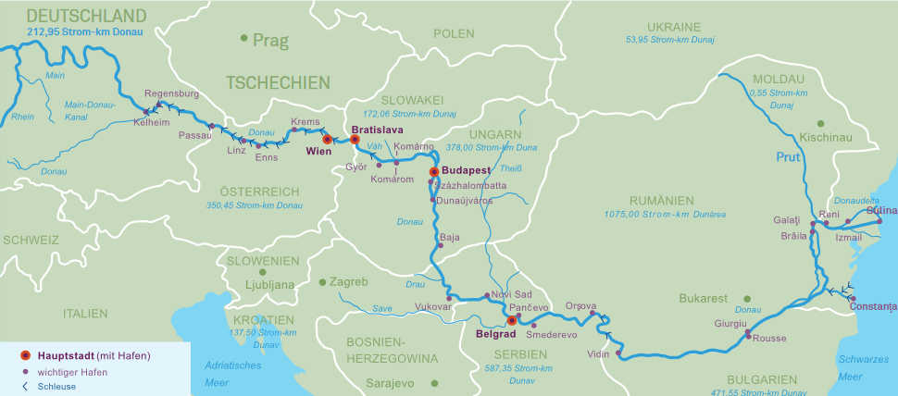
The Danube
from the Black Forest (Germany) to the Black Sea (Romania and Ukraine)
10 riparian states: Germany, Austria, Slovakia, Hungary, Croatia, Serbia, Bulgaria, Romania, Moldova, Ukraine
most international river in the world
2.845 km long, 2.415 km navigable
Image: viadonau
Notes:
The Danube, which flows from the Black Forest in Germany to its mouth in the Black Sea in Romania and Ukraine, runs through ten riparian states (Germany, Austria, Slovakia, Hungary, Croatia, Serbia, Bulgaria, Romania, Moldova, Ukraine) and is thus considered the river with the highest internationality in the world.
The Danube is 2,845 km long and has a navigable length of 2,415 km for international freight shipping.
Source:
Viadonau (2019): Handbook of Danube Navigation; p. 38 ff.
Image source:
Viadonau (2019): Handbook of Danube Navigation; p. 46

Slide 44
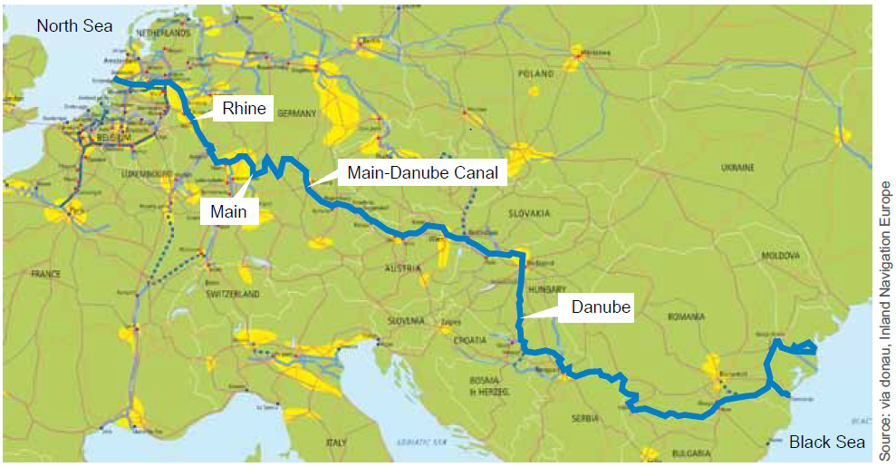
Rhine-Main-Danube Corridor
Total length: 3,504 km
Continuous east-west
connection between the North Sea
and the Black Sea
Notes:
The Rhine-Main-Danube Corridor has a total length of 3,504 km and connects the port of Rotterdam (Netherlands) with the port of Constanta (Romania) and thus also 15 European countries directly by water.
Source:
Viadonau (2019): Handbook of Danube Navigation; p.20, 21
Image source:
Viadonau (2019): Handbook of Danube Navigation; p. 44

Slide 45
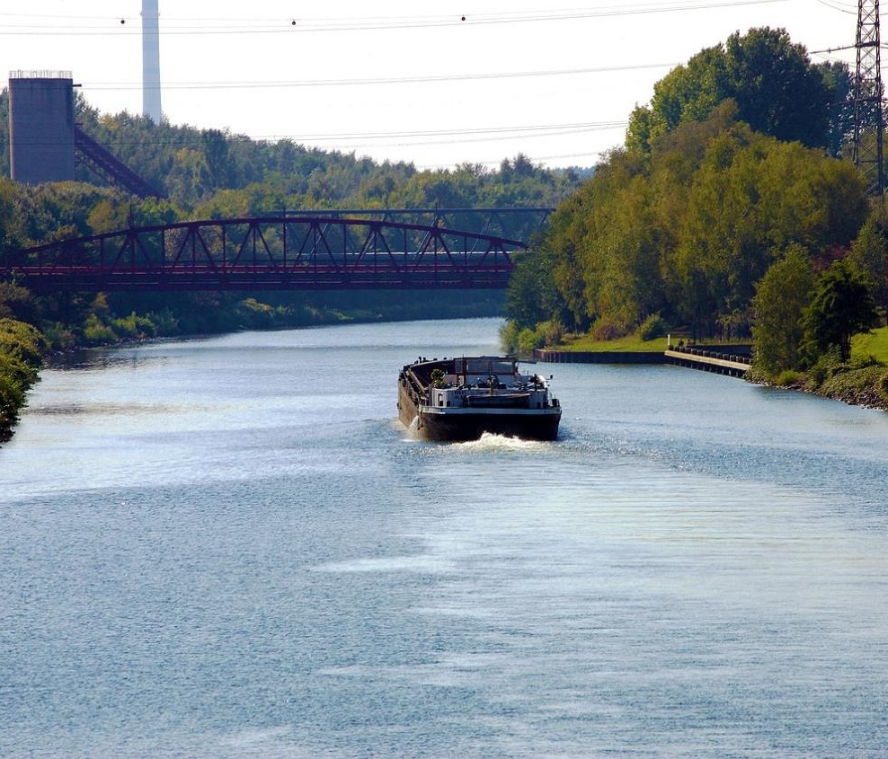
German canals
Linking the Rhine, Ems, Weser and Elbe river systems
West German canals: Dortmund-Ems Canal, Rhine-Herne Canal, Wesel-Datteln Canal, Elbe Lateral Canal, Coastal Canal
Transport volume: 8.3 billion tkm (2024)
Mittelland Canal: Germany's longest artificial waterway: 325 km
Transport performance: 8 billion tkm (2024)
Image: Pixabay
Notes:
The rivers Rhine, Ems, Weser and Elbe run through the North German Plain in a north-south orientation. Until the early 20th century, shipping was essentially only possible along this direction.
It was only through the construction of artificial waterways that connections in a west-east direction could be created. In this way, the West German canal network was created in the first decades of the 20th century, linking the individual river systems with each other.
WSV (2024): https://www.gdws.wsv.bund.de/DE/wasserstrassen/01_bundeswasserstrassen/05_westdeutsches_Kanalnetz/Kanalnetz.html; Retrieved 21.05.2026
CCNR (2025): Market observation - Annual Report 2025; https://www.ccr-zkr.org/files/documents/om/om25_II_en.pdf; S 30
Image source:
Pixabay (2024): https://pixabay.com/de/photos/kanal-schiff-rhein-herne-kanal-346282/; Accessed 30.04.2024

Slide 46
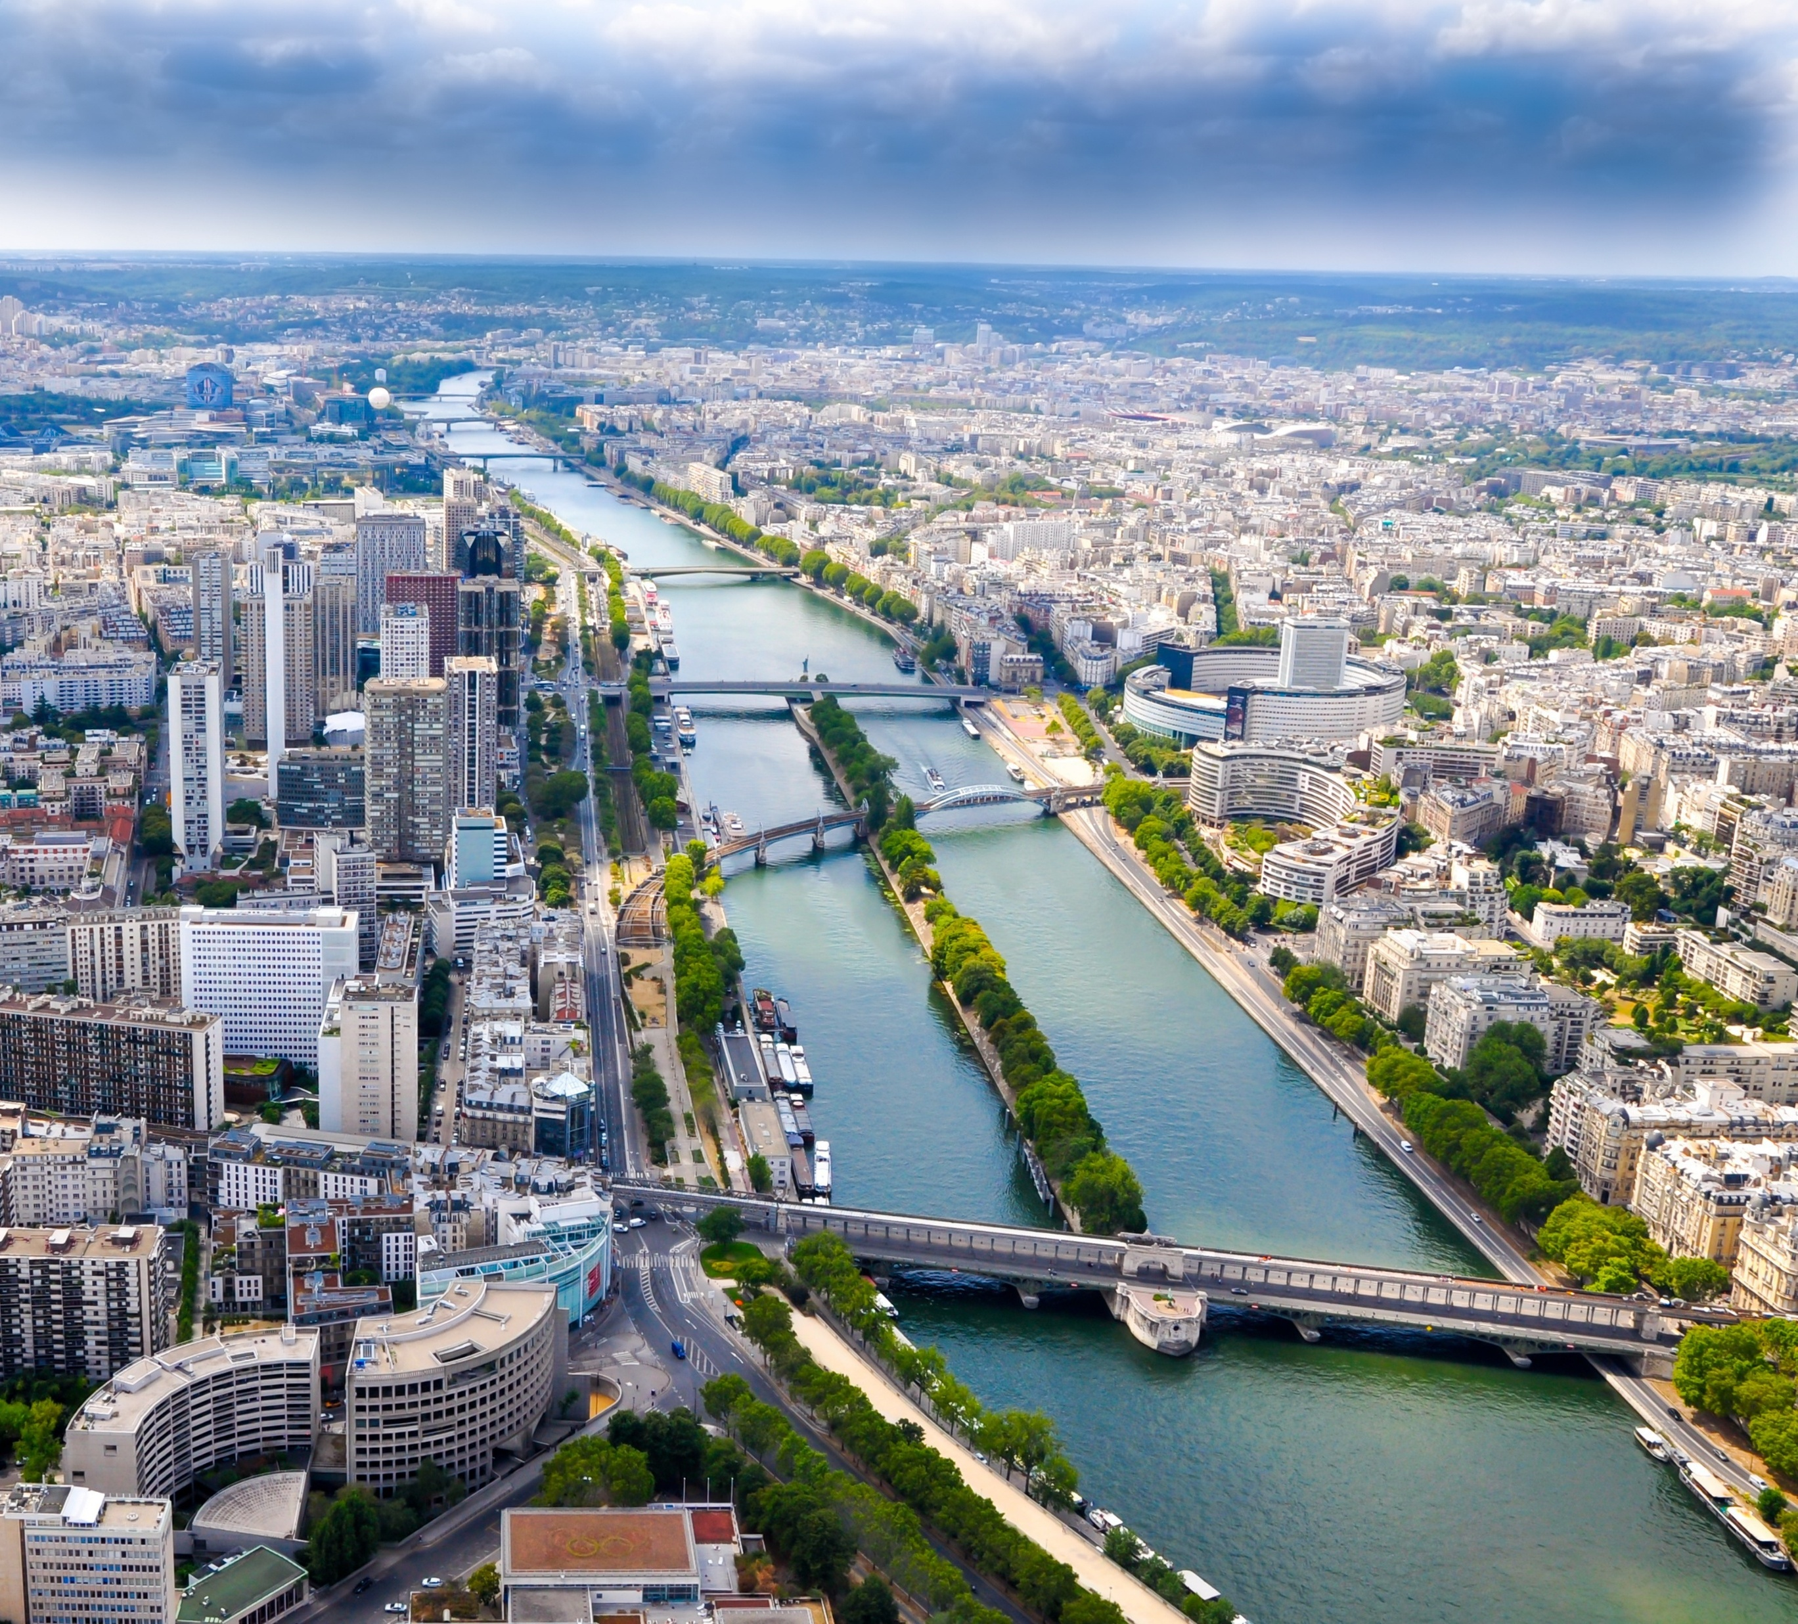
The Seine
The most important river basin in France in terms of freight transport
Transport volume: 3 billion tkm (2024)
Seine-Nord-Europa Canal (project): Construction to start in 2017 – completion planned for 2032, connects Seine with the Rhine
Key Markets:
Sands
Agricultural products
Machines
Petroleum products
Image: Pixabay
Notes:
In terms of freight transport, the Seine basin is the most important river basin in France. Its main waterways are the Seine, Oise, Marne rivers and canals, such as the Canal du Nord, which is being upgraded by the Canal Seine Nord-Europe project. The most important markets are sands, stones and building materials.
CCNR (2025): Market observation - Annual Report 2025; https://www.ccr-zkr.org/files/documents/om/om25_II_en.pdf; S 30
Société du Canal Seine-Nord Europe: https://www.canal-seine-nord-europe.fr/en/channel-essentials/; Abruf 21.05.2026
Image source:
Pixabay: https://pixabay.com/photos/city-buildings-skyline-paris-4627143/; Retrieved 21.05.2026

Slide 47
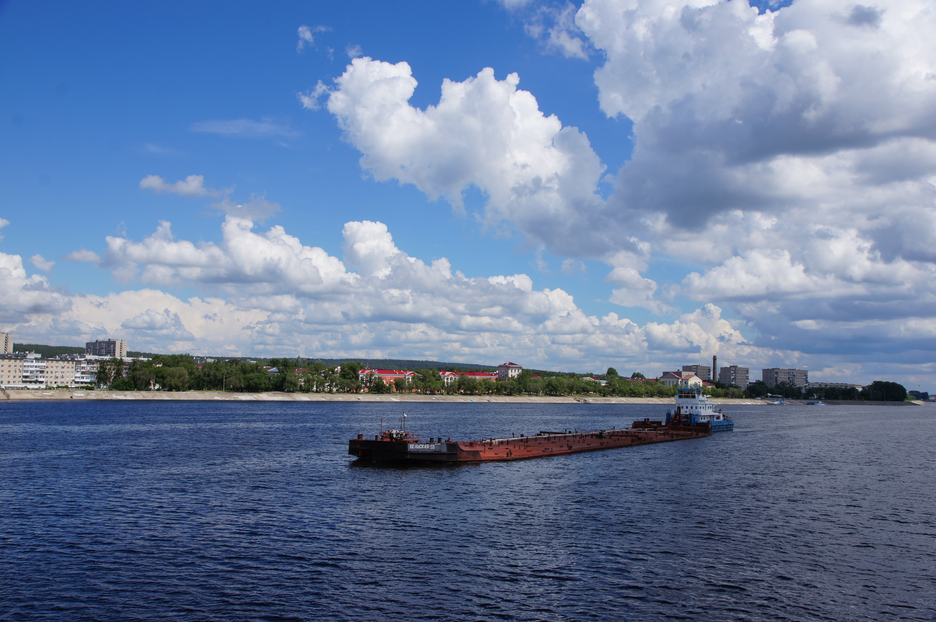
Russia
Volga: Longest river in Europe (3,530 km), mostly navigable
Russia owns 16% of the world's navigable inland waterways (after China with 18%)
Unified Deep-Water System of European Russia (UDWS): connects the White Sea, Baltic Sea, Caspian Sea, Sea of Azov, Black Sea via several rivers, lakes and canals
Transport of approx. 63 billion tkm on inland waterways in Russia (2022)
Image: Pixabay
Notes:
Federal Agency for Civic Education (2023): https://www.bpb.de/themen/europa/russland-analysen/nr-443/543594/analyse-die-strategische-bedeutung-des-russischen-wolga-flusssystems/; Retrieved 21.05.2026
Image source:
Pixabay: https://pixabay.com/photos/volga-river-river-summer-water-4922233/; Retrieved 21.05.2026

Slide 48
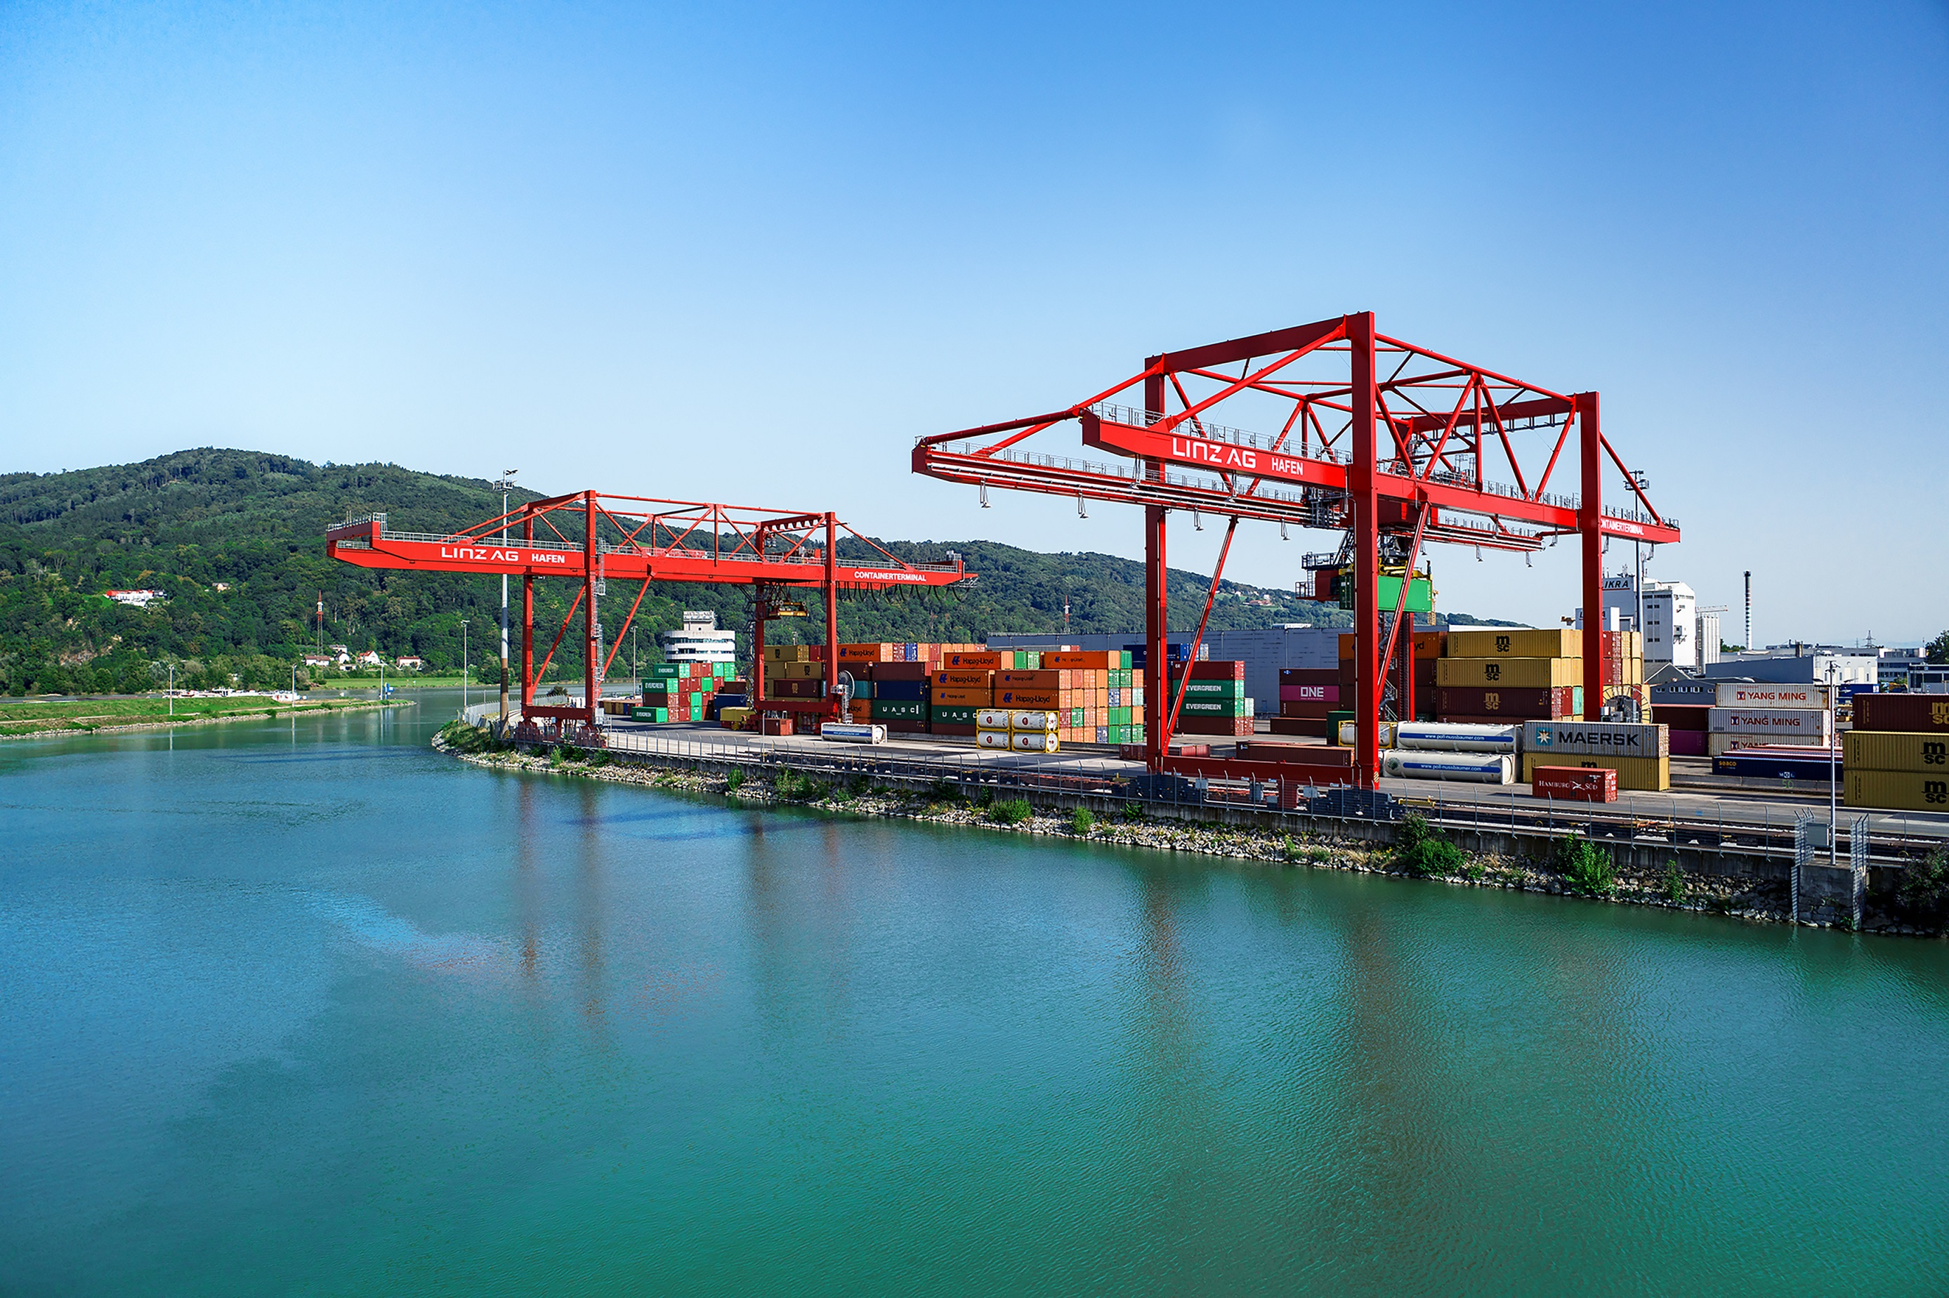
European ports
Central hubs in freight transport:
connection to hinterland traffic, hub for multimodal transport
Port of Duisburg – largest inland port in the world
Major seaports: ARA (Antwerp, Rotterdam, Amsterdam)
Austria: Vienna, Linz, Enns...
Image: Linz AG
Notes:
Important ports act as central hubs for freight traffic:
The port of Duisburg on the German Rhine is considered the largest inland port in the world
In Austria, the ports of Linz and Vienna are particularly important for the handling of goods
Some companies even have their own factory ports. voestalpine in Linz uses the Danube intensively and handles around 2.5 million tons of goods and raw materials via the waterway every year.
Sources:
Viadonau (2025): Annual Report Danube Navigation in Austria 2024, p. 18
Duisport (2026): https://duisport.de/presse/, accessed 18.05.2026
Image Credit: Linz AG

Slide 49
Port of Rotterdam
Europe's largest seaport
428 million tonnes
handled
940 million € turnover
182,000 jobs
27,384 seagoing vessels per year
93,680 inland vessels per year
Among the TOP 15 worldwide
Notes:
The port of Rotterdam (Netherlands), also known as the "Gateway to Europe", is not only the largest seaport in Europe, but is also one of the most important ports in the world. With a total cargo throughput of 428 million tons in 2025, it plays a crucial role in international trade and represents an important link between Europe and the rest of the world (source: Statista). The location of the port offers excellent connections to the North Sea and the Atlantic Ocean.
Gross sales amounted to €940 million.
In addition to its economic importance, the Port of Rotterdam also plays an important role in terms of employment: approx. 182,000 jobs (directly and indirectly in Rotterdam-Rijnmond)
Sources:
Port of Rotterdam (2024): https://www.portofrotterdam.com/de/online-erleben/fakten-und-zahlen, Abruf 29.05.2026
Statista (2026): https://de.statista.com/themen/10797/hafen-rotterdam/#topicOverview; Retrieved 29.05.2026

Slide 50
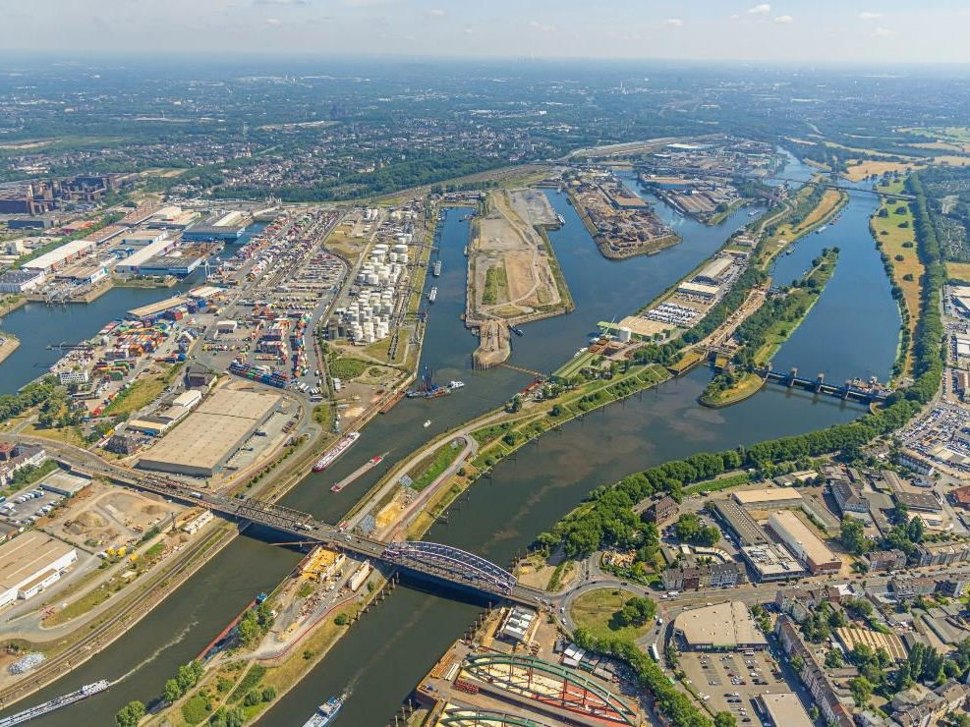
The Port of Duisburg
largest inland port in the world
Logistics hub
30 million consumers within a radius of 150 km
More than 20,000 ships and 25,000 trains and several million containers every year
Image: duisport, Hans Blossey
Notes:
The port of Duisburg is considered the largest inland port in the world and is an important hub for logistics in Central Europe. Around 30 million consumers live within a radius of 150 kilometers. The port plays an important role in the transport of goods and records more than 20,000 ship and 25,000 train clearances annually as well as the handling of several million containers.
Duisport (2026): https://duisport.de/unternehmen/; Retrieved 20.05.2026
Image source:
Duisport/Hans Blossey

Slide 51
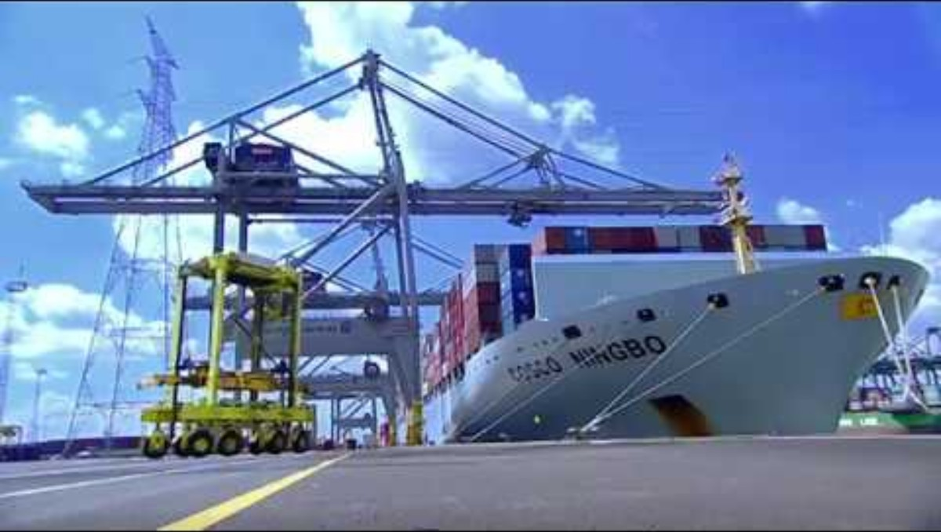
Duisport Video
https://youtu.be/9sF_Sx2CVqA?si=FfQC8LWEWilxrAb9

Slide 52
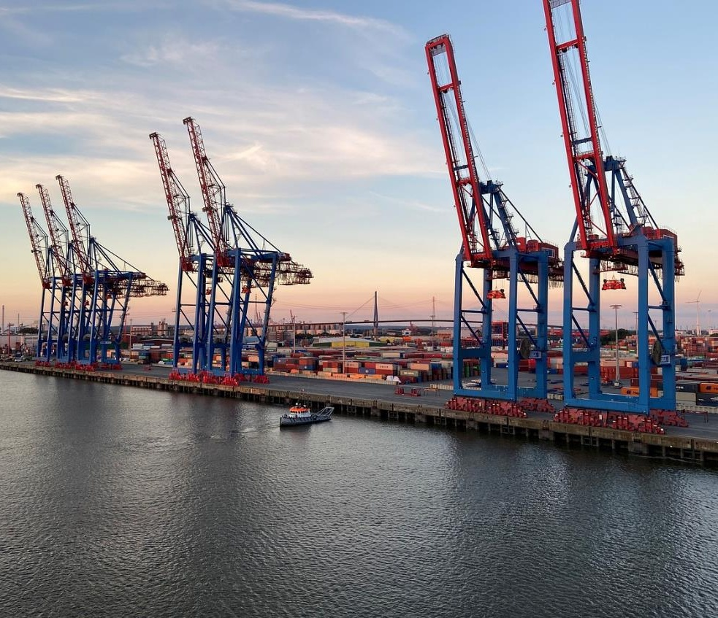
Port of Hamburg
largest port in Germany.
Third largest port in Europe
Supplying Europe's domestic markets
China as the most important trading partner
Image: Pixabay
Notes:
The Port of Hamburg is the largest port in Germany and the third largest port in Europe (after Rotterdam and Antwerp). As the largest universal port in Germany, it plays a crucial role in supplying Europe's domestic markets. China is considered the most important trading partner in terms of container throughput. Europe's largest rail port: excellent connection to the rail network
Sources:
Port of Hamburg Marketing (2024): Container throughput in the Port of Hamburg from 1991 to 2023 and a forecast for the year 2035; In Statista: https://de.statista.com/statistik/daten/studie/29789/umfrage/containerumschlag-im-hamburger-hafen/; Retrieved 21.05.2026
Port of Hamburg (2024): https://www.hafen-hamburg.de/; Abruf 29.05.2026
Image source:
Pixabay (2024): https://pixabay.com/de/photos/hamburg-containerhafen-elbe-schiff-7447789/; Retrieved 17.04.2024

Slide 53
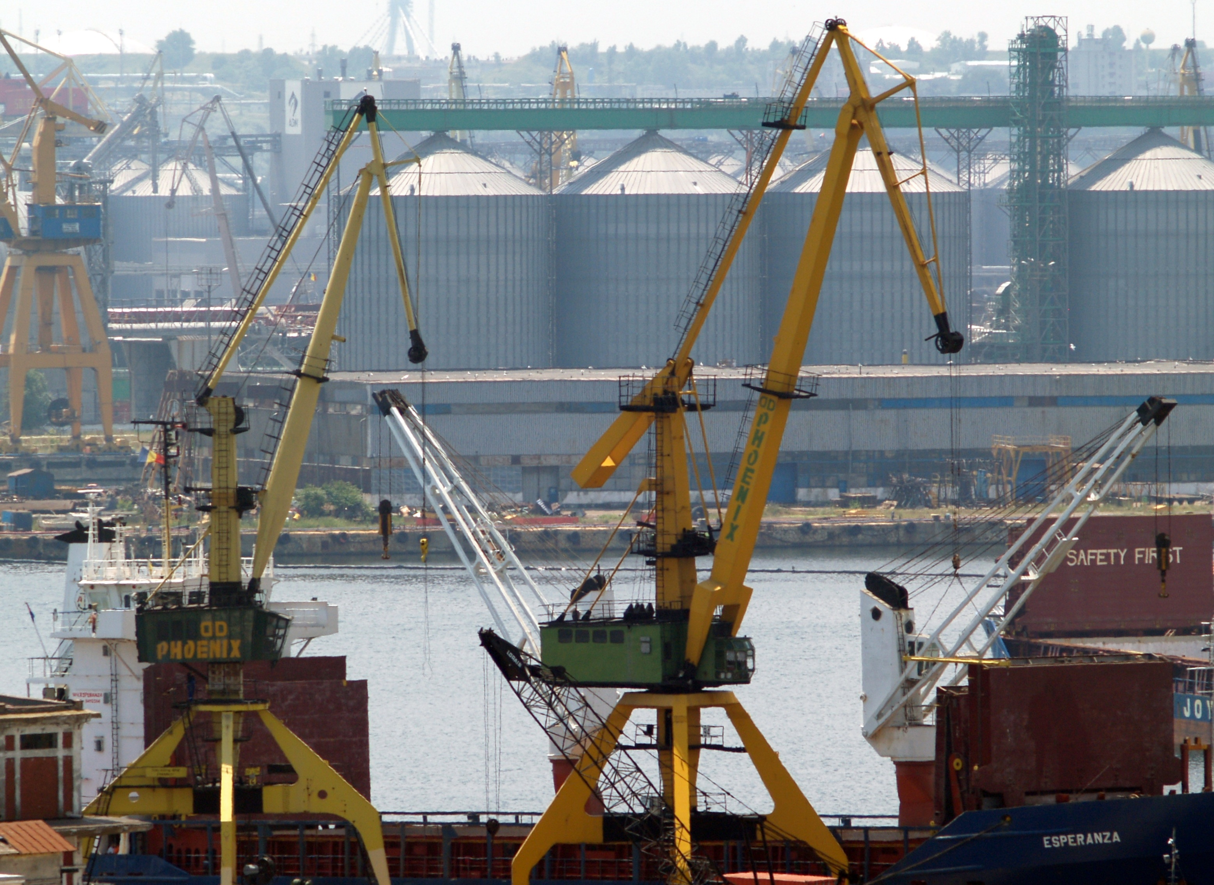
Port of Constanța
Located in Romania on the Black Sea
largest seaport in Eastern Europe
most important inland port in the Danube region
Cargo throughput in 2024: 17 million tonnes
Increasing importance since the Ukraine war
Dry goods are mainly handled (grain)
Image: Pixabay
Notes:
CCNR (2025): Market observation - Annual Report 2025; https://www.ccr-zkr.org/files/documents/om/om25_II_en.pdf, S 90
Image source:
Pixabay: https://pixabay.com/photos/port-romania-crane-constanta-silo-3852195/; Retrieved 21.05.2026

Slide 54
Danube waterway
3

Slide 55
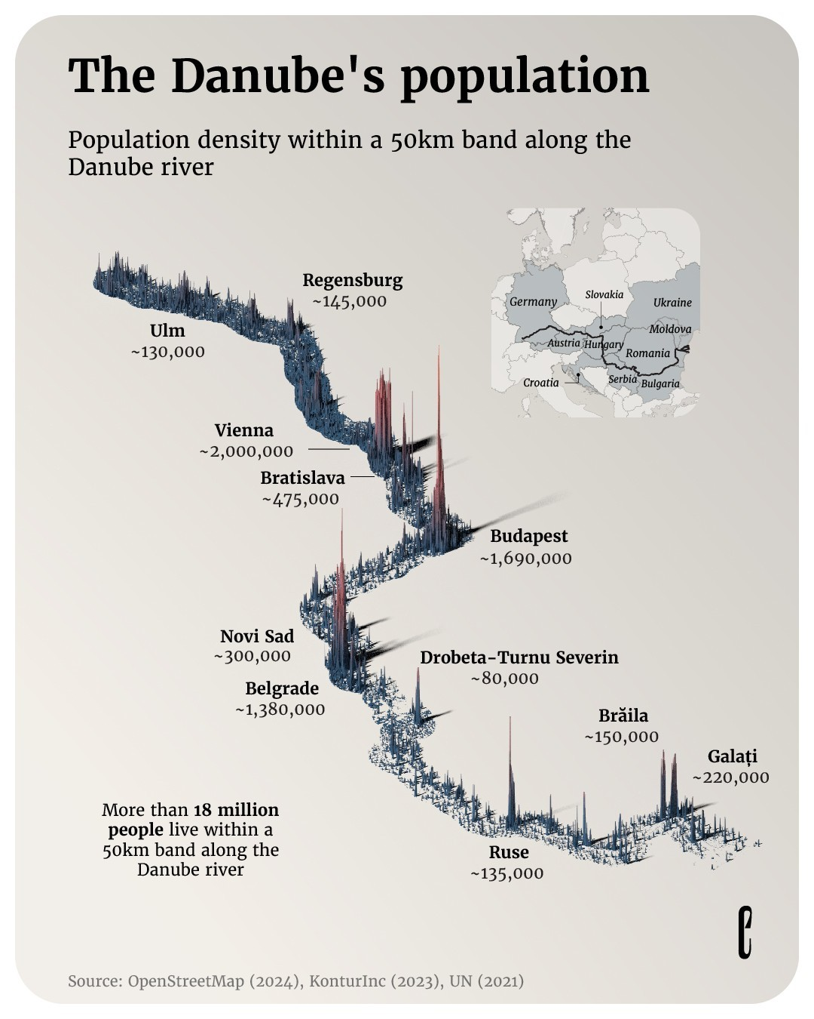
Population in the Danube Corridor
More than 18 million people live within a radius of 50 km along the Danube!
Created by Sebastian Gräff and copyrighted by The European Correspondent
Notes:
Bildquelle: (c)Created by Sebastian Gräff and copyrighted by The European Correspondent

Slide 56
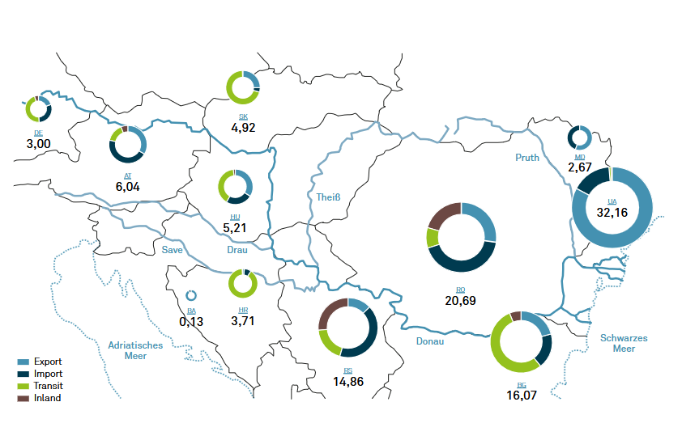
Freight transport on the entire Danube (2023)
Image: viadonau
Notes:
The transport volume on the Danube and its tributaries was 55.2 million tonnes in 2023. In a country comparison, Ukraine is clearly in the lead with 32 million tonnes, mainly due to exports via its Danube ports. This is followed by Romania (20.7 million tonnes), Bulgaria (16.1 million tonnes) and Serbia (14.9 million tonnes). Significantly lower volumes were recorded by Austria (6 million tonnes), Hungary (5.2 million tonnes) and Germany (3 million tonnes), among others, while Bosnia-Herzegovina brought up the rear with 0.1 million tonnes.
Source: Viadonau (2025): Annual Report Danube Navigation in Austria 2024, p. 45
Graphic: Viadonau (2025): Annual Report Danube Navigation in Austria 2024, p. 44

Slide 57
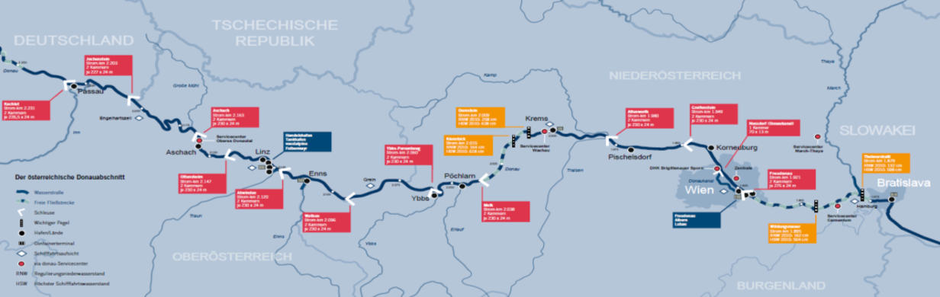
Significance of Danube navigation in Austria
In the Danube Corridor: 12% share of the Austrian modal split
Transport of 2,177 million tonnes of goods per year on the Austrian section of the Danube
Austrian section of the Danube = approx. 351 km
Austrian Danube section
Image: viadonau
Notes:
In Austria, 2,177 million tonnes of goods are transported annually, which means that the Danube waterway's share of the modal split in the Austrian Danube corridor is around 12%. The Danube plays an important role especially in transport to the mountain, especially in import across the eastern border and in transit, in these areas the Danube is about on a par with rail. In Austria as a whole, the Danube has a modal split share of around 3.5%.
The Danube is 2845 km long and is the second longest river in Europe. The Danube connects a total of ten countries and serves as an important waterway for the movement of goods on inland waterway vessels. The Austrian section of the Danube is approx. 351 km and is located in the middle of the Rhine-Main-Danube waterway axis, which connects the North Sea and the Black Sea. In Austria, there are no other relevant waterways for the transport of goods besides the Danube.
Source:
Dalziel, A. (2013). Whitepaper Logistics in 2020. Bod Homburg: Kewill.
Viadonau (2019): Manual on Danube Navigation, pp. 22, 41

Slide 58
Transport volume on the Danube
Own illustration based on viadonau
Notes:
The transport volume on the Danube is between 34 and 55 million tons per year.
Image: Own illustration based on:
Viadonau (2022): Annual Report Danube Navigation in Austria 2021; https://www.viadonau.org/fileadmin/user_upload/viadonau_Annual_Report_on_Danube_Navigation_2021.pdf; p. 45; Retrieved 26.05.2026
Viadonau (2023): Annual Report Danube Navigation in Austria 2022; https://www.viadonau.org/fileadmin/user_upload/viadonau_Annual_Report_on_Danube_Navigation_2022.pdf; p. 45; Retrieved 26.05.2026
Viadonau (2024): Annual Report Danube Navigation in Austria 2023; https://www.viadonau.org/fileadmin/user_upload/Annual_Report_on_Danube_Navigation_2023.pdf ; p. 45; Retrieved 26.05.2026
Viadonau (2025): Annual Report Danube Navigation in Austria 2024; https://www.viadonau.org/fileadmin/user_upload/Annual_Report_on_Danube_Navigation_2024.pdf; p. 45; Retrieved 26.05.2026

Slide 59
Danube traffic by freight segment
Own presentation based on CCNR
Notes:
The main traffic volume of inland waterway transport is mainly based on traditional market segments. Examples include the transport of steel, agricultural products, foodstuffs and chemicals. In 2022, steel production accounted for about 40% of all freight traffic on the Danube, which includes materials such as iron ore, steel scrap, coal, metals and metal products. The agricultural sector and the segment for foodstuffs, especially cereals, are also significant markets for inland navigation (23% on the Danube). Another important industry is the chemical industry. In 2022, chemicals transported on the Danube accounted for a share of 11%.
Source:
CCNR (2023): Annual Report 2023 – European Inland Navigation Market Observation; https://www.ccr-zkr.org/files/documents/om/om23_II_en.pdf; Accessed 11.04.2024
Image: Own illustration based on:
CCNR (2023): Annual Report 2024 – European Inland Navigation Market Observation; https://www.ccr-zkr.org/files/documents/om/om24_II_en.pdf; p. 40; or https://inland-navigation-market.org/chapitre/2-transport-fluvial-de-marchandises-2/?lang=de; Retrieved 26.05.2026

Slide 60
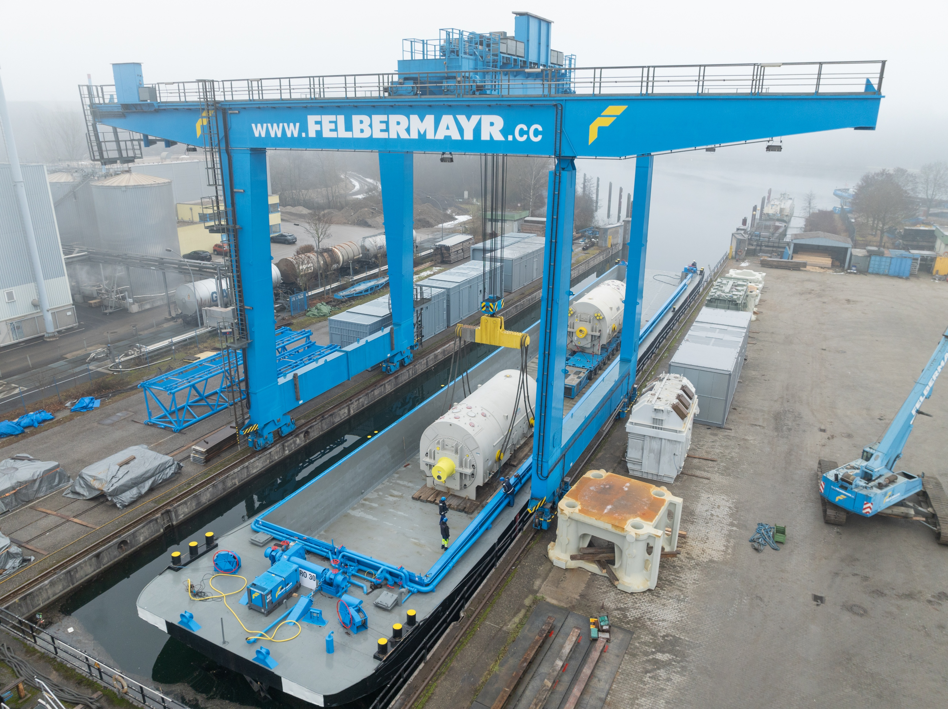
High & Heavy Transports on the Danube
Enormous load capacity
Operational 24/7
No infrastructure costs
No permit & escort/roadblocks
Environmentally friendly
40
Image: Felbermayr
Notes:
When it comes to the transport of particularly large and heavy goods – i.e. so-called high and heavy transports – inland waterway vessels offer a number of advantages that other modes of transport can hardly achieve.
The enormous load capacity: ideal for machines, components or industrial plants that are too large for trucks or trains.
Operational 24/7: In contrast to road transport, which is often restricted by driving bans or rest periods, a ship can sail around the clock – without breaks, without traffic jams.
No infrastructure costs: roads do not have to be reinforced, bridges do not have to be adapted. The waterways are already in place and can be used without additional construction costs.
No permits or escort vehicles necessary: While heavy transports by road often require lengthy approval procedures and police escort, a ship can normally move these goods as standard cargo – without permits and closures.
Environmentally friendly: Transport by ship causes significantly less CO₂ than trucks or planes. Especially for long distances and heavy loads, this is a real advantage for sustainability.
Source:
Viadonau (2025): https://www.viadonau.org/wirtschaft/donaulogistik/high-heavy-transporte; Retrieved 10.07.2025
Image: Felbermayr

Slide 61
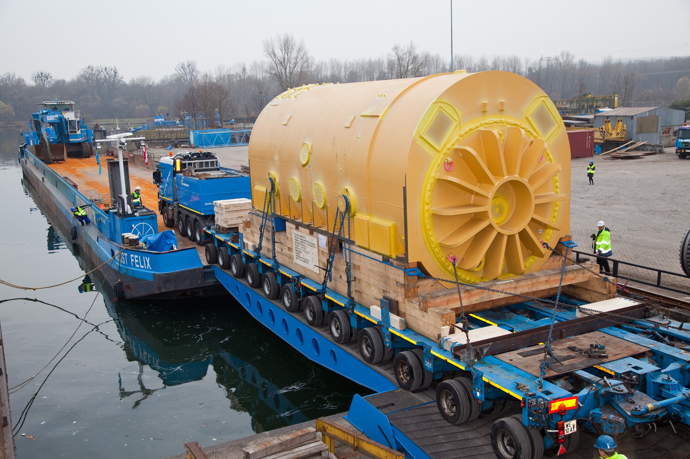
High & Heavy Transport
Image: Felbermayr
Notes:
Image: Felbermayr

Slide 62
Legal framework: The Belgrade Convention
"Convention on the Regulation of Navigation on the Danube"
signed by all Danube riparian states
Main objectives:
Freedom of navigation on the Danube
Maintenance obligation of the Danube waterway by the states
Enforcement monitored by the Danube Commission: (www.danubecommission.org)
makes recommendations (e.g. on the shipping channel or on the expansion)
establishes a uniform system of designation and traffic rules
Unifies power monitoring rules
Notes:
The Convention on the Regulation of Navigation on the Danube was signed by all Danube riparian states ("Belgrade Convention" of 1948). The main objectives of the Convention are to ensure freedom of navigation on the Danube for all States and to oblige the Danube States to maintain their sections of the Danube in a condition suitable for navigation.
The implementation of the Belgrade Convention and compliance with its provisions is monitored by the Danube Commission, based in Budapest. This is made up of the signatory states (Bulgaria, Germany, Croatia, Moldova, Austria, Romania, Russia, Serbia, Slovakia, Ukraine and Hungary) to the Belgrade Convention. Decisions of the Danube Commission are only of a recommendatory nature. For example, for the shipping channel or the expansion of the Danube waterway, it establishes a uniform system for naming the waterways and uniform traffic rules and standardizes the rules for electricity monitoring.
(For more details, see the Handbook of Danube Navigation p. 29)

Slide 63
Legal framework: The Belgrade Convention
free navigation on the Danube for merchant ships under the flags of all states of the Danube riparian states
No canal and lock fees on the Danube and Rhine (classification as an international waterway)
Sailing on the Main-Danube Canal (Germany) has been free of charge since 2019
On the Danube-Black Sea Canal (Romania) taxes are payable (nat. Waterways are not covered by the Belgrade Convention)
Notes:
No shipping taxes are levied on the Danube and Rhine international waterways. Taxes are payable for navigation on the Danube-Black Sea Canal (Romania), as these are national waterways that are not covered by the Belgrade Convention of 1948. Sailing on the Main-Danube Canal has been free of charge since 2019. In this Convention on the Regulation of Navigation on the Danube, free navigation on the Danube for merchant ships under the flags of all states was laid down by the Danube riparian states.
Viadonau (2026): http://www.viadonau.org/wirtschaft/transportachse-donau/; Retrieved 26.05.2026

Slide 64
Expert panel on the Danube
Research one of the topics on the Internet in the group and present your results to the class:
What role does the transport of goods on waterways play in the global economy?
What are the advantages of transporting goods by waterway compared to other modes of transport?
What other well-known European waterways are there besides the Danube and how are they connected to each other?
What are the current problems facing Danube shipping?
The future of the Danube: How could the waterway be made more sustainable?
Notes:
Expert panel on the Danube – waterways in focus
Duration: 30-40 minutes (10 min research phase, 10–15 min short presentations of the groups, 10–15 min joint final discussion)
The students work in groups. Each group gets a topic:
What role does the transport of goods on waterways play in the global economy?
What are the advantages of transporting goods by waterway compared to other modes of transport?
What other well-known European waterways are there besides the Danube and how are they connected to each other?
What are the current problems facing Danube shipping?
The future of the Danube: How could the waterway be made more sustainable?
Procedure:
Each group researches the internet for 10 minutes, and the questioning of AI (e.g. ChatGPT) is also allowed.
Afterwards, each group presents its topic in 2-3 sentences.
Conclusion: Joint discussion on the importance of waterways and the Danube.
Learning objectives:
The students discuss the importance of waterways in the context of sustainable mobility and the global economy.
The students reflect on how infrastructure, the environment and trade are interlinked.
The students strengthen their teamwork, media literacy and argumentation skills.

Slide 65
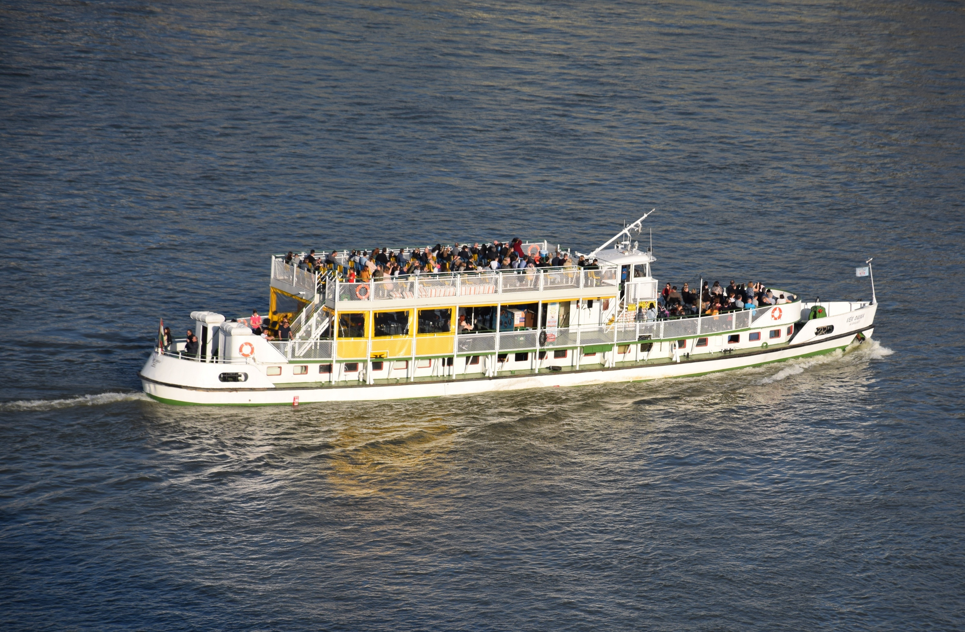
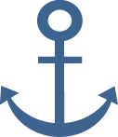
Tourism on the Danube
In addition to its importance as a mode of transport, the Danube is
also a popular destination for leisure activities
Image: Pixabay
Notes:
Image:
Pixabay: https://pixabay.com/photos/sightseeing-boat-danube-donau-4106146/; Retrieved 26.05.2026

Slide 66

Passengers on the Austrian Danube (2024)
1,095,000 passengers in 2024
Graphic: viadonau
Notes:
In 2024, around 1.095 million passengers were transported on the Danube in Austria. River cruises continued to grow, reaching about 470,000 passengers, 6.8% more than in 2023. Around 540,000 people were transported in scheduled services – a decline compared to the previous year. Occasional traffic (e.g. theme or charter trips) had about 85,000 passengers.
Viadonau (2025): Annual Report Danube Navigation in Austria 2024; https://www.viadonau.org/fileadmin/user_upload/Annual_Report_on_Danube_Navigation_2024.pdf ; p. 23; Retrieved 26.05.2026

Slide 67
Thank you for your attention!

Slide 68
Additional information for teachers
This set of teaching materials is available under the so-called Creative Commons Attribution 4.0 International Licence.
You may therefore freely integrate these materials into your teaching, adapt them to your needs and share them with your students or other individuals.
We kindly ask you to leave the logos on the slides unchanged.
Image rights are indicated in the notes sections; use in other contexts is not permitted.
Explanation of the use of generative AI and AI-supported technologies:
During the development of this project, the authors used ChatGPT and Microsoft Copilot to support conceptual design and idea generation — particularly with regard to interactive exercises. The use of these AI tools was carried out with careful consideration. The content was subsequently thoroughly reviewed by the authors and revised where necessary to ensure compliance with academic standards. The authors take full responsibility for the final content of the publication.
40

Slide 69
Additional information for teachers
For questions and feedback, please contact us by email at:
rewway@fh-steyr.at.
Further slide sets and practical exercises can be found at:
https://www.rewway.at/en/teaching-materials/
Are you interested in a Transport School Lab, an excursion or a guest lecture?
https://www.rewway.at/en/pages/workshops
40

Slide 70
List of sources I
BDB (2024): https://www.binnenschiff.de/system-wasserstrasse/gueterschifffahrt/; Abruf 19.04.2024
BDB (2026): https://www.binnenschiff.de/system-wasserstrasse/wasserstrasse/; Abruf 15.05.2026
Bundesanstalt für Wasserbau (2017): Kolloquium Wasserbauliche Herausforderungen an den Binnenschifffahrtsstraßen, https://izw.baw.de/publikationen/kolloquien/0/02_Kempmann-Kriedel_Rusche-Pauli-Georges_Herausforderungen....pdf; Abruf: 27.05.2026
Bundeszentrale für politische Bildung (2023): https://www.bpb.de/themen/europa/russland-analysen/nr-443/543594/analyse-die-strategische-bedeutung-des-russischen-wolga-flusssystems/; Abruf 21.05.2026
Christidis, P., & Brons, M. (2016): External costs of freight transport in European Union Member States (Joint Research Centre (JRC)). Harvard Dataverse. https://dataverse.harvard.edu/dataset.xhtml?persistentId=doi:10.7910/DVN/YA3VCY https://doi.org/10.7910/DVN/YA3VCY; Abruf 28.01.2025
Dalziel, A. (2013). Whitepaper Logistik im Jahr 2020. Bod Homburg: Kewill.
Duisport (2026): https://duisport.de/presse/, Abruf 18.05.2026
Duisport (2026): https://duisport.de/unternehmen/; Abruf 20.05.2026
Eurostat (2024): Modal split of inland freight transport: https://ec.europa.eu/eurostat/databrowser/view/tran_hv_frmod/default/table?lang=en&category=tran.tran_hv_ms; Abruf 28.04.2026
Eurostat (2025): https://ec.europa.eu/eurostat/statistics-explained/index.php?title=Characteristics_of_the_railway_network_in_Europe; Abruf 06.03.2025
“Facts & Figures- Inland Navigation in Europe”, slide 2, URL: http://de.slideshare.net/carolinevandeleur/platina-ff-general-14427068; Abruf 21.05.2026
40

Slide 71
List of sources II
Hafen Hamburg Marketing (2024): Containerumschlag im Hamburger Hafen von 1991 bis 2023 und eine Prognose für das Jahr 2035; In Statista: https://de.statista.com/statistik/daten/studie/29789/umfrage/containerumschlag-im-hamburger-hafen/; Abruf 21.05.2026
Heinzelmann, Christoph / Bödefeld, Jörg / Duric, Zorana (2020): Digitalisierung im Verkehrswasserbau. Bautechnik, 97; In: https://doi.org/10.1002/bate.202000029; S. 441-444
Indexmundi: http://www.indexmundi.com/map/?t=10&v=116&r=eu&l=en; Abruf 21.05.2026
Juha Schweighofer, “The impact of extreme weather and climate change on inland waterway transport” in Natural Hazards, May 2014, Volume 72, Issue 1, p 23-40, p. 25-27
Klexikon (2024): https://klexikon.zum.de/wiki/Kanal; Abruf 15.05.2026
Klexikon (2026): https://klexikon.zum.de/wiki/Schleuse; Abruf 26.05.2026
Koch, Susanne (2012): Logistik – Eine Einführung in Ökonomie und Nachhaltigkeit
Planet wissen WDR (2026): https://www.planet-wissen.de/technik/schifffahrt/kanaele_kuenstliche_wasserwege/pwieeuropaeischekanalgeschichte100.html; Abruf 27.05.2026
Port of Hamburg (2024): https://www.hafen-hamburg.de/; Abruf 29.05.2026
Port of Rotterdam (2024): https://www.portofrotterdam.com/de/online-erleben/fakten-und-zahlen, Abruf 29.05.2026
Schienen-Control (2025): https://www.schienencontrol.gv.at/de/wettbewerbsregulierung/eisenbahnnetz-oesterreich.html, Abruf 28.01.2025
Société du Canal Seine-Nord Europe: https://www.canal-seine-nord-europe.fr/en/channel-essentials/; Abruf 21.05.2026
Statista (2026): https://de.statista.com/themen/10797/hafen-rotterdam/#topicOverview; Abruf 29.05.2026
40

Slide 72
List of sources III
Strobl, T., Zunic, F. (2006): Wasserbau. Aktuelle Grundlagen – Neue Entwicklungen. Springer-Verlag, Berlin Heidelberg. S.383-447.
Studysmarter (2026): https://www.studysmarter.de/schule/geographie/hydrographie/fliessgewaesser/; Abruf 15.05.2026
Verband deutscher Reeder (2016): https://www.reederverband.de/sites/default/files/publikationen/deutsche_seeschifffahrt/deutsche_seeschifffahrt_2016_-_umweltspecial.pdf; Abruf 18.03.2025
Viadonau (2019): Manual on Danube Navigation; https://www.viadonau.org/fileadmin/user_upload/Manual_on_Danube_Navigation.pdf; Abruf 27.05.2026
Viadonau (2022): Annual Report Danube Navigation in Austria 2021; https://www.viadonau.org/fileadmin/user_upload/viadonau_Annual_Report_on_Danube_Navigation_2021.pdf
Viadonau (2023): Annual Report Danube Navigation in Austria 2022; https://www.viadonau.org/fileadmin/user_upload/viadonau_Annual_Report_on_Danube_Navigation_2022.pdf;
Viadonau (2024): Annual Report Danube Navigation in Austria 2023; https://www.viadonau.org/fileadmin/user_upload/Annual_Report_on_Danube_Navigation_2023.pdf;
Viadonau (2025): Annual Report Danube Navigation in Austria 2024; https://www.viadonau.org/fileadmin/user_upload/Annual_Report_on_Danube_Navigation_2024.pdf
Viadonau (2026): https://www.viadonau.org/wirtschaft/donaulogistik/high-heavy-transporte; Abruf 26.05.2026
Viadonau (2026): http://www.viadonau.org/wirtschaft/transportachse-donau/; Abruf 26.05.2026
WSV (2024): https://www.gdws.wsv.bund.de/DE/wasserstrassen/01_bundeswasserstrassen/Klassifizierung/Klassifizierung_node.html; Abruf 29.05.2026
WSV (2026): https://www.gdws.wsv.bund.de/DE/wasserstrassen/01_bundeswasserstrassen/02_Rhein/Rhein.html; Abruf 20.05.2026
WSV: https://www.schifffahrtsschule.wsv.de/Webs/Schifffahrtsschule/SharedDocs/Downloads/Rheinstromgebiet/Wasserstrassen.pdf?__blob=publicationFile&v=1; Abruf 27.05.2026
ZKR (2025): Annual Report 2025; https://www.ccr-zkr.org/files/documents/om/om25_II_en.pdf
40

