Slide 1
From A to B the green way – Transport explained
TEACHING MATERIALS

Slide 2
Guidance for teachers: Tips for using these teaching materials
PowerPoint: The following PowerPoint provides an introduction to the topic of “Sustainable Transport.” In the corresponding notes, the slides are briefly described, and the sources used for them are listed, which can be used for further information.
Info Sheet: The info sheet provides a compact overview that facilitates lesson planning: learning objectives, target groups, level of difficulty, methods, and links to the curriculum.
Videos and Supplementary Exercises: In addition, videos and exercises are made available. These can be found here in the presentation as well as online at: https://rewway.at/en/teaching-materials/
Kahoot!: For a playful review of learning progress, there is the option to use a freely accessible pre-prepared Kahoot! in class. The QR-code or direct link to the quiz can be found at the end of the PowerPoint.

Slide 3
Learning objectives and target group
Learning objectives:
The students understand the term “climate change,” recognize its effects on humans, animals, and the environment, and can explain the meaning of “sustainability.”
The students can describe the environmental impacts of transportation and reflect on how their own transport and consumption behavior affects the environment.
The students know various modes of transport and their characteristics.
The students can explain the advantages and disadvantages of transport modes such as truck, train, and inland waterway vessel in freight transport.
The students know the Danube as Austria’s largest river and understand its importance as a waterway.
The students use their creativity to develop innovative and environmentally friendly transport ideas for the future.
Target group:
Students in elementary/primary school

Slide 4

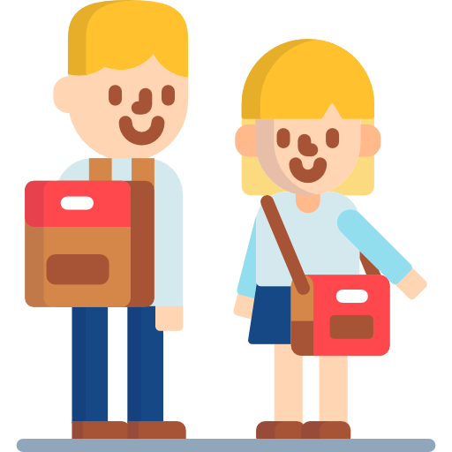
How did you get to school today?
Image: Flaticon
Notes:
Introduction to the Topic of Mobility:
Question for the students:
“How did you get to school today?”
“Could you have come in a different way?”
Movement activity:
The children form groups based on the means of transport they used.
Then, the advantages and disadvantages of each mode of transportation are collected:
Walking: healthy, environmentally friendly, you discover new things or meet friends along the way; sometimes takes longer, unpleasant in rain or cold, you have to pay close attention to traffic, not always possible if you live too far away...
Bicycle / Scooter: fast, healthy, no traffic jams, environmentally friendly; you need to watch out for cars and pedestrians, only allowed to ride alone after passing the cycling test, dangerous in winter or rain...
Bus: more environmentally friendly than a car, you often meet friends, safe; you need to be on time at the bus stop, sometimes no seat available, often takes longer than by car (waiting times, many stops)...
Car: fast and convenient, practical in rain, no need to carry a school bag; sometimes traffic jams, getting out in front of school can be dangerous, not good for the environment, little movement – you just sit...
In-depth questions:
“Do you move using your own energy, or is your mode of transport powered?”
“Which means of transport are motorized?”
“What does ‘traveling in an environmentally friendly way’ mean?”
Image source:
Flaticon (2025): https://www.flaticon.com/de/kostenlose-icons/schule; Schule Icons erstellt von Freepik – Flaticon; Accessed at 14.02.2025
Flaticon (2025): https://www.flaticon.com/de/kostenlose-icons/schule; Schule Icons erstellt von Freepik – Flaticon; Accessed at 14.02.2025

Slide 5
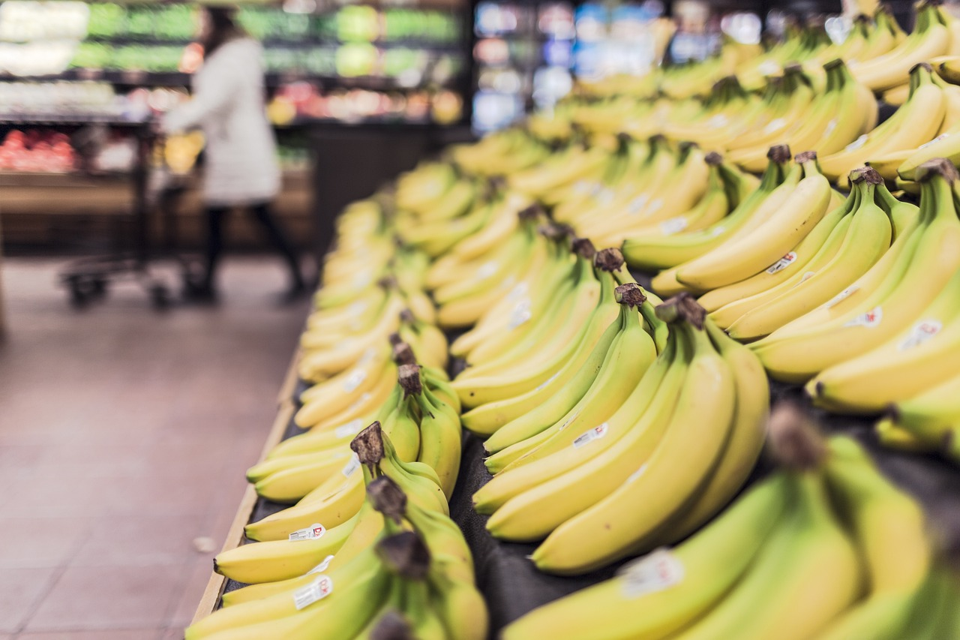
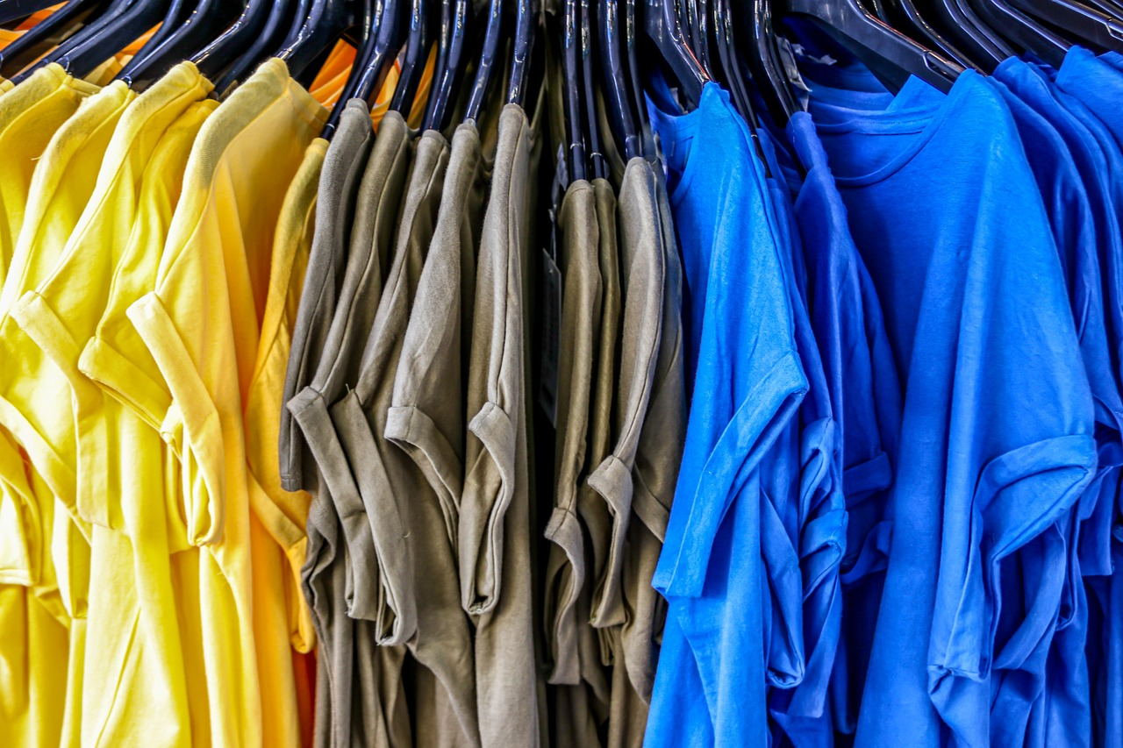
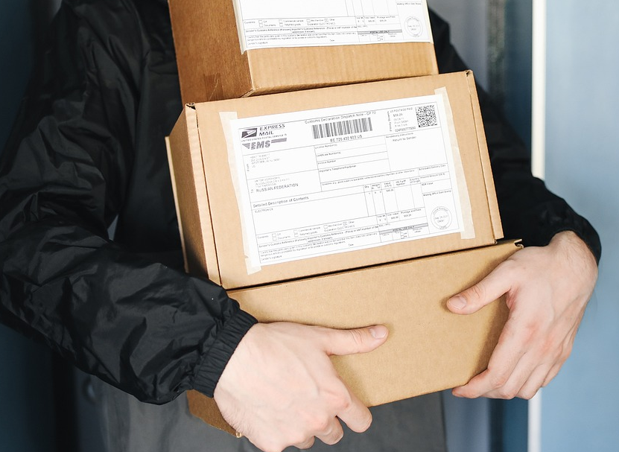
How do the things we need every day get to us?
Images: Pixabay
Notes:
Introduction to Freight Transport/Logistics:
How do groceries get to the store?
How does the T-shirt get into the shop?
Who delivers the package to my home, and where does it come from?
Pictures source:
Pixabay (2025): https://pixabay.com/de/photos/pakete-lieferung-lieferung-mann-6153947/; Accessed at 14.02.2025
Pixabay (2025): https://pixabay.com/de/photos/t-shirt-kaufen-verkaufsstand-l%C3%A4ssig-4367577/; Accessed at 14.02.2025
Pixabay (2025): https://pixabay.com/de/photos/bananen-fr%C3%BCchte-lebensmittel-698608/; Accessed at 14.02.2025

Slide 6
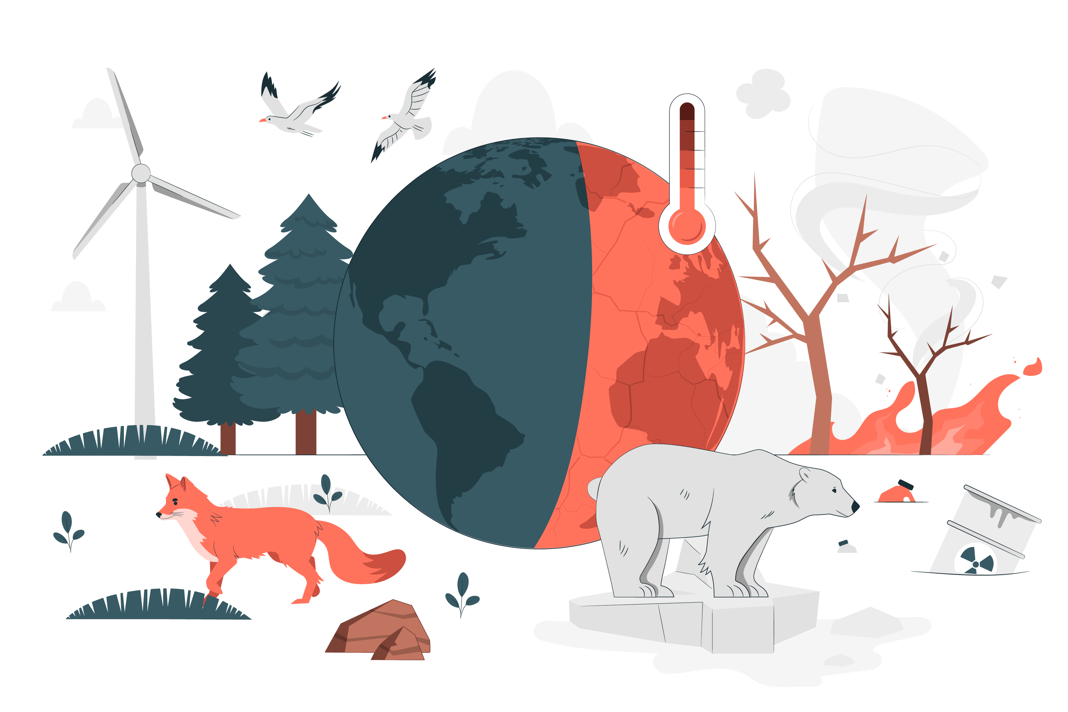
What does 'climate change' mean?
Image: Freepik
Notes:
What does climate change actually mean?
Climate change means that the weather on Earth is slowly changing. It’s getting warmer and warmer because too many exhaust gases are released into the air – for example, from vehicles or factories. As a result, icebergs are melting, there are more storms, and sometimes it rains or snows too much or too little.
Imagine this: Earth has a warm blanket. When we produce too many exhaust gases, the blanket gets too thick – and the planet gets too hot.
What happens because of climate change?
For animals:
Polar bears and penguins lose their homes because the ice is melting.
Many animals can no longer find food or become extinct.
For us humans:
It gets very hot: On some days, it’s so hot that people can get sick.
Less water: In some countries, there isn’t enough water to drink or for plants.
Less food: When it’s too hot or too dry, fruits, vegetables, and grains don’t grow well.
More extreme weather: There are more strong storms, floods, or wildfires – these can destroy houses.
Image source:
Desgined by Freepik (2025)

Slide 7

What does 'sustainable' mean?
Image: Freepik
Notes:
Sustainable means: good for the environment and for the future.
When we live sustainably, we take good care of the Earth – so that children in the future can also live well here.
Example:
If you plant a tree and take good care of it, your children will still have shade and fresh air later on – that’s sustainable!
It’s also sustainable when we treat each other kindly, don’t exclude anyone, and help when someone needs help.
Sustainability also means that companies work in a way that allows them to last a long time and provide jobs for people.
They shouldn’t waste raw materials and should work in a way that ensures there will still be enough for everyone in the future.
Image source:
Desgined by Freepik (2025)

Slide 8
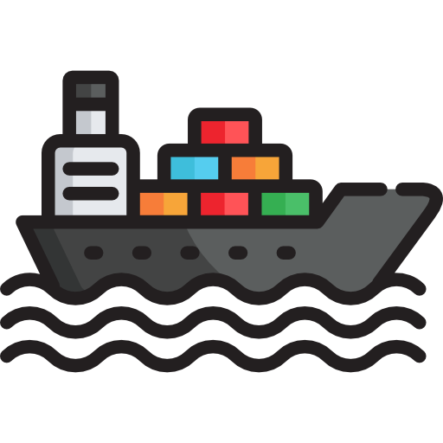
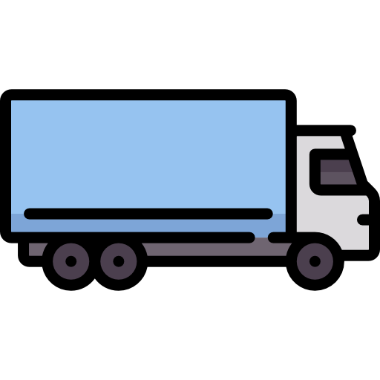
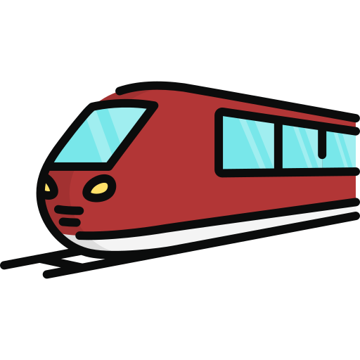
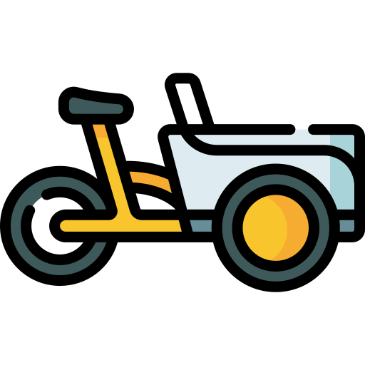
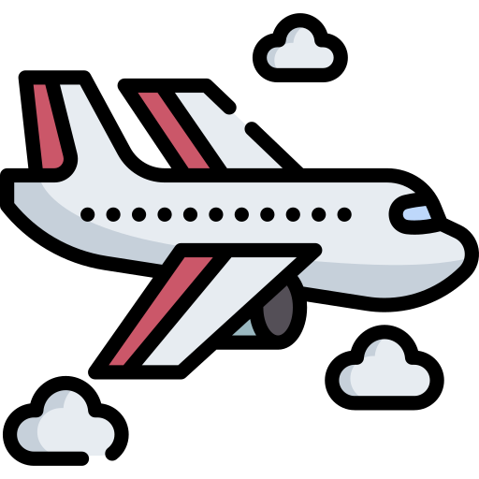
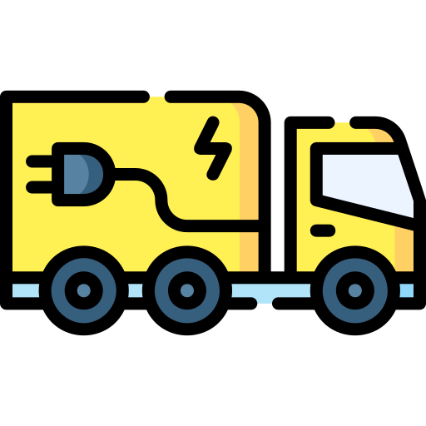
What means of transport are there for goods?
Images: Flaticon
Notes:
Truck (LKW):
+ Can go almost anywhere: It delivers goods directly to cities, villages, and even to your front door.
+ Fast and flexible: It can drive day and night and deliver straight to its destination.
– Makes a lot of noise: Trucks are big and loud, especially in cities.
– Causes emissions: That harms the environment and pollutes the air.
– Often stuck in traffic: Because there are so many cars and trucks, it can take a long time to arrive.
– Accidents: There are many road accidents involving trucks.
Electric trucks are in development and would be a good alternative without harmful emissions. Currently, almost all trucks still run on diesel.
Ship:
We distinguish between ocean-going ships and inland vessels. In Austria, there are only inland vessels.
An inland vessel is a large ship that travels on rivers, lakes, and canals. It transports many types of goods, such as food, cars, or building materials. On the Danube and other large rivers, you often see these ships.
+ Can transport a lot at once: One ship can carry as many goods as many trucks combined.
+ More environmentally friendly than trucks: Ships need less energy and produce fewer emissions.
+ No traffic jams: There is no road traffic on the water, so ships usually arrive without long delays.
+ Safety: Accidents involving inland ships are rare.
– Slow: Ships are slower than trucks or trains.
– Needs waterways: Ships can only travel where there are rivers or canals.
– Needs unloading: Goods must be transferred to trucks or trains at the port to reach their final destination.
Freight Train:
+ Fast: Trains can travel very quickly, often faster than cars or trucks.
+ Environmentally friendly: Especially electric trains produce few emissions and are better for the environment.
+ Transports a lot of goods at once.
+ No traffic jams: Since trains run on tracks, there are no long delays from traffic.
+ Very few accidents.
– Doesn’t go everywhere: Train stations and tracks only exist in certain places, so you often need another vehicle like a truck.
– Not always on time: Trains can be delayed.
Airplane:
+ Very fast: It is the fastest mode of transport over long distances. You can reach another country in just a few hours.
+ Can cover long distances: An airplane can fly over oceans, mountains, and deserts without needing roads or tracks.
– Harms the environment: Compared to ships, trains, and trucks, planes produce the most harmful emissions.
– Expensive: Transporting goods by plane is costly.
– Airports aren’t everywhere: You often need a truck before or after to get the goods where they’re needed.
Cargo Bike:
+ Environmentally friendly: It runs without gas or diesel and produces no emissions.
+ No traffic jams: You can ride past many cars and often reach your destination faster.
+ Healthy: Riding a cargo bike keeps you active and fit.
– Not very fast: Slower than a car or train, especially over long distances.
– Only suitable for very small amounts and short distances.
– No weather protection.
Electric Truck / Van:
+ Environmentally friendly: No harmful emissions compared to diesel trucks.
+ Same flexibility as traditional trucks: Can deliver directly to destinations (cities, villages, front doors).
+ Less noise: Electric trucks are quieter than diesel trucks.
– Still in development: Currently, only a few electric trucks are in use.
– Limited range: The battery often doesn’t last as long as a diesel tank.
– Charging infrastructure: Suitable charging stations are not yet available everywhere.
Environmental Aspect to Consider: “Which transport is better?”
What uses more energy: a plane or a bicycle courier?
How can we shop more sustainably? (Buy regional products, place fewer online orders).
Why is there often plastic packaging?
Images source:
Flaticon (2024): https://www.flaticon.com/de/kostenlose-icons/lkw; Lkw Icons erstellt von Freepik – Flaticon, Accessed at 20.05.2024
Flaticon (2025): https://www.flaticon.com/de/kostenlose-icons/zug; Zug Icons erstellt von Mihimihi – Flaticon; Accessed at 06.02.2025
Flaticon (2024): https://www.flaticon.com/de/kostenlose-icons/schiff; Schiff Icons erstellt von Freepik – Flaticon, Accessed at 29.04.2024
Flaticon (2025): https://www.flaticon.com/de/kostenlose-icons/flugzeug; Flugzeug Icons erstellt von Freepik – Flaticon; Accessed at 14.02.2025
Flaticon (2025): https://www.flaticon.com/de/kostenlose-icons/lastenfahrrad; Lastenfahrrad Icons erstellt von Freepik - Flaticon; Accessed at 14.02.2025
Flaticon (2025): https://www.flaticon.com/free-icons/electric-truck; Electric truck icons created by Freepik – Flaticon; Accessed at 08.04.2025

Slide 9
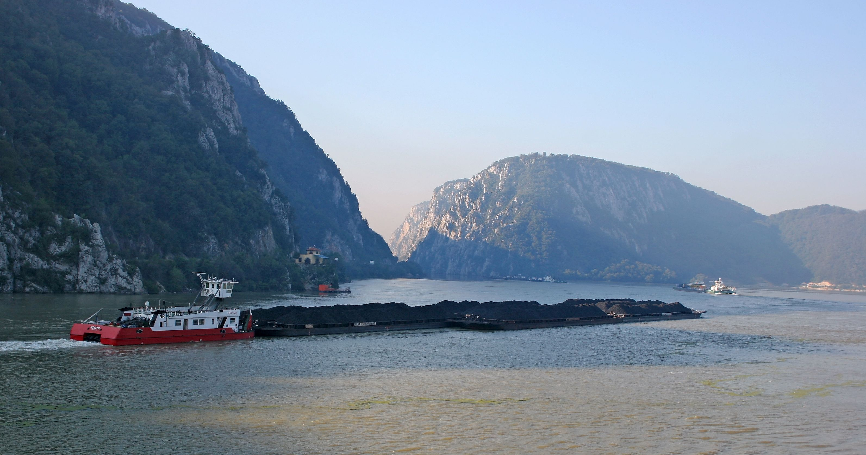
This is what an inland vessel looks like:
Leitner@TTS, Austria
Notes:
Here you can see a push convoy on the Danube in Serbia/Romania:
It consists of a pusher vessel (a motor ship designed for pushing) and eight coupled barges carrying bulk cargo.
On the Danube in Austria, a vessel can push up to four barges. On the lower Danube in Romania, where the river is very wide, up to twelve barges are possible.
Picture: Leitner@TTS, Austria

Slide 10
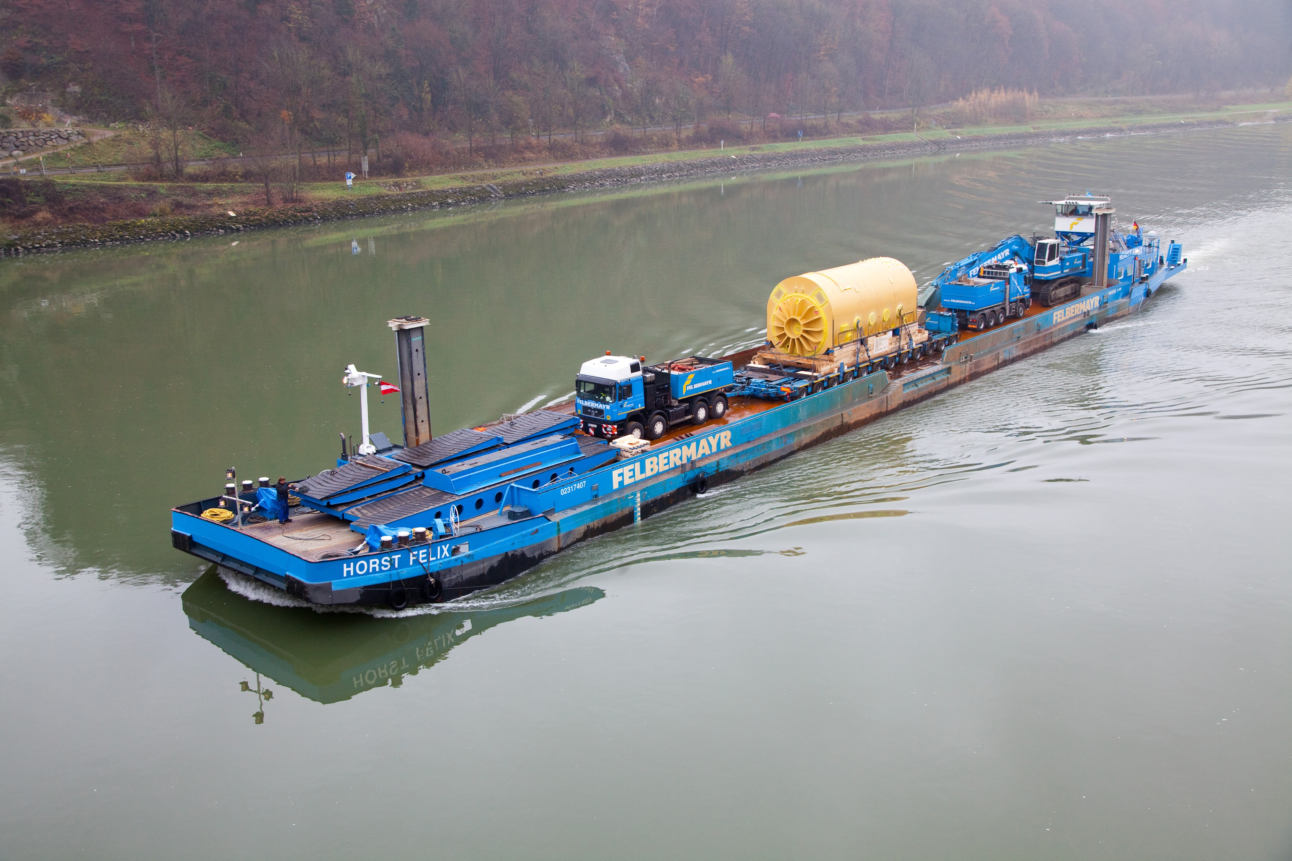
This is what an inland vessel looks like:
Felbermayr
Notes:
Here you can see a High & Heavy transport (heavy cargo transport) on an inland vessel operated by the company Felbermayr.
Picture: Felbermayr

Slide 11
Transport Quiz
1, 2 or 3…
Think about where your little stone belongs!
Images: Flaticon
Notes:
Transport Quiz in a Circle
For this game, the children sit in a circle. In the center are placed pictures of different means of transport, with a focus on freight transport: truck, train, and inland vessel.
A template for the images can be downloaded at www.rewway.at.
Each child receives small balls or stones.
The teacher asks a question, for example:
“Which means of transport is especially environmentally friendly?”
The children think for a moment and then place a ball on the picture they believe is the correct answer (e.g., the train).
Afterward, the class discusses the answers together. If needed, the teacher explains again why a certain answer is correct or less suitable.
The game continues with new questions until all have been discussed.
At the end, the class can reflect together on how to travel more sustainably in everyday life.
Example Questions:
Which means of transport is especially environmentally friendly?
→ Train, inland vessel
Which means of transport produces a lot of harmful emissions?
→ Truck
Which means of transport can carry a lot at once?
→ Inland vessel (see next slide for visual explanation)
Which means of transport is fast and can reach your front door?
→ Truck
Which means of transport doesn’t drive on roads?
→ Train, inland vessel
Which means of transport is often stuck in traffic?
→ Truck
Which means of transport carries goods on the Danube?
→ Inland vessel
Images source:
Flaticon (2024): https://www.flaticon.com/de/kostenlose-icons/lkw; Lkw Icons erstellt von Freepik – Flaticon, Accessed at 20.05.2024
Flaticon (2025): https://www.flaticon.com/de/kostenlose-icons/zug; Zug Icons erstellt von Mihimihi – Flaticon; Accessed at 06.02.2025
Flaticon (2024): https://www.flaticon.com/de/kostenlose-icons/schiff; Schiff Icons erstellt von Freepik – Flaticon, Accessed at 29.04.2024

Slide 12
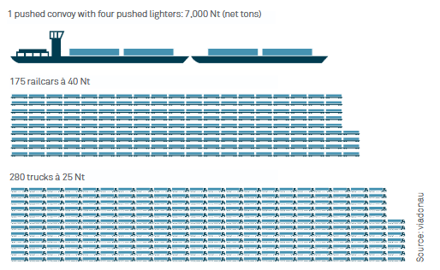

This is how big an inland vessel is!
Inland vessel with 4 barges = 175 railcars = 280 trucks
Notes:
Compared to other land-based modes of transport, the inland vessel offers a significantly greater transport capacity (i.e., loading volume) per transport unit and can — or could — make an important contribution to reducing the burden on roads and railways.
An inland vessel with 4 barges can transport as much as 175 railcars or 280 trucks.
What is a barge?
A barge is a floating cargo container without its own engine. It is attached to the front of an inland vessel and pushed.
Source: Viadonau (2019): Handbuch der Donauschifffahrt S. 18, 19, 112
Picture source: Viadonau (2019): Manual on Danube Navigation, p19

Slide 13
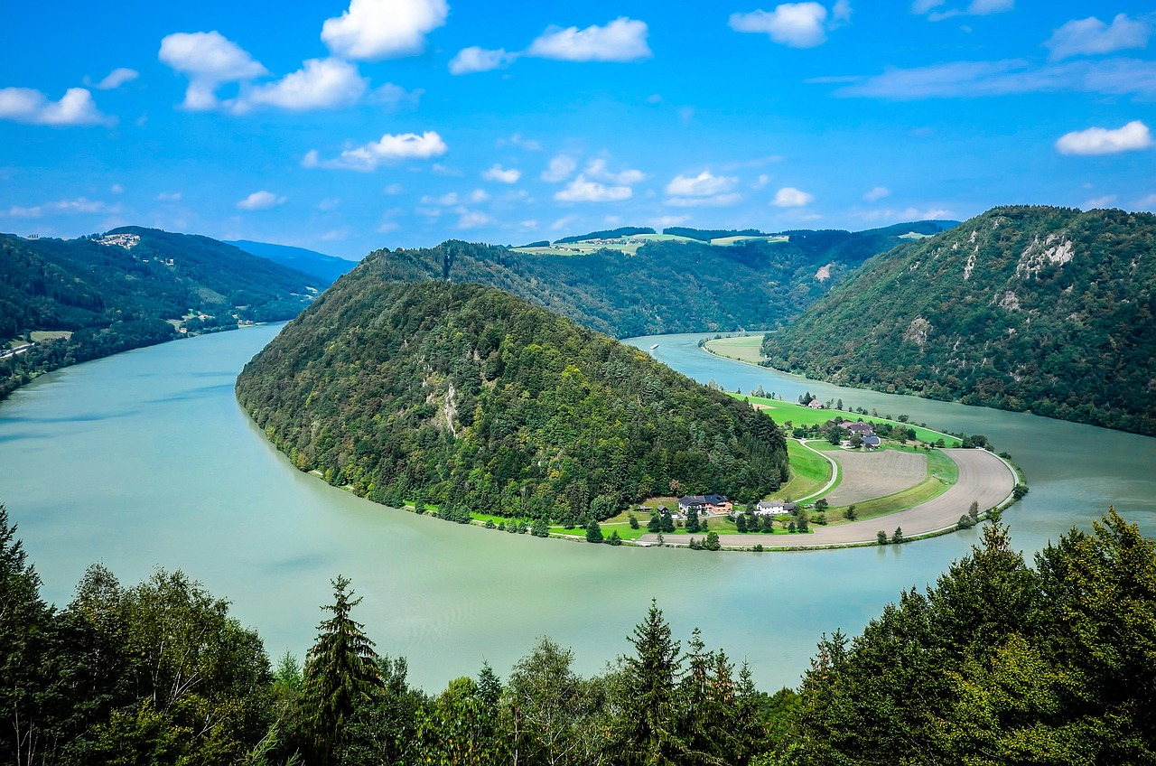
The Danube
Austria’s Largest River
The Danube is a waterway:
😊 Environmentally friendly freight transport
😊 Connects Europe
Pixabay
Notes:
The Danube is the largest river in Austria.
It flows through many cities, for example Vienna, Linz, and Krems. It begins in Germany’s Black Forest and flows all the way to the Black Sea.
But did you know that the Danube is not only a beautiful river, but also an important transport route?
Every day, ships travel along the Danube and transport many goods – such as grain, oil, or even cars.
This is much more environmentally friendly than trucks on the road, because ships produce fewer emissions.
So the Danube is not only a beautiful river, but also an important transport link for all of Europe – this is called a waterway.
Picture source:
Pixabay (2025): https://pixabay.com/de/photos/schl%C3%B6gen-sch%C3%B6gener-schlinge-donau-4795383/; Accessed at 20.03.2025

Slide 14

How can we transport our goods in an environmentally friendly way?
Fewer trucks, more trains & ships
– That’s how we protect the environment!
Why is this important?
Clean air, fewer emissions 🌱
Less traffic on the roads
More safety for people and animals
Image: Flaticon
Notes:
Imagine how many trucks are on the roads every day.
They transport food, clothing, and many other things.
But too many trucks also mean traffic jams, emissions, and sometimes even accidents.
That’s why we try to transport more goods using more environmentally friendly means of transport – like trains or ships.
This is called modal shift (or shifting transport to greener alternatives).
How does it work?
Trucks first bring the goods to the nearest train station or port.
From there, the goods continue their journey by train or ship.
This helps make roads safer, keeps the air cleaner, and protects the environment.
Why is this important?
Fewer trucks on the roads mean fewer traffic jams.
Trucks produce a lot of exhaust gases, which pollute the air and are harmful to our health and the environment.
If we use more trains and ships instead, there are fewer pollutants in the air, and we help protect the climate.
Another benefit is safety: there are far fewer accidents with trains and ships than on the roads.
Image source:
Flaticon (2024): https://www.flaticon.com/de/kostenlose-icons/erde; Erde Icons erstellt von Freepik – Flaticon, Accessed at 08.07.2024

Slide 15
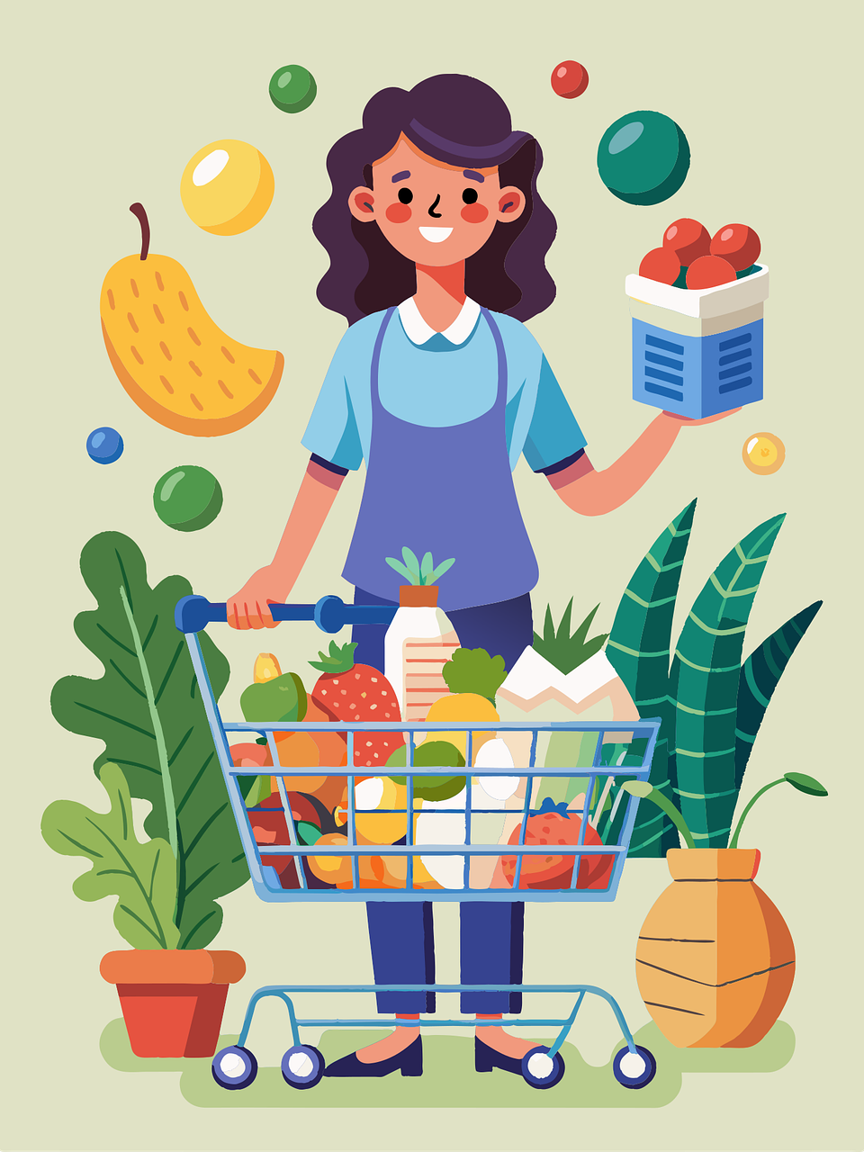
What can I do myself?
The transport of goods causes a lot of emissions.
But everyone can help reduce them!
What ideas do you have?
Pixabay
Notes:
Class Discussion:
How can we personally help reduce freight transport and avoid emissions?
Even if we don’t drive trucks ourselves, we can still help reduce the number of goods being transported — especially through the way we shop.
Here are some ideas:
– Buy regional products
When you buy fruit, vegetables, or other goods from your local area, they don’t have to be transported by trucks or planes from faraway countries.
Farmers' markets or stores with local food are a great choice.
– Eat seasonal food
Strawberries in winter often arrive by airplane from distant countries.
It’s better to buy local fruits and vegetables in their natural season.
– Fewer online orders
Many small online orders mean lots of delivery vehicles on the road.
Better: order multiple items at once or shop in stores.
– Avoid packaging
Less plastic and fewer disposable packages mean fewer waste transports.
Products without unnecessary packaging help protect the environment.
– Use delivery services with sustainable transport
Some companies deliver by bike or electric vehicle – this is more eco-friendly than large delivery vans.
– Support rail and ship transport
Look for companies that use trains or ships to transport their goods – this is much better for the environment than trucks or airplanes.
– Repair instead of buying new, and choose secondhand
Clothes, furniture, toys, or books can often be bought secondhand.
This saves resources and avoids unnecessary transport.
If something breaks, it’s often worth repairing it instead of buying something new right away.
Every small step helps!
If many people shop more consciously, we can make freight transport more environmentally friendly.
Image source:
Pixabay (2025): https://pixabay.com/de/vectors/ai-generiert-laden-markt-wagen-8793076/; Accessed at 10.02.2025

Slide 16
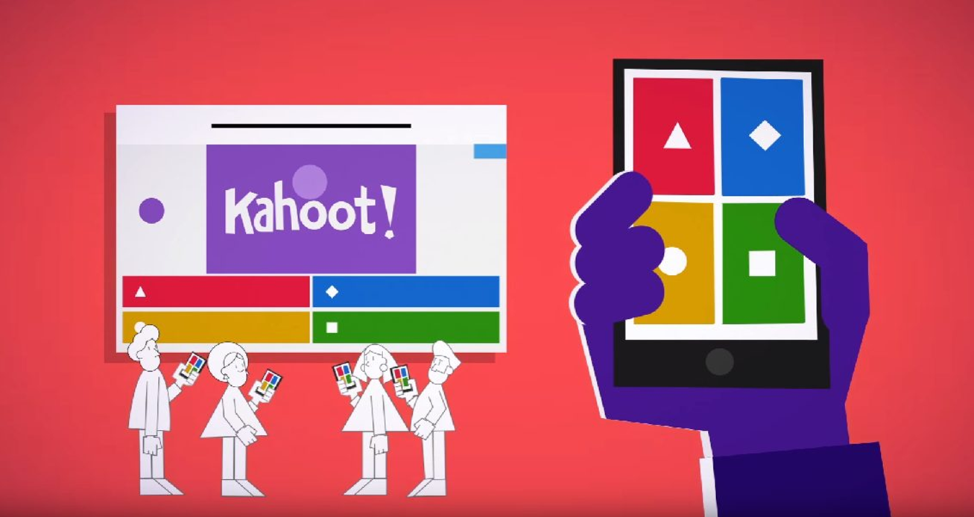
KAHOOT! Quiz
Testing your knowledge with our transport quiz!
https://create.kahoot.it/share/from-a-to-b-the-green-way-primary-school/c44ab573-dbf2-4f1a-9cc9-22ca6869c9df
https://kahoot.com/de/
Notes:
Kahoot! Quiz: Sustainable Transport – Testing Knowledge in a Playful Way
Use this ready-made Kahoot! quiz to playfully assess your students’ knowledge of the topic covered in this lesson. The questions are deliberately kept simple and are ideally suited for primary school.
How it works:
Log in to Kahoot! or register for free: https://kahoot.com/en/
Open the following link to the quiz: https://create.kahoot.it/share/from-a-to-b-the-green-way-primary-school/c44ab573-dbf2-4f1a-9cc9-22ca6869c9df
Start the quiz in class – either in individual mode or as a group game.

Slide 17
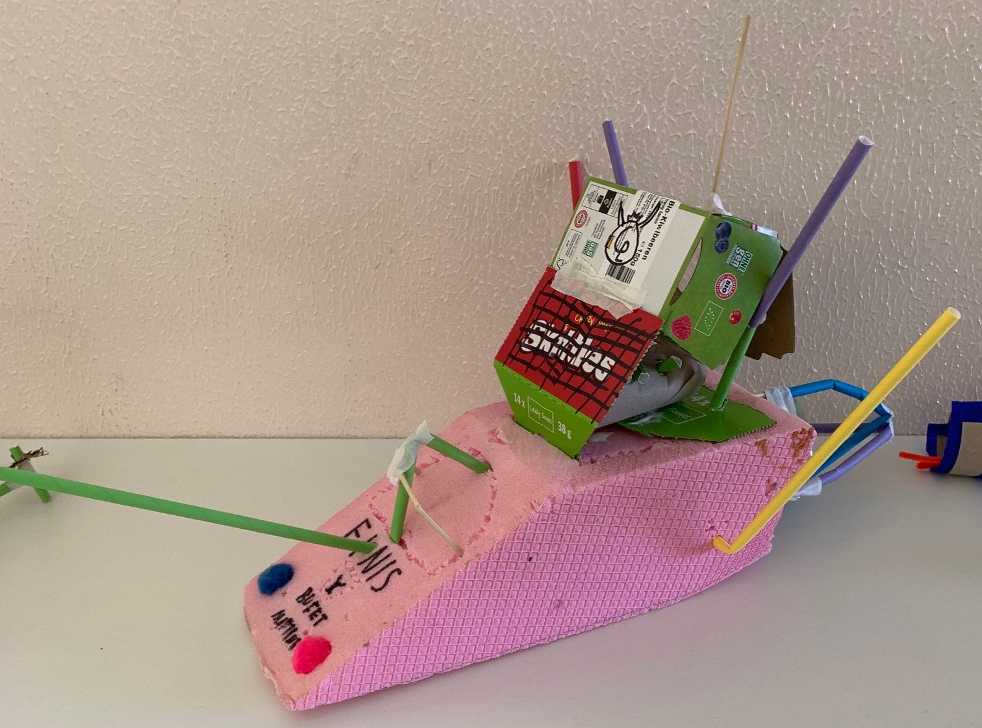
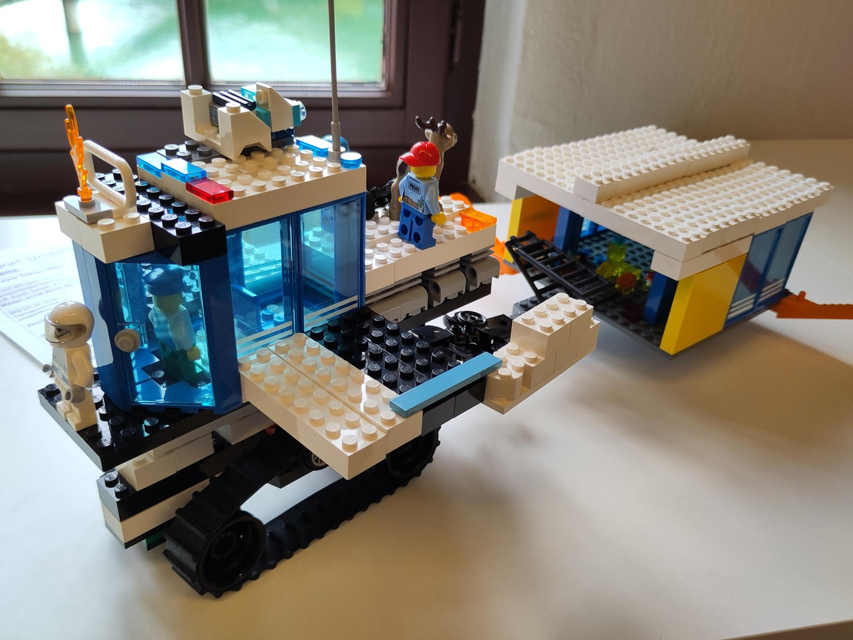
Build your creative transport idea for the future!
Notes:
Transports of the Future – Build Your Transport Idea for a Green World
Get creative and work together in a team to design future transport systems!
Let’s help shape a more environmentally friendly world and bring your wildest ideas to life:
Maybe a solar-powered robot, a plastic-bottle-recycling drone, or a hydrogen-powered hovercraft?
There are no limits to your imagination!
In small groups, children create a future transport idea and build it using available materials.
A project sheet guides the children through the process (downloadable at www.rewway.at):
Come up with a name for your transport idea and your team.
Think about the following:
Where and how does your transport move?
(e.g., through a tunnel, on water, it can fly, has legs/wheels, etc.)
Why is your vehicle environmentally friendly?
What kind of fuel does it need?
How is it powered?
How and by whom is it controlled?
What goods does it deliver?
What special features does your idea have?
2 Variants:
Upcycling:
Students build their transport idea using collected waste materials such as cardboard, empty bottles, packaging film, yarn scraps, straws, etc.
Materials needed:
Recyclable waste, scissors, tape, markers, string/yarn, possibly small amounts of crafting materials (pipe cleaners, pompoms)
LEGO:
Students use LEGO to represent their transport concept.
Learning Objectives:
Students learn to develop creative solutions for real-world challenges in mobility and environmental protection.
Students gain an understanding of sustainable mobility and reflect on how transport systems can be made more environmentally friendly.
They explore alternative energy sources and resource-saving construction methods.
Students think about how a transport system moves, how it is controlled, and what energy sources are suitable for it.
Basic technical principles are applied.
Students work in small teams, make joint decisions, divide tasks, and present their ideas to the class (teamwork and communication).
Pictures source:
Fachhochschule Oberösterreich, Logistikum

Slide 18
Thank you for your attention!

Slide 19
Additional Information for Teachers
This teaching material package is available under a so-called Creative Commons Attribution 4.0 International License.
You may therefore freely integrate these materials into your lessons, adapt them to your needs, and share them with your students or other individuals.
We only ask that you keep the logos on the slides.
The image rights are listed in the notes section; use in other settings is not permitted.
Explanation on the Use of Generative AI and AI-Supported Technologies:
During the development of this project, the authors used ChatGPT and Microsoft CoPilot to support concept development and content creation — especially with regard to interactive exercises. The use of these AI tools was carried out carefully and responsibly.
Afterwards, the content was thoroughly reviewed by the authors and, where necessary, revised to ensure compliance with scientific standards.
The authors take full responsibility for the final published content.

Slide 20
Additional Information for Teachers
If you have any questions or feedback, feel free to contact us via email at:
rewway@fh-steyr.at
You can find more slide sets and practical exercises at:
http://www.rewway.at/en/teaching-materials/
Are you interested in a Transport School Lab, an excursion, or a specialist lecture?
http://www.rewway.at/en/pages/workshops

