Slide 1
Economy meets environment – The future of freight transport
TEACHING MATERIALS

Slide 2
How to work best with this teaching material
PowerPoint: The following PowerPoint provides an introduction to the topic “Sustainable transport”. Each slide includes speaker notes, explanations, and source references. Activity slides are highlighted and contain practical examples, exercises, videos, and other interactive elements specifically designed for use in the classroom.
Videos and supplementary exercises: Videos and exercises on the topic can be found in the presentation on the color-coded activity slides as well as at: https://www.rewway.at/en/teaching-materials
All teaching materials offer a compact overview to support lesson planning: learning objectives, target groups, level of difficulty, methods, and links to the curriculum.
Kahoot!: To review learning progress in a playful way, a freely accessible, pre-prepared Kahoot! quiz can be used in class. You’ll find the QR code or direct link to the quiz at the end of the PowerPoint.
List of Sources: The sources used in the presentation are noted in the speaker notes of each slide and are also compiled at the end of the PowerPoint.

Slide 3
Learning objectives and target groups
Learning objectives:
Learners can define the term "logistics" and identify the different types of freight transport.
Learners can explain the advantages and disadvantages of the transport modes truck, rail, and inland waterway vessel.
Learners are familiar with the criteria that play a role in the selection of transport modes.
Learners can describe the environmental impacts of transport and reflect on how their own travel behavior affects the environment.
Learners can explain what sustainability means and which dimensions (ecological, economic, social) it encompasses.
Learners can represent the causes and consequences of climate change and global warming.
Learners can explain the significance of the Danube as a waterway for freight transport.
Target group:
Students in lower secondary education

Slide 4
Have you ever asked yourself...?
…how you get to school every day and what impact that has on the environment?
Do you know why transport sometimes takes place on the road, but also in the air, on rail, or on water?
What actually is a waterway?
Notes:
The questions are suitable as a warm-up: brainstorming & class discussion (approx. 10 minutes)
Objective: Activation of prior knowledge, promotion of critical thinking, and introduction to the topic through everyday relevance.
Learning objectives:
Students reflect on their own everyday experiences in relation to consumption and transport routes.
Students critically examine the significance of different modes of transport.
Students engage in argumentative exchange about potential challenges and opportunities of sustainable logistics.
Students develop an initial awareness of the ecological relevance of freight transport.

Slide 5
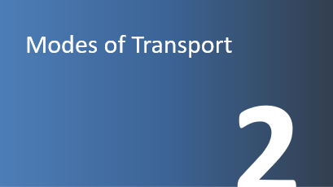
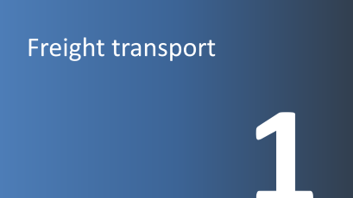
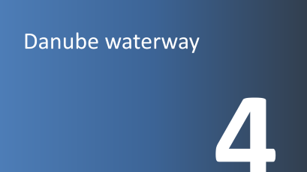
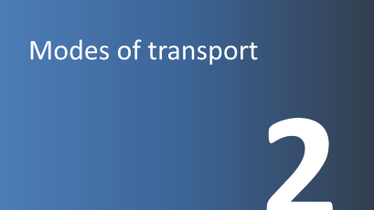
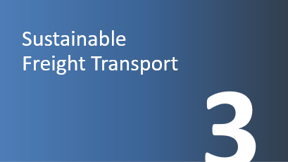
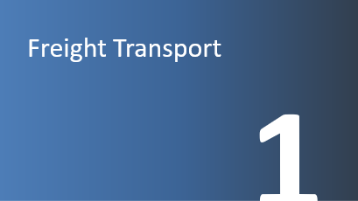
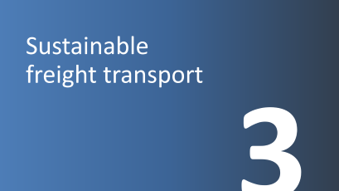
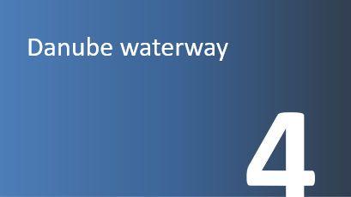

Slide 6
Freight transport
1

Slide 7
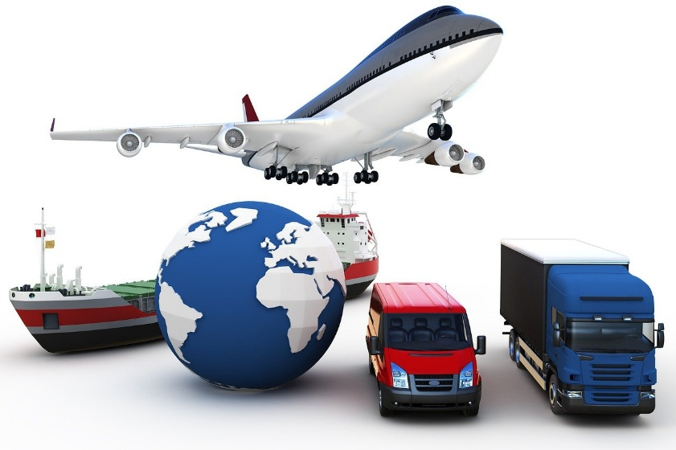
What is meant by freight transport?
Freight transport = Movement of goods from one place to another
e.g., via roads, railways, waterways, or through the air
Image: Pixabay
Notes:
Transport is the change of location of goods using means of transportation.
Source: Clausen, Uwe / Geiger, Christiane Hrsg. (2013): Verkehrs- und Transportlogistik, S. 3ff.
Image source:
Pixabay (2025): https://pixabay.com/illustrations/transportation-logistics-business-4506971/; Accessed 07.01.2025

Slide 8
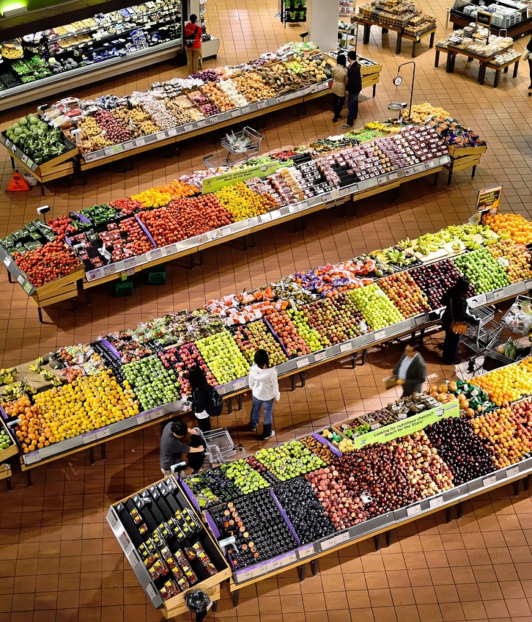
Why do we need freight transport?
Basic requirement for industry and commerce
Supply of the population
More freight transport due to globalization
(a connected world)
Ensures our prosperity
40
Image: Pixabay
Notes:
A fundamental requirement for industry and commerce is transport. It therefore ensures our prosperity and contributes to our quality of life. However, it must not be the cause of increasing strain on people and the environment. In the design of a transport system, freight transport and logistics play a particularly important role.
Supply of the population: Daily necessities such as food, clothing, and medicine must be transported to ensure they are available everywhere.
Economic development: Companies rely on the transport of raw materials to maintain production and sell their products.
Globalization: International trade requires the transport of goods over long distances, making freight transport a global network.
Source:
Clausen, Uwe / Geiger, Christiane Hrsg. (2013): Verkehrs- und Transportlogistik, S. 3ff.
Picture source:
Pixabay (2025): https://pixabay.com/photos/supermarket-stalls-coolers-market-949913/; Accessed 04.02.2025

Slide 9


How do your everyday products get to you?
For which products in your daily life is freight transport necessary, to the store or directly to your home?
Image: Pixabay
Notes:
How do your everyday products get to you and how sustainable is that?
Open discussion in small groups or as a class:
Which products that we use every day are delivered via freight transport – to a store or directly to our homes?
What have you used today that had to be transported?
Examples:
Food
Clothing
Cosmetic products
Electronic devices
Medication
Car/bike
Toys
Final joint reflection: What surprised you? What would you like to change?
Learning objectives:
Students recognize which everyday products reach them via freight transport.
Students understand which modes of transport are used for freight and what ecological impacts they have.
Students reflect on how their own consumption habits are connected to global supply chains and transport routes.
Images sources:
Pixabay (2025): https://pixabay.com/de/vectors/smartphone-tragbar-telefon-2237421/; Accessed 10.02.2025
Pixabay (2025): https://pixabay.com/de/vectors/ai-generiert-laden-markt-wagen-8793076/; Accessed 10.02.2025

Slide 10
Modes of transport
2

Slide 11

What is a mode of transport?
Means of transport: Vehicle used for transporting people and goods
Mode of transport: Infrastructure for the use of means of transport
40
Image: Pixabay
Notes:
There are different types of modes and means of transport. A mode of transport provides the infrastructure required for the use of a specific means of transport. Roads, railways, and waterways are examples of transport modes.
Means of transport refers to vehicles and equipment used to transport people and goods, such as inland vessels, trucks, or trains.
Infrastructure, simply explained: equipment, substructure, facility
Explanation for inland vessel: a ship that operates on inland waterways (rivers, canals, lakes) – as opposed to an ocean-going vessel on the sea.
Source:
Viadonau (2019): Handbuch der Donauschifffahrt, pp. 185–187
Image source:
Pixabay (2025): https://pixabay.com/de/vectors/ampel-rot-schwarz-gr%C3%BCn-gelb-24177/; Accessed 10.02.2025

Slide 12
Mode of transport quiz
Assign each statement to a mode of transport (road, waterway, rail):
This mode of transport enables fast delivery right to your doorstep.
This mode of transport can carry large quantities of goods at once but is slower than other options.
This mode of transport often experiences traffic jams, especially in large cities.
This mode of transport is particularly suitable for transporting goods over long distances within a country.
This mode of transport uses natural infrastructure and is especially environmentally friendly.
This mode of transport causes the most harmful air pollution.
These two modes of transport are particularly safe, as hardly any accidents occur.
Notes:
The quiz questions are suitable for starting the lesson or loosening up the class and can be discussed either in a classroom setting or completed in pairs.
Duration: approx. 10 minutes
Answers:
This mode of transport enables fast delivery right to your doorstep. (Road/truck)
This mode of transport can carry large quantities of goods at once, but is slower than other options. (Waterway/inland vessel)
This mode of transport often experiences traffic jams, especially in large cities. (Road)
This mode of transport is particularly suitable for transporting goods over long distances within a country. (Rail/train)
This mode of transport uses natural infrastructure and is especially environmentally friendly. (Waterway/inland vessel)
This mode of transport causes the most harmful air pollution. (Road/truck)
These two modes of transport are particularly safe, as very few accidents occur. (Rail/train and waterway/inland vessel)
Learning objectives:
Students recognize fundamental differences between road, rail, and waterways.
Students reflect on initial connections between transport, the environment, and everyday life.
Students exchange personal experiences with freight transport and supply chains.

Slide 13
Mode of transport: Road
Fast
Dense network & area-wide coverage
Flexible
Technological progress
Low operating costs
Door-to-door transport without reloading
Vehicle tracking and communication with personnel
High external costs (CO₂ emissions, noise, accidents, etc.)
High environmental impact
Small load capacities
Time-based restrictions: driving bans
High accident risk
Dependence on road conditions and traffic situation
Notes:
The high transport speed compared to the modes of rail and inland waterways can be considered an advantage of road transport. The widespread coverage of road infrastructure, and thus the ability to form a network (from door to door), is also one of its strengths. Due to the wide range of available transport vehicles, this mode offers great flexibility. Furthermore, many IT solutions (e.g., tracing and tracking) are already widely used. In addition, the use of the infrastructure is associated with low direct costs (e.g., road damage costs are only partially covered).
However, as costs related to traffic jams or noise pollution (so-called external costs) are receiving more attention, road transport is facing increasing cost pressure. Time-based restrictions, such as driving bans, also affect the road transport mode. In terms of environmental aspects like noise pollution and accidents, road transport performs poorly compared to other transport modes.
Source:
Kille, Christian/ Schmidt , Norbert (2008): Wirtschaftliche Rahmenbedingungen des Güterverkehrs. Studie zum Vergleich der Verkehrsträger im Rahmen des Logistikprozesses in Deutschland, p. 53
Online: Fraunhofer SCS Study; Accessed 04.02.2025

Slide 14
Mode of transport: Rail
Large volumes
Predictable (timetables)
Low accident risk
Largely weather-independent
Cost-effective over long distances
Low environmental impact
Limited cross-border transport
Inflexible (fixed timetable)
Low network density
Difficult shipment tracking
Low punctuality rate (ÖBB freight transport approx. 70%)
Notes:
Especially with block or direct trains, rail transport can score points with high transport speeds. In addition, this mode of transport is capable of handling large volumes and offers predictable transport due to fixed schedules. Thanks to standardized procedures, the level of safety is very high. Unlike road transport, rail transport prices are not affected by toll fees and can therefore be relatively cost-effective depending on the quantity transported. Lower CO₂ emissions compared to road transport are also a clear advantage.
Due to infrastructural differences, cross-border transport by rail remains challenging. Dependence on fixed timetables reduces the flexibility of transport. Shipment tracking is also much more difficult compared to road transport. Furthermore, unlike air transport, rail does not benefit from tax advantages.
Sources:
Kille, Christian/ Schmidt , Norbert (2008): Wirtschaftliche Rahmenbedingungen des Güterverkehrs. Studie zum Vergleich der Verkehrsträger im Rahmen des Logistikprozesses in Deutschland, S.54
Online: http://www.scs.fraunhofer.de/content/dam/scs/de/dokumente/studien/Wirtschaftliche_Rahmenbedingungen_des_Gueterverkehrs.pdf; accessed 04.02.2025
ÖBB (2025): Punctuality Focus – ÖBB Infrastructure (Accessed: 06.03.2025)

Slide 15
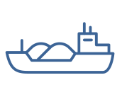
Mode of transport: Inland waterway
Large volumes
Very low transport costs
Low environmental impact
Safety
Always operational
Low infrastructure costs
Freely available infrastructure capacity (e.g. Danube)
Slow
Low network density
Dependent on fairway conditions
Mooring/unloading fees at ports
Almost always requires land-based transport modes for pre- and onward carriage
Notes:
The strengths of Danube shipping lie primarily in its ability to transport large volumes per vessel unit, its low transport costs, and its environmental friendliness. In addition, it is available around the clock (e.g., no weekend or night driving bans) and offers a high level of safety.
In 2023, there were a total of 17 shipping accidents involving inland vessels on the Austrian Danube, none of which resulted in personal injury. (Viadonau 2024: p. 41)
Due to the mostly natural infrastructure of the waterway, lower route and maintenance costs are incurred.
The weaknesses lie in the dependence on fluctuating fairway conditions and the associated varying utilization rates of the ships, the low transport speed, and the low network density, which often necessitate pre- and onward carriage by road or rail.
Sources:
Kille, Christian/ Schmidt , Norbert (2008): Wirtschaftliche Rahmenbedingungen des Güterverkehrs. Studie zum Vergleich der Verkehrsträger im Rahmen des Logistikprozesses in Deutschland, S.56
Online: http://www.scs.fraunhofer.de/content/dam/scs/de/dokumente/studien/Wirtschaftliche_Rahmenbedingungen_des_Gueterverkehrs.pdf; accessed 04.02.2025
Viadonau (2019): Handbuch der Donauschifffahrt, p. 17
Viadonau (2024): Jahresbericht der viadonau 2023

Slide 16
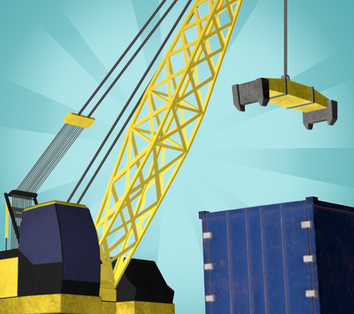
Transport planning with the Logistify App
Game 1 – Mode of Transport
Your transport planning skills are needed – we need your help!
We want to transport various goods in the best possible way from A to B. In doing so, we place particular importance on choosing the appropriate mode of transport (truck, train, or inland vessel).
The transport should be planned to be as environmentally friendly and economically efficient as possible.
Download the app at: Logistify: Understanding the World of Logistics
Instructional video: https://www.youtube.com/watch?v=kZhL5SPtn6A
Image: FH OÖ
Notes:
Download App unter: https://logistify.app/
Erklärvideo: https://www.youtube.com/watch?v=kZhL5SPtn6A
More information at: https://rewway.at/en/teaching-materials/transport-planning-with-the-logistify-app
The educational app “Logistify” deals with different modes of transport, their resource-efficient and sustainable use, and job profiles in the logistics sector. In the games, students’ transport planning skills are put to the test. The task is to transport various goods efficiently from A to B, plan multimodal transport chains from raw product to end customer, and explore professions within the logistics industry.
Duration: Approximately 15 minutes are needed for Game 1.
Learning Objectives:
Students recognize the importance of various modes of transport in freight logistics.
Students reflect on how resources can be used carefully and efficiently in the transport sector.
Students analyze logistical challenges and make well-founded decisions in transport planning.
Students playfully use digital learning tools to understand logistics processes.

Slide 17
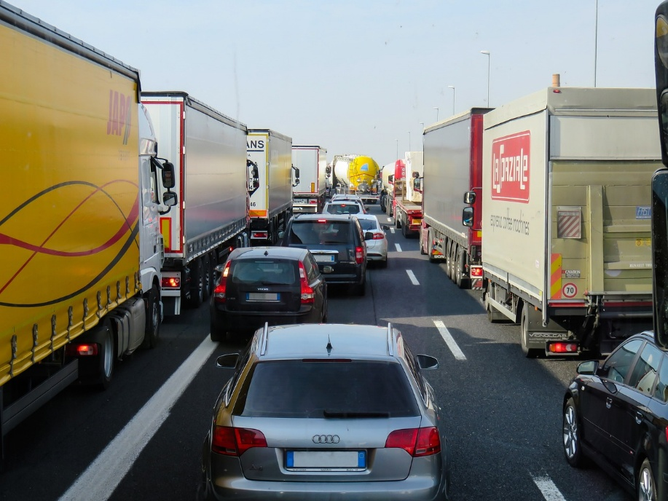
External costs of transportation
Costs that are not covered by the polluters – society pays for them, meaning all of us!
Pollutant emissions
Noise
Accident costs
Land consumption
Impact on flora and fauna
Congestion costs
Picture: Pixabay
Notes:
Costs that arise from mobility but are not borne by those who use transportation are referred to as external costs of transport. These costs are passed on to third parties, such as taxpayers and future generations.
The negative external effects of transport particularly include pollutant emissions, CO₂ emissions, noise emissions, accident-related costs, land use, and impacts on flora and fauna.
External costs have significant societal and health impacts (e.g., quality of life, noise pollution, stress, illness) as well as environmental consequences (climate change, biodiversity loss).
Source:
Koch, Susanne (2012): Logistik – Eine Einführung in Ökonomie und Nachhaltigkeit, pp. 294f
Picture source:
Pixabay (2025): https://pixabay.com/de/photos/verkehr-transport-stau-autobahn-2251530; Accessed: 27.02.2025

Slide 18
External costs of transport – Comparison of transport modes
Congestion
Infrastructure
Climate costs
Emissions
Noise
Accidents
Road
Rail (Diesel)
Rail (Electrified)
Inland Waterway
Graphic: own illustration based on Christidis/Brons
Notes:
Inland waterway vessels and electrified railways cause by far the lowest external costs compared to trucks.
In 2023, the share of electrified routes among all infrastructure operators in Austria was around 75 percent (cf. Schienen-Control).
In the EU-27, the degree of railway network electrification in 2023 was 57.4% (cf. Eurostat 2025).
Sources:
Own representation based on:
Christidis, P., & Brons, M. (2016): External costs of freight transport in European Union Member States (Joint Research Centre (JRC)). Harvard Dataverse.
https://dataverse.harvard.edu/dataset.xhtml?persistentId=doi:10.7910/DVN/YA3VCY https://doi.org/10.7910/DVN/YA3VCY; Accessed 28.01.2025
Eurostat (2025): https://ec.europa.eu/eurostat/statistics-explained/index.php?title=Characteristics_of_the_railway_network_in_Europe; Accessed 06.03.2025
Schienen-Control (2025): https://www.schienencontrol.gv.at/de/wettbewerbsregulierung/eisenbahnnetz-oesterreich.html; Accessed 28.01.2025

Slide 19
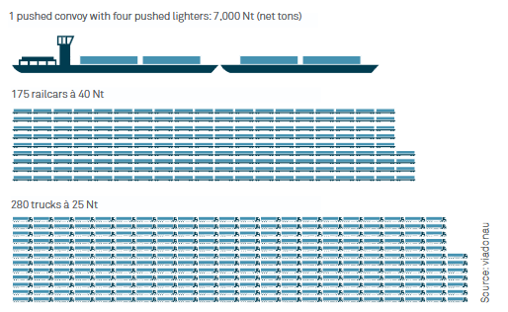
Transport capacity – Comparison of modes of transport
Largest transport capacity of the inland vessel:
Pushed convoy with 4 barges
= 175 rail wagons
= 280 trucks
Graphic: viadonau
Notes:
The inland vessel offers numerous advantages over other modes of transport:
Compared to other land transport modes, inland shipping provides significantly higher transport capacity per transport unit and can (or could) make an important contribution to relieving road and rail traffic.
To illustrate the mass transport capability of inland shipping:
An inland vessel with 4 barges (7,000 net tons) can transport as much as 175 rail wagons or 280 trucks.
This corresponds to a convoy of trucks stretching about 20 km on the highway.
What is a barge?
A floating cargo container without its own propulsion. It is connected to the front of an inland vessel and pushed.
Source: Viadonau (2019): Handbuch der Donauschifffahrt, pp. 18, 19, 112
Picture source: Viadonau (2019): Manual on Danube Navigation, p19

Slide 20
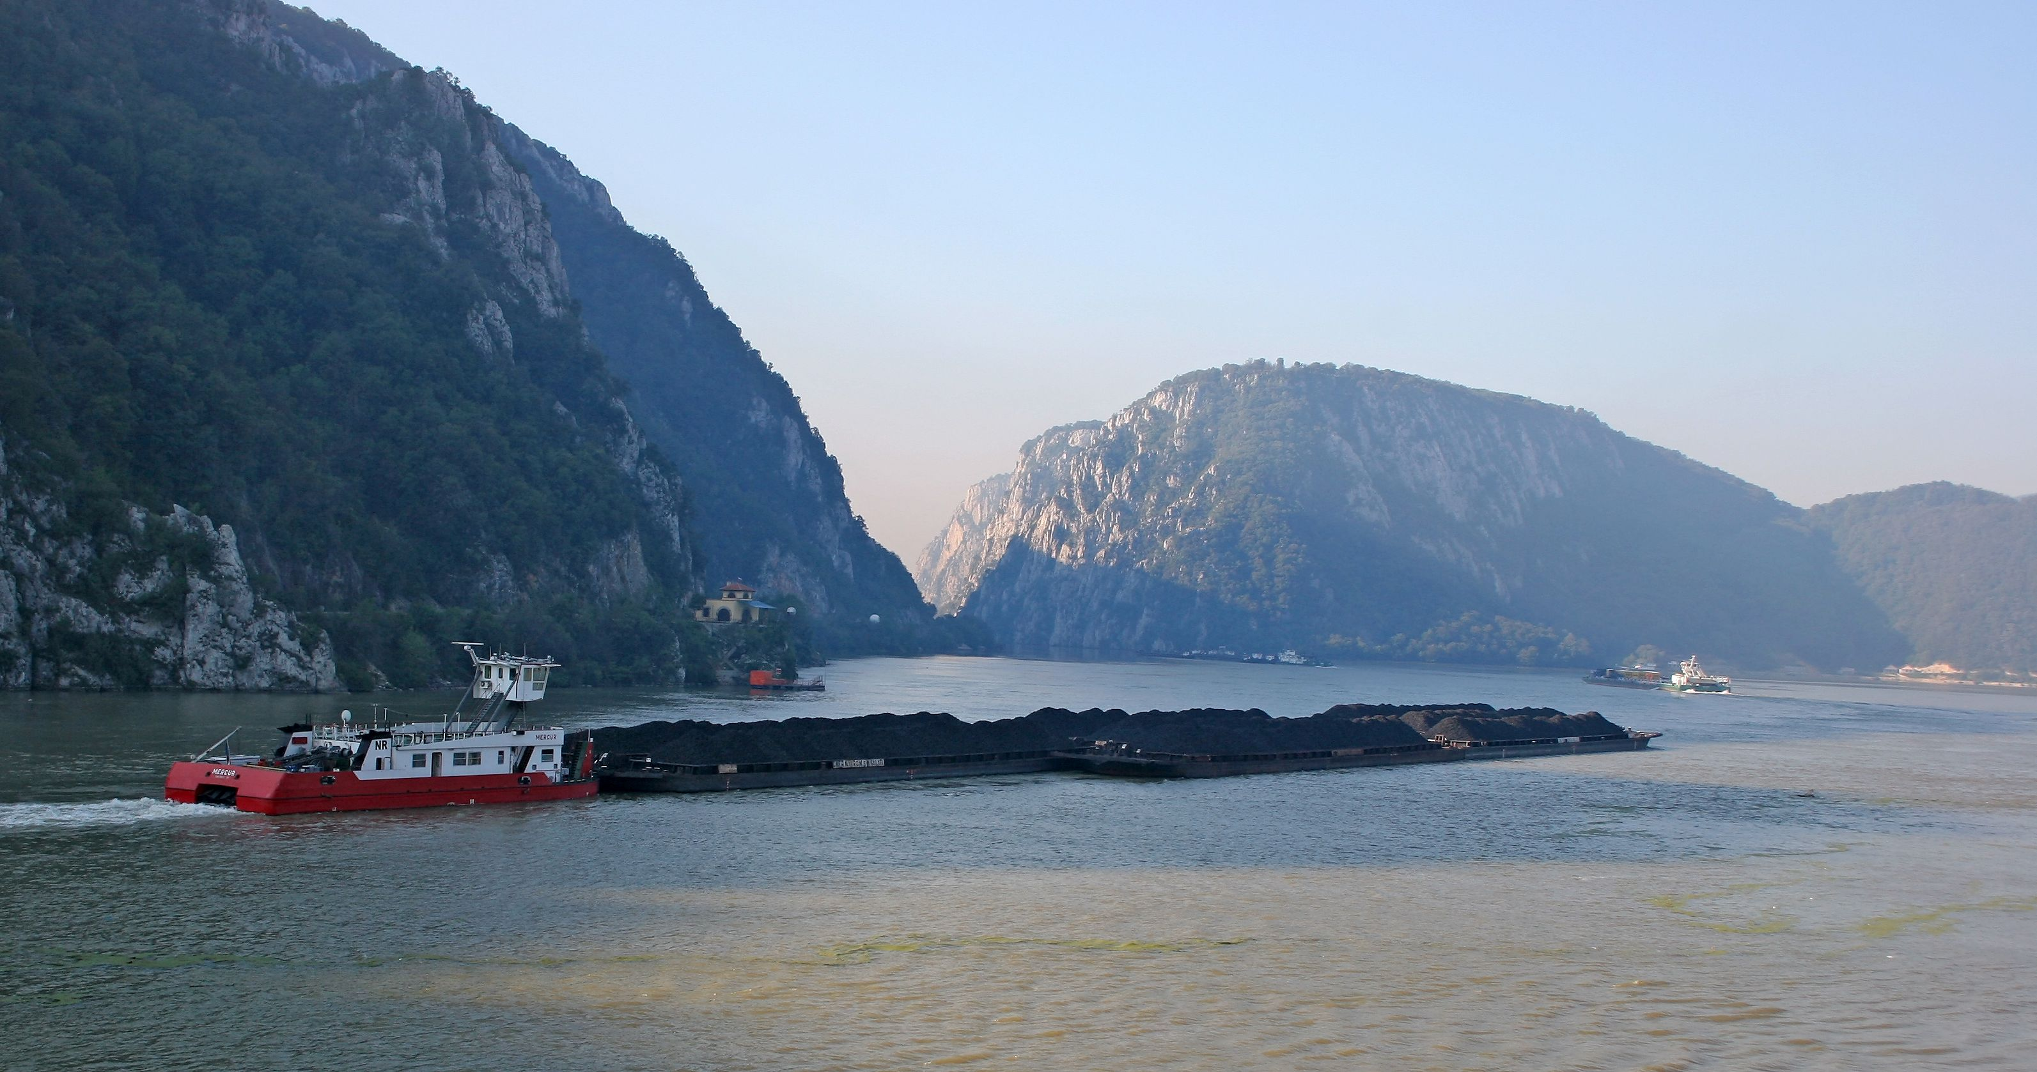
This is what an inland vessel looks like:
Picture: Leitner@TTS, Austria
Notes:
Here you can see a push convoy on the Danube in Serbia/Romania:
It consists of a pusher vessel (a motor ship designed for pushing) and eight coupled barges carrying bulk cargo.
On the Danube in Austria, a vessel can push up to four barges. On the lower Danube in Romania, where the river is very wide, up to twelve barges are possible.
Picture: Leitner@TTS, Austria

Slide 21
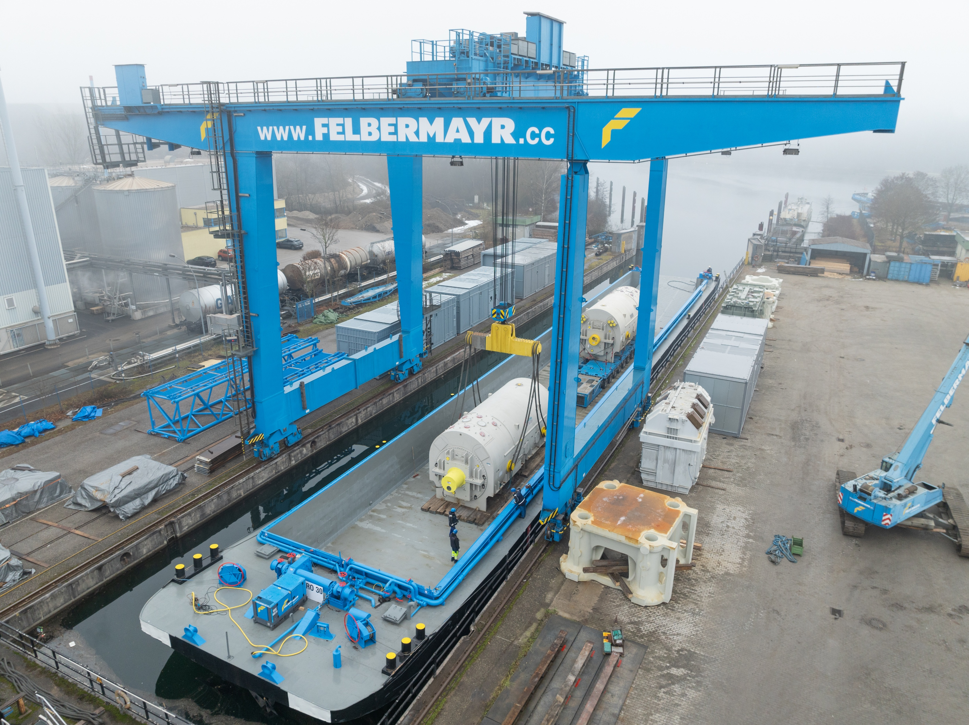
High & Heavy transport on inland waterways
enormous loading capacity
operational 24/7
no infrastructure costs
no permits, escorts, or road closures required
environmentally friendly
40
Picture: Felbermayr
Notes:
When it comes to transporting particularly large and heavy goods—so-called High & Heavy transports—the inland waterway vessel offers a range of advantages that other modes of transport can hardly match.
Enormous loading capacity: Ideal for machinery, components, or industrial equipment that are too large for trucks or trains.
Operable 24/7: Unlike road transport, which is often limited by driving bans or mandatory rest periods, a ship can operate around the clock—without breaks, without traffic jams.
No infrastructure costs: Roads don’t need reinforcement, and bridges don’t need adjustment. Waterways are already available and can be used without additional construction costs.
No permits or escort vehicles required: While road heavy transports often require lengthy permit procedures and police escorts, a ship can usually carry these goods as regular cargo—no permits or roadblocks needed.
Environmentally friendly: Transporting by ship generates significantly less CO₂ than trucks or airplanes. Especially over long distances and with heavy loads, this is a real sustainability advantage.
Source:
Viadonau (2025): https://www.viadonau.org/wirtschaft/donaulogistik/high-heavy-transporte; Accessed 10.07.2025
Picture: Felbermayr

Slide 22
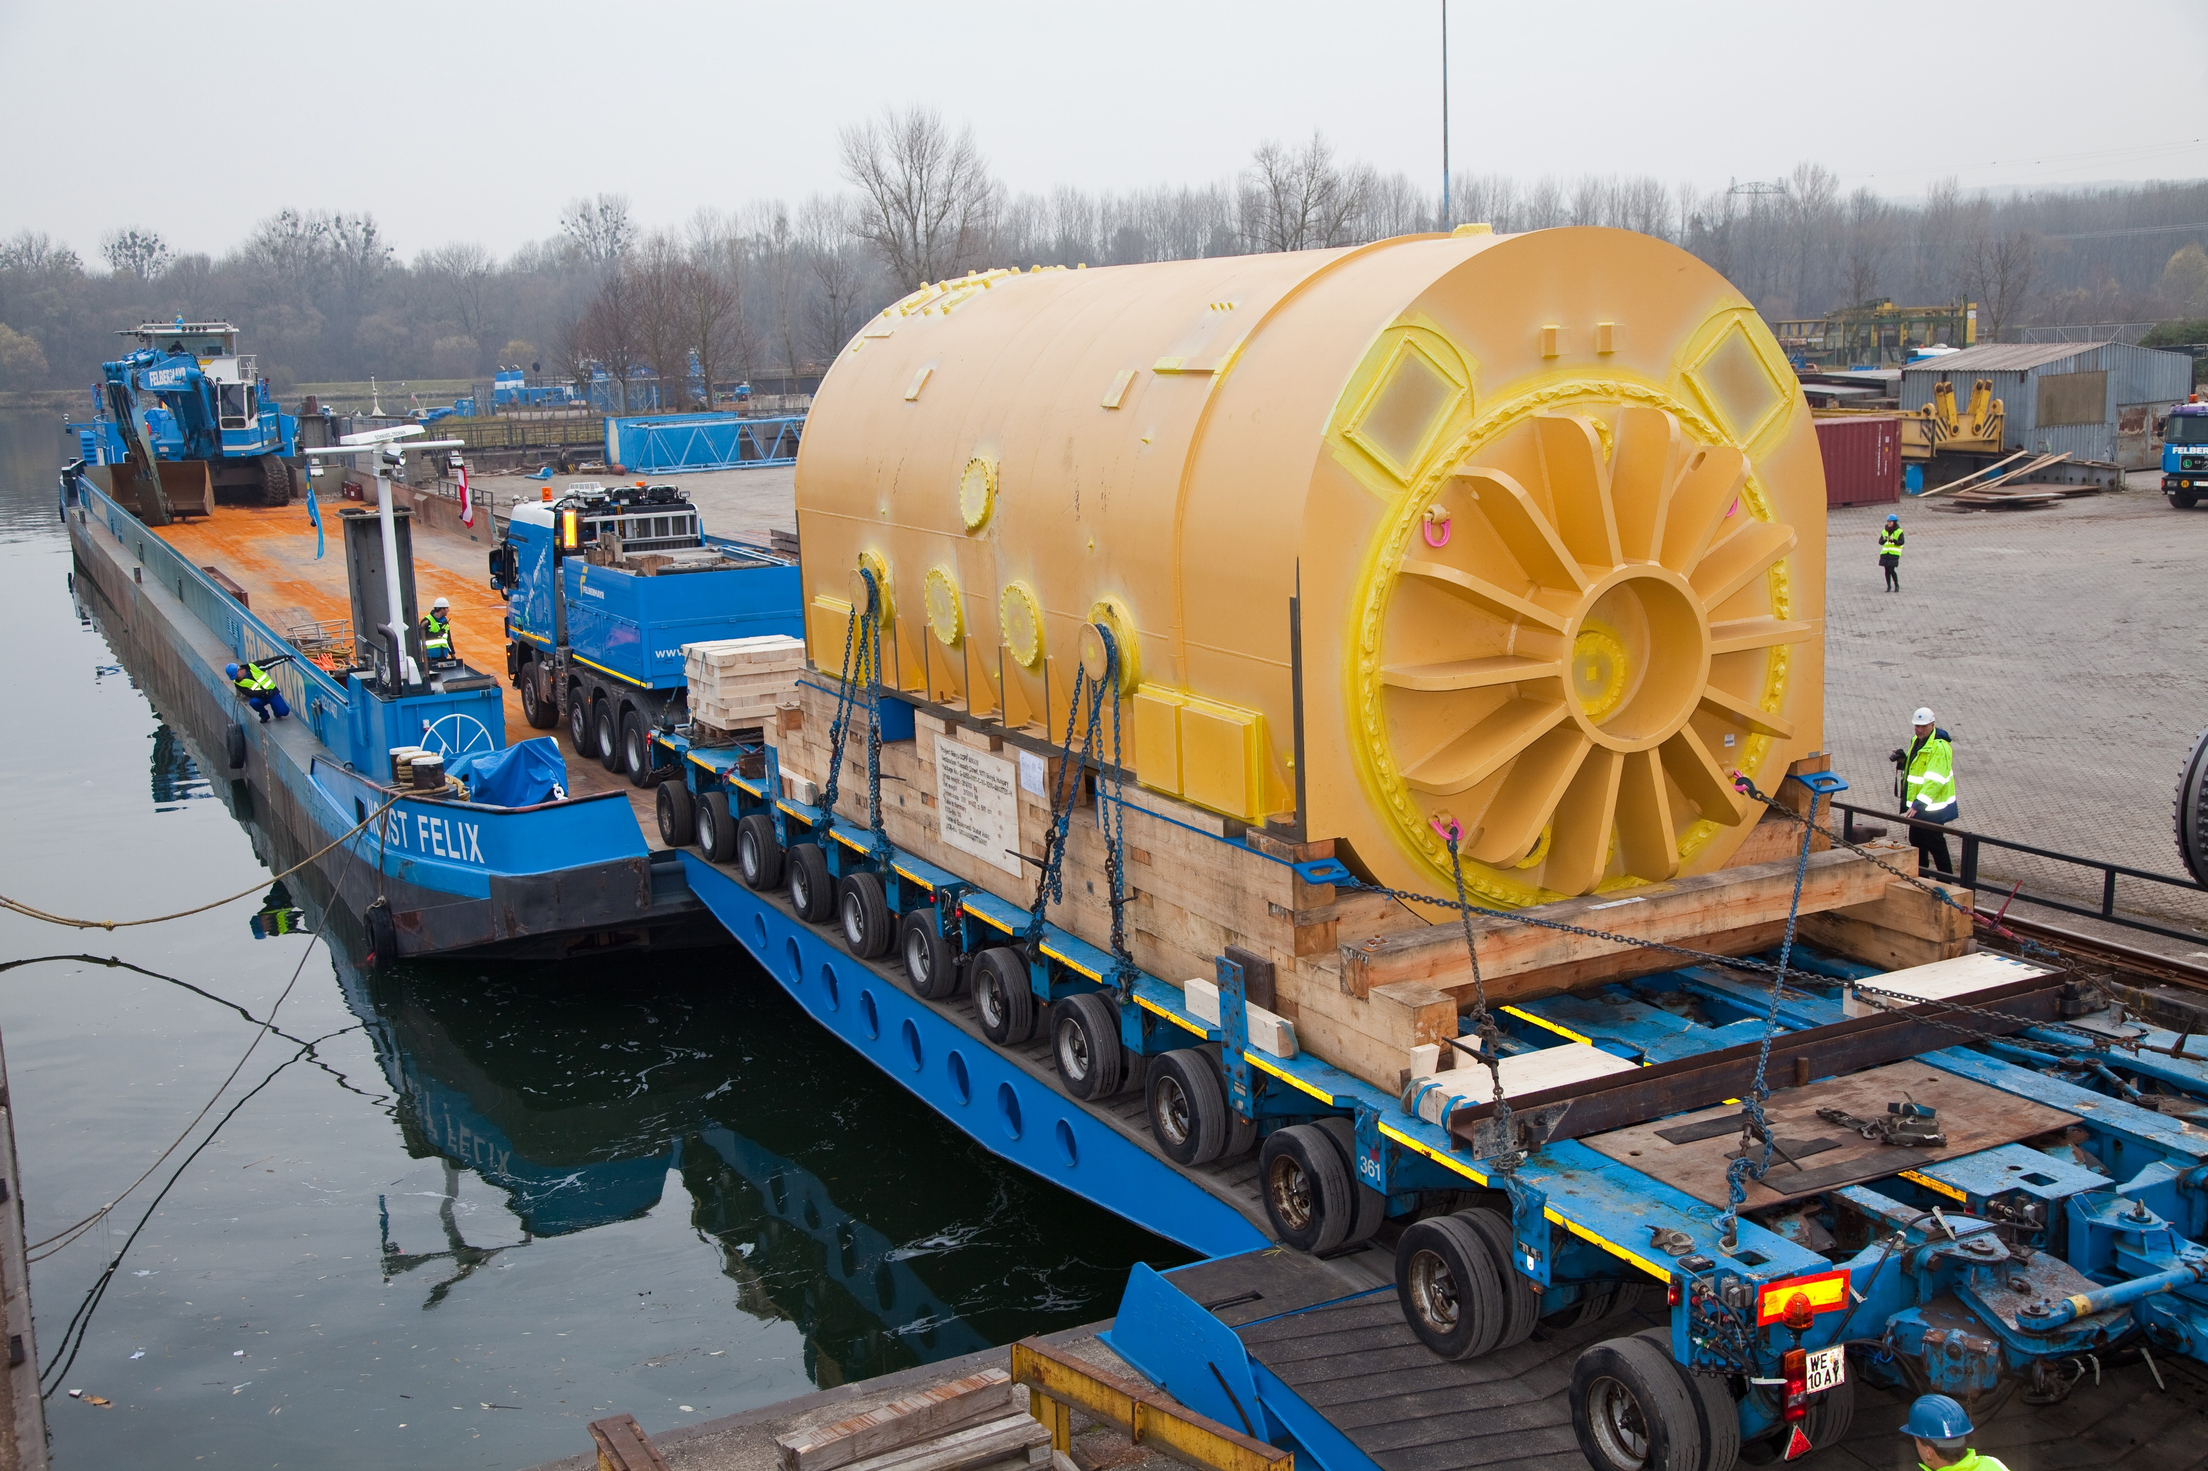
High & Heavy transport
Picture: Felbermayr
Notes:
Picture: Felbermayr

Slide 23
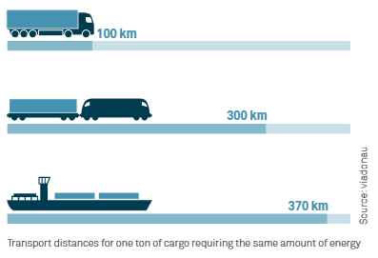
Specific energy consumption – Comparison of modes of transport
An inland vessel can transport one ton of cargo nearly four times farther than a truck using the same amount of energy.
Notes:
In terms of specific energy consumption, inland waterway transport can be considered the most efficient and therefore the most environmentally friendly mode of transport. An inland vessel can transport one ton of cargo nearly four times farther than a truck using the same amount of energy.
Source: Viadonau (2019): Handbuch der Donauschifffahrt , p. 18
Image source: Viadonau (2019): Manual of Danube Navigation, p. 18

Slide 24





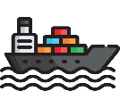


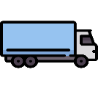
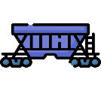
Transport chains
Transports using one mode of transport = unimodal transport
e.g. by road.
Multiple modes of transport = multimodal transport
e.g. transshipment from a truck to an inland vessel.
40
Absender
Sender
Receiver
Vorlauf
Nachlauf
Pre-carriage
Hauptlauf
On-carriage
Main leg (ship, train, truck)
Umschlagspunkt
Transshipment point
Image: Flaticon
Notes:
An unbroken or single-stage transport refers to direct transportation from the sender to the recipient.
The term “transport chain” or “multi-stage transport” refers to the transport from sender to recipient using different means of transport.
In unimodal transport, the mode of transport does not change. Examples include truck transport on the road or rail transport between two sites with direct rail access. Although goods may be reloaded, only one mode of transport is used.
Multimodal transport, on the other hand, involves using more than one mode of transport during the transportation process.
Source:
Muchna, Claus / Brandenburg, Hans / Fottner, Johannes / Gutermuth, Jens (2nd edition, 2021): Grundlagen der Logistik. Begriffe, Strukturen und Prozesse, pp. 152–161
Images sources:
Flaticon (2024): https://www.flaticon.com/de/kostenlose-icons/lkw Truck icons by Freepik – Flaticon
Flaticon (2024): https://www.flaticon.com/de/kostenlose-icons/fabrik Factory icons by Freepik – Flaticon
Flaticon (2024): https://www.flaticon.com/de/kostenlose-icons/boxen Box icons by monkik – Flaticon
Flaticon (2024): https://www.flaticon.com/de/kostenlose-icons/guterzug Freight train icons by Freepik – Flaticon
Flaticon (2024): https://www.flaticon.com/de/kostenlose-icons/Schiff Ship icons by Freepik – Flaticon

Slide 25
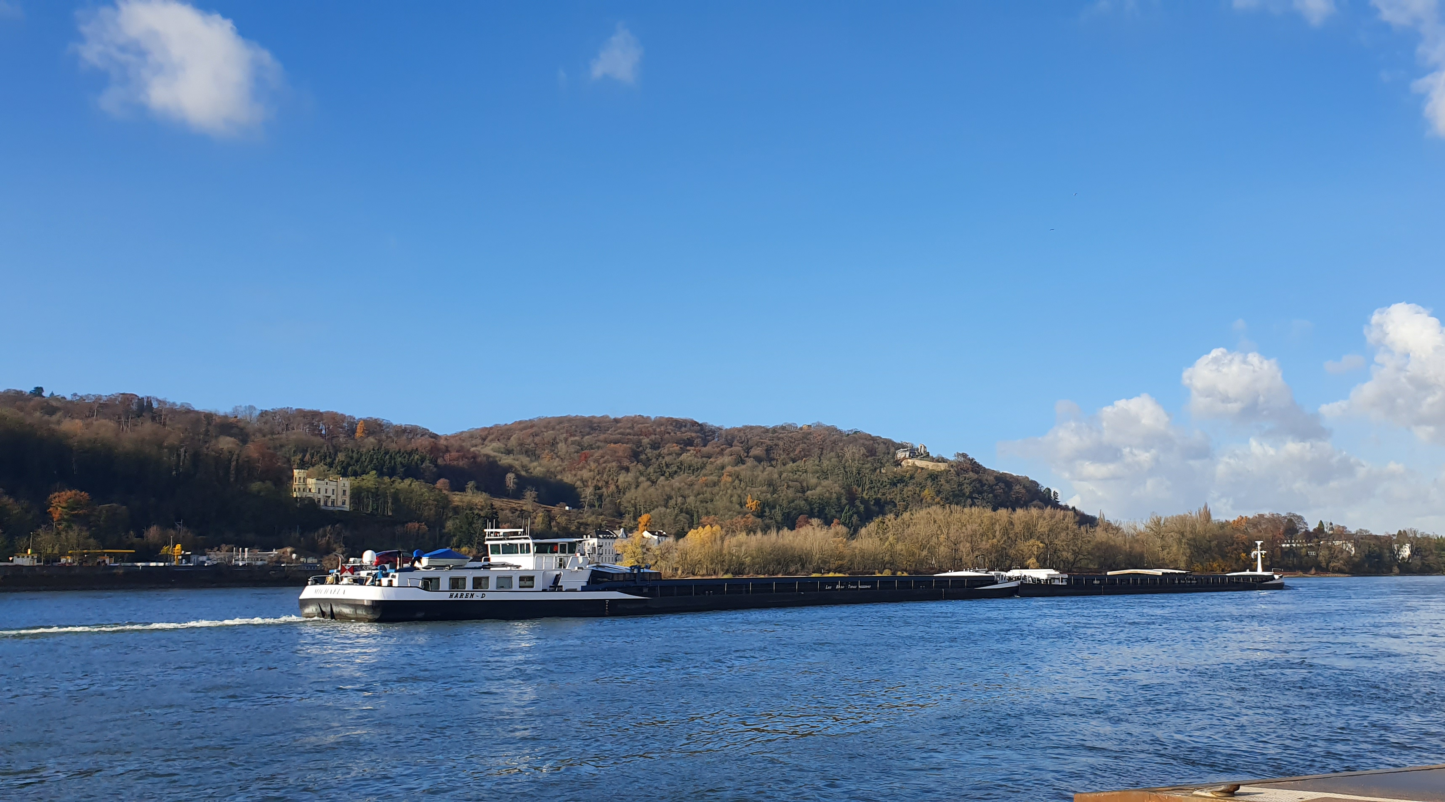
Shift in freight transport
What does that mean?
Fewer trucks on the road – more goods transported by rail or inland waterway vessels.
Why is this important?
Less exhaust emissions
Less congestion
More safety – fewer accidents
Less noise
Goal: A sustainable future for transport!🌱✨
Picture: Björn Bosch
Notes:
Modal shift means that the transport of goods is increasingly being moved to more environmentally friendly modes of transport such as rail or inland waterways, instead of relying primarily on trucks on the road. The goal is to minimize environmental impact and reduce congestion on roads. Road transport is the largest source of greenhouse gas emissions in the transport sector. Fewer truck transports—or reducing them to short distances—and instead increased use of more sustainable transport modes like rail and inland waterways automatically means fewer emissions. This also leads to fewer traffic jams, less noise, and greater safety.
Source:
Allianz pro Schiene (2025): https://www.allianz-pro-schiene.de/glossar/verkehrsverlagerung/; Accessed 11.02.2025
Bundesministerium Klimaschutz, Umwelt, Energie, Mobilität, Innovation und Technologie (2023): Masterplan Güterverkehr 2023
Picture source:
Björn Bosch

Slide 26
Goods by rail and water – A good idea?
Discuss in small groups:
What are the advantages of transporting more goods by rail or inland waterways instead of by truck?
→ Think, for example, about the environment, traffic, safety, space usage, noise.
What challenges might arise?
→ Think, for example, about infrastructure, costs, flexibility, time, accessibility.
Notes:
Discussion in Small Groups and Final Reflection with the Whole Class
What are the advantages of transporting more goods by rail or inland waterways instead of by truck?
→ Think about environment, traffic, safety, space usage, noise
What challenges might arise?
→ Think about infrastructure, costs, flexibility, time, accessibility
Duration: approx. 15 minutes
Suggested Prompt Questions for Support:
What happens if there are fewer trucks on the roads?
Can trains or ships reach every destination?
What would need to change to transport more goods by rail or inland waterways?
Possible Discussion Points:
Advantages:
Environmental protection: Lower CO₂ emissions compared to road transport.
Relief for roads: Less congestion and lower risk of accidents.
Energy efficiency: Rail and ship use less energy per ton transported than trucks.
Economic benefits: Cost savings from more efficient long-distance transport.
Noise reduction: Trains and ships are quieter than trucks.
Challenges:
Infrastructure: Rail and waterway networks need expansion and modernization.
Flexibility: Trucks are more flexible and can deliver directly to customers.
Time requirements: Inland waterway and rail transport are generally slower than trucks.
Weather dependency: Shipping can be affected by high or low water levels.
Learning Objectives:
Students understand the available modes of freight transport and their differences.
Students recognize the ecological and societal advantages of using rail or inland waterways over trucks.
Students discuss the challenges involved in shifting to more sustainable modes of transport.
Students practice reasoning by weighing different perspectives and expressing their opinions with justification in group discussions.

Slide 27
Sustainable freight transport
3

Slide 28
Climate Change Detectives
Work in groups:
Cards with impacts of climate change: Each group receives cards with pictures showing various effects of climate change.
Group discussion: Think about what you see in the pictures and how these effects are related to climate change.
Which regions and people are especially affected?
How can we personally feel the effects of climate change?
Present your results: Present your findings and stick the cards on a poster. Use colored markers to highlight which impacts are the most severe.
Notes:
Introductory Activity on the Topic of Climate Change:
The images serve as a prompt for a discussion on climate change and global warming in small groups and with the whole class. Consequences and facts about global warming will also be presented in the next slide.
Duration: 1 lesson
Social form:
Group work (4–5 students)
Preparation:
Images or cards showing different effects of climate change (e.g. melting glaciers, floods, droughts), colored markers or pens, large sheets of paper or a whiteboard.
The images can be accessed and printed via this link: www.rewway.at
Cards with effects: Each group receives cards with images showing various impacts of climate change.
Group discussion: Groups discuss what is visible in the images and how these effects are connected to climate change. They also consider which regions and people are particularly affected. How can we personally experience climate change?
Presenting results: Each group presents their findings and sticks the cards onto a large sheet of paper or a whiteboard. They use colored pens to mark which impacts are especially severe.
Joint reflection: Discuss the results with the whole class. What did the students learn about climate change? Which impacts stood out the most? How can we feel the effects of climate change?
Guiding questions for discussion:
What do you see in the images and how are these effects related to climate change?
How can we personally feel the effects of climate change?
Which regions and people are most affected?
What feelings or thoughts do the images trigger in you?
Learning objectives:
Students recognize visual signs and impacts of climate change.
Students identify connections between global environmental changes and climate change.
Students exchange personal perceptions and global perspectives.
Students begin to develop an awareness of the urgency of climate-related challenges.

Slide 29
Greenhouse gases: what are they and which ones exist?
Greenhouse gases influence the Earth’s energy balance
Greenhouse effect, global warming
Most well-known greenhouse gases: carbon dioxide (CO₂), methane, and nitrous oxide
Low natural occurrence of greenhouse gases
Increase in greenhouse gases due to human activity
Chart based on EEA data
Notes:
Greenhouse gases are gases in the atmosphere that amplify the greenhouse effect by influencing the Earth's energy balance.
Although carbon dioxide, methane, and nitrous oxide occur naturally in small concentrations, human activities have significantly increased their levels since the last century.
To make the climate impact of different greenhouse gases comparable and to define their warming potential, methane and nitrous oxide are often expressed in so-called CO₂ equivalents (CO₂e).
The EU’s greenhouse gas emissions in 2021 amounted to approximately 3.5 billion tons of CO₂ equivalents.
In 2019, greenhouse gas emissions in the EU consisted of: 80% carbon dioxide, 11% methane, 6% nitrous oxide and 2% fluorinated gases.
Chart adapted from the European Environment Agency (EEA):
European Parliament (2024): https://www.europarl.europa.eu/resources/library/images/20211027PHT16017/20211027PHT16017_original.jpg; accessed 18.03.2025
Sources:
DESTATIS (2024): https://www.destatis.de/Europa/DE/Thema/GreenDeal/_inhalt.html; accessed 18.03.2025
Myclimate (2024): https://www.myclimate.org/de/informieren/faq/faq-detail/was-sind-treibhausgase/; accessed 18.03.2025

Slide 30
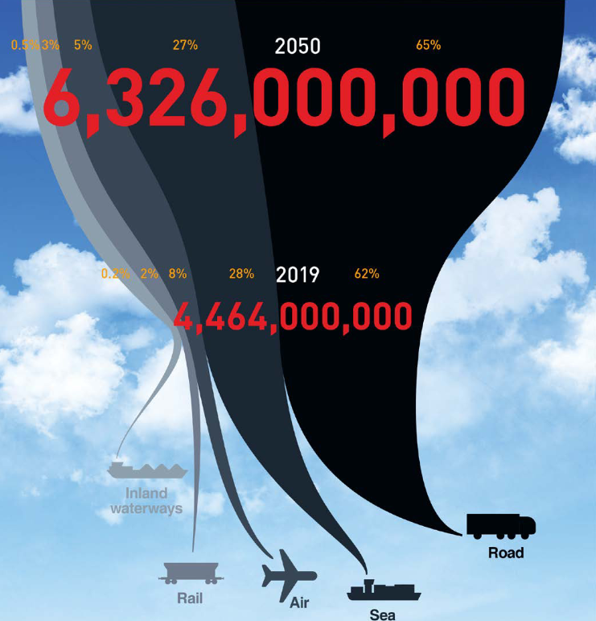
Impacts of the transport sector
Transport emissions are rising sharply
Forecasts predict an almost doubling of freight transport by 2050 (compared to 2019)
Especially truck transport is increasing
40
Image: Smart Freight Centre
Notes:
The ongoing increase in freight transport, especially in road freight (trucks), has significant impacts on the environment and climate.
Forecasts predict that freight transport will nearly double by 2050 compared to 2019. (cf. ITF 2023, p. 67)
Image source:
Smart Freight Centre (2024): GLEC Framework v3.1 edition, revised and updated. In: https://www.smartfreightcentre.org/en/our-programs/emissions-accounting/global-logistics-emissions-council/calculate-report-glec-framework/, p. 8
Based on: ITF (2023): ITF Transport Outlook 2023, OECD Publishing, Paris; at https://doi.org/10.1787/b6cc9ad5-en ; last viewed 25/09/2024
Source:
ITF (2023): ITF Transport Outlook 2023, OECD Publishing, Paris; at https://doi.org/10.1787/b6cc9ad5-en ; accessed 06/03/2025

Slide 31
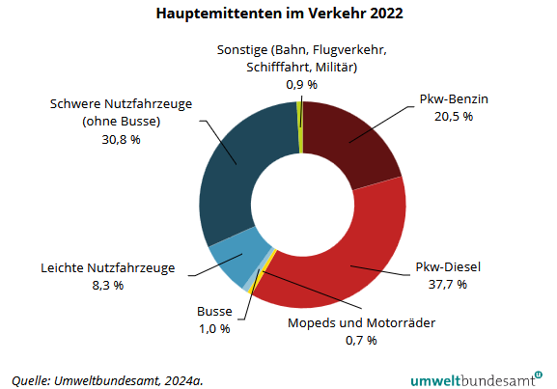
Road traffic as the main polluter
Main Emitters in Transport 2022
Other (rail, aviation, shipping, military):
Passenger Cars – Petrol:
Heavy Commercial Vehicles (excluding buses):
Passenger Cars – Diesel:
Light Commercial Vehicles:
Buses:
Mopeds and Motorcycles:
Source: Umweltbundesamt, 2024a.
Notes:
Road traffic is responsible for around 99% of emissions in the transport sector. (cf. Umweltbundesamt 2024: p. 138)
Source:
Umweltbundesamt (2024): Klimaschutzbericht 2024. Available at: https://www.umweltbundesamt.at/fileadmin/site/publikationen/rep0913.pdf; accessed 14/01/2025

Slide 32
The 3 pillars of sustainability in logistics
Green Logistics
economic
ecological
social
„…environmentally friendly and socially responsible, but also financially viable “
Notes:
The concept of “green logistics” aims to balance economic, ecological, and social goals within the field of logistics, which also includes the transport sector. This creates areas of tension between the three dimensions, as it is not always possible to pursue all individual goals simultaneously. The following objectives can be assigned to each area:
Social goals: Raising awareness for sustainable transport and ensuring a good quality of life.
Ecological goals: Reducing emissions and, more broadly, lowering resource consumption.
Economic goals: From a financial perspective, there should be no additional costs, or ideally, cost reductions should be achieved, and inefficiencies (periods of unproductivity) should be minimized.
Naturally, further objectives could be assigned to each area, making it even more challenging to achieve a balanced pursuit of goals across all dimensions.
Sources:
Pazirandeh, Ali / Jafari, Hamid (2013): Making sense of green logistics; In: International Journal of Productivity and Performance Management, p. 889f.
Saroha, Rituraj (2014): Green logistics & its significance in modern day systems; In: International Review of Applied Engineering Research, p. 90

Slide 33

Sustainable freight transport – Why and how?
Increasing transport volumes raise the need for action.
Sustainable transport through:
Avoidance of transport
Shift to sustainable modes of transport such as rail and inland waterways
Alternative fuels
Innovative technologies, digitalization
Adjusted pricing
Holistic consideration of the value chain and suppliers
Image: Flaticon
Notes:
Freight transport is identified as an environmentally harmful area within logistics, as it contributes significantly to greenhouse gas emissions and traffic congestion—key environmental and sustainability challenges in Europe.
With increasing transport volumes, the need for action and the relevance of sustainability in freight transport continue to grow.
To counter these problems, various measures are being implemented. These include adjusted pricing, the use of alternative fuels, the promotion of shifting to more sustainable modes of transport such as rail and inland waterways, and the increased use of innovative technologies.
Source:
European Commission (2011): White Paper – Roadmap to a Single European Transport Area – Towards a competitive and resource-efficient transport system, p. 10 ff.
Image source:
Flaticon (2024): https://www.flaticon.com/de/kostenlose-icons/erde; Earth icons created by Freepik – Flaticon, accessed 08.07.2024.

Slide 34

Sustainable Development Goals (SDG)
17 global goals of the United Nations for sustainable development
Include economic, ecological, and social aspects
Image: United Nations
Notes:
In 2015, the international community, under the leadership of the United Nations, adopted the 2030 Agenda. This agenda consists of 17 global goals aimed at creating a better future for all. The aim of the 2030 Agenda is to enable a life of dignity for people worldwide while simultaneously protecting the natural foundations of life in a sustainable way. Economic, ecological, and social aspects are taken into account. The 2030 Agenda emphasizes the shared responsibility of all stakeholders, including politics, business, science, civil society, and each individual person.
Source:
UNRIC (2025): https://unric.org/de/17ziele/; accessed 18.03.2025
Image Source:
United Nations (2024): https://www.un.org/sustainabledevelopment/news/communications-material/, accessed 22.10.2024

Slide 35
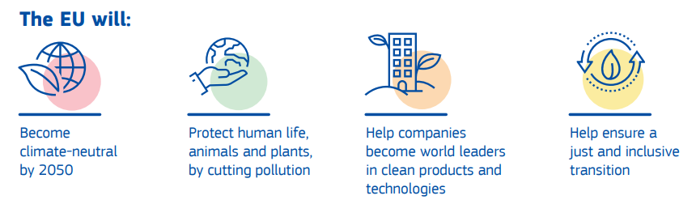
The European Green Deal
EU action package for a green transition
Image: European Commission
Notes:
The European Green Deal was launched in 2019 and is a compilation of policy measures taken by the EU to enable the transition to a climate-neutral society by 2050. The aim of the Green Deal is to create a fair and prosperous society supported by a modern and competitive economy.
To achieve this goal, the Green Deal emphasizes that a holistic and cross-sectoral approach is necessary, where all relevant policy areas are aligned with the overarching objective of climate protection. The package includes measures covering a wide range of policy fields, including climate, environment, energy, transport, industry, agriculture, and sustainable finance.
The European Green Deal aims to achieve a climate-neutral EU by 2050, with greenhouse gas emissions to be reduced by at least 55% by 2030 compared to 1990 levels. Achieving this requires a fundamental transformation of the economy and society in many sectors.
"Fit for 55" is a package of measures that includes the revision and update of EU legislation as well as the introduction of new initiatives to ensure that EU action aligns with the climate goals of the Council and the European Parliament.
Sources:
European Commission, Directorate-General for Communication (2019): What is the European Green Deal?, at https://data.europa.eu/doi/10.2775/944554 ; accessed 13.03.2025
European Council of the European Union (2024): https://www.consilium.europa.eu/de/policies/green-deal/; accessed 13.03.2025
Image source:
European Commission, Directorate-General for Communication (2019): What is the European Green Deal?, at https://op.europa.eu/en/publication-detail/-/publication/2e009f04-1d90-11ea-95ab-01aa75ed71a1; accessed 13.03.2025

Slide 36
My contribution to climate protection
Think for yourself and discuss with your partner: what can you personally do to help achieve the goals?
Image: United Nations
Notes:
This exercise is suitable as an individual exercise or as a group exercise for small groups (max. 3 people)
Duration: 10-20 minutes
Possible prompts for students:
Goal 1 – No poverty: Donate clothing and toys for children in need / organize collection drives for schools in poorer countries.
Goal 2 – Zero hunger: Participate in food donation campaigns.
Goal 3 – Good health and well-being: Take part in sports programs yourself, eat healthily.
Goal 4 – Quality education: Offer tutoring for younger students, organize a book exchange.
Goal 5 – Gender equality: Use gender-inclusive language.
Goal 6 – Clean water and sanitation: Save and use water consciously.
Goal 12 – Responsible consumption and production: Consider where your food comes from, buy local products.
Reflection prompt after the discussion:
Which goal speaks to you personally the most – and why?
Securing results: Short presentation in the plenary session or collection on a poster / digital board (e.g., Padlet).
Extension idea: Create an "SDG action plan" for the school or class.
Learning objectives:
Students reflect on how they themselves can contribute to achieving the SDGs.
Students develop concrete ideas for sustainable actions in their personal environment.
Students exchange individual perspectives and foster mutual understanding of global responsibility.
Students strengthen their communication and argumentation skills when discussing societal issues.
Image source:
United Nations (2024): https://www.un.org/sustainabledevelopment/news/communications-material/, accessed 22.10.2024

Slide 37
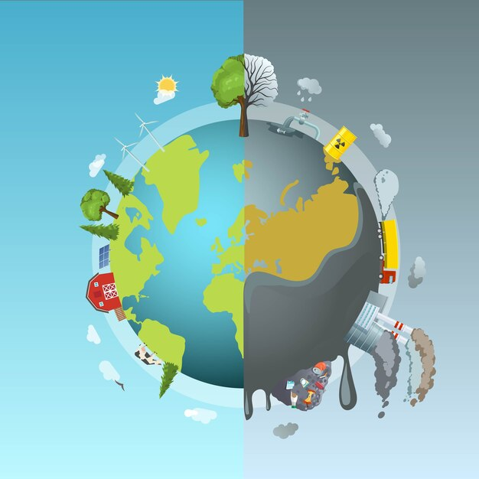
We must take action!
Climate change affects all countries and regions of the Earth
For more than half of young people in Europe, climate change is the most important global challenge(Eurobarometer Survey 2022)
Action on a global level is necessary
Everyone’s contribution is needed
Reduction of transport emissions
Modal shift in transport: inland waterways and rail as sustainable modes of transport
Image: Freepik
Notes:
Climate change is a global issue that affects all countries and regions of the Earth.
According to a Eurobarometer survey, over half of young people consider climate change to be the most important global challenge for the future of the EU. In fact, 91% of 15- to 24-year-olds believe that combating climate change can have a positive impact on their personal health and well-being.
To effectively address the consequences of climate change, international agreements and cooperation are urgently needed.
Reducing transport emissions is essential and can be achieved, among other things, through traffic reduction and shifting transport to rail and inland waterways. Inland shipping, in particular, presents itself as a sustainable mode of transport with available capacity.
Sources:
European Parliament (2022): https://www.europarl.europa.eu/news/de/press-room/20220119IPR21314/zukunft-europas-klimawandel-grosste-herausforderung-fur-die-eu-so-die-burger; accessed 18.03.2025
European Commission (2023): Sustainable & Smart Mobility Strategy, https://transport.ec.europa.eu/transport-themes/mobility-strategy_en; accessed 05.02.2025
Image source:
Freepik (2024): https://de.freepik.com/vektoren-kostenlos/konzept-der-runde-der-umweltverschmutzung_10155239.htm; accessed 14.05.2024

Slide 38
Danube waterway
4

Slide 39
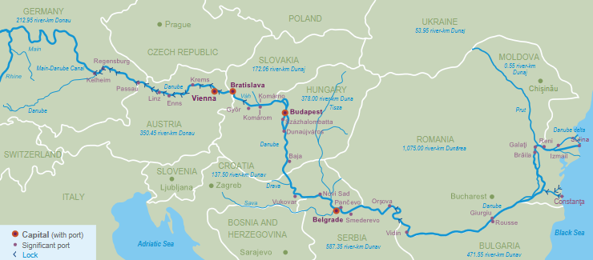
The international waterway Danube
How many riparian countries does the Danube have?
Which major cities lie along the Danube?
Why is the Danube important for the Austrian/European economy?
Image: viadonau
Notes:
The questions in the slide above can be used as a warm-up exercise for the topic “The International Waterway Danube.”
Didactic note:
This exercise is particularly suitable as an engaging introduction to a lesson unit on inland shipping, sustainable logistics, or European infrastructure. The questions can be used at the beginning to encourage hypothesis building and revisited at the end of the unit for reflection and consolidation.
Discussion input (5–10 minutes discussion):
How many riparian states does the Danube have? 10
Why is the Danube important for the Austrian economy? Important transport route, crucial for international trade, connects Central and Southern Europe, creates jobs (e.g., in ports, as inland navigation operators), contributes to GDP
Which major cities lie on the Danube? Regensburg, Passau, Linz, Vienna, Bratislava, Budapest, Novi Sad, Belgrade, Constanța…
Input – Possible discussion points:
Infrastructure: What infrastructure is needed for the Danube to be used efficiently as a transport route (e.g., locks, ports, types of ships)?
Waterways in Europe: How is the Danube connected to other waterways (e.g., Rhine-Main-Danube Canal)?
Markets: What types of goods are transported on the Danube? Which countries benefit most?
Riparian states: What political challenges arise due to the number of countries along the Danube?
Availability of the Danube: How do water levels, climate change, or environmental regulations affect its usability?
Free capacities: Why is the Danube used relatively little despite available capacity?
Learning objectives:
Students activate their prior knowledge about the geographic location and significance of the Danube.
Students formulate initial questions and hypotheses about the importance of the Danube for European freight transport and the Austrian economy.
Image source:
Viadonau (2019): Manual of Danube Navigation, p. 46

Slide 40
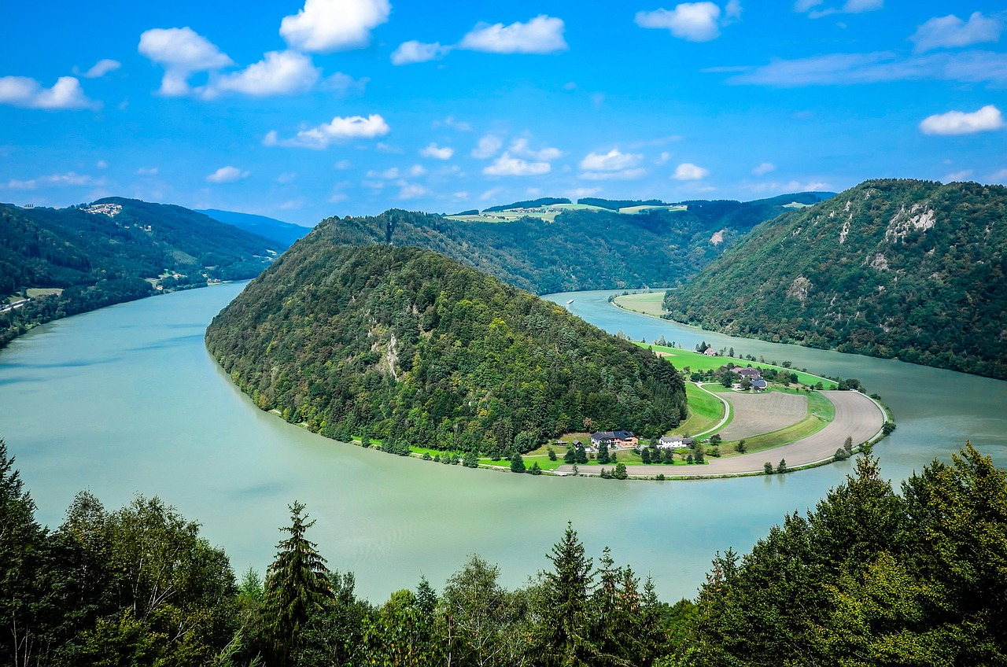
The international waterway Danube
From the Black Forest (Germany) to the Black Sea (Romania and Ukraine)
10 riparian countries: Germany, Austria, Slovakia, Hungary, Croatia, Serbia, Bulgaria, Romania, Moldova, Ukraine
Almost one-third of the total river length is in Romania
Most international river in the world
2,845 km long, 2,415 km navigable
Most water-rich river in Europe
Picture: Pixabay
Notes:
The Danube, which flows from the Black Forest in Germany to its mouth at the Black Sea in Romania and Ukraine, passes through ten riparian countries (Germany, Austria, Slovakia, Hungary, Croatia, Serbia, Bulgaria, Romania, Moldova, Ukraine), making it the most international river in the world.
The Danube is 2,845 km long and has a navigable length of 2,415 km for international freight shipping.
Source:
Viadonau (2019): Handbuch der Donauschifffahrt, p. 38 ff.
Picture Source:
Pixabay (2025): https://pixabay.com/de/photos/schl%C3%B6gen-sch%C3%B6gener-schlinge-donau-4795383/; Accessed 20.03.2025

Slide 41




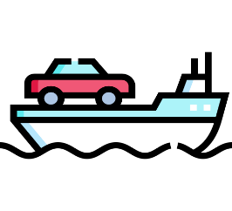
Freight transport on inland waterways
Bulk Goods
Ores, coal, steel, agricultural products
Predominant goods in Danube traffic
Hazardous Goods
e.g., flammable liquid goods such as gasoline, heating oil, chemicals, liquefied gases
Containers
Growing market segment
Heavy Cargo
Heavy or bulky loads
RoRo Ships
(Roll on / Roll off)
Images: Flaticon
Notes:
Inland waterway transport is primarily dominated by bulk goods. These include, for example, agricultural products, ores, coal, and steel. Especially for Austria’s steel industry (voestalpine, headquartered in Linz on the Danube), inland shipping is an important mode of transport.
One key function of inland navigation is the transport of hazardous goods, which includes flammable liquid substances like gasoline and heating oil, basic chemicals like methanol, end products such as acids, and liquefied gases like ammonia—as well as dry, hazardous goods transported in bulk. Strict safety norms and standards are essential for transporting these materials.
Container transport by inland vessel has more than doubled in recent years. A large portion of container and hinterland traffic is handled along the Rhine and through the ZARA ports (Zeebrugge, Antwerp, Rotterdam, Amsterdam).
Thanks to their dimensions, inland vessels are particularly well-suited for transporting heavy or bulky cargo. These ships can withstand point loads of over 40 tonnes per square meter or single unit weights of up to 1,000 tonnes. Waterborne heavy cargo transport offers clear advantages: it avoids damage to infrastructure and eliminates the need to remove obstacles like streetlights or trees, as would be necessary with road transport. Increasingly, turbines or rotor blades for wind energy plants are transported via waterways. The rising number of heavy cargo shipments by inland vessels in recent years confirms this trend.
RoRo ships (short for Roll-on/Roll-off) are special vessels designed for transporting movable goods, where the cargo is driven onto the ship. This usually involves vehicles such as cars, trucks, or trains that can board under their own power, but also loading units rolled aboard using towing equipment. RoRo ships feature driveable decks and usually variable deck heights to make better use of cargo space. They are particularly important for the automotive industry.
Sources:
BDB (2025): https://www.binnenschiff.de/system-wasserstrasse/gueterschifffahrt/ (Accessed 18.03.2025)
Viadonau (2019): Handbuch der Donauschifffahrt, pp. 161 ff.
Images sources:
Flour: https://www.flaticon.com/de/kostenlose-icons/mehl – Freepik via Flaticon
Hazardous goods: https://www.flaticon.com/de/kostenlose-icons/gefahrgut – surang via Flaticon
Container: https://www.flaticon.com/de/kostenlose-icons/container – Freepik via Flaticon
Metal: https://www.flaticon.com/de/kostenlose-icons/metall – surang via Flaticon
Ferry boat: https://www.flaticon.com/free-icons/ferry-boat – Freepik via Flaticon

Slide 42
The Danube as a transport route
Research one of the topics in your group using the internet and present your results to the class:
Goods on the Danube (Which types of goods are transported?)
Advantages of the Danube as a transport route (Why is it better than the road?)
Problems of Danube shipping (What obstacles are there?)
Future of the Danube (How could the waterway be made more sustainable?)
Notes:
Expert Group on the Danube – Focus on Waterways
Duration: 30–40 minutes (10 min research phase, 10–15 min short group presentations, 10–15 min final group discussion)
Students work in groups. Each group is assigned one topic:
Goods on the Danube (What types of goods are transported?)
Advantages of the Danube as a transport route (Why is it better than road transport?)
Problems of Danube shipping (What obstacles exist?)
Future of the Danube (How could the waterway be made more sustainable?)
Procedure:
Each group conducts 10 minutes of online research (consulting AI like ChatGPT is allowed).
Then, each group presents its topic in 2–3 sentences.
Final step: A joint discussion on the importance of waterways, particularly the Danube.
Learning Objectives:
Students conduct targeted online research on a specific aspect of Danube shipping.
Students understand what types of goods are transported on the Danube and its economic relevance.
Students describe the challenges associated with shipping on the Danube.
Students strengthen their teamwork, media literacy, and argumentation skills.

Slide 43
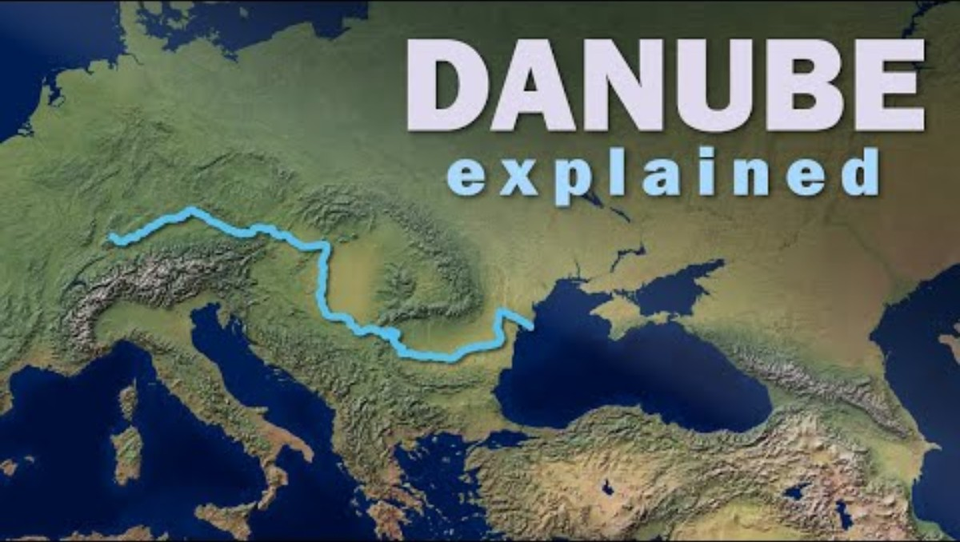
Video: Danube explained
Questions about the video:
How long is the Danube River, approximately?
Where does the Danube originate and where does it end?
Through how many countries does the Danube pass or border?
Name at least two national capitals situated on the Danube.
What is one major modern use of the Danube mentioned in the video?
https://www.youtube.com/watch?v=NcdgMj3nDvE
Notes:
Questions including answers:
How long is the Danube River, approximately? - About 2,888 km (commonly rounded to ~2,850 km).
Where does the Danube originate and where does it end? - It starts in the Black Forest in Germany and flows into the Black Sea.
Through how many countries does the Danube pass or border? - It flows through or borders ten countries.
Name at least two national capitals situated on the Danube. - Vienna, Bratislava, Budapest, and Belgrade.
What is one major modern use of the Danube mentioned in the video? - It is a vital navigable waterway for trade and transport.

Slide 44
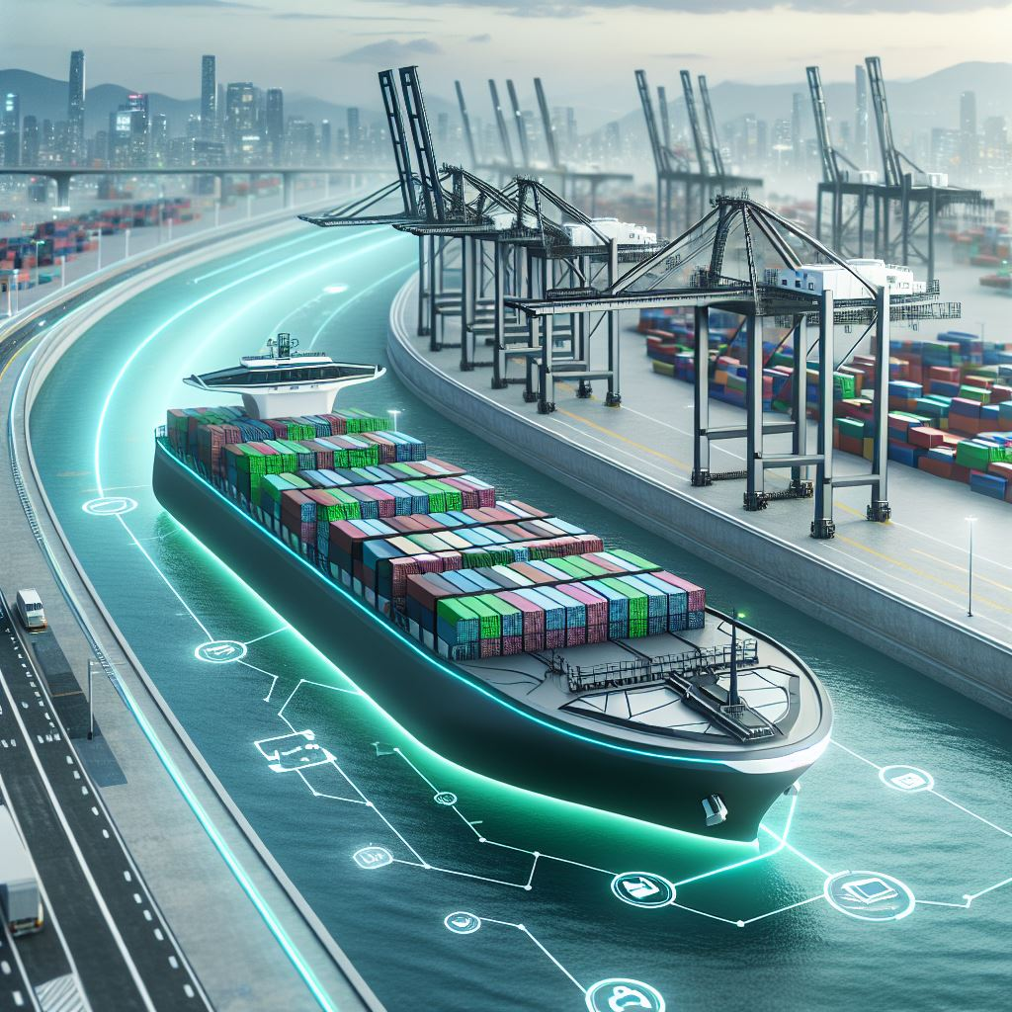
Development trends in inland waterway shipping
Modernization of ships and ports ("retrofitting")
Digitalization
Automation
Use of sustainable resources
Low-water ships
Waterway connectivity
Opening up of new markets
40
Image: AI-generated (MS Copilot)
Notes:
Measures to further promote the sustainability and usability of inland waterway shipping:
Retrofitting refers to the process of equipping existing ships with modern technology to maintain their competitiveness, save fuel, and become more environmentally friendly. One example is the refitting of the MSC Flaminia by the shipping company NSB after a fire. By installing a new bulbous bow and propeller, fuel consumption was reduced by up to twelve percent. Retrofitting also serves as a demonstration that older ships with modern design and efficiency can compete with new vessels.
Digitalization: The use of modern technologies such as automated systems, telematics, and data analytics can improve efficiency and reduce emissions. Digital networking of ships and ports enables, for example, optimized route planning, improved cargo tracking, and more efficient use of resources such as fuel. Digitalization helps increase efficiency, reduce costs, and ease environmental impacts in inland navigation.
Waterway connectivity supports greater usability of inland waterway transport by improving waterway infrastructure and creating efficient connections between different bodies of water. The goal is to facilitate the transport of goods by inland vessels while minimizing environmental impact. This is achieved through optimizing waterways, expanding locks, and reducing bottlenecks, leading to shorter transport times, lower energy consumption, and fewer CO₂ emissions.
The use of environmentally friendly fuels and the shift to alternative propulsion systems such as electromobility or hydrogen propulsion contribute to sustainable inland waterway transport.
Opening up new markets and market segments (e.g., container transport) can increase the share of inland shipping in total freight transport.
Source:
Bundesanstalt für Wasserbau (2017): Kolloquium Wasserbauliche Herausforderungen an den Binnenschifffahrtsstraßen, https://izw.baw.de/publikationen/kolloquien/0/02_Kempmann-Kriedel_Rusche-Pauli-Georges_Herausforderungen....pdf; retrieved 18.03.2025
Verband deutscher Reeder (2016): https://www.reederverband.de/sites/default/files/publikationen/deutsche_seeschifffahrt/deutsche_seeschifffahrt_2016_-_umweltspecial.pdf; retrieved 18.03.2025
Heinzelmann, Christoph / Bödefeld, Jörg / Duric, Zorana (2020): Digitalisierung im Verkehrswasserbau. Bautechnik, 97; In: https://doi.org/10.1002/bate.202000029 ; pp. 441-444
Image source:
Generated with AI (Microsoft Copilot) on 12.06.2025, prompt: “Create an image of a futuristic cargo ship (loaded with containers) showing visions and development trends in inland shipping – focusing on modern technologies, sustainability, and autonomous navigation. Urban port environment along the river.”

Slide 45
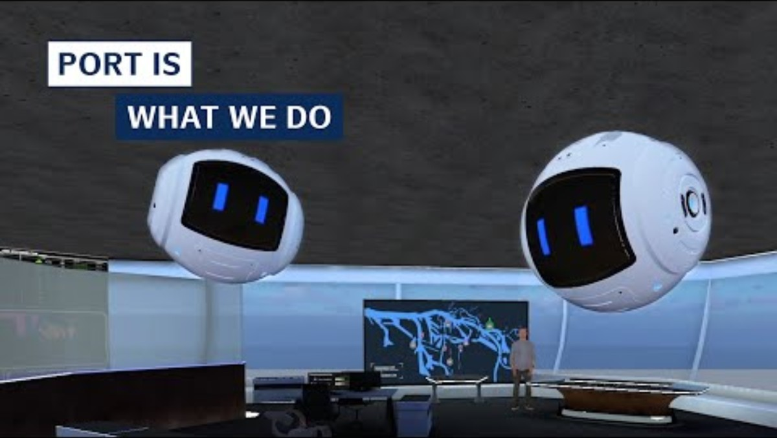
Best practice example: Digitalisation
Smart Ports: Port of Hamburg
Increased efficiency through sensor technology, analytics, forecasting, and information systems
Networking of traffic flows, infrastructure, and goods flows
Application examples:
Vehicle fleet with sensors for shorter routes & better capacity utilization
Handling all documentation in digital form
Real-time processing of navigation and parking space assignment
https://www.youtube.com/watch?v=CiMUtD8pYAg
Notes:
With the implementation of the Smart Port concept at the Port of Hamburg, efficiency can be increased to a whole new level. Sensor technology, analysis, forecasting, and information systems are used in real time to exploit every opportunity for greater efficiency. This enables optimal networking of traffic flows, infrastructure, and goods flows.
Big words, but what does it really mean:
By equipping the vehicle fleet with sensor technology, the location of each vehicle can be determined at any time. Efficient transport routes can be planned and optimized, leading to better fleet utilization.
Maintenance documentation is handled in digital format, making it accessible and updatable at any time.
Real-time navigation across the port area and parking space allocation for trucks accelerates the handling of transfers.
Sustainability is also a key part of the Smart Port concept. There is a strong focus on electromobility, including the necessary infrastructure. Renewable energy is essential, both as a propulsion source in shipping and in the use of shore power. The corresponding infrastructure is being developed and expanded.
Source:
Hamburg Port Authority (2025): https://www.hamburg-port-authority.de/de/hpa-360/smartport; Retrieved: 18.03.2025

Slide 46
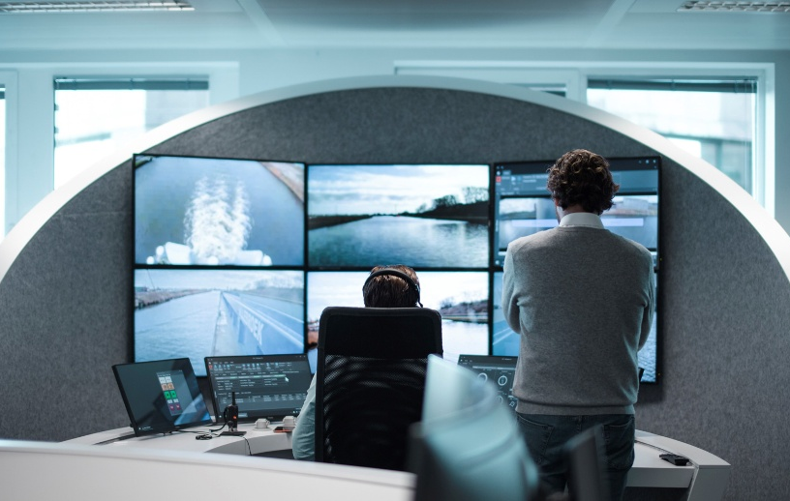
Innovation: Autonomous ships
Belgian company SEAFAR as a pioneer in (semi-)autonomous shipping
3 SEAFAR remote control centers (Antwerp, Charleroi, Duisburg), 1 customer-owned remote control center in Dordrecht
Gradual development and automation in accordance with regulatory authorities
Remote-controlled ships operating with full crews and also with reduced crews
Technology to increase the safety of human-centered operations
Remote-controlled navigation of unmanned and highly automated push boats
40
Picture: Seafar
Notes:
The Belgian company SEAFAR was founded in 2018 in Antwerp and specializes in the development and operational integration of technologies for remote-controlled operations in shipping. The ships are controlled from three modern control centers in Antwerp, Charleroi, and Duisburg. Ship automation is carried out gradually and in accordance with local regulatory authorities. Both remote-controlled ships with full crews and ships with reduced crews are in operation. While the operation is remote-controlled, navigation is handled by the crew on board. Through technologies such as object detection and data collection, the crew on board can be supported, and safety can be increased. On two routes in Belgium, remote-controlled ships without any crew on board are also being tested.
Source:
SEAFAR Company Presentation (2024), https://seafar.eu/de/;
Picture Source:
Seafar (2024)

Slide 47

Kahoot!
Testing your knowledge with our transport quiz!
https://create.kahoot.it/share/transport-quiz-secondary-education/727960a1-679c-4bcd-89b2-bd3a65e78b1d
https://kahoot.com/de/
Notes:
How it works:
Log in to Kahoot! or register for free: https://kahoot.com/en/
Open the following link to the quiz: https://create.kahoot.it/share/transport-quiz-secondary-education/727960a1-679c-4bcd-89b2-bd3a65e78b1d
Start the quiz in class – either in individual mode or as a group game.

Slide 48
Thank you for your attention!

Slide 49
Additional information for teachers
This teaching material package is available under a so-called Creative Commons Attribution 4.0 International License .
You may therefore freely integrate these teaching materials into your lessons, adapt them to your requirements, and pass them on to your pupils/students or other individuals.
We only ask that you leave the logos on the slides.
Image rights are indicated in the notes section; use in other settings is not permitted.
Explanation on the use of generative AI and AI-supported technologies:
During the development of this project, the authors used ChatGPT and Microsoft CoPilot to support concept design and idea generation – particularly with regard to interactive exercises. The use of these AI tools was done with careful consideration. Afterwards, the content was thoroughly reviewed and, if necessary, revised by the authors to ensure compliance with academic standards. The authors take full responsibility for the final content of the publication.

Slide 50
Additional information for teachers
For questions and feedback, please feel free to contact us by email at:
rewway@fh-steyr.at .
You can find more slide sets and practical exercises at:
http://www.rewway.at/en/teaching-materials/
Are you interested in a Transport School Lab, an excursion, or a specialist lecture?
http://www.rewway.at/en/pages/workshops

Slide 51
References I
Allianz pro Schiene & Europäische Kommission (2025): Elektrifizierungsgrad staatlicher Eisenbahnnetze in ausgewählten Ländern in Europa in den Jahren 2020 bis 2023 (Graph). In: Statista https://de.statista.com/statistik/daten/studie/689512/umfrage/elektrifizierungsgrad-staatlicher-eisenbahnnetze-in-europa/; accessed 25.02.2025
Allianz pro Schiene (2025): https://www.allianz-pro-schiene.de/glossar/verkehrsverlagerung/; accessed 11.02.2025
Bundesanstalt für Wasserbau (2017): Kolloquium Wasserbauliche Herausforderungen an den Binnenschifffahrtsstraßen, https://izw.baw.de/publikationen/kolloquien/0/02_Kempmann-Kriedel_Rusche-Pauli-Georges_Herausforderungen....pdf; accessed: 18.03.2025
Bundesministerium Klimaschutz, Umwelt, Energie, Mobilität, Innovation und Technologie (2023): Masterplan Güterverkehr 2023
Christidis, P., & Brons, M. (2016): External costs of freight transport in European Union Member States (Joint Research Centre (JRC)). Harvard Dataverse. https://dataverse.harvard.edu/dataset.xhtml?persistentId=doi:10.7910/DVN/YA3VCY https://doi.org/10.7910/DVN/YA3VCY; accessed 28.01.2025
Clausen, Uwe / Geiger, Christiane Hrsg. (2013): Verkehrs- und Transportlogistik
DESTATIS (2024): https://www.destatis.de/Europa/DE/Thema/GreenDeal/_inhalt.html; accessed 18.03.2025
Europäische Kommission (2011): Weißbuch - Fahrplan zu einem einheitlichen europäischen Verkehrsraum – Hin zu einem wettbewerbsorientierten und ressourcenschonenden Verkehrssystem
Europäische Kommission (2024): https://climate.ec.europa.eu/climate-change/causes-climate-change_de; accessed 15.05.2024
Europäische Kommission, Generaldirektion Kommunikation (2019): Was ist der europäische Grüne Deal?, In: https://data.europa.eu/doi/10.2775/944554; accessed 13.03.2025
Europäischer Rat der Europäischen Union (2024): https://www.consilium.europa.eu/de/policies/green-deal/; accessed 13.03.2025
Europäisches Parlament (2022): https://www.europarl.europa.eu/news/de/press-room/20220119IPR21314/zukunft-europas-klimawandel-grosste-herausforderung-fur-die-eu-so-die-burger; accessed 14.05.2024

Slide 52
References II
Europäisches Parlament (2024): https://www.europarl.europa.eu/resources/library/images/20211027PHT16017/20211027PHT16017_original.jpg; accessed 18.03.2025
European Commission (2023): Sustainable & Smart Mobility Strategy, In: https://transport.ec.europa.eu/transport-themes/mobility-strategy_en; accessed 05.02.2025
Hamburg Port Authority (2023): https://www.hamburg-port-authority.de/de/hpa-360/smartport; accessed 18.03.2025
Heinzelmann, Christoph / Bödefeld, Jörg / Duric, Zorana (2020): Digitalisierung im Verkehrswasserbau. Bautechnik, 97; In: https://doi.org/10.1002/bate.202000029; S. 441-444
IPCC (2023): https://www.de-ipcc.de/media/content/IPCC_AR6_SYR_DE_barrierefei.pdf, accessed 16.05.2024
ITF (2023): ITF Transport Outlook 2023, OECD Publishing, Paris; on https://doi.org/10.1787/b6cc9ad5-en; accessed 06.03.2025
Kille, Christian/ Schmidt , Norbert, „Wirtschaftliche Rahmenbedingungen des Güterverkehrs. Studie zum Vergleich der Verkehrsträger im Rahmen des Logistikprozesses in Deutschland“ (2008), S. 53. In: http://www.scs.fraunhofer.de/content/dam/scs/de/dokumente/studien/Wirtschaftliche_Rahmenbedingungen_des_Gueterverkehrs.pdf; accessed 04.02.2025
Koch, Susanne (2012): Logistik – Eine Einführung in Ökonomie und Nachhaltigkeit
Myclimate (2024): https://www.myclimate.org/de/informieren/faq/faq-detail/was-sind-treibhausgase/; accessed 18.03.2025
ÖBB (2025): https://infrastruktur.oebb.at/de/unternehmen/kundinnen-im-mittelpunkt/schwerpunkt-puenktlichkeit; accessed 06.03.2025

Slide 53
References III
Pazirandeh, Ali / Jafari, Hamid (2013): Making sense of green logistics; In: International Journal of Productivity and Performance Management
Saroha, Rituraj (2014): Green logistics & its significance in modern day systems; In: International Review of Applied Engineering Research
Schienen-Control (2025): https://www.schienencontrol.gv.at/de/wettbewerbsregulierung/eisenbahnnetz-oesterreich.html, accessed 28.01.2025
SEAFAR Unternehmenspräsentation (2024)
Smart Freight Centre (2024): GLEC Framework v3.1 edition, revised and updated. In: https://https://www.smartfreightcentre.org/en/our-programs/emissions-accounting/global-logistics-emissions-council/calculate-report-glec-framework/; accessed 06.03.2025
Umweltbundesamt (2024): Klimaschutzbericht 2024. In: https://www.umweltbundesamt.at/fileadmin/site/publikationen/rep0913.pdf
UNRIC (2025): https://unric.org/de/17ziele/; accessed 18.03.2025
Verband deutscher Reeder (2016): https://www.reederverband.de/sites/default/files/publikationen/deutsche_seeschifffahrt/deutsche_seeschifffahrt_2016_-_umweltspecial.pdf; accessed 18.03.2025
Viadonau (2019): Handbuch der Donauschifffahrt
Viadonau (2019): Manual of Danube Navigation
Viadonau (2024): Jahresbericht der viadonau 2023

