Slide 1
Freight transport in transition – Sustainable, digital, and efficient
Teaching Materials

Slide 2
What proportion of global freight transport is
handled by shipping?
And how high is the share in Austria?
Worldwide, more than 90 percent of globally traded goods are transported via waterways. In Austria, the share is significantly lower, at just under one percent.
Notes:
Sources:
Statista (2026), Schifffahrt, https://de.statista.com/statistik/kategorien/kategorie/16/themen/131/branche/schifffahrt/#overview (accessed 10.02.2026)
Statista (2026), Verteilung des Transportaufkommens im Güterverkehr in Österreich nach Verkehrsträgern in den Jahren 2015 bis 2023, https://de.statista.com/statistik/daten/studie/791008/umfrage/verteilung-des-transportaufkommens-gueteraufkommen-nach-verkehrstraegern-in-oesterreich/ (accessed 10.02.2026)

Slide 3
How to best Work with these teaching materials
PowerPoint: The following PowerPoint provides an introduction to the topic “Freight Transport in Transition – Sustainable, Digital, and Efficient.” Each slide includes speaker notes with scripts, explanations, and source references. Activity slides are highlighted in yellow and include practical examples, exercises, videos, and other interactive elements specifically designed for classroom use.
Videos and supplementary exercises: Videos and exercises on the topic can be found in the presentation on the color-coded activity slides as well as at: https://www.rewway.at/en/teaching-materials
All teaching materials offer a compact overview to support lesson planning: learning objectives, target groups, level of difficulty, methods, and links to the curriculum.
Kahoot!: For a playful review of learning progress, a prepared and freely accessible Kahoot! quiz can be used in class. The QR code or direct link to the quiz can be found at the end of the PowerPoint.
Bibliography: The sources used for the presentation are listed in the speaker notes of each slide as well as at the end of the PowerPoint.

Slide 4
Learning objectives and target groups
Learning objectives:
Learners can define the term “logistics” and name the different types of freight transport.
Learners can explain the advantages and disadvantages of the transport modes truck, rail, and inland waterway vessel.
Learners know the criteria that play a role in choosing transport modes.
Learners can describe the environmental impacts of transport and reflect on how their own transportation and consumption behavior affects the environment.
Learners can explain what sustainability means and what dimensions (ecological, economic, social) it includes.
Learners can present the causes and consequences of climate change and global warming.
Learners can explain what multimodal transport means and how combining different modes of transport leads to more efficient and sustainable logistics.
Learners can explain the significance of the Danube as a waterway for freight transport.
Target groups:
Upper secondary school students (AHS) and BHS
Vocational school students
University students taking an introduction to the topics of transport logistics, inland navigation, and multimodal transport
Career changers and professionals from other industries

Slide 5
Have you ever asked yourself…?
… how global freight transport contributes to climate change and what steps are necessary to make this sector more sustainable?
… why the majority of freight transport still takes place on the road instead of by rail or inland waterways?
…what potential inland waterway transport offers for more sustainable logistics, and why it has been used so little up to now?
Notes:
The questions are suitable as a warm-up: brainstorming & class discussion (approx. 10 minutes)
Goal: Activation of prior knowledge, promotion of critical thinking, and introduction to the topic through real-life relevance.
Learning Objectives:
Students reflect on their own everyday experiences related to consumption and transport routes.
Students critically examine the significance of different modes of transport.
Students engage in argumentative exchange about possible challenges and opportunities of sustainable logistics.
Students develop an initial awareness of the environmental relevance of freight transport.

Slide 6
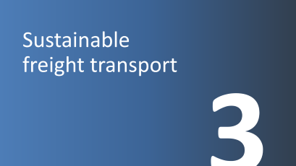
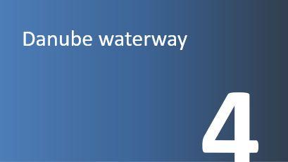
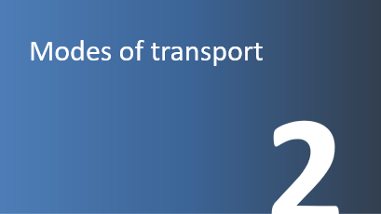
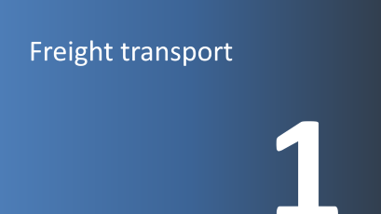
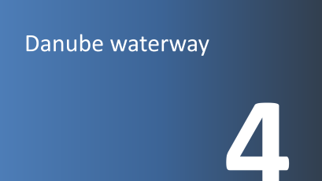
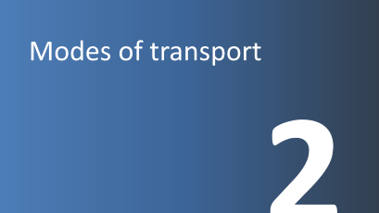
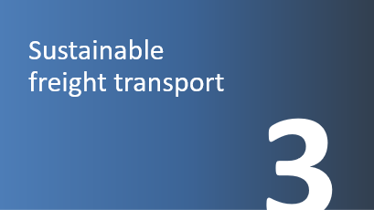
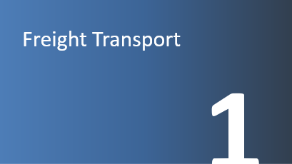

Slide 7
Freight transport
1

Slide 8
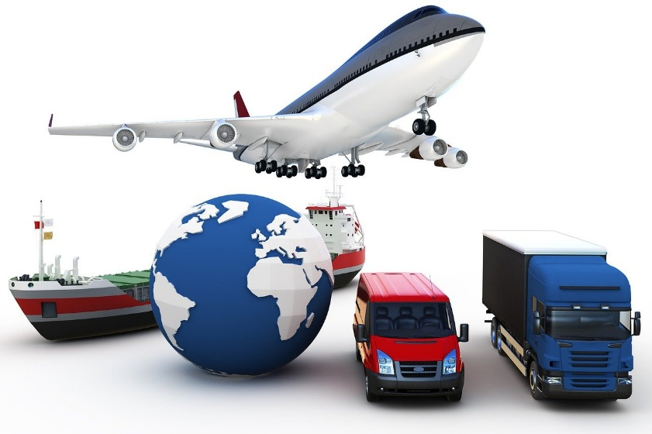
Logistics – what is it?
Planning, coordination, execution, and monitoring of goods flows as well as the associated goods-related information
Linguistic roots:
Greek: "Lego" (to think, conceivable)
French: "logement" (accommodation)
Origin in the military:
the third art of war alongside tactics and strategy
After World War II: transferred to the economy
Image: Pixabay
Notes:
Logistics refers to the planning, coordination, execution, and monitoring of the flow of goods, as well as the associated goods-related information, from production to the consumer.
See: Wirtschaftslexikon Gabler (2025): https://wirtschaftslexikon.gabler.de/definition/logistik-40330. Accessed at 07.01.2025
The term logistics has two linguistic roots: the Greek “lego” (to think, conceivable) and the French “logement” (accommodation). The origin of logistics lies in the military sector and encompasses all activities (e.g., the transport of troops and supplies) that support the army—falling under the scope of logistics. Over the years, logistics gained increasing importance in the military and, after World War II, was also adopted by the economy in the United States.
In Europe, logistics only became significant in the economy during the 1970s. At that time, its development was largely driven by engineers who mainly focused on the advancement of material flow technologies (transport and storage techniques). Only later, at the end of the 1970s, were new economic and process-organizational aspects addressed, leading to the emergence of concepts such as zero-inventory production, batch size one, just-in-time, and Kanban (make-to-order production). After automotive companies led the way by integrating initial logistics concepts into industry, other sectors followed this example and increasingly engaged with the discipline of logistics.
See: Kummer, Sebastian / Grün, Oskar / Jammernegg, Werner (4th edition 2019): Grundzüge der Beschaffung, Produktion und Logistik, pp. 334f
Image source:
Pixabay (2025): https://pixabay.com/illustrations/transportation-logistics-business-4506971/; Accessed at 07.01.2025

Slide 9
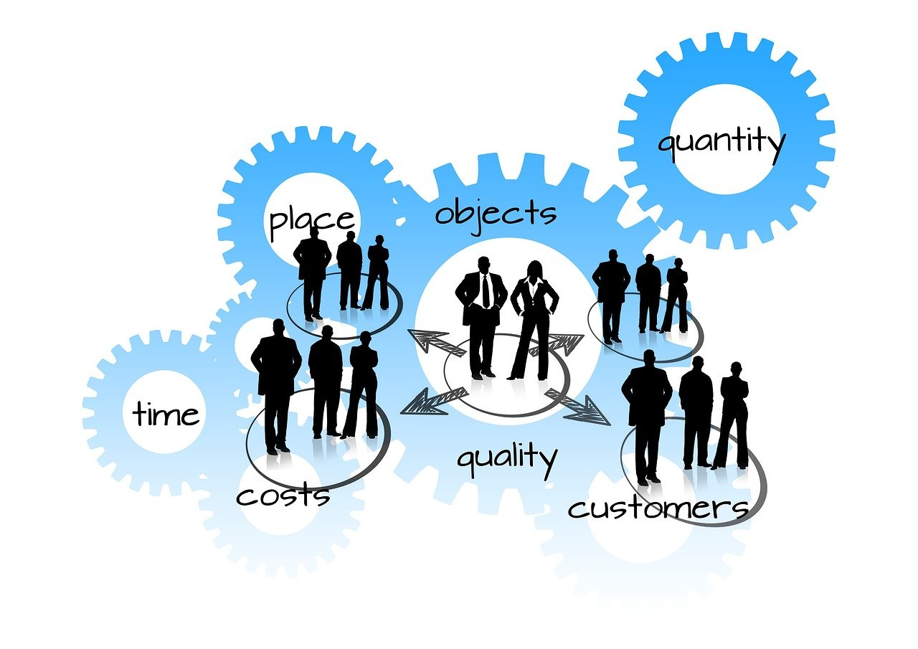
Tasks of logistics
The right products...
in the right quantity
in the right quality
without damage
at the right time
at the right place
at the right price...
…made available to customers
40
Image: Pixabay
Notes:
In today's world, logistics is one of the most important aspects of the economy. Various definitions can be found in the literature, as logistics takes on different meanings in each industry and company. However, its main task can be seen as ensuring that the products desired by customers are available in the right quantity and quality, at the right time, in the right place, and at the right price.
This definition is commonly found in the literature. For example, logistics ensures that the food products consumers want are available in supermarkets at the right time, in the right quality, and at a reasonable price.
See: Ten Hompel, Michael / Schmidt, Thorsten (2003): Warehouse Management: Automatisierung und Organisation von Lager- und Kommissioniersystemen, p. 10
Image source:
Pixabay (2025): https://pixabay.com/illustrations/logistics-people-group-gears-877568/. Accessed at 07.01.2025

Slide 10
Transport
Transport = movement of materials, goods, or products from a starting point to a destination
Internal transport (conveyor systems)
External transport (transportation vehicles)
Tasks:
Transport preparation (packaging, shipping documents)
Loading of the transport vehicle
Transport execution
Unloading
Post-transport processing
Notes:
Transport refers to the movement of materials, goods, or products from a starting point to a destination. In addition to this primary function, the following secondary functions can be identified: transport preparation (packaging and creation of shipping documents), loading of the selected means of transport, execution of the transport, unloading, and post-transport processing, including handling of transport documents.A distinction can also be made between internal transport— which is not discussed further here— and external transport, which will be examined in more detail in the following chapter.
See: Kummer, Sebastian / Grün, Oskar / Jammernegg, Werner (4. Auflage 2019): Grundzüge der Beschaffung, Produktion und Logistik, p. 384

Slide 11
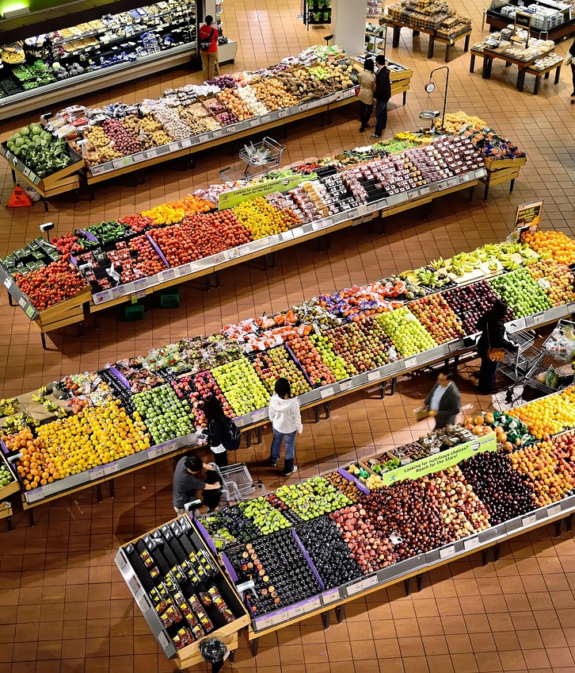
Freight transport
Freight transport is a fundamental prerequisite for trade and industry and ensures our prosperity.
Increasing freight traffic due to growing globalisation and division of labor
Freight transport contributes to our quality of life
Must not be the cause of increasing burdens on people and the environment
40
Picture: Pixabay
Notes:
Transport is the movement of goods from one location to another using means of transport. A distinction is made between internal and external transport. External transport takes place outside of buildings and typically uses public transport infrastructure. Devices used to move goods are called means of transport. These can range from carrying aids and containers to vehicles.
Transport is a fundamental requirement for industry and commerce; it thus ensures our prosperity and contributes to our quality of life. However, it must not be the cause of increasing burdens on people and the environment. In the design of a transport system, freight transport and logistics play an especially important role.
Source: Clausen, Uwe / Geiger, Christiane (eds.) (2013): Verkehrs- und Transportlogistik, pp. 3ff.
Image source:
Pixabay (2025): https://pixabay.com/photos/supermarket-stalls-coolers-market-949913/. Accessed at 04.02.2025

Slide 12

What is globalisation?
Networking of the economy, communication, environment, politics, culture, and language
3 phases of development:
Colonialization: Considered the beginning; emergence of new trade routes and sea routes
Industrialization: Acceleration phase; growth of global trade
Hyperglobalisation: Current state; communication innovations and trade agreements
Picture: Pixabay
Notes:
globalisation can be understood as the interconnection of various areas. Here are a few examples: The interconnection of the economy is represented by international trade; The interconnection of communication happens through the telephone and the internet; with social media, people around the world can be contacted at any time; Politics operates in an interconnected way through various organizations like the EU and the UN; The five dimensions of globalisation are described as: economy, environment, politics, language, and culture.
globalisation is divided into three phases of development:
Colonialization: This phase began in the 15th century. Through European conquests, new trade routes were established and new sea routes developed.
Industrialization: Industrialization and related inventions like steam engines and railways—later followed by cars and airplanes—significantly accelerated globalisation. Transport became cheaper and faster, and trade relations between countries were established.
Hyperglobalisation: This phase began at the end of the last century. Key drivers were the advent of the internet and inventions like computers and smartphones, which enabled fast and global communication. Countries signed trade agreements and began reducing trade barriers such as tariffs.
Tip: Globalisation Dashboard from Eurostat: https://ec.europa.eu/eurostat/cache/dashboard/globalisation/
Sources:
Studyflix (2025): https://studyflix.de/wirtschaft/globalisierung-7814. Accessed at 05.05.2025
Studyflix (2025): https://studyflix.de/wirtschaft/globalisierung-vor-und-nachteile-1909. Accessed at 05.05.2025
Image source:
Pixabay (2025): https://pixabay.com/photos/worldwide-global-globe-earth-world-6064090/. Accessed at 05.05.2025

Slide 13

Globalisation Video
Questions about the video:
What is globalisation according to the IMF, and how has it evolved over time?
What are the key drivers that made globalisation possible?
Can globalisation be categorized into different dimensions? What are they?
What are some positive outcomes of globalisation?
What concerns and criticisms are associated with globalisation?
https://www.youtube.com/watch?v=15d818t9UZ0
Notes:
Source:
Studyflix (2025): https://studyflix.de/wirtschaft/globalisierung-vor-und-nachteile-1909. Accessed at 05.05.2025
Questions including answers:
1. What is globalisation according to the IMF, and how has it evolved over time?
Answer:
globalisation is described as the increasing integration of the world economy through flows of goods, services, investment, technology, data, ideas, and labor. It gained momentum around 1870 and accelerated significantly post–World War II with reduced barriers to trade and capital, the formation of institutions like the WTO, and technological advancements like container shipping and jet travel.
2. What are the key drivers that made globalisation possible?
Answer:
Technological innovations (e.g. containerization, jet engines, telecommunication) that cut trade and transaction costs.
Post-WWII institutional frameworks, such as GATT, WTO, and IMF, that promoted open markets and trade liberalization.
3. Can globalisation be categorized into different dimensions? What are they?
Answer:
Yes. Four main dimensions include:
Economic: Integration of markets, capital flows, trade, and technology.
Cultural: Spread of media, ideas, values, practices across borders.
Political: Global governance, intergovernmental organizations, and decline in absolute sovereignty.
Ecological: Transnational environmental concerns like climate change and biodiversity loss.
4. What are some positive outcomes of globalisation?
Answer:
Expanded access to global markets, capital, and innovation.
Economic growth, improved standards of living, and reduced poverty in countries embracing globalisation.
Cultural exchange enhancing global connection and understanding.
5. What concerns and criticisms are associated with globalisation?
Answer:
Economic inequality: While global inequality has decreased in many cases, within-country disparities have increased.
Cultural homogenization (“McDonaldization” or Western dominance) risking erasure of local cultures.
Environmental degradation and exploitation of resources, often burdening poorer nations disproportionately.
Financial instability: Unregulated capital flows can provoke economic crises and speculative bubbles.
Sovereignty concerns: Global institutions are seen by some as undermining the decision-making of individual nations.

Slide 14
The largest goods exporters
Graphic: own representation based on WTO
Notes:
The chart shows the 10 largest goods exporters in the world. In 2024, China remains the world's largest exporting country. In 2024, China’s goods exports amounted to approximately 3.58 trillion US dollars. This puts China well ahead of the USA (2.07 trillion US dollars) and Germany (1.68 trillion US dollars).
Source:
WTO (2025): Die 20 größten Exportländer weltweit im Jahr 2024. In: Statista: https://de-statista-com.fhooe.idm.oclc.org/statistik/daten/studie/37013/umfrage/ranking-der-top-20-exportlaender-weltweit/; Accessed at 05/05/2025

Slide 15
Modes of transport
2

Slide 16
Comparison of transport modes
Mode of transport (infrastructure)
Means of transport (vehicles)
Means of transport:
Vehicle used for transporting people and goods
Land
Road
Pipeline
Rail
Pipeline
Train
Truck
Mode of transport:
Infrastructure used for the operation of transport vehicles
Water
Inland Waterways
Sea/Ocean
Inland Ship
Ocean-going Ship
Air
Air Transport
Airplane
Freight transport
Transport chain:
Pre-carriage, main carriage, on-carriage
Multimodal transport:
Transport of goods using at least two different means of transport
Graphic: adapted from viadonau and Eurostat
Notes:
There are different types of modes of transport and means of transport. A mode of transport provides the infrastructure required for the use of a specific means of transport. Roads, railways, and waterways are examples of modes of transport.
Means of transport refer to vehicles and equipment used to transport people and goods, such as inland vessels, trucks, or trains.
Multimodal transport means transporting goods using two or more different modes of transport.
The pre-carriage represents the first leg of a transport chain, i.e., the transport of goods to a transshipment hub (e.g., a port). In many cases, the pre-carriage is carried out by truck.
The on-carriage refers to the transport of goods from the transshipment hub to the recipient's location; this is also usually carried out by truck.
The main leg connects the pre-carriage and the on-carriage. In multimodal transport, this typically refers to the longest distance traveled by rail or inland waterway.
Sources:
Viadonau (2019): Handbuch der Donauschifffahrt, pp. 185–187
Eurostat (2025): Transport Mode Glossary – Eurostat. Accessed at 27.02.2025

Slide 17
Mode of transport quiz
Assign each statement to a mode of transport (Road, Waterway, Rail):
This mode of transport enables fast delivery right to your doorstep.
This mode of transport can carry large amounts of goods at once but is slower than other options.
There are often traffic jams on this mode of transport, especially in large cities.
This mode of transport is particularly suitable for transporting goods over long distances within a country.
This mode of transport uses natural infrastructure and is especially environmentally friendly.
This mode of transport causes the most harmful air pollutants.
These two modes of transport are particularly safe, with very few accidents occurring.
Notes:
The quiz questions are suitable as an introduction or to lighten the mood and are either discussed as a class or worked on in pairs.
Duration: approx. 10 minutes
Answers:
This mode of transport enables fast delivery right to your doorstep. (Road/Truck)
This mode of transport can carry large quantities of goods at once but is slower than other options. (Waterway/Inland Ship)
There are often traffic jams on this mode of transport, especially in large cities. (Road)
This mode of transport is particularly suitable for transporting goods over long distances within a country. (Rail/Train)
This mode of transport uses natural infrastructure and is especially environmentally friendly. (Waterway/Inland Ship)
This mode of transport causes the most harmful air pollutants. (Road/Truck)
These two modes of transport are particularly safe, as hardly any accidents occur. (Rail/Train and Waterway/Inland Ship)
Learning objectives:
Students recognize the fundamental differences between road, rail, and waterways.
Students reflect on initial connections between transport, the environment, and everyday life.
Students exchange experiences about freight transport and supply chains.

Slide 18
Mode of transport: Road
Transport speed
Network density & area coverage
Flexibility
Technological progress
Low usage costs
Door-to-door transport without transshipment
Vehicle tracking and communication with personnel
High external costs (environment, CO₂ emissions, noise, accidents, etc.)
Unfavorable ratio between payload and vehicle weight
Limited loading capacity
Time restrictions: driving bans
Relatively high accident risk
Dependency on road conditions and traffic situations
Notes:
The high transport speed compared to the modes of transport rail and inland waterway can be seen as an advantage of road transport. The widespread infrastructure coverage—and therefore the ability to form a network (door-to-door)—is also one of the strengths of road transport. Due to the wide range of available vehicles, this mode offers great flexibility. In addition, many IT solutions (e.g., tracing and tracking) are already widely used. Furthermore, the use of infrastructure is associated with relatively low costs (costs for road damage are only partially covered).
However, since costs related to traffic congestion or noise pollution (so-called external costs) are gaining increasing attention, road transport is facing growing cost pressure. Time restrictions in the form of driving bans also affect this mode of transport. In terms of environmental aspects such as noise pollution and accidents, road transport performs poorly compared to other modes.
Source:
Kille, Christian/ Schmidt , Norbert (2008): Wirtschaftliche Rahmenbedingungen des Güterverkehrs. Studie zum Vergleich der Verkehrsträger im Rahmen des Logistikprozesses in Deutschland, p. 53; Online: http://www.scs.fraunhofer.de/content/dam/scs/de/dokumente/studien/Wirtschaftliche_Rahmenbedingungen_des_Gueterverkehrs.pdf. Accessed at 04.02.2025

Slide 19
Mode of transport: Rail
High capacity for bulk transport
Predictability
Low accident risk
Largely weather-independent
Low transport costs over long distances
Low environmental impact
Limited cross-border operations
Limited flexibility
Low network density
Difficult shipment tracking
Low punctuality rate (ÖBB rail freight approx. 70%)
Notes:
Especially with block or direct trains, rail can score points with fast transport speeds. In addition, this mode of transport has high bulk transport capacity, and shipments are predictable. Due to established standards, the safety level is very high. Unlike road transport, transport prices are not influenced by toll charges and can therefore be relatively inexpensive depending on the quantity transported. The lower CO₂ consumption compared to road transport is also an advantage.
However, due to infrastructural differences, cross-border transport by rail remains challenging. Dependence on timetables limits the flexibility of rail transport. Shipment tracking is also much more difficult compared to road transport. Furthermore, unlike air transport, rail does not benefit from any tax advantages.
Sources:
Kille, Christian/ Schmidt , Norbert (2008): Wirtschaftliche Rahmenbedingungen des Güterverkehrs. Studie zum Vergleich der Verkehrsträger im Rahmen des Logistikprozesses in Deutschland, p. 54; Online: http://www.scs.fraunhofer.de/content/dam/scs/de/dokumente/studien/Wirtschaftliche_Rahmenbedingungen_des_Gueterverkehrs.pdf; Retrieved 04.02.2025
ÖBB (2025): https://infrastruktur.oebb.at/de/unternehmen/kundinnen-im-mittelpunkt/schwerpunkt-puenktlichkeit; Retrieved 06.03.2025

Slide 20
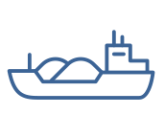
Mode of transport: Inland Waterway
High capacity for bulk transport
Very low transport costs
Low environmental impact
Safety
Frequent transport availability (operational 24/7)
Low infrastructure costs
Freely available infrastructure capacity (e.g., Danube)
Low transport speed
Low network density
Dependence on navigable waterway conditions
Berthing/discharge fees at ports
Almost always requires additional land transport for pre- and onward carriage
Notes:
The strengths of Danube shipping lie primarily in its ability to transport large quantities per vessel unit, its low transport costs, and its environmental friendliness. In addition, it is available for use around the clock (e.g., no weekend or night driving bans) and offers a high level of safety.
In 2023, there were a total of 17 inland shipping accidents on the Austrian section of the Danube, none of which resulted in personal injury. (Viadonau 2024: p. 41)
Due to the largely natural infrastructure of the waterway, there are lower route and maintenance costs.
The weaknesses lie in the dependence on fluctuating navigational conditions, which lead to varying levels of vessel utilization, the low transport speed, and the low network density, which often makes pre- and onward carriage by road or rail necessary.
Sources:
Kille, Christian/ Schmidt , Norbert (2008): Wirtschaftliche Rahmenbedingungen des Güterverkehrs. Studie zum Vergleich der Verkehrsträger im Rahmen des Logistikprozesses in Deutschland, p. 56; Online: http://www.scs.fraunhofer.de/content/dam/scs/de/dokumente/studien/Wirtschaftliche_Rahmenbedingungen_des_Gueterverkehrs.pdf; Retrieved 04.02.2025
Viadonau (2019): Handbuch der Donauschifffahrt, p. 17
Viadonau (2024): Jahresbericht der viadonau 2023

Slide 21
Freight transport in Austria and Europe (Modal Split)
Own illustration based on Statistik Austria and Eurostat.
Notes:
Modal split describes the share of transport performance by mode of transport.
Sources:
Statistik Austria (2024): Verkehrsstatistik 2023, In: https://www.statistik.at/fileadmin/publications/Verkehr2023barr.pdf, Retrieved 05.02.2025
Eurostat (2024): Modal split of inland freight transport: https://ec.europa.eu/eurostat/databrowser/view/tran_hv_frmod/default/table?lang=en&category=tran.tran_hv_ms; Retrieved 06.02.2025

Slide 22
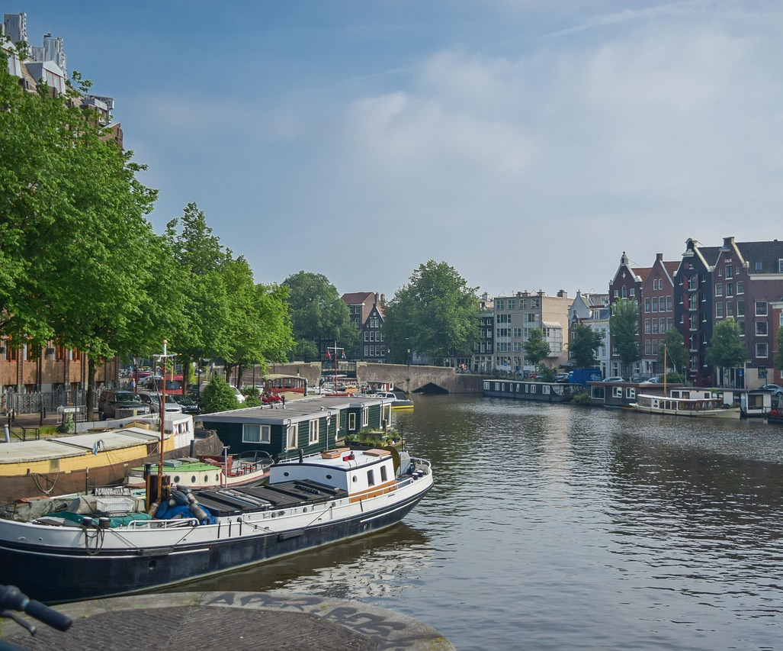
Best practice inland waterway: Netherlands
Own illustration based on Eurostat
  Picture: Pixabay
Notes:
The share of freight tonne-kilometers transported via inland waterways varies greatly among EU countries.
For example:
Netherlands: major seaports and a dense inland waterway network → highest inland shipping share at 41% (2022)
Malta & Cyprus: have no inland waterways, so the share is 0%
Source:
Eurostat (2024): Modal split of inland freight transport: https://ec.europa.eu/eurostat/databrowser/view/tran_hv_frmod/default/table?lang=en&category=tran.tran_hv_ms; Retrieved 06.02.2025
Picture source:
Pixabay (2025): https://pixabay.com/de/photos/amsterdam-kanal-stadt-boot-6619660/; Retrieved 26.02.2025

Slide 23
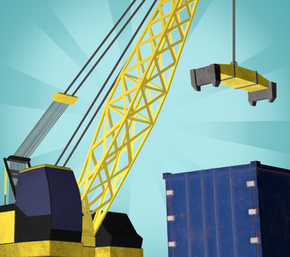
Transport planning with the Logistify App
Game 1 – Means of Transport
Your transport planning talent is needed – we need your help!
We want to transport various goods from A to B in the best possible way. In doing so, we place particular emphasis on choosing the right means of transport (truck, train, or inland ship).
The transport should be planned to be as ecological and economically efficient as possible.
Download the app at:
Logistify: Understanding the World of Logistics
Explanation video: https://www.youtube.com/watch?v=kZhL5SPtn6A
Image: FH OÖ
Notes:
Download App unter: https://logistify.app/
Erklärvideo: https://www.youtube.com/watch?v=kZhL5SPtn6A
More information at: https://rewway.at/en/teaching-materials/transport-planning-with-the-logistify-app
The learning app "Logistify" focuses on various means of transport, their sustainable and efficient use of resources, and logistics-related careers. In the games, students are challenged to use their transport planning skills. The task is to transport various goods efficiently from A to B, to plan multimodal transport chains from raw materials to end customers, and to explore careers in the logistics sector.
Duration: Game 1 takes approximately 15 minutes.
Learning objectives:
Students recognize the importance of different modes of transport in freight logistics.
Students reflect on how resources can be used sustainably and efficiently in transportation.
Students analyze logistical challenges and make well-reasoned decisions in transport planning.
Students playfully engage with digital learning formats to understand logistics concepts.

Slide 24
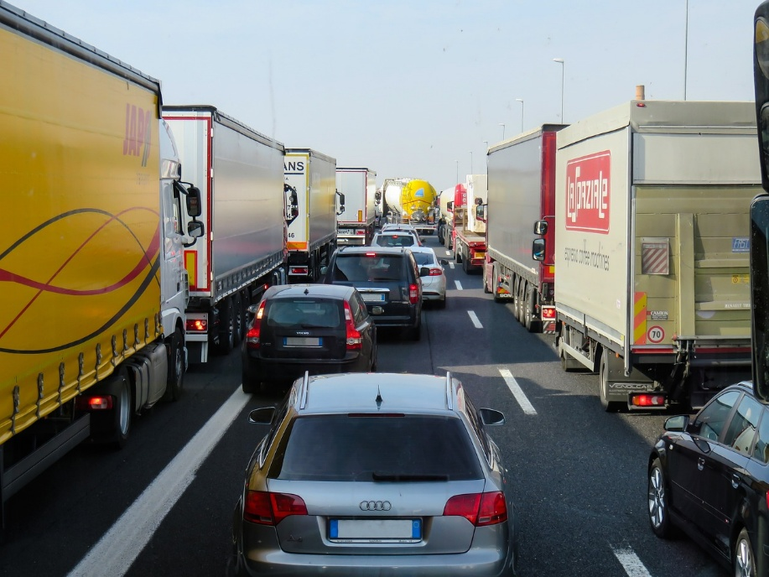
External costs of transport
Costs that are not paid by the polluters – the costs are borne by society, i.e., by all of us!
Pollutant emissions
Noise
Accident costs
Land consumption
Impact on flora and fauna
Congestion costs
40
Picture: Pixabay
Notes:
Costs that arise from mobility but are not borne by those who use transport are referred to as external costs of transport. These costs are passed on to third parties, such as taxpayers and future generations. The negative external effects of transport include, in particular: pollutant emissions, CO₂ emissions, noise emissions, accident-related costs, land use, and impacts on flora and fauna.
External costs have significant effects on society and health (e.g., quality of life, noise pollution, stress, illnesses) as well as on the environment (climate change, biodiversity).
Source:
Koch, Susanne (2012): Logistik – Eine Einführung in Ökonomie und Nachhaltigkeit, pp. 294f
Picture source:
Pixabay (2025): https://pixabay.com/de/photos/verkehr-transport-stau-autobahn-2251530; Retrieved 27.02.2025

Slide 25
External costs of transport – comparison
Traffic Congestion
Climate Costs
Emissions
Noise
Accidents
Road
Rail (Diesel)
Rail (Electrified)
Inland Waterway
Graphic: Own illustration based on Christidis/Brons
Notes:
Inland waterway vessels and electrified rail cause by far the lowest external costs compared to trucks.
In 2023, approximately 75 percent of all railway infrastructure in Austria was electrified. (cf. Schienen-Control)
In the EU-27, the electrification rate of railway networks in 2023 was 57.4%. (cf. Eurostat 2025)
Sources:
Own illustration based on:
Christidis, P., & Brons, M. (2016): External costs of freight transport in European Union Member States (Joint Research Centre (JRC)). Harvard Dataverse.
https://dataverse.harvard.edu/dataset.xhtml?persistentId=doi:10.7910/DVN/YA3VCY
https://doi.org/10.7910/DVN/YA3VCY; Retrieved 28.01.2025
Eurostat (2025): https://ec.europa.eu/eurostat/statistics-explained/index.php?title=Characteristics_of_the_railway_network_in_Europe; Retrieved 06.03.2025
Schienen-Control (2025): https://www.schienencontrol.gv.at/de/wettbewerbsregulierung/eisenbahnnetz-oesterreich.html; Retrieved 28.01.2025

Slide 26
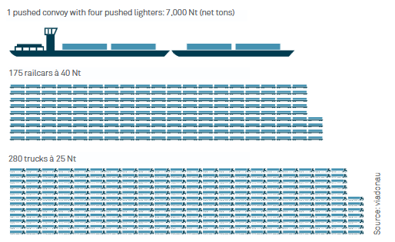
Transport capacity – Comparison of modes of transport
Largest transport capacity of the inland vessel:
Pushed convoy with 4 barges
= 175 rail wagons
= 280 trucks
Graphic: viadonau
Notes:
The inland vessel offers numerous advantages over other modes of transport:
Compared to other land transport modes, inland shipping provides significantly higher transport capacity per transport unit and can (or could) make an important contribution to relieving road and rail traffic.
To illustrate the mass transport capability of inland shipping:
An inland vessel with 4 barges (7,000 net tons) can transport as much as 175 rail wagons or 280 trucks.
This corresponds to a convoy of trucks stretching about 20 km on the highway.
What is a barge?
A floating cargo container without its own propulsion. It is connected to the front of an inland vessel and pushed.
Source: Viadonau (2019): Handbuch der Donauschifffahrt, pp. 18, 19, 112
Picture source: Viadonau (2019): Manual on Danube Navigation, p19

Slide 27
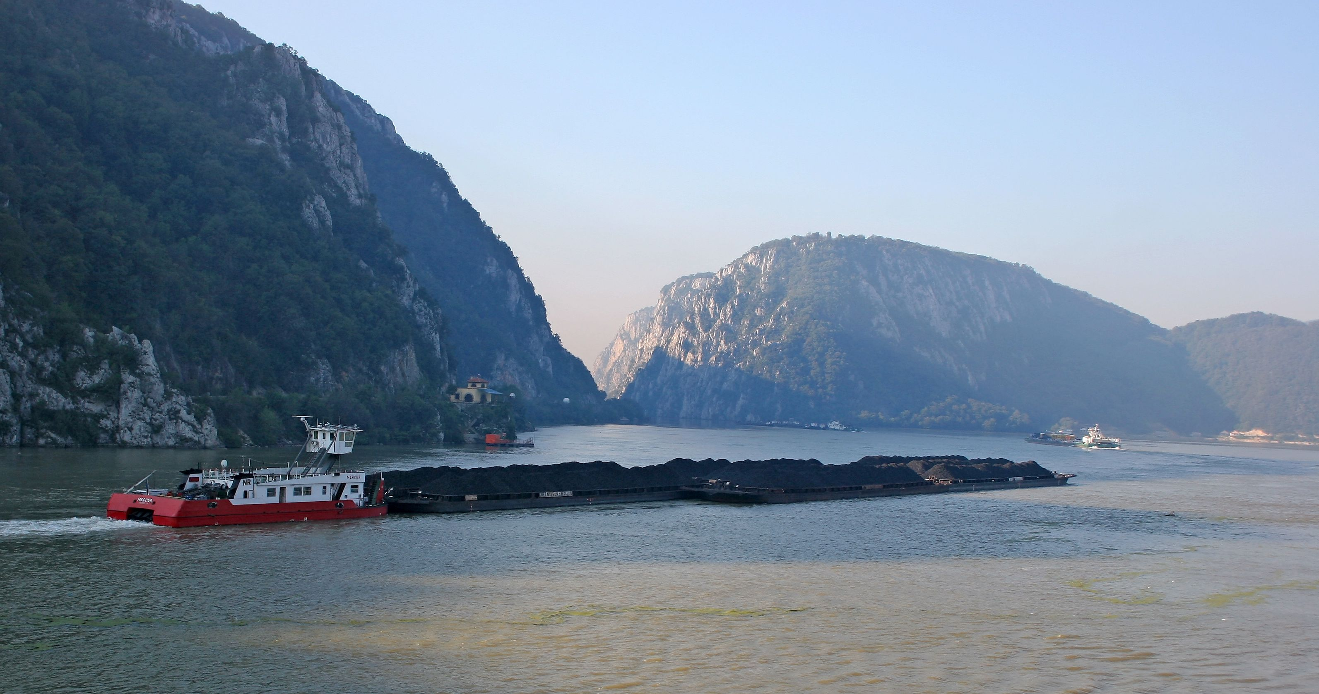
This is what an inland vessel looks like:
Picture: Leitner@TTS, Austria
Notes:
Here you can see a push convoy on the Danube in Serbia/Romania:
It consists of a pusher vessel (a motor ship designed for pushing) and eight coupled barges carrying bulk cargo.
On the Danube in Austria, a vessel can push up to four barges. On the lower Danube in Romania, where the river is very wide, up to twelve barges are possible.
Picture: Leitner@TTS, Austria

Slide 28
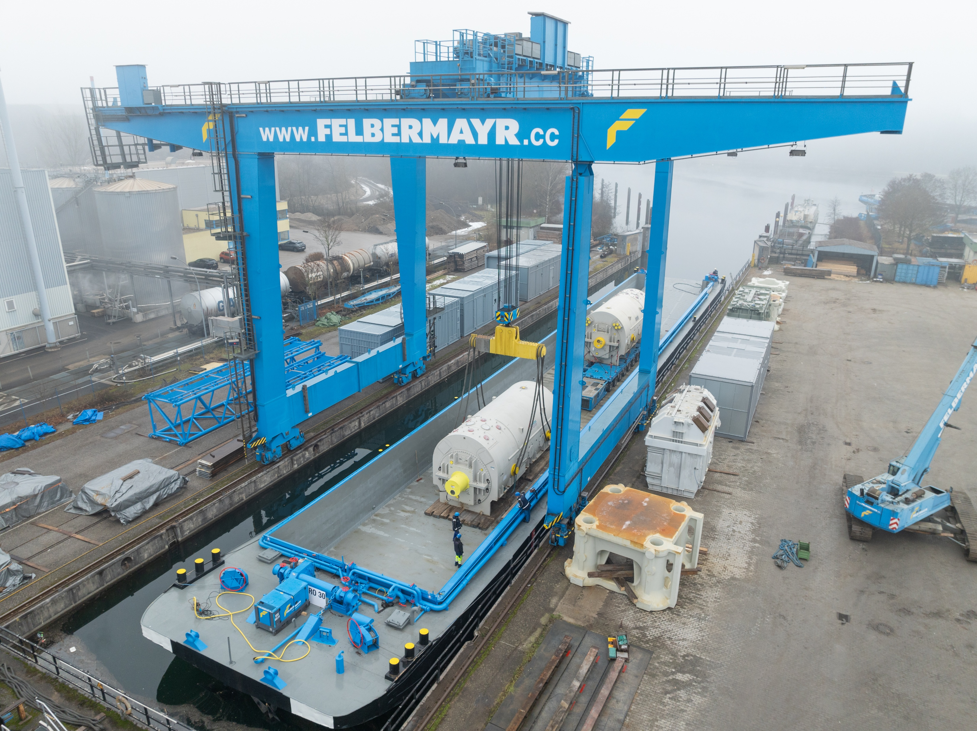
High & Heavy transport on inland waterways
enormous loading capacity
operational 24/7
no infrastructure costs
no permits, escorts, or road closures required
environmentally friendly
40
Picture: Felbermayr
Notes:
When it comes to transporting especially large and heavy goods—so-called High & Heavy transports—inland shipping offers a number of advantages that other modes of transport can hardly match.
Enormous loading capacity: Ideal for machines, components, or industrial plants that are too large for trucks or trains.
Operational 24/7: Unlike road transport, which is often restricted by driving bans or rest periods, a ship can operate around the clock—without breaks, without traffic jams.
No infrastructure costs: Roads don’t need reinforcement, and bridges don’t need adjustment. Waterways already exist and can be used without additional construction costs.
No permits or escort vehicles required: While heavy road transports often require lengthy approval processes and police escorts, a ship can usually carry such goods as regular cargo—without permits or road closures.
Environmentally friendly: Transport by ship generates significantly less CO₂ than trucks or airplanes. Especially over long distances and with heavy loads, this is a major sustainability advantage.
Source:
Viadonau (2025): https://www.viadonau.org/wirtschaft/donaulogistik/high-heavy-transporte; Retrieved 10.07.2025
Picture: Felbermayr

Slide 29
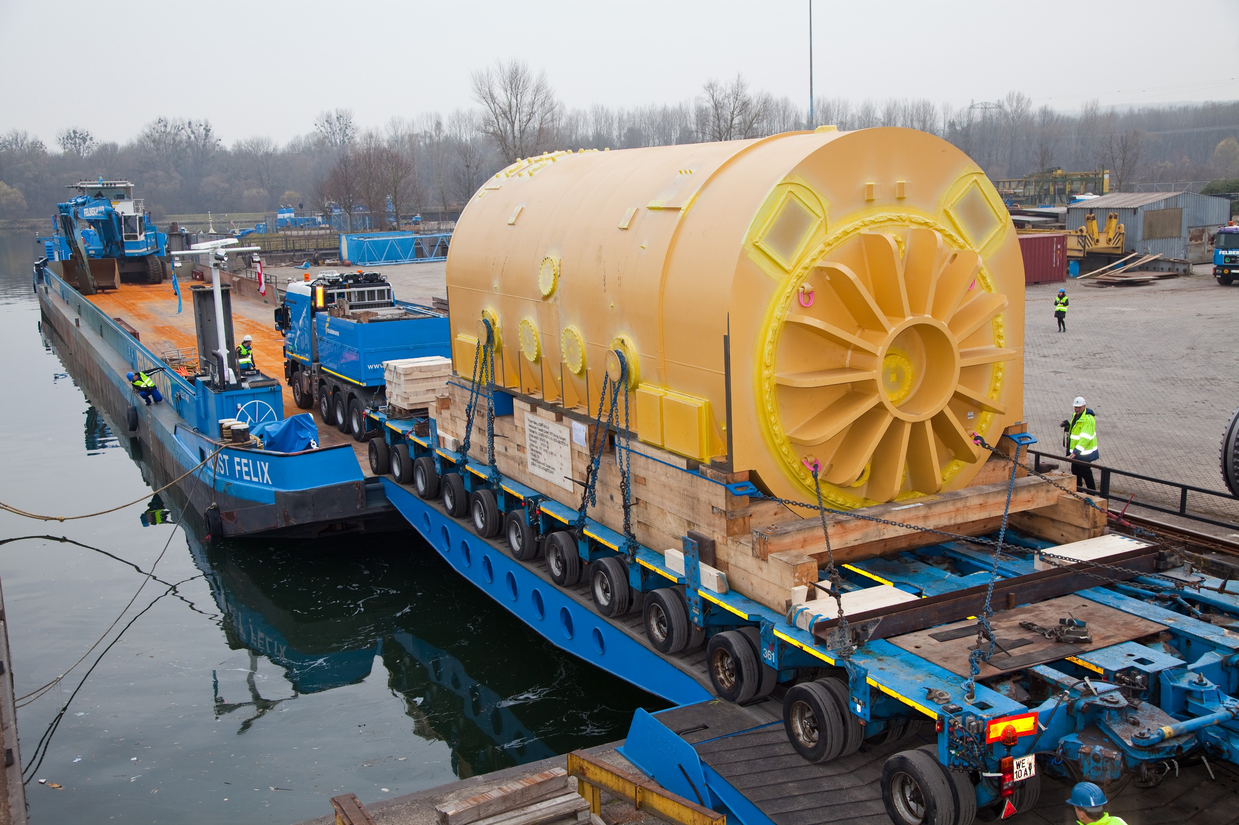
High & Heavy transport
Picture: Felbermayr
Notes:
Picture: Felbermayr

Slide 30
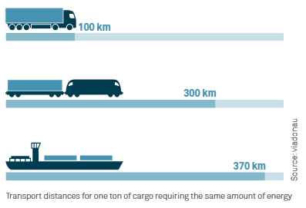
Specific energy consumption – Comparison of modes of transport
An inland vessel can transport one ton of cargo nearly four times farther than a truck using the same amount of energy.
Notes:
In terms of specific energy consumption, inland waterway transport can be considered the most efficient and therefore the most environmentally friendly mode of transport. An inland vessel can transport one ton of cargo nearly four times farther than a truck using the same amount of energy.
Source: Viadonau (2019): Handbuch der Donauschifffahrt , p. 18
Image source: Viadonau (2019): Manual of Danube Navigation, p. 18

Slide 31


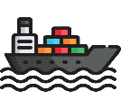





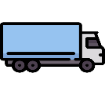
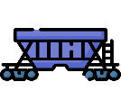
Transport chains
Transport using one mode of transport = unimodal transport
e.g. Road
Multiple modes of transport = multimodal transport
e.g. Transshipment from a truck to an inland vessel
Sender
Receiver
Pre-carriage
Main carriage
On-carriage
Transshipment point
Images: Flaticon
Notes:
A direct or single-stage transport refers to direct delivery from the sender to the receiver.
The term “transport chain” or “multi-stage transport” refers to transport from sender to receiver using different means of transport.
In unimodal transport, the mode of transport does not change.
Examples include truck transport by road or rail transport between two locations with direct rail access. The goods may be reloaded, but only one mode of transport is used.
In multimodal transport, the transport is carried out using more than one mode of transport.
Source:
Muchna, Claus / Brandenburg, Hans / Fottner, Johannes / Gutermuth, Jens (2nd edition 2021): Grundlagen der Logistik. Begriffe, Strukturen und Prozesse, pp. 152–161
Images sources:
Flaticon (2024): https://www.flaticon.com/de/kostenlose-icons/lkw; Truck icons by Freepik – Flaticon, accessed 20.05.2024
Flaticon (2024): https://www.flaticon.com/de/kostenlose-icons/fabrik; Factory icons by Freepik – Flaticon, accessed 03.05.2024
Flaticon (2024): https://www.flaticon.com/de/kostenlose-icons/boxen; Box icons by monkik – Flaticon, accessed 20.05.2024
Flaticon (2024): https://www.flaticon.com/de/kostenlose-icons/guterzug; Freight train icons by Freepik – Flaticon, accessed 20.05.2024
Flaticon (2024): https://www.flaticon.com/de/kostenlose-icons/schiff; Ship icons by Freepik – Flaticon, accessed 29.04.2024

Slide 32
Transport planning with the Logistify App
Game 2 – Transport Chains
Plan the appropriate transport based on the means of transport, production facilities, and plants shown on the cards.
To ensure the transport runs as smoothly as possible, you must choose the suitable means of transport, especially those that offer advantages over long distances.
Download the app at: Logistify: Understanding the World of Logistics
Explanation video: https://www.youtube.com/watch?v=kZhL5SPtn6A
Image: FH OÖ
Notes:
Download App unter: https://logistify.app/
Erklärvideo: https://www.youtube.com/watch?v=kZhL5SPtn6A
More information at: https://rewway.at/en/teaching-materials/transport-planning-with-the-logistify-app
The educational app "Logistify" focuses on different means of transport, their careful and efficient use of resources, and career profiles in the logistics sector. In the games, students are challenged to apply their transport planning skills.
Tasks include efficiently transporting various goods from A to B, planning multimodal transport chains from raw material to end customer, and exploring logistics professions.
For Game 2, printed cards with transport modes, production facilities, and transshipment points are required!
Duration: Game 2 takes up to 30 minutes, depending on the number of transport examples.
Learning objectives:
Students plan simple multimodal transport chains considering efficiency and sustainability.
Students develop a basic understanding of the complexity of modern supply chains.
Students use digital learning tools in a playful way to grasp logistical relationships.

Slide 33
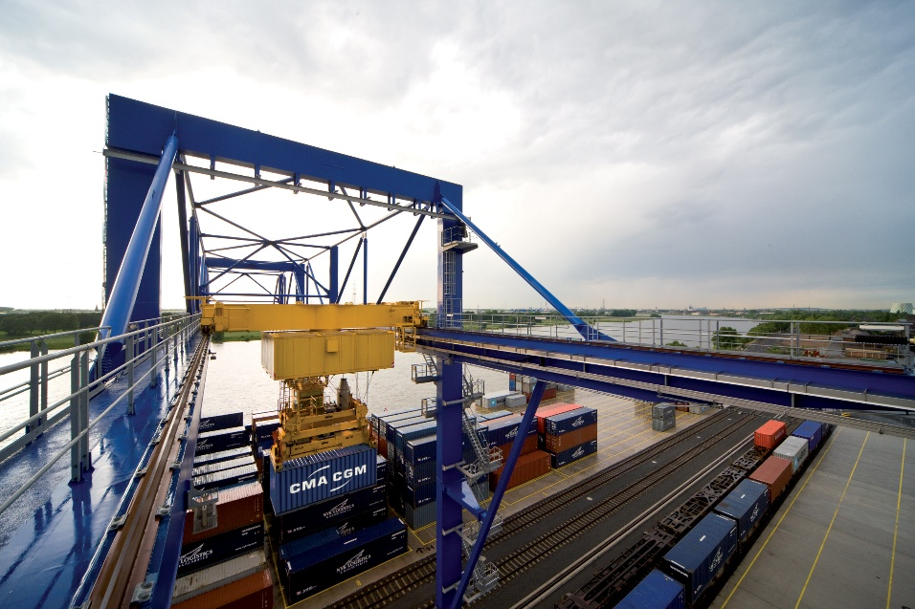
Terminals
= Transshipment facilities
Loading of cargo units (e.g., containers) between different modes of transport
Prerequisite for multimodal transport
Also serve as storage facilities
14 publicly accessible transshipment facilities in Austria
Picture: duisport
Notes:
A terminal is a spatially defined facility for handling, storage, and logistics of a specific type of cargo (e.g., container or heavy cargo terminal).” (viadonau 2019)The loading and unloading of cargo units (e.g., containers) enables the use of different modes of transport. Terminals are a key prerequisite for multimodal transport and also serve as storage facilities. In Austria, there are 14 publicly accessible transshipment terminals.
Sources:
Bundesministerium für Innovation, Mobilität und Infrastruktur (2025): https://www.bmimi.gv.at/themen/mobilitaet/transport/gueterverkehr/kombiverkehr/terminals-rola/oesterreich.html; accessed 14.07.2025
SGKV – Studiengesellschaft für den Kombinierten Verkehr (2025): https://www.intermodal-info.com/terminals-im-kv/; accessed 18.03.2025
Viadonau (2019): Handbuch der Donauschifffahrt
Image source:
Duisport / Frank Reinhold: Container handling – logport II Gateway West, Duisburg

Slide 34
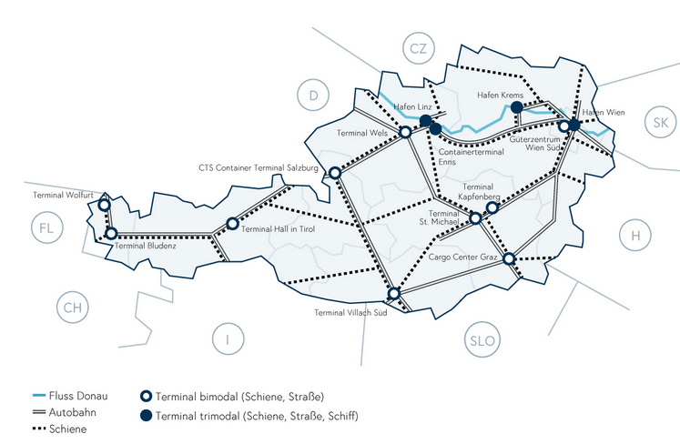
Terminals in Austria
Danube River
Bimodal terminal (rail, road)
Motorway
Trimodal terminal (rail, road, inland waterway)
Rail
Image: BMIMI
Notes:
Image source:
Bundesministerium für Innovation, Mobilität und Infrastruktur (2025): https://www.bmimi.gv.at/themen/mobilitaet/transport/gueterverkehr/kombiverkehr/terminals-rola/oesterreich.html; Accessed on 14.07.2025

Slide 35
Modal shift in freight transport
EU target by 2050: Reduction of greenhouse gas emissions in the transport sector by 90%
EU target for freight transport:
Increase in inland waterway and short-sea shipping by 25% by 2030, and by 50% by 2050
Increase in rail freight transport by 50% by 2030, and doubling by 2050
Advantages of inland waterway transport:
Sustainable mode of transport
Waterways offer sufficient free capacity
Notes:
The European Union has set itself the goal of becoming the first climate-neutral continent by 2050 and reducing greenhouse gas emissions in the transport sector by 90%.
To achieve this, the European Commission’s Strategy for Sustainable and Smart Mobility outlines, among other measures, a modal shift toward more sustainable modes of transport.
The target for shipping includes a 25% increase in inland waterway and short-sea shipping by 2030, and a 50% increase by 2050.
Rail freight transport is to increase by 50% by 2030 and double by 2050.
Source:
European Commission (2025): https://commission.europa.eu/strategy-and-policy/priorities-2019-2024/european-green-deal_de; accessed 05.02.2025
European Commission (2023): Sustainable & Smart Mobility Strategy, at: https://transport.ec.europa.eu/transport-themes/mobility-strategy_en; accessed 05.02.2025; p.10

Slide 36
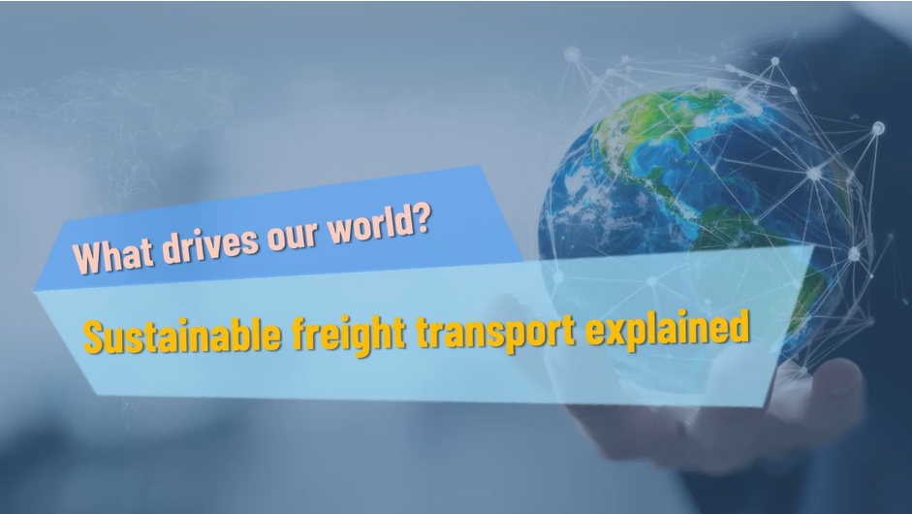
Interactive video
https://rewway.at/en/teaching-materials/what-drives-our-world
Notes:
In this interactive video, you will learn which routes goods take on their way to the store shelves and how freight transport can be designed sustainably - with built‑in quiz questions that invite you to participate directly in the video.

Slide 37
Think-Pair-Share: Inland waterway transport – an underrated climate protector?
First, think on your own (think – 5 min): What are the advantages of multimodal transport when linking trucks and inland waterway vessels? What measures could be taken to create more incentives for this? What are the concrete economic benefits for freight carriers or trucking companies?
Share your thoughts (pair – 5 min) with your seatmates.
Prepare your answer for a presentation to the class (share – 3 min).
Notes:
Think-Pair-Share: Individually (Think), in pairs or small groups (Pair), then present discussion results to the class (Share)
Duration: approx. 15–20 minutes
Social structure: Individual work → partner or small group work → class discussion
Possible arguments (to support or inspire):
Low primary energy demand: Inland waterway vessels consume significantly less energy per ton transported compared to trucks or trains.
Lowest external costs: Less air pollution, noise, CO₂ emissions, and infrastructure wear.
Few accidents: Very high safety compared to road and rail transport.
Large transport volumes possible: One ship can replace many trucks.
Use of existing natural infrastructure: Rivers and canals already exist.
Cost-effective in the long term: Especially for bulk goods and long distances.
Learning objectives:
Students analyze the ecological and economic advantages of inland waterway transport compared to other transport modes.
Students argue factually and with reasoning for or against greater use of waterways for freight transport.
Students reflect on the political and societal conditions that influence the use of inland navigation.
Students present their results clearly and structured to the class and engage with other perspectives.

Slide 38
Sustainable freight transport
3

Slide 39
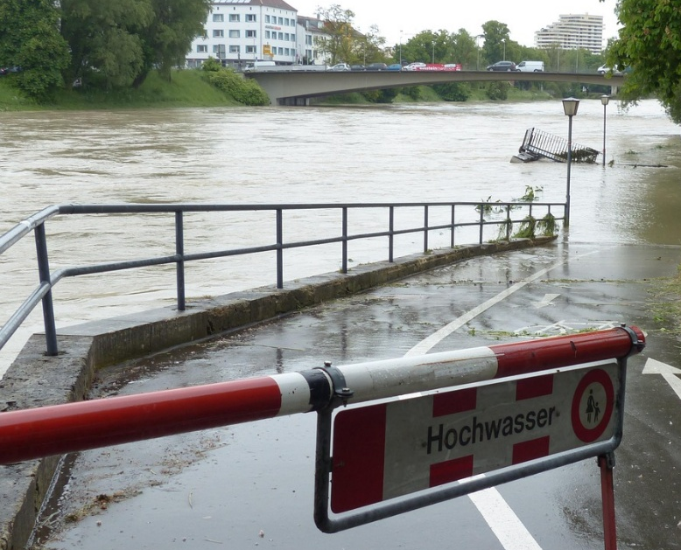


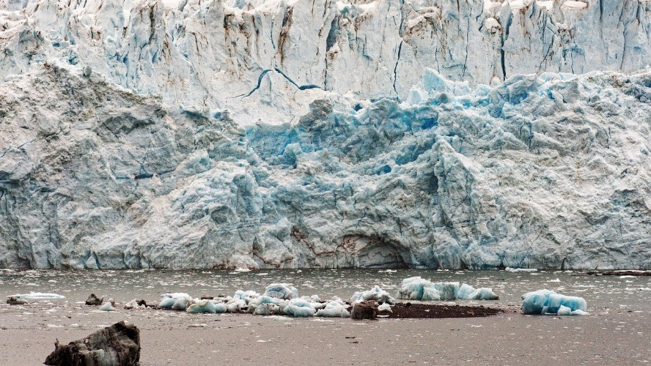
Climate change and global warming
Pictures: Pixabay
Notes:
Introductory Activity on Climate Change:
The images serve as inspiration for a warm-up discussion on climate change and global warming in class or small groups. The consequences and facts of global warming are presented on the next slide.
Duration: approx. 10 minutes
Social format:
Small group work (2–4 people) or class discussion
Optional: Individual reflection at the beginning (e.g. using a short writing prompt)
Guiding questions for the discussion:
What do you see in the images, and how do these effects relate to climate change?
How can we personally feel the impact of climate change?
Which regions and people are especially affected?
What feelings or thoughts do the images evoke in you?
Learning objectives:
Students recognize visual signs and impacts of climate change.
Students identify connections between global environmental changes and climate change.
Students share personal perceptions and global perspectives.
Students develop an initial awareness of the urgency of climate-related challenges.
Images sources:
Pixabay (2025): https://pixabay.com/de/photos/hochwasser-stra%C3%9Fe-gesperrt-schaden-123218/ (Accessed: 12.02.2025)
Pixabay (2025): https://pixabay.com/de/photos/klimawandel-thermometer-waldbrand-3836835/ (Accessed: 27.02.2025)
Pixabay (2025): https://pixabay.com/de/photos/wasserhahn-installation-tippen-2151449/ (Accessed: 12.02.2025)
Pixabay (2025): https://pixabay.com/de/photos/eis-gletscher-schmelzen-klimawandel-7678230/ (Accessed: 12.02.2025)

Slide 40
Greenhouse gases
Greenhouse gases influence the Earth's energy balance.
  Greenhouse effect, global warming
  Most well-known greenhouse gases: carbon dioxide (CO₂), methane, and nitrous oxide
  Low natural occurrence of greenhouse gases
  Increase in greenhouse gases caused by human activity
40
Diagram based on EEA
Notes:
Greenhouse gases are gases in the atmosphere that amplify the greenhouse effect by influencing the Earth’s energy balance. Although carbon dioxide, methane, and nitrous oxide naturally occur in low concentrations, human activities have significantly increased their levels since the last century.
To compare the climate impact of different greenhouse gases and define their warming potential, methane and nitrous oxide are often expressed in so-called CO₂ equivalents (CO₂e).
In 2021, the EU’s greenhouse gas emissions amounted to approximately 3.5 billion tonnes of CO₂ equivalents.
In 2019, greenhouse gas emissions in the EU were composed of:
80% carbon dioxide,
11% methane,
6% nitrous oxide, and
2% fluorinated gases.
Diagram adapted from the European Environment Agency (EEA):
European Parliament (2024): https://www.europarl.europa.eu/resources/library/images/20211027PHT16017/20211027PHT16017_original.jpg; accessed 18.03.2025
Sources:
DESTATIS (2024): https://www.destatis.de/Europa/DE/Thema/GreenDeal/_inhalt.html; accessed 18.03.2025
Myclimate (2024): https://www.myclimate.org/de/informieren/faq/faq-detail/was-sind-treibhausgase/; accessed 18.03.2025

Slide 41
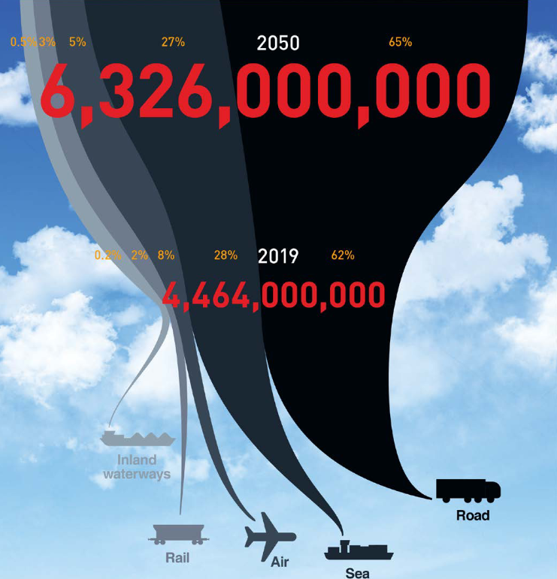
Impacts of the transport sector
Traffic emissions are increasing significantly
Forecasts predict an almost doubling of freight transport by 2050 (compared to 2019)
Especially truck transport is increasing
40
Image: Smart Freight Centre
Notes:
The continued increase in freight transport, especially road freight (trucks), has significant impacts on the environment and climate.
Forecasts predict an almost doubling of freight transport by 2050 compared to 2019. (cf. ITF 2023: p. 67)
Image Source:
Smart Freight Centre (2024): GLEC Framework v3.1 edition, revised and updated. In: https://www.smartfreightcentre.org/en/our-programs/emissions-accounting/global-logistics-emissions-council/calculate-report-glec-framework/, p. 8
Based on: ITF (2023): ITF Transport Outlook 2023, OECD Publishing, Paris; available at https://doi.org/10.1787/b6cc9ad5-en ; last viewed 25/09/2024
Source:
ITF (2023): ITF Transport Outlook 2023, OECD Publishing, Paris; available at https://doi.org/10.1787/b6cc9ad5-en ; accessed 06/03/2025

Slide 42
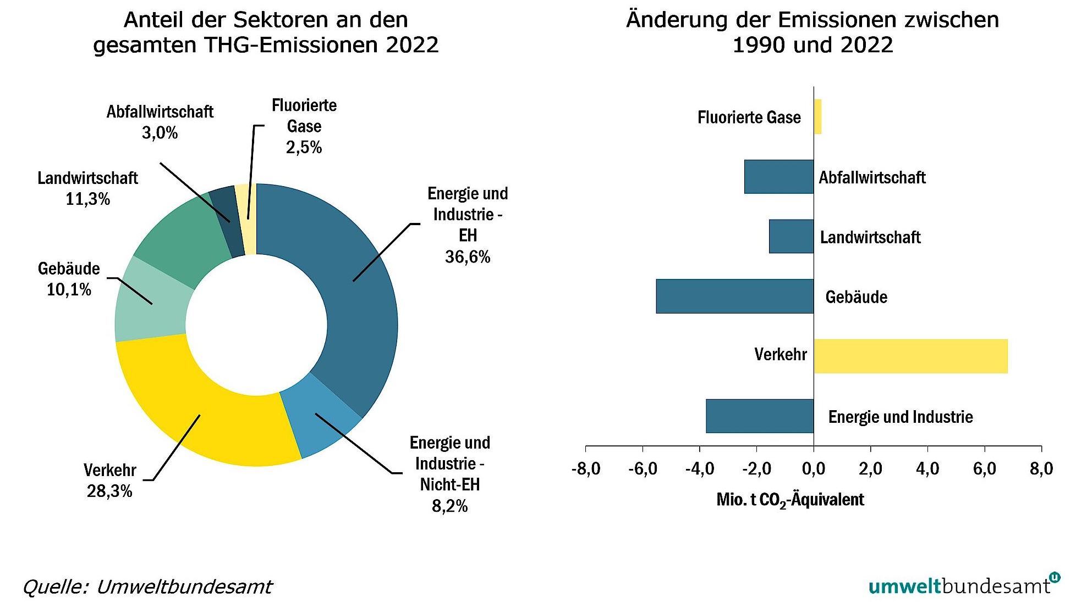
Emissions by sector in Austria
Share of Sectors in Total GHG Emissions 2022
Change in Emissions between 1990 and 2022
Waste Management: 3.0%
Fluorinated Gases: 2.5%
Fluorinated Gases
Agriculture: 11.3%
Waste Management
Energy and Industry – ETS: 36.6%
Agriculture
Buildings: 10.1%
Buildings
Transport
Energy and Industry
Energy and Industry – non-ETS: 8.2%
Transport: 28.3%
(Unit: million tons CO₂ equivalent)
Source: Umweltbundesamt
Notes:
The transport sector is the second-largest emitter of greenhouse gases, accounting for around 28%, after the energy and industry sector. It is the only sector that has significantly increased its emissions since 1990.
“Since 1990, the transport sector (including domestic air traffic) has recorded the highest increase in emissions of all sectors from 1990 to 2022, with a 49.6% rise, mainly caused by the increase in road traffic volume.” (Environment Agency Austria 2024: p. 138)
Road transport is responsible for around 99% of emissions within the transport sector.
Source:
Umweltbundesamt (2024): Klimaschutzbericht 2024. Available at: https://www.umweltbundesamt.at/fileadmin/site/publikationen/rep0913.pdf; accessed 14.01.2025

Slide 43
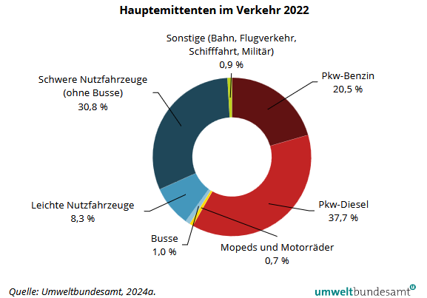
Road traffic as the main contributor
Main Emitters in the Transport Sector (2022)
Others
(rail, air traffic, shipping, military):
0.9%
Heavy-duty vehicles (excluding buses):
30.8%
Passenger cars – gasoline: 20.5%
Light commercial vehicles: 8.3%
Passenger cars – diesel: 37.7%
Buses: 1.0%
Mopeds and motorcycles: 0.7%
Source: Umweltbundesamt, 2024a.
Notes:
Road traffic is responsible for around 99% of emissions in the transport sector. (cf. Environment Agency Austria 2024: p. 138)
Source:
Umweltbundesamt (2024): Klimaschutzbericht 2024. Available at: https://www.umweltbundesamt.at/fileadmin/site/publikationen/rep0913.pdf; accessed 14/01/2025

Slide 44
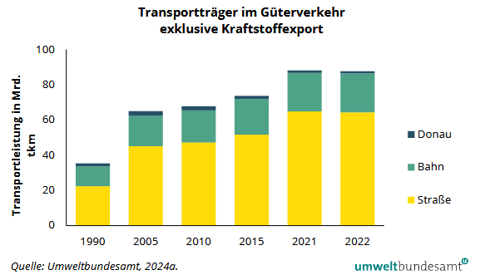
Development of modal split in Austria
Modes of Transport in Freight Traffic (excluding fuel exports)
Despite global warming and climate targets:
Strong increase in road freight transport
Slight decline in rail transport
Share of inland waterway transport is decreasing
Transport performance in billion tkm (tonne-kilometres)
Danube
Rail
Road
Source: Umweltbundesamt, 2024a.
Notes:
Over the course of the year, Austria has seen a significant increase in freight transport performance by road, a slight decline in the share of rail in the modal split based on tonne-kilometres, and a decrease in the share of national freight transport on the Danube.
Umweltbundesamt (2024): Klimaschutzbericht 2024. In: https://www.umweltbundesamt.at/fileadmin/site/publikationen/rep0913.pdf; Accessed on 14.01.2025, p. 156

Slide 45
Sustainability and green logistics
Sustainability:
Long-term development that meets the needs of the present generation without compromising the ability of future generations to meet their own needs.
Green Logistics:
Holistic transformation of the logistics sector to create environmentally friendly and resource-efficient logistics processes, aiming for a balance between economic and ecological efficiency.
Notes:
The term sustainability was first developed in forestry in the 18th century to prevent deforestation. It had already been practiced regionally as early as the 15th century. Since the 1970s, there has been growing concern about how the economy—especially logistics—impacts the environment and exploits and pollutes natural resources. The concept of "sustainability" was coined to achieve long-term development that meets the needs of the present generation without endangering the possibilities of future generations. According to the Brundtland Commission, the needs of the present generation should not be met at the expense of future generations. Natural resources should only be used to the extent that they can regenerate. Environmental problems require not only subsequent protective measures, but also active climate protection through a rethinking of industrial society. In the logistics and transport sector, "Green Logistics" is a common term. It refers to the holistic transformation of logistics strategies, structures, processes, and systems to create environmentally friendly and resource-efficient logistics operations. The goal of "green" logistics is to strike a balance between economic and ecological efficiency and to create sustainable corporate value.
Source:
Koch, Susanne (2012): Logistik – Eine Einführung in Ökonomie und Nachhaltigkeit, p. 292 ff.

Slide 46
The 3 Pillars of Sustainability in Logistics
Green Logistics
Economic
Ecological
Social
"...environmentally friendly and socially responsible, but also financially viable"
Notes:
The concept of "green logistics" aims to strike a balance between economic, ecological, and social goals within the field of logistics, which also includes the transport sector. This leads to areas of tension between these three domains, as not all goals from each area can be pursued simultaneously. The following goals can be assigned to each respective area:
Social goals: Raise awareness for sustainable transport and ensure a good quality of life.
Ecological goals: Reduce emissions and overall resource consumption.
Economic goals: From a financial perspective, there should be no additional costs, or ideally, a cost reduction should be achieved, and unproductivity (periods in which something or someone is not productive) should be minimized.
Of course, other goals can also be assigned to the different areas, which makes it even more challenging to pursue a balanced approach across all three dimensions.
Sources:
Pazirandeh, Ali / Jafari, Hamid (2013): Making sense of green logistics; In: International Journal of Productivity and Performance Management, p. 889f.
Saroha, Rituraj (2014): Green logistics & its significance in modern day systems; In: International Review of Applied Engineering Research, p. 90

Slide 47
Sustainability: Economy, ecology, and social Issues in conflict
Critically question the three pillars of sustainability in three groups. What often doesn't work well in our world?
Discuss the guiding questions for each pillar.
Group 1: Economy – Sustainability vs. Profit
Group 2: Ecology – Save the environment, but how?
Group 3: Social – Sustainability for everyone?
Notes:
Sustainability in Harmony – Economy, Ecology, and Social Aspects in Conflict
Duration: 1 teaching unit
Group discussion in three teams.
Each group is assigned one pillar of sustainability and discusses the following questions:
Group 1: Economy – Sustainability vs. Profit
Where do economic interests conflict with ecological or social goals?
Examples of companies or industries that do not act sustainably
Are there positive examples of sustainable business practices?
Group 2: Ecology – Saving the environment, but how?
Why are environmental goals often not achieved?
What challenges exist (e.g., climate protection, resource consumption, pollution, loss of biodiversity)?
Who is responsible – politics, businesses, or consumers?
Group 3: Social – Sustainability for everyone?
Where does our economic system lead to social injustice?
Which people or countries are particularly affected by unsustainable behavior?
Why is sustainable living difficult for many people to implement?
Joint Reflection in the Class:
How can we implement sustainability better in all areas?
What can we do as individuals or as a society?
Which of the three pillars is the hardest to achieve?
Possible Solutions / Input for Teachers:
Economy – Sustainability vs. Profit
Discussion: Is sustainable business compatible with making profits? Which companies are setting a good example?
Approaches:
Promote sustainable business models: Reward companies with environmental certifications or circular economy systems.
Introduce real prices ("true cost pricing"): Factor environmental and social costs into prices (e.g., CO₂ tax, plastic tax).
Laws & incentives for companies: Tax breaks for sustainable companies, stricter environmental regulations for polluters.
Change consumer behavior: Raise awareness for sustainable consumption (e.g., less fast fashion, more local products).
Ensure fair supply chains: Mandatory sustainability reporting for large companies.
Ecology – Saving the environment, but how?
Discussion: Why is it so hard to enforce environmental goals? Who’s responsible – politics, business, or consumers?
Approaches:
Promote environmentally conscious behavior: More education on sustainability in schools and companies.
Radically reduce CO₂ emissions: Expand renewable energy, increase CO₂ taxes, stricter emission standards.
Strengthen circular economy: More recycling, less waste, longer product lifespans (e.g., promote repairability).
Reward ecological action: Grants for sustainable businesses and subsidies for climate-friendly technologies.
Strengthen global cooperation: Environmental problems are global – international agreements and stronger enforcement needed.
Social – Sustainability for Everyone?
Discussion: Is sustainable living a luxury problem? How can sustainability be made socially fair?
Approaches:
Fair wages & working conditions worldwide: Enforce minimum standards for wages and working conditions.
Socially fair sustainability: Make eco-friendly products and services affordable for all.
Strengthen social safety nets: Improve access to education, healthcare, and fair work conditions.
Make urban planning & infrastructure more sustainable: More public transport, less car traffic, affordable housing.
Promote awareness: Campaigns and educational programs on sustainable consumption and fair production.
Additional Discussion Questions for the Groups:
What can individuals do – and where are politics & businesses needed?
Is a "green economy" even realistic, or are more radical changes needed?
Should companies be held liable for environmental and social damage?
Why is sustainability often perceived as expensive or impractical?
Which countries or sectors are leading the way in sustainable business?
Learning Objectives:
Students understand the three pillars of sustainability – economy, ecology, and social – and recognize their interdependence and potential conflicts.
Students critically evaluate business strategies and political measures in terms of their sustainability.
Students reflect on their own role as consumers and develop awareness of global responsibility.
Students apply critical thinking, work cooperatively in teams, and improve their ability to structure and present arguments persuasively.

Slide 48
What makes a sustainable mode of transport?
Ecological influence areas
Emissions
Land use
Noise
Specific energy consumption
Social influence areas
Traffic safety
Working conditions
Pay
Economic influence areas
Transport costs
Reliability
Punctuality
Transport duration
Notes:
Currently, ecological factors (especially CO₂ emissions) and economic factors (transport costs) are the primary focus when assessing modes of transport. Environmental protection is still a secondary consideration for many companies and is mainly used for marketing purposes. From a business management perspective, environmental protection is often also seen as an opportunity to reduce costs or increase revenue.
However, for a comprehensive comparison of modes of transport from the perspective of sustainability, additional factors beyond emissions and transport costs must be considered (see above). The assessment criteria mentioned in the figure within the three areas of influence represent a selection of possible comparison factors. These can, of course, be even more extensive.
Source:
Pazirandeh, Ali / Jafari, Hamid (2013): Making sense of green logistics; In: International Journal of Productivity and Performance Management, p. 889f.

Slide 49

Sustainable freight transport – why and how?
Increasing transport volumes increase the need for action
Sustainable transport through:
Avoidance of transport
Shift to sustainable modes of transport such as rail and inland waterways
Alternative fuels
Innovative technologies, digitalisation
Adjusted pricing
Holistic consideration of the value chain and suppliers
Image: Flaticon
Notes:
Freight transport is identified as an environmentally harmful area of logistics because it causes major environmental and sustainability problems in Europe through greenhouse gas emissions and traffic congestion. Given the increasing volume of transport, the need for action and the relevance of the topic of sustainability in freight transport is growing ever greater.
To counteract these problems, various measures are being taken. These include adjusted pricing, the use of alternative fuels, the promotion of a shift to sustainable modes of transport such as rail and inland waterways, as well as increased use of innovative technologies.
Source:
European Commission (2011): Weißbuch - Fahrplan zu einem einheitlichen europäischen Verkehrsraum – Hin zu einem wettbewerbsorientierten und ressourcenschonenden Verkehrssystem, p. 10 ff.
Image Source:
Flaticon (2024): https://www.flaticon.com/de/kostenlose-icons/erde; Earth icons created by Freepik – Flaticon, accessed 08.07.2024

Slide 50

Sustainable Development Goals (SDG)
17 global goals of the United Nations for sustainable development
Include economic, ecological, and social aspects
Image: United Nations
Notes:
In 2015, the international community, under the leadership of the United Nations, adopted the 2030 Agenda. This agenda consists of 17 global goals aimed at creating a better future for all. The aim of the 2030 Agenda is to enable a life of dignity for people worldwide while simultaneously protecting the natural foundations of life in a sustainable way. Economic, ecological, and social aspects are taken into account. The 2030 Agenda emphasizes the shared responsibility of all stakeholders, including politics, business, science, civil society, and each individual person.
Source:
UNRIC (2025): https://unric.org/de/17ziele/; accessed 18.03.2025
Image Source:
United Nations (2024): https://www.un.org/sustainabledevelopment/news/communications-material/, accessed 22.10.2024

Slide 51
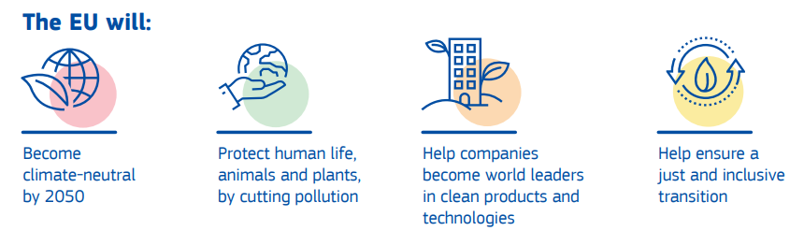
The European Green Deal
EU package of measures for a green transition
Image: European Commission
Notes:
The European Green Deal was launched in 2019 and is a collection of policy measures taken by the EU to enable the transition to a climate-neutral society by 2050. The goal of the Green Deal is to create a fair and prosperous society supported by a modern and competitive economy.
To achieve this goal, the Green Deal emphasizes that a holistic and cross-sectoral approach is necessary, aligning all relevant policy areas with the overarching goal of climate protection. The package includes measures that affect a wide range of policy areas, including climate, environment, energy, transport, industry, agriculture, and sustainable finance.
The European Green Deal aims to achieve a climate-neutral EU by 2050, with greenhouse gas emissions reduced by at least 55% compared to 1990 levels by 2030. This requires a fundamental transformation of the economy and society in many areas.
"Fit for 55" is a package of measures that includes the revision and updating of EU legislation as well as the introduction of new initiatives to ensure that EU actions are in line with the climate goals of the Council and the European Parliament.
Sources:
Europäische Kommission, Generaldirektion Kommunikation (2019): Was ist der europäische Grüne Deal?, In: https://data.europa.eu/doi/10.2775/944554; accessed 13.03.2025
Europäischer Rat der Europäischen Union (2024): https://www.consilium.europa.eu/de/policies/green-deal/; accessed 13.03.2025
Image Source:
European Commission, Directorate-General for Communication (2019): What is the European Green Deal?, In: https://op.europa.eu/en/publication-detail/-/publication/2e009f04-1d90-11ea-95ab-01aa75ed71a1; accessed 13.03.2025

Slide 52
My contribution to climate protection
Think for yourself and discuss with your partner: what can you personally do to help achieve the goals?
Image: United Nations
Notes:
This exercise is suitable as an individual exercise or as a group exercise for small groups (max. 3 people)
Duration: 10-20 minutes
Possible prompts for students:
Goal 1 – No poverty: Donate clothing and toys for children in need / organize collection drives for schools in poorer countries.
Goal 2 – Zero hunger: Participate in food donation campaigns.
Goal 3 – Good health and well-being: Take part in sports programs yourself, eat healthily.
Goal 4 – Quality education: Offer tutoring for younger students, organize a book exchange.
Goal 5 – Gender equality: Use gender-inclusive language.
Goal 6 – Clean water and sanitation: Save and use water consciously.
Goal 12 – Responsible consumption and production: Consider where your food comes from, buy local products.
Reflection prompt after the discussion:
Which goal speaks to you personally the most – and why?
Securing results: Short presentation in the plenary session or collection on a poster / digital board (e.g., Padlet).
Extension idea: Create an "SDG action plan" for the school or class.
Learning objectives:
Students reflect on how they themselves can contribute to achieving the SDGs.
Students develop concrete ideas for sustainable actions in their personal environment.
Students exchange individual perspectives and foster mutual understanding of global responsibility.
Students strengthen their communication and argumentation skills when discussing societal issues.
Image source:
United Nations (2024): https://www.un.org/sustainabledevelopment/news/communications-material/, accessed 22.10.2024

Slide 53

We must act!
Climate change affects all countries and regions of the Earth
For more than half of young people in Europe, climate change is the most important global challenge (Eurobarometer survey 2022)
Action on a global level is necessary
Help from every individual
Reduction of transport emissions
Modal shift: waterways and rail as sustainable modes of transport
Image: Freepik
Notes:
Climate change is a global issue that affects all countries and regions of the Earth.
According to the Eurobarometer survey, more than half of young people view climate change as the most important global challenge for the future of the EU. In fact, 91% of 15- to 24-year-olds believe that combating climate change can have a positive impact on their personal health and well-being. To effectively address the consequences of climate change, international agreements and cooperation are urgently required.
Reducing transport emissions is essential and can be achieved, among other things, by avoiding transport and shifting it to rail and waterways. Inland shipping is a sustainable mode of transport with available capacity.
Sources:
European Parliament (2022): https://www.europarl.europa.eu/news/de/press-room/20220119IPR21314/zukunft-europas-klimawandel-grosste-herausforderung-fur-die-eu-so-die-burger; accessed 18.03.2025
European Commission (2023): Sustainable & Smart Mobility Strategy, In: https://transport.ec.europa.eu/transport-themes/mobility-strategy_en; accessed 05.02.2025
Image source:
Freepik (2024): https://de.freepik.com/vektoren-kostenlos/konzept-der-runde-der-umweltverschmutzung_10155239.htm; accessed 14.05.2024

Slide 54
Danube waterway
4

Slide 55
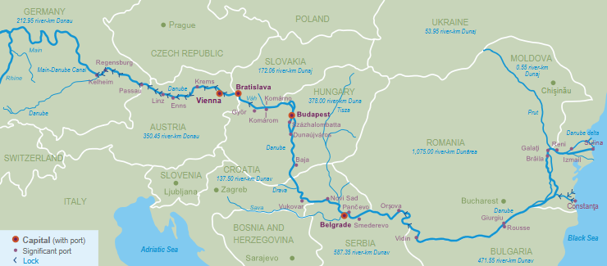
The international waterway Danube
How many riparian states does the Danube have?
Which major cities are located along the Danube?
Why is the Danube important for the Austrian/European economy?
Image: viadonau
Notes:
The questions in the slide above can be used as a warm-up exercise on the topic “The International Waterway Danube.”
Didactic Note:
This exercise is especially well-suited as an activating introduction to a lesson unit on inland navigation, sustainable logistics, or European infrastructure. The questions can be used at the beginning to form hypotheses and revisited at the end of the unit for reflection and deeper understanding.
Discussion input (5–10 minutes of discussion):
How many riparian states does the Danube have? → 10
Why is the Danube important for the Austrian economy?→ Important transport route, essential for international trade, connects Central and Southern Europe, creates jobs (e.g., in ports, as inland shippers), contributes to GDP
Which major cities lie along the Danube?→ Regensburg, Passau, Linz, Vienna, Bratislava, Budapest, Novi Sad, Belgrade, Constanța…
Input – possible discussion points:
Infrastructure: What infrastructure is needed for the Danube to be used efficiently as a transport route (e.g., locks, ports, types of vessels)?
Waterways in Europe: How is the Danube connected to other waterways (e.g., Rhine-Main-Danube Canal)?
Markets: What goods are transported on the Danube? Which countries benefit most?
Riparian states: What political challenges arise from the large number of Danube countries?
Availability of the Danube: How do water levels, climate change, or environmental regulations affect usability?
Unused capacity: Why is the Danube, despite its capacity, used relatively little?
Learning objectives:
Students activate their prior knowledge about the geographic location and importance of the Danube.
Students formulate initial questions and hypotheses about the Danube's significance for European freight transport and the Austrian economy.
Image source:
Viadonau (2019): Manual of Danube Navigation, p. 46

Slide 56
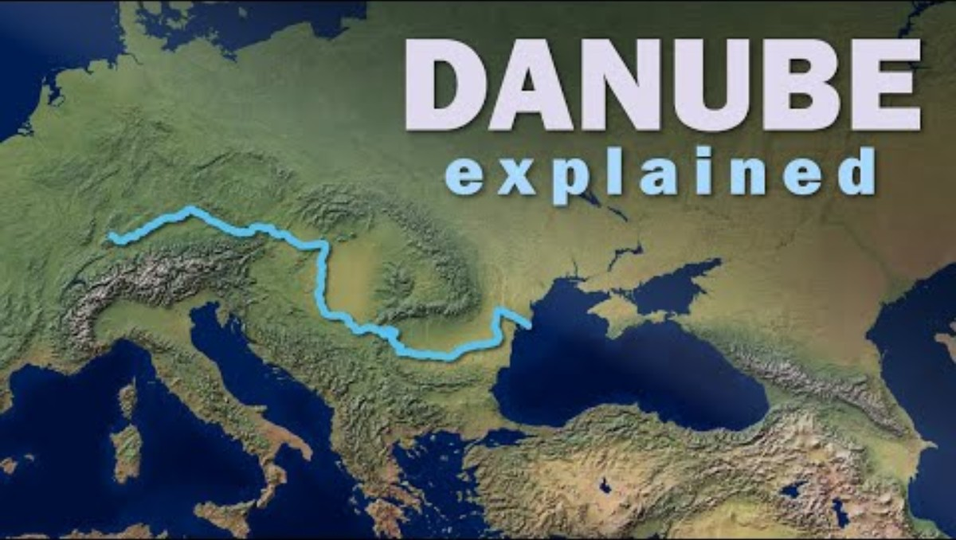
Video: Danube explained
Questions about the video:
How long is the Danube River, approximately?
Where does the Danube originate and where does it end?
Through how many countries does the Danube pass or border?
Name at least two national capitals situated on the Danube.
What is one major modern use of the Danube mentioned in the video?
https://www.youtube.com/watch?v=NcdgMj3nDvE
Notes:
Questions including answers:
How long is the Danube River, approximately? - About 2,888 km (commonly rounded to ~2,850 km).
Where does the Danube originate and where does it end? - It starts in the Black Forest in Germany and flows into the Black Sea.
Through how many countries does the Danube pass or border? - It flows through or borders ten countries.
Name at least two national capitals situated on the Danube. - Vienna, Bratislava, Budapest, and Belgrade.
What is one major modern use of the Danube mentioned in the video? - It is a vital navigable waterway for trade and transport.

Slide 57
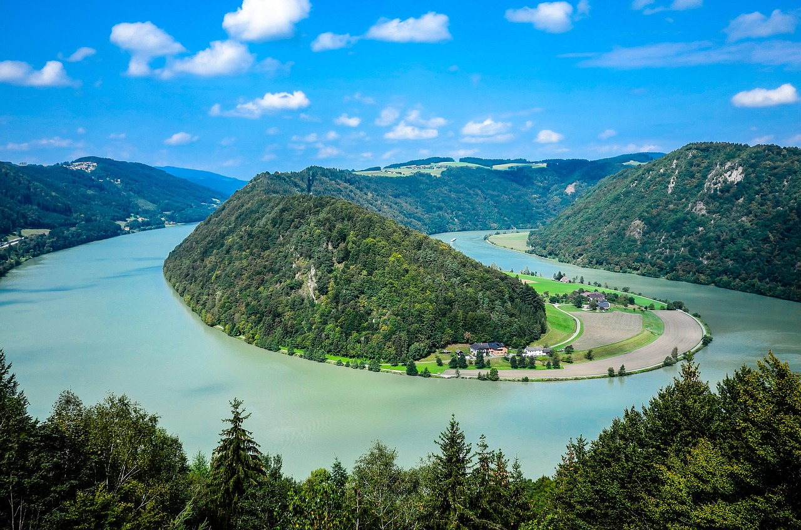
The international waterway Danube
from the Black Forest (Germany) to the Black Sea (Romania and Ukraine)
10 riparian states: Germany, Austria, Slovakia, Hungary, Croatia, Serbia, Bulgaria, Romania, Moldova, Ukraine
nearly one third of the entire river length is in Romania
the most international river in the world
2,845 km long, 2,415 km navigable
Europe’s most water-rich river
Picture: Pixabay
Notes:
The Danube, which flows from the Black Forest in Germany to its mouth in the Black Sea in Romania and Ukraine, passes through ten riparian states (Germany, Austria, Slovakia, Hungary, Croatia, Serbia, Bulgaria, Romania, Moldova, Ukraine), making it the most international river in the world.
The Danube is 2,845 km long and has a navigable length of 2,415 km for international freight shipping.
Source:
Viadonau (2019): Handbuch der Donauschifffahrt, p. 38 ff.
Picture source:
Pixabay (2025): https://pixabay.com/de/photos/schl%C3%B6gen-sch%C3%B6gener-schlinge-donau-4795383/; accessed 20.03.2025

Slide 58




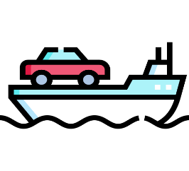
Freight transport on inland waterways
Bulk Goods
Ores, coal, steel, agricultural products
Main type of goods transported on the Danube
Hazardous Goods
e.g. flammable liquid goods such as gasoline, heating oil, chemicals, liquefied gases
Containers
Growing market segment
Heavy Goods
Heavy or bulky cargo
RoRo Ships
(eng. Roll on/Roll off)
Images: Flaticon
Notes:
Inland waterway transport is primarily dominated by bulk goods. These include, for example, agricultural products, ores, coal, and steel. Inland shipping is particularly important for the steel industry in Austria (voestalpine, headquartered in Linz on the Danube).
A key function of inland waterway transport is the transportation of hazardous goods, which includes flammable liquid goods such as gasoline and heating oil, basic chemicals like methanol, finished products such as acids, and liquefied gases like ammonia. It also includes dry hazardous goods transported in bulk. Safety norms and standards are essential for this type of transport.
The transport of containers by inland vessels has more than doubled in recent years. A large portion of container and hinterland transport is handled on the Rhine and via the ZARA ports (Zeebrugge, Antwerp, Rotterdam, Amsterdam).
Due to their dimensions, inland vessels are particularly well suited for transporting heavy or bulky cargo. These ships can withstand point loads of over 40 tons per square meter or individual item weights of up to 1,000 tons. Transporting heavy goods by water offers clear advantages: infrastructure is not damaged, and obstacles like streetlights or trees do not need to be removed in advance, as would be the case with truck transport. Increasingly, turbines or rotor blades for wind turbines are transported via waterways. The rising number of heavy cargo shipments on inland vessels in recent years confirms this trend.
RoRo ships are specialized vessels designed to transport movable goods, where the cargo is driven onto the ship (roll-on/roll-off). This typically involves a combination of vehicles such as cars or trucks, or trains that can drive onboard themselves, as well as cargo units that are rolled on using tractors. RoRo ships have drivable decks and usually adjustable deck heights to make more flexible use of cargo space. RoRo ships are especially important for the automotive industry.
Sources:
BDB (2025): https://www.binnenschiff.de/system-wasserstrasse/gueterschifffahrt/ (Accessed 18.03.2025)
Viadonau (2019): Handbuch der Donauschifffahrt, pp. 161 ff.
Images sources:
https://www.flaticon.com/de/kostenlose-icons/mehl; Flour icons by Freepik – Flaticon; accessed 07.02.2025
https://www.flaticon.com/de/kostenlose-icons/gefahrgut; Hazardous goods icons by surang – Flaticon; accessed 19.04.2024
https://www.flaticon.com/de/kostenlose-icons/container; Container icons by Freepik – Flaticon; accessed 07.02.2025
https://www.flaticon.com/de/kostenlose-icons/metall; Metal icons by surang – Flaticon; accessed 07.02.2025
https://www.flaticon.com/free-icons/ferry-boat; Ferry boat icons by Freepik – Flaticon; accessed 19.04.2024

Slide 59
Expert group discussion on the Danube
Research one of the topics in a group using the internet and present your findings to the class:
What role does freight transport on waterways play in the global economy?
What advantages does freight transport on waterways offer compared to other modes of transport?
What well-known European waterways exist besides the Danube, and how are they connected?
What current problems does Danube shipping face?
The future of the Danube: How could the waterway be made more sustainable?
Notes:
Expert Group Discussion on the Danube – Focus on Waterways
Duration: 30–40 minutes (10 min research phase, 10–15 min group presentations, 10–15 min concluding class discussion)
Students work in groups. Each group is assigned a topic:
What role does freight transport on waterways play in the global economy?
What advantages does freight transport on waterways offer compared to other modes of transport?
What well-known European waterways exist besides the Danube, and how are they connected?
What current challenges does Danube shipping face?
The future of the Danube: How could the waterway be made more sustainable?
Procedure:
Each group researches their topic for 10 minutes online; consulting AI tools (e.g., ChatGPT) is allowed.
Then, each group presents their topic in 2–3 sentences.
Final step: A joint discussion on the importance of waterways and the Danube.
Learning Objectives:
Students discuss the significance of waterways in the context of sustainable mobility and the global economy.
Students reflect on how infrastructure, the environment, and trade are interconnected.
Students strengthen their teamwork, media literacy, and argumentation skills.

Slide 60
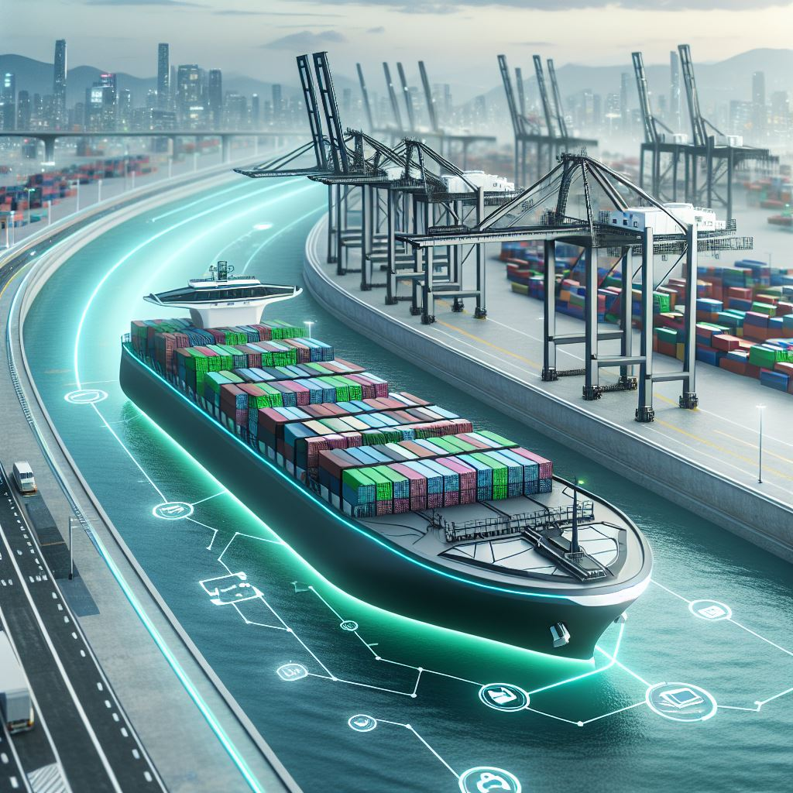
Development trends in inland waterway shipping
Modernization of ships and ports ("retrofitting")
Digitalisation
Automation
Use of sustainable resources
Low-water vessels
Waterway interconnectivity
Opening up new markets
40
Image: KI-generiert (MS Copilot)
Notes:
Measures to Further Promote the Sustainability and Usability of Inland Waterway Shipping:
Retrofitting refers to the process of equipping existing ships with modern technology to maintain their competitiveness, save fuel, and become more environmentally friendly. One example is the conversion of the “MSC Flaminia” by the shipping company NSB after a fire. By installing a new bulbous bow and propeller, fuel consumption was reduced by up to twelve percent. Retrofitting also demonstrates that older vessels can compete with new ones in terms of design and efficiency.
Digitalisation: By using modern technologies such as automated systems, telematics, and data analysis, efficiency gains and emission reductions can be achieved. The digital networking of ships and ports allows for optimized route planning, improved cargo tracking, and more efficient use of resources like fuel. Digitalisation contributes to increased efficiency, cost reduction, and environmental relief in inland shipping.
Waterway interconnectivity supports the increased usability of inland navigation by improving waterway infrastructure and creating efficient connections between various bodies of water. The goal is to facilitate the transport of goods by inland vessels while minimizing environmental impact. This is achieved through optimizing waterways, expanding locks, and eliminating bottlenecks, resulting in shorter transport times, reduced energy consumption, and lower CO₂ emissions.
The use of eco-friendly fuels and the switch to alternative propulsion systems such as electric mobility or hydrogen propulsion also contribute to sustainable inland shipping.
Opening up new markets and market segments (e.g., container transport) can increase the share of inland waterway transport in the overall traffic volume.
Sources:
Bundesanstalt für Wasserbau (2017): Kolloquium Wasserbauliche Herausforderungen an den Binnenschifffahrtsstraßen, https://izw.baw.de/publikationen/kolloquien/0/02_Kempmann-Kriedel_Rusche-Pauli-Georges_Herausforderungen....pdf; retrieved 18.03.2025
Verband deutscher Reeder (2016): https://www.reederverband.de/sites/default/files/publikationen/deutsche_seeschifffahrt/deutsche_seeschifffahrt_2016_-_umweltspecial.pdf; retrieved 18.03.2025
Heinzelmann, Christoph / Bödefeld, Jörg / Duric, Zorana (2020): Digitalisierung im Verkehrswasserbau. Bautechnik, 97; In: https://doi.org/10.1002/bate.202000029 ; pp. 441-444
Image source:
Generated using AI (Microsoft Copilot) on 12.06.2025, Prompt: "Create an image of a futuristic cargo ship (loaded with containers) that reflects visions and development trends in inland waterway shipping – with a focus on modern technologies, sustainability, and autonomous navigation. Urban port environment along a river."

Slide 61
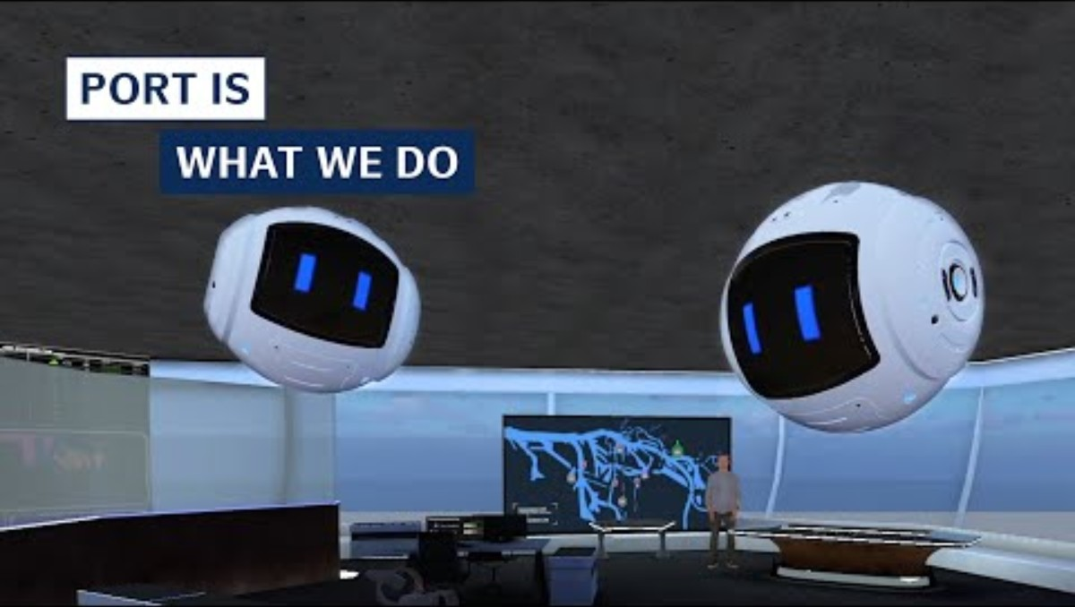
Best practice example: Digitalisation
Smart Ports: Port of Hamburg
Increased efficiency through sensor technology, analytics, forecasting, and information systems
Networking of traffic flows, infrastructure, and goods flows
Application examples:
Vehicle fleet with sensors for shorter routes & better capacity utilization
Handling all documentation in digital form
Real-time processing of navigation and parking space assignment
https://www.youtube.com/watch?v=CiMUtD8pYAg
Notes:
With the implementation of the Smart Port concept at the Port of Hamburg, efficiency can be increased to a whole new level. Sensor technology, analysis, forecasting, and information systems are used in real time to exploit every opportunity for greater efficiency. This enables optimal networking of traffic flows, infrastructure, and goods flows.
Big words, but what does it really mean:
By equipping the vehicle fleet with sensor technology, the location of each vehicle can be determined at any time. Efficient transport routes can be planned and optimized, leading to better fleet utilization.
Maintenance documentation is handled in digital format, making it accessible and updatable at any time.
Real-time navigation across the port area and parking space allocation for trucks accelerates the handling of transfers.
Sustainability is also a key part of the Smart Port concept. There is a strong focus on electromobility, including the necessary infrastructure. Renewable energy is essential, both as a propulsion source in shipping and in the use of shore power. The corresponding infrastructure is being developed and expanded.
Source:
Hamburg Port Authority (2025): https://www.hamburg-port-authority.de/de/hpa-360/smartport; Retrieved: 18.03.2025

Slide 62
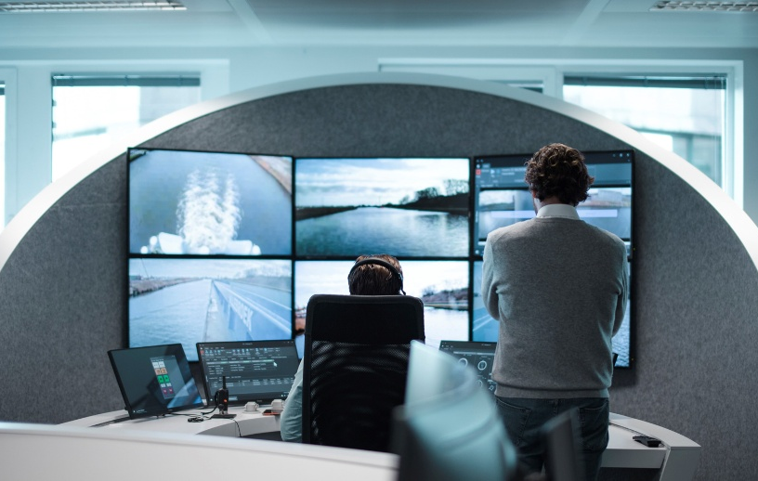
Innovation: Autonomous ships
Belgian company SEAFAR as a pioneer in (semi-)autonomous shipping
3 SEAFAR remote control centers (Antwerp, Charleroi, Duisburg), 1 customer-owned control center in Dordrecht
Step-by-step development and automation in coordination with regulatory authorities
Remote-controlled ships operating with full crews and also reduced crews
Technology to increase safety in human-centered operations
Remote-controlled navigation of unmanned and highly automated push barges
40
Picture: Seafar
Notes:
The Belgian company SEAFAR was founded in 2018 in Antwerp and specializes in the development and operational integration of technologies for remote-controlled operations in shipping. Ships are operated from three modern control centers located in Antwerp, Charleroi, and Duisburg. The automation of ships is implemented gradually and in coordination with local regulatory authorities. Both remote-controlled ships with full crews and ships with reduced crews are in operation. While the operation is remote-controlled, navigation is carried out by the crew on board. Technologies such as object detection and data collection support the crew on board and enhance safety. Currently, two routes in Belgium are testing remote-controlled ships without crews on board.
Source:
SEAFAR Company Presentation (2024)
https://seafar.eu/de/
Picture source:
Seafar (2024)

Slide 63

Kahoot!
Testing your knowledge with our transport quiz!
https://create.kahoot.it/share/freight-transport-in-transition/3796411b-309b-45e2-8752-0b98b2bbb873
https://kahoot.com/de/
Notes:
How it works:
Log in to Kahoot! or register for free: https://kahoot.com/en/
Open the following link to the quiz: https://create.kahoot.it/share/freight-transport-in-transition/3796411b-309b-45e2-8752-0b98b2bbb873
Start the quiz in class – either in individual mode or as a group game.
Tip:
For a playful review of the knowledge gained, the following online quiz is also suitable:
https://quizzes.biwas.de/ – Climate Change

Slide 64
Thank you for your attention!

Slide 65
Additional information for teachers
This teaching material package is available under a so-called Creative Commons Attribution 4.0 International License.
You may therefore freely integrate these teaching materials into your lessons, adapt them to your needs, and share them with your students or other individuals.
We only ask that you leave the logos on the slides.
The image rights are specified in the notes fields; usage in other settings is not permitted.
Explanation of the Use of Generative AI and AI-Supported Technologies:
During the development of this project, the authors used ChatGPT and Microsoft CoPilot to support concept creation and idea generation—especially for interactive exercises. The use of these AI tools was done with careful consideration. Afterwards, the content was thoroughly reviewed and, if necessary, revised by the authors to ensure compliance with academic standards.The authors bear full responsibility for the final published content.

Slide 66
Additional information for teachers
For questions and feedback, feel free to contact us via email at:
rewway@fh-steyr.at.
You can find additional slide sets and practical exercises at:
http://www.rewway.at/en/teaching-materials/
Are you perhaps interested in a Transport School Lab, an excursion, or a guest lecture?
http://www.rewway.at/en/pages/workshops

Slide 67
References I
BDB (2025): https://www.binnenschiff.de/system-wasserstrasse/gueterschifffahrt/; accessed 18.03.2025
Bundesanstalt für Wasserbau (2017): Kolloquium Wasserbauliche Herausforderungen an den Binnenschifffahrtsstraßen, https://izw.baw.de/publikationen/kolloquien/0/02_Kempmann-Kriedel_Rusche-Pauli-Georges_Herausforderungen....pdf; accessed: 18.03.2025
Bundesministerium für Innovation, Mobilität und Infrastruktur (2025): https://www.bmimi.gv.at/themen/mobilitaet/transport/gueterverkehr/kombiverkehr/terminals-rola/oesterreich.html; accessed 14.07.2025
Christidis, P., & Brons, M. (2016): External costs of freight transport in European Union Member States (Joint Research Centre (JRC)). Harvard Dataverse. https://dataverse.harvard.edu/dataset.xhtml?persistentId=doi:10.7910/DVN/YA3VCY https://doi.org/10.7910/DVN/YA3VCY; accessed 28.01.2025
Clausen, Uwe / Geiger, Christiane Hrsg. (2013): Verkehrs- und Transportlogistik
DESTATIS (2024): https://www.destatis.de/Europa/DE/Thema/GreenDeal/_inhalt.html; accessed 18.03.2025
Europäische Kommission (2011): Weißbuch - Fahrplan zu einem einheitlichen europäischen Verkehrsraum – Hin zu einem wettbewerbsorientierten und ressourcenschonenden Verkehrssystem
Europäische Kommission (2024): https://climate.ec.europa.eu/climate-change/causes-climate-change_de; accessed 15.05.2024
Europäische Kommission, Generaldirektion Kommunikation (2019): Was ist der europäische Grüne Deal?, In: https://data.europa.eu/doi/10.2775/944554; accessed 13.03.2025
Europäische Kommissione (2025): https://commission.europa.eu/strategy-and-policy/priorities-2019-2024/european-green-deal_de; accessed 05.02.2025
Europäischer Rat der Europäischen Union (2024): https://www.consilium.europa.eu/de/policies/green-deal/; accessed 13.03.2025
Europäisches Parlament (2022): https://www.europarl.europa.eu/news/de/press-room/20220119IPR21314/zukunft-europas-klimawandel-grosste-herausforderung-fur-die-eu-so-die-burger; accessed 18.03.2025
Europäisches Parlament (2024): https://www.europarl.europa.eu/resources/library/images/20211027PHT16017/20211027PHT16017_original.jpg; accessed 18.03.2025

Slide 68
References II
European Commission (2023): Sustainable & Smart Mobility Strategy, In: https://transport.ec.europa.eu/transport-themes/mobility-strategy_en; accessed 05.02.2025
Eurostat (2024): Modal split of inland freight transport: https://ec.europa.eu/eurostat/databrowser/view/tran_hv_frmod/default/table?lang=en&category=tran.tran_hv_ms; accessed 06.02.2025
Eurostat (2025): https://ec.europa.eu/eurostat/statistics-explained/index.php?title=Glossary:Transport_mode/de; accessed 27.02.2025
Eurostat (2025): https://ec.europa.eu/eurostat/statistics-explained/index.php?title=Characteristics_of_the_railway_network_in_Europe; accessed 06.03.2025
Hamburg Port Authority (2025): https://www.hamburg-port-authority.de/de/hpa-360/smartport; accessed: 18.03.2025
Heinzelmann, Christoph / Bödefeld, Jörg / Duric, Zorana (2020): Digitalisierung im Verkehrswasserbau. Bautechnik, 97; In: https://doi.org/10.1002/bate.202000029; p. 441-444
IPCC (2023): https://www.de-ipcc.de/media/content/IPCC_AR6_SYR_DE_barrierefei.pdf, accessed 16.05.2024
ITF (2023): ITF Transport Outlook 2023, OECD Publishing, Paris; on https://doi.org/10.1787/b6cc9ad5-en; accessed 06.03.2025
Kille, Christian/ Schmidt , Norbert (2008): Wirtschaftliche Rahmenbedingungen des Güterverkehrs. Studie zum Vergleich der Verkehrsträger im Rahmen des Logistikprozesses in Deutschland, S.53. Online: http://www.scs.fraunhofer.de/content/dam/scs/de/dokumente/studien/Wirtschaftliche_Rahmenbedingungen_des_Gueterverkehrs.pdf; accessed 04.02.2025
Koch, Susanne (2012): Logistik – Eine Einführung in Ökonomie und Nachhaltigkeit
Kummer, Sebastian / Grün, Oskar / Jammernegg, Werner (4. Auflage 2019): Grundzüge der Beschaffung, Produktion und Logistik
Muchna, Claus/ Brandenburg, Hans/ Fottner, Johannes/ Gutermuth, Jens (2. Auflage 2021): Grundlagen der Logistik. Begriffe, Strukturen und Prozesse
Myclimate (2024): https://www.myclimate.org/de/informieren/faq/faq-detail/was-sind-treibhausgase/; accessed 18.03.2025
ÖBB (2025): https://infrastruktur.oebb.at/de/unternehmen/kundinnen-im-mittelpunkt/schwerpunkt-puenktlichkeit; accessed 06.03.2025
Pazirandeh, Ali / Jafari, Hamid (2013): Making sense of green logistics; In: International Journal of Productivity and Performance Management

Slide 69
References III
Saroha, Rituraj (2014): Green logistics & its significance in modern day systems; In: International Review of Applied Engineering Research, S. 90
Schienen-Control (2025): https://www.schienencontrol.gv.at/de/wettbewerbsregulierung/eisenbahnnetz-oesterreich.html, accessed 28.01.2025
SEAFAR Unternehmenspräsentation (2024)
SGKV – Studiengesellschaft für den Kombinierten Verkehr (2025): https://www.intermodal-info.com/terminals-im-kv/; accessed 18.03.2025
Smart Freight Centre (2024): GLEC Framework v3.1 edition, revised and updated. In: https://https://www.smartfreightcentre.org/en/our-programs/emissions-accounting/global-logistics-emissions-council/calculate-report-glec-framework/; accessed 06.03.2025
Statista (2026), Schifffahrt, https://de.statista.com/statistik/kategorien/kategorie/16/themen/131/branche/schifffahrt/#overview (accessed 10.02.2026)
Statista (2026), Verteilung des Transportaufkommens im Güterverkehr in Österreich nach Verkehrsträgern in den Jahren 2015 bis 2023, https://de.statista.com/statistik/daten/studie/791008/umfrage/verteilung-des-transportaufkommens-gueteraufkommen-nach-verkehrstraegern-in-oesterreich/ (accessed 10.02.2026)
Statistik Austria (2024): Verkehrsstatistik 2023, In: https://www.statistik.at/fileadmin/publications/Verkehr2023barr.pdf, accessed 05.02.2025
Ten Hompel, Michael / Schmidt, Thorsten (2003): Warehouse Management: Automatisierung und Organisation von Lager- und Kommissioniersystemen
Umweltbundesamt (2024): Klimaschutzbericht 2024. In: https://www.umweltbundesamt.at/fileadmin/site/publikationen/rep0913.pdf; accessed 14.01.2025
UNRIC (2025): https://unric.org/de/17ziele/; accessed 18.03.2025
Verband deutscher Reeder (2016): https://www.reederverband.de/sites/default/files/publikationen/deutsche_seeschifffahrt/deutsche_seeschifffahrt_2016_-_umweltspecial.pdf; accessed 18.03.2025
Viadonau (2019): Handbuch der Donauschifffahrt / Manual on Danube Navigation
Viadonau (2024): Jahresbericht der viadonau 2023
Wirtschaftslexikon Gabler (2025): https://wirtschaftslexikon.gabler.de/definition/logistik-40330, accessed 07.01.2025

