Slide 1
Understanding Emissions – Shaping Climate Protection: The Role of Inland Waterway Transport
Teaching Material

Slide 2
What share of global greenhouse gas emissions is caused by the transport sector?
Around one fifth (21%) of global greenhouse gas emissions come from the transport sector.
Notes:
Quelle:
EDGAR/JRC (2024): Verteilung der CO₂-Emissionen weltweit nach Sektor 2024. In: https://de.statista.com/statistik/daten/studie/167957/umfrage/verteilung-der-co-emissionen-weltweit-nach-bereich/; Abruf 02.12.2025

Slide 3
How to best work with this teaching material
Power Point: The following PowerPoint presentation provides an introduction to the topic “Logistics”. Each slide includes speaker notes with explanations and source references. Activity slides are highlighted in yellow and contain practical examples, exercises, videos, and other interactive elements specifically prepared for classroom use.
Videos and supplementary exercises: Videos and exercises on the topic can be found in the presentation on the color-coded activity slides as well as at: https://www.rewway.at/en/teaching-materials
All teaching materials offer a compact overview to support lesson planning: learning objectives, target groups, level of difficulty, methods, and links to the curriculum.
Kahoot!: For a playful review of learning progress, there is the option of integrating a pre-prepared, freely accessible Kahoot! into your lesson. The QR code or direct link to the quiz can be found at the end of the PowerPoint.
References: The sources used in the presentation are available both in the notes section of each slide and at the end of the PowerPoint

Slide 4
Learning objectives and target groups
Learning objectives:
Participants should…
  understand the basics of climate change as well as the effects of greenhouse gas emissions
  become familiar with the transport sector in relation to greenhouse gas emissions
  carry out exercises on emission calculations
  reflect on emissions in inland waterway transport, and
  get to know different approaches and technologies that can reduce emissions in inland navigation
Target group:
Upper secondary school students (AHS) and vocational school students (BHS)
Apprentices
University students in introductory courses on transport logistics, inland waterway transport, and multimodal transport
Career changers and professionals from other industries

Slide 5
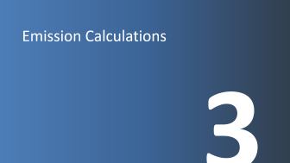
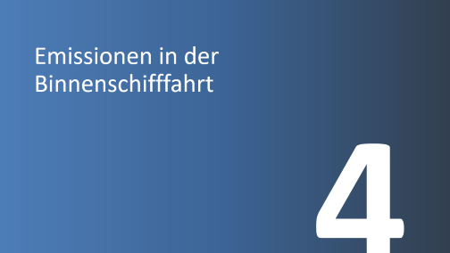

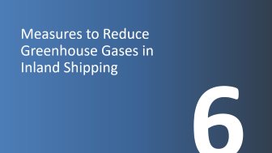
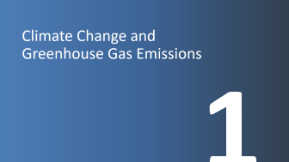

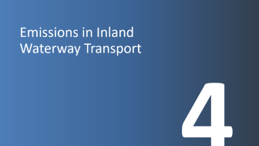
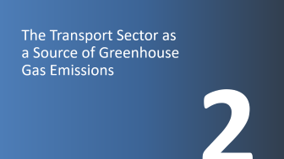
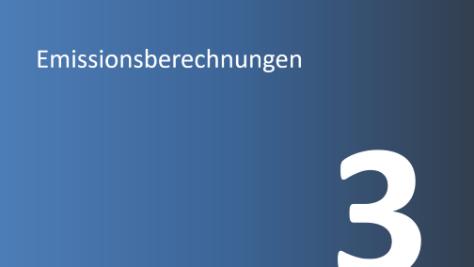
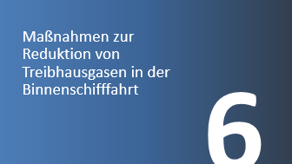


Understanding Emissions – Shaping Climate Protection: The Role of Inland Waterway Transport

Slide 6
Climate Change and Greenhouse Gas Emissions
1

Slide 7

What is climate?
Weather ≠ Climate
Weather describes short-term phenomena in our atmosphere at a specific location. It can vary from day to day and even from hour to hour.
Climate, on the other hand, is the statistical description of weather conditions over a longer period (at least 30 years).
Picture: Pixabay
Notes:
Source: Klimabündnis (2024): https://www.klimabuendnis.at/wp-content/uploads/2024/09/Praesentationen_zu_Klimafakten_Klimawandel.pdf (Accessed on: 01.07.2025)
Picture source: Pixabay (2025): https://pixabay.com/de/photos/wolken-himmel-natur-wetter-2085112/ (Accessed on: 01.07.2025)

Slide 8
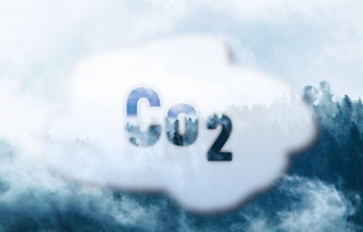
Greenhouse gases
Picture: Pixabay
The naturally occurring greenhouse effect is an essential prerequisite for life on Earth. Without it, the average temperature of our planet would be around –18 °C despite solar radiation.
Greenhouse gases such as carbon dioxide (CO₂), ozone (O₃), methane (CH₄), and nitrous oxide (N₂O) are present in the atmosphere only in very small amounts — about 0.04 %. Nevertheless, their ability to absorb heat radiation has a significant influence on the global climate.
Carbon dioxide (CO₂) is the most important greenhouse gas in terms of quantity. The average residence time of CO₂ in the atmosphere is about 120 years. CO₂ is produced as a final product during the combustion of substances containing carbon.
Methane (CH₄) is released during the decomposition of organic material in the absence of air — for example, in the stomachs of ruminants (cattle), in rice cultivation, and in landfills.
Nitrous oxide (N₂O) is produced by the breakdown of nitrogen-containing compounds in soils. It is mainly emitted from the use of nitrogen fertilizers in agriculture, intensive livestock farming, and combustion or sewage treatment processes.
Fluorinated greenhouse gases (HFCs, PFCs, SF₆, NF₃) do not occur naturally in contrast to other greenhouse gases. They are used, for example, as refrigerants in air-conditioning systems, as propellants in sprays, and as blowing agents in foams and insulation materials.
Notes:
Source: Klimabündnis (2024): https://www.klimabuendnis.at/wp-content/uploads/2024/09/Praesentationen_zu_Klimafakten_Klimawandel.pdf (Accessed on: 01.07.2025)
Picture source: Pixabay (2025): https://pixabay.com/de/photos/kohlendioxid-co2-klimawandel-7123532/ (Accessed on: 01.07.2025)
Further reading: https://www.ardalpha.de/wissen/umwelt/klima/klimawandel/treibhausgase-gase-kohlendioxid-methan-klimawandel-100.html

Slide 9
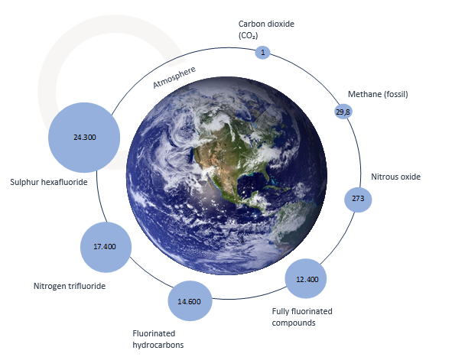
CO₂ equivalents (CO₂e) = Global warming potential
CO₂e is a unit of measurement that makes the effect of all greenhouse gases on the climate comparable.
Different greenhouse gases contribute to the greenhouse effect to varying degrees and remain in the Earth’s atmosphere for different lengths of time.
Example: Comparison of the impact of one ton of CO₂ with one ton of methane over a period of 100 years: one ton of methane is about 30 times more harmful to the climate than one ton of CO₂.Therefore, one ton of methane corresponds to about 30 tons of CO₂ equivalents (CO₂e).
Picture: Pixabay and own illustration, data from IPCC (2024)
Notes:
Source: ClimatePartner GmbH (2025): https://www.climatepartner.com/de/wissen/glossar/co2-aequivalente-co2e (Accessed on: 01.07.2025)
Picture source: Own illustration, Earth image from Pixabay (2025): https://pixabay.com/de/photos/erde-planet-raum-welt-universum-11009/ (Accessed on: 01.07.2025), Data from: IPCC (2024a): https://ghgprotocol.org/sites/default/files/2024-08/Global-Warming-Potential-Values%20%28August%202024%29.pdf (Accessed on: 01.07.2025)

Slide 10
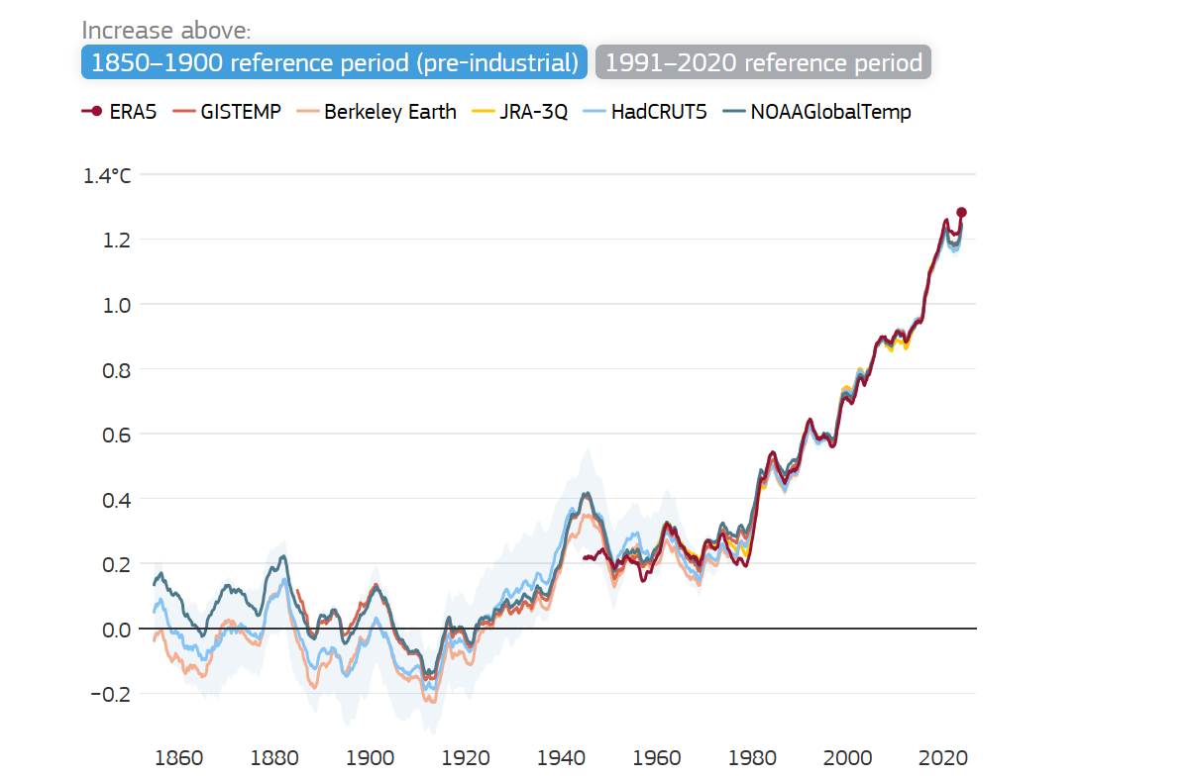
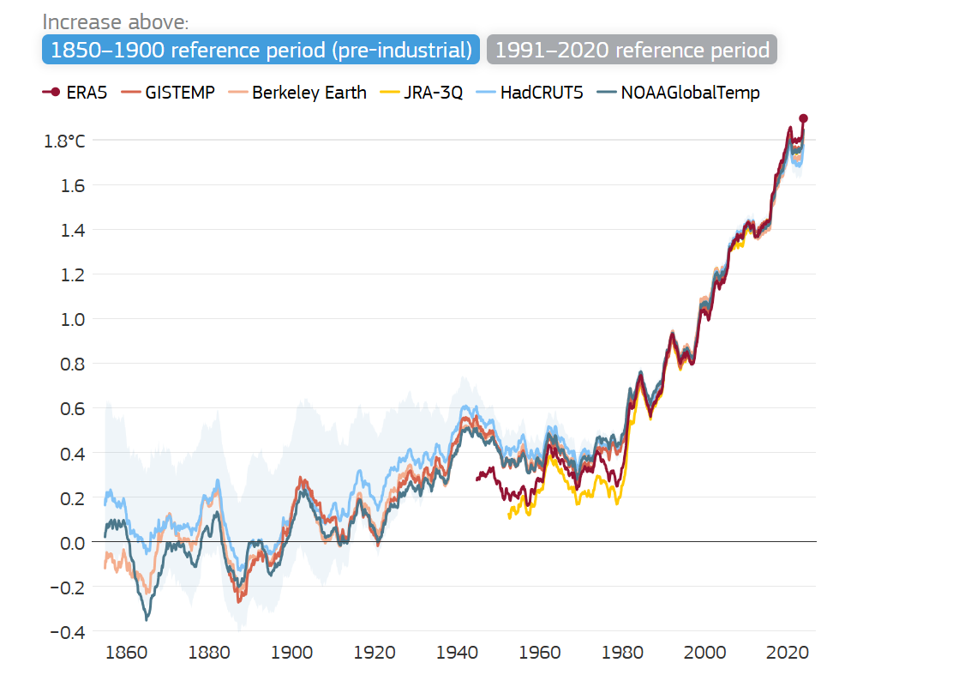
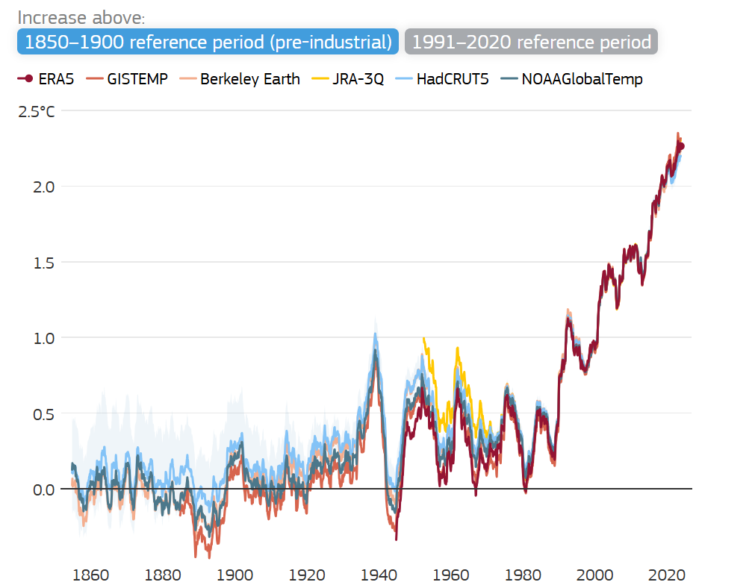
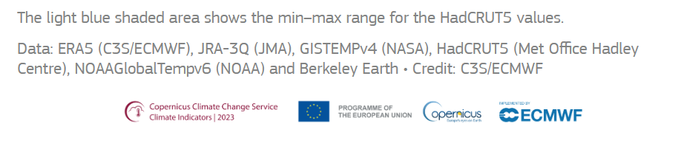

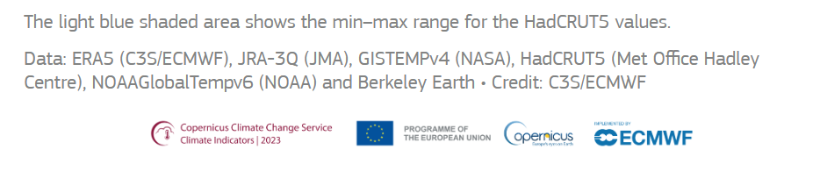
Rise in temperature
Increase in global average temperature
Increase in average temperature over land
Increase in average European temperature
Figure 1. Global average near-surface temperature for centred running 60-month periods, relative to the average for the 1991–2020 reference period and as an increase above the 1850–1900 average, according to six datasets. The average temperature for 1991–2020 from ERA5 is 14.4°C. Data sources: ERA5 (C3S/ECMWF), JRA-3Q (JMA), GISTEMPv4 (NASA), HadCRUT5 (Met Office Hadley Centre), NOAAGlobalTempv6 (NOAA) and Berkeley Earth. Credit: C3S/ECMWF.
Figure 2. Average temperature over all land for centred running 60-month periods, relative to the average for the 1991–2020 reference period and as an increase above the 1850–1900 average, according to six different datasets. The average temperature for 1991–2020 from ERA5 is 9.2°C. Data sources: ERA5 (C3S/ECMWF), JRA-3Q (JMA), GISTEMPv4 (NASA), HadCRUT5 (Met Office Hadley Centre), NOAAGlobalTempv6 (NOAA) and Berkeley Earth. Credit: C3S/ECMWF.
Figure 3. Average temperature over European land for centred running 60-month periods, relative to the average for the 1991–2020 reference period and as an increase above the 1850–1900 average, according to six different datasets. The average temperature for 1991–2020 from ERA5 is 9.2°C. Data sources: ERA5 (C3S/ECMWF), JRA-3Q (JMA), GISTEMPv4 (NASA), HadCRUT5 (Met Office Hadley Centre), NOAAGlobalTempv6 (NOAA) and Berkeley Earth. Credit: C3S/ECMWF.
Picture: Copernicus Climate Change Service (2025)
Notes:
The global near-surface air temperature has increased by about 1.3 °C to 1.4 °C since pre-industrial times.
The average values of the past five years are among the highest—or the highest—since records began.
The temperature rise has been more pronounced over land than over the ocean.
In Europe, the increase was about 1 °C higher than the global average.
Six commonly used datasets show that the most recent five-year average (2020–2024) is the highest on record, and that 2024 was the warmest year ever, followed by 2023 and 2016. The lower temperatures in 2021 and 2022 are linked to a prolonged La Niña event. All datasets show that the years 2015 to 2024 were the ten warmest years since records began, even though the ranking of individual years varies slightly.
Source: Copernicus Climate Change Service (2025a): https://climate.copernicus.eu/climate-indicators/temperature (Accessed on: 02.02.2025)
Picture source: Copernicus Climate Change Service (2025a): https://climate.copernicus.eu/climate-indicators/temperature (Accessed on: 02.02.2025)

Slide 11
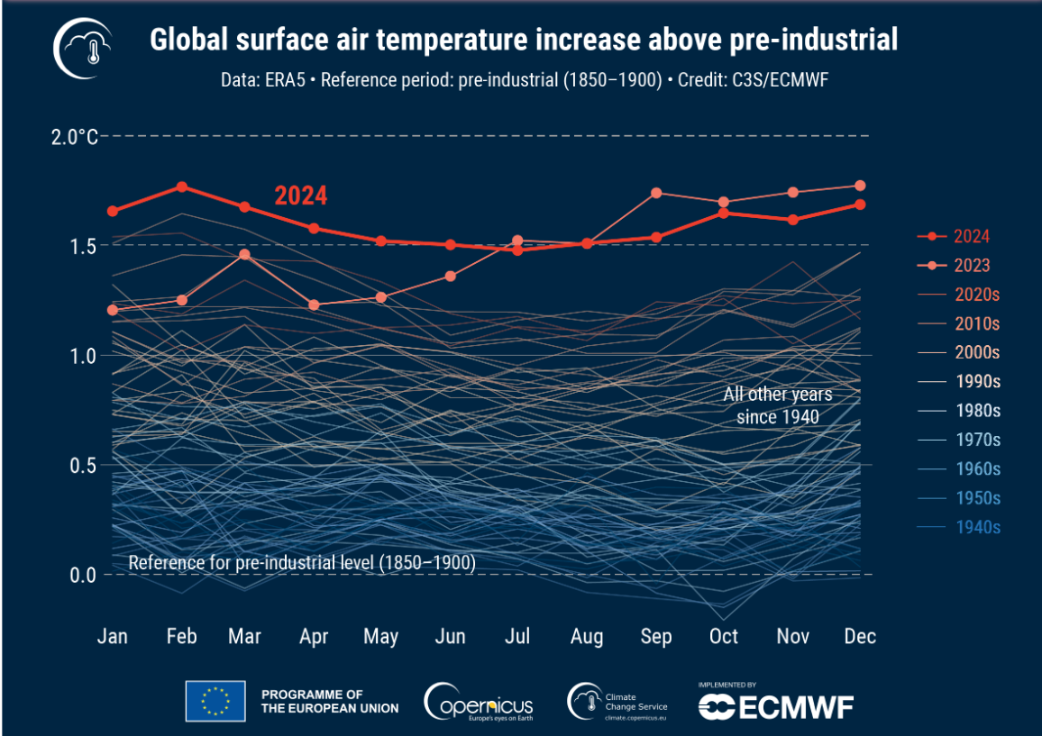
Rise in temperature
2024 was the hottest year since records began.
Particularly noteworthy was July 22, which was considered the hottest day ever recorded, with a global average temperature of 17.16 °C, according to ERA5.
2024 was also the first year to reach an annual temperature anomaly exceeding the 1.5 °C threshold compared to pre-industrial levels.
Picture: Copernicus Climate Change Service (2025)
Although this does not mean that the limit set in the Paris Agreement has been exceeded — as that refers to temperature deviations averaged over at least 20 years — it nevertheless highlights that global temperatures have risen to levels never before experienced by modern humans.
Notes:
Source: Copernicus Climate Change Service (2025b): https://climate.copernicus.eu/copernicus-2024-first-year-exceed-15degc-above-pre-industrial-level (Accessed on: 03.07.2025)
Image source: Copernicus Climate Change Service (2025b): https://climate.copernicus.eu/copernicus-2024-first-year-exceed-15degc-above-pre-industrial-level (Accessed on: 03.07.2025)

Slide 12

Effects of climate change
Polar ice is melting: When ice sheets turn into seawater, the reflection of sunlight changes, causing even more ice to melt. As sea ice retreats, hunting grounds and habitats for many species disappear, and ocean circulation patterns change.
Picture: Pixabay
Rising sea levels: Sea levels are rising due to melting ice masses and the thermal expansion of water. With a 2 °C increase in temperature, around 130 million people would be affected by higher sea levels.
Glaciers are shrinking: Glacier retreat affects ecosystems, drinking water, energy, and tourism in the Alps. More than 100 million people are impacted through river systems such as the Danube, Po, Rhine, and Rhone.
Thawing permafrost: Permafrost soils contain enormous amounts of carbon—around 1,700 gigatons in the Arctic alone. As permafrost thaws, large quantities of greenhouse gases can be released, posing a global risk.
Notes:
Source: Klimabündnis (2024): https://www.klimabuendnis.at/wp-content/uploads/2024/09/Praesentationen_zu_Klimafakten_Klimawandel.pdf (Accessed on: 01.07.2025)
Picture source: Pixabay (2025): https://pixabay.com/de/photos/gletscher-morteratschgletscher-berge-7125359/ (Accessed on: 03.07.2025)

Slide 13
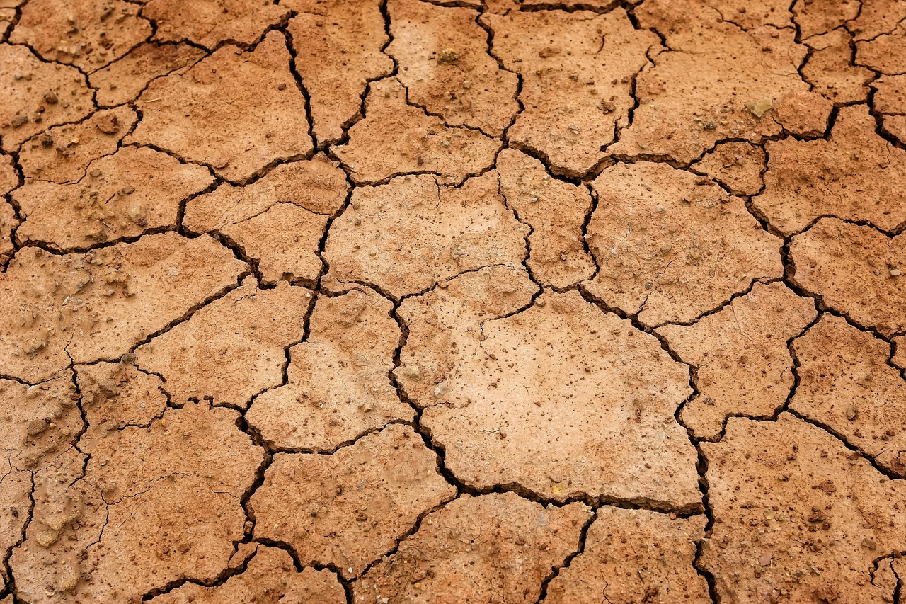
Effects of climate change
Increase in extreme weather events
Ecosystems and biodiversity: According to the World Biodiversity Council, 1 in about 8 million species is threatened with extinction. Many cannot adapt quickly enough, leading to impoverished ecosystems. In addition, habitat destruction, pollution, pesticides, invasive species, and overexploitation further strain biodiversity.
Picture: Pixabay
Ocean acidification: The oceans absorb around 22% of human-made CO₂ emissions, which causes acidification. This harms many marine organisms, especially those that form calcium carbonate shells, and threatens coral reefs. Once a reef is destroyed, it can take several thousand years to recover.
Agriculture and food security
Displacement and climate migration
Notes:
Source: Klimabündnis (2024): https://www.klimabuendnis.at/wp-content/uploads/2024/09/Praesentationen_zu_Klimafakten_Klimawandel.pdf (Accessed on: 01.07.2025)
Picture source: Pixabay (2025): https://pixabay.com/de/photos/erde-d%C3%BCrre-boden-trockenheit-3355931/ (Accessed on: 03.07.2025)

Slide 14
The consequences of global warming of 1.5° vs. 2.0°
Loss of Arctic Sea Ice
1,5°
An ice-free summer in the Arctic every 100 years.
2,0°
An ice-free summer in the Arctic every 10 years.
Flooding
1,5°
100% higher (i.e., twice as high) flood risk.
2,0°
170% higher flood risk.
Species Extinction
1,5°
6% of insects
8% of plants
4% of vertebrates affected
2,0°
18% of insects
16% of plants
8% of vertebrates affected
Droughts and Water Scarcity
1,5°
50 million people in urban areas affected by drought and water scarcity.
2,0°
410 million people in urban areas affected by drought and water scarcity.
Coral Bleaching and Death
1,5°
At least 70% of all coral reefs worldwide will have disappeared by 2050.
2,0°
Almost all coral reefs worldwide will have disappeared by 2050.
Notes:
Alternatively or additionally, the following video can be shown: https://www.youtube.com/watch?v=nARngHsFtl0
Source: WWF Austria (2023): https://www.wwf.at/artikel/folgen-der-klimakrise-15-grad-oder-2-grad/ (Accessed on: 01.07.2025)

Slide 15

World climate council
The World climate council (IPCC – Intergovernmental Panel on Climate Change) is the international body for assessing climate science. It was established in 1988 by the World Meteorological Organization (WMO) and the United Nations Environment Programme (UNEP) to provide decision-makers with regular reports on the scientific foundations of climate change, its impacts, risks, and possible countermeasures.
In 2023, the sixth assessment report was published, which was written by hundreds of leading scientists and experts.
Notes:
Source: IPCC (2024b): https://www.ipcc.ch/site/assets/uploads/2024/04/IPCCFactSheet_WhatisIPCC.pdf (Accessed on: 03.07.2025)

Slide 16
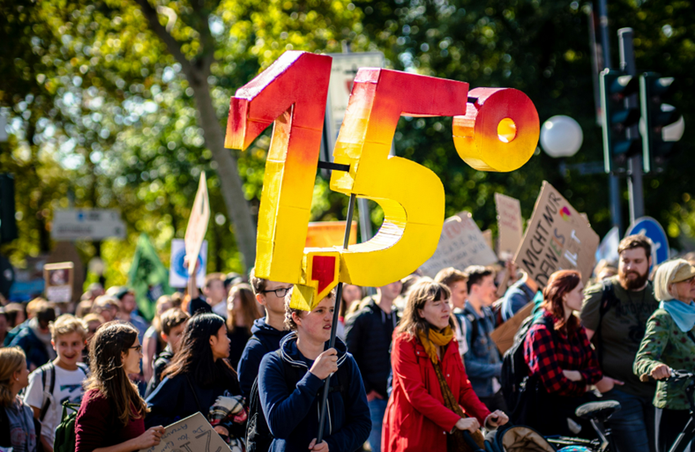
International climate goals
Picture: Unsplash
The Paris Climate Agreement – a milestone in global climate protection
  The climate crisis is a global problem that can only be solved through international cooperation.
  A decisive step was the World Climate Conference in 2015 in Paris, at which the Paris Agreement was adopted by 195 member states of the UN Framework Convention on Climate Change (UNFCCC).
  The agreement aims to limit global warming to well below 2 °C – preferably to 1.5 °C – compared to pre-industrial levels.
  In addition, only as many greenhouse gases should be emitted as can be reabsorbed by natural and artificial CO₂ sinks.
  Another important point is financial support for poorer countries, enabling them to implement both climate protection measures and adaptations to the consequences of climate change.
Meanwhile, 198 states belong to the Climate Framework Convention, and 195 of them have signed the Paris Agreement – almost the entire world community. Despite this broad consensus, concrete measures often remain difficult, as different interests collide.
In addition to the Paris Agreement, there are other international initiatives that advance climate protection in industrialized, emerging, and developing countries, each with its own priorities and members.
Notes:
Source: Klimabündnis (2024): https://www.klimabuendnis.at/wp-content/uploads/2024/09/Praesentationen_zu_Klimafakten_Klimawandel.pdf (Accessed on: 01.07.2025)
Umweltbundesamt (2024a): https://www.umweltbundesamt.de/themen/klima-energie/internationale-klimapolitik#internationale-klimapolitik (Accessed on: 07.07.2025)
Picture source: Photo by Mika Baumeister on Unsplash
Further information on the history of climate negotiations: https://www.europarl.europa.eu/topics/en/article/20180404STO00910/infographic-history-of-climate-negotiations

Slide 17
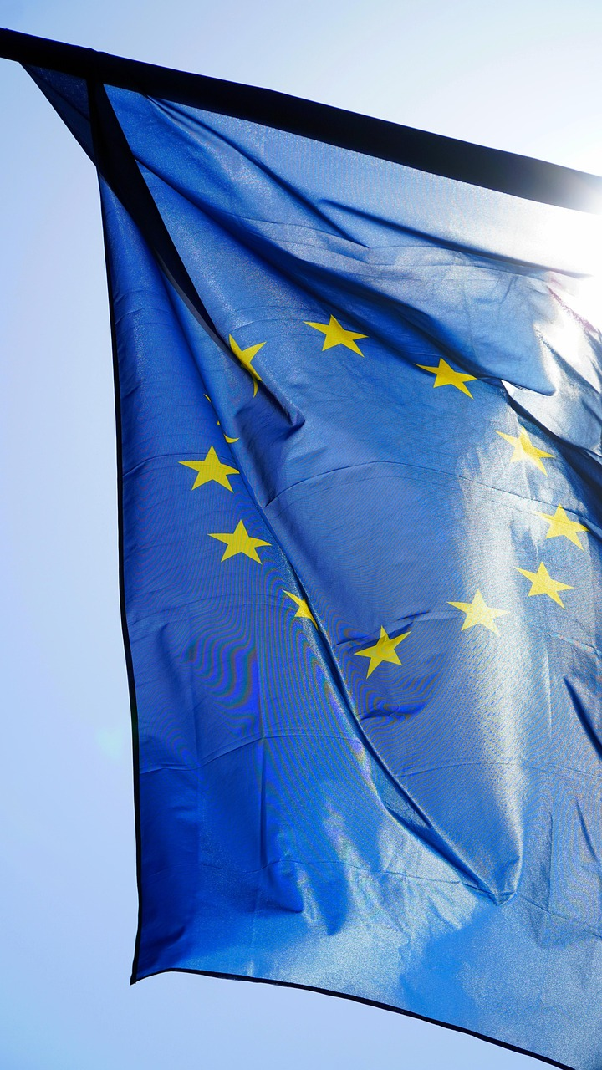
EU goals
28 Nov 2019 The European Parliament declares a climate emergency.
The Commission is to ensure that all relevant legislative and budgetary proposals are fully consistent with the goal of limiting global warming to below 1.5 °C.
11 Dec 2019 The EU Commission presents the European Green Deal. With the help of a European Climate Law, the EU aims to become climate-neutral by 2050.
12 Dec 2019 At an EU summit in Brussels, the heads of state and government agree on the EU’s climate neutrality target for 2050.
29 July 2021 The first EU Climate Law makes the achievement of climate neutrality by 2050 legally binding. The law also stipulates that negative emissions should be achieved after 2050. As an interim target, a reduction in net greenhouse gas emissions of at least 55 % by 2030 is set.
Picture: Pixabay
Notes:
Source: European Parliament (2018): https://www.europarl.europa.eu/topics/en/article/20180404STO00910/infographic-history-of-climate-negotiations (Accessed on: 07.07.2025)
Picture source: Pixabay (2025): https://pixabay.com/photos/europe-flag-european-flag-eu-4977601/ (Accessed on: 07.07.2025)

Slide 18
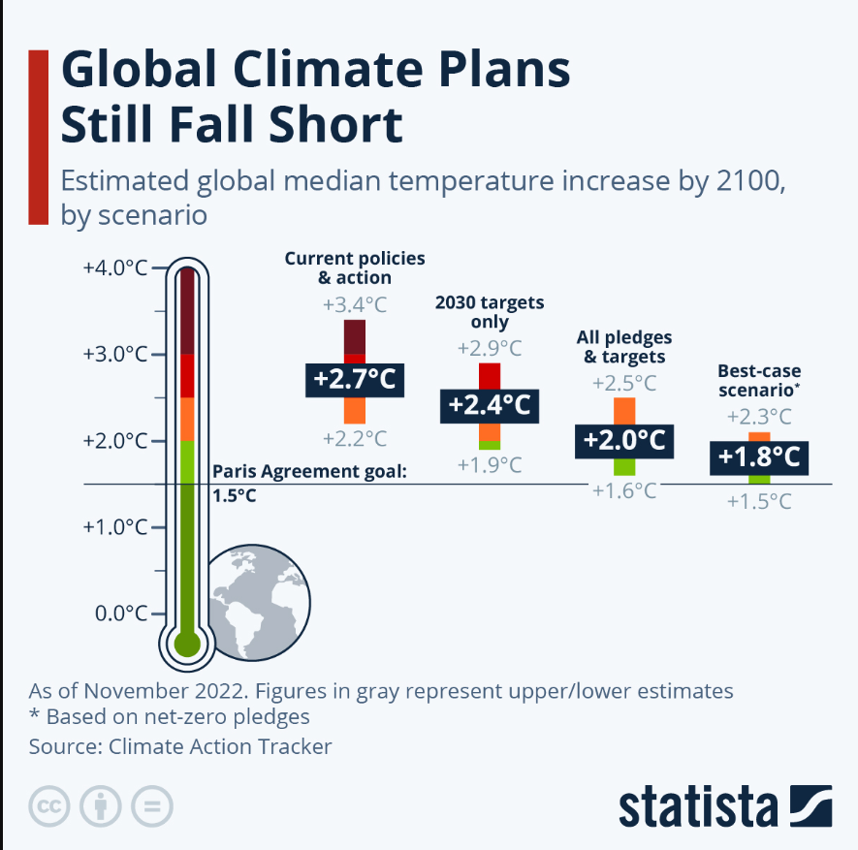
Projections
1,000 Gt CO₂ cause an increase in global surface temperature of about half a degree (0.27 °C to 0.63 °C). From this relationship, a remaining carbon budget can be derived within which the temperature increase can be limited to a certain level.
To keep warming below 1.5 °C compared to pre-industrial levels, only 275 Gt CO₂ may still be emitted worldwide (as of 2022).
To limit the global surface temperature increase to 2 °C, 1,150 Gt CO₂ remain (as of 2022).
For comparison: in 2022, a total of 40.7 Gt CO₂ emissions were caused worldwide.
Image: Armstrong (2025)
Notes:
The current commitments and targets of governments worldwide to reduce greenhouse gas emissions are not sufficient to limit global warming to 1.5 degrees Celsius. According to researchers, by the end of the century, global warming would then reach 2.1 degrees Celsius compared to pre-industrial times.
If the targets and promises are not implemented and the status quo remains, the global average temperature in the year 2100 would even reach +2.7 degrees Celsius.
In the optimistic scenario, with intensified climate protection efforts, global warming would still amount to 1.9 degrees. However, the margin of error here lies between 1.5 and 2.4 degrees – meaning that the Paris target could either be achieved or missed by an even greater margin.
With every lost decade in which efforts do not increase, the challenges and costs of achieving the goals continue to rise and will eventually become insurmountable.
The CAT data indicate a global warming level of 1.3 degrees for the year 2023.
The EU climate service Copernicus recently announced that the year 2024 was the warmest year worldwide since records began – with an average global temperature 1.6 °C above the pre-industrial average.
Accordingly, 2024 was the first calendar year in which the global average temperature exceeded 1.5 °C above the pre-industrial level.
Source: Janson (2025): https://de.statista.com/infografik/24799/prognose-zum-anstieg-der-globalen-durchschnittstemperatur/ (Accessed on: 07.07.2025)
Anderl et al. (2024): https://www.umweltbundesamt.at/fileadmin/site/publikationen/rep0913.pdf (Accessed on: 07.07.2025)
Image source: Armstrong (2025): https://www.statista.com/chart/26160/global-mean-temperature-increase-2100-estimates/ (Accessed on: 07.07.2025)

Slide 19
The Transport Sector as a Source of Greenhouse Gas Emissions
2

Slide 20
Transport sector worldwide
In 2023, the transport sector was responsible for 21.11% of global CO₂ emissions.
Each year, the transport sector releases more than eight billion tons of CO₂ equivalents into the atmosphere.
The emissions from this sector have almost doubled since 1990 and are expected to continue increasing.
Road vehicles are by far the largest sources of emissions within the transport sector. In 2023, they accounted for three quarters of all transport-related CO₂ emissions.
Picture: Own representation, data from Statista (2024a)
Notes:
Source: Janson (2025): https://de.statista.com/infografik/24799/prognose-zum-anstieg-der-globalen-durchschnittstemperatur/ (Accessed on: 07.07.2025)
Picture source: Own representation, data from Statista (2024a): https://de.statista.com/statistik/daten/studie/167957/umfrage/verteilung-der-co-emissionen-weltweit-nach-bereich/ (Accessed on: 07.07.2025)

Slide 21
Transport sector in the EU
In 2023, the transport sector was responsible for 25.2% of CO₂ emissions in the EU.
Cars are the largest emitters in EU transport: In 2022, road vehicles in the EU caused around 755 million tons of CO₂. This accounted for three quarters of the emissions in the transport sector.
International aviation
Picture: Own representation, data from Statista (2024b)
Notes:
Source: Statista (2025b): https://www.statista.com/topics/7968/transportation-emissions-in-the-eu/#statisticChapter (Accessed on: 07.07.2025)
Picture source: Own representation, data from Statista (2024b): https://www.statista.com/statistics/1325132/ghg-emissions-shares-sector-european-union-eu/ (Accessed on: 07.07.2025)

Slide 22
Emission Calculations
3

Slide 23
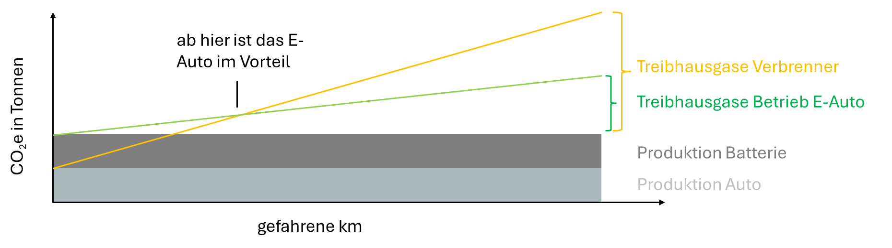
Electric car or combustion engine
Which is better for the climate?
from here on, the electric car has the advantage
Greenhouse gases – combustion engine
Greenhouse gases – operation of electric car
CO₂e in tons
Battery production
Car production
kilometers driven
Picture: own representation, data from Kühl 2021
Notes:
You often read conflicting reports about whether electric cars are really more climate-friendly than combustion engine cars.
The reason: studies make different assumptions – for example, about the electricity mix, battery size, or mileage.
Production:
An electric car causes more CO₂ during production, mainly because of the battery.
A compact-class electric car starts with about 13 tons of CO₂, while a diesel or petrol car starts with around 7.5 tons.
Operation:
In everyday use, the climate balance depends on the electricity mix. The more green electricity is used for charging, the better the electric car performs.
Combustion engines continuously produce emissions through the burning of petrol or diesel.
When does the electric car become better?
Depending on battery size and electricity source, an electric car becomes more climate-friendly after around 150,000 kilometers.
With larger batteries, this point shifts further, but even then the electric car usually has the advantage – especially at today’s average driving distances.
Future trend:
The CO₂ balance of electric cars is improving thanks to more renewable energy and more efficient battery production.
New studies show significantly lower emissions from battery manufacturing than just a few years ago.
Conclusion:
There is no simple, one-size-fits-all answer – it depends on the car, the number of kilometers driven, the electricity mix, and other factors.
Today, electric cars are usually already more climate-friendly than combustion engine vehicles, especially if they are driven for a longer time and charged mainly with renewable electricity.
However, those who drive only rarely or choose a very large electric car should take a closer look.
Such comparisons are made using life cycle assessments, which calculate and compare emissions from production to disposal.
Further information, for example, in this video: https://www.youtube.com/watch?v=fZFe6iaOJhQ (Accessed on: 07.07.2025)
Source: Kühl (2021): https://klimaandmore.de/?p=3518 (Accessed on: 07.07.2025)
Picture source: Own representation, data from https://klimaandmore.de/?p=3518 (Accessed on: 07.07.2025)

Slide 24
Why are emission calculations important?
Accurate and precise calculations are an essential prerequisite in order to:
Evaluate measures for shifting transport modes
Assess options for decarbonization
Support companies in reducing their emission footprint
Track progress in emission reduction over time
„If you can´t measure it, you can´t manage it“
(Peter Drucker)
Notes:
Source: ClimatePartner (2022): https://www.climatepartner.com/en/knowledge/insights/scope-emissions-reduce (Accessed on: 08.07.2025)

Slide 25



Calculation of emissions in the transport sector: From the source to the vehicle
Well-to-Tank (WtT)
Tank-to-Wheel (TtW)
Picture: own illustration, images from Freepik
Well-to-Wheel (WtW)
The concept of “Well to Wheel” analyses the environmental impact of a vehicle from fuel production to combustion in the vehicle. It enables a comprehensive assessment of the emissions of different fuels and drive systems.
Notes:
“Well to Wheel” (WtW) describes the entire process chain of energy production and use in the transport sector. It considers how a fuel or energy source — such as crude oil — reaches actual use in a vehicle through extraction, processing, transport, and storage. The entire chain is usually divided into two main sections:“Well to Tank” (WtT) includes all processes up to refuelling the vehicle, i.e. stationary, upstream steps.“Tank to Wheel” (TtW) includes the energy consumption and emissions during the actual driving of the vehicle.When comparing different propulsion technologies — such as combustion engines and electric drives — the WtW approach plays an important role.While electric cars produce no CO₂ emissions during driving (TtW), emissions can occur during electricity generation (WtT), depending on the energy source, e.g. coal, gas, or renewable sources.The WtW concept thus enables a comprehensive and fair assessment of the actual environmental impacts of different fuels and drive systems by considering the entire energy path from source to use.Its goal is to make the entire CO₂ footprint and other environmental impacts throughout the value chain transparent — not just to reduce emissions.
Source: IKEM (2010): https://www.forschungsinformationssystem.de/servlet/is/332825/ (Accessed on: 08.07.2025)
Picture source: Freepik (2025): https://www.freepik.com/icon/pumpjack_3621824#fromView=keyword&page=1&position=6&uuid=959a46a4-31a3-4798-8bdd-4b9389de631c (Accessed on: 08.07.2025)
Freepik (2025): https://www.freepik.com/icon/fuel_16737890#fromView=search&page=1&position=31&uuid=6f32b84e-a3ae-4674-a12b-0ddd8d2bbbc2 (Accessed on: 08.07.2025)
Freepik (2025): https://www.freepik.com/icon/transport_10192279#fromView=search&page=1&position=26&uuid=114c4ee8-0616-47b5-880e-f6ce30901755 (Accessed on: 08.07.2025)

Slide 26
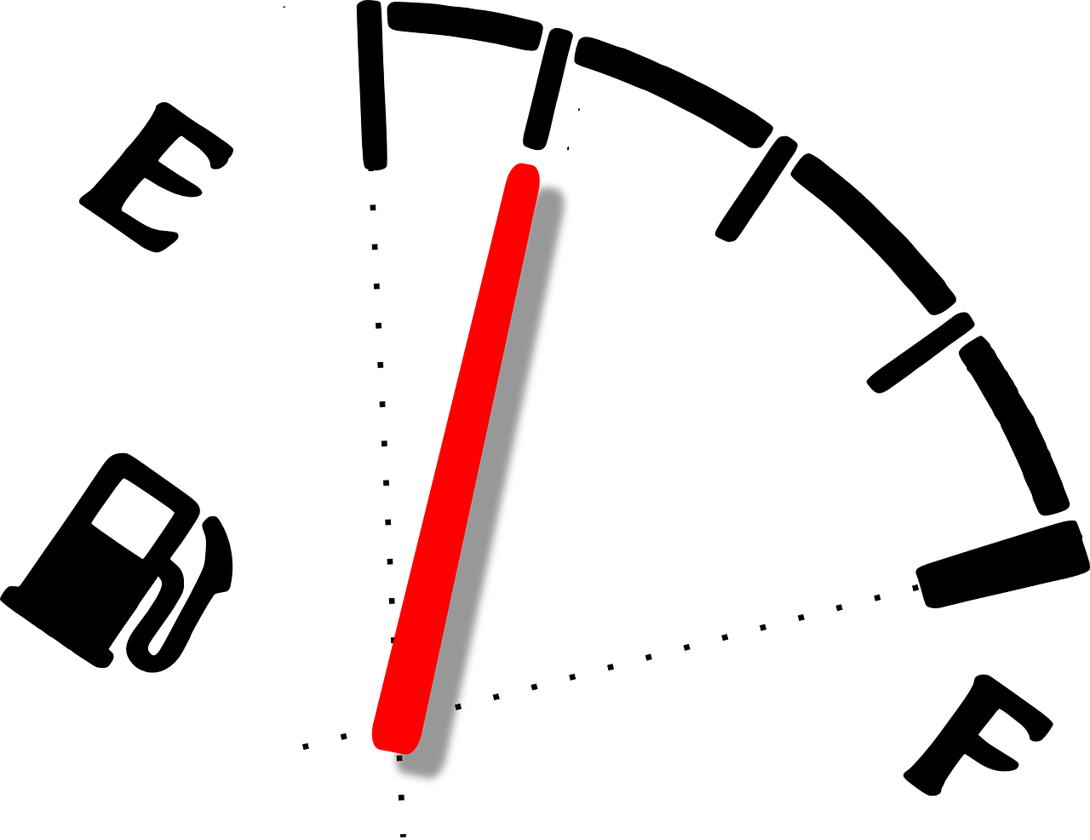
Data source
The ISO 14083 standard for quantifying and reporting greenhouse gas emissions from transport operations describes a methodology that enables freight forwarding and logistics companies to calculate and assess GHG emissions of global and regional supply chains across all modes of transport.
An essential basis for any GHG emission calculation is the selection and collection of suitable and high-quality data.
According to ISO 14083, there are generally two different types of data that can be used in calculations:
  Primary data
    Fuel consumption
    Energy consumption
  Secondary data
    Modelled data
    Default values (default data)
Picture: Pixabay
Notes:
The ISO 14083 standard for quantifying and reporting greenhouse gas emissions from transport operations describes a methodology that enables freight forwarding and logistics companies to calculate and assess GHG emissions of global and regional supply chains across all modes of transport.
An essential basis for any GHG emission calculation is the selection and collection of suitable and high-quality data. Regardless of which step of the calculation is being quantified, it is important that the data used are representative of the specific transport chains (or elements) under consideration and that they are geographically, temporally, and technologically well aligned in order to obtain meaningful results.
According to ISO 14083, there are generally two types of data that can be used in the calculations:
Primary data, which are derived directly from measurements (or calculated based on measured values), and Secondary data. Among secondary data, a distinction is made between modelled data and default values (default data).
In principle, ISO 14083 requires the use of specific primary data collected for the transport chain.
Only when such primary data are not available may secondary data be used, and then only with proper justification. In such cases, modelled data should be preferred over default values.
Source: Umweltbundesamt (2024b): https://www.umweltbundesamt.de/sites/default/files/medien/479/publikationen/uba_treibhausgasemissionen_im_transportsektor_0.pdf (Accessed on: 08.07.2025)
Image source: Pixabay (2025): https://pixabay.com/de/vectors/kraftstoffz%C3%A4hler-meter-indikation-311685/ (Accessed on: 08.07.2025)

Slide 27
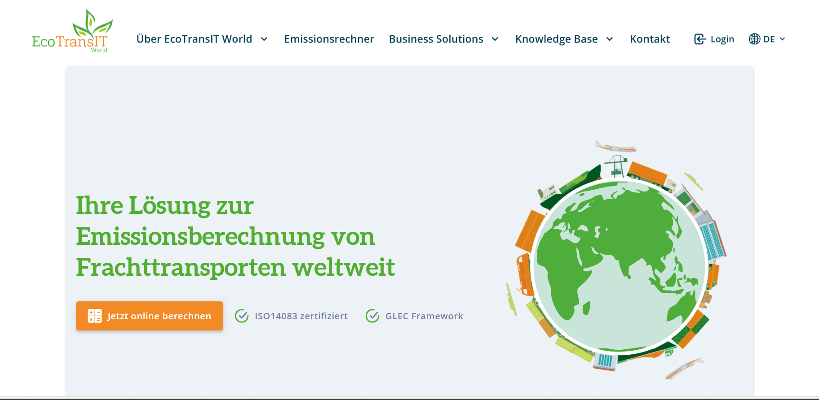
Practical application for emission calculation – EcoTransIT World
https://www.ecotransit.world/de/emissionsrechner/
Notes:
EcoTransIT World is software for calculating the energy consumption and greenhouse gas emissions of transport chains worldwide. It takes into account all modes of transport such as trucks, ships, airplanes, trains, and inland vessels. The software is based on an energy-based bottom-up approach and internal routing, and it complies with current standards such as the GLEC Framework and the GHG Protocol.
Picture source: Screenshot: https://www.ecotransit.org/en/ (Accessed on: 08.07.2025)

Slide 28
Exercise
Calculate the emissions for the transport of 900 tons from St. Florian (Austria) to Cobadin (Romania) for:
  Transport by truck
  Transport by inland vessel
  Transport by train
Use the following emission calculator:
  https://emissioncalculator.ecotransit.world/
When preparing your results, pay attention to:
  Pre- and post-transport stages
Present your results using a medium of your choice

Slide 29
Solution
Truck transport: 1,444 km, 110,900.5 kg CO₂e WTW
Inland vessel transport with pre-carriage (St. Florian to Enns) and post-carriage (Medgidia to Cobadin) by truck: 1,864.6 km, 56,446.1 kg CO₂e WTW
Train (electric) with pre-carriage (St. Florian to Uttendorf) and post-carriage (Cobadin station to Cobadin city) by truck: 1,599.5 km, 18,370.5 kg CO₂e WTW

Slide 30
Emissions in Inland Waterway Transport
4

Slide 31
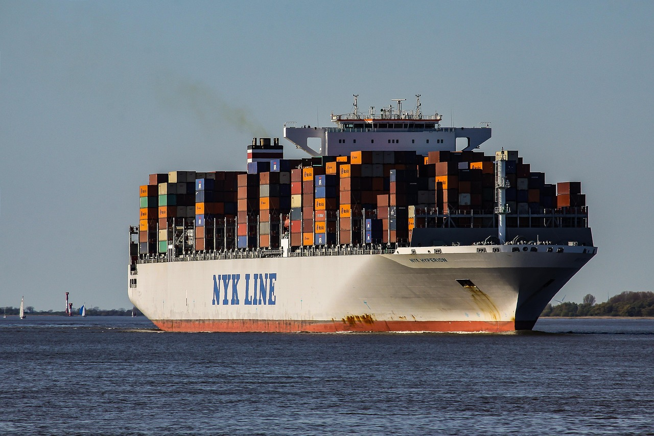
Share of shipping in global greenhouse gas emissions
Shipping transports billions of tons of goods annually and is responsible for around 2% of global greenhouse gas emissions.
Since 1990, these emissions have increased by over 90%, which is why pressure on the industry is growing.
Picture: Pixabay
In 2023, the International Maritime Organization (IMO) decided to reduce emissions from international shipping to net zero by 2050. As interim targets, emissions are to be reduced by 70–80% by 2040 compared to 2008 levels.
To achieve this, the switch to zero-emission fuels must be significantly accelerated.
Notes:
Source: Statista (2025a): https://www.statista.com/topics/11288/shipping-emissions-worldwide/#topicOverview (Accessed on: 08.07.2025)
Picture source: Pixabay (2025): https://pixabay.com/photos/container-ship-freight-cargo-ship-2893480/ (Accessed on: 08.07.2025)

Slide 32
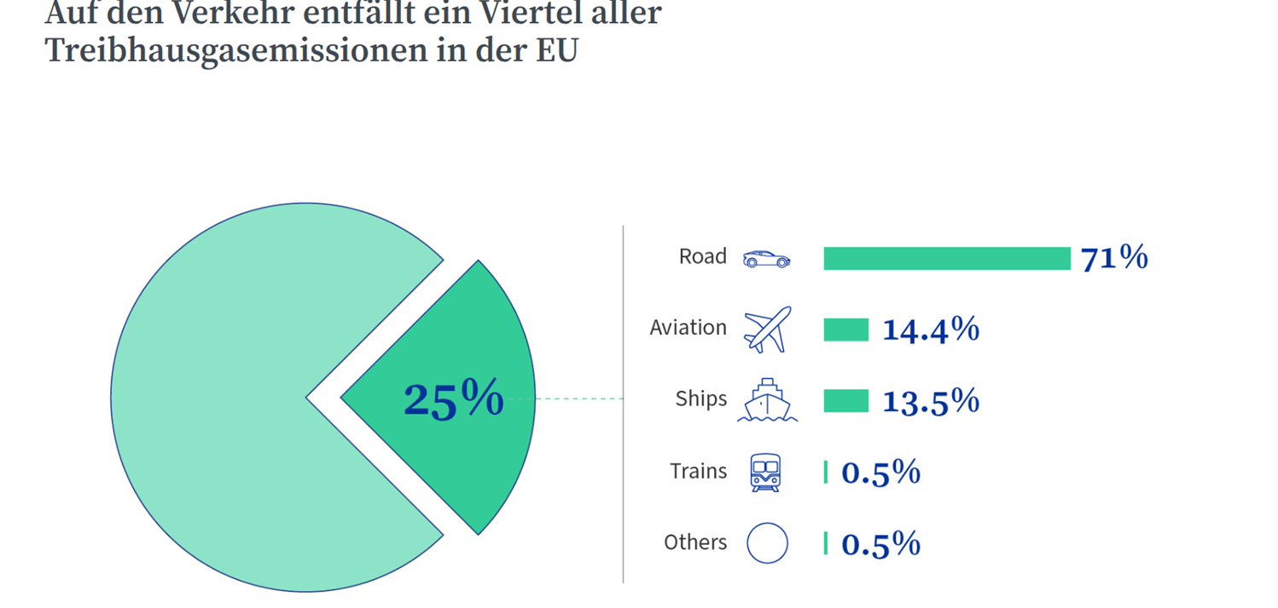
Share of shipping in European greenhouse gas emissions
In recent years, road transport accounted for between 71% and 74% of transport-related GHG emissions in the European Union (EU-27), while shipping was responsible for about 14%.
Emissions from inland waterway transport are included together with those from maritime shipping under total shipping emissions.Emission data for pure inland shipping are not reported separately from European sources.
A quarter of all greenhouse gas emissions in the EU come from transport
Picture: European Council (2025)
Notes:
Source: Statista (2024c): https://www.statista.com/statistics/1237597/transport-greenhouse-gas-emissions-by-mode-eu/ (Accessed on: 08.07.2025)
Statista (2025c): https://www.statista.com/statistics/1237597/transport-greenhouse-gas-emissions-by-mode-eu/ (Accessed on: 08.07.2025)
Fraunhofer ISI (2020): https://cedelft.eu/wp-content/uploads/sites/2/2021/05/CE_Delft_200258_Methodology_GHG_Efficiency_Transport_Modes.pdf (Accessed on: 08.07.2025)
Picture source: European Council (2025): https://www.consilium.europa.eu/en/policies/greener-transport/ (Accessed on: 08.07.2025)

Slide 33
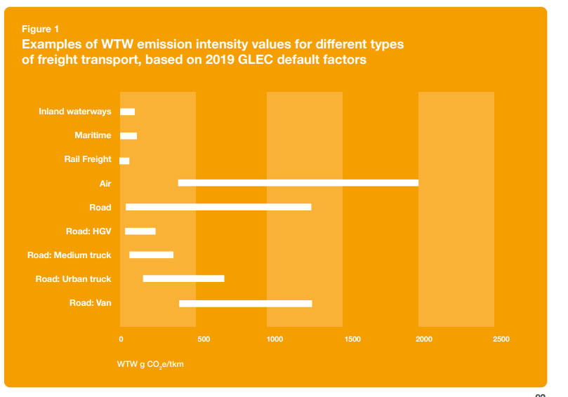
The difference between emissions from inland shipping and other modes of transport
Although inland vessels emit less greenhouse gases per tonne-kilometre (tkm) compared to trucks, alternative propulsion technologies and fuels are needed to achieve climate policy goals.
Picture: Smart Freight Centre from: GLEC Framework v3.1 edition, revised and updated (2024).
Notes:
Source: DST and Marin (2022): https://www.wko.at/oe/transport-verkehr/schifffahrt/alternative-kraftstoffe-und-antriebstechnologien.pdf (Accessed on: 08.07.2025)
Picture source: Smart Freight Center (2024): Global Logistics Emissions Council Framework v3.1 edition: https://www.smartfreightcentre.org/en/our-programs/emissions-accounting/global-logistics-emissions-council/calculate-report-glec-framework/ (Accessed on: 15.09.2025)

Slide 34
Challenges of emission reduction
In inland shipping, innovations for emission reduction are increasingly emerging; however, these usually remain limited to pilot projects.
The causes are diverse: economic uncertainties, high investment requirements, technical complexity, and regulatory hurdles (e.g. lengthy approval procedures, legal uncertainties).
A realistic and flexible roadmap is needed, with clear political and economic framework conditions, as well as funding programmes and financial incentives to make zero-emission technologies competitive.
Since the market for inland waterway transport is relatively small, specific innovations are often not economically viable.
Developments from other transport modes (e.g. road, rail, coastal shipping) offer valuable insights and technical synergies.
Notes:
Source: Central Commission for Navigation on the Rhine (CCNR) (2022): https://www.ccr-zkr.org/files/documents/Roadmap/Roadmap_de.pdf (Accessed on: 08.07.2025)
Additional information: The fleet of innovative vessels monitored by the CCNR as part of its roadmap for emission reduction is steadily growing, although it represents less than 0.2% of the European inland shipping fleet:
https://www.ccr-zkr.org/files/documents/om/om24_II_de.pdf

Slide 35
Political Framework Conditions
5

Slide 36
Political framework conditions for climate neutrality in inland shipping
Document / Declaration | Range | Goal
EU Green Deal | EU-27 | The European Green Deal is the European Union’s growth strategy and includes a package of political initiatives with the overarching goal of making the EU climate-neutral by 2050.
Fit for 55 | EU-27 | The “Fit for 55” package includes a series of legislative measures aimed at reducing the EU’s greenhouse gas emissions by at least 55% by 2030 and making the EU climate-neutral by 2050.
Sustainable and Smart Mobility Strategy (COM(2020) 789 final) | EU-27 | This strategy, together with an action plan of 82 initiatives, provides the foundation for how the EU transport system will achieve ecological and digital transformation and become more resilient to future crises.
NAIADES III Action Programme (2021-2027) | EU-27 | A 35-point action plan with the core aim of shifting more freight onto Europe’s rivers and canals and facilitating the transition to zero-emission inland vessels by 2050.
Platina4Action | EU-27 | Aims to provide targeted coordination and support measures for inland shipping in Europe. Platina4Action will help implement the NAIADES III Action Plan.
Master Plan for Freight Transport | AT | Provides concrete goals and measures for climate-neutral freight transport in Austria.
Danube 2030 Action Programme | AT | Is an implementation strategy of the Mobility Master Plan 2030 as well as the Master Plan for Freight Transport 2030 in the area of Danube shipping.
Funding Programme for Climate- and Environmentally-Friendly Shipping 2022–2026 | AT | A financial incentive programme to increase efficiency and adapt the fleet of inland vessels in Austria, improving competitiveness.
Notes:
Source: European Council (2025a): https://www.consilium.europa.eu/de/policies/european-green-deal/ (Accessed on: 05.08.2025)
European Council (2025b): https://www.consilium.europa.eu/de/policies/fit-for-55/ (Accessed on: 05.08.2025)
European Commission (2025a): https://transport.ec.europa.eu/transport-themes/mobility-strategy_en?etransnolive=1 (Accessed on: 05.08.2025)
European Commission (2025b): https://transport.ec.europa.eu/transport-modes/inland-waterways/promotion-inland-waterway-transport/naiades-iii-action-plan_en?prefLang=de&etrans=de (Accessed on: 05.08.2025)
BMIMI (2025a): https://www.bmimi.gv.at/themen/verkehr/wasser/schifffahrt/donau/publikationen/aktionsprogramm-donau.html (Accessed on: 05.08.2025)
BMIMI (2025b): https://www.bmimi.gv.at/themen/verkehr/wasser/schifffahrt/foerderung.html
EU Green Deal
The European Green Deal is the European Union’s growth strategy. It was launched in 2019 and includes a package of political initiatives designed to guide the EU toward a green transformation, with the overarching goal of becoming climate-neutral by 2050.
Fit for 55
The “Fit for 55” package includes a series of legislative measures aimed at reducing the EU’s greenhouse gas emissions by at least 55% by 2030 and achieving climate neutrality by 2050.
The package includes, for example: reform of the EU Emissions Trading System, establishment of a Climate Social Fund, a Carbon Border Adjustment Mechanism, new CO₂ standards for passenger cars and light commercial vehicles, sustainable aviation fuels, new regulations for the use of renewable and low-carbon fuels in shipping, energy taxation, and energy efficiency measures, among others.
Sustainable and Smart Mobility Strategy
This strategy, along with an action plan of 82 initiatives, forms the foundation for how the EU transport system will achieve its ecological and digital transformation and become more resilient to future crises.
To make transport more sustainable, it promotes: the use of zero-emission vehicles, ships, and aircraft, renewable and low-carbon fuels and the associated infrastructure.
In addition, it foresees: the creation of zero-emission airports and ports, a doubling of high-speed rail traffic, and the expansion of cycling infrastructure.
NAIADES (currently NAIADES III, 2021–2027)
In June 2021, the European Commission presented a 35-point action plan to strengthen the role of inland waterway transport in Europe’s mobility and logistics systems.
The core objectives are to shift more freight to Europe’s rivers and canals and to facilitate the transition to zero-emission inland vessels by 2050.
This aligns the European Green Deal and the Sustainable and Smart Mobility Strategy.
Platina4Action
The EU-funded PLATINA4Action project aims to promote inland waterway transport (IWT) in Europe through targeted coordination and support measures.
The project started in January 2024 and runs until the end of 2026.
Its focus areas include:
introducing environmentally friendly and interconnected inland navigation,
evaluating NAIADES III, and
preparing a new transport policy agenda.
The PLATINA4Action consortium works closely with the European Commission to implement and assess the NAIADES III Action Plan and to develop a new policy agenda for inland shipping.
https://platina4action.iwtprojects.eu/
Master Plan for Freight Transport 2030
The Master Plan for Freight Transport 2030 serves as a technical strategy for the Mobility Master Plan and provides concrete goals and measures for climate-neutral freight transport in Austria.
It is based on three key principles: avoid, shift, improve.
The Master Plan for Freight Transport (MPF) includes annual monitoring of implementation progress.
By 2023 and early 2024, numerous measures had already been implemented, such as:
targeted investments in rail infrastructure,
introduction of a “shift coach,”
promotion of zero-emission commercial vehicles and related infrastructure (in road transport),
and successful electrification and decarbonisation measures in shipping.
Danube 2030 Action Programme
The Danube 2030 Action Programme is an implementation strategy of the Mobility Master Plan 2030 and the Master Plan for Freight Transport 2030 for the Danube shipping sector.
It follows an integrated approach:
Ensuring that shipping is environmentally friendly and sustainable while strengthening its position in the overall transport system is a key part of the programme, as is the protection and improvement of habitats along the Danube, March, and Thaya rivers.
Funding Programme for Climate- and Environmentally-Friendly Shipping 2022–2026
This funding programme aims to increase the competitiveness of inland shipping through efficiency improvements and fleet upgrades.
The Federal Ministry for Climate Action, Environment, Energy, Mobility, Innovation and Technology (BMK), together with the Austrian Waterways Company (viadonau) as the implementing body, provides attractive financial incentives for the sustainable modernisation of inland shipping — contributing to Austria’s environmental goals and strengthening its economy.
The programme supports: measures to improve efficiency, the reduction of CO₂ and air pollutant emissions from inland vessels, and adaptations to promote modal shift toward inland waterway transport.

Slide 37
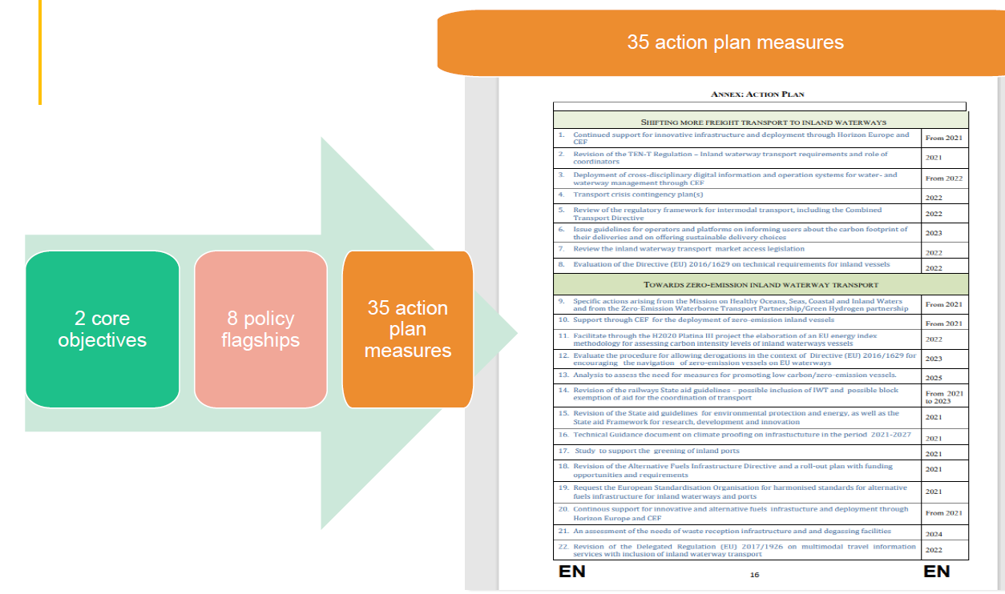
Document / Declaration | Range | Goal
NAIADES III Action Programme (2021–2027) | EU-27 | 35-point action plan with the core objective of shifting more freight onto Europe’s rivers and canals and facilitating the transition to zero-emission inland vessels by 2050.
Image: Hugues Van Honacker
Notes:
Source: European Commission (2025b): https://transport.ec.europa.eu/transport-modes/inland-waterways/promotion-inland-waterway-transport/naiades-iii-action-plan_en?prefLang=de&etrans=de (Accessed on: 05.08.2025)
Picture source: Hugues Van Honacker: https://www.clinsh.eu/iu-assets/4/CLINSH_NAIADESIII.pdf
NAIADES (currently NAIADES III, 2021–2027)
In June 2021, the European Commission presented a 35-point action plan aimed at strengthening the role of inland navigation in Europe’s mobility and logistics systems. The core objectives are to shift more freight onto Europe’s rivers and canals and to facilitate the transition to zero-emission inland vessels by 2050. This initiative aligns with the European Green Deal and the Sustainable and Smart Mobility Strategy.

Slide 38
Document / Declaration | Range | Goal
Master Plan for Freight Transport | AT | Provides concrete goals and measures for climate-neutral freight transport in Austria.
Measure Inland Navigation 3: Promote Ship Technologies and Digitalisation of Waterways:
4 Measures in the Field of Inland Navigation
Further develop inland waterway infrastructure
Improve the operation and use of waterways
Promote ship technologies and digitalisation of waterways
Create legal frameworks and financial incentives to promote the use of waterways
Implementation responsibility:
BMK / viadonau
Key cooperation partners:
Austrian shipping companies RIS operators in Europe
Frameworks and instruments
Sustainable and Smart Mobility Strategy
Mobility Master Plan 2030 for Austria
Alternative Fuel Infrastructure Regulation (AFIR Regulation)
eFTI Regulation
RIS Directive
Implementation period:
Since 2022: Review of the RIS Directive
Publication of the Austrian Fleet Promotion Programme 2023
Areas of impact:
Financial, legal/regulatory, research/innovation
Notes:
Source: BMIMI (2025c): https://www.bmimi.gv.at/themen/mobilitaet/transport/gueterverkehr/masterplan.html (Accessed on: 05.08.2025)

Slide 39
Measures to Reduce Greenhouse Gases in Inland Shipping
6

Slide 40
Alternative fuels and propulsion systems
The infrastructure, especially the nationwide supply of ports, represents a central challenge for the use of alternative fuels, since all different types of fuels would need to be stored accordingly.
Of particular interest are also the costs for converting ships when changing fuels, the space requirements on board and on land, safety aspects, and the performance balance of the alternative propulsion systems.
Biofuels
Methanol
Electric Drive
Hybrid Systems
Hydrogen
Ammonia
Notes:
Source: Erwin van der Linden (2024): https://www.viadonau.org/fileadmin/content/20241128_Aristoi_Study_Viadonau_final.pdf (Accessed on: 05.08.2025)
Further links: https://www.wko.at/oe/transport-verkehr/schifffahrt/alternative-kraftstoffe-und-antriebstechnologien.pdf

Slide 41
Biofuels
Biofuels such as HVO (Hydrotreated Vegetable Oil) and LBM (Liquid Bio Methane) are considered short-term realistic solutions for reducing emissions in inland shipping.
Sustainability strongly depends on the origin of the raw materials.
Pilot project: The grain ship Nedertarwe operates with HVO100 from Utrecht to Rotterdam.
Significantly less CO₂ than diesel.
Can be used in existing engines.
Lower investment costs than hydrogen or batteries.
No new infrastructure required.
EU approvals up to 37% blending, possibly up to 100% for new engines.
Currently cheaper and faster to deploy compared to hydrogen or ammonia.
Higher operating costs than diesel.
Quality varies depending on the raw material.
Using food products as raw materials can cause social conflicts.
Notes:
Source: Erwin van der Linden (2024): https://www.viadonau.org/fileadmin/content/20241128_Aristoi_Study_Viadonau_final.pdf (Accessed on: 05.08.2025)

Slide 42
Methanol
Methanol is a realistic and scalable solution for the decarbonization of inland shipping.
It can be produced from renewable sources such as biomass or CO₂ recycling.
Pilot project: Chemical tanker Stolt Lissel, of the Dutch shipping company Mercurius Shipping.
Greenhouse gas emissions are almost zero with green methanol.
Easy storage and handling (liquid at ambient temperature).
Good availability.
Conversion of existing engines possible with manageable effort.
High production costs, but cheaper than hydrogen or ammonia.
Handling the toxic, flammable substance requires special safety measures and training.
Production capacities are still very low.
Lower energy density than diesel – larger tanks required.
Notes:
Source: Erwin van der Linden (2024): https://www.viadonau.org/fileadmin/content/20241128_Aristoi_Study_Viadonau_final.pdf (Accessed on: 05.08.2025)
DLR (2025): https://www.dlr.de/de/ms/aktuelles/nachrichten/neue-studie-veroeffentlicht-gruenes-methanol-als-alternativer-schiffskraftstoff#:~:text=Fazit%20der%20Studie%3A%20Gr%C3%BCnes%20Methanol,Gesamtbedarfe%20der%20Schifffahrt%20zu%20decken (Accessed on: 05.08.2025)

Slide 43
Electric propulsion
Pilot project: The inland vessel “Alphenaar”, equipped with interchangeable battery containers, has been operating in the Netherlands since 2021.
No direct emissions (CO₂, NOx, PM)
Lower maintenance requirements
Use of existing power grids possible
Indirect emissions possible when electricity is generated from fossil fuels
Higher investment costs
Limited range when using batteries only
Charging infrastructure needs to be expanded
Long-distance operation still challenging
Staff retraining required
Notes:
Source: Erwin van der Linden (2024): https://www.viadonau.org/fileadmin/content/20241128_Aristoi_Study_Viadonau_final.pdf (Accessed on: 05.08.2025)

Slide 44
Hydrogen
Hydrogen is developing into a very promising energy carrier for emission-free inland shipping.
Pilot project: H2 Barge 1 by the Dutch shipping company Future Proof Shipping, conversion costs approx. €6–7 million, in operation since May 2023.
No CO₂ or NOx emissions during operation, no particulate pollution
Can be produced entirely from renewable electricity (green hydrogen)
Large storage volume required
More expensive than diesel
Staff retraining required; safety risks when handling H₂
Efficiency in production (electrolysis) is limited
High effort for bunker stations and safety technology
High investment and conversion costs
Notes:
Source: Erwin van der Linden (2024): https://www.viadonau.org/fileadmin/content/20241128_Aristoi_Study_Viadonau_final.pdf (Accessed on: 05.08.2025)

Slide 45
Ammonia
Although ammonia is a widely traded chemical substance with global infrastructure in the maritime sector, its use in inland navigation is technically, economically, and in terms of safety much more demanding.
Pilot project: Antwerp – conversion of an inland vessel to ammonia (since 2021)
No CO₂ emissions during operation
Renewable production possible
Still mostly fossil-based
Produces NOₓ during combustion, which must be controlled through exhaust aftertreatment
Hardly any infrastructure available in the inland sector
Toxic, corrosive → high safety requirements, special training and extensive technical adjustments necessary
Currently almost twice as expensive as diesel
Lower energy density → larger tanks, reduced cargo capacity
High investments required for new infrastructure and vessel conversions
Notes:
Source: Erwin van der Linden (2024): https://www.viadonau.org/fileadmin/content/20241128_Aristoi_Study_Viadonau_final.pdf (Accessed on: 05.08.2025)

Slide 46

Kahoot!
Testing your knowledge with our transport quiz!
https://create.kahoot.it/share/understanding-emissions-shaping-climate-action-the-role-of-inland-waterway-transport/7da0b7b1-6370-4503-82e0-66db947e31f9
https://kahoot.com/de/
Notes:
How it works:
Log in to Kahoot! or register for free: https://kahoot.com/en/
Open the following link to the quiz: https://create.kahoot.it/share/understanding-emissions-shaping-climate-action-the-role-of-inland-waterway-transport/7da0b7b1-6370-4503-82e0-66db947e31f9
Start the quiz in class – either in individual mode or as a group game.

Slide 47
Thank you for your attention!

Slide 48
Additional information for teachers
This teaching material package is available under the so-called Creative Commons Attribution 4.0 International License .
You may therefore freely integrate this material into your lessons, adapt it to your requirements, and share it with your students or other interested persons.
We only ask that you keep the logos on the slides.
The image sources are indicated in the notes section; use in other settings is not permitted.
Statement on the Use of Generative AI and AI-Supported Technologies:
During the preparation of this project, the authors used ChatGPT and Microsoft CoPilot for support in concept design and idea generation, particularly for interactive exercises.
The use of these AI tools was carefully considered. The content was then thoroughly reviewed by the authors and revised as needed to ensure compliance with scientific standards.
The authors bear full responsibility for the final published content.

Slide 49
Additional information for teachers
For questions and feedback, feel free to contact us by email at:
rewway@fh-steyr.at .
Further slide sets and practical exercises can be found at:
http://www.rewway.at/en/teaching-materials/
Are you interested in a Transport School Lab, an excursion, or a guest lecture?
http://www.rewway.at/en/pages/workshops

Slide 50
List of Sources
Anderl et al. (2024): Climate Protection Report 2024, https://www.umweltbundesamt.at/fileadmin/site/publikationen/rep0913.pdf (Accessed on: 07.07.2025)
Armstrong (2025): https://www.statista.com/chart/26160/global-mean-temperature-increase-2100-estimates/ (Accessed on: 07.07.2025)
BMIMI (2025a): Aktionsprogramm Donau, https://www.bmimi.gv.at/themen/verkehr/wasser/schifffahrt/donau/publikationen/aktionsprogramm-donau.html (Accessed on: 05.08.2025)
BMIMI (2025b): Förderung, https://www.bmimi.gv.at/themen/verkehr/wasser/schifffahrt/foerderung.html (Accessed on: 08.07.2025)
BMIMI (2025c): Masterplan Güterverkehr 2030, https://www.bmimi.gv.at/themen/mobilitaet/transport/gueterverkehr/masterplan.html (Accessed on: 05.08.2025)
ClimatePartner (2022): What are Scope 1, Scope 2 and Scope 3 emissions?, https://www.climatepartner.com/de/wissen/insights/scope-emissionen-reduzieren (Accessed on: 08.07.2025)
ClimatePartner GmbH (2025): CO2 Equivalents, https://www.climatepartner.com/de/wissen/glossar/co2-aequivalente-co2e (Accessed on: 01.07.2025)
Copernicus Climate Change Service (2025a): Temperature, https://climate.copernicus.eu/climate-indicators/temperature (Accessed on: 02.02.2025)
Copernicus Climate Change Service (2025b): Copernicus: 2024 is the first year to exceed 1.5°C above pre-industrial level, https://climate.copernicus.eu/copernicus-2024-first-year-exceed-15deg-above-pre-industrial-level (Accessed on: 03.07.2025)
DLR (2025): New Study Published: Green Methanol as an Alternative Marine Fuel, https://www.dlr.de/de/ms/aktuelles/nachrichten/neue-studie-veroeffentlicht-gruenes-methanol-als-alternativer-schiffskraftstoff#:~:text=Fazit%20der%20Studie%3A%20Gr%C3%BCnes%20Methanol,Gesamtbedarf%20der%20Schifffahrt%20zu%20decken (Accessed on: 05.08.2025)
DST and Marin (2022): Alternative Fuels and Propulsion Technologies for Inland Shipping, https://www.wko.at/oe/transport-verkehr/schifffahrt/alternative-kraftstoffe-und-antriebstechnologien.pdf (Accessed on: 08.07.2025)

Slide 51
List of Sources
EcoTransIT (2025): Emission calculator for greenhouse gases and air pollutants, https://www.ecotransit.world/de/emissionsrechner/ (Accessed on: 05.08.2025)
Erwin van der Linden (2024): Study on Alternative Propulsion on the Danube, https://www.viadonau.org/fileadmin/content/20241128_Aristoi_Study_Viadonau_final.pdf (Accessed on: 05.08.2025)
European Commission (2025a): Mobility Strategy, https://transport.ec.europa.eu/transport-themes/mobility-strategy_en?etransnolive=1 (Accessed on: 05.08.2025)
European Commission (2025b): NAIADES III Action Plan, https://transport.ec.europa.eu/transport-modes/inland-waterways/promotion-inland-waterway-transport/naiades-iii-action-plan_en?preflang=de&etrans=de (Accessed on: 05.08.2025)
European Parliament (2018): Infographic: History of Climate Negotiations, https://www.europarl.europa.eu/topics/de/article/20180430STO00910/infografik-geschichte-der-klimaverhandlungen (Accessed on: 07.07.2025)
European Council (2025a): A European Green Deal, https://www.consilium.europa.eu/de/policies/european-green-deal/ (Accessed on: 05.08.2025)
European Council (2025b): Fit for 55, https://www.consilium.europa.eu/de/policies/fit-for-55/ (Accessed on: 05.08.2025)
Fraunhofer ISI (2020): Methodology for GHG Efficiency of Transport Modes, https://cedelft.eu/wp-content/uploads/sites/2/2021/05/CE_Delft_200258_Methodology_GHG_Efficiency_Transport_Modes.pdf (Accessed on: 08.07.2025)
IKEM (2010): Well-to-Wheel Analysis of Drive Technologies, https://www.forschungsinformationssystem.de/servlet/is/323825/ (Accessed on: 08.07.2025)
IPCC (2024a): IPCC Global Warming Potential Values, https://ghgprotocol.org/sites/default/files/2024-08/Global-Warming-Potential-Values%20%28August%202024%29.pdf (Accessed on: 01.07.2025)
IPCC (2024b): What is the IPCC, https://www.ipcc.ch/site/assets/uploads/2024/04/IPCCFactSheet_WhatisIPCC.pdf (Accessed on: 03.07.2025)

Slide 52
List of Sources
Klimabündnis Österreich (2024): Klimafakten, Klimawandel, https://www.klimabuendnis.at/wp-content/uploads/2024/09/Praesentationen_zu_Klimafakten_Klimawandel.pdf (Accessed on: 01.07.2025)
Kühl (2021): Electric Car or Combustion Engine – Which Is Better for the Climate?, https://klimaandmore.de/?p=3518 (Accessed on: 07.07.2025)
Statista (2024a): Distribution of CO₂ Emissions Worldwide by Sector 2023,
https://de.statista.com/statistik/daten/studie/167957/umfrage/verteilung-der-co-emissionen-weltweit-nach-bereich/ (Accessed on: 07.07.2025)
Statista (2024b): Distribution of Greenhouse Gas Emissions in the European Union (EU-27) in 2023, by Sector,
https://www.statista.com/statistics/1325132/ghg-emissions-shares-sector-european-union-eu/ (Accessed on: 07.07.2025)
Statista (2024c): Distribution of Greenhouse Gas Emissions from Transportation in the European Union (EU-27) in 2022, by Mode,
https://www.statista.com/statistics/1237597/transport-greenhouse-gas-emissions-by-mode-eu/ (Accessed on: 08.07.2025)
Statista (2025a): Transportation Emissions Worldwide – Statistics & Facts,
https://www.statista.com/topics/7476/transportation-emissions-worldwide/#topicOverview (Accessed on: 07.07.2025)
Statista (2025b): Transportation GHG Emissions in the European Union – Statistics & Facts,
https://www.statista.com/topics/7968/transportation-emissions-in-the-eu/#statisticChapter (Accessed on: 07.07.2025)
Statista (2025c): Distribution of Greenhouse Gas Emissions from Transportation in the European Union (EU-27) in 2022, by Mode,
https://www.statista.com/statistics/1237597/transport-greenhouse-gas-emissions-by-mode-eu/ (Accessed on: 08.07.2025)

Slide 53
List of Sources
Umweltbundesamt (2024a): Internationale Klimapolitik, https://www.umweltbundesamt.de/themen/klima-energie/internationale-klimapolitik#internationale-klimapolitik (Accessed on: 07.07.2025)
Umweltbundesamt (2024b): Treibhausgasemissionen im Transportsektor, Leitfaden zur ISO 14083, https://www.umweltbundesamt.de/publikationen/treibhausgasemissionen-im-transportsektor (Accessed on: 08.07.2025)
WWF Austria (2023): Consequences of the Climate Crisis: 1.5 Degrees versus 2 Degrees, https://www.wwf.at/artikel/folgen-der-klimakrise-15-grad-oder-2-grad/ (Accessed on: 01.07.2025)
Central Commission for the Navigation of the Rhine (CCNR) (2022): CCNR Roadmap for Reducing Emissions in Inland Shipping, https://www.ccr-zkr.org/files/documents/Roadmap/Roadmap_de.pdf (Accessed on: 08.07.2025)

