Slide 1
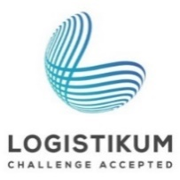
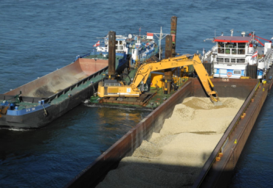
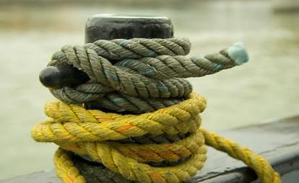


Inland Navigation Million Show

Slide 2



Inland Navigation Million Show
Source: ORF
15 questions with 4 possible answers each, but only one of them is correct. The question is, which one?
Each candidate has a telephone joker, an audience joker and a 50:50 joker. Use them wisely, because you will need them.
Questions will be asked on the following topics: Comparison of modes of transport, types of ships, logistics - general conditions and costs, International Waterways.
Have Fun!

Slide 3
How many trucks do you need to have the same transport capacity as a pushing unit with four lighters?
A: 150
B: 240
C: 280
C: 280
D: 320

Slide 4
By how much further than a truck can an inland vessel transport a tonne of cargo with the same energy consumption?
A: the same distance
B: twice as far
C: thrice as far
D: four times as far
D: four times as far

Slide 5
Which means of transport causes the lowest accident, noise, pollution and climate costs?
A: inland vessel
A: inland vessel
B: train
C: truck
D: airplane

Slide 6
How big was the share of inland navigation in the modal split of the EU-28 (status 2014)?
A: 2,8 %
B: 6,7 %
B: 6,7 %
C: 18,4 %
D: 74,9 %

Slide 7
How many tons of goods are transported annually on the EU's inland waterways (as of 2013)?
A: 250 million
B: 500 million
B: 500 million
C: 750 million
D: 950 million

Slide 8
What is the maximum load capacity of motor cargo vessels?
A: 2.000 tons
A: 2.000 tons
B: 3.000 tons
C: 4.000 tons
D: 5.000 tons

Slide 9
What else are motor cargo ships called?
A: pushing unit
B: lighter
C: driveless
D: self-propelled vessels
D: self-propelled vessels

Slide 10
What do you call the first section of a transport chain?
A: End-haulage
B: main run
C: Pre-haulage
C: Pre-haulage
D: Transhipment

Slide 11
What is the average age of the pushing units on the Danube (as of 2013)?
A: 5 years
B: 10 years
C: 15 years
D: 20 years
D: 20 years

Slide 12
What is the international set of rules on the contract of carriage?
A: CMNI
A: CMNI
B: BMVIT
C: ABGB
D: AXP

Slide 13
Which of the following goods is a hazardous good?
A: new cars
B: petroleum products
B: petroleum products
C: ores
D: flowers

Slide 14
Which of the following tasks does a shipping agent perform?
A: acceptance of the goods
B: Customs clearance
B: Customs clearance
C: Allocation of the place of unloading
D: organisation of the end-haulage

Slide 15
The most important inland navigation axis on the European mainland is ...?
A: Steyr-Inn-Danube corridor
B: Seine-Rhine-Danube corridor
C: Rhine-Main-Danube corridor
C: Rhine-Main-Danube corridor
D: Enns-Elbe-Danube corridor

Slide 16
What is the main traffic route in Brazil regarding waterways?
A: Danube
B: Rhine
C: Paraná
D: Amazon
D: Amazon

Slide 17
Which country within Europe has the most available waterways?
A: France
A: France
B: the Netherlands
C: Germany
D: Romania

Slide 18


Additional information
We hope our set of slides has met your requirements!
- You are welcome to adapt the set of slides according to your wishes and requirements and use it for your lessons/lectures.
For questions and feedback we are available at any time by e-mail at
rewway@fh-steyr.at is available.
You will find further sets of slides under:
https://www.rewway.at/en/teaching-materials/bundles/
Are you perhaps interested in an excursion or a lecture?
https://www.rewway.at/en/services/

