Slide 1
How to work best with this learning material
Power Point
The following power point presents DANUBE NAVIGATION –
Markets and Strengthening of the waterway. The slides are shortly described in the notes below, they also provide the link to the source if you need further information.
Reader
  In addition to the power point presentation, you can also use the reader provided on our platform. It’s more detailed and can be used as a script for your lessons.
Links
You can find the sources of our presentation and reader in the link section of the relevant bundled teaching material.
Videos and exercises
There are different videos and exercises used as sources in this presentation. You can find these videos and a variety of exercises separately in the corresponding section of the relevant bundled teaching material.
https://www.rewway.at/en/teaching-materials/bundles/danube-navigation-markets-and-strenghts/

Slide 2
Learning objectives and target groups
After having dealt with the contents, the learners know:
Numbers, data and facts about the Danube waterway; locks, bridges and the availability of the Danube
Danube navigation markets: from freight transport to tourism and passenger transport in Austria and the entire Danube corridor
Strengths of Danube inland navigation, weaknesses and possibilities to minimize the weaknesses: from training to maintenance measures to transport speed and network density. In addition, the transport policy framework of Danube inland navigation.
Target group
University students
Vocational students
High School students

Slide 3
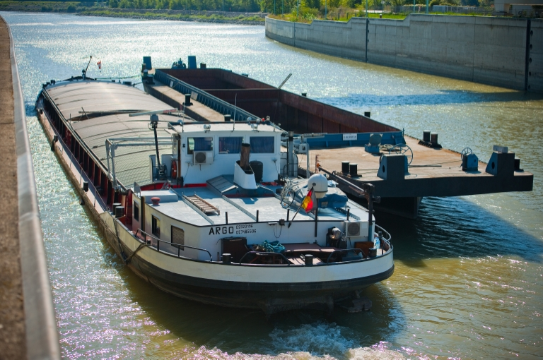
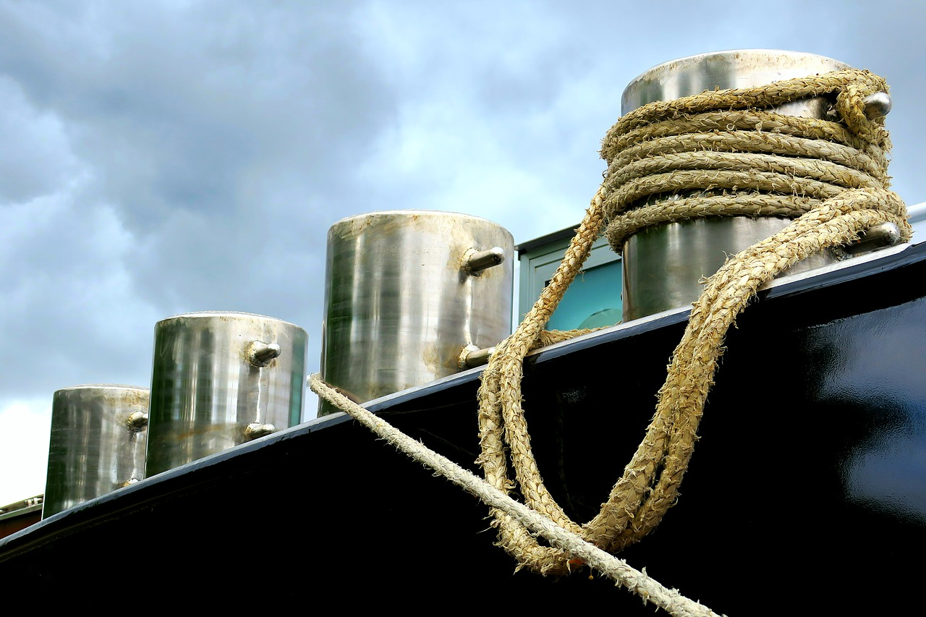



DANUBE NAVIGATION – Markets and Strengthening of the Waterway
Quelle: via donau
Quelle: pixabay
Notes:
Following slides consist of geographical information about the Danube waterway, as well as about the whole Danube-Corridor. Furthermore a comparison between the Danube and the Rhine is included.
Pictures: viadonau, https://fotos.viadonau.org; www.pixabay.com

Slide 4
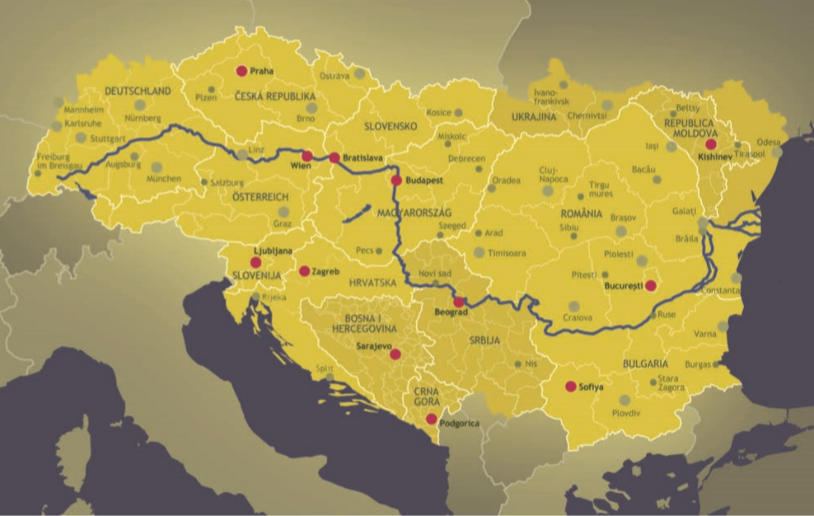
Warm-Up:
DANUBE NAVIGATION – Markets and Strengthening of the Waterway
Source: INTERACT
What are the problems of Danube navigatino and how can they be solved?
What are the strengths of Danube navigation?
Is the Danube important for the Austrian economy?
Which countries transport the most goods on the Danube?
What is being transported on the Danube?
Which countries does the Danube flow through?
Notes:
The questions mentioned in the slide above can be used as a warm up exercise for the topic “DANUBE NAVIGATION – Markets and Strengthening of the waterway”. The aim is to discuss the questions in plenum with students. Answers to the questions will be provided during the presentation. Therefore, the questions can be discussed again at the end of the presentation.
Discussion questions (5-10 Minute Discussion):
The Danube flows through which countries?
Germany, Austria, Slovakia, Hungary, Croatia, Serbia, Rumania, Bulgaria, Moldavia, Ukraine
Is the Danube important for the Austrian economy?
Slides 16-23
Which countries transport the most goods on the Danube?
Rumania, Serbia, Austria (Slide 17)
What goods have the highest transport volume on the Danube?
Mainly ores and metal waste, agricultural and forestry products and petroleum products (Slide 20)
What are the strengths of Danube navigation?
Low transport costs, Environmentally friendly, High performance, Safe, Ready for use around the clock, Low infrastructure/way costs, High free capacities (use of capacity at 10-15%) (Slide 26-29)
What are the problems of Danube navigations and how could they be solved?
Dependence on navigable water conditions, bridges, low transport speed, low network density (pre-/post-carriage necessary), partly no adequate maintenance, high need for modernisation of ports and fleets, personnel problems (lack of trained personnel) (Slide 30)
Input- possible topics of discussion:
Sustainability
Modal Split
Bridges
Watergates
Availability of the Danube
Daube Tourism
Shipping Telematics: River Information Services (RIS)
Education
Picture: INTERACT in Manual on Danube Navigation p 29.

Slide 5
DANUBE NAVIGATION – Markets and Strengthening of the Waterway
Markets of Danube Navigation
Transport Examples
The Danube Waterway
Strengths of Danube Navigation

Slide 6
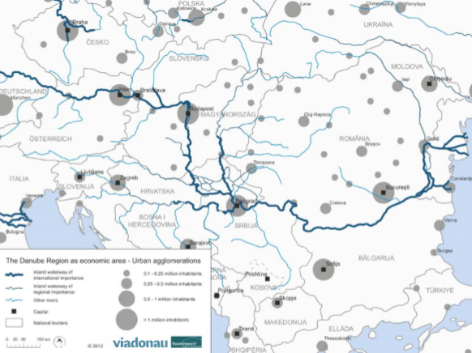
Danube Region
The Danube Waterway
90 Mio. inhabitants
transport mode for industrial sites
along the Danube
steel, paper, petroleum and chemical
industries along with the mechanical
engineering and automotive industry
are to be found within the catchment
area of the Danube
fertile soil→ agricultural raw materials
source: via donau
Overview of the waterways in the Danube region
Notes:
With approximately 90 million inhabitants, the Danube region is of great economic interest. Many production facilities for the steel, paper, petroleum and chemical industries along with the mechanical engineering and automotive industry are to be found within the catchment area of the Danube. The Danube is of importance as a transport mode for the industrial sites that are located along the Danube corridor. Bulk freight capacity, the proximity to raw material markets, large free transport capacities and low transport costs all add up to make inland navigation the logical partner for resource-intensive industries.
Source: Manual on Danube Navigation p. 146
Picture: viadonau in Manual on Danube Navigation p. 147

Slide 7
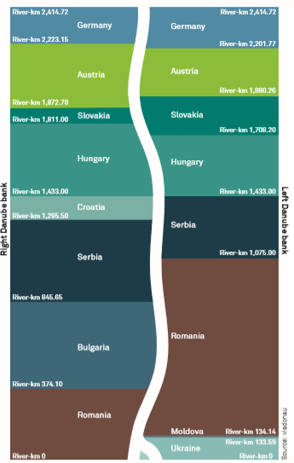
Danube – Data and Facts
The Danube Waterway
Danube Bordering States
second largest river in
Europe
2.845 km long
from the Black Forest to the Black Sea
flows from West to East (the only big European river which flows into this direction)
Danube passes through 10 bordering states
Austrian segment: 351 km
Romanian segment of 1.075 km largest share
river basin covers 801.463 km²
  important transport mode
  important source of energy and drinking water
  valuable recreational and living environment
source: via donau
Notes:
The Danube passes through 10 riparian states, thus it is the most international river in the world and a very important transport route for freight transport by inland vessels.
With a total length of 1,075 kilometers, Romania has the largest share of the Danube. Thereof, some 470 kilometers make up the common state border with Bulgaria. Moldova has the smallest share of the Danube with just 550 meters. Four countries, i.e. Croatia, Bulgaria, Moldova and Ukraine, are situated on only one bank of the river. The river basin of the Danube covers 801,463 km². It lies to the west of the Black Sea in Central and South-Eastern Europe.
The river basin district is the catchment area where all water from land surfaces, streams and ground water sources drains into the respective river.
Source: Manual on Danube Navigation p. 38 et. Seqq
Picture: viadonau in Manual on Danube Navigation p. 38

Slide 8
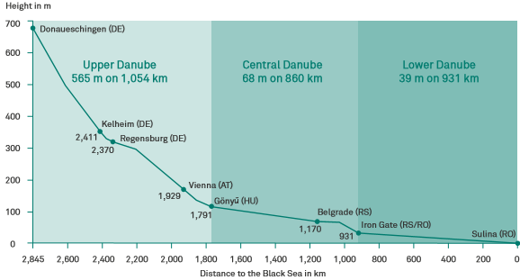
Subdivision of the Danube
The Danube Waterway
Subdivision of the navigable part of the Danube into 3 main sections:
Upper Danube
Kelheim–Gönyű, 623 km length,
due to the high gradient, this part has
the characteristics of a mountain river
Central Danube
Gönyű–Turnu-Severin,
860 km length
Lower Danube
Turnu-Severin–Sulina,
931 km length
Source: via donau
source: via donau
Notes:
According to the Danube Commission the navigable part of the Danube can be structured in 3 main sections:
The Upper Danube from Kelheim (Germany) to Gönyű (Hungary) (623 km long),
The Central Danube from Gönyű (Hungary)to Drobeta Turnu-Severin (Romania) (860 km long) und
the Lower Danube from Drobeta Turnu-Severin to Sulina (Romania) (931 km long)
Due to the high gradient in the first third of its course (over a length of 1,055 kilometers), the upper part of the Danube has the characteristics of a mountain river. For this reason, nearly all river power plants, taking advantage of the gradient of a watercourse, are located on this part of the Danube. Only after the change of gradient at Gönyű in the north of Hungary (river-km 1,791) does the river gradually change into a lowland river. While the Upper Danube has an average height difference of slightly more than 0.5 meters per kilometer, the average height difference on the Lower Danube is only slightly more than 4 centimeters per kilometer.
Source: Manual on Danube Navigation p. 41
Picture: viadonau in Manual on Danube Navigation p. 41

Slide 9
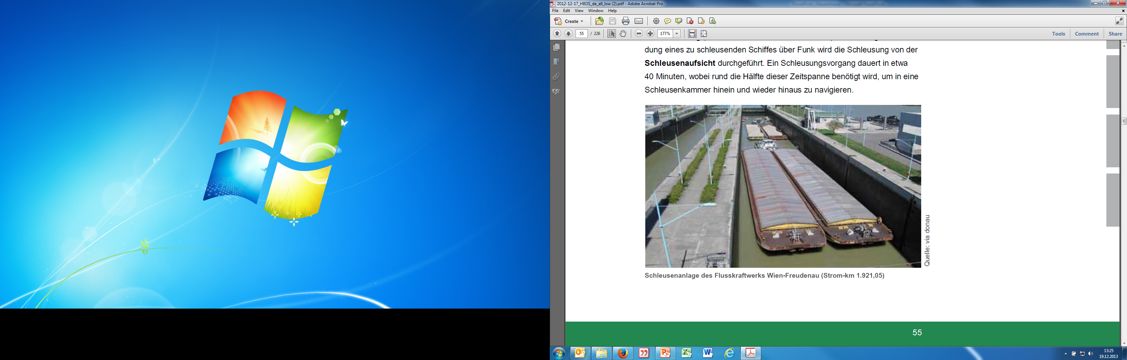
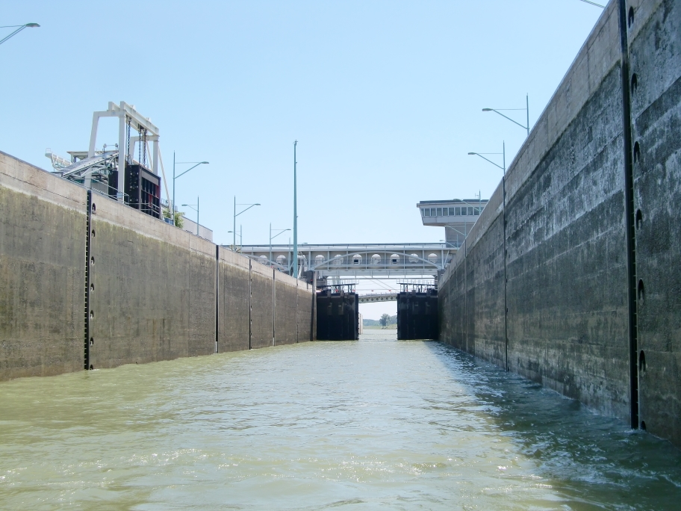

Lock Facilities
The Danube Waterway
allow to overcome differences in height along a waterway (river power plants)
18 locks along the Danube
9 locks at the Austrian Danube
lock operation: about 40 minutes
(50 % of the time are required to navigate the vessel
in and out of the lock chamber)
source: via donau
Lock in Freudenau
source: via donau
Lock operations are carried out free of charge
24 hours/7 days a week
Lock in Freudenau
© via donau I 9
source: via donau
Notes:
Barrages, i.e. facilities which impound a river with the aim of regulating its water levels, are often created in the form of river power plants, which convert the power of the flowing water into electrical energy. In this process they make use of the incline created by impounding the water between the water upstream and downstream of the power plant (headwater and tailwater).
Locks enable inland vessels to negotiate the differences in height between the impounded river upstream of a power plant and the flowing river downstream of a power plant. A locking operation takes approximately 40 minutes, about half of which is required to navigate the vessel into and out of a lock chamber.
Source: Manual on Danube Navigation p. 53-54
Picture: viadonau in Manual on Danube Navigation p. 54 and https://fotos.viadonau.org

Slide 10

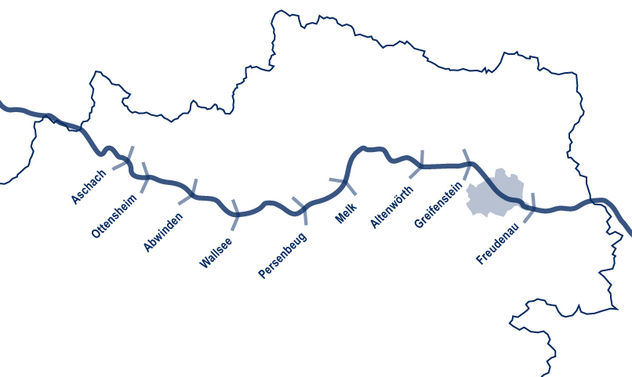
Austrian Locks
The Danube Waterway
source: via donau
9 locks/river power plants on the Austrian Danube
source: via donau
Notes:
The picture above shows the nine water power plants with its location on the Austrian part of the Danube.
Source: Manual on Danube Navigation p 55
Picture: viadonau

Slide 11
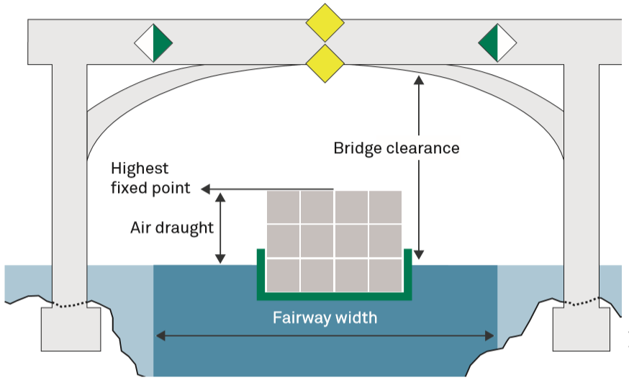
Bridges – Navigability
The Danube Waterway
bridge clearance: important for container transports and cabin vessels (possibility → ballast water)
from the Austrian Danube to the east ≥ 7m at times of highest navigable water level → 3 layered container transport possible
Source: via donau
Highest fixed point of the vessel is an important parameter to calculate the bridge’s clearance
© via donau I 11
source: via donau
Notes:
Bridges span waterways, a port entrance or a river power plant and hence a lock facility. On free-flowing, i.e. unimpounded river sections, water levels can be subject to considerable fluctuations which influence the potential passage under bridges at high water levels.
Whether a vessel can pass under a bridge depends on the vertical bridge clearance above the water level and on the air draught of the vessel. The air draught of a vessel is the vertical distance between the waterline and the highest fixed point of a vessel once movable parts such as masts, radar devices or the steering house have been removed or lowered. The air draught of a vessel can be reduced by ballasting the vessel. For this purpose, ballast water is pumped into the ballast tanks or solid ballast is loaded.
Source: Manual on Danube Navigation p. 55-56
Picture: viadonau in Manual on Danube Navigation p. 56
11

Slide 12
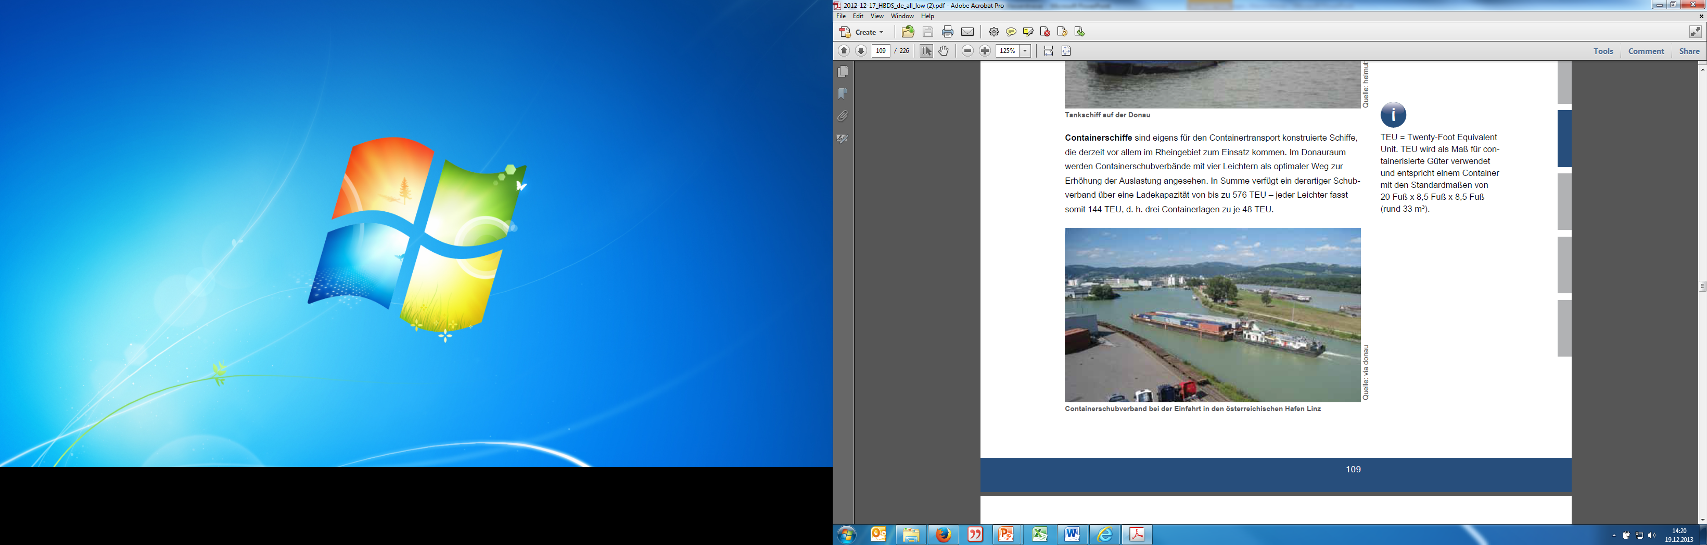
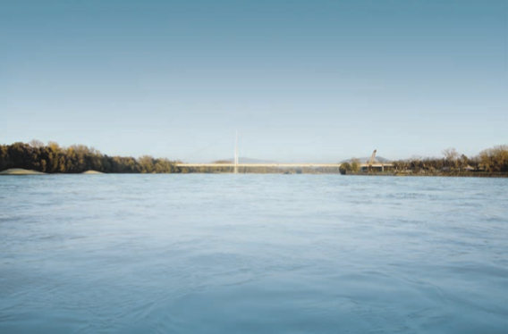
Bridges along the Danube
The Danube Waterway
Source: via donau
129 bridges along the Danube
42 bridges on the Austrian Danube
maximum 2-3 layered container transport
possible on the Danube
almost no container transport on the Upper Danube
(not profitable)
container transport mainly on the Rhine
Source: via donau/Pilo Pichler
source: via donau
Notes:
Between Kelheim and Sulina, a total of 129 bridges span the international Danube waterway. Of these 129 Danube bridges, 21 are bridges over locks and weirs. By far the greatest frequency of bridges is found on the Upper Danube (89 bridges): 41 bridges span the Austrian Danube and seven the Slovakian or Hungarian sections of the Danube. On the Central Danube there are a total of 33 bridges; on the Lower Danube there are only seven.
Container vessels are ships constructed specifically for the transport of containers and are currently used primarily in the Rhine region. Due to the bridges on the Danube, a containers could be stacked only in 2-3 layers, which is hardly profitable.
Source: Manual on Danube Navigation p. 56, 117
Picture: viadonau; viadonau/Pilo Pichler in Manual on Danube Navigation p. 117, 39

Slide 13
Availability of the Danube
The Danube Waterway
navigability of 98,3 %* or 359 days per year
weather-related closures caused by high water or ice formation possible
low water periods (water level < 2,5 )
→ vessels can not be fully loaded
→ economic efficiency declines
* observation period: 2007-2021
Maintaining the waterway (e.g. riverbed surveying) and information on fairway depth (RIS) improve the usability of the Danube
source: via donau
Notes:
Over a 15-year annual average from 2007 to 2021, the availability of the Austrian
section of the Danube waterway was 98.3%, or approximately 359 days per year.
During this period, three closures due to ice were recorded with an average duration
of just under 14 days, while the waterway had to be closed in eight of these years
due to high water with an average duration of around six days respectively.
Hydrologically, a high water wave occurred on the Danube in mid-July in 2021 (exceeding
the highest navigable water level 2010). For almost two and a half days, the
entire Austrian Danube section had to be closed to navigation. By contrast, it was
not necessary to officially close the waterway due to ice in 2021. This means that
the Danube waterway was available on 363 days or for 99.5% of the year.
Weather-related closures can be implemented by the relevant authorities on the
Austrian section of the Danube waterway in extreme situations, such as high water
or ice. While closures due to ice are normally confined to the winter months of January
and February, high water tends to occur during the spring or summer months.
Source: Annual report on Danube Navigation, viadonau, 2021, p. 25.

Slide 14
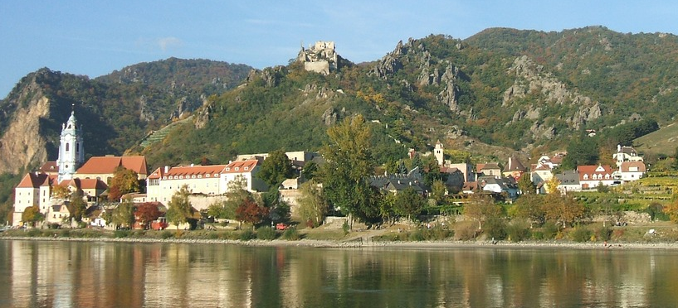
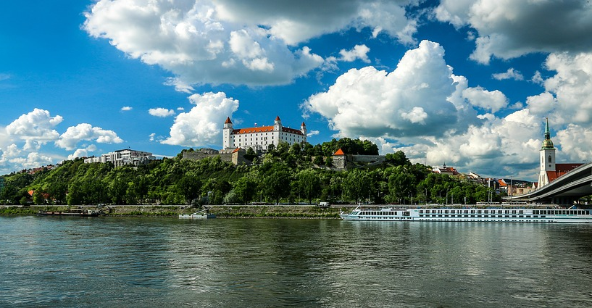

Quiz
The Danube Waterway
How many countries does the Danube flow through?
7
5
10
12
source: pixabay
Notes:
How many countries does the Danube flow through? 10
Pictures: www.pixabay.com

Slide 15
DANUBE NAVIGATION – Markets and Strengthening of the Waterway
Markets of Danube Navigation
Transport Examples
The Danube Waterway
Strengts of Danube Navigation

Slide 16
Freight transport on the Danube
Markets of the Danube Navigation
total freight traffic 2020:
  about 34,0 million tons of goods transported on the Danube and its tributaries
  Romania with 24,4 million tons of goods has the largest transport volume
Austrian Danube 2020:
  Transport of 7,6 million. tons of goods (→ decline due to low water levels and Ukraine crises)
transnational freight transport on the Austrian Danube corridor 2020:
  Share of the Danube in the total modal split 8%.
  Highest share of the Danube in transports across the eastern border
source: via donau, WKO
Notes:
In 2020, a total of around 34.0 million tons of goods were transported on the entire
navigable Danube between Kelheim and the Black Sea, its tributaries and the
Danube-Black Sea Canal. This corresponds to a slight decrease of 2.2 million tons
or 6.1% compared to 2019.
In terms of individual countries, the largest transport volumes were achieved by far
in Romania with 24.4 million tons, Bulgaria with 22.2 million tons and Serbia with
16.0 million tons. Trailing behind were Hungary with 8.5 million tons, Austria with
7.6 million tons, Croatia with 7.0 million tons, Slovakia with 6.1 million tons, Germany
(local government districts of the Upper Palatinate/Lower Bavaria) with 3.5 million
tons, Ukraine with 2.7 million tons*, Moldova with 0.5 million tons and Bosnia-Herzegovina,
which is connected indirectly to the Danube via the Sava, with 0.1
million tons.
As expected, the negative general conditions, below-average fairway conditions in the first half of the year and a reduced demand for goods due to the economic impairments in connection with the Corona crisis led to a decline in the volume of goods transported on the Austrian Danube. A total of 7.6 million tons of goods were transported in Austria.
Within the Austrian Danube corridor, a total of 91.5 million tons of goods were transported across borders by road, rail and Danube waterway in 2021. Compared to the previous year, this corresponds to an increase of 6.6 million tons or about 8%. Only road transport was able to benefit from the increase in the total volume transported, increasing its share of the modal split by two percentage points compared to 2020, while the rail and Danube transport modes each decreased their share by one percentage point. Broken down by the different transport sectors and traffic directions, the highest cargo volume was achieved in import transports across the western border with 25.4 million tons. The largest change in terms of volume compared with the previous year was recorded in export traffic across the western border. Here, the transport volume increased by 29% to 17.3 million tons, with only minor changes in the modal split.
Source: Annual Report on Danube Navigation, viadonau, 2021, p. 17, 45 et seqq

Slide 17
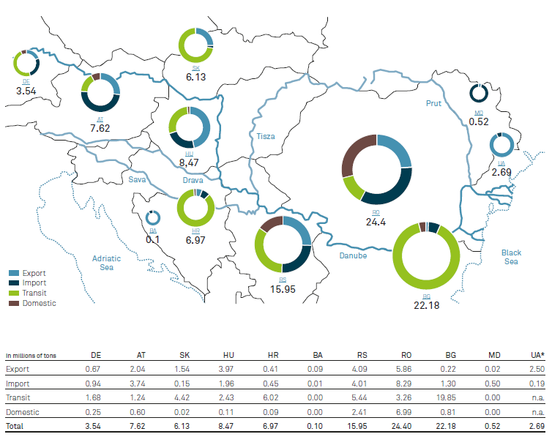

Freight Transport on the entire Danube – in million tons/year (2020)
Markets of Danube Navigation
source: via donau
source: via donau
Notes:
In 2020, a total of around 34.0 million tons of goods were transported on the entire
navigable Danube between Kelheim and the Black Sea, its tributaries and the
Danube-Black Sea Canal. This corresponds to a slight decrease of 2.2 million tons
or 6.1% compared to 2019.
In terms of individual countries, the largest transport volumes were achieved by far
in Romania with 24.4 million tons, Bulgaria with 22.2 million tons and Serbia with
16.0 million tons. Trailing behind were Hungary with 8.5 million tons, Austria with
7.6 million tons, Croatia with 7.0 million tons, Slovakia with 6.1 million tons, Germany
(local government districts of the Upper Palatinate/Lower Bavaria) with 3.5 million
tons, Ukraine with 2.7 million tons*, Moldova with 0.5 million tons and Bosnia-Herzegovina,
which is connected indirectly to the Danube via the Sava, with 0.1
million tons.
These size ratios show that considerably higher transport volumes are achieved on
the lower and middle Danube than on the upper Danube. For comparison: in 2020,
more than three times the quantity generated in Austria was shipped in Romania.
Quelle: via donau annual report Danube Navigation 2021, p. 41
Picture: via donau annual report Danube Navigation 2021, p. 40

Slide 18
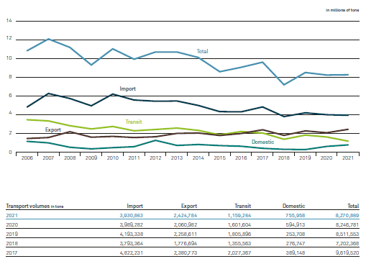
Freight Transport on the Austrian
Danube 2006-2021
Markets of Danube Navigation
source: via donau
source: via donau
Notes:
A total of 8.3 million tons of goods were shipped on the Austrian Danube in 2021.
Despite the negative framework conditions, such as uncharacteristically low fairway
conditions in the months of March and April, there was a slight overall increase of
24 088 tons or 0.3% compared to the previous year.
The imports traffic area experienced only a slight decrease of 1.5% compared to the
previous year. At 3.9 million tons, however, imports remain the highest-volume
transport sector on the Austrian Danube. However, there were major changes compared to the previous year in the other transport areas.
Exports, which continued their long-term rising trend in 2021, increased sharply by
17.7% and have been the second most important traffic area since 2017. In turn,
transit traffic experienced a further decline in 2021, falling significantly by 27.6% to
1.2 million tons.
In 2021, for the second time in a row, the volume transported domestically increased.
Source: via donau annual report Danube Navigation 2021, p. 17
Picture: via donau annual report Danube Navigation 2021, p. 16

Slide 19
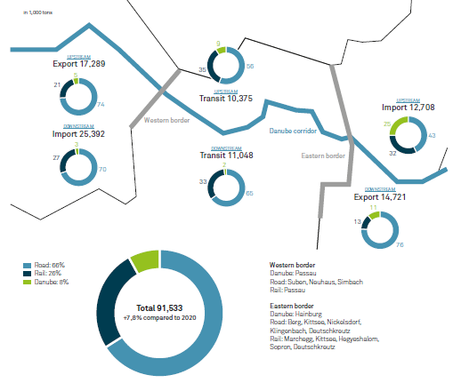
Cross-Border Freight Transport at the Austrian Danube 2021
Markets of Danube Navigation
source: via donau
source: via donau
Notes:
In 2021, a total of 91.5 million tons of goods were transported across the border
within the Austrian Danube corridor by road, rail and the river Danube. This represents
an increase of 6.6 million tons or about 8% compared to the previous year.
In 2021, 66% of the modal split was made up of road, 26% of rail and 8% of inland
waterway transport. Only road transport, which increased its share of the modal
split by two percentage points compared to 2020, benefited from the increase in the
total amount transported, while the rail and Danube modes reduced their share by
one percentage point each.
At 25.4 million tons, the highest volume of goods was reached in imports over the
western border, divided between the different traffic areas and traffic directions.
Of this, 70% was executed by road, 27% by rail and 3% by inland waterway.
The biggest change in terms of volume compared to the previous year was recorded
in exports over the western border. Here, transport volume increased by 29% to 17.3
million tons, with only a slight change in the modal split.
Source: via donau annual report Danube Navigation 2021, p. 42
Picture: via donau annual report Danube Navigation 2021, p. 43

Slide 20
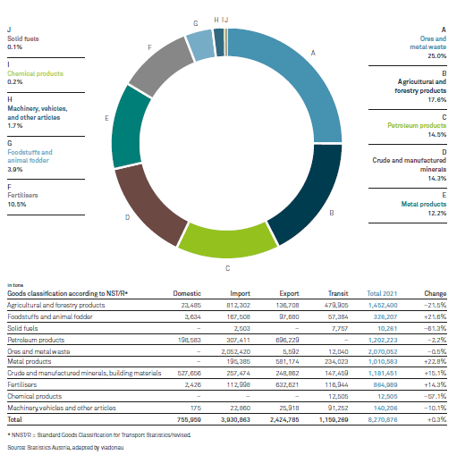
Transport Volume on the Austrian Danube by Commodity Groups 2021
Markets of Danube Navigation
source: via donau
source: via donau
Notes:
Just under 8.3 million tons were transported on the Austrian Danube in 2021, similar
to the previous year. This corresponds to a slight increase of 0.3% in transport
volume. Compared to the previous year, the commodity group ranking also remained unchanged in terms of total transport volume.
At 2,070,052 tons, ore and metal waste is still the highest-yielding commodity group, which is usually due to heavy import traffic. It represents 25.0% of the total volume transported on the Austrian Danube, which corresponds to a slight decrease of 0.5% compared to the previous year.
In second place in the ranking, with 1,452,400 tons, are once again agricultural and
forestry products. However, compared to the previous year, the commodity group
recorded a decrease of 21.5% or 398,768 tons in transport volume.
Petroleum products account for 1,202,223 tons (–2.2% compared to 2020) of the
transport volume on the Austrian Danube and remain in third place in the commodity group ranking.
Source: via donau annual report Danube Navigation 2021, p. 21
Picture: via donau annual report Danube Navigation 2021, p. 20

Slide 21
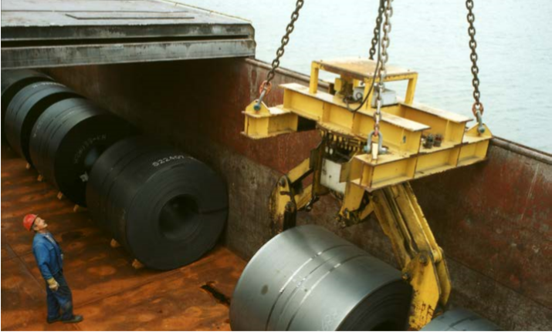
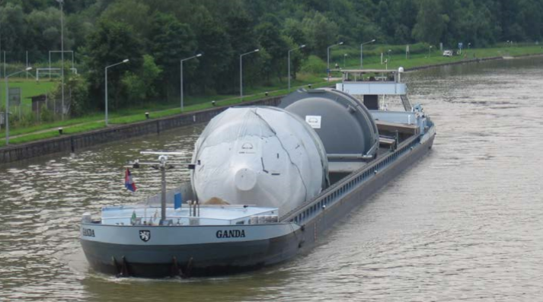
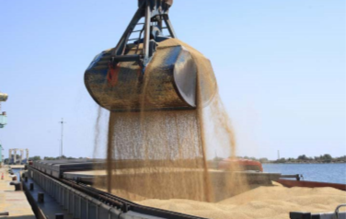
Transported Goods
Markets of Danube Navigation
Source: via donau
dry cargo
  ore, raw material, oil
  agricultural and forestry products
liquid goods
  petroleum products
other cargo
  construction material
  used materials and waste
  new cars
  biogenic raw materials
  heavy/oversized goods
Source: via donau
Source: Voies Navigables de France
source: via donau
Notes:
Inland navigation vessels are ideally suited to the transport of bulk cargo, due to the large volume of goods that can be transported on a vessel unit. If planned and carried out correctly, transport costs can be reduced in comparison to road and rail and this in turn compensates for longer transport times. The inland vessel is especially suitable for the transport of large quantities of cargo over long distances.
For the steel industry inland navigation is a vital transport mode. Iron ore accounts for example for 25-30% of the total transport volume shipped on the Austrian stretch of the Danube. Due to their heavy weight, finished and semi-finished goods such as steel coils can also be transported economically using inland navigation.
Agricultural and forestry products together account for around 20% of the total volume of goods transported annually on the Austrian stretch of the Danube. Many Austrian companies trading in agricultural products or involved in the processing of such goods (i.e. starch, foodstuffs and animal fodder, biogenic fuel) have settled directly on the waterway.
Petroleum products from the mineral oil industry account for a large share of total transport volumes on the Austrian stretch of the Danube and therefore constitute a key market. In the Danube region there are many refineries located either on or near the waterway.
Source: Manual on Danube Navigation p. 166-161
Picture: viadonau; Voies navigables de France; viadonau in Manual on Danube Navigation p. 161, 162, 163

Slide 22
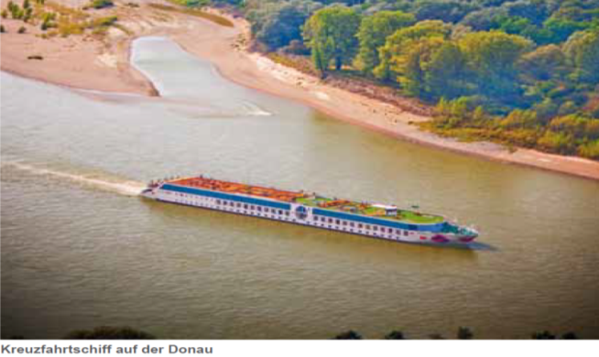
Tourism at the Austrian Danube
Markets of Danube Navigation
Besides its importance as a mode of transport the Danube is also a popular leisure destination
Quelle: via donau/Andi Bruckner
2021 about 290,000 guests on passenger vessels in Austria → decrease of 79.0% in passenger numbers since 2019 (corona-related slump)
cruises to the black sea become more popular
source: via donau
Notes:
In 2021, passenger transport was again influenced by the pandemic and the strict
conditions attached to it. Around 290,000 passengers were carried on the Austrian
stretches of the Danube, which is equivalent to an increase of 75.8% in comparison
to 2020. However, this figure is still 79.0% below the 2019 figures.
Source: via donau annual report Danube Navigation 2021, p. 22
Picture: viadonau/Andi Bruckner in Manual on Danube Navigation p. 119

Slide 23
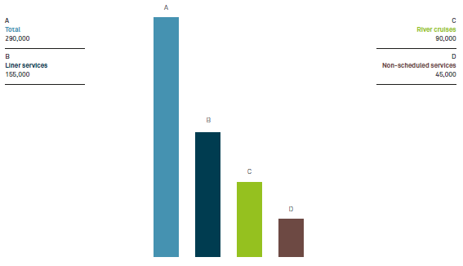
Tourismus at the Austrian Danube 2021
Markets of Danube Navigation
Almost 290 000 passengers
in 2021
source: via donau
Notes:
In 2021, passenger transport was again influenced by the pandemic and the strict
conditions attached to it. Around 290,000 passengers were carried on the Austrian
stretches of the Danube, which is equivalent to an increase of 75.8% in comparison
to 2020. However, this figure is still 79.0% below the 2019 figures.
River cruises recorded around 90,000 passengers carried in 2021 (+80.0% compared
to 2020), but are still 83.2% below the 2019 figures. The number of cabin
vessels operating on the Austrian section increased again to 113 ships (+91.5%) in
2021, of which two were new vessels. In total, 1,826 journeys (+81.3%) were completed.
Source: via donau annual report Danube Navigation 2021, p. 22
Picture: via donau annual report Danube Navigation 2021, p. 23

Slide 24
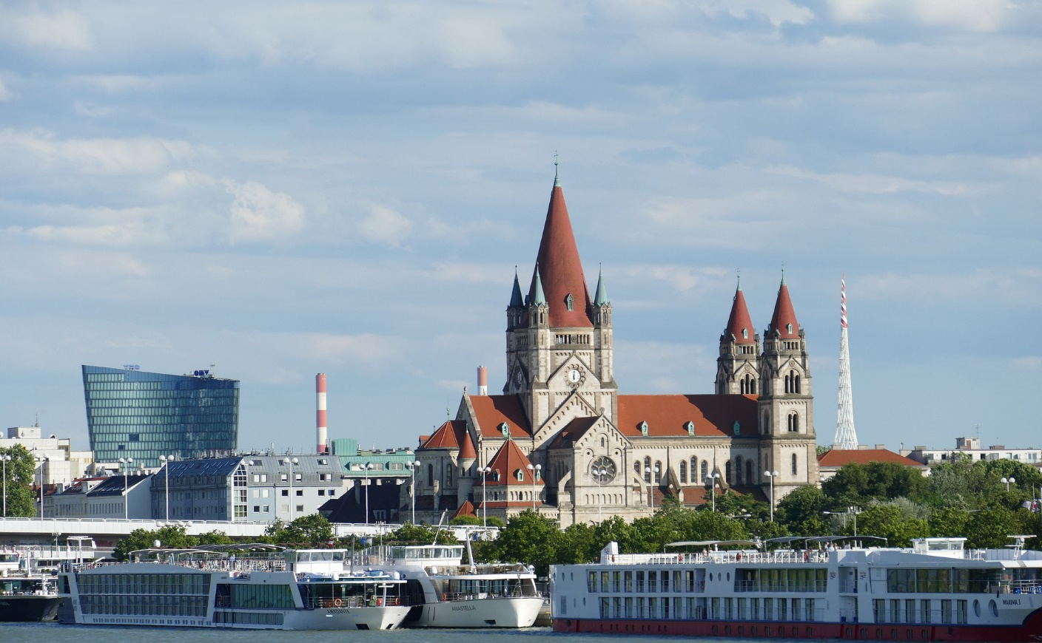
Quiz
Markets of Danube Navigation
source: www.pixabay.com
How many passengers were on the Danube in 2017?
700.000 c) 2.1 Mio
1.2 Mio. d) 1.7 Mio
Notes:
How many passengers were on the Danube in 2017? 1.3 Mio
Picture: www.pixabay.com

Slide 25
DANUBE NAVIGATION – Markets and Strengthening of the Waterway
Markets of Danube Navigation
Transport Examples
The Danube Waterway
Strengths of Danube Navigation

Slide 26
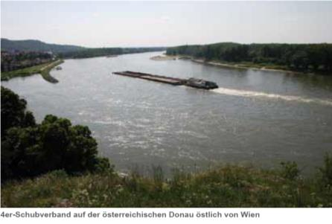
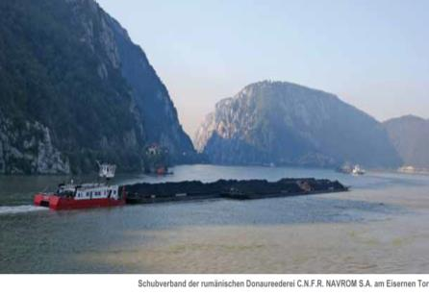
Strengths of Danube Navigation
low transport costs
eco-friendly
high transport capacity per unit
safe
24/7 availability
low infrastructure expenses
free capacity (use of capacity at 10-15 % !)
source: via donau
source: C.N.F.R. NAVROM S.A. Galaţi
source: via donau
Notes:
The principal strengths of Danube navigation are the ability to transport large quantities of goods per vessel unit, its low transport costs and its environmental friendliness. Furthermore, it is available around the clock, with no prohibition on driving at weekends or during the night and can provide a high degree of safety and low infrastructure costs.
Source: Manual on Danube Navigation p. 17
Picture: C.N.F.R. NAVROM S.A. Galaţi, viadonau in Manual on Danube Navigation S. 112, 125

Slide 27
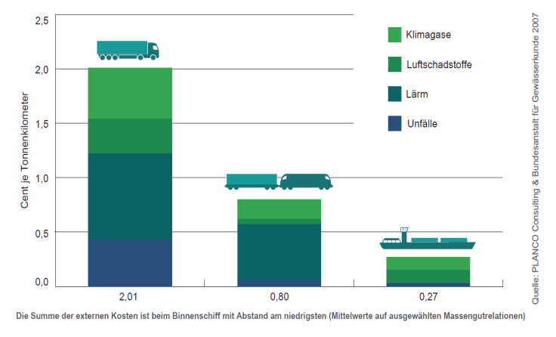
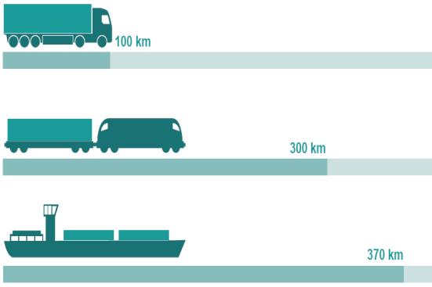

Strengths of Danube Navigation
Eco-friendly and economic
specific energy consumption: low external costs:
source: via donau
Source: Planco Consulting GmbH 2007
Greenhouse gas
Air pollutant
Noise
Accidents
Cent per ton kilometers
An inland vessel can transport one ton of cargo almost four times as far as a truck with the same energy consumption
Inland vessels cause the lowest accident, noise, pollution and climate costs
source: via donau
Notes:
Inland vessels show a lot of advantages in comparison to other transport means.
In regard to specific energy consumption, inland navigation can be described as the most efficient and hence environmentally friendly transport mode. Inland vessels can transport one ton of cargo almost four times as far as a truck with the same energy consumption.
In comparison to other means of transport inland navigation also accounts for the lowest external costs, so those costs associated with climate gases, air pollutants, accidents and noise. CO2 emissions are comparatively low in particular, which means that inland navigation can contribute to achieving the European Union climate targets.
Source: Manual on Danube Navigation p 18, 19
Pictures: viadonau; PLANCO Consulting für Gewässerkunde 2007 in Manual on Danube Navigation p 18, 19

Slide 28
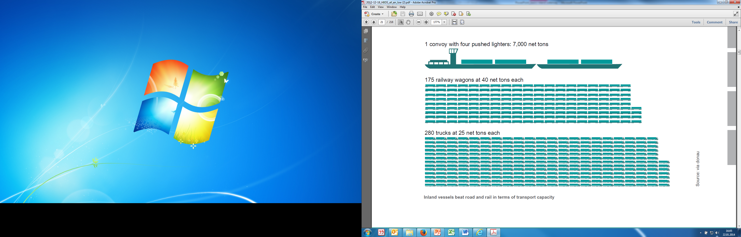
Strengths of Danube Navigation
high transport capacity per unit
largest transport capacity: 1 pushed convoy with 4 push barges =
175 railway wagons = 280 trucks = 20 km convoy of trucks
source: via donau
Notes:
In comparison to other land transport modes, Danube navigation offers a significantly higher transport capacity per transport unit. For instance, a single convoy with four pushed lighters can transport around 7,000 tons of goods – equivalent to the cargo carried by 175 railcars (with 40 net tons each) or 280 trucks (with 25 net tons each). Hence, increasing cargo transport on the Danube means a significant reduction in congestion, noise emissions, environmental pollutions, road accidents and the burden on the rail system.
Source: Manual on Danube Navigation p. 18
Picture: viadonau in Manual on Danube Navigation p. 19

Slide 29
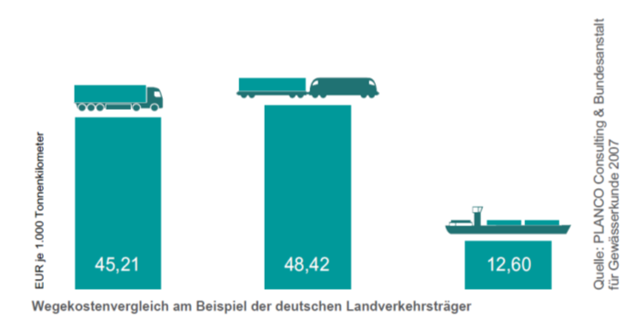
Strengths of Danube Navigation
inland vessels as safest transport mode:
  only 12 traffic accidents on the Austrian-Danube in 2018 (no cases of death)
  in comparison: 1379 accidents with trucks (>3,5 tons) in Austria in 2014
availability around the clock: no bans on weekend- and night driving
low infrastructure costs: natural infrastructure is usually available → low costs
Source: Planco Consulting GmbH 2007
Improving the complete infrastructure of the Danube waterway would require an investment of € 1.2 billion. This corresponds roughly with the cost of constructing 50 km of road or rail infrastructure.
Euro per 1.000 ton kilometers
source: via donau
Notes:
The inland vessel is by far the safest means of transport. In 2018, a total of 12 traffic accidents occurred on the Austrian Danube without any personal injuries.
In addition, inland vessels can be used around the clock, there are no restrictions such as weekend and night driving bans.
Due to the mostly natural infrastructure of the waterway, lower path and maintenance costs are required. To illustrate: to improve the infrastructure of the entire Danube, it is estimated that around 1.2 billion euros would be needed, which corresponds to the construction costs of around 50 kilometers of road! The graph on the right shows a comparison of infrastructure costs based on the example of the German land transport modes, which are by far the lowest for inland navigation vessels at 12.60 euros per 1000 ton- kilometers.
Source: Manual on Danube Navigation p. 17, 20, Annual Report on Danube Inland Navigation 2018, p.2
Picture: PLANCO Consulting für Gewässerkunde 2007 in Manual on Danube Navigation p. 19

Slide 30
Problems of Danube Navigation
Strengthening of Danube Navigation
dependence on fairway conditions
bridges
low transport speed
low network density (pre/post-carriage necessary)
partly no adequate maintenance
high need for modernization of ports and fleets
shortage of qualified personnel
source: via donau
Notes:
The weaknesses lie in its dependence on fluctuating fairway conditions and the consequent, varying degree of the vessel load factor, the low transport speed and network density, which often necessitate pre- and end-haulage by road or rail.
The threats of Danube navigation are found in the different political and hence budgetary importance assigned to this transport mode in the individual Danube states, as well as in the need to modernise many Danube ports and parts of the Danube fleet.
Source: Manual on Danube Navigation p. 17

Slide 31
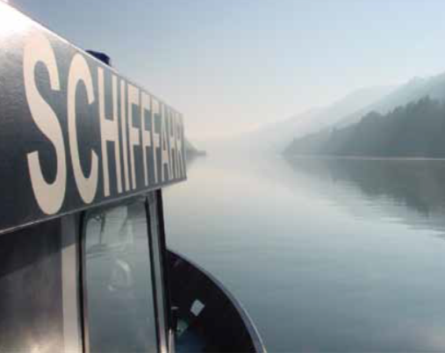

General Requirements
Strengthening of Danube Navigation
National and international
transport policy sets direction
for further development by:
defining basic targets and strategies
establishing infrastructural projects
source: via donau
  Important: cooperation between riparian states of the Danube
Notes:
In order to strengthen Danube navigation in the long term and to be able to implement the approaches described in more detail below, the best possible specification of a uniform direction of development by national and international transport policy is unavoidable and a basic requirement. This requires, among other things, the definition of basic objectives and strategies and the introduction and implementation of additional infrastructure projects. Cooperation between the Danube riparian states is important and unavoidable.
Source: Manual on Danube Navigation p. 24
Picture: viadonau in Manual on Danube Navigation p 24/23

Slide 32
Framework of Transport Policy – at pan-European level
Strengthening of Danube Navigation
NAIADES (European Commission, 2006) and NAIADES II –
Action Programme for the promotion of inland
waterway transport:
guidelines for a joint approach
areas: infrastructure, markets, fleet, jobs/skills and RIS
goal: improve capacity and sustainability
Since 2014, the programme of measures to further improve the quality of inland navigation has been continued.
PLATINA II: Platform for the Implementation of NAIADES
EU Strategy for the Danube Region – EUSDR (European Commission, 2010)
Danube countries and stakeholders
action plan with targets until 2020
i.e. Pillar 1: Connecting the region, Priority area: Water mobility, Action 1: Contribute to improve waterway and port infrastructure & management
source: via donau, danube-region.eu, ec.europa.eu
Notes:
NAIADES II is designed to augment the capacity utilisation of inland waterways along with the sustainability of inland navigation in Europe. The European Commission published the NAIADES II Mid-term Progress Report in 2018, setting out the progress in the five areas until 2017. It provides a positive assessment and describes the next necessary steps.
PLATINA II (Platform for the Implementation of NAIADES II) was installed as a platform for the coordinated implementation of the strategies and measures of the NAIADES II Action Programme in 2013-2016. The initiative was implemented by numerous organizations from several European countries and by the European.
The Strategy of the European Union for the Danube Region (EUSDR) has been in force since 2011 ( European Commission, 2010b). It is a macro-regional strategy comprising the 14 Danube countries, among them EU Member States, accession candidates and third countries. Additionally, a large number of stakeholders are involved in the process of the strategy’s implementation. The strategy is intended to be implemented until 2020 on the basis of an action plan which rests on four pillars: Connecting the Danube Region, Protecting the Environment in the Danube Region, Building Prosperity in the Danube Region and Strengthening the Danube Region. For each pillar, distinct objectives and actions have been specified by the EU and the Danube countries. The four pillars focus on 12 priority area, which consists of a total of 85 actions. The EUSDR was revised in 2020, changes for example technological ones were considerate and new actions decided.
Source: Manual on Danube Navigation p. 28, 29 and at https://ec.europa.eu/transport/modes/inland/promotion/naiades2_en) [06.04.2020].
https://danube-region.eu/wp-content/uploads/2020/04/EUSDR-ACTION-PLAN-SWD202059-final.pdf [12.05.2020]
http://www.viadonau.org/unternehmen/europaeische-strategien/europaeische-schifffahrtspolitik

Slide 33
Framework of Transport Policy – at pan-European level
Strengthening of Danube Navigation
White paper on Transport (European Commission, 2011)
target settings for reducing CO2 emissions and oil dependency:
  shifting 30% of the road transport >300 km until 2030
  establishing a fully operational trans-European core network until 2030 (EU Guideline, 2010)
  establishing River Information Services (RIS)
inland navigation recognized as energy-efficient transport mode
sourcee: via donau, ec.europa.eu
Notes:
The process will be steered on the basis of five policy objectives, which will enable the measurement of its implementation. The fields of climate change and energy together with research and development are of particular relevance to inland navigation. In the field of climate change and energy, objectives have been set to cut greenhouse gas emissions in the range of 20 to 30% in comparison to 1990, to raise the share of renewable energy to 20% and to boost energy efficiency by 20%. For research and development in Europe, 3% of the gross domestic product of the EU will be made available. The European Commission publishes ongoing monitoring reports on the indicators, which are accessible online.
The European Commission’s 2011 White Paper on Transport titled ‘Roadmap to a Single European Transport Area – Towards a competitive and resource efficient transport system’ sets ambitious objectives for reducing oil dependency and CO2 emissions. The latter should be reduced by 60% by 2050 in comparison to 1990.
Source: Manual on Danube Navigation p. 26, 27

Slide 34
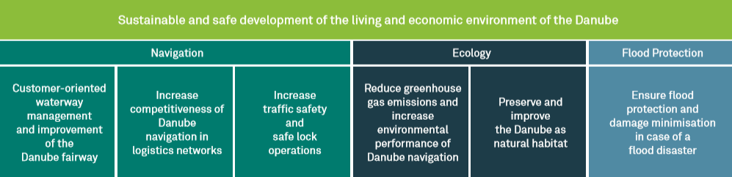
Transport Policy – in Austria
Strengthening of Danube Navigation
Overall Transport Plan for Austria
  Sets out objectives and policies of Austrian transport planning until 2025.
Action Program Danube
  Until 2022
  Objectives apply equally to ecology, flood protection and navigation
  Implemented by viadonau.
Source: viadonau
source: via donau, bmvit
Notes:
The ‘Overall Transport Plan for Austria’ sets out the objectives and policies of Austrian transport planning until 2025 for all transport modes.
The detailed basis for the Austrian navigation policy is defined until 2022 in the Action Program Danube (APD), whose objectives, for the first time, apply equally to ecology and flood protection in addition to navigation itself. By proceeding in this way, the program reflects the multifunctional character of the Danube and uses synergies between these three fields of action. The program is being implemented by viadonau – Österreichische Wasserstraßen-Gesellschaft mbH, together with Federal ministry for climate protection, environment, energy, mobility, innovation and technology as well as in close cooperation with the relevant stakeholders.
The action program's six impact objectives (as shown in the diagram below) will be implemented in 23 measures, each of which contributes to one, two or all three fields of action. Underlying the efforts is the intention to continue strengthening inland navigation within the overall system of Austrian transport – also based on the European guidelines. The measures included in the action field of inland navigation refer to the areas of waterway infrastructure, lock operations, provision of user information (River Information Services), transport development, fleet modernization and knowledge management.
Source: Manual on Danube Navigation p. 31
Picture: viadonau in Manual on Danube Navigation p. 31

Slide 35
Problem solving & improvement
Strengthening of Danube Navigation
dependence on fairway conditions
seasonal low water (water levels < 2.5 m )-> ships cannot be fully loaded -> economy decreases
solution & improvement approach:
  waterway maintenance, river engineering measures
  Information on water levels through River Information Services (RIS)
viadonau:
  responsible for the maintenance/improvement of the waterway
  operates DoRIS - the Austrian RIS
source: via donau
Notes:
The depth of the fairway determines how far an inland vessel can be "unloaded"; the more goods a ship has loaded, the greater its unloading depth, i.e. the draught of the ship at rest corresponding to a certain loading condition. The depths of unloading that can be used by shipping have a decisive influence on the profitability of inland waterway transport. In the case of seasonal low water, i.e. water levels of less than 2.5, inland vessels cannot be fully loaded and their economic efficiency is reduced. This problem can be counteracted by the waterway maintenance activities described below, river engineering measures and the provision of up-to-date and timely information on the respective water levels.
Source: Manual on Danube Navigation p. 59, 50

Slide 36

Problem solving & improvement
Strengthening of Danube Navigation
Maintenance work:
transport of sediments (gravel, sand)
dredging shallow areas
riverbed surveying
provision of continuous and target group
specific information on the current state
of the fairway to the users of
the waterway
improvement and extension of waterways
In Austria viadonau is responsible for maintaining the Austrian section of the Danube waterway
source: via donau
source: via donau
Notes:
This problem can be prevented or improved on the one hand by adequate maintenance of the waterway by the responsible authorities. In Austria this is the responsibility of viadonau. Through maintenance work such as dredging, the removal of sediments such as gravel and sand or the continuous development and extension of the waterway, the depth of the fairway should be kept constant at a certain minimum height if possible. Translated with www.DeepL.com/Translator (free version)
Source: Manual on Danube Navigation p. 58 et seqq
Picture: viadonau in Manual of Danube Navigation p. 59

Slide 37
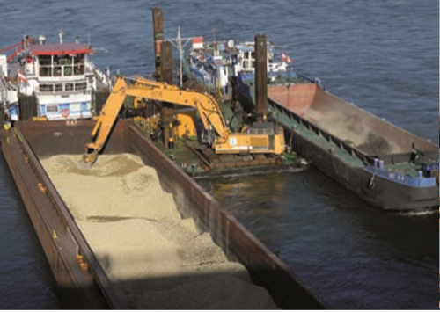
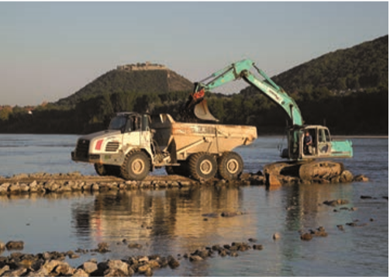
Problem solving & improvement example: The Danube east of Vienna
Integrative bedload
management
Optimization of
regulating structures
Riverbank restoration
Source: via donau
Stakeholder
participation
Sidearm reconnection
A learning system
Source: via donau
source: via donau
Notes:
The aim of this measures is an integrative approach to stabilize the water level on the free-flowing section of the Danube east of Vienna, to preserve the unique habitat in the Danube-Auen National Park and to structure the waterway infrastructure in line with the requirements of safe and efficient Danube navigation.
The measures are following:
Integrative bedload management: In order to maintain safe and cost-effective navigable fairway conditions, gravel is excavated every year at the critical shallow sections. Gravel is also obtained from bedload traps specially set up for the purpose. This material is taken as far upstream as possible and dumped there in areas where the riverbed is deep.
Riverbank restoration: Natural riverbank structures are forming due to the local dismantling of the stone armour on the banks of the Danube. New habitats are being created for birds that breed on gravel banks and for typical riverine plant species.
Sidearm reconnection: Branches bring life to the wetland forest and have become a rare type of habitat. They shape the landscape through erosion and sedimentation. Connections between the largest branch systems in the Danube-Auen National Park and the Danube will therefore be strengthened once again.
Optimisation of the regulating structures: In order to ensure navigability also during low water periods and to reduce the operating costs of waterway infrastructure, low water regulation structures (groynes, training walls) are improved in critical ford areas (shallow sections).
Stakeholder participation: The involvement of the most diverse stakeholders and civil society is an important prerequisite for the development and implementation of socially and environmentally compatible solutions.
A learning system: The Catalogue of Measures affords the flexibility required for new findings and current developments to be incorporated into the implementation.
Source: Manual on Danube Navigation p. 78,79
Pictures: viadonau in Manual on Danube Navigation p. 79

Slide 38
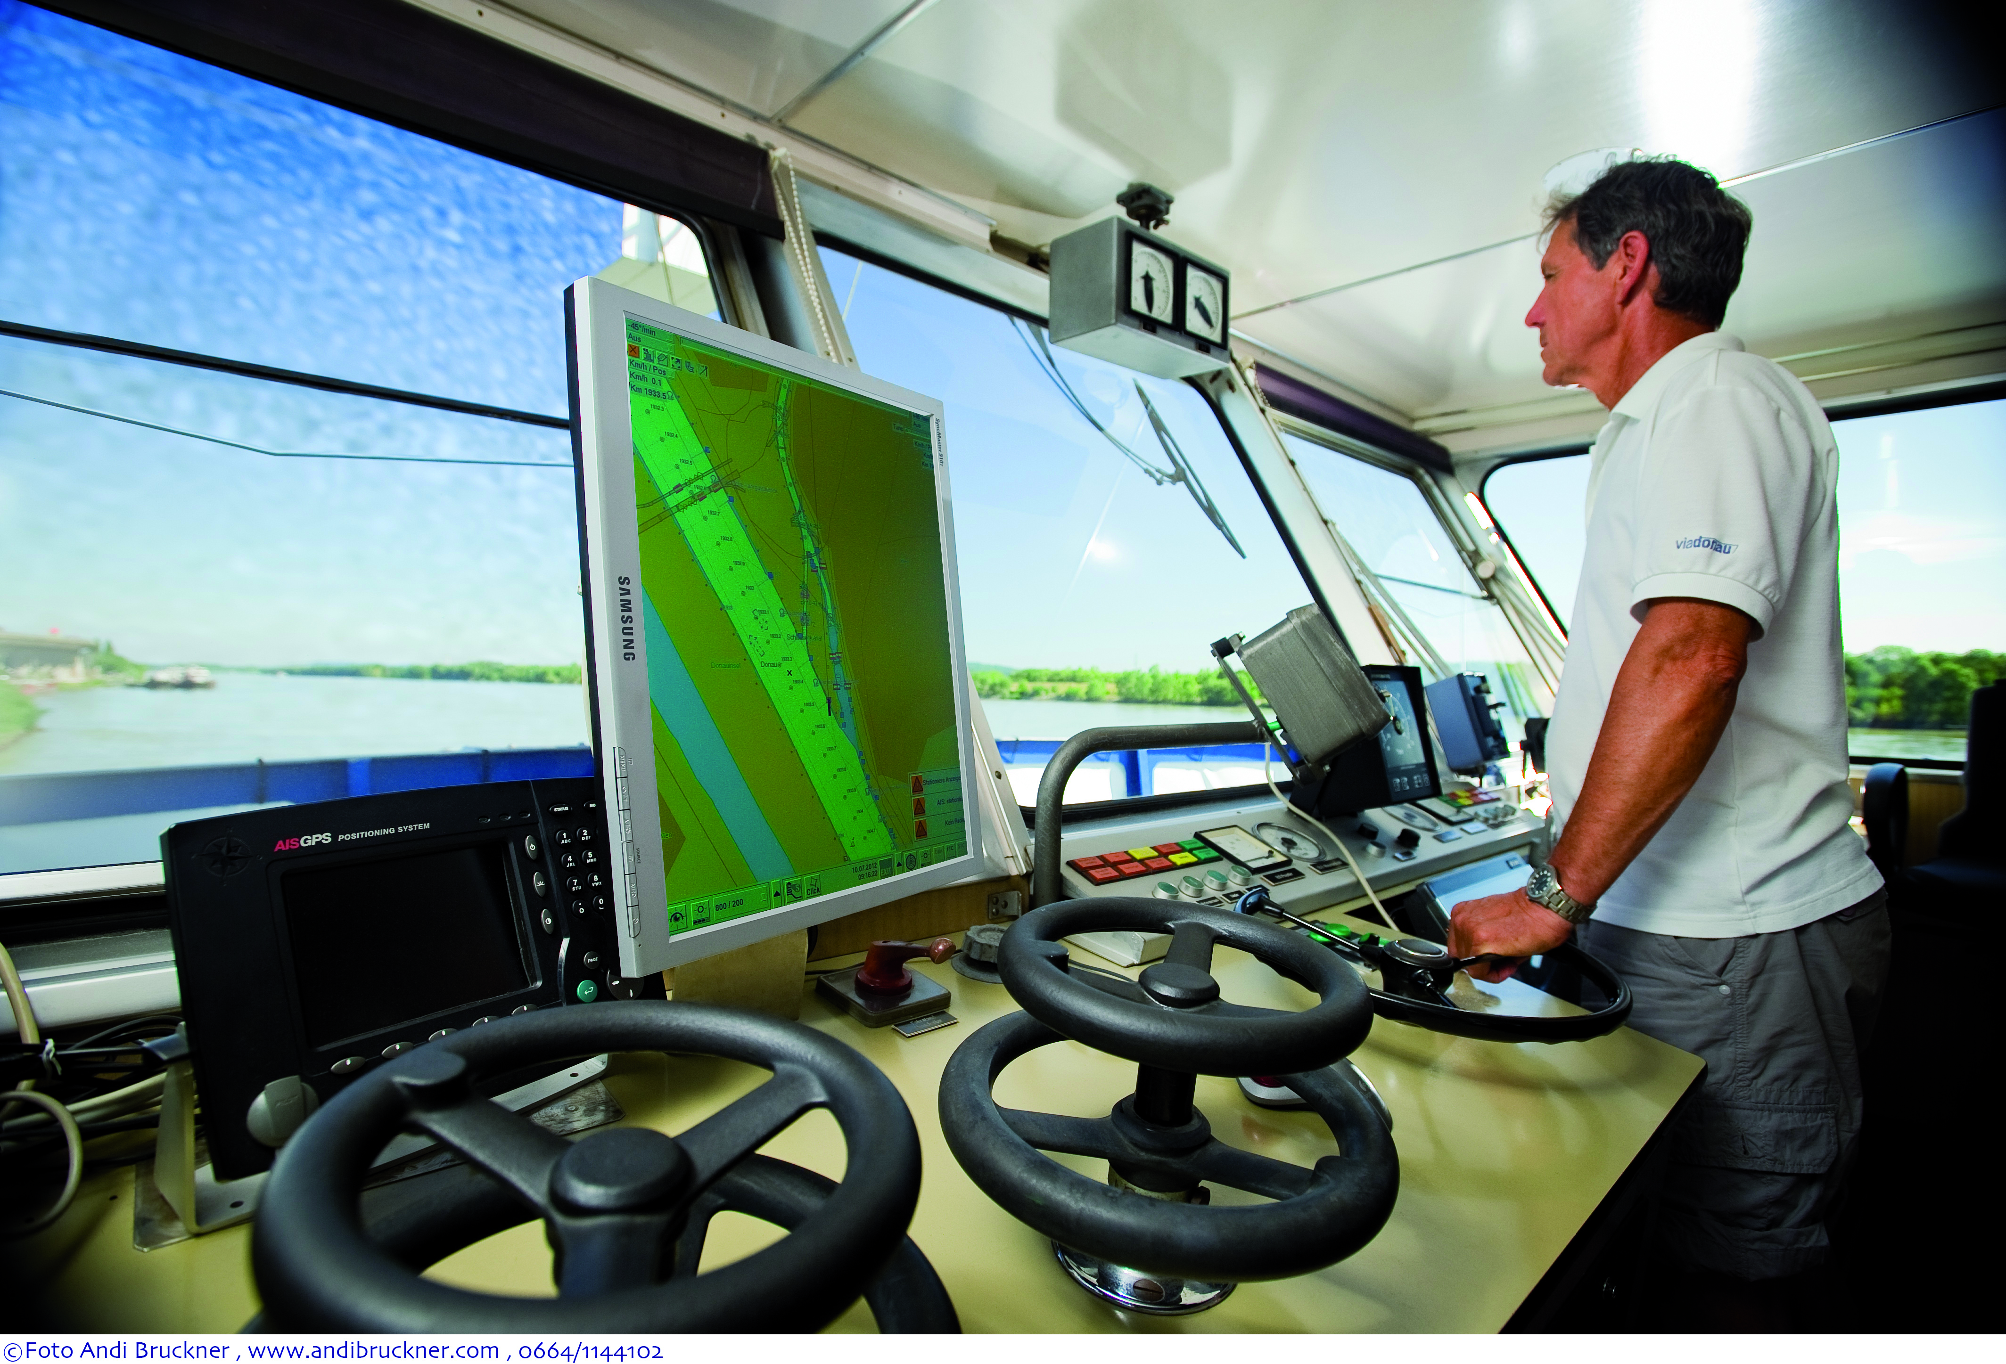
Problem solving & improvement
Strengthening of Danube Navigation
Telematics for inland vessels:
River Information Services (RIS)
fairway information on water level and forecasts
shallow areas and notices to skippers
representation – so called tracking and
tracing of vessels on an electronic chart
DoRIS: www.doris.bmvit.gv.at
source: via donau
© via donau I 38
source: via donau
Notes:
RIS technologies such as Inland AIS, Inland ECDIS (Electronic Chart Display and Information System), NtS and ERI are specified in the RIS Directive. These technologies are the basis for a variety of services, including fairway information services, traffic information, traffic management, information for transport logistics, port and terminal management, voyage planning and statistics. In Austria the DoRis (Donau River Information system) is operating.
Source: Manual on Danube Navigation, p 204 et seqq
Picture: viadonau in Manual on Danube Navigation p 138

Slide 39
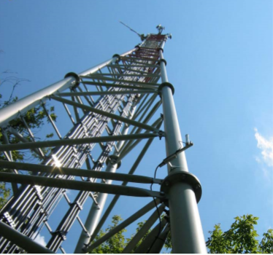
Problem solving & improvement
Strengthening of Danube Navigation
speed and network density
the weaknesses of inland navigation are the low transport speed and the low network density, which usually requires a pre- and end-haulage.
River Information Services provide up-to-date and timely information to improve the profitability, reliability and planning of transport and reduce weaknesses.
source: via donau
source: via donau
Notes:
In the field of inland navigation, a balance must always be struck between the factors of time and cost. Naturally, not all goods are suitable for transport by ship. However, if the transport of goods is flexible in terms of time, there is considerable potential for savings in the area of inland waterway transport, if well planned. Optimal planning of the transport chain can additionally reduce transport times and reduce the pre- and end-haulage. With up-to-date information and perfect lock management, RIS tour and loading can be optimally planned and additional time can be saved.
Sources: Manual on Danube Navigation p. 17, 204
Picture: viadonau in Manual on Danube Navigation p. 204

Slide 40
Problem solving & improvement
Strengthening of Danube Navigation
Public awareness and education - trough target group oriented information
Annual report Danube navigation – data & facts, current projects, developments
Manual on Danube Navigation – basic knowledge Danube Navigation, 4th edition
Online Portals: www.donauschifffahrt.info, www.danubeports.info, www.blaue-seiten.at
Waterway map: Europe, Danube, Danube for children
INeS Danube: multilingual eLearning Platform for logistics with inland vessels
www.ines-danube.info
REWWay (Research and Education on Waterway Logistics): Teaching materials about inland navigation
© via donau I 40
source: via donau
39
Notes:
Target group oriented information on inland navigation can additionally help to create awareness of the advantages of inland navigation and thus increase the capacity utilisation of Danube navigation.
Examples are the Annual Report of Danube Navigation, the Danube Navigation Manual, numerous online portals, waterway charts and the multilingual eLearning platform INeS Danube.
Sources (for download): Annual Report on Danube Naviagtion and Manual on Danube Navigation: http://www.viadonau.org/en/newsroom/publications/folders
https://www.ines-danube.info
https://www.rewway.at/en/teaching-materials/bundles/

Slide 41
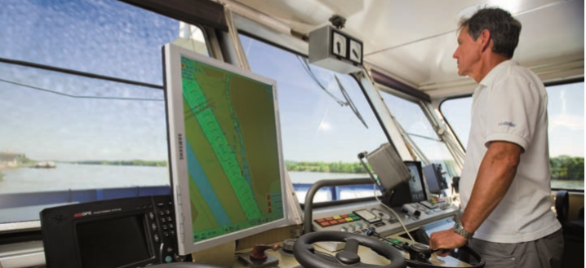
Lack of Qualified Staff
Strengths of Danube Navigation
increasing shortage of qualified staff
over aging of personnel
job opportunities in Danube navigation little known to young people
family-related changes to jobs ashore
few internationally uniform qualification standards
Sources: viadonau
source: via donau, edinna.eu, bag.bund.de
Notes:
Education and further training differs greatly between the individual Danube countries, as well as in Europe as a whole. The approaches vary from very practical concepts with no obligation to attend a training institute, through to the award of academic qualifications. Some countries have several courses of education running parallel to each other.
Introduced in January 2018, Directive (EU) 2017/2397 creates a common framework to guarantee minimum professional qualifications in the area of inland navigation. This Directive defines the requirements and procedures for the award of certificates of qualification and their mutual recognition in the Member States. The qualifications apply to persons involved in the operation of a vehicle on the inland waterways of the European Union.
EDINNA, the association of inland waterway navigation schools and training institutes in Europe, provides an overview of the training opportunities in Europe on its website. EDINNA supports the European Commission in its efforts to harmonise education and its certification in inland navigation.
Sources: Manual on Danube Navigation p. 142 and
https://www.bag.bund.de/SharedDocs/Downloads/DE/Marktbeobachtung/Sonderberichte/Sonderber_Personalsituation_in_der_deutschen_Binnenschifffahrt.pdf?__blob=publicationFile, S.2f. [03.04.2020]
Picture: viadonau in Manual on Danube Navigation p. 138

Slide 42
Education and Training Standards
Strengths of Danube Navigation
training times and contents strongly differ among countries
no harmonization and minimum standards on a European level
variety of different diplomas and certificates
harmonization of training standards is sought
source: via donau, binnenschiff.de, bmvit.gv.at
Notes:
Within Europe and throughout the EU, training standards vary greatly depending on the country. The length of the training, the duration of the practical training, the general structure and the contents vary considerably from country to country, and there is no EU-wide harmonization or at least no specification of minimum standards.
The existence of numerous different diplomas and certificates makes it difficult to assess the respective qualification standards and makes the transnational deployment of personnel more difficult.
Source: Manual on Danube Navigation p. 142

Slide 43
Training standards – solution approach
Strengthening of Danube navigation
improvement of harmonization of training standards
EU Directive 2017/2397 creates a common framework to guarantee minimum professional qualifications.
the requirements and procedures for the award of certificates of qualification and their mutual recognition in the Member States.
EDINNA, the association of inland waterway navigation schools and training institutes in Europe, supports the European Commission in its efforts to harmonize education and its certification
source: via donau, edinna.eu
Notes:
Education and further training differs greatly between the individual Danube countries, as well as in Europe as a whole. The approaches vary from very practical concepts with no obligation to attend a training institute, through to the award of academic qualifications. Some countries have several courses of education running parallel to each other.
Introduced in January 2018, Directive (EU) 2017/2397 creates a common framework to guarantee minimum professional qualifications in the area of inland navigation. This Directive defines the requirements and procedures for the award of certificates of qualification and their mutual recognition in the Member States. The qualifications apply to persons involved in the operation of a vehicle on the inland waterways of the European Union.
EDINNA, the association of inland waterway navigation schools and training institutes in Europe, provides an overview of the training opportunities in Europe on its website. EDINNA supports the European Commission in its efforts to harmonize education and its certification in inland navigation.
Source: Manual on Danube Navigation p. 142
and at https://www.edinna.eu/

Slide 44
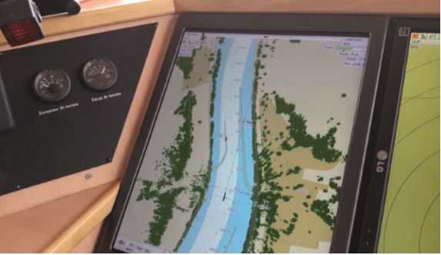
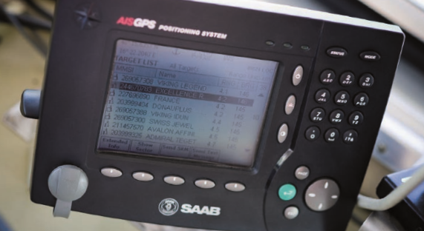
Quiz
Strengthening of Danube Navigation
Source: viadonau / Andi Bruckner.
How is the Austrian telematics system for shipping called?
Doris
Oliver
Lisa
Thomas
Source: viadonau/ Andi Bruckner
Notes:
How is the Austrian telematics system for shipping called? Doris
Donau River Information Services.
Picture: viadonau/Andi Bruckner in Manual on Danube Navigation p. 206, 207

Slide 45
DANUBE NAVIGATION – Markets and Strengths of the Waterway
Markets of Danube Navigation
Transport Examples
The Danube Waterway
Strengths of Danube Navigation

Slide 46
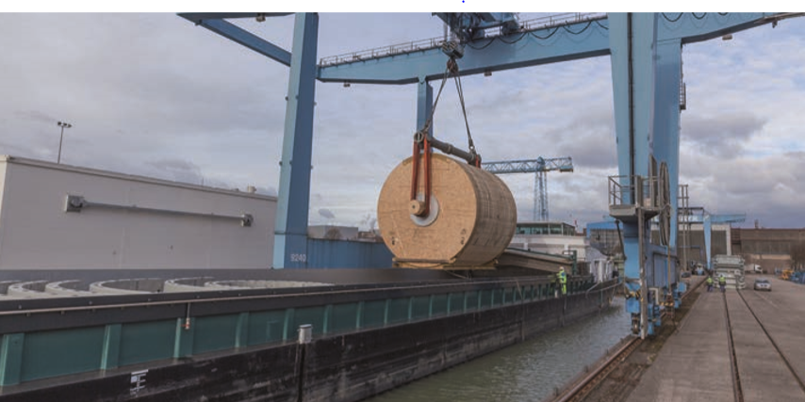
High & Heavy – heavy load transports on the Danube
Transport examples
3 heavy load terminals are operated along the Austria and German Danube
Lifting capacity in the terminal up to 500 tons.
Transhipment via port cranes
The heavy load terminal in Linz consists of 220,000 m² open area and roughly 55,000 m² heavy load warehouse capacity
Source: Ferlbermayer
source: via donau
Notes:
Three heavy load terminals with direct connection to waterways are operating along the Danube. The establishment of facilities along the waterways gives the heavy cargo specialist a strategic advantage over its competitors. Besides its proprietary heavy load port at the Linz location, terminals for high & heavy transhipment are also operated at the ports in Vienna Albern and in Krefeld (Germany) with a lifting capacity of 450, i.e. 500 tons, respectively.
A 27.5 hectare complex, the heavy load port in Linz was purchased in 1996. Extending more than 100 meters and with a width of 17 meters, the basin can accommodate the standard inland vessels travelling the Danube. Two port cranes with an aggregate lifting capacity of up to 600 tons are available at the port. Moreover, over 220,000 m² of open area and roughly 55,000 m² heavy load warehouse capacity is available at the Linz complex. These warehouses are rented to a variety of customers to preassemble extremely large parts. These parts then be shifted directly to the waterways without pre-haulage on road or rail.
Source: Manual on Danube Navigation p. 175
Picture: Felbermayer in Manual on Danube Navigation p. 175

Slide 47
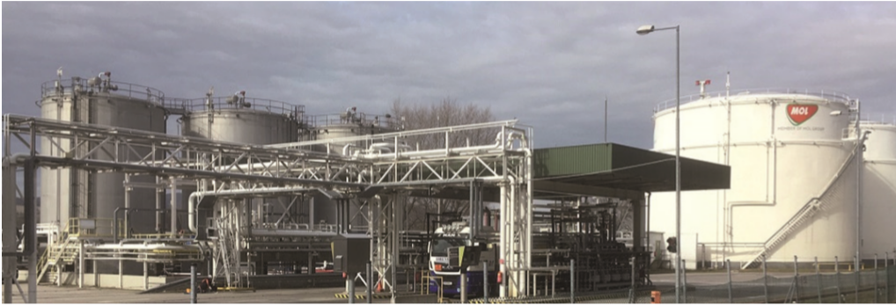
Mineral oil products
Transport examples
3 transhipment facilities (2x in HU, 1x in SK) serve customers in western Europe (AT and DE) and in Eastern Europe (Serbia and RO)
Tonnage costs are comparatively low
A tanker vessel can carry up to 2,000 tons of mineral oil, if the water level is ideal
source: MOL-Group
source: via donau
Notes:
Three transhipment facilities are operated along the Danube (two in Hungary, Százhalombatta and Komárom, one in Slovacia, Bratislava). These locations along the Danube are used to supply customers in the West (Austria and eastern Germany) and in the East (Serbia and Romania).
Moreover, a tank storage complex with transhipment facility in Korneuburg (river-km 1,942 – Austria) and Giurgiu (Romania) is operated. Large quantities of liquid cargo need to be shipped and the tonnage costs are comparatively inexpensive. Each tanker vessel can transport up to 2,000 tons, provided the water level is ideal.
The tank storage facility in Korneuburg is used to store and distribute liquid, combustible mineral oil products (Super 95 and 98, Diesel B7, bunker fuel and Heating Oil Extra Light). The products are usually delivered by inland vessel. There are now seven above-ground fixed-roof tanks and two horizontal tanks available at the Korneuburg site for the storage of products. Approx. 6,200 m³ for petrol and 10,000 m³ for diesel and other gas oil is the total storage capacity.
Source: Manual on Danube Navigation p. 180
Picture: MOL-Group in Manual on Danube Navigation p. 180

Slide 48
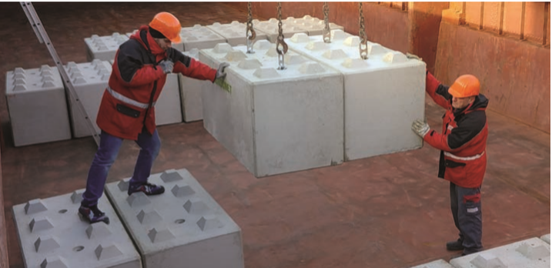
Construction materials
Transport examples
Transport of prefab concrete parts for underground, special and building engineering
Weight up to 50 tons per part
Transshipment on a Danube quay located next to the concrete plant
→ short pre-haulage
Important sales markets situated in the Danube Region
source: GEROCRET
source: via donau
Notes:
The company produces prefab concrete parts for underground, special and building engineering with an weight of up to 50 tons per element. Customers throughout Austria and Europe are supplied with prefab parts for rail, bridge, canal, road, tunnel and industrial construction, as well as for special projects.
Seeking to introduce innovative solutions for its customers. The company recommissioned the Danube quay located directly adjacent to its complex at the end of 2017 and has since shipped prefab concrete parts to a customer by inland vessel. The short pre-haulage gives ideal conditions for use of the Danube waterway.
In addition, the company has important sales markets located in the Danube region. Transport of heavy cargo and oversized goods by inland vessel has proven extremely cost-efficient and has provided a key sustainability benefit compared to other transport modes, as this means of transport is ideal to accommodate the high unit weights and large-format dimensions of the products.
Source: Manual on Danube Navigation p. 179
Picture: GEROCRET in Manual on Danube Navigation p. 179

Slide 49
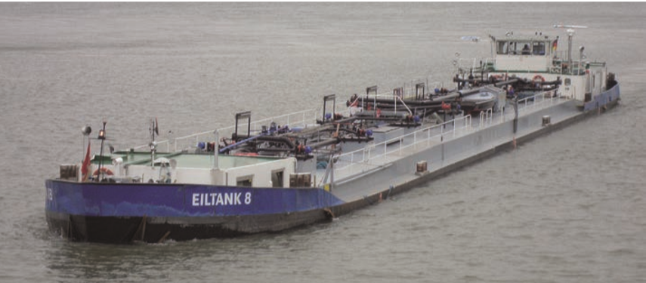
Quiz
Transport Examples
How many tons of liquid goods can a tanker transport on the Danube at optimal water level?
4,200 tons
2,500 tons
600 tons
2,000 tons
Source: helmut1972, www.binnenschifffartsforum.de
Notes:
How many tons of liquid goods can a tanker transport on the Danube at optimal water level? 2,000 tons
Picture: helmut1972, www.binnenschifffahrtsforum.de in Manual on Danube Navigation S. 117

Slide 50
ABC-list final exercise
Create an ABC-list of the most important terms of the topic “Danube navigation – markets and strengthening of the waterway”
Take a piece of paper, write down the ABC on the longer side of the paper.
Afterwards, you write down important terms of the topic “DANUBE NAVIGATION – Markets and Strengthening of the Waterway” for every letter. In each line you write down terms, which start with the letter of that line for example S … shipping charges.
At the end you will have a collection of all the important terms regarding the topic “Danube navigation – markets and strengthening of the waterway”
Notes:
This exercise could be an individual exercise or to be solved in small groups of max. 2-3 people.
Duration: 20 minutes

Slide 51
Sources
Manual on Danube Navigation, viadonau, Vienna, 2019 –
Download: http://www.viadonau.org/de/newsroom/publikationen/broschueren
viadonau (2021): Danube Navigation – annual report 2021, Wien
Download: http://www.viadonau.org/de/newsroom/publikationen/broschueren
INeS Danube Information platform for intermodal inland navigation
Excess: www.ines-danube.info
Federal association inland waterway transport e.V. (BDB): online: https://www.binnenschiff.de/
EDINNA – Education in Inland Navigation: online: https://www.edinna.eu/
Europäische Kommission: EU Strategy for the Danube Region (COMMISSION STAFF WORKING DOCUMENT), Brüssel, 2020.
Federal Ministry of Transport, Innovation and Technology: online: www.bmvit.gv.at
European Union: https://ec.europa.eu/transport/modes/inland/promotion/naiades2_en) [08.04.2020]

Slide 52

Further Information
We hope our set of slides has met your expectations!
- you are free to adapt the set of slides to your wishes and requirements and use it for your lectures.
For questions and feedback please do not hesitate to contact us:
rewway@fh-steyr.at
Further set of slides are available at:
http://www.rewway.at/en/teaching-materials/bundles/
Maybe you are interested to book a Transport School Lab, a guest lecture or an excursion?
http://www.rewway.at/en/services/

