Slide 1
How to work with this learning material
Power Point
The following power point presents Green transport by inland waterways. The slides are shortly described in the notes below and you can also find the link to the source if you need further information.
Reader
In addition to the power point presentation, you can also use the reader provided on our platform. It’s more detailed and could be used as a script.
Links
You can also find the sources of our presentation and reader in the links section of the relevant bundled teaching material.
Videos
There are also different videos used as sources in this presentation. You can find these videos separately in the relevant bundled teaching material.

Slide 2
Learning objectives and target groups
After dealing with the contents the learners know…
the status quo of freight transport, the modal split of Austria compared to Europe; drivers for sustainable logistics and challenges for sustainable freight transport
what makes a sustainable mode of transport, divided into economic, ecological and social factors
the comparison of the modes of transport road, rail and waterway with a focus on waterways, as well as the functioning of the fuel LNG and examples of its use.
Target groups
Vocational students
High School students

Slide 3
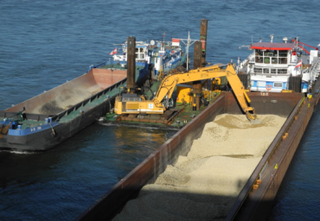
Green Transport
Source: viadonau
Source: viadonau
Notes:
Source: Manual on Danube Navigation, 2019, p 79, 106

Slide 4
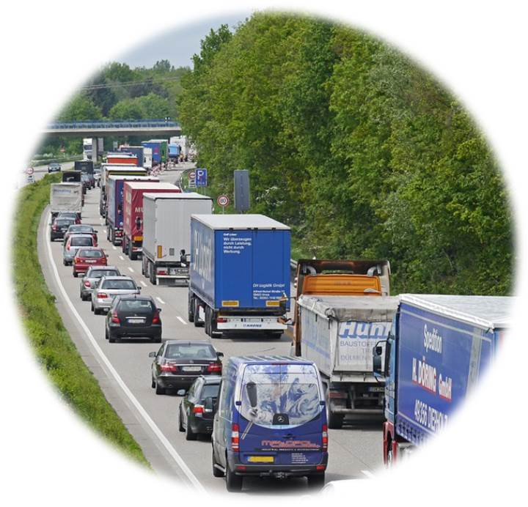
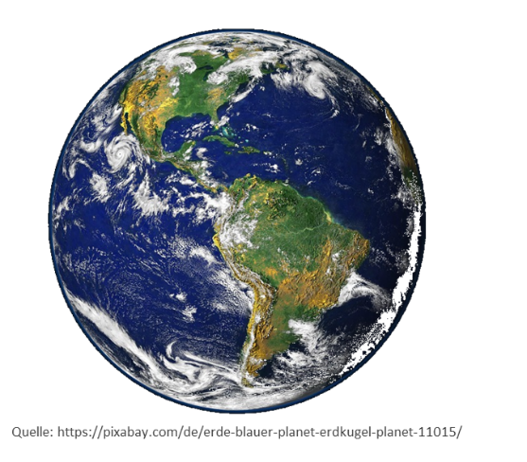
Warm-Up Green Transport
CO₂
particulate matter
Increasing freight transport
noise
How could freight transport be made more environmentally friendly in the future?
Source: pixabay
What possibilities are there to solve this problem in freight traffic?
Notes:
A discussion can serve as an introduction to the topic "Green Transport".
The global freight traffic is increasing more and more - you can buy any product. This leads to an overload of the transport infrastructure. Especially the road transport mode is increasingly reaching its limits, which is reflected in increasing traffic jams. Environmental pollution is also on the rise: increasing CO2 emissions, particulate matter and noise pollution.
Discussion questions (5-10 minutes discussion):
What are the possibilities to solve this problem in freight transport?
How could freight transport be made more environmentally friendly in the future?
Inputs and discussion points:
alternative modes of transport
Transport concepts
ecological areas of influence
Infrastructure requirements in the future
LNG

Slide 5
Agenda Green Transport
Sustainable modes of transport
Liquefied gas - LNG
Comparison of transport modes
Transport and environment

Slide 6
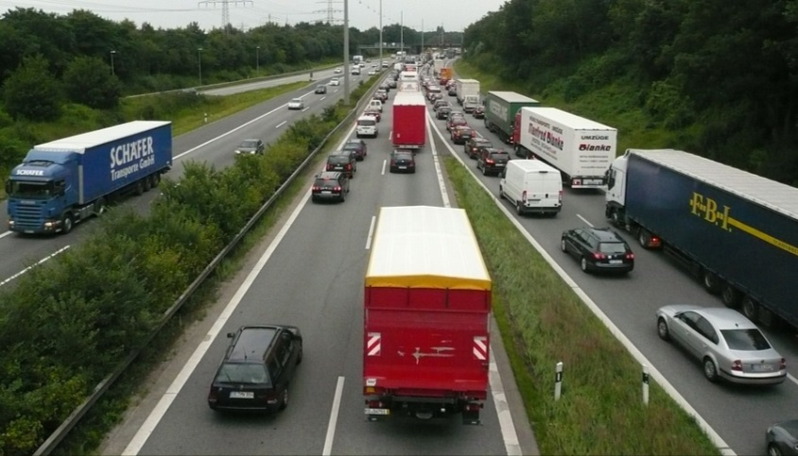
Transport and environment
Status Quo:
Freight transport = most environmentally harmful area of logistics
Noise, congestion, air pollution and environmental pollution are most visibly and often associated with trucks
Outlook:
International freight traffic is increasing transport distances
Source: pixabay
2050
2020
Notes:
Logistics plays an essential role in the economy as it ensures that goods are transported from the raw material supplier via the producer to the end consumer. Although logistics encompasses many processes and activities, transport and thus freight traffic can be identified as the most environmentally damaging area.
For 2050, an additional 55% increase in truck transport is predicted, with the total transport volume also increasing by 57%. Above all, international freight traffic will increase and thus also the transport distances. In addition, the transport infrastructure is increasingly reaching its limits - traffic jams are the consequence.
Sources:
Whiteing A. : „Die Zukunft der Nachhaltigkeit in
Güterverkehr und Logistik“, 2010, p 7
Online: http://www.europarl.europa.eu/RegData/etudes/note/join/2010/431578/IPOL-TRAN_NT(2010)431578_DE.pdf [17.08.2020]
European Commission, “EU energy, transport and GHG emissions - Trends to 2050 Reference Scenario 2013”. 2013, p 39
Online: http://ec.europa.eu/transport/media/publications/doc/trends-to-2050-update-2013.pdf [17.08.2020]

Slide 7
Transport and environment
Source: Eurostat (2018)
Source: based on statista.com
Notes:
On a European level, the transport sector is the second largest emitter of greenhouse gases (25% of all greenhouse gases) after fuel combustion.
Within the transport sector, the truck is the largest emitter of greenhouse gases (68%), as is clearly shown in the right-hand chart using Germany as an example.
Sources:
Eurostat, „Greenhouse gas emission statistics“, 2018, online: https://ec.europa.eu/eurostat/statistics-explained/index.php?title=File:Greenhouse_gas_emissions,_analysis_by_source_sector,_EU-27,_1990_and_2018_(Percentage_of_total).png [17.08.2020].
statista.com
Online: https://de.statista.com/statistik/daten/studie/881600/umfrage/co2-emissionen-im-deutschen-gueterverkehr-nach-verkehrsmitteln/ [17.08.2020].

Slide 8
Drivers for sustainable development – White Paper of the European Commission 2011 Transport and environment
Oil dependence
Increasing transport volume
Greenhouse Gases
Multimodality*/ modal shift
Rising demand for sustainable modes of transport
* Transport of goods using two or more modes of transport
Modal shift targets:
2030: 30 % of road traffic > 300 km on rail/ inland waterways
2050: 50 % of road traffic >300 km on rail/ inland waterways
→ Rail & inland waterways are recognized as sustainable modes of transport!
Notes:
As described in the previous slide, a change to sustainable modes of transport is necessary. Therefore, the EU policy tries to promote a change to such modes of transport by means of different measures. The European Commission's White Paper of 2011 "Roadmap to a Single European Transport Area - Towards a competitive and resource-efficient transport system" presented the EU vision for transport in the future. This White Paper contains proposals for action by the EU to make transport more sustainable in the future. Since rail and inland waterways are recognized as sustainable modes of transport, a modal shift towards these modes of transport should also take place. The goal is to shift 30% of road traffic exceeding 300 km to rail or inland waterways by 2030. By 2050 the value should be 50 %.
Source:
European Comission, “White Paper of the European Commission 2011” (2011), S. 3ff; Online: https://ec.europa.eu/transport/sites/transport/files/themes/strategies/doc/2011_white_paper/white-paper-illustrated-brochure_en.pdf [17.08.2020]

Slide 9
Sustainable Transport Transport and environment
Sustainable production
Sustainable products
Sustainable transport
(green logistics)
(Freight) transport is essential to connect raw material suppliers with producers and end consumers
"Green logistics is a logistics concept that claims to be environmentally friendly, socially acceptable and financially sustainable.” - Rituray Saroha (2014)
Notes:
A large number of producers are making their production increasingly sustainable and more and more sustainable products are demanded by consumers (especially in the food sector), there is also an increased need for sustainable transport. An important logistics concept in this context is "green logistics". As it can be seen in the description, besides the environmental friendliness and social compatibility of the transport modes, the financial aspect is also very important. As transport is essential to connect all actors along the value chain (from raw material supplier to producer to consumer), it can be identified as one of the most important elements of logistics. It is therefore important to first measure the impact of the transport sector from an ecological, social and economic perspective and then define appropriate measures to reduce it.
Source:
Saroha Rituraj, “Green Logistics & its Significance in Modern Day Systems”, 2014, p 90
Kudla, Nicole: Nachhaltigkeitsmanagement, in: Fagagnini Hans Peter/Stöltzle Wolfgang (Hrsg.): Güterverkehr kompakt, München, 2010, p 232

Slide 10
Green logistics Transport and environment
costs
unproductivity
Green logistics
economic
ecological
social
"...environmentally friendly and socially acceptable but also financially viable"
awareness
quality of life
emissions
resource consumption
Notes:
As mentioned in the previous slide, the concept of "green logistics" tries to achieve a balance between economic, ecological and social goals in the field of logistics, which in turn affects the transport sector. This leads to tensions between these three areas, as not all goals of the individual areas can be pursued at the same time. The following goals can be assigned to the respective areas:
Social goals: Creating awareness for sustainable transport and guaranteeing a good quality of life.
Ecological goals: Reduce emissions and generally reduce the consumption of resources.
Economic goals: from a financial point of view, no additional costs should be incurred or a cost reduction should be realized and unproductivity (time span in which something or someone is not productive) should be minimized.
Of course, different goals can be assigned to the different areas, which makes it even more difficult to achieve balanced goal tracking across all areas.
Sources:
Pazirandeh, Ali/Jafari, Hamid: Making sense of green logistics, in: International Journal of Productivity and Performance Management, 2013, S.889f.
Saroha Rituraj, “Green Logistics & its Significance in Modern Day Systems” (2014), S. 90
„Green Logistics“ (2019), Online: https://www.youtube.com/watch?v=xPohCtbL4SQ [19.08.2020]

Slide 11
Challenges for a sustainable freight transport
Use of new technologies
Choice of transport depending on goods
Value of goods
Time factor
Trend towards individualization → transport volumes on the rise
Rail
Passenger traffic has priority
Fewer innovations
Need for reverse logistics (recycling, waste management)
Local disposal decreases
Notes:
Various challenges can be identified in the course of implementing sustainable freight transport:
For example, the use of new technologies is not yet possible in a commercial sense.
The choice of transport is highly dependent on the value of the goods transported and the transport time. Due to the cost advantage of truck transport, it is still frequently used as a means of transport.
The trend away from mass production towards individualization means that shipments are increasing and the volume of transport is growing.
Rail has the disadvantage that passenger transport is often given preferential treatment and fewer innovations are available in the technical field. This makes this mode of transport less attractive as an alternative to the truck.
As local waste disposal declines, the need for reverse logistics for recycling processes or waste management results in higher transport volumes.
Source:
Institute for Transport Studies, “Die Zukunft der Nachhaltigkeit in Güterverkehr und Logistik”, 2010, p 15. Online: http://www.europarl.europa.eu/RegData/etudes/note/join/2010/431578/IPOL-TRAN_NT(2010)431578_DE.pdf [20.08.2020]

Slide 12
Promotion of sustainable freight transport Challenges for sustainable freight transport
Transport prices
Alternative fuels
Modal shift
Improvement of existing means of transport or development of new means of transport
Combination of transport modes
Information and Communication Technologies (ICT)
new business models
Notes:
Different possibilities can be identified to promote sustainable freight transport.
Since the choice of transport mode is strongly dependent on transport prices, a new pricing policy in the transport sector could help to increase the use of sustainable transport modes.
The development and use of alternative fuels, such as LNG, could also lead to more sustainable freight transport.
As mentioned at the beginning of the presentation, modal shift is also seen as a suitable measure to promote sustainable freight transport. By shifting from road to rail or waterways, the environmental impact should thus be reduced.
With regard to the means of transport, improvements of existing means of transport in terms of size, weight or capacity and fuel consumption can be useful to achieve sustainable freight transport in the long run. Also the development of new means of transport according to the requirements of the transported goods would be a possible solution (e.g. self-propelled means of transport).
An efficient combination of the existing modes of transport can also reduce the environmental impact. By using information and communication technologies (ICT), transports can be planned more efficiently and better, which could, for example, reduce empty runs or ensure that transports are efficiently utilized to capacity.
Finally, the development of new business models can also lead to freight transport becoming more sustainable. By focusing on local production and local distribution, for example, long transport distances could be reduced.
Source:
Institute for Transport Studies, “Die Zukunft der Nachhaltigkeit in Güterverkehr und Logistik” (2010). S.21-26
Online: http://www.europarl.europa.eu/RegData/etudes/note/join/2010/431578/IPOL-TRAN_NT(2010)431578_DE.pdf [20.08.2020]

Slide 13
Quiz
International freight transport is increasing and transport distances are becoming longer and longer. According to forecasts, the total volume of transport will increase by the year 2050 by ...
+ 57 %
+ 35 %
+ 55 %
the total transport volume will not increase.

Slide 14
Agenda Green Transport
Sustainable modes of transport
Liquefied gas - LNG
Comparison of transport modes
Transport and environment

Slide 15
What makes a sustainable transport mode? Sustainable modes of transport
Current focus for evaluation ONLY on ecological (CO2 emissions) and economic (transport costs) fields of influence
Companies see sustainable modes of transport as an opportunity to reduce costs/increase revenues OR environmental protection as a secondary condition – marketing
The following additional assessment criteria are necessary for each field of influence:
Ecological fields of influence
Emissions
Social fields of influence
Traffic Safety
Economic fields of influence
Transport costs
External costs
Working conditions
Land consumption – infrastructure costs
Noise
Specific energy consumption
Notes:
Currently, ecological (especially CO2 emissions) and economic factors (transport costs) are in the foreground when evaluating the transport modes. Environmental protection is still a secondary condition for many companies and is mainly used for marketing purposes. From a business point of view, environmental protection is often seen as an opportunity to reduce costs or increase revenues.
However, for a comprehensive comparison of transport modes from the point of view of sustainability, other factors must be taken into account in addition to emissions and transport costs (see above). The assessment criteria in the three fields of influence shown in the figure represent a selection of possible comparison factors. These can of course be even more extensive.
The individual fields of influence and the factors listed are described in more detail in the following slides.
Source:
Pazirandeh, Ali/Jafari, Hamid: Making sense of green logistics, in: International Journal of Productivity and Performance Management, 2013, S.889f.
Bretzke, Wolf-Rüdiger/Karmin Barkawi: Nachhaltige Logistik: Antworten auf eine globale Herausforderung. Berlin Heidelberg, 2010, S.47

Slide 16
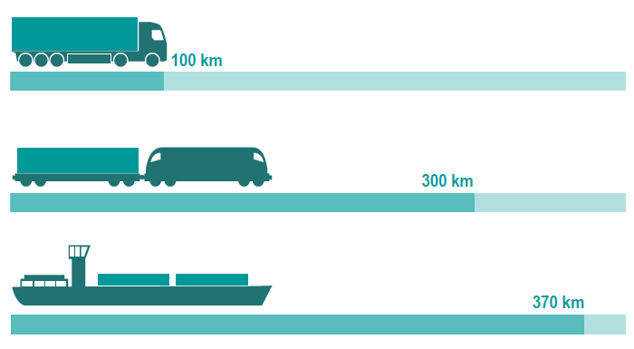
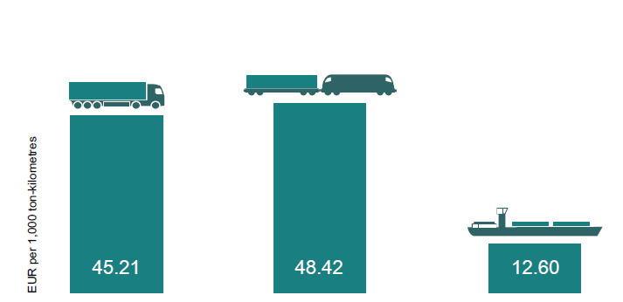
Ecological fields of influence Sustainable modes of transport
Specific energy consumption
Land consumption / infrastructure costs
Source: PLANCO Consulting & Bundesanstalt für Gewässerkunde 2007
Source: viadonau
An inland vessel can transport a ton of cargo almost four times as far as a truck with the same energy consumption
Improving the infrastructure of the entire Danube would cost around EUR 1.2 billion
this corresponds to the construction costs of ONLY about 50 kilometers of road
Notes:
Land consumption / infrastructure costs:
Infrastructure costs consist of the costs for the construction and maintenance of traffic routes. Since in the case of inland waterways it is usually possible to fall back on a natural infrastructure, the costs for the infrastructure and the land consumption are correspondingly low. Detailed comparisons of this with land transport modes are available from Germany: According to these, the infrastructure costs per ton-kilometer are about four times higher for rail or road than for waterways. According to current cost estimates for infrastructure projects in the riparian states, the improvement of the entire infrastructure of the Danube waterway, which is just under 2,415 km long, would amount to a total of EUR 1.2 billion. This corresponds roughly to the costs incurred for the construction of about 50 km of road or rail infrastructure. Current European rail tunnel projects cost around EUR 10 to 20 billion each.
Specific energy consumption
In terms of specific energy consumption, inland navigation can be considered the most effective and therefore the most environmentally friendly mode of transport. The inland vessel can transport a ton of cargo almost four times as far as a truck for the same energy consumption.
Source:
viadonau, Manual on Danube Navigation, 2019, p 18-20
Picture source:
viadonau in Manual on Danube Navigation, p 8
PLANCO Consulting & Bundesanstalt für Gewässerkunde 2007 in Manual on Danube Navigation, p 20

Slide 17
Ecological fields of influence Sustainable modes of transport
Noise
Noise pollution mainly from road –> Network density compared to rail and waterways larger
Railway noise in certain areas
Subjective perception
Noise pollution can lead to sleep and hearing damage
hardly any noise pollution due to waterway
Source: adaptiert aus pixabay
Notes:
Due to the network density and the proximity to settlements and conurbations, noise pollution is mainly caused by the road transport. Railway noise affects the environment especially in certain areas whereas freight traffic on waterways hardly causes any noise at all. Noise also depends on subjective perception - for example, road noise is perceived as more disturbing than railroad noise for the same noise level.
As the "Noise Viewer" of the Noise Observation and Information Service for Europe shows, the UK and Germany are affected by road noise at night and during the day. In Austria, noise pollution during the day is mainly due to rail traffic. In Italy and France, a large part of the population is affected by both road and rail noise during the day and at night.
Source:
„Noise Viewer“, Online: http://noise.eionet.europa.eu/viewer.html [19.08.2020]
VDC, Online: https://www.vcd.org/themen/verkehrslaerm/strassenlaerm/ [19.08.2020].
Picture: based on www.pixabay.com

Slide 18
Social fields of influence Sustainable modes of transport
Traffic safety
inland waterway vessel is safest in comparison to rail and truck
high safety standards
low accident costs
2021: 12 accidents, no personal injury
Working conditions
inland waterway vessel:
long stays on ship, long working hours
train:
shift operation regulated working hours
passenger transport primarily during the day
trucks:
long and irregular working hours
deadline and time pressure, non-compliance with driving and rest periods
long distance transport: absence from home
Notes:
Traffic safety:
Compared to rail and truck, the inland waterway vessel can be called the safest means of transport. This is made possible by high safety standards. This in turn has an impact on accident costs, which are comparatively low (see also external costs in comparison). Therefore, about 80% of the dangerous goods transports in Europe are carried out by barge.
Working conditions:
In inland navigation, long stays on the ship are not uncommon, which means that a large part of the leisure time is spent on the ship.
In rain transport there is often a 3-shift model which leads to regulated working hours. Since passenger traffic is given priority during the day, the majority of freight traffic takes place at night, which in turn leads to night work.
Truck drivers are often faced with long and irregular working hours. In addition, the deadline and time pressure in the competition-driven industry means that driving and rest periods are neglected. For long-distance truck drivers, the long absence from home is an additional factor.
Sources:
viadonau, Annual report on Danube Navigation 2021, Vienna, 2021, p 36
Bundesamt für Güterverkehr (BAG), „Marktbeobachtung Güterverkehr. Auswertung der Arbeitsbedingungen in Güterverkehr und Logistik 2015-I“ 2015, p 9, 31, 47; Online: https://www.dslv.org/dslv/web.nsf/gfx/0C7783035E0D583FC1257EEC00373613/$file/BAG%20Markbeobachtung%20Fahrerberufe%202015.pdf [19.08.2020]

Slide 19
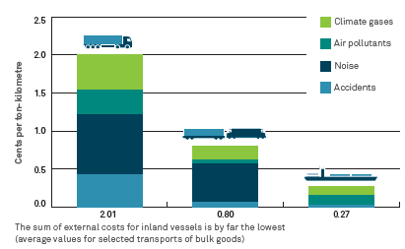
Economic fields of influence Sustainable modes of transport
Shipping costs
Most important factor in economic comparison
→ influencing factors:
Transport volume - capacity utilization
Transport distance
Transported goods
Decreasing transport costs with increasing transport distance for all modes of transport
Transport per ton-kilometer by inland waterway vessel is the cheapest
External costs
Source: PLANCO Consulting & Bundesanstalt für Gewässerkunde 2007
Notes:
Transportation costs:
Transportation costs are one of the most important factors in economic comparison. They are mainly influenced by the transport volume and thus the capacity utilization of the carriers, the transport distance and the type of goods transported. In principle, transport costs decrease with increasing transport distance for all modes of transport. In terms of transport per ton-kilometer, inland waterways are the cheapest mode of transport compared to rail and truck. However, the actual costs of a transport can vary.
External costs:
The external costs, i.e. those costs resulting from climate gases, air pollutants, accidents and noise, are also lowest for inland waterway vessels. In particular, CO2 emissions are comparatively low, which means that inland navigation can make a contribution to achieving the climate goals of the European Union.
Sources:
viadonau, Manual on Danube Navigation, 2019, p 19f.
Kille, Christian/ Schmidt , Norbert, „Wirtschaftliche Rahmenbedingungen des Güterverkehrs. Studie zum Vergleich der Verkehrsträger im Rahmen des Logistikprozesses in Deutschland“, 2008, p 22, Online: http://www.scs.fraunhofer.de/content/dam/scs/de/dokumente/studien/Wirtschaftliche_Rahmenbedingungen_des_Gueterverkehrs.pdf [19.08.2020]
Picture
PLANCO Consulting & Bundesanstalt für Gewässerkunde 2007 in Manual on Danube Navigation, 2019, p 19

Slide 20
Quiz
What are the assessment criteria for a sustainable transport mode?
Ecological and economic fields of influence
Social and economic fields of influence
Social, ecological and economic fields of influence

Slide 21
Agenda Green Transport
Sustainable transport modes
Liquefied gas - LNG
Comparison of transport modes
Transport and environment

Slide 22
Road transport Comparison of transport modes
Transport speed
Area coverage
Network building capability
Flexibility
Technical progress
Low usage costs
Rising costs
Time restrictions
Driving bans
Environmental aspects (CO2 emissions, noise, accidents, ...)
Notes:
The high transport speed in comparison to rail and waterways can be cited as an advantage of road transport. Also the area coverage of the infrastructure and thus the possibility of network formation (door-to-door) are among the strengths of the road. Due to the wide range of different means of transport, this mode of transport offers great flexibility. In addition, many IT solutions (e.g. tracing and tracking) are already widely used. In addition, the use of the infrastructure is associated with low costs (costs for road damage are only partially covered).
As the costs of congestion or noise pollution (so-called external costs) are gaining more and more attention, roads are facing increasing cost pressure. Time restrictions in the form of driving bans also have an impact on the road transport mode. With regard to environmental aspects such as noise pollution or accidents, road scores relatively poorly in a comparison of transport modes.
Source:
Kille, Christian/ Schmidt , Norbert, „Wirtschaftliche Rahmenbedingungen des Güterverkehrs. Studie zum Vergleich der Verkehrsträger im Rahmen des Logistikprozesses in Deutschland“, 2008, p 53, Online: http://www.scs.fraunhofer.de/content/dam/scs/de/dokumente/studien/Wirtschaftliche_Rahmenbedingungen_des_Gueterverkehrs.pdf [19.08.2020]

Slide 23
Railway transport Comparison of transport modes
Speed
Mass efficiency
Calculability
Security
transport price
Environmental aspects
(CO2 emissions)
Crossing borders difficult
Flexibility
Tracking and Tracing
Energy costs
Notes:
Especially for block or direct trains, the rail can score points with a fast transport speed. In addition, the mode of transport is capable of mass transport and the transports are predictable. Due to standards the security level is very high. Unlike road transport, transport prices are not influenced by toll charges and can therefore be relatively favorable depending on the quantity transported. Also the lower CO2 consumption compared to the road can be mentioned as an advantage.
Due to infrastructural differences, cross-border transport by rail is still difficult. The dependence on timetables impairs the flexibility of the transports. In addition, tracking and tracing is very difficult compared to road transport. Furthermore, unlike air transport, rail transport does not have any tax advantages.
Source:
Kille, Christian/ Schmidt , Norbert, „Wirtschaftliche Rahmenbedingungen des Güterverkehrs. Studie zum Vergleich der Verkehrsträger im Rahmen des Logistikprozesses in Deutschland“, 2008, p 54, Online: http://www.scs.fraunhofer.de/content/dam/scs/de/dokumente/studien/Wirtschaftliche_Rahmenbedingungen_des_Gueterverkehrs.pdf [18.08.2020]

Slide 24
Inland waterway transport Comparison of transport modes
Low transport costs
Mass efficiency
Environmental friendliness
Security
Transport frequency - 24 h ready for use
Low infrastructure costs
Dependence on fairway conditions
Low transport speed
Low network density - pre/end -haulage necessary
Notes:
The strengths of Danube navigation lies above all in its ability to transport large quantities per ship unit, in its low transport costs and in its environmental friendliness. In addition, it can be used around the clock (e.g. no weekend or night sailing bans) and can boast a high level of safety and low infrastructure costs.
The weaknesses lie in the dependence on fluctuating fairway conditions and the associated varying degree of utilization of the ships, the low transport speed and the low network density, which often require pre- and end- haulage by road or rail.
Source:
viadonau, Manual on Danube Navigation, 2019, p 17

Slide 25
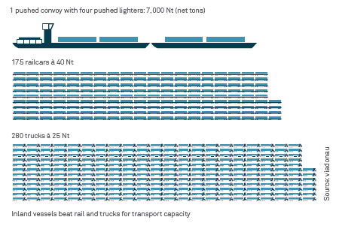
Inland waterway transport Comparison of transport modes
Bulk freight capacity:
Largest transport capacity: one convoy with four pushed lighters =
175 train wagons = 280 trucks = 20 km truck convoy
Notes:
In addition, compared to other land transport modes, inland waterway transport offers a significantly larger transport capacity per transport unit and can or could thus make an important contribution to relieving the burden on road and rail. To illustrate the mass capacity of inland navigation: An inland vessel with 4 lighters (7,000 net tons) can transport as much as 175 railroad cars or 280 trucks. This corresponds to a truck convoy of about 20 km on the freeway!
Source: viadonau, Manual on Danube Navigation, 2019, p 18
Picture: viadonau in Manual on Danube Navigation, 2019, p 19

Slide 26
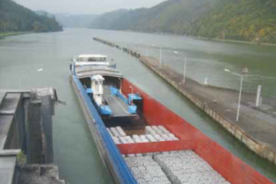
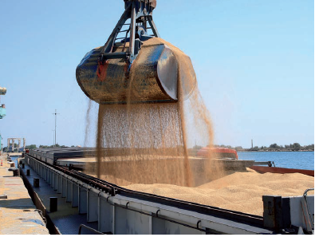
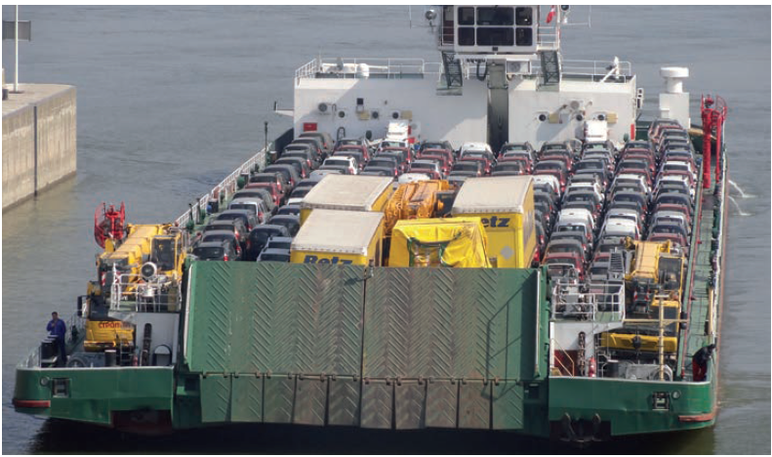
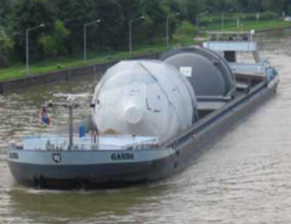
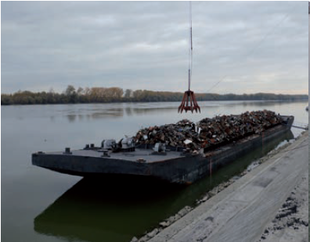
Inland waterway transport Comparison of transport modes
Construction materials
Old materials and waste
Biogenic raw materials
High- and Heavy goods
New cars
Source: : viadonau
Source: Voies navigables de France
Source: TTS
Quelle: helmut1972, www.binnenschifferforum.de
Source:: viadonau
26
Notes:
In addition to the traditional markets, several other industries offer great potential for inland navigation.
For the transport of heavy and oversized goods, the waterway is the most suitable means of transport due to its dimensions and the available infrastructure (no need to adapt traffic routes, no roadblocks, etc.).
Due to the low transport costs and the environmental friendliness, the inland waterway is also optimally suited for the transport of biogenic raw materials, for old and waste materials and building materials. These advantages can also be increasingly used in the automotive industry on ro-ro ships through optimized logistics chains.
Source: viadonau, Manual on Danube Navigation, 2019, p 161-166
Picture:
helmut1972, www.binnenschifferforum.de in Manual on Danube Navigation, 2019, p 118
Voies navigables de France in Manual on Danube Navigation, 2019, p 162
viadonau in Manual on Danube Navigation, 2019, p 163
viadonau in Manual on Danube Navigation, 2019, p 165
TTS in Manual on Danube Navigation, 2019, p 195

Slide 27
Share of inland navigation in transport volume Comparison with Europe
?
Source: Statistik Austria
Source: Eurostat
Notes:
The share of inland waterways in the modal split in 2020 in the 27 countries of the European Union was 5.8% - thus 5.8% of the total freight ton kilometers were covered by waterways. This share differs greatly in the individual EU countries. The Netherlands, for example, has important seaports and an extensive and fragmented network of waterways, and therefore has the highest share of inland waterway transport in the 27 countries of the EU (41.6% in 2020).
Source: Manual on Danube Navigation, 2019, p 21
Eurostat, https://ec.europa.eu/eurostat/statistics-explained/index.php/Freight_transport_statistics_-_modal_split [19.08.2020]
Statistik Austria, https://www.statistik.at/web_de/statistiken/energie_umwelt_innovation_mobilitaet/verkehr/modal_split_gueterverkehr/index.html [19.08.2020]

Slide 28
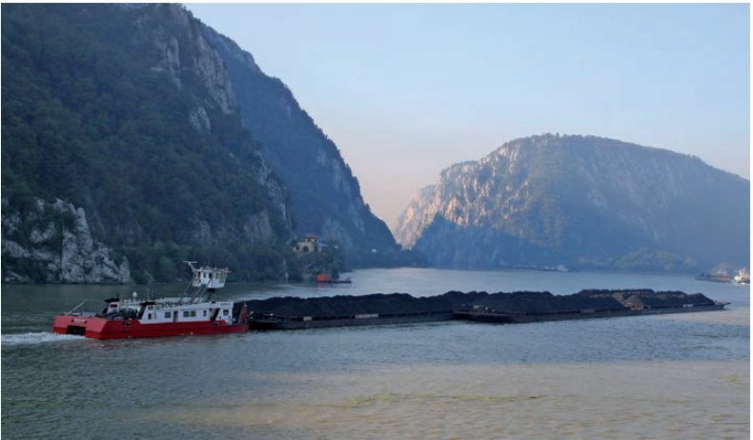
Quiz
Up to how many trucks can a one convoy with four pushed lighters replace?
a) 15 trucks c) 120 trucks
b) 300 trucks d) 280 trucks
Source: C.N.F.R. NAVROM S.A., Galati
Notes:
Picture: C.N.F.R. NAVROM S.A., Galati in Manual on Danube Navigation, 2019, p 125

Slide 29
Agenda Green Transport
Sustainable transport modes
Liquefied gas - LNG
Comparison of transport modes
Transport and environment

Slide 30
Facts Liquefied Natural Gas - LNG
LNG = Liquefied Natural Gas
volume is reduced to -162° by cooling → LNG requires 600 times less space than natural gas
Fields of application:
Inland navigation (liquid)
Truck (liquid)
Industrial processes (gaseous)
2 bunker stations on the Rhine (Rotterdam, Amsterdam)
Pioneers in liquid gas as fuel for ships → Norway and Scandinavian countries (ocean shipping)
75 LNG operated vessels active worldwide, 155 vessels under construction (2019)
Natural Gas
LNG
600x less space
Source: own illustration
Notes:
LNG or liquefied natural gas is a natural gas that has been cooled to at least -162 ° C and thus takes up 600 times less space than unprocessed natural gas. This is also the main advantage in connection with transport! In addition to being used as fuel for inland waterway vessels and trucks, LNG can also be used for industrial processes in gas form. inland waterway transport already has two bunker stations on the Rhine - at the port of Rotterdam and the port of Amsterdam. These are truck-to-ship bunker stations, which means that the truck is connected to the ship that refuels it. Norway and other Scandinavian countries can be seen as pioneers for LNG. In 2009 there were already 336 ships in the LNG tanker fleet worldwide.
Source:
Liquefied Natural Gas LNG 101; Online: https://www.youtube.com/watch?v=WyZTuzUzR68 [19.08.2020]
LNG Masterplan for Rhine-Main-Danube, Online: http://www.lngmasterplan.eu/images/D_111__Status_Quo__Trend_Analysis_-_Danube_and_Italy_v2.1_FINAL_2015-3-12.pdf p.24 [19.08.2020]
Challenges and opportunities for LNG as a ship fuel source and an application to bunkering network optimisation;, Online: https://www.researchgate.net/profile/Murat_Aymelek/publication/274379729_Challenges_and_opportunities_for_LNG_as_a_ship_fuel_source_and_an_application_to_bunkering_network_optimisation/links/55e5bf9f08aecb1a7ccd4ab6.pdf p.768 [19.08.2020]
Statista.com; online: https://www.statista.com/statistics/1102212/lng-fueled-vessels-worldwide-by-type/ [19.08.2020].
Picture: own illustrations

Slide 31
Value chain Liquefied Natural Gas - LNG
Cooling to -162°
Extraction & Production
Transport
Storage & Reevaporation
Liquefaction
End consumer
LNG Value Chain
Source: own illustration
Source: https://www.youtube.com/watch?v=WyZTuzUzR68
Largest supplier to Europe: USA (since end of 2019; daily 107,000 tons)
Largest importer: Japan (until at least 2022)
Notes:
As the figure shows, the LNG value chain begins with the extraction and production of natural gas. In the next step, the gas is liquefied and is thus ready to be transported to the ship. After transport, LNG is reevaporated and stored until the end user needs it.
Since the end of 2019, the largest supplier of LNG to Europe has been the USA with around 107,000 tons per day. Japan, on the other hand, is the largest importer until at least 2022.
Source:
Liquefied Natural Gas LNG 101; Online: https://www.youtube.com/watch?v=WyZTuzUzR68 [19.08.2020]
Der größte Lieferant von Naturflüssigerdgas (LNG) nach Europa …., online: https://www.umwelt-energie-report.de/2020/04/der-groesste-lieferant-von-naturfluessigerdgas-lng-nach-europa.html [19.08.2020]
LNG-Investitionen 2019 auf Rekord-Niveau, online: https://www.en-former.com/lng-investitionen-2019-auf-rekord-niveau/ [19.08.2020].
Picture: own illustration.

Slide 32
Chances Liquefied Natural Gas - LNG
Global demand for energy will double by 2050 → Sustainable, renewable energy sources are needed
Rising demand for sustainable fuels and the closure of nuclear power plants
Overarching goal to increase energy efficiency and reduce emissions and costs
Increasing demand in markets with limited gas production or pipeline imports
competitive advantages:
Weakening the gas monopoly
Diversification of the energy mix
Notes:
As global energy demand is expected to double by 2050, demand for renewable and cleaner energy sources is increasing. The demand for cleaner fuels and the decommissioning of nuclear power plants also make alternative fuels such as LNG necessary and attractive. The growing demand for LNG in markets with limited gas production or pipeline imports is leading to an increased need for transportation by ship.
Source:
Marjan von Loon: Driving innovation across the LNG value chain, online: http://www.google.at/url?sa=t&rct=j&q=&esrc=s&source=web&cd=1&ved=0ahUKEwiH-4PAgZ3LAhVI2SwKHbsvAoQQFgggMAA&url=http%3A%2F%2Fwww.firstmagazine.com%2FDownloadSpecialistPublicationDetail.475.ashx&usg=AFQjCNHA3p1tXvou2G-mum2mVn9-M0sVCA&bvm=bv.115339255,d.bGs, p.91,93 [19.08.2020]
Liquefied Natural Gas LNG 101; Online: https://www.youtube.com/watch?v=WyZTuzUzR68 [19.08.2020]

Slide 33
Quiz
To how many degrees does LNG have to be cooled to be liquefied?
-60°C b) -162°C
c) -310°C d) -183°C
Natural Gas
LNG
600x less space
PSource: own illustration.
Notes:
Picture: own illustration.

Slide 34
ABC-List final exercise
Create an ABC list for yourself with the most important terms on the topic of "green transport".
Take a sheet of paper and write down all letters of the alphabet on the long side underneath each other.
Then write down important terms about "Green Transport" for each letter, which begin with the respective letter, for example T ... Transport cost calculation.
At the end you will have a great list full of the most important keywords on the topic of framework conditions and costs in logistics.
Notes:
This exercise is suitable as individual exercise.
Duration: 30-40 minutes

Slide 35
Sources
Bretzke, Wolf-Rüdiger/Karmin Barkawi: Nachhaltige Logistik: Antworten auf eine globale Herausforderung. Berlin Heidelberg, 2010, S.47.
Bundesamt für Güterverkehr (BAG), „Marktbeobachtung Güterverkehr. Auswertung der Arbeitsbedingungen in Güterverkehr und Logistik 2015-I“ (2015). S.9, 31, 47; Online: https://www.dslv.org/dslv/web.nsf/gfx/0C7783035E0D583FC1257EEC00373613/$file/BAG%20Markbeobachtung%20Fahrerberufe%202015.pdf [19.08.2020].
Challenges and opportunities for LNG as a ship fuel source and an application to bunkering network optimisation;, Online: https://www.researchgate.net/profile/Murat_Aymelek/publication/274379729_Challenges_and_opportunities_for_LNG_as_a_ship_fuel_source_and_an_application_to_bunkering_network_optimisation/links/55e5bf9f08aecb1a7ccd4ab6.pdf p.768 [19.08.2020].
Der größte Lieferant von Naturflüssigerdgas (LNG) nach Europa …., online: https://www.umwelt-energie-report.de/2020/04/der-groesste-lieferant-von-naturfluessigerdgas-lng-nach-europa.html [19.08.2020].
Europäische Komission, “Weissbuch - Fahrplan zu einem einheitlichen europäischen Verkehrsraum – Hin zu einem wettbewerbsorientierten und ressourcenschonenden Verkehrssystem” (2011), S. 3ff; Online: http://eur-lex.europa.eu/legal-content/de/TXT/PDF/?uri=CELEX:52011DC0144 [17.08.2020].
European Commission, “EU energy, transport and GHG emissions - Trends to 2050 Reference Scenario 2013” (2013), S.39, Online: http://ec.europa.eu/transport/media/publications/doc/trends-to-2050-update-2013.pdf [17.08.2020].
Eurostat: Modal Split, Online: https://ec.europa.eu/eurostat/statistics-explained/index.php/Freight_transport_statistics_-_modal_split [19.08.2020].
Eurostat, „Greenhouse gas emission statistics“, (2018), Online: https://ec.europa.eu/eurostat/statistics-explained/index.php?title=File:Greenhouse_gas_emissions,_analysis_by_source_sector,_EU-27,_1990_and_2018_(Percentage_of_total).png [17.08.2020].
„Green Logistics“ (2019), Online: https://www.youtube.com/watch?v=xPohCtbL4SQ [19.08.2020].
Institute for Transport Studies, “Die Zukunft der Nachhaltigkeit in Güterverkehr und Logistik” (2010). S.15, 20,21; Online: http://www.europarl.europa.eu/RegData/etudes/note/join/2010/431578/IPOL-TRAN_NT(2010)431578_DE.pdf [20.08.2020].
Kille, Christian/ Schmidt , Norbert, „Wirtschaftliche Rahmenbedingungen des Güterverkehrs. Studie zum Vergleich der Verkehrsträger im Rahmen des Logistikprozesses in Deutschland“ (2008). S.22, Online: http://www.scs.fraunhofer.de/content/dam/scs/de/dokumente/studien/Wirtschaftliche_Rahmenbedingungen_des_Gueterverkehrs.pdf [19.08.2020]
Kudla, Nicole: Nachhaltigkeitsmanagement, in: Fagagnini Hans Peter/Stöltzle Wolfgang (Hrsg.): Güterverkehr kompakt, München, 2010, S.232.
Liquefied Natural Gas LNG 101; Online: https://www.youtube.com/watch?v=WyZTuzUzR68 [19.08.2020].
LNG-Investitionen 2019 auf Rekord-Niveau, online: https://www.en-former.com/lng-investitionen-2019-auf-rekord-niveau/ [19.08.2020].
LNG Masterplan for Rhine-Main-Danube, Online: http://www.lngmasterplan.eu/images/D_111__Status_Quo__Trend_Analysis_-_Danube_and_Italy_v2.1_FINAL_2015-3-12.pdf p.24 [19.08.2020].
Marjan von Loon: Driving innovation across the LNG value chain, online: http://www.google.at/url?sa=t&rct=j&q=&esrc=s&source=web&cd=1&ved=0ahUKEwiH-4PAgZ3LAhVI2SwKHbsvAoQQFgggMAA&url=http%3A%2F%2Fwww.firstmagazine.com%2FDownloadSpecialistPublicationDetail.475.ashx&usg=AFQjCNHA3p1tXvou2G-mum2mVn9-M0sVCA&bvm=bv.115339255,d.bGs, p.91,93 [19.08.2020].
„Noise Viewer“, Online: http://noise.eionet.europa.eu/viewer.html [19.08.2020]
Pazirandeh, Ali/Jafari, Hamid: Making sense of green logistics, in: International Journal of Productivity and Performance Management, 2013, S.889f.
Saroha Rituraj, “Green Logistics & its Significance in Modern Day Systems” (2014), S. 90statista.com; Online: https://de.statista.com/statistik/daten/studie/881600/umfrage/co2-emissionen-im-deutschen-gueterverkehr-nach-verkehrsmitteln/ [17.08.2020].
Statista.com; online: https://www.statista.com/statistics/1102212/lng-fueled-vessels-worldwide-by-type/ [19.08.2020].
Statistik Austria, Online: https://www.statistik.at/web_de/statistiken/energie_umwelt_innovation_mobilitaet/verkehr/modal_split_gueterverkehr/index.html [19.08.2020]
VDC, Online: https://www.vcd.org/themen/verkehrslaerm/strassenlaerm/ [19.08.2020].
viadonau, Annual report on Danube Navigation 2021, Vienna, 2021.
viadonau, Manual on Danube Navigation, Wien, 2019.
Whiteing A. : „Die Zukunft der Nachhaltigkeit in Güterverkehr und Logistik“ (2010), S.7; Online: http://www.europarl.europa.eu/RegData/etudes/note/join/2010/431578/IPOL-TRAN_NT(2010)431578_DE.pdf [17.08.2020].

Slide 36
Further Information
We hope our set of slides has met your expectations!
- you are free to use, adapt and share this slides and to use it for your lectures.
For questions and feedback please do not hesitate to contact us:
rewway@fh-steyr.at
Further set of slides are available at:
http://www.rewway.at/en/teaching-materials/bundles/
Maybe you are interested to book a guest lecture or an excursion?
http://www.rewway.at/en/services/

