Slide 1


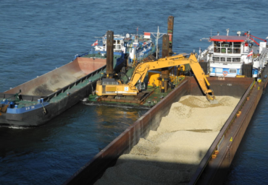
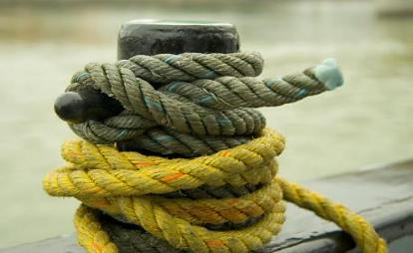


STRENGTHENING OF DANUBE NAVIGATION
from the Presentations Series
„Basics of Inland Navigation“
Notes:
This set of slides gives an overview of the potential of Danube navigation and shows solution approaches how to face existing problems of the Danube waterway.

Slide 2
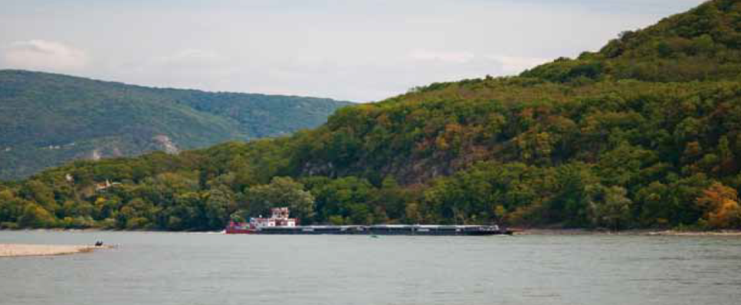
Strengthening of Danube Navigation
Strengthening of Danube Navigation- Why?
Strengthening of Danube Navigation- How?
source: via donau/Andi Bruckner

Slide 3
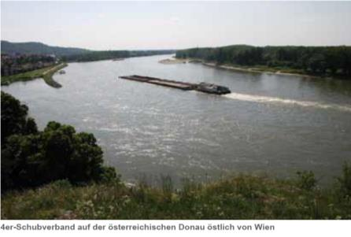
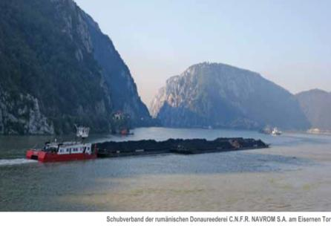
Strengthening of Danube Navigation
Why?
low transport costs
environmental friendliness
high transport capacity per unit
save
availability around the clock
low Infrastructure costs
free capacity (utilization 10-15 % !)
source: viadonau
source: C.N.F.R. NAVROM S.A. Galaţi
Notes:
Manual on Danube Navigation page 16 – 20.

Slide 4
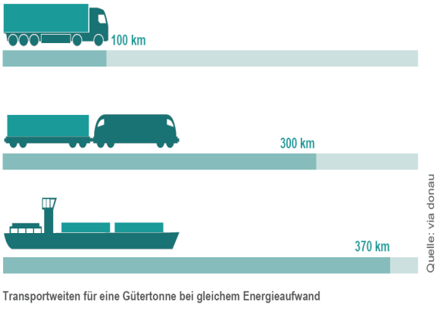
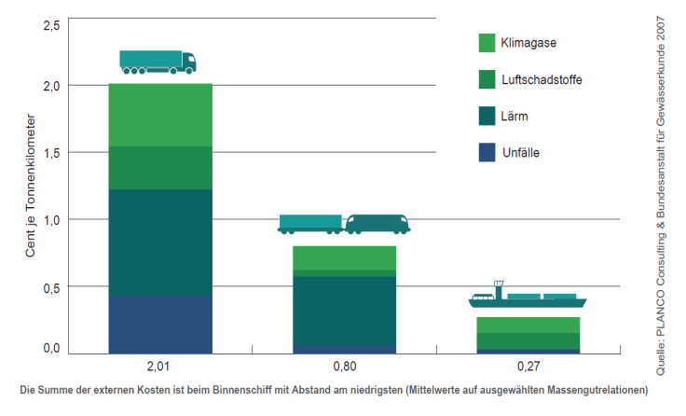

Strengthening of Danube Navigation
Why?
Environmentally friendly and economical -
specific energy consumption: low external costs:
an inland vessel is able to transport one ton of cargo almost four times further than a truck using the same consumption of energy
inland vessels cause the lowest costs of accidents, noise, air pollution and climate
Notes:
Manual on Danube Navigation page 18 – 19.

Slide 5
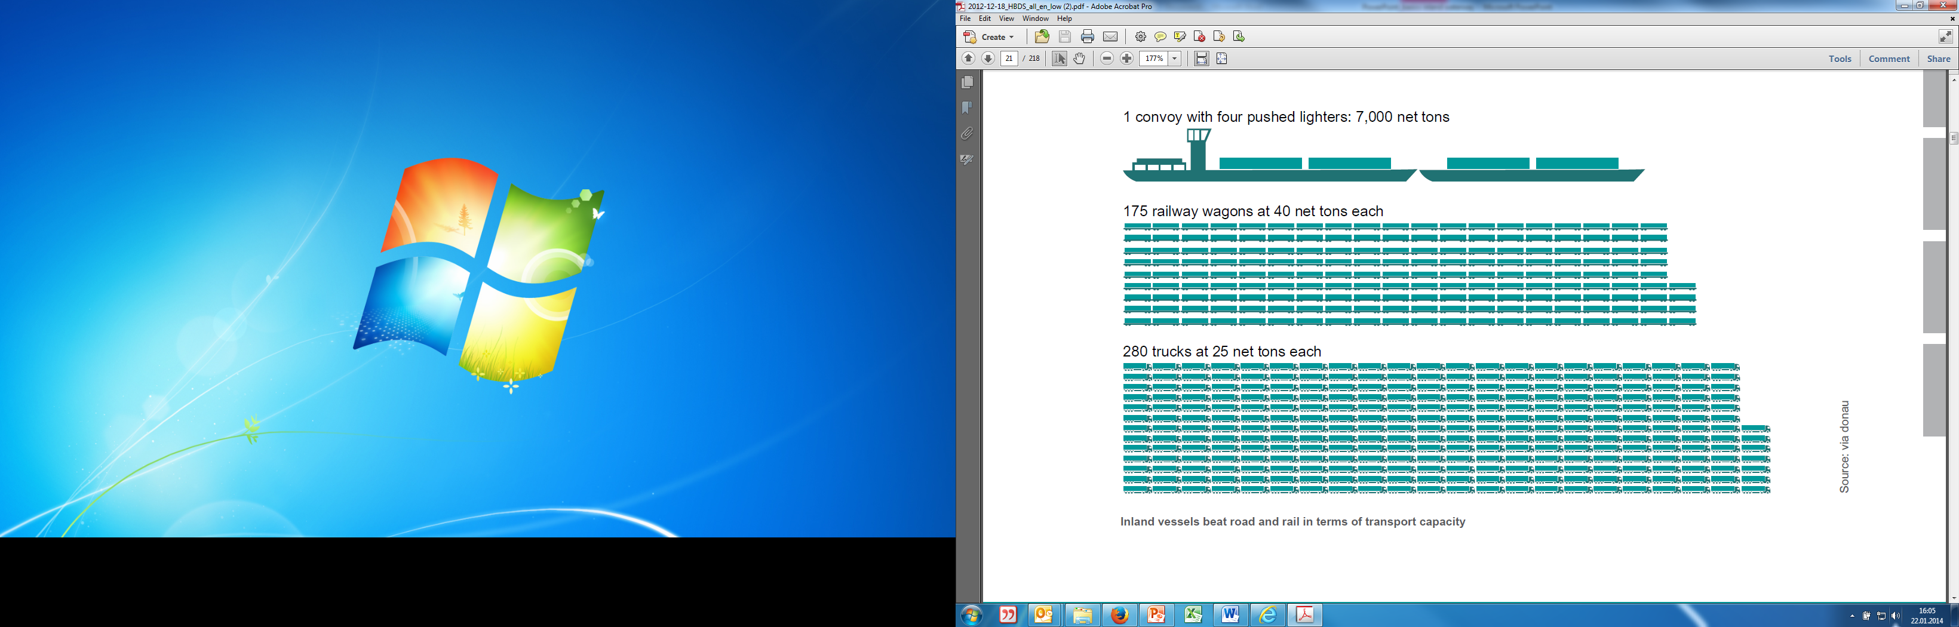

Strengthening of Danube Navigation
Why?
transport capacity : 1 pushed convoy with 4 pushed lighter =
175 railway wagons = 280 trucks = 20 km convoy of trucks
Notes:
Manual on Danube Navigation page 19.

Slide 6
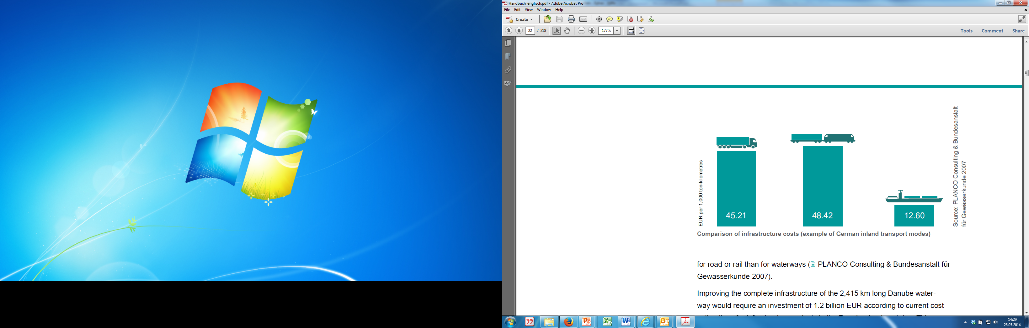
Strengthening of Danube Navigation
Why?
inland vessels as safest transport mode:
  only 29 traffic accidents on the Austrian-Danube in 2014 (no cases of death)
  in comparison: 1117 accidents with trucks (>3,5 tons) in Austria in 2014
availability around the clock: no bans on weekend- and night driving
low infrastructure costs: natural infrastructure is usually available -> low costs:
improving the complete infrastructure of the Danube waterway would require an investment of 1.2 billion €. This corresponds roughly with the cost of constructing 50 km of road or rail infrastructure.
Notes:
Manual on Danube Navigation page 17-20.
Source: Statistik Austria and Annual Report on Danube Navigation 2014 (http://www.viadonau.org/en/newsroom/publications/folders/ )

Slide 7
Problems of Danube Navigation
dependence on variable fairway condition
bridges
low transport velocity
low network density (often requiring pre- and end-haulage)
inadequate waterway maintenance (in some Danube riparian countries)
high requirement for modernisation of ports and fleets
lack of qualified staff
Notes:
Manual on Danube Navigation page 17.

Slide 8
Strengthening of Danube Navigation
Strengthening of Danube Navigation- Why?
Strengthening of Danube Navigation- How?
source: via donau/Andi Bruckner

Slide 9
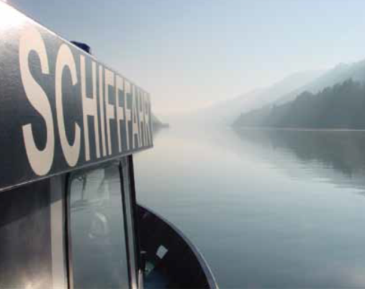

General Requirements strengthening of Danube Navigation
national and international
Transport Policy sets direction
for further development by:
defining basic targets and
strategies
establishing infrastructural projects
source: viadonau/Jürgen Trögl
  Important: teamwork between the Danube riparian states

Slide 10
Framework of Transport Policy- on pan-European level
EU-Strategy Europa 2020 (European Commission, 2010a)
defines transport policy goals
e.g. reducing greenhouse gas emissions
stipulates framework of development for inland vessels
White paper on Transport(European Commission, 2011)
target settings for reducing CO2 emissions and oil dependency:
  shifting 30% of the road transport >300 km until 2030
  establishing a fully operational trans-European core network until 2030 (EU Guidline, 2010)
  establishing River Information Services (RIS)
inland navigation recognized as energy-efficient transport mode
Notes:
Manual on Danube Navigation page 25-26.

Slide 11
Framework of Transport Policy- on pan-European level
website of NAIADES-
Action Programme:
www.naiades.info
NAIADES (European Commission, 2006) and NAIADES II –
Action Programme for the promotion of inland waterway transport:
guidelines for a joint approach
areas: infrastructure, markets, fleet, jobs/skills and RIS
goal: improve capacity and sustainability
PLATINA: Platform for the Implementation of NAIADES
EU Strategy for the Danube Region – EUSDR (European Commission, 2010)
Danube countries and stakeholders
action plan with targets until 2020
e.g. increase cargo transport on the river by 20%
by 2020 compared to 2010
website of PLATINA: www.naiades.info/platina
web-Plattform EUSDR: www.danube-region.eu
Notes:
Manual on Danube Navigation page 26 – 29.

Slide 12
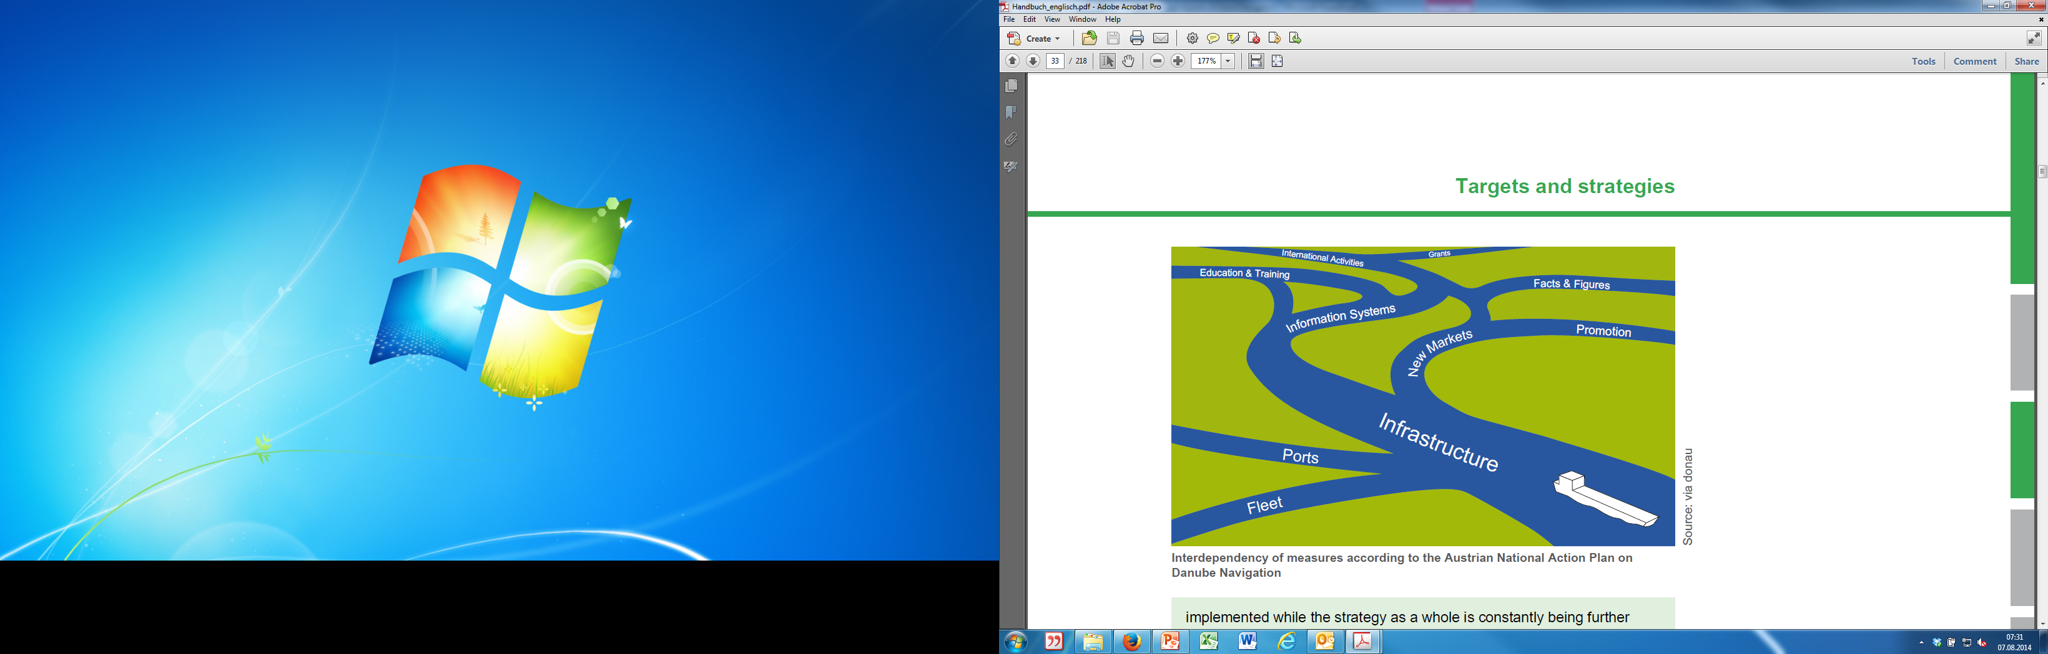
Transport Policy- in Austria
transport master planning defined by “National Investment Programme for Federal Transport Infrastructure 2011 – 2016”
National Action Plan for Danube Navigation – NAP (bmvit, viadonau, 2006)
  guidelines to strengthen inland navigation in Austria
  since 2007 included in Austria‘s governmental programme
  jointly implemented by viadonau and
  the Federal Ministry for Transport
  Innovation and Technology
further information on the NAP
source: viadonau
Interdependency of measures according to the Austrian National Action Plan on Danube Navigation
Notes:
Manual on Danube Navigation page 30 – 31.

Slide 13
Problem solving/improvement dependency on fairway conditions
seasonal low water (Water levels < 2,5 m )-> ships can not be fully loaded-> economic efficiency drops
solution/attempt for improvement:
  fairway maintenance
  information on the current state of the fairway - River Information Services (RIS)
viadonau:
  responsible for maintenance/improvement of the waterway
  conducts DoRIS – the Austrian RIS
Notes:
Manual on Danube Navigation 49 – 67.

Slide 14
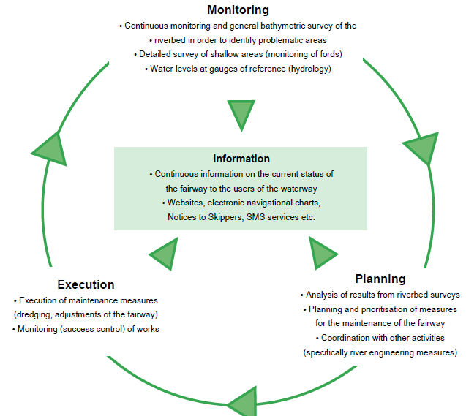
Problem solving/improvement dependency on fairway conditions
source: viadonau
maintenance work:
  transport of sediments (gravel, sand)
  dredging shallow areas
  riverbed surveying
  provision of continuous and target group specific
  information on the current state of the
  fairway to the users of the waterway
  improvement and extension of waterways
in Austria viadonau responsible for maintaining the Austrian section of the Danube waterway
Fairway maintenance cycle
Notes:
Manual on Danube Navigation page 61 – 63.

Slide 15
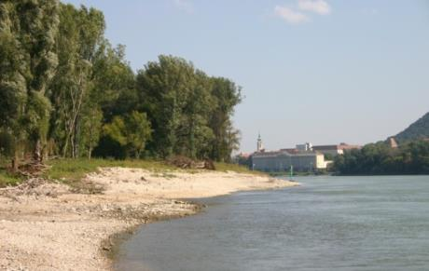
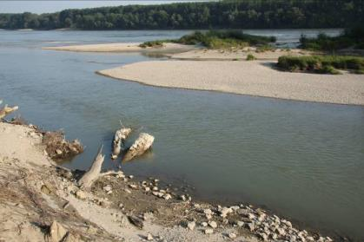
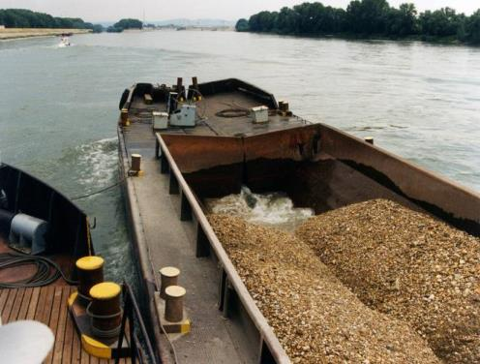
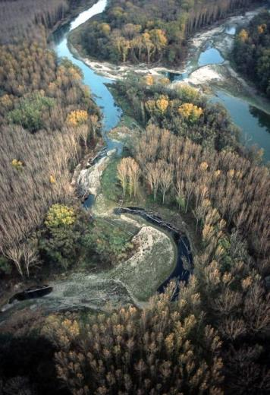
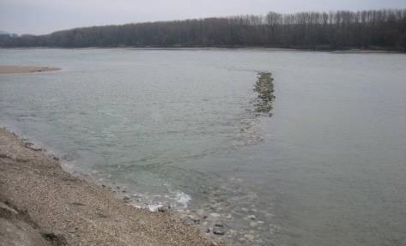
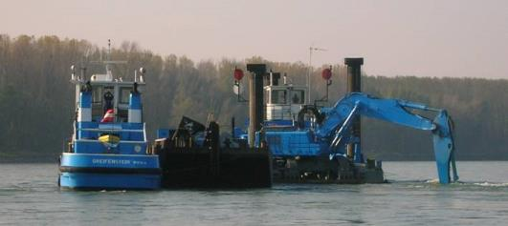
Problem solving/improvement
example river engineering measures
Bad Deutsch-Altenburg pilot project
restoration of river banks
© viadonau
riverbed adjustment
„creation of sidearms “
granulometric riverbed
improvement
improving ecological conditions
Goals
© Verbund Hydro Power
optimisation of low-water regulation
improvement of shipping conditions
reconnection of sidearms
© Kovacs
lowering bank structures
www.donau.bmvit.gv.at/index.php
Notes:
Manual on Danube navigation page 69 – 71.

Slide 16
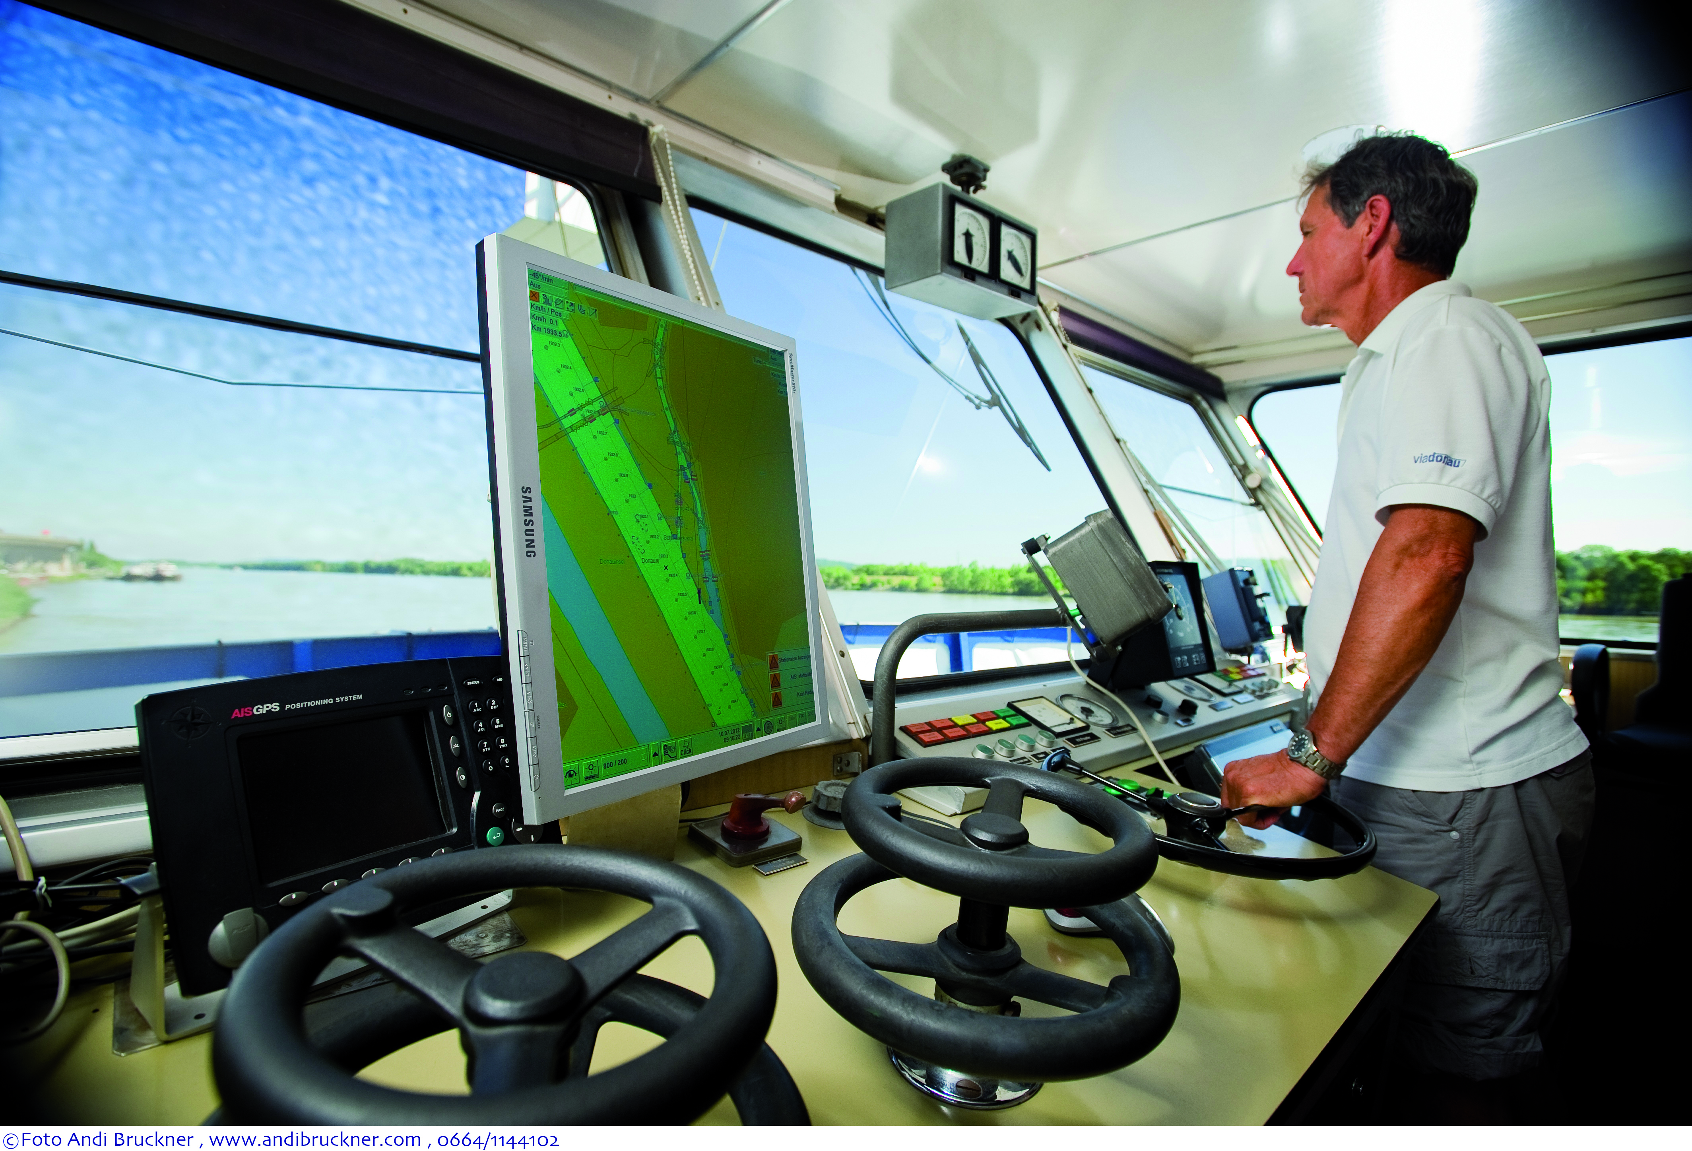
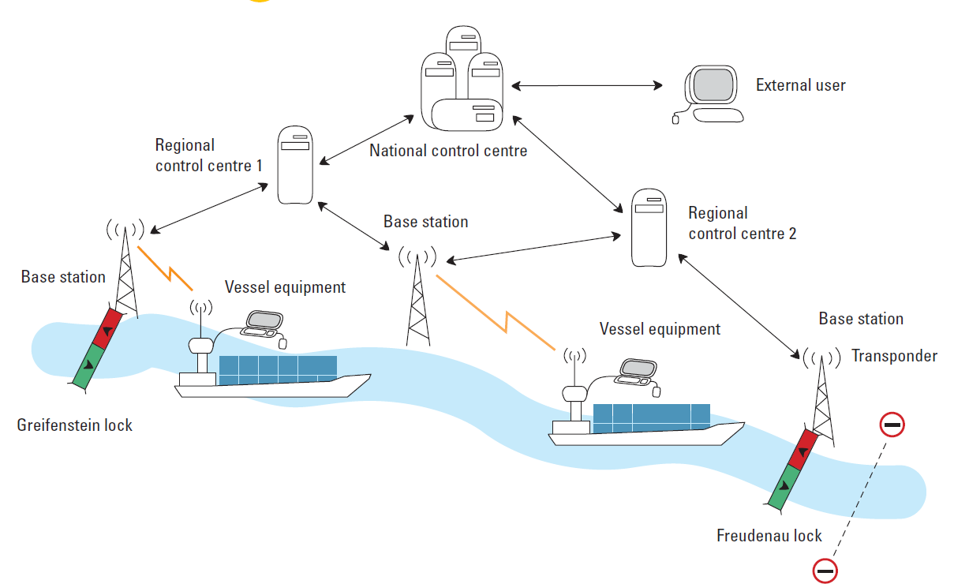
Solution/Improvement dependency on fairway conditions
© viadonau
telematics for inland vessels:
River Information Services (RIS)
fairway information on water level and forecasts
shallow areas and notices to skippers
representation – so called tracking and
tracing of vessels on an electronic chart
DoRIS:
www.doris.bmvit.gv.at
© via donau
the DoRIS system and how it works
© via donau I 16
Notes:
Manual on Danube Navigation page 122 – 130.

Slide 17
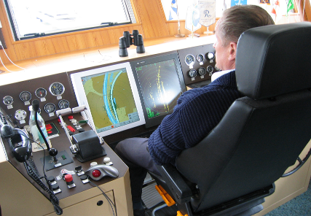
Solution/Improvement speed, traffic density
inland water vessels are not suitable for all type of goods (e.g. not for perishable goods such as fruits, vegetables,…)
many cargo transports are flexible in time->
perfect planning saves time and
money, can reduce pre- and end-Haulage
River Information Services help with latest and punctual information
source: via donau

Slide 18
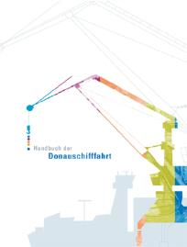
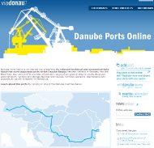
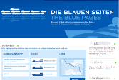
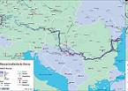
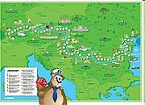
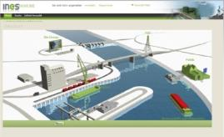
Solution/Improvement public awareness and education
trough target group oriented information:
Annual report Danube navigation – data & facts, current projects, developments
Manual on Danube Navigation – basic knowledge Danube Navigation, 3rd edition
Online Portals: www.donauschifffahrt.info, www.danubeports.info, www.blaue-seiten.at
Waterway map: Europe, Danube, Danube for children
INeS Danube: multilingual eLearning Platform for logistics with inland vessels
www.ines-danube.info
© via donau I 18

Slide 19

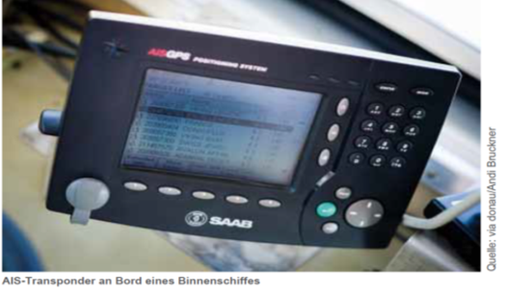
Solution/Improvement infrastructure
Maintenance, expansion and
modernisation trough…
cooperation among Danube riparian states
pan-European goals and guidelines
targeted support of inland navigation
e.g. with EU-Projects
elaboration and use of
new technologies

Slide 20
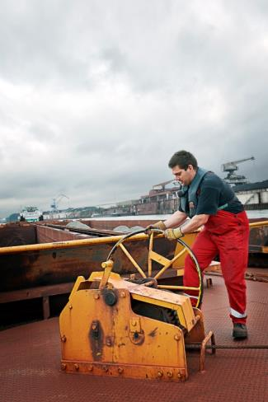
Lack of Qualified Staff
increasing lack of qualified staff
plenty of (old) staff –inland navigation career
mainly due to family background (becoming less)
often no „lifelong“ career
Danube navigation as career opportunity
not popular among young people
family related change to other jobs (on land/at the port)
few internationally uniform training and qualification standards
© BDB e.V.

Slide 21

Solution/Improvement lack of qualified staff
reasons for choosing a career “on board”: family background, idealism, love of freedom, desire to travel and personal interests
standardized collection of data on actually needed/available staff required
encouraging people to work within the inland waterway transport sector by providing incentives
enough information/advertisement –>
create awareness, point out advantages
EU-wide advertising campaigns
reduction of job changes (e.g. by improving working time models)

Slide 22
Education and Training Standards
training times and contents strongly differ among countries
no harmonization and minimum standards on a European level
variety of different diplomas and certificates
education standards regulated by river commissions (Rhine-Commission, Danube-Commission) and national guidelines
change from maritime shipping to inland vessels difficult
(due to the absence of mutual recognition of diplomas and certificates)

Slide 23
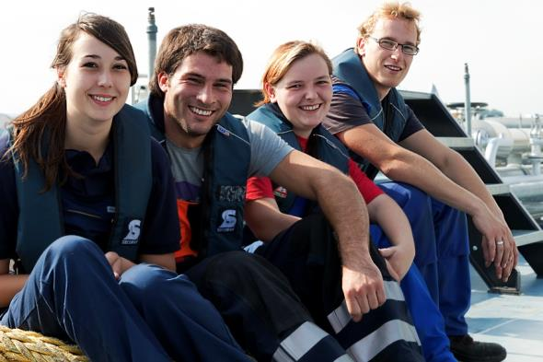
Solution/Improvement
Education and Training Standards
source: via donau
© BDB e.V.
improvement and harmonization of education/training standards
to establish minimum standards on education/training
uniform international standards for the required board-crew
international or at least EU-wide harmonized standards for certification/qualification
EU-wide mutual recognition of professional qualification
long-term goal: EU-wide standardised masters certificate

Slide 24
Sources
viadonau (2013): Manual on Danube Navigation, Vienna.
Order: http://www.viadonau.org/en/newsroom/publications/manual-on-danube-navigation/
viadonau (2015): Danube Navigation in Austria–
Annual Report 2014, Vienna.
Download : http://www.viadonau.org/en/newsroom/publications/folders/
INeS Danube information platform on intermodal inland navigation
Homepage: http://www.ines-danube.info/?lang=en

Slide 25


Further Information
We hope our set of slides has met your expectations!
- you are free to use, adapt and share this slides and to use it for your lectures.
For questions and feedback please do not hesitate to contact us:
rewway@fh-steyr.at
Further set of slides are available at:
http://www.rewway.at/en/teaching-materials/bundles/
Maybe you are interested to book a guest lecture or an excursion?
http://www.rewway.at/en/services/

